Slide 1

ABBEY STADIUM AND CAMBRIDGE UNITED

Slide 2
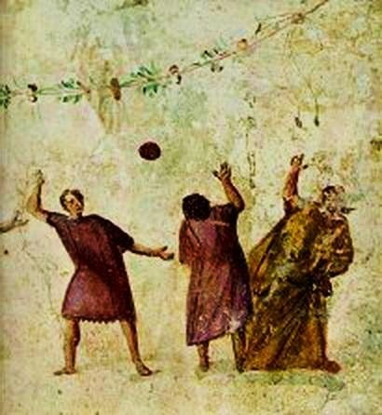
Cambridge and The History of Football
When the Romans settled in Cambridge, one of their sites was based in Barnwell, which means that they were perhaps the first people to play a kind of football in the area where the stadium is today!
Another important moment in football history was in 1579 when a Cambridge town against gown match ended in a brawl!
FACTOID!
Football originated from the Roman game of harpastum- an early form of football.
Picture of people playing harpastum
in Roman times

Slide 3
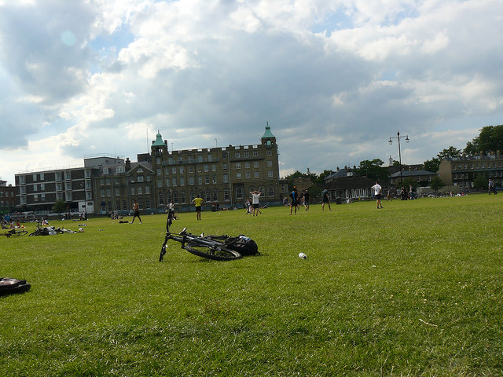
Today’s Rules of Football Inspired by Cambridge Rules!
In 1848 the teams in the Cambridge area met to establish one uniform set of rules as a way of preventing fights and disagreements.
FACOID!
The football rules were written on papers fixed to the trees on Parker’s Piece. Later, when the Football Association was founded in 1863, they used the Cambridge rules, which are still the rules used
today!
Photo of football team playing match on Parker’s Piece
- the site where the original rules were created!
This history shows that
football has been at the centre of Cambridge’s culture for generations!

Slide 4
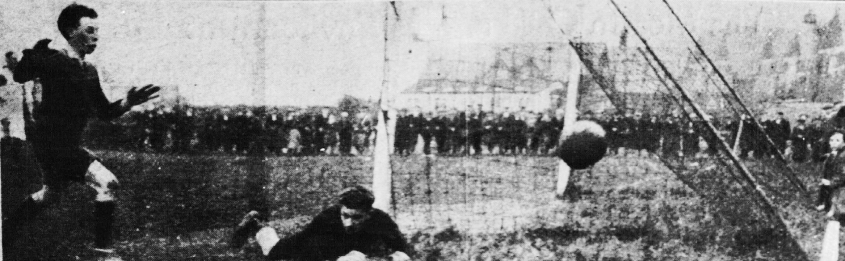
The Origins of Cambridge United
The ‘Cambridge United’ football team was established in 1912 and initially named ‘Abbey United’, after the Abbey area where it was set up. In fact the name ‘Cambridge United’ originally belonged to a completely different Cambridge club, based in Romsey!
Photo of ball going wide at Creake Charity Shield football match on Milton Road
on 2nd July in 1925.

Slide 5
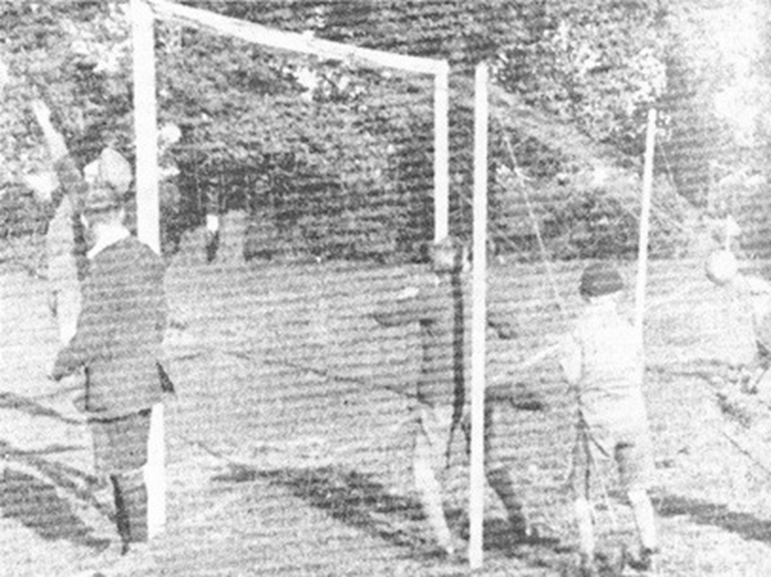
The original grounds- back in the day!
This photo shows a match from 1928 at Abbey United’s first ground, which was called the Celery Trenches because the surface was so rough! The grounds were on the old Whitehill Farm, which was eventually covered by the Whitehill estate.
FACTOID!
Before the club moved to the Celery Trenches, the players & supporters had to carry the goalposts from the Dog & Pheasant pub, Newmarket Road to a pitch on Stourbridge Common and back again after
the game. .

Slide 6
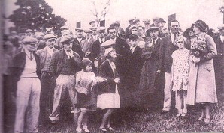
The Opening of Abbey Stadium
The team settled in the Abbey Stadium
in 1932 and are still there today.
The land was gifted to them by Harry Cement Francis, the president at the time, who was managing director of the Star Brewery and lived in Burleigh House on Newmarket Road
Photo of Abbey Stadium’s Opening Ceremony in 1932

Slide 7
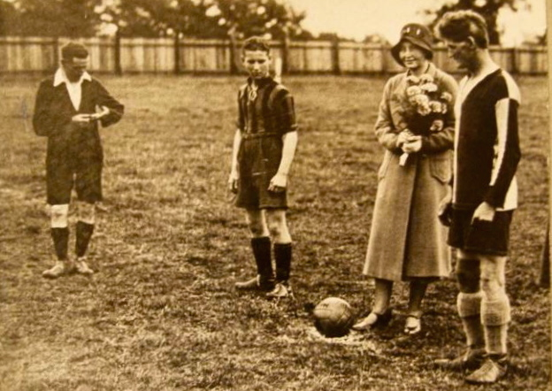
The First Match at
Abbey Road Stadium
The ever first match at Abbey Road Stadium was kicked off by Mrs Saxon, Henry Clement Francis’ daughter.
The player on the right is Harvey Cornwell, who was the star player of the 1920s.
Photo of Mrs Saxon marking the start of
the first match at the stadium

Slide 8
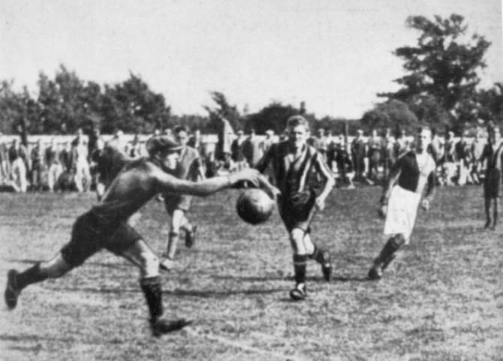
First Competitive Football Match
The team played their
1st competitive football match as ‘Abbey United’
at the Abbey Stadium
on Newmarket Road on
3rd September 1932.
Photo of Harvey Cornwell playing in the team’s first competitive match as ‘Abbey United’

Slide 9
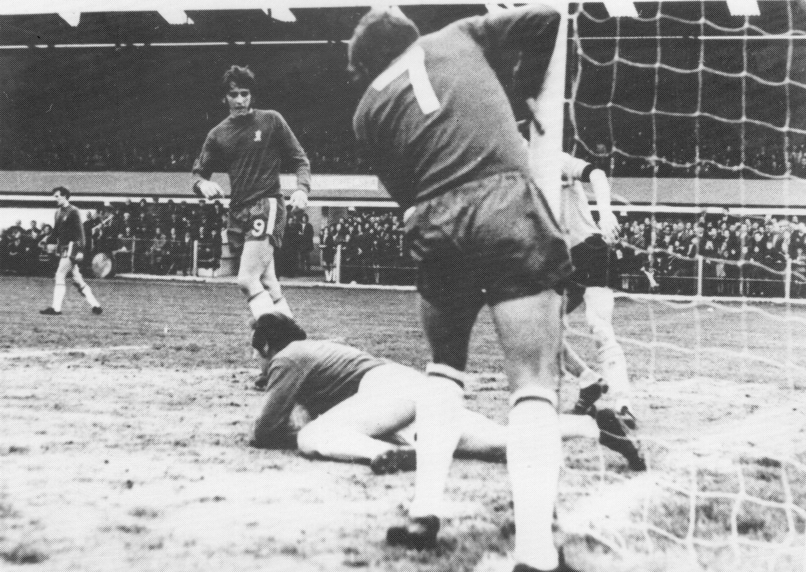
Cambridge United Join the Football League
Cambridge United Football Club entered the promised land of the Football League in 1970 for the first time.
It was the latest twist in the tale of Cambridge football because people had already been playing the beautiful game in the city for centuries!
Cambridge United V Chelsea Match
in 1970s- Photo by Ian Hutchinson

Slide 10
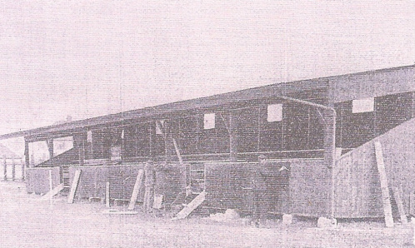
Abbey United’s First Grandstand
This is a photo of Abbey United’s first grandstand, which opened in 1934 and could seat around 400 people.
It was on the side where the main stand is now.

Slide 11
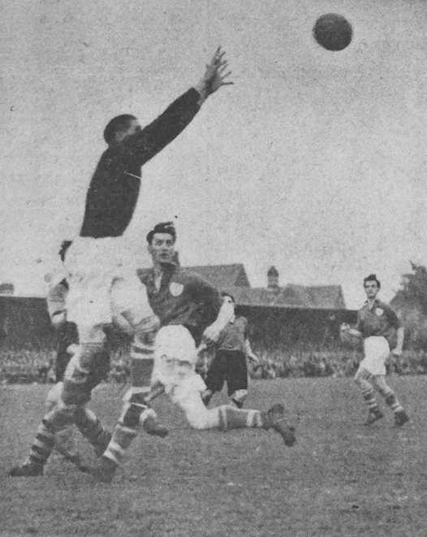
Abbey United Becomes Cambridge United
In 1949 the club turned professional, and changed its name to Cambridge United in 1951.
This photo shows a match in the 1950s of Abbey United playing against Cambridge City.
Derby matches in those days were huge affairs, sometimes drawing 10,000 or 12,000 people to watch!
Photo of Goalkeeper Sam Cornwell reaching to save a goal.

Slide 12
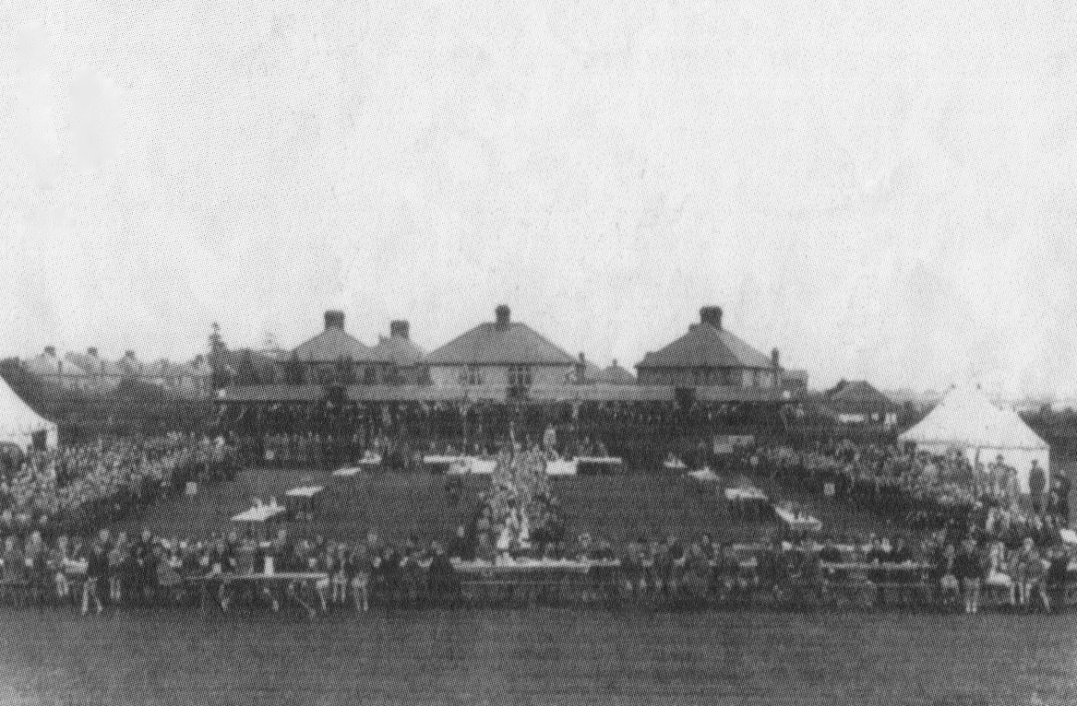
Celebrations at Abbey Stadium
This photo is from
around 1950 and
shows a celebration
at the stadium-
possibly celebrating
the Queen’s
Coronation in 1951
or Cambridge gaining
it’s City status in 1953.

Slide 13
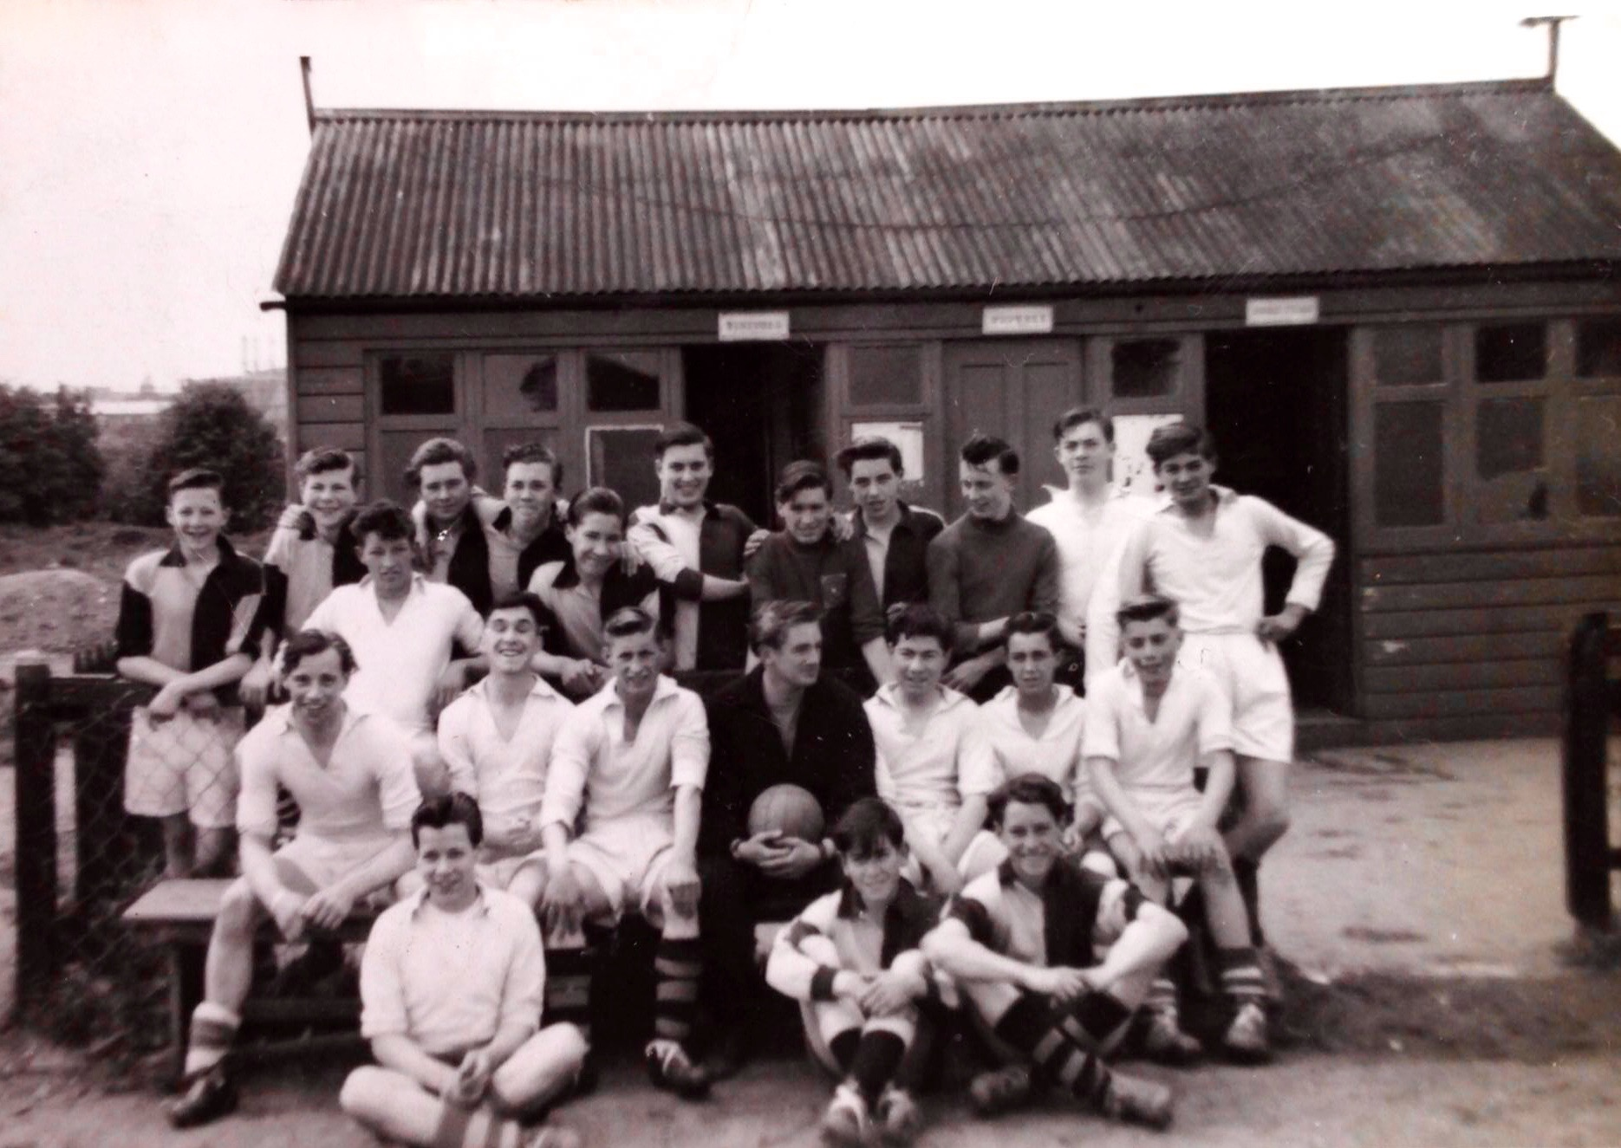
Central Youth Centre Boys Football Match
Local boys teams also
played at the stadium in
1950s.
The changing rooms
weren’t as fancy as they
are today- they were
basically just a hut, as
the picture shows.
Boys Team Group photo
outside the Changing
Rooms at Abbey Stadium
in 1950s.

Slide 14
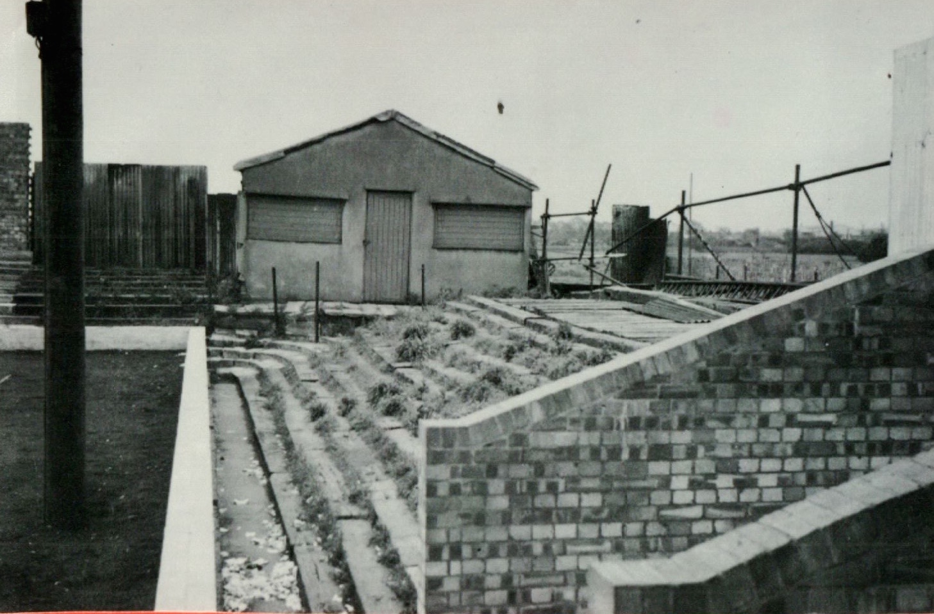
Old Faithful Canteen at
Abbey Stadium
The Old Faithful canteen as it was named was built in 1953 and demolished in 1962 to make space for floodlight pylons and terrace improvements.
The floodlights are still there today but might have to be demolished when the new development takes place.
In the background of this photo you can see the old tea bar, where supporters Mrs Morgan and Mrs Harrison, both local ladies, used to serve teas.

Slide 15
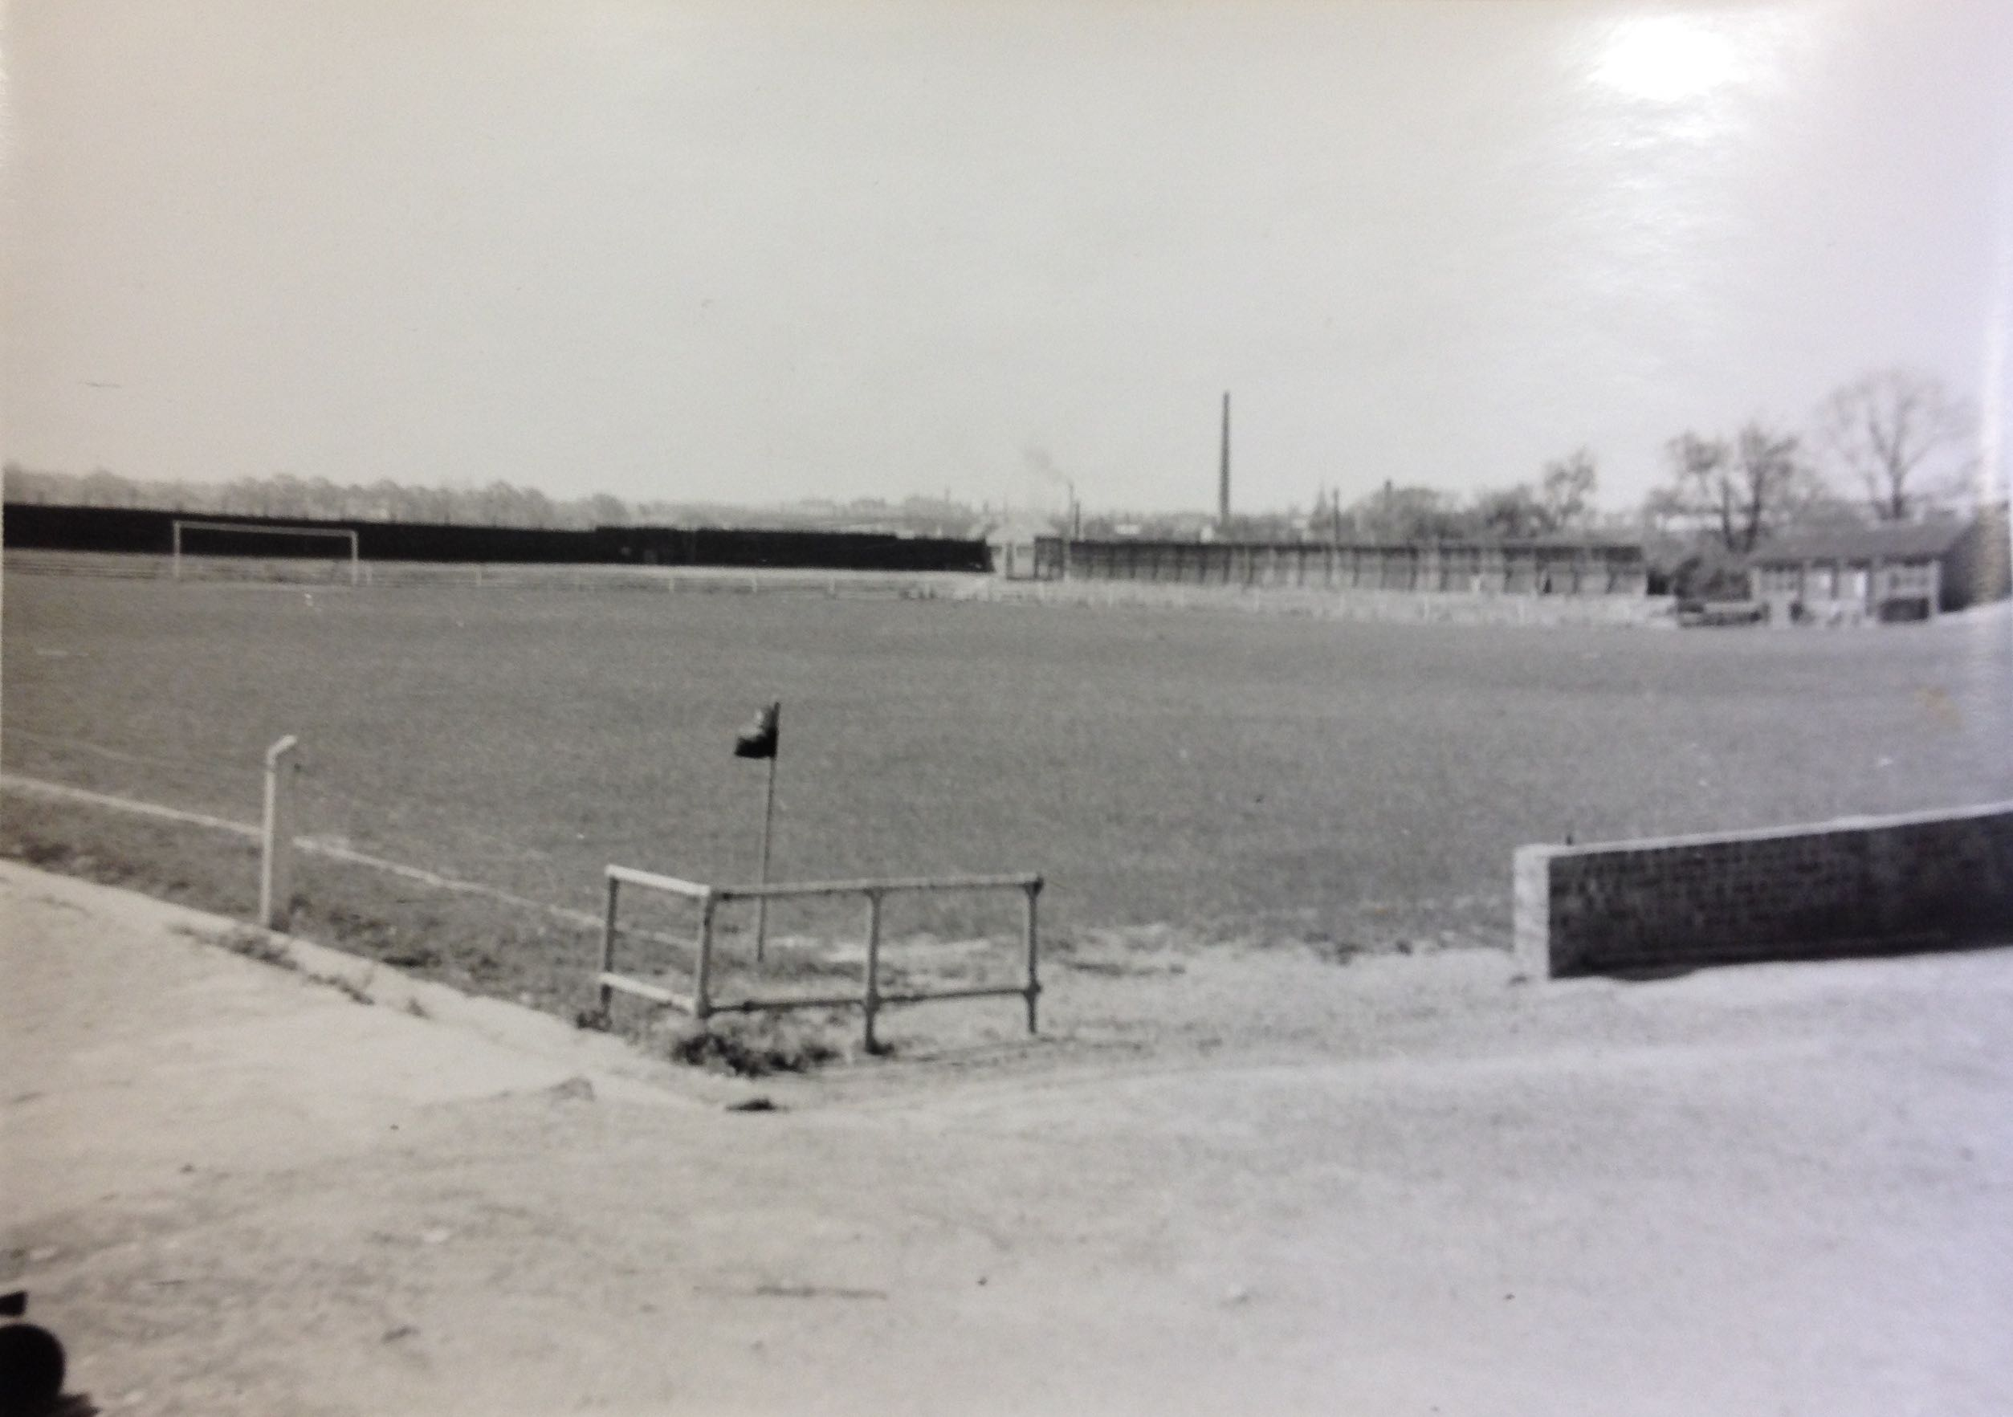
The Pitch and Grounds in 1950s
This shows just how open and empty the ground used to be, before the club and supporters started to build the ground as we know it today.
You can see the old changing rooms on the right. The supporters built the terraces now known as the Habbin (named after a supporters’ club chairman) and the Newmarket Road End.
The view from Habbins and allotments end
of the pitch in 1950s.
Photo from J Swailand Collection

Slide 16
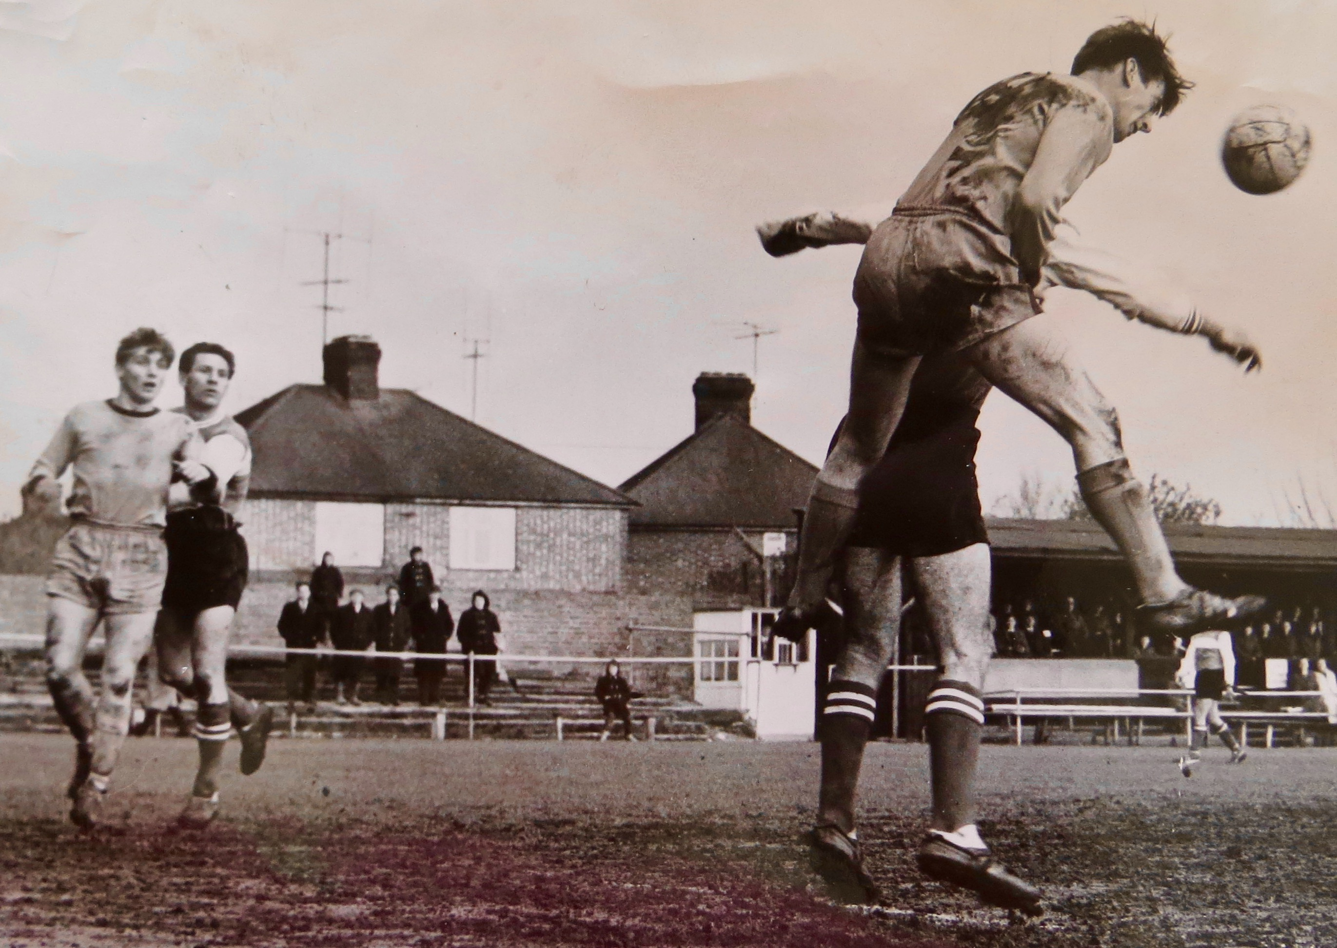
The Football Ground in 1960s
A photo from 1960 showing how different the ground was in those days, with the old
Stand still there infront of the houses in Elfleda Road.
FACTOID!
The old main stand and the old floodlights were put up by supporters on telegraph poles!

Slide 17

Cambridge United Vs Chelsea
On 1 May 1970 a record crowd of 14,000 packed into the Abbey Stadium to see United take on Chelsea, who had won the FA Cup a few days before.
The United goalkeeper making the save is Rodney Slack, who still lives opposite the ground on Newmarket Road and is a Coconuts committee member.

Slide 18
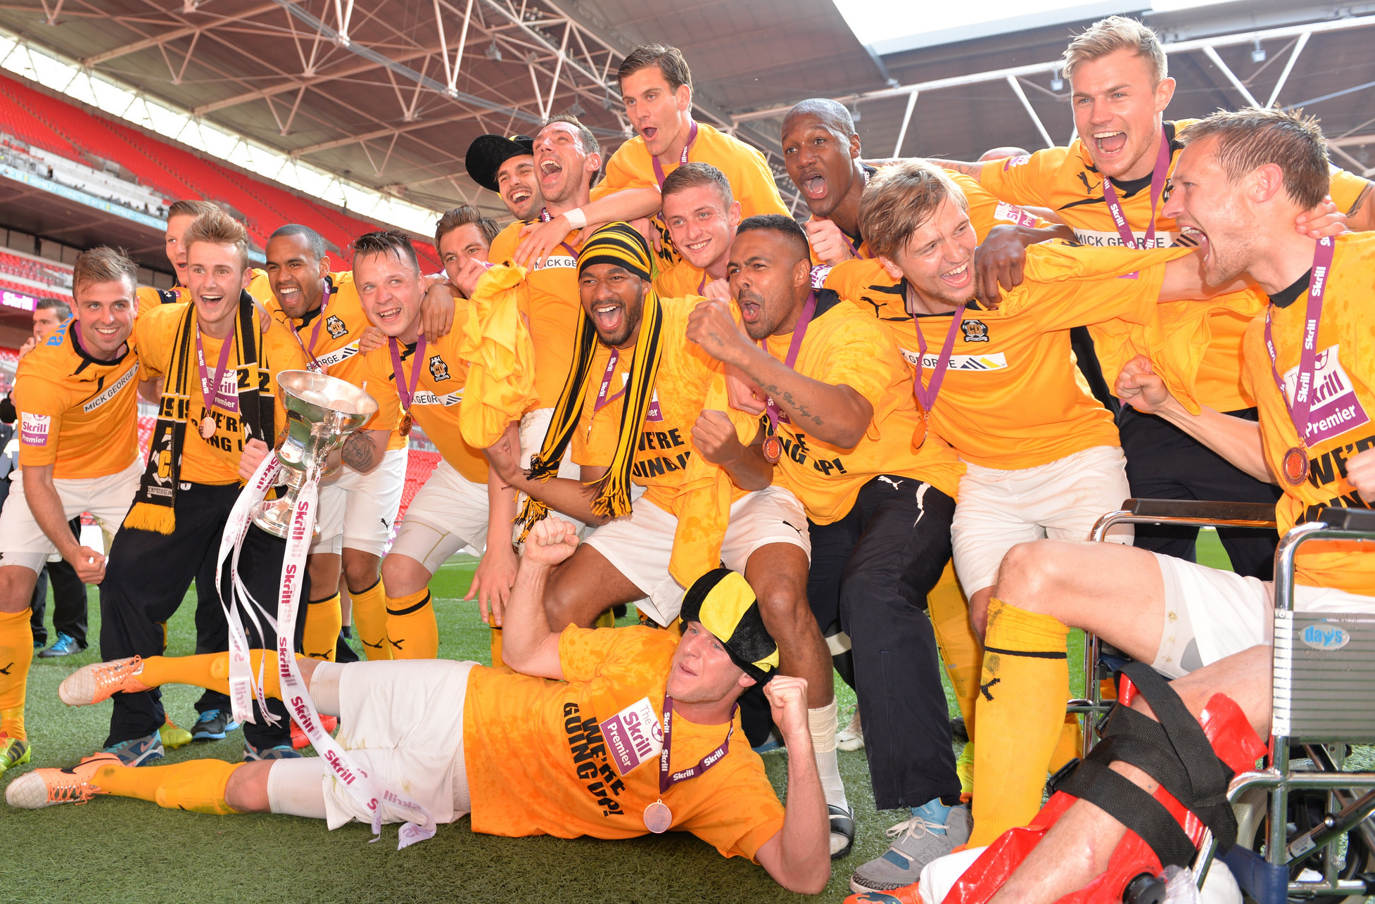
Cambridge United’s Double Victory at Wembley Stadium
FACTOID!
In 2014, Cambridge United went to Wembley twice and won twice – and were promoted back to the Football League.
Cambridge United’s Celebration on Wembley Pitch in 2014.

Slide 19
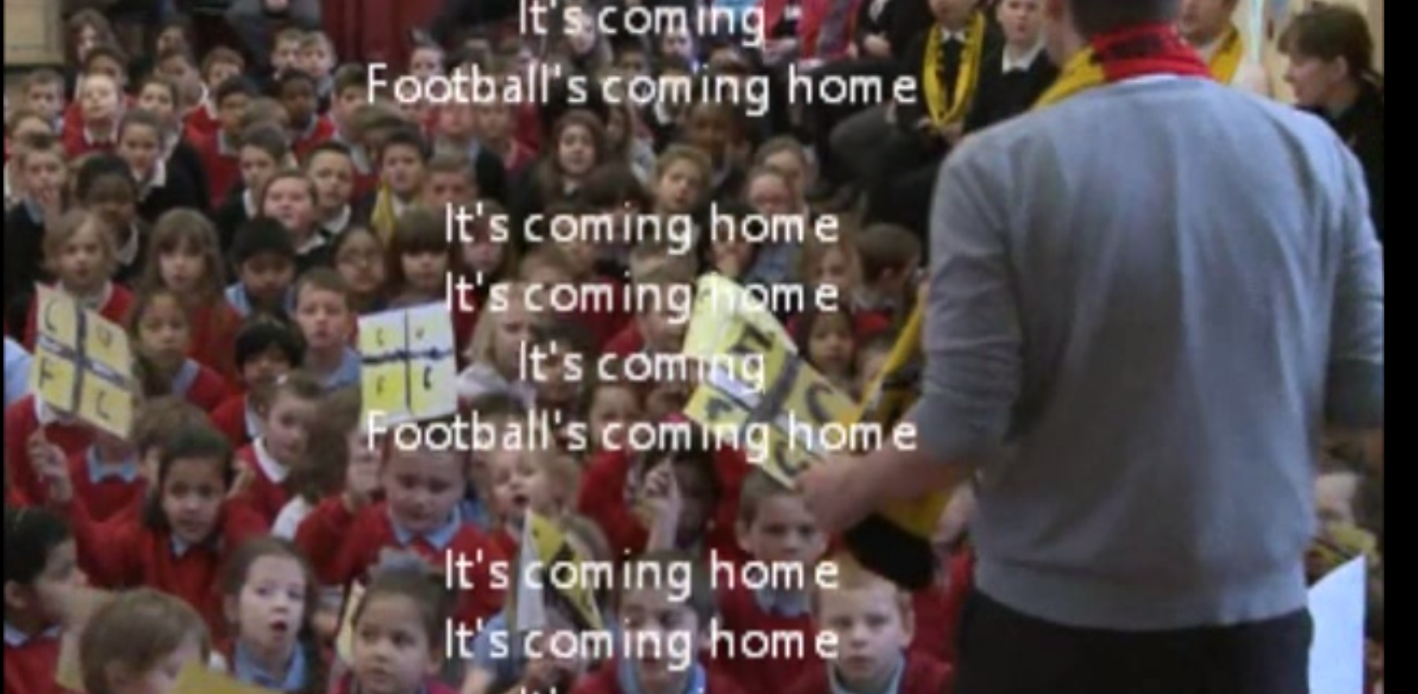
Abbey Meadows School Singing Three Lions Song on BBC Newsround
Abbey Meadows pupils sang their own version of the famous Three Lions song,
to support Cambridge United in their match against Manchester United in Feb 2015.

Slide 20

Web Resources available at:
http://www.creatingmycambridge.com/
history-stories

