Slide 1

ABBEY

Slide 2
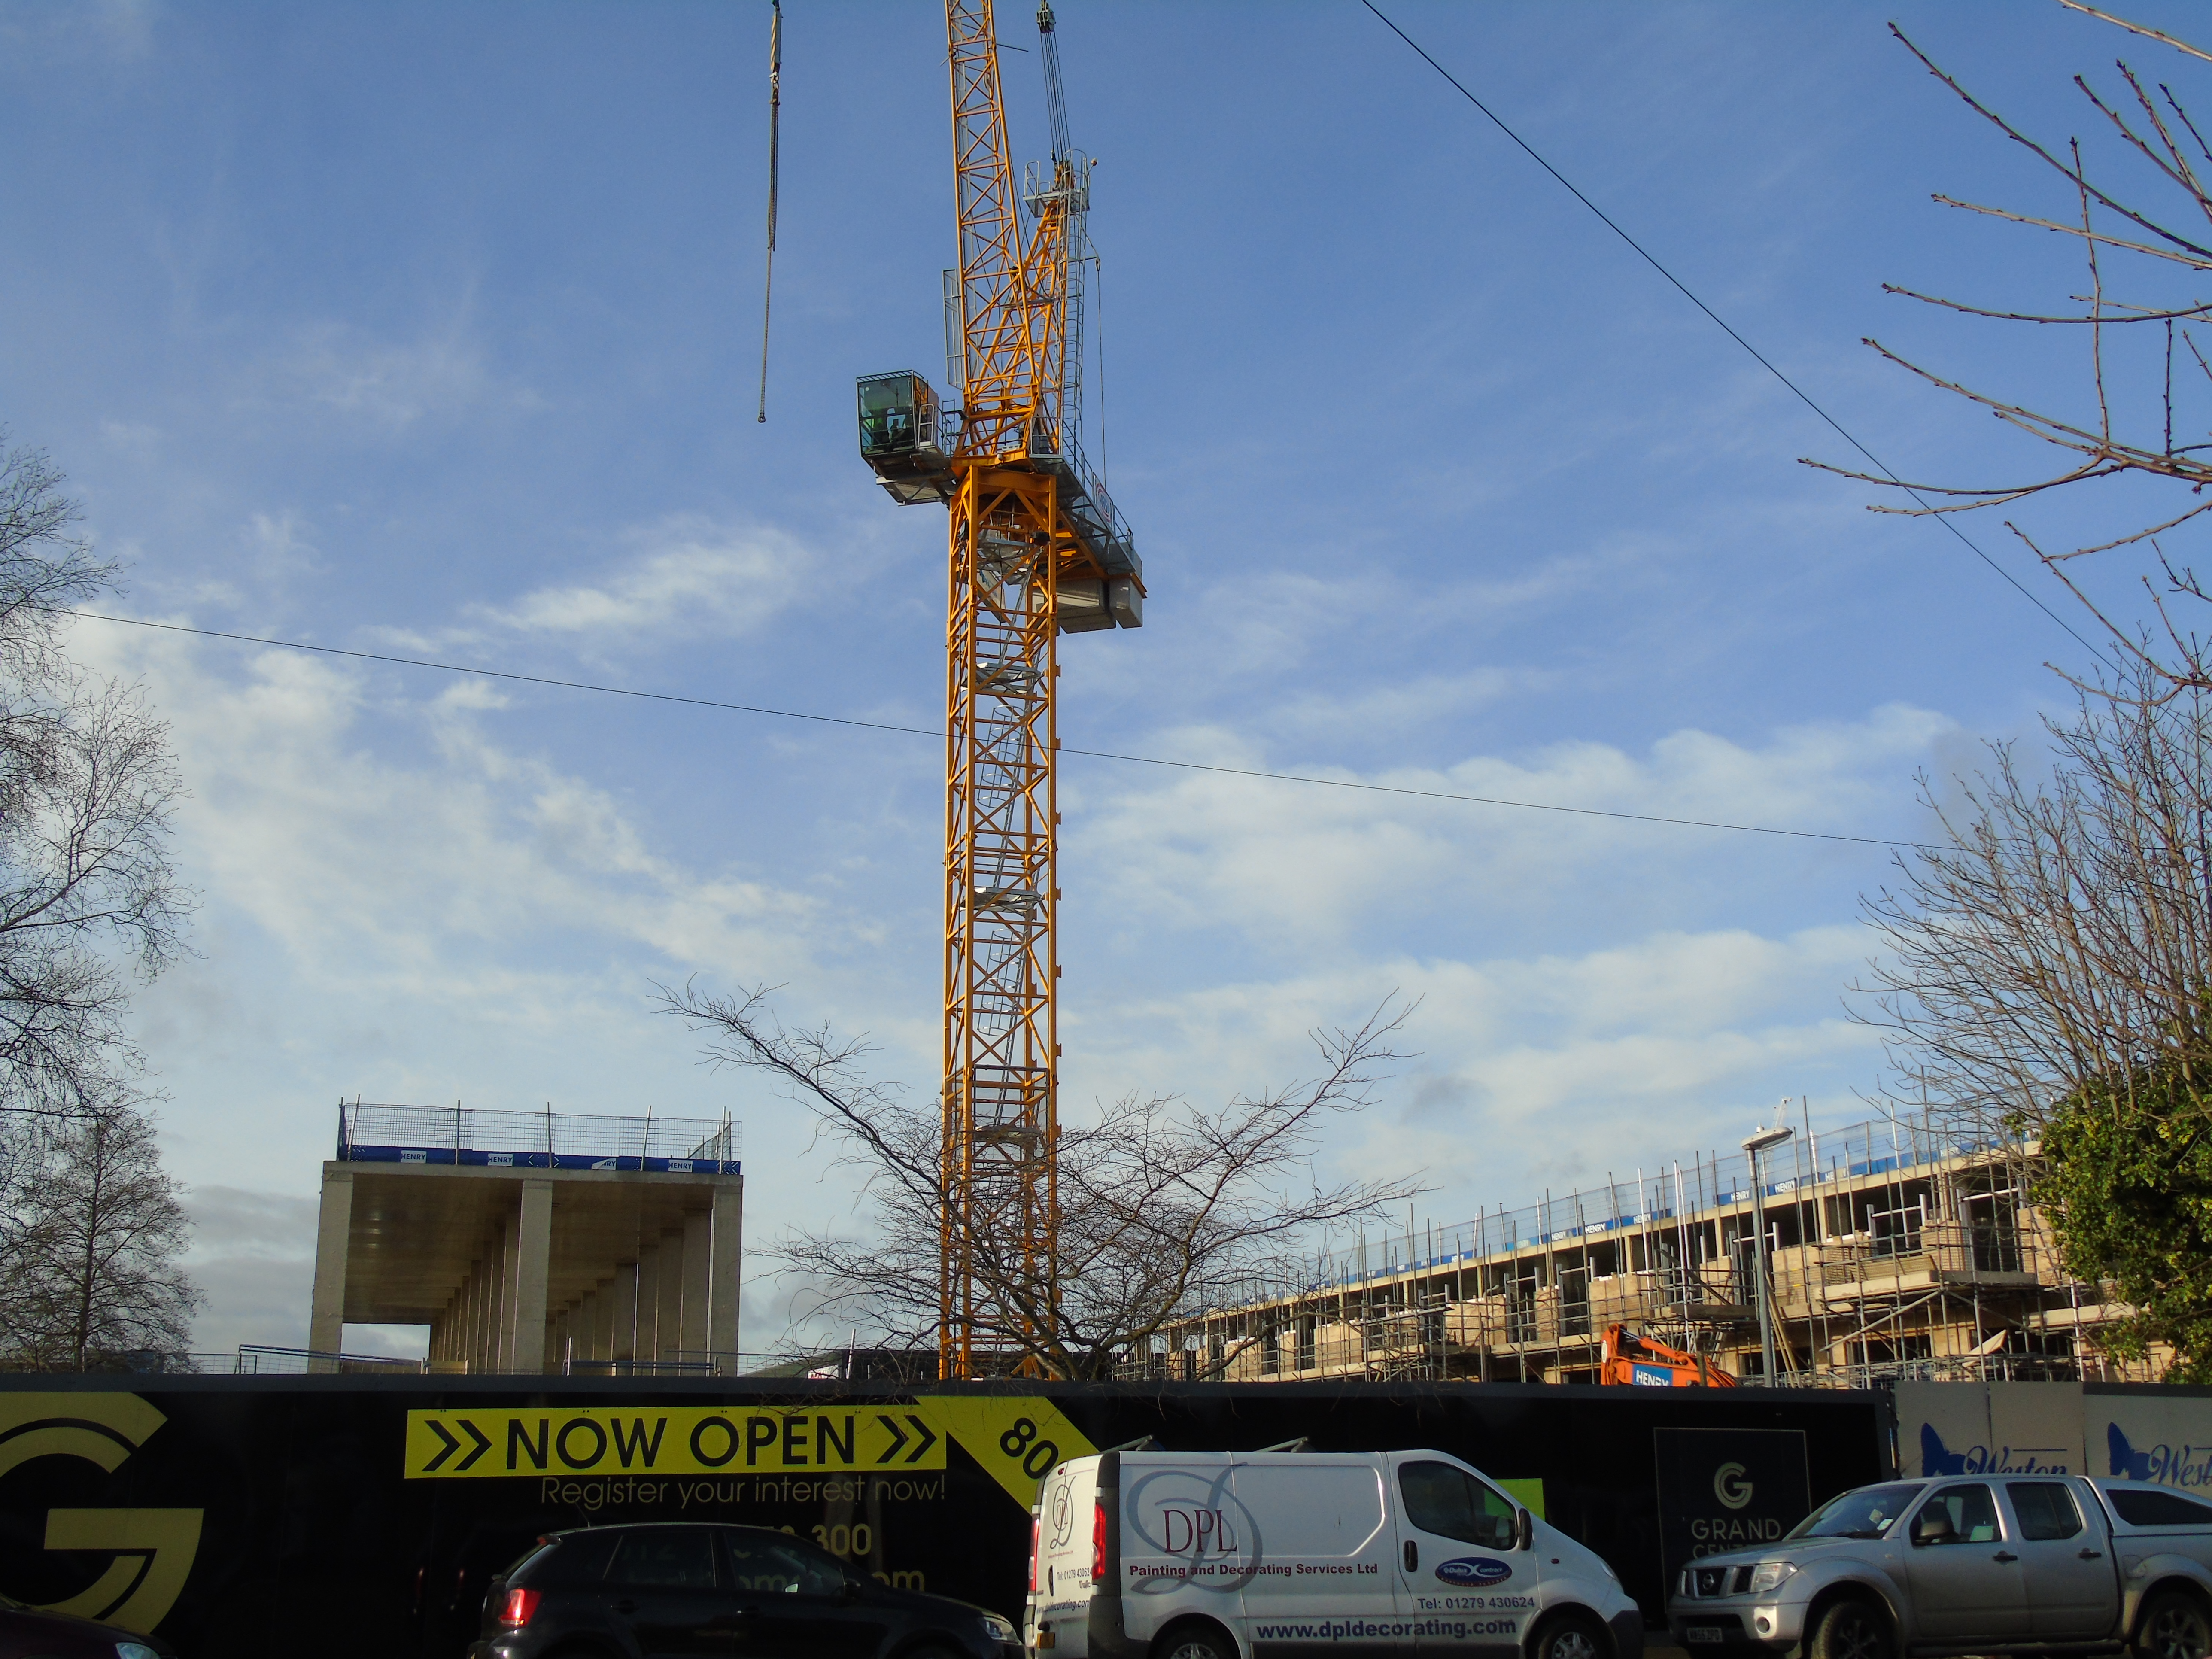
Cambridge- a growing city!
Cambridge is growing! The number of
people living in the city is already 123,000,
with nearly 30,000 more expected by 2020.
People need homes and flats and new
buildings are springing up all around the city.

Slide 3
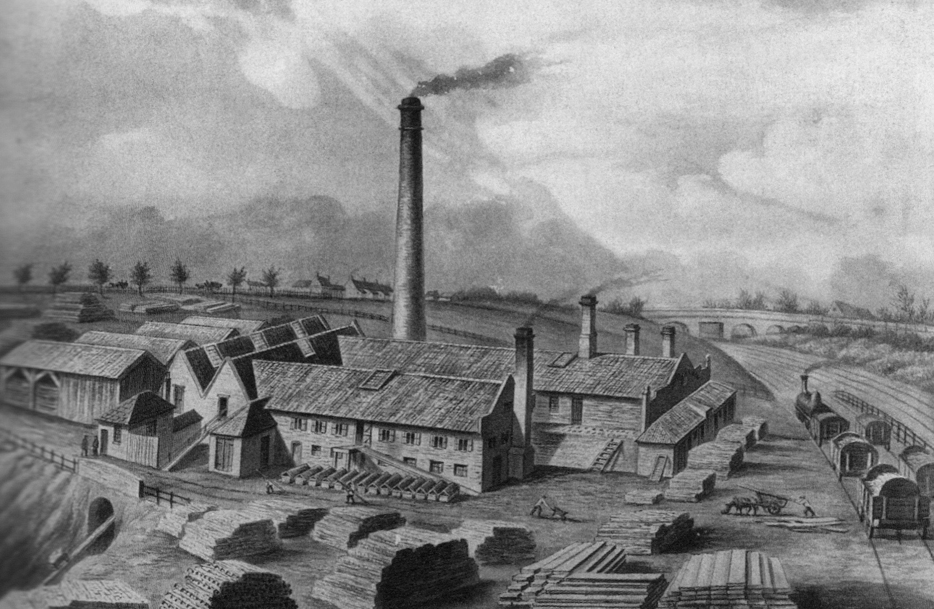
Busy Builders!
But this isn’t the first time builders have been busy. In 1801 there were just 252 people living in the Abbey ward, but by 1851 there were almost 12,000!
Picture of Watts Brick and Timber
Yard on Newmarket Road
in 19th century

Slide 4
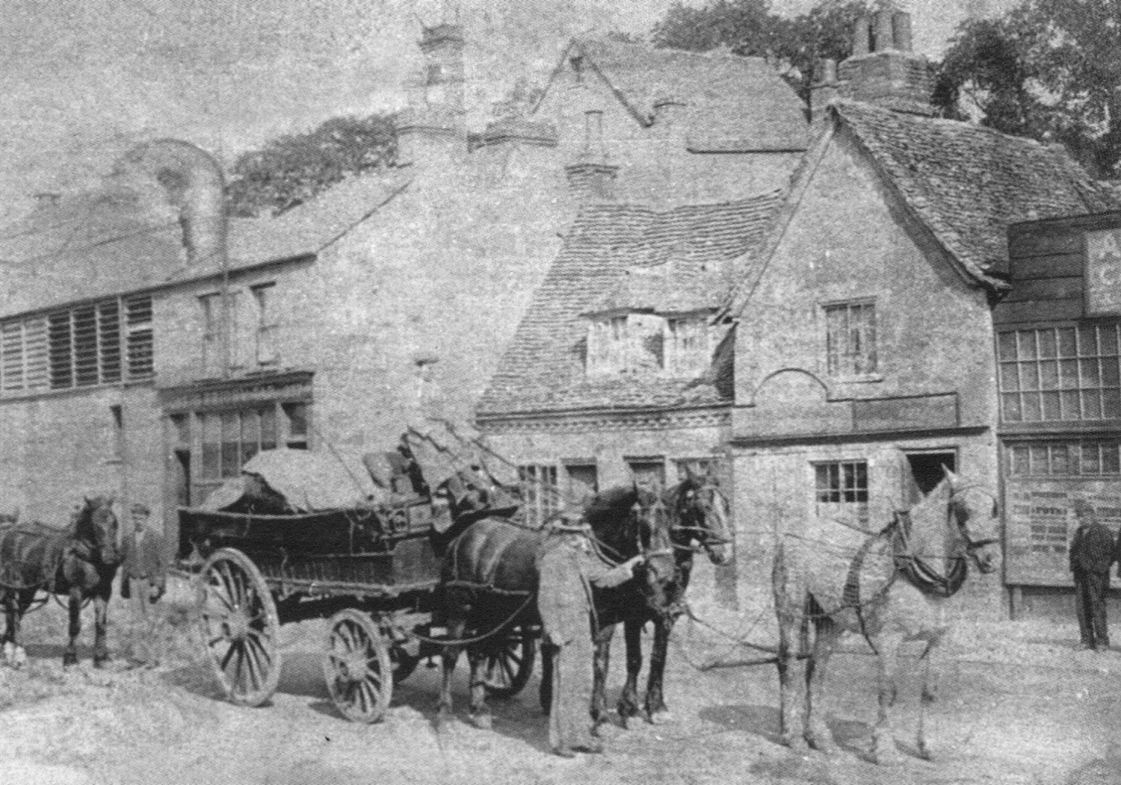
New Homes Needed!
In the 19th century new homes were needed for growing numbers of railway workers, craftsmen and shopkeepers.
Photo of Bird in Hand, Newmarket
Road From Cambridge Collection

Slide 5
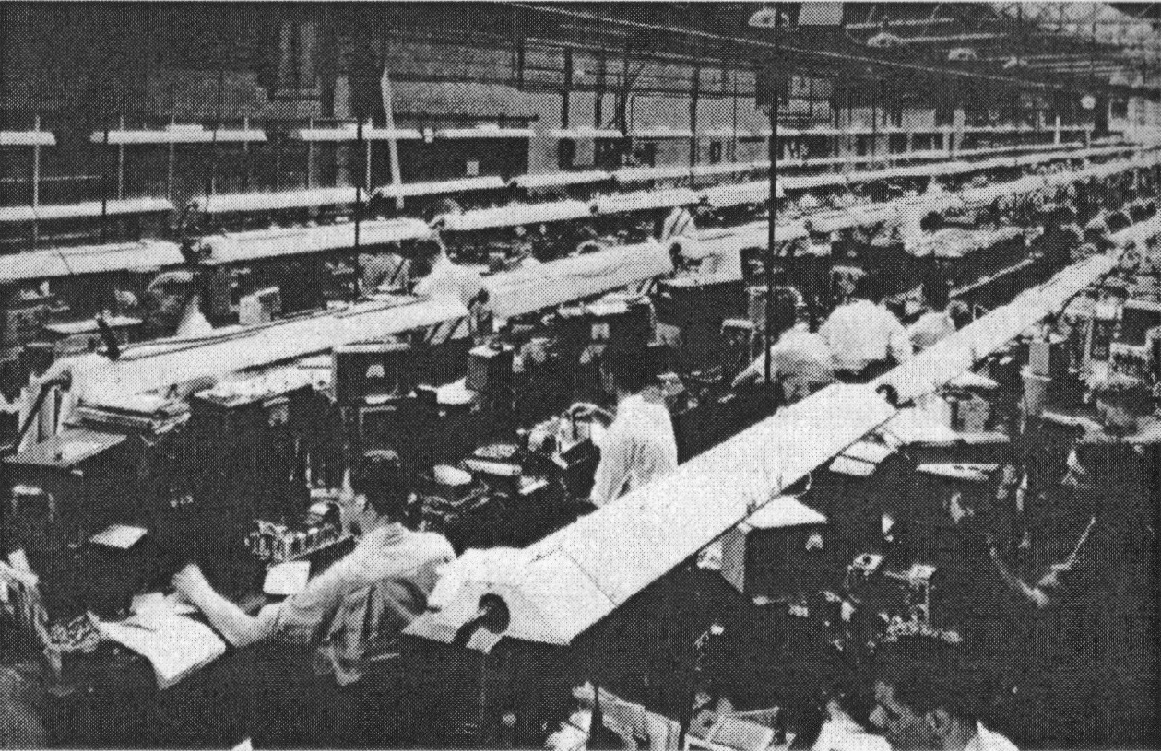
East Cambridge is Built
In the 20th century east Cambridge was newly built, including Abbey Meadows School in
the 1950s & new estates nearby for families, with the adults working in firms such as
Marshall’s Aerospace and Pye Electronics.
Photo of workers at Pye Electronics.

Slide 6
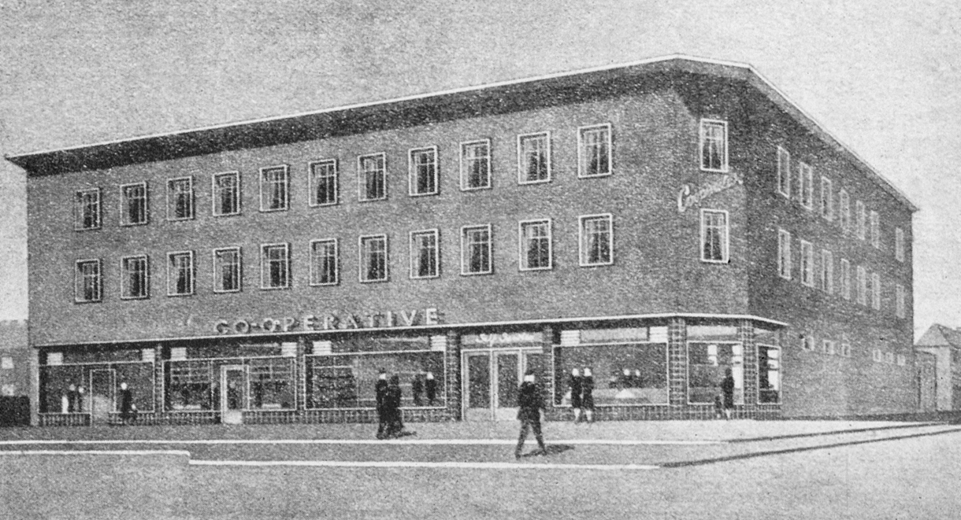
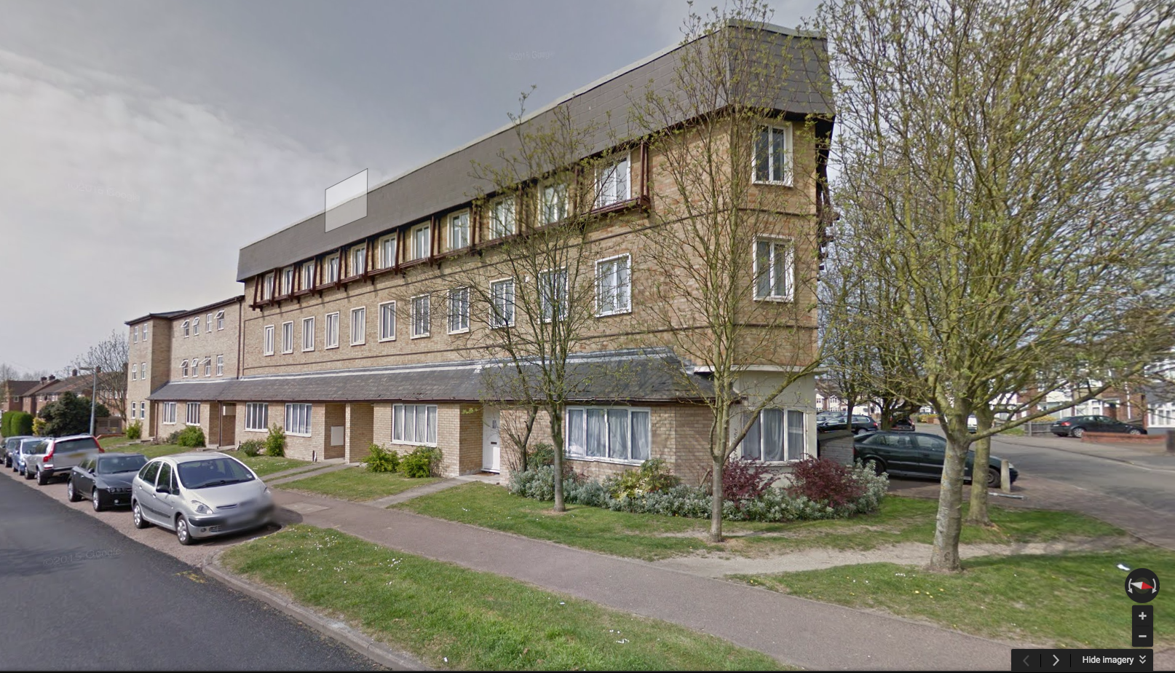
Times Change, Buildings Change
Then
Now
There used to be a Co-op supermarket on Whitehill Road with flats above, now the Co-op has been converted to make more flats.

Slide 7
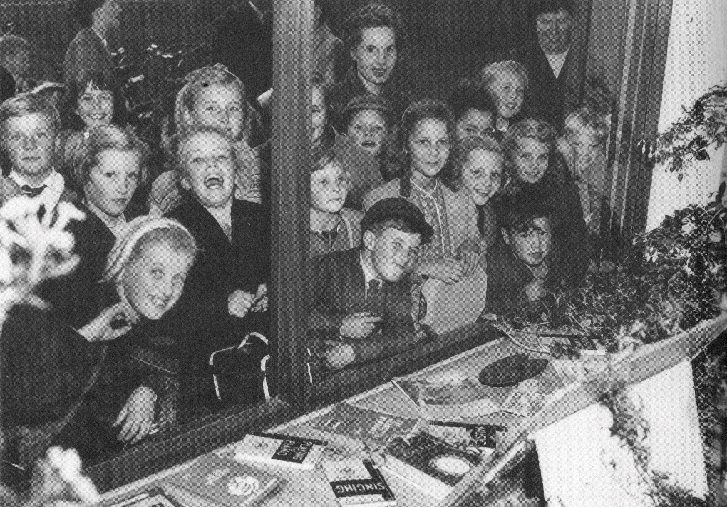
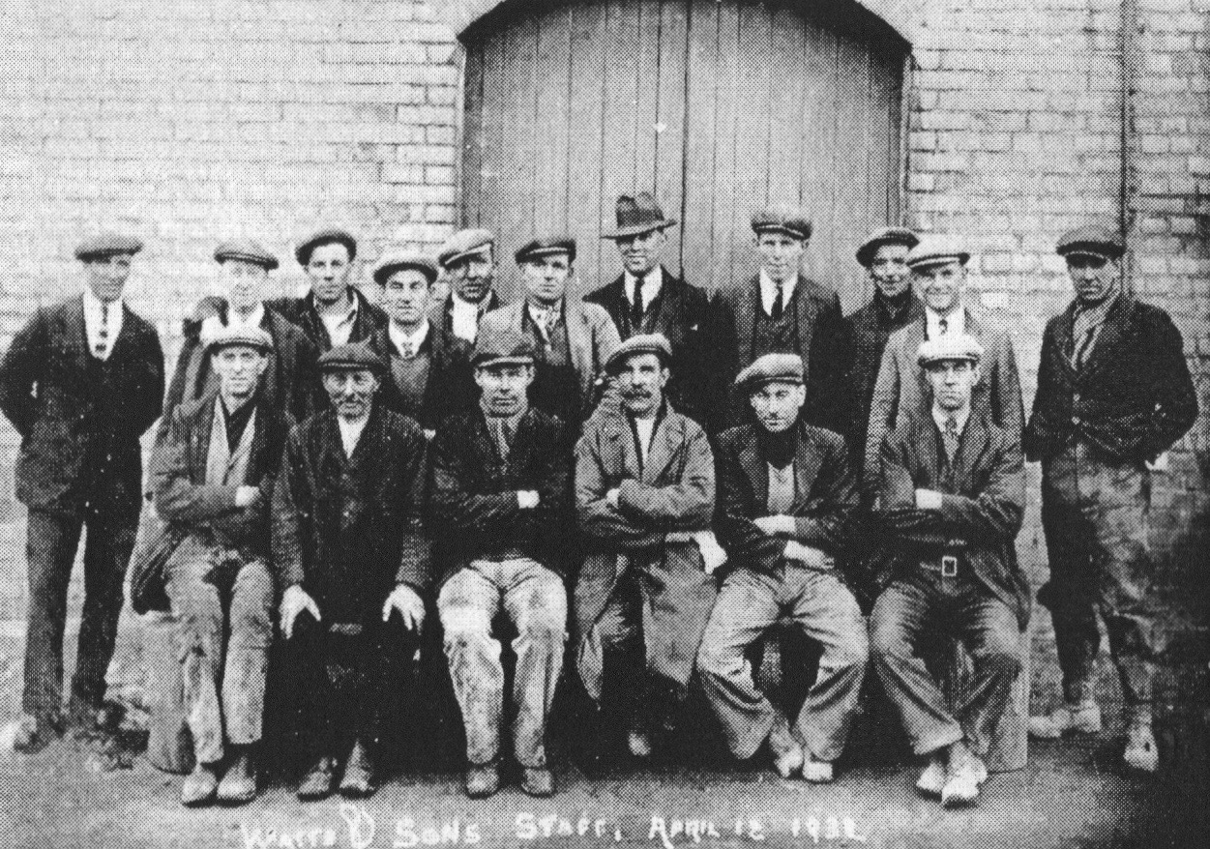
Stories of the Past
Children at Barnwell Library in 1958
Workers from Watts Timber Yard in 1932
Stories of people’s work and homes tell the story of Cambridge!

Slide 8

Web Resources available at:
http://www.creatingmycambridge.com/
history-stories

