Slide 1

The Bath House

Slide 2
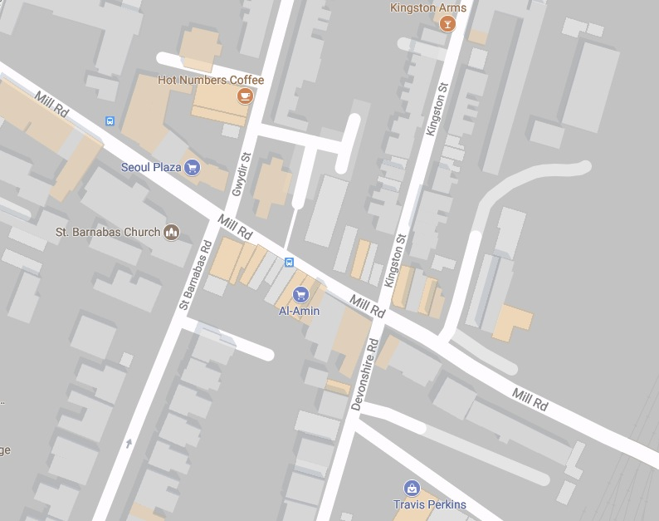
Where is the Bath House?
The Bath House sits on the corner of Gwydir Street and Mill Road!
Map from Google Maps

Slide 3
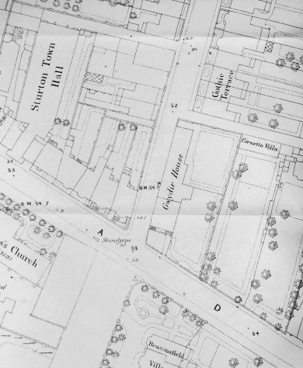
Was it always a Bath House?
No! Where the Bath House is now used to be someone’s home.
James Naden, a draper, built a house there in 1850 for his wife, his children and his mother to live in.
The house was called Gwydir House. Can you see it on this map from 1886?
Map from Capturing Cambridge

Slide 4
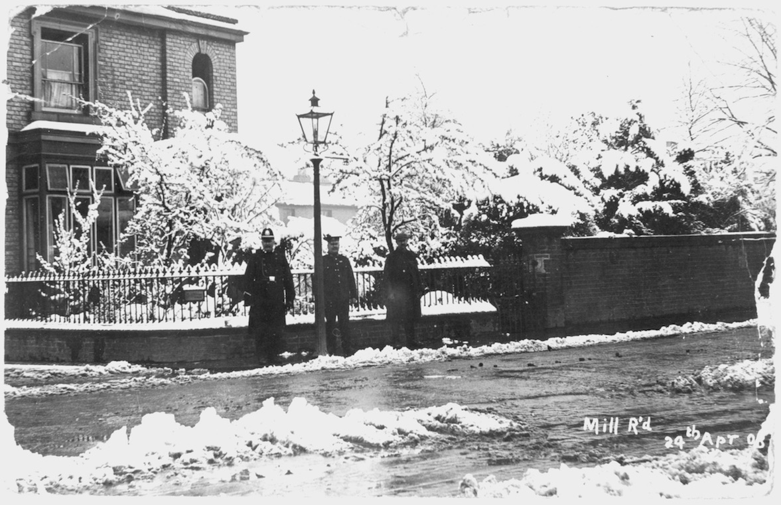
What happened to the house next?
For the next 60 years lots of different families lived in Gwydir House.
This is the house in 1908 with three very cold policemen outside!
FACTOID
FIVE doctors in a row lived in this house, so it became known as the Doctor’s House
Photo of Gwydir House from Capturing Cambridge

Slide 5
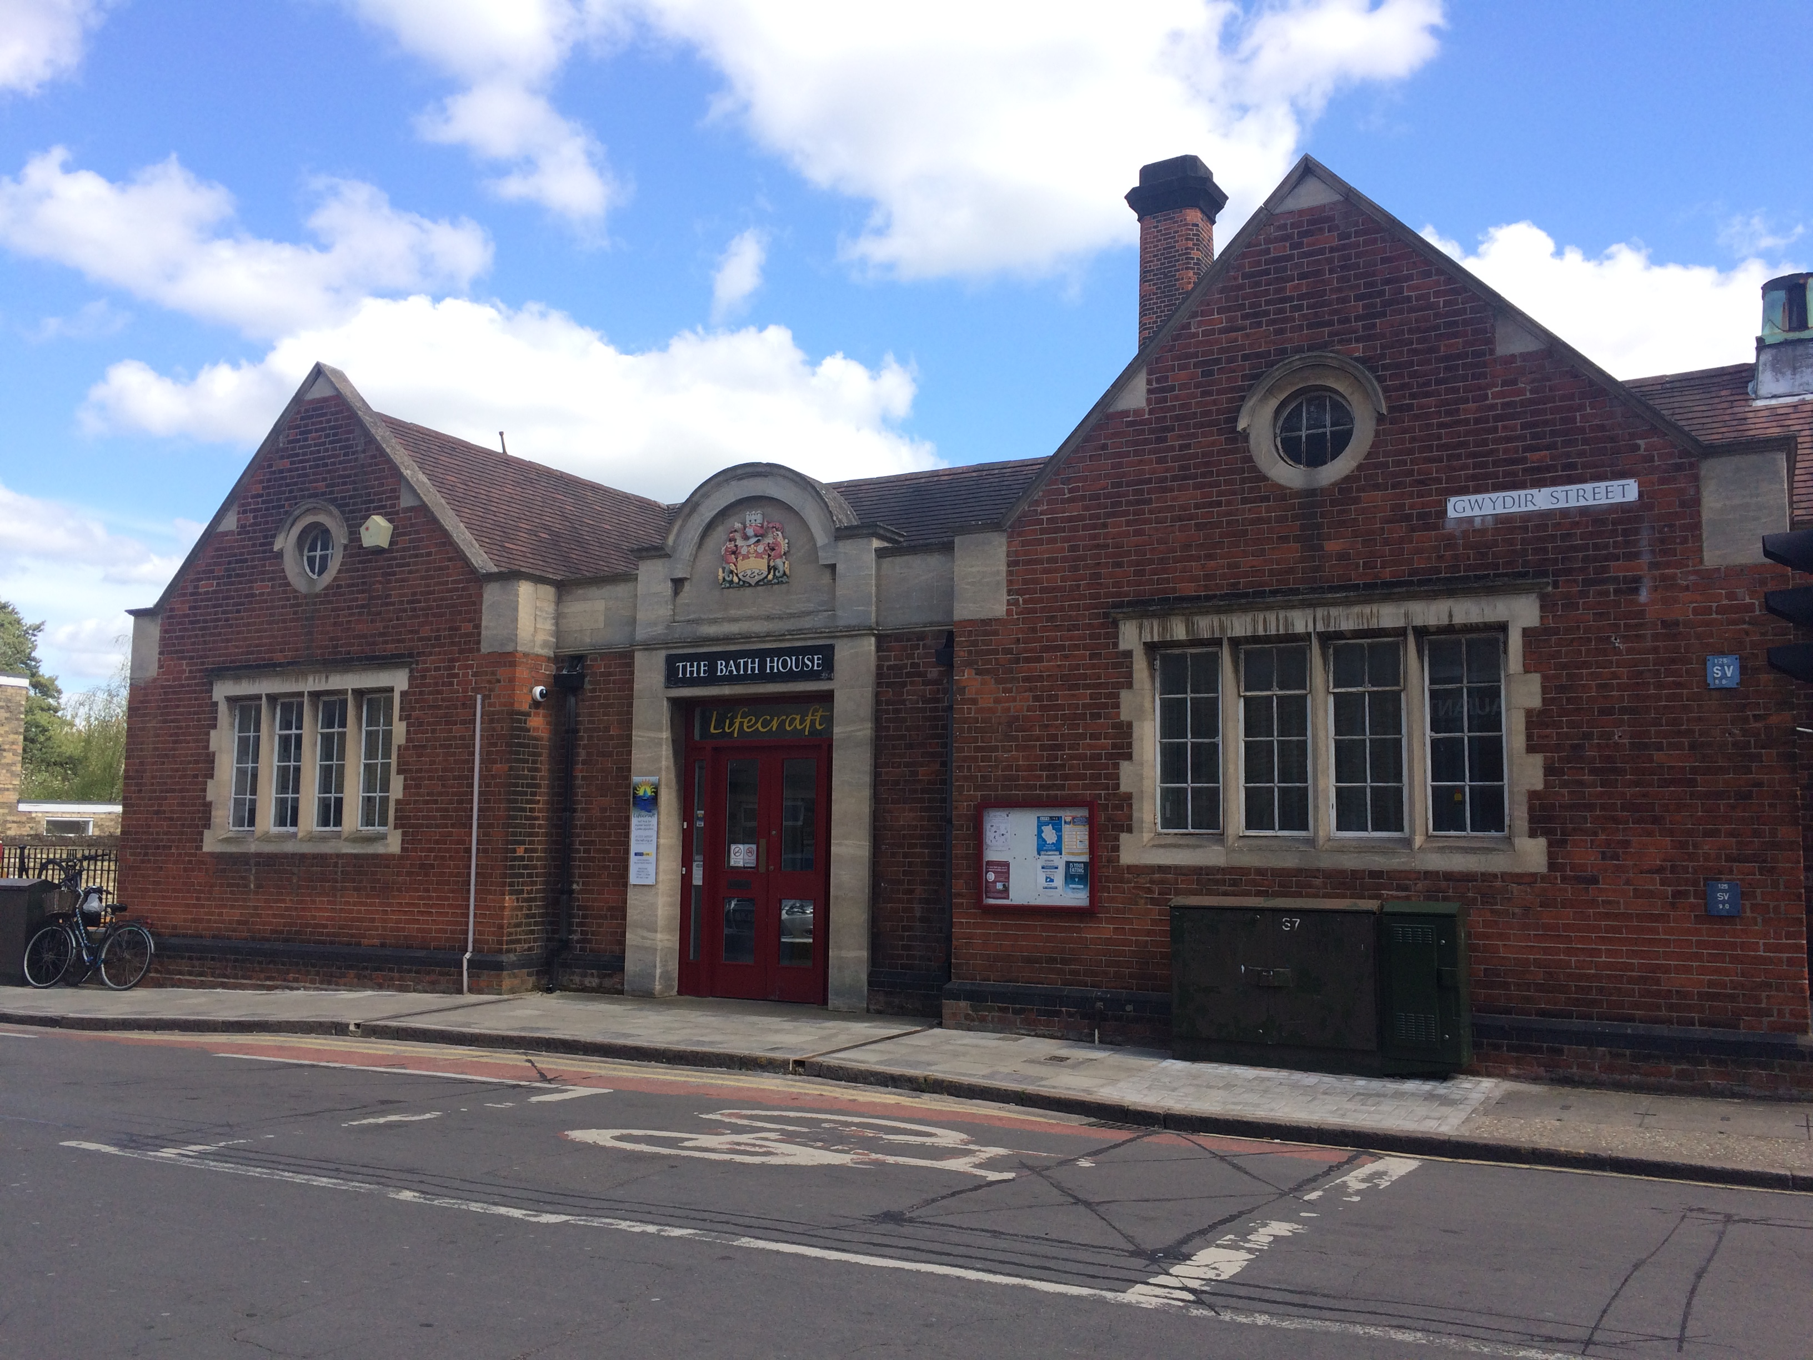
When did it become the Bath House?
The council bought the house in 1913 and soon demolished it.
They decided in 1923 to build a public baths there, where people could wash and do their laundry.
Photo of the Bath House today, which is now used by a local charity called ‘Lifecraft’

Slide 6
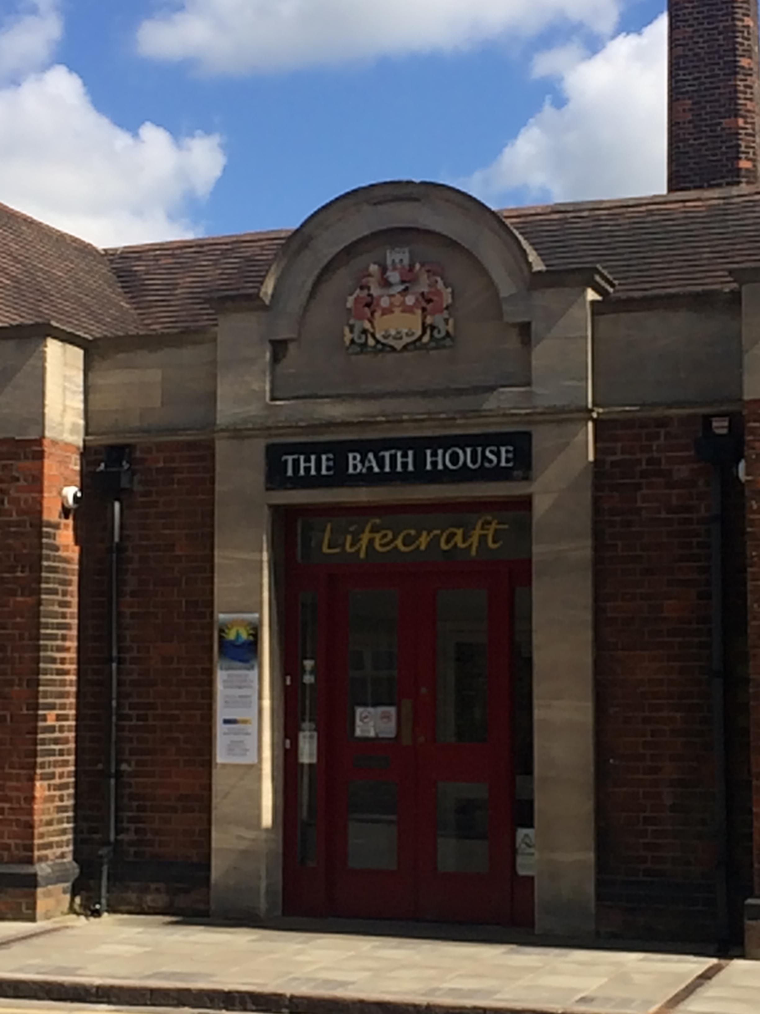
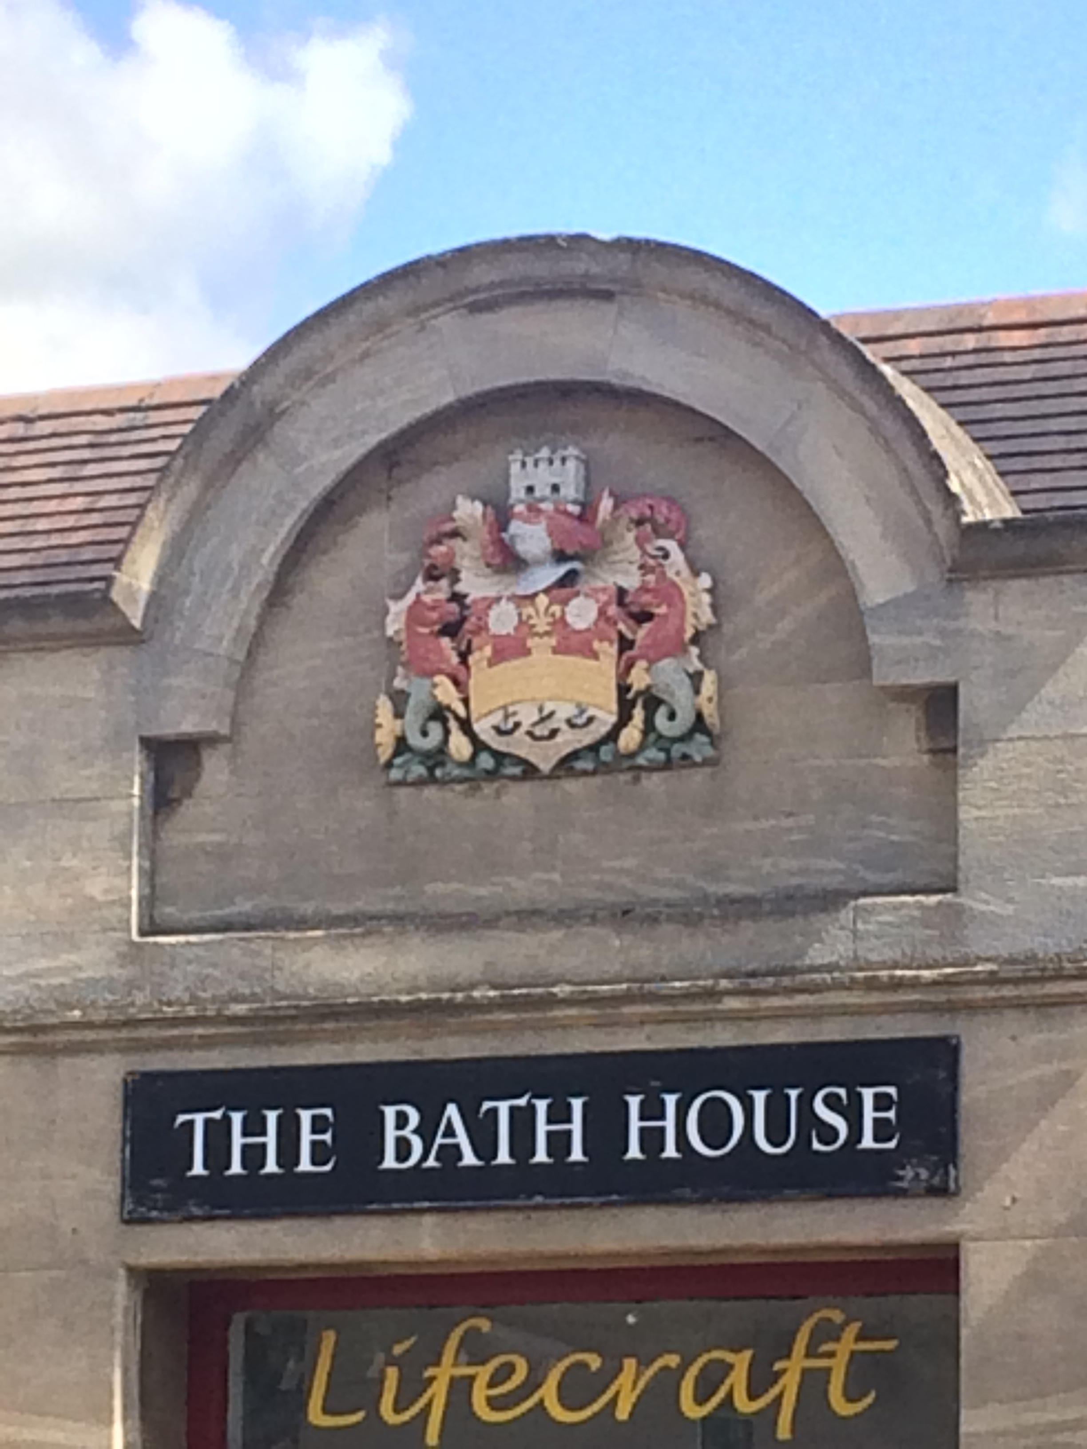
The Entrance to the Bath House
This was the entrance to the
Bath House where people
would enter to go have their
bath or do their washing.
Can you spot a Coat of Arms
above the door?
This is the Cambridge Coat
of Arms! It has seahorses
and a bridge on it as these
are reminders of how Cambridge
used to be an important trade
route from the sea to places in
land.

Slide 7
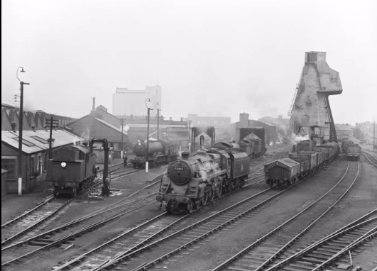
Why did Cambridge need a public baths?
Most of the people living in the Mill Road area, including lots of children, worked on the railway.
This often involved lots of shoveling coal, so the workers always came home covered in soot! They really needed a bath!!
Photo of Cambridge Railway Shed from National Railways Museum Collection

Slide 8
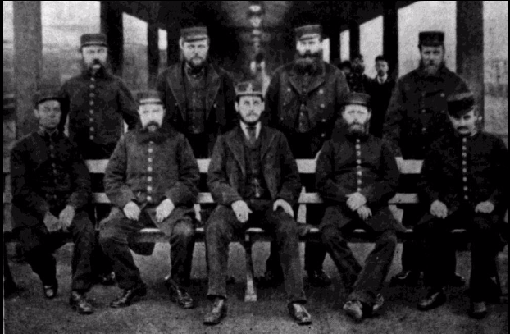
But why couldn’t they wash at home?
Photo of the Station Master and workers, from Capturing Cambridge
FACTOID
Even in 1923, 3/4 of Cambridge houses didn’t have a bath!
Most houses didn’t have running water, so you couldn’t just turn on a tap! And if you don’t have running water, a bathtub is no use!

Slide 9

Washing before the Bath House
Minnie Baraclough, a Cambridge resident, remembers how you washed at home in the 1920s and 30s!
“Mum used to wash you on the kitchen table. Shove you on the kitchen table with a bowl of water to rub up and down your legs like that: ‘now the other leg – put your other leg out!’”
Do you fancy a bath like this?

Slide 10
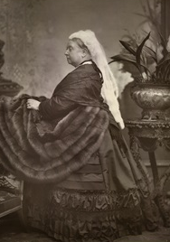
Why not just take a dip in the river?
At this time, the Cambridge rivers were where everyone dumped their rubbish. They were basically open sewers!
They were so bad even Queen Victoria asked why there was so much paper in them when she visited in 1843!
Photo of Queen Victoria
from the British Library

Slide 11
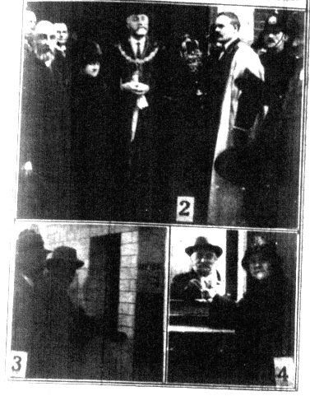
The Grand Opening
The Bath House opened on the 3rd February 1927.
The opening of the Bath House was a grand affair, with all the councillors of Cambridge attending. The mayor was given a golden key to unlock the building for the first time.
Here is a picture from the Cambridge Daily News Paper of the big opening. Can you spot the mayor?
Photo from Capturing Cambridge

Slide 12
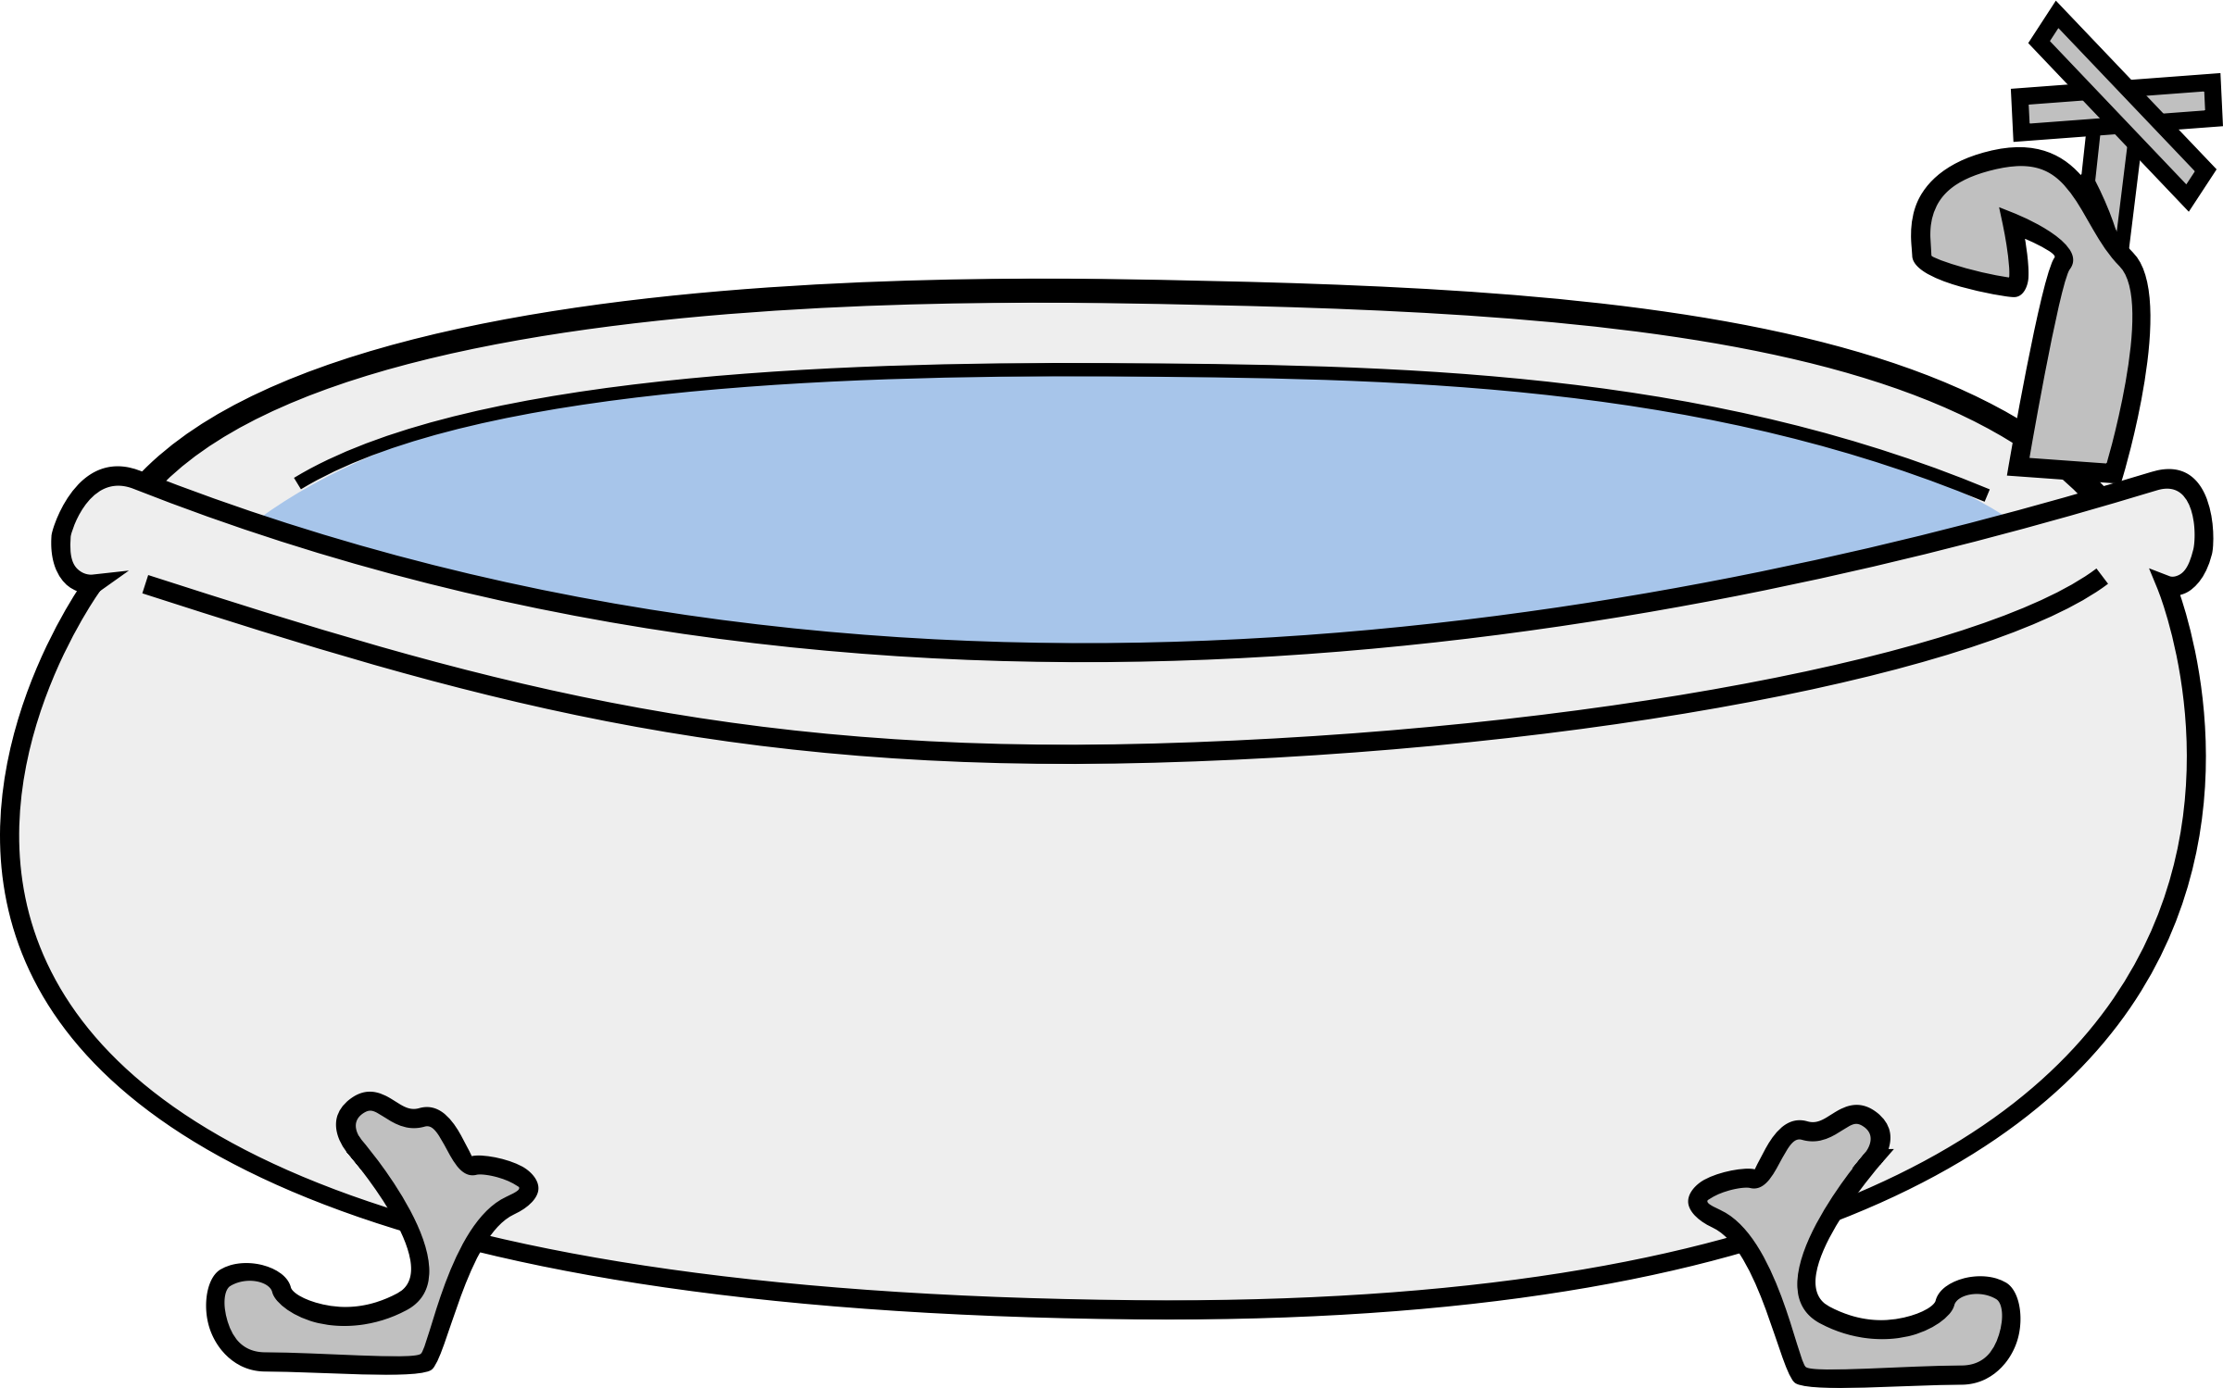
The First Bath
Ben Benstead, who lived in Victoria Road, took the first bath.
BUT there was something wrong with the boiler, so it was FREEZING!
Ben said “Lukewarm?- Forget it! My first real bath was in stone-cold water!”

Slide 13

How much did it cost?
To have a bath cost 4 pennies, which included a towel and some soap.
An extra towel cost 1 penny.
FACTOID
4 pennies in 1927 was roughly equal to £2.82 today! Would you pay that for a bath?
If a parent brought more than one child, they got a cheaper rate!

Slide 14
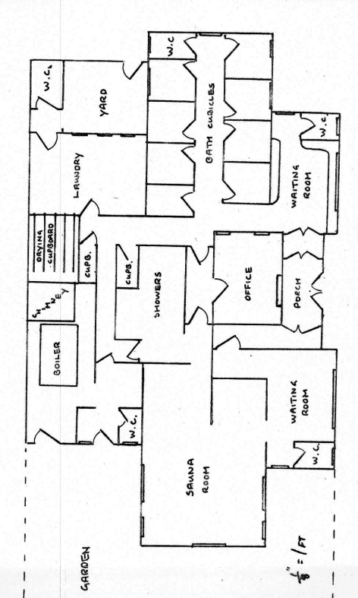
How did you use the Bath House?
Firstly, when you entered, you would pay at the office. Then men would be sent to the left and women to the right.
You would wait in the waiting room until a bath was free, then you would wash in a closed-off cubicle.
Here is a plan of the building from 1978. Where it says ‘Sauna room’ would have been the men’s bath cubicles in 1927. Can you trace where customers would have gone?
Plan from Capturing Cambridge

Slide 15
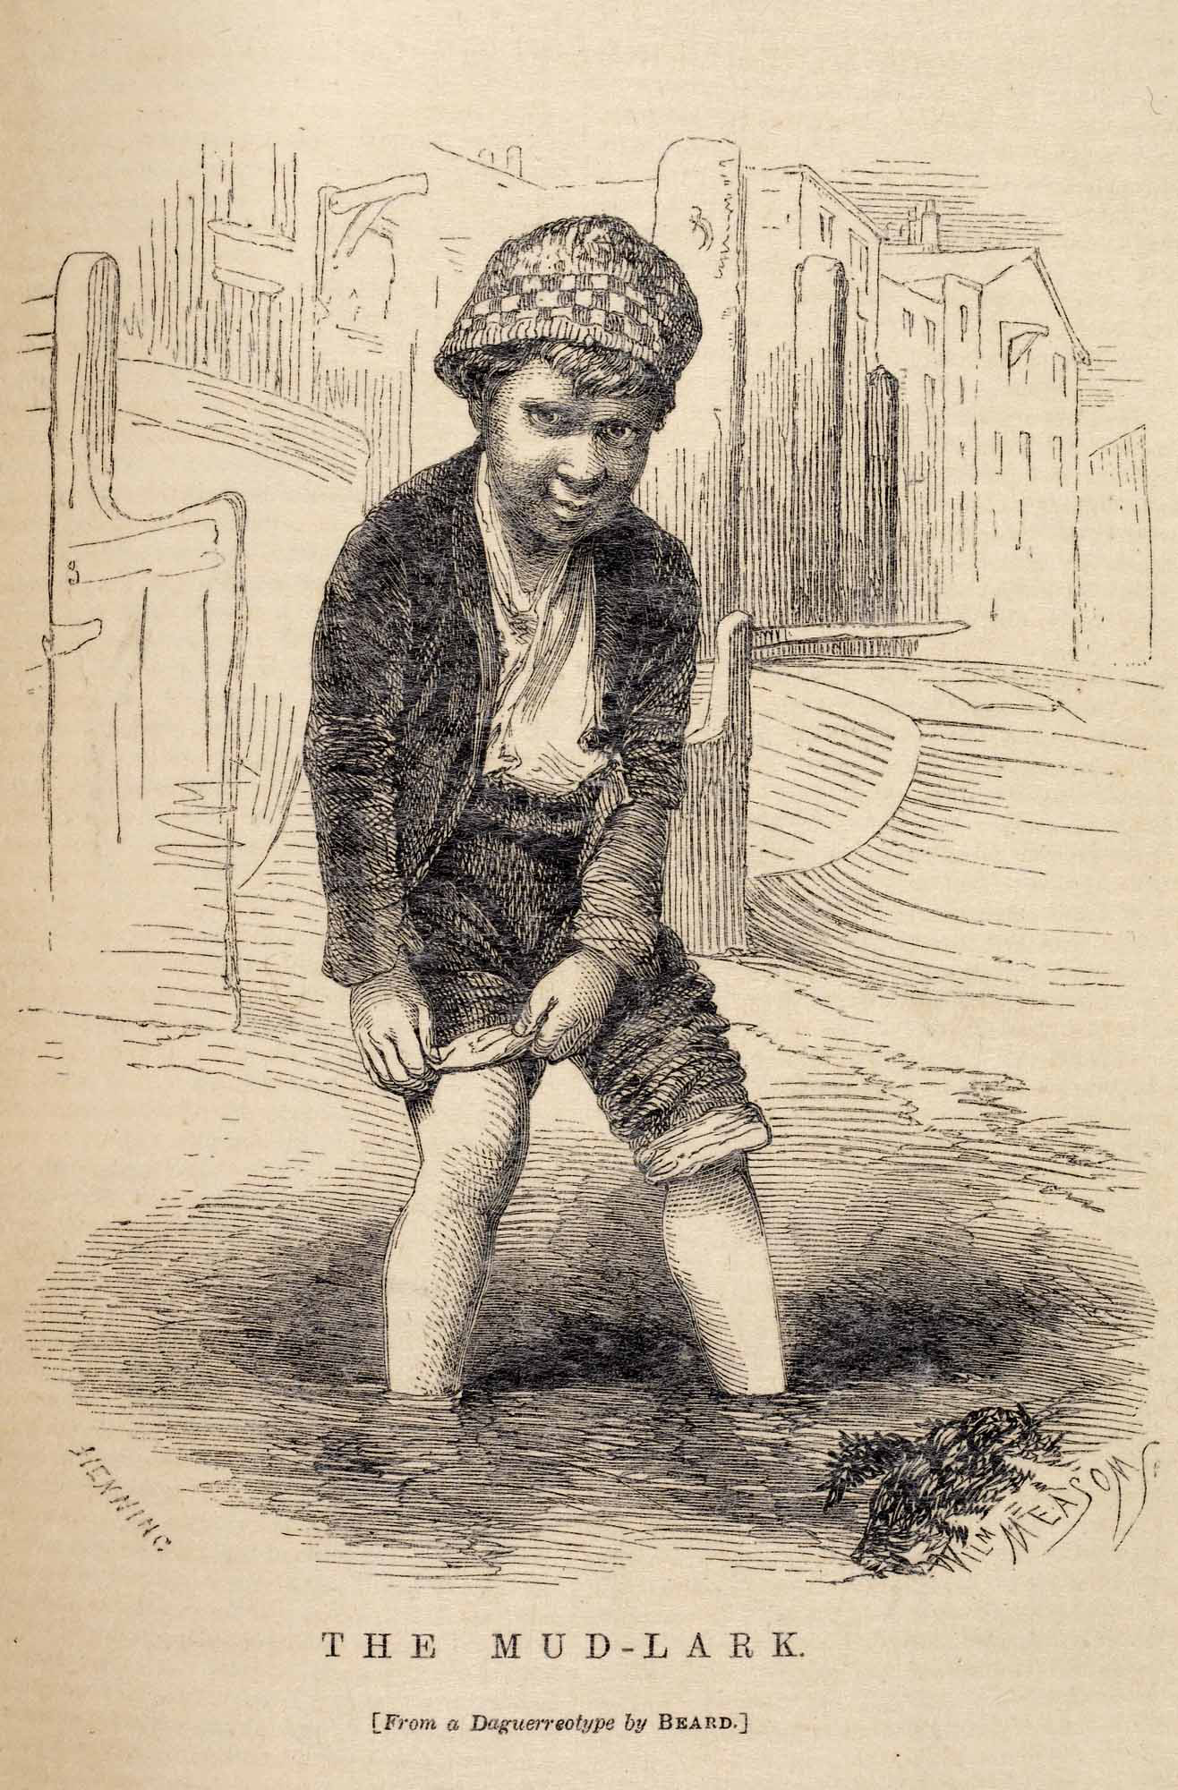
Men to the left, women to the right!
There was a law at the time that men and women had to use different baths, in different areas. This was because upper-class Victorians were worried about the morals of the poor – it would be very improper for a man to see a woman naked!
Children generally went in the same tub as their mum or dad! Would you like to share a bath with one of your parents?
Photo from the British Library

Slide 16
“Cold water, please!”
The baths in the Bath House had no taps! Instead, an attendant outside turned the water on and it gushed into the bath through a pipe!
Monica Smith remembers having a bath at the Bath House:
‘So you put your foot in – ‘Ow! It’s too hot!’ – so you have to then call out [to the attendant] and say ‘Number (whatever number [cubicle] you’ve landed yourself in)’ and ask for cold water’

Slide 17
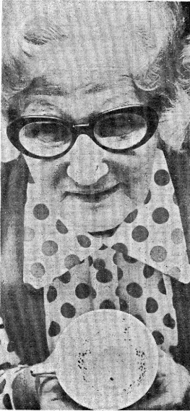
Dolly, the Fortune Teller
The Bath House was not just a place for cleaning; the waiting rooms were also somewhere to socialise!
A newspaper article records how Dolly, an attendant at the baths, entertained those waiting.
She would put on music and dance, give out advice to girls worried about their boyfriend and even predict people’s future but looking at their tea leaves!
Photo of Dolly from Capturing Cambridge

Slide 18
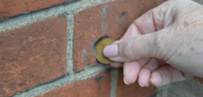
Discover More
You could ask your grandparents or someone else who has lived in the Mill Road area for a while. They will probably remember the Bath House, as it only closed in 1976!
Go and visit the Bath House! Have a look for holes in the wall where people waiting rubbed their coins on the wall. They wrote their names there too! Can you see them?
Photo from Capturing Cambridge

Slide 19
Discover More
* To find out more about the Bath House visit:
http://www.capturingcambridge.org/mill-road-area/mill-road/the-bath-house/ - It provides a comprehensive report on the building and it’s history, with personal accounts and lots of pictures. * The Bath House sits on the corner of Gwydir Street and Mill Road. To arrange a visit email:
bathhousemanager@lifecraft.org.uk

Slide 20

Web Resources available at:
http://www.creatingmycambridge.com/
history-stories

