Slide 1

CAMBRIDGE BRICK AND TILE WORKS

Slide 2
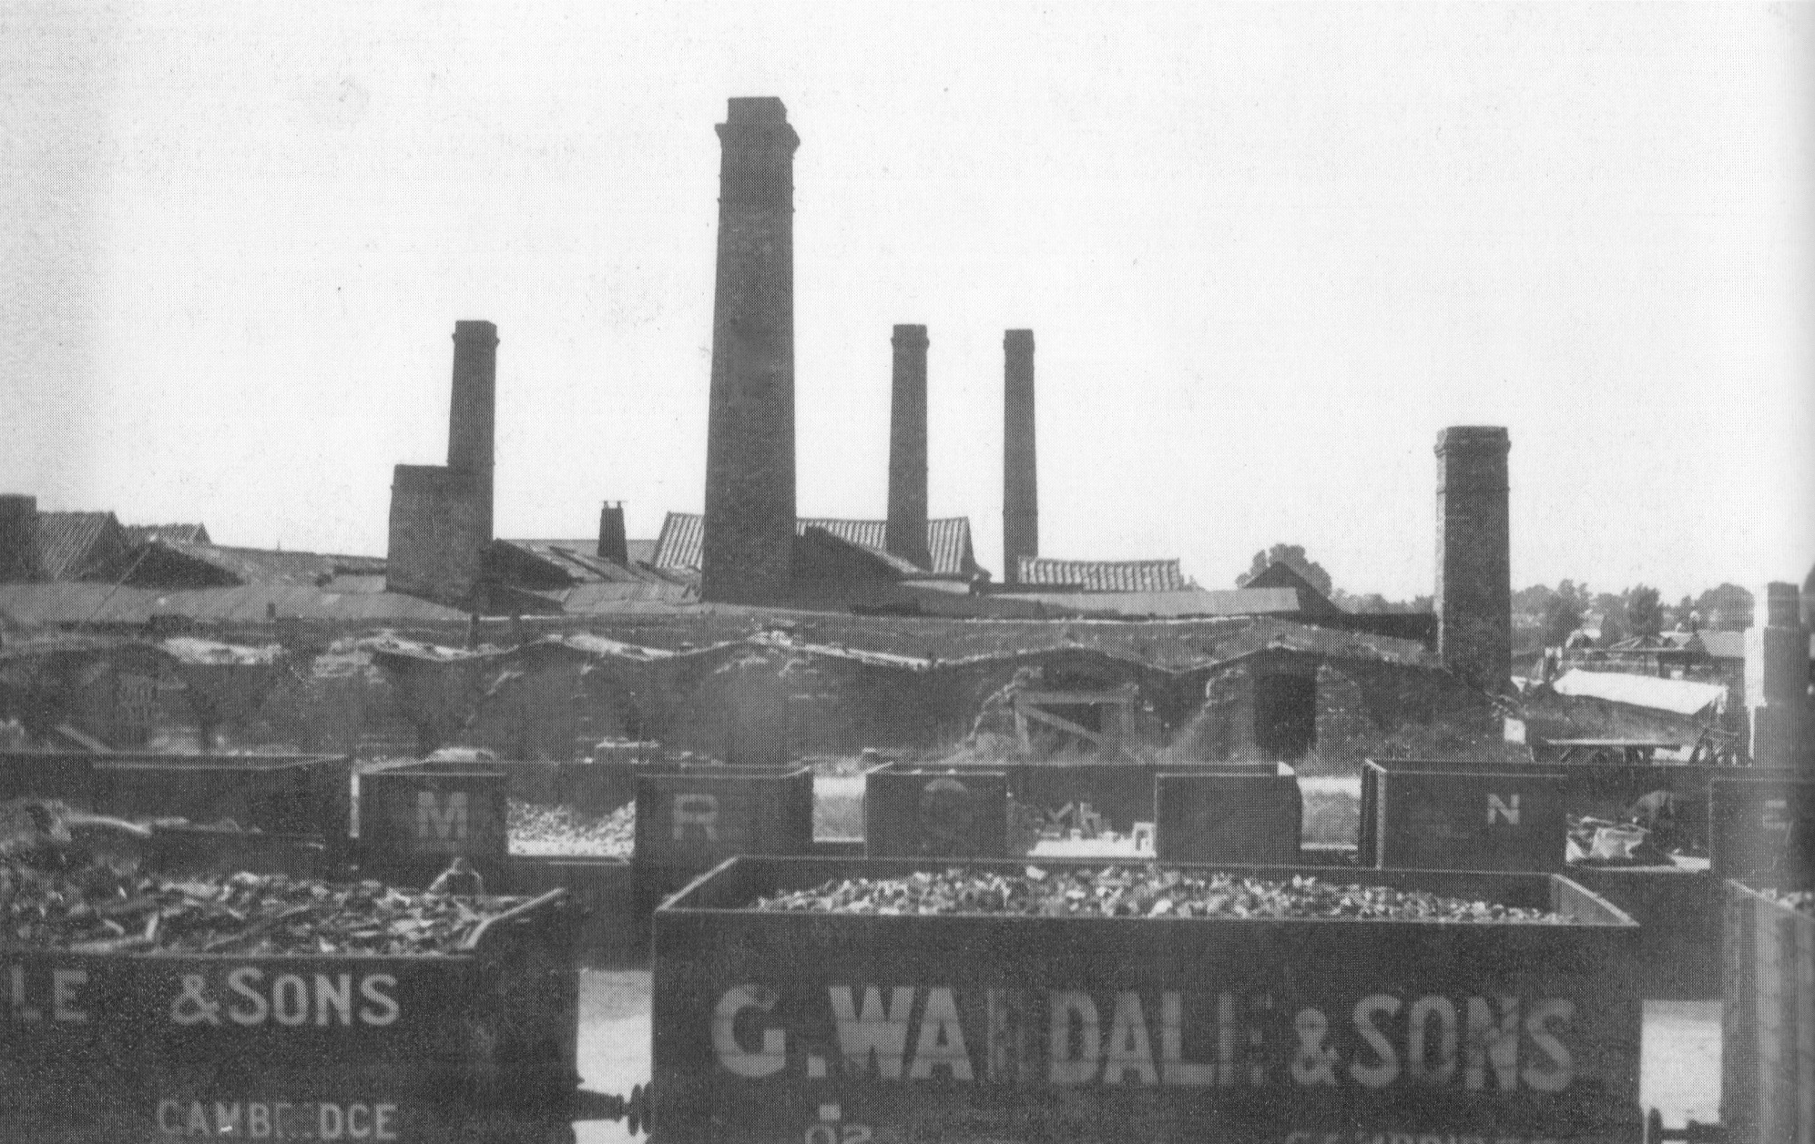
Cambridge Brick and Tile Works
The kilns at the brick and tile works had very tall chimneys, which were used to make bricks and tiles in the 1800s and 1900s.

Slide 3
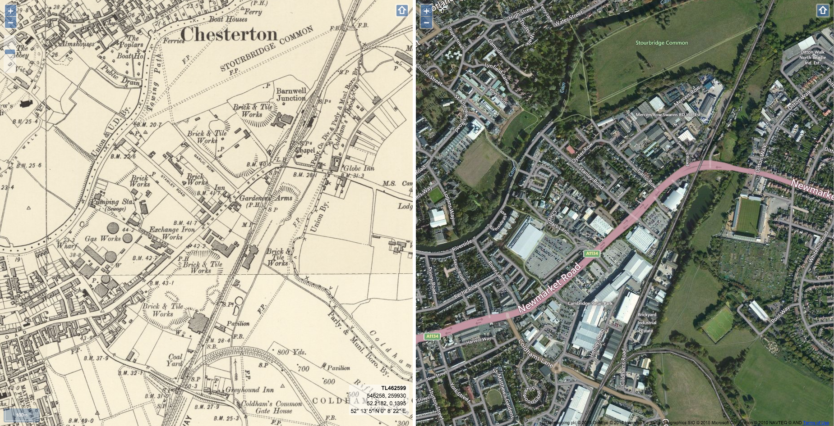
Then and Now
The Brick and Tile Works were located in buildings stretching across a vast area on both sides of the Newmarket Road and all the way over to Coldham’s Lane, which is now known as Cambridge Retail Park.

Slide 4

Industrial Abbey
Abbey became a very industrial area of iron works and timber merchants, brick and tile factories which provided materials for Cambridge buildings in the 19th and 20th centuries.
There were chimneys everywhere in the Abbey area and smoke-filled the air.
Just imagine how different it would have been like to live near there then!

Slide 5
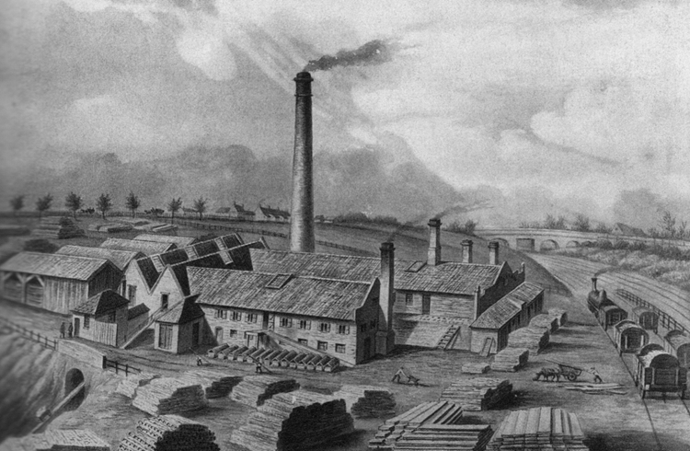
The Industry Expands Further
These factories grew in number after 1845 when the railway line was built for Cambridge.
Can you spot the
Railway line and
Steam train in the
picture?

Slide 6
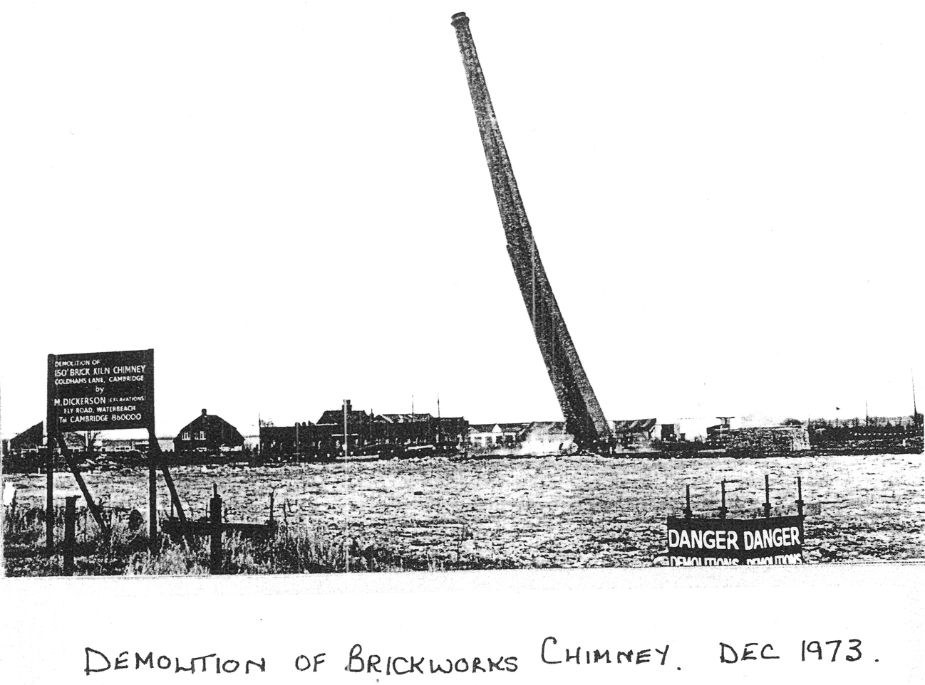
Demolition of the Brickworks
By the 1970s the
Brickworks were no longer needed so the factories were demolished. It was then redeveloped to create what we now know as Cambridge Retail Park.

Slide 7

Web Resources available at:
http://www.creatingmycambridge.com/
history-stories

