Slide 1

OLIVER CROMWELL’S HEAD

Slide 2
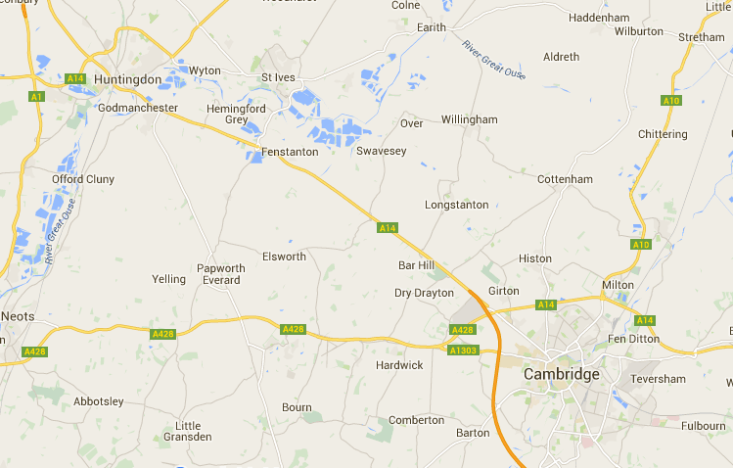
Who was Cromwell?
Cromwell was a local lad- he was born in 1599 and grew up in Huntingdon,
not far from Cambridge.
Cromwell was born here
Cromwell went to
university here
He went to Huntington Grammar School then studied at Sidney Sussex College in Cambridge in 1616. He lived in and around Cambridge for twenty years before joining the Parliamentarians during the English Civil War.

Slide 3
Cromwell in Parliament
Cromwell was a Member of Parliament, first in his hometown of Huntingdon and then in Cambridge.
FACTOID!
Cromwell wasn’t a fan of the well known document, the ‘Magna Carta’ (which had been approved by King John 300 years before). So he gave it the nickname ‘Magna Farta’, which showed how terrible he thought it was!

Slide 4
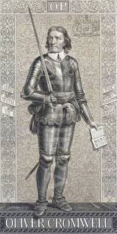
Royalists V Parliamentarians
In the 17th Century Parliament saw that King Charles I was using his power unwisely and wanted him to make significant changes.
When the King refused to do this, a civil war broke out - Royalists (supporters of the King) fighting against the Parliamentarians (supporters of Parliament).
The University was mostly Royalist and the townspeople were mostly Parliamentarians.
Cromwell was Cambridge’s local MP and a commander in the Parliamentarians. Cromwell forced Cambridge Colleges to house his troops and used King’s College for military exercises. You can still see graffiti left by the soldiers, near the altar to this day!

Slide 5
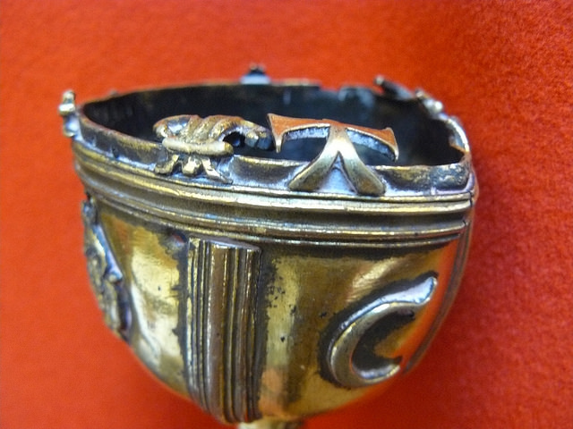
Chop Off His Head!
Cromwell ordered for Charles I to be executed outside the Banqueting Hall in Whitehall on 30th January 1649.
Cromwell was put in charge of the county and was given the title of ‘Lord Protector’. Cromwell refused to wear a crown on principle as wanted his rule to be different from those that came before him.
When Charles I was executed, the Cambridge mace was also executed! The jagged edge shows where the crown was ritually hacked off with a butcher’s knife to represent the King’s Head being taken off with a sword!

Slide 6
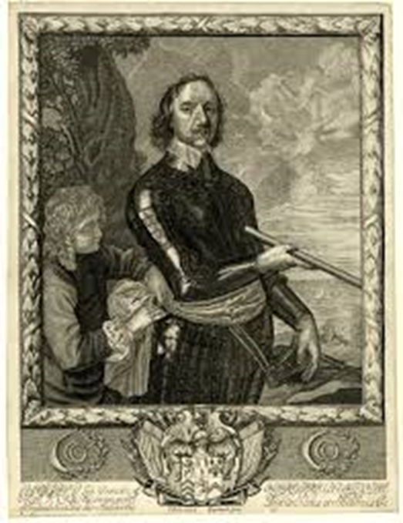
Don’t Loose Your Head About It!
Despite being buried whole in Westminster Abbey, London in the 1600s, Oliver Cromwell’s head ended up buried in Cambridge in the 20th Century!
Cromwell died of natural causes in 1658 and was given a fitting burial place in Westminster Abbey.
However, on the Restoration of the Monarchy in 1660 his body was dug up and ended up on a spike above Westminster. Years later it blew off in a storm and was eventually given back to his family.

Slide 7
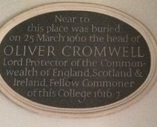
So the mystery continues…
There are a number of stories of how Cromwell’s head eventually ended up back in Cambridge, but we still don’t know which is true!
However Cromwell’s head was eventually laid to rest in Sidney Sussex College after his family decided it should be buried in the college he’d previously attended.
FACTOID!
To this day the exact location of Cromwell’s head is still a mystery! It was placed in an unmarked grave in Sidney Sussex College and even those who claim to know will never tell…

Slide 8
Cromwell Round
Words by Dave Cohen
Cromwell’s head is,
Buried in Cambridge
Near the supermarket
Buy one get one free
Click here to listen
to the song

Slide 9

Web Resources available at:
http://www.creatingmycambridge.com/history-stories/cromwells-head/

