Slide 1

CAMBRIDGE TOWN GAOL
(JAIL)

Slide 2
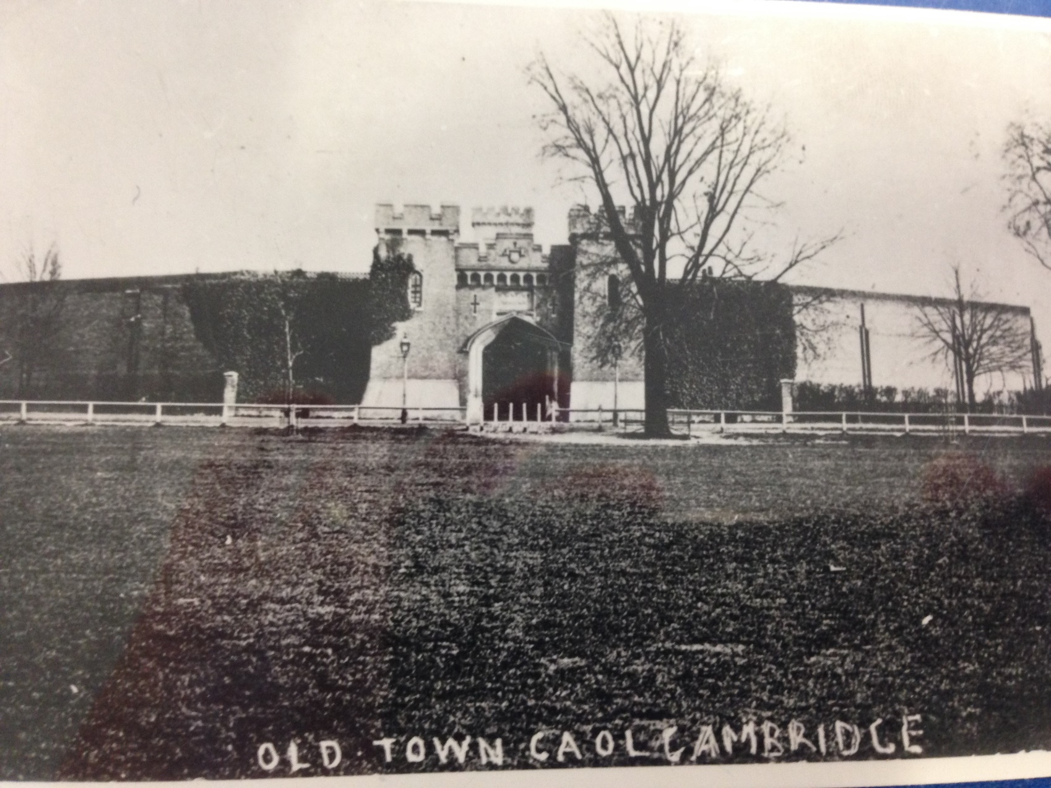
A Gaol (Jail) on Parker’s Piece!
Do you recognise Parker’s Piece?
Cambridge Town Gaol (now called a jail or prison) was located here in the 19th century.

Slide 3
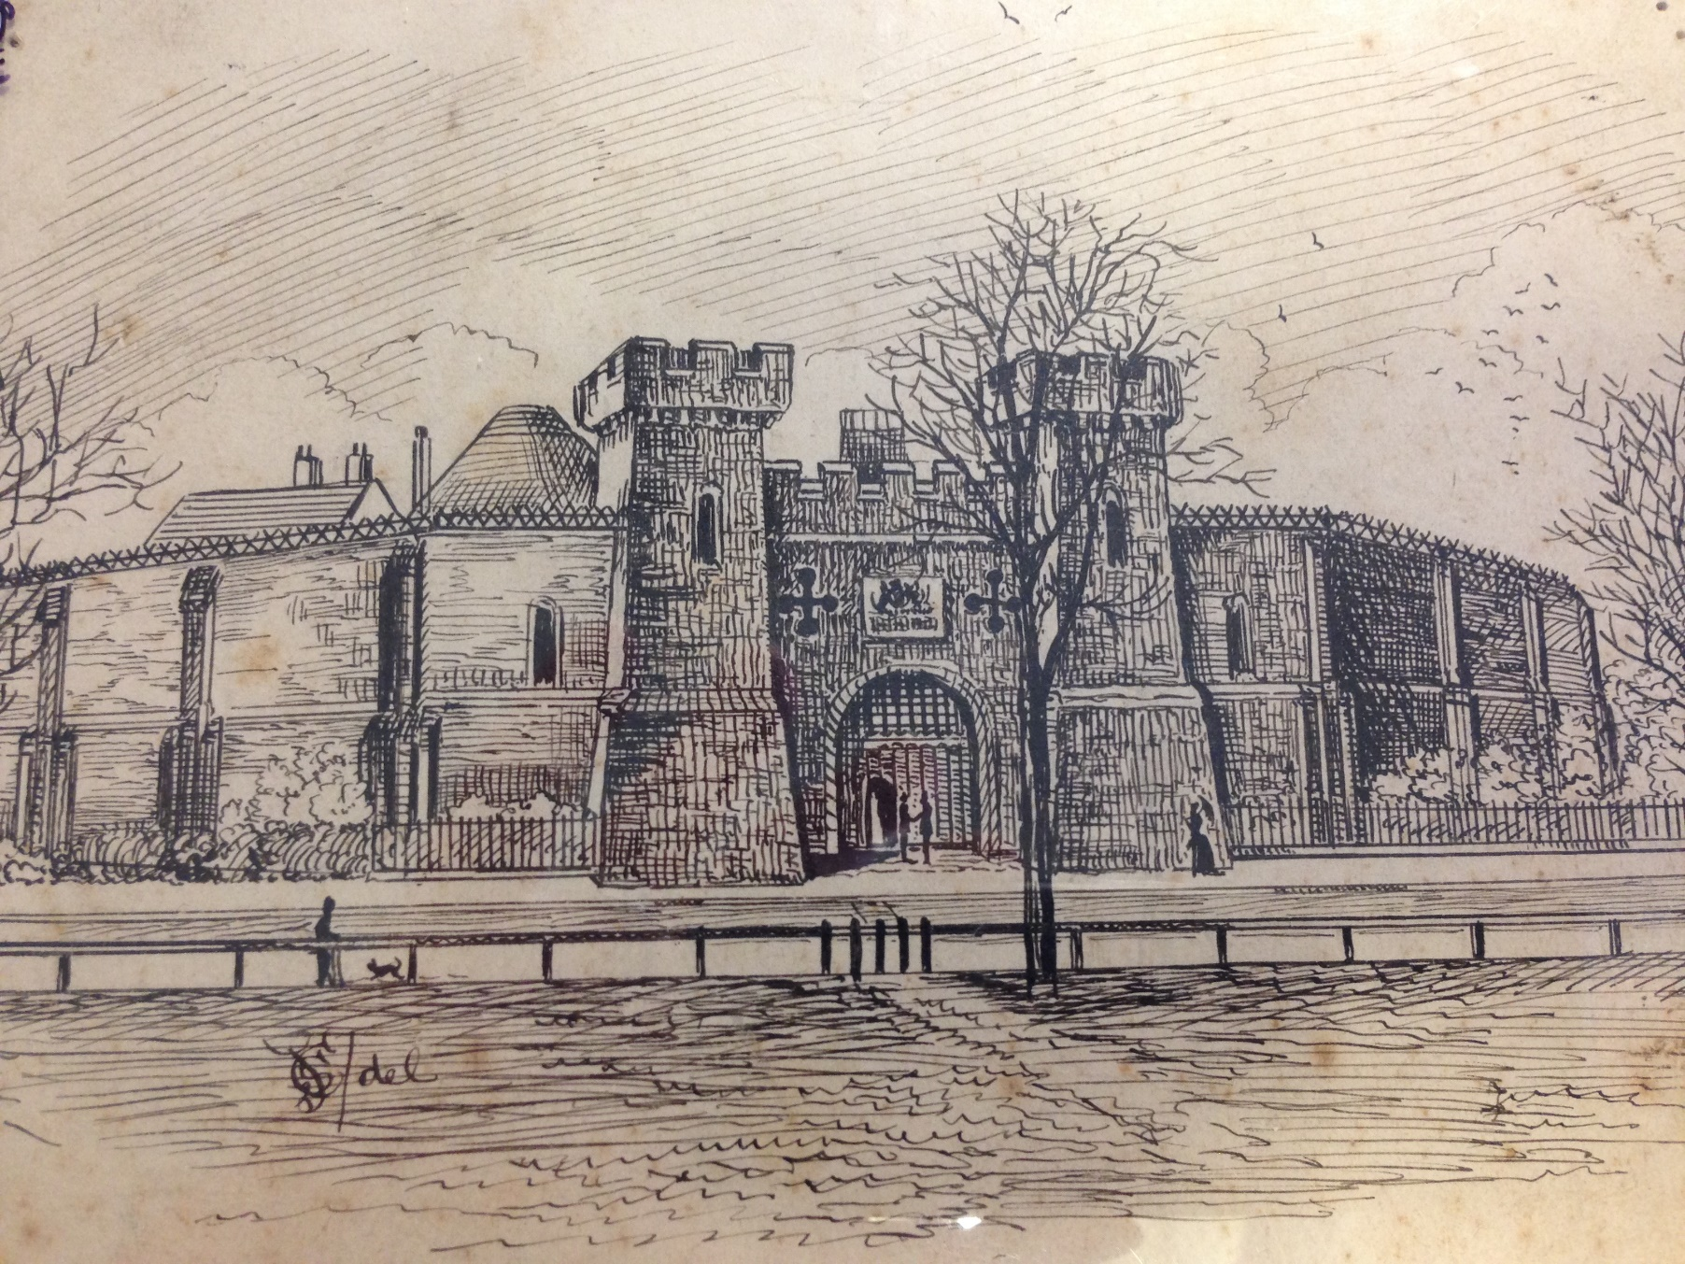
An Expensive Build!
FACTOID!
The Town Gaol cost £25,000 to build!

Slide 4
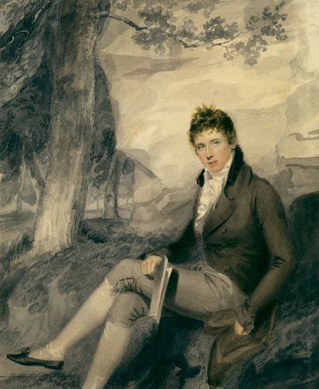
We Won’t Pay!
The University did not want to pay for the Prison… leading to a lot of arguing between the University and the Town.
The local paper stated:
‘Lord Palmerston presented a Petition from the Chancellor, Master, and Scholars of the University of Cambridge, complaining of several clauses in the New Cambridge Gaol Bill, which obliged them to bear their share of the expense.’
The Morning Post, 1826
A painting of Lord
Palmerston

Slide 5
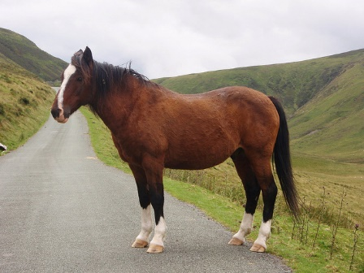
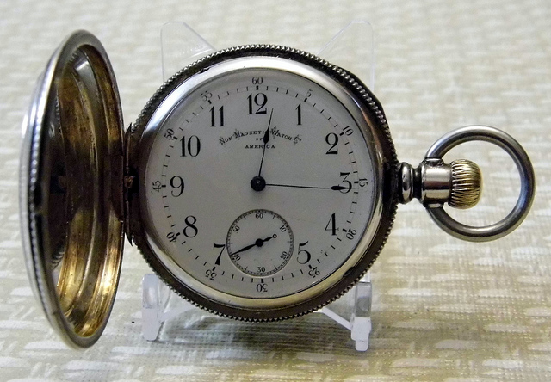
What Was Their Crime?
Frederick Housden was charged with stealing a bay horse in 1834.
A ring of thieves were imprisoned for stealing a silver watch in 1832.

Slide 6
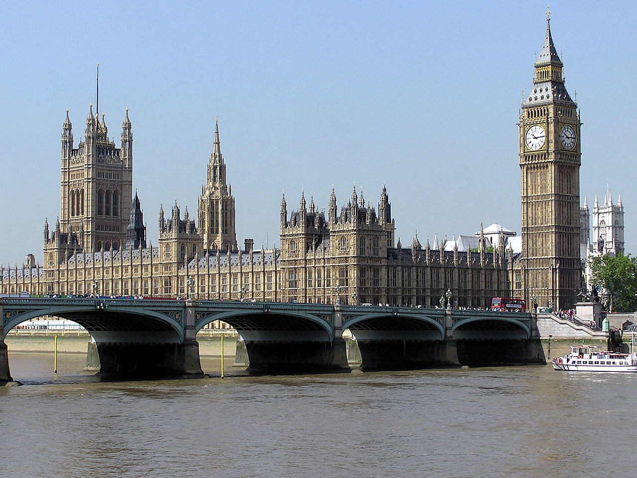
What Was Their Crime?
Do you recognise this place in London?
It is where Members of Parliament (MPs) meet
In 1835 Mr Robert Canham was imprisoned at Cambridge Town Gaol for bribing residents of Cambridge to vote for the Tory candidate to become their next Member of Parliament (MP) for Cambridge in the election!

Slide 7
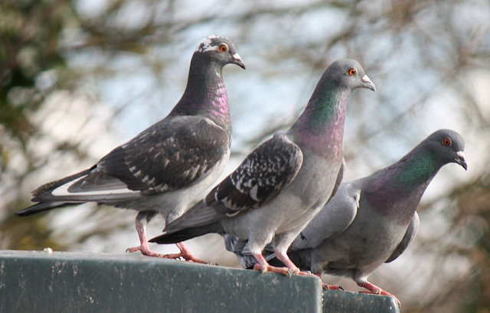
“Whoops, We’ve Got the
Wrong Prisoner!”
Some prisoners were sent to Cambridge Town Gaol by mistake!
An unnamed person was falsely charged with stealing pigeons in 1828…
He received 5 pounds in compensation.

Slide 8

The Final Days of the Town Gaol
The Town Gaol on Parker’s Piece was the last Cambridge Town Gaol.
It was abandoned in 1878.
After 1878 prisoners were sent to the County Gaol instead, which was on Castle Hill.

Slide 9
Discover More
Visit the Museum of Cambridge. See the website below for more information about the museum
or to contact their Education Officer:
http://www.museumofcambridge.org.uk/
Visit the Cambridgeshire Collection at the Cambridge Central Library:
https://www.cambridgeshire.gov.uk/residents/libraries-leisure-&-culture/archives/local-studies/cambridgeshire-collection/

Slide 10

Web Resources available at:
http://www.creatingmycambridge.com/
history-stories

