Slide 1

Ditchburn Place

Slide 2
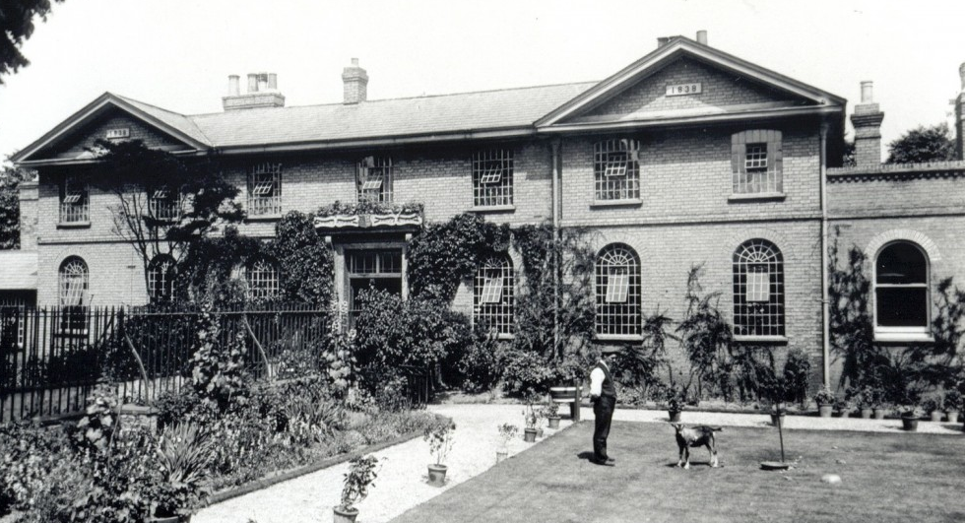
Ditchburn Place

Slide 3
Cambridge Union Workhouse
From 1838 to 1930, Ditchburn Place on Mill Road was known as the Cambridge Union Workhouse.
A workhouse was a place where the poor, ill and elderly went to live and work if they could not afford their own homes.
Before workhouses existed, it was the responsibility of the parishes to look after the poor.

Slide 4
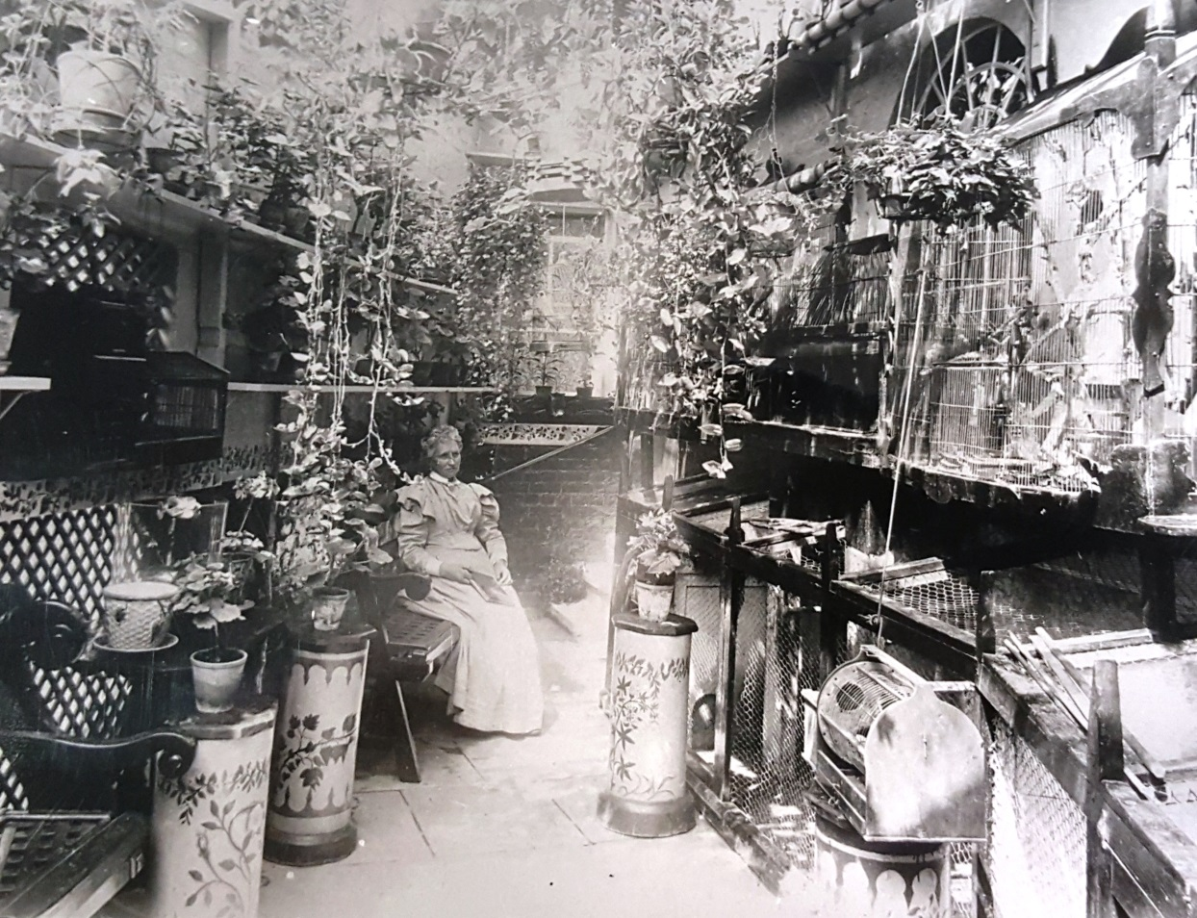
Life in the Workhouse
The workhouse had a matron and a master who were in charge of running everything.
This is a photo of the matron on the grounds of the Cambridge Union Workhouse.

Slide 5
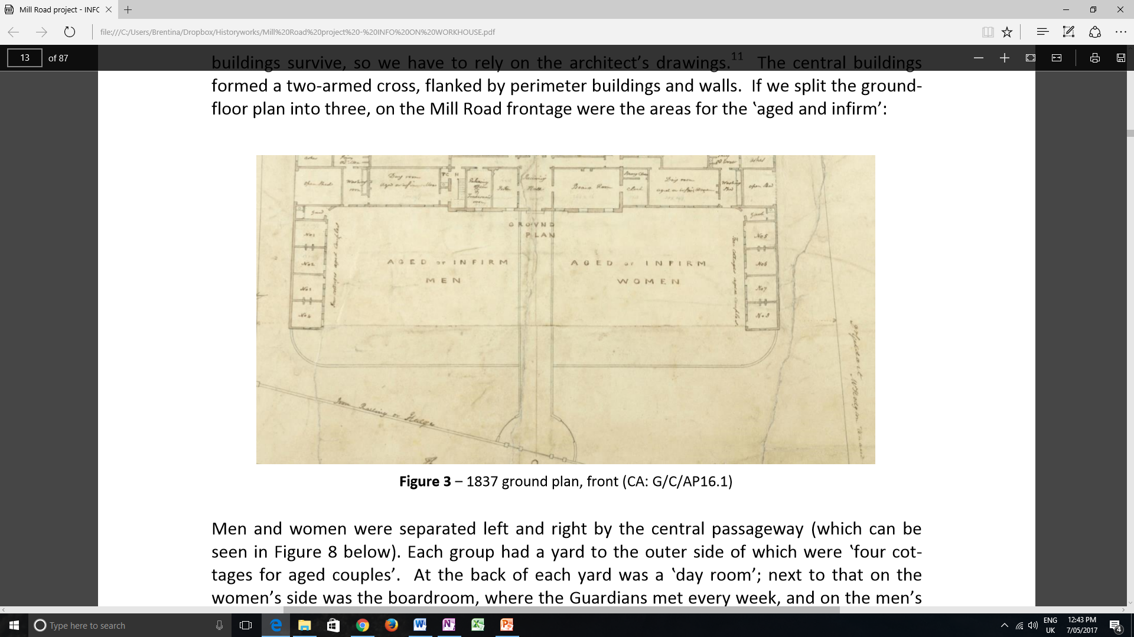
It’s A Hard Knock Life!
Life in a workhouse was tough.
Everyone was divided up by their age, gender and state of health so family members could not see each other.
How many different sections can you see in this building plan?

Slide 6
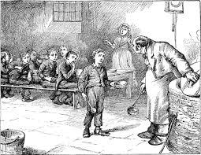
Daily Life in the Workhouse
Those who were able to work had to wake up at 6am every morning and work for ten hours every day. They stopped for meals but the rules were very strict and all food had to be eaten in silence.
From the age of seven, children had three hours of school every day and spent the rest of the time at work like the adults.
This picture is from ‘Oliver Twist’
-a Charles Dickens Novel about children living in the Workhouse

Slide 7
Food in the Workhouse
The Weekly Menu in the Workhouse
  Sundays, Tuesdays, Thursdays
    Breakfast – bread, gruel
    Dinner – meat, potatoes
    Supper – bread, broth
  Mondays, Wednesdays, Saturdays
    Breakfast – bread, gruel
    Dinner – soup
    Supper – bread, cheese
  Fridays
    Breakfast – bread, gruel
    Dinner – suet (fat from meat) or rice pudding
    Supper – bread, cheese
  FACTOID!
  Gruel is a type of porridge made of rice, flour or millet mixed with water or milk.

Slide 8
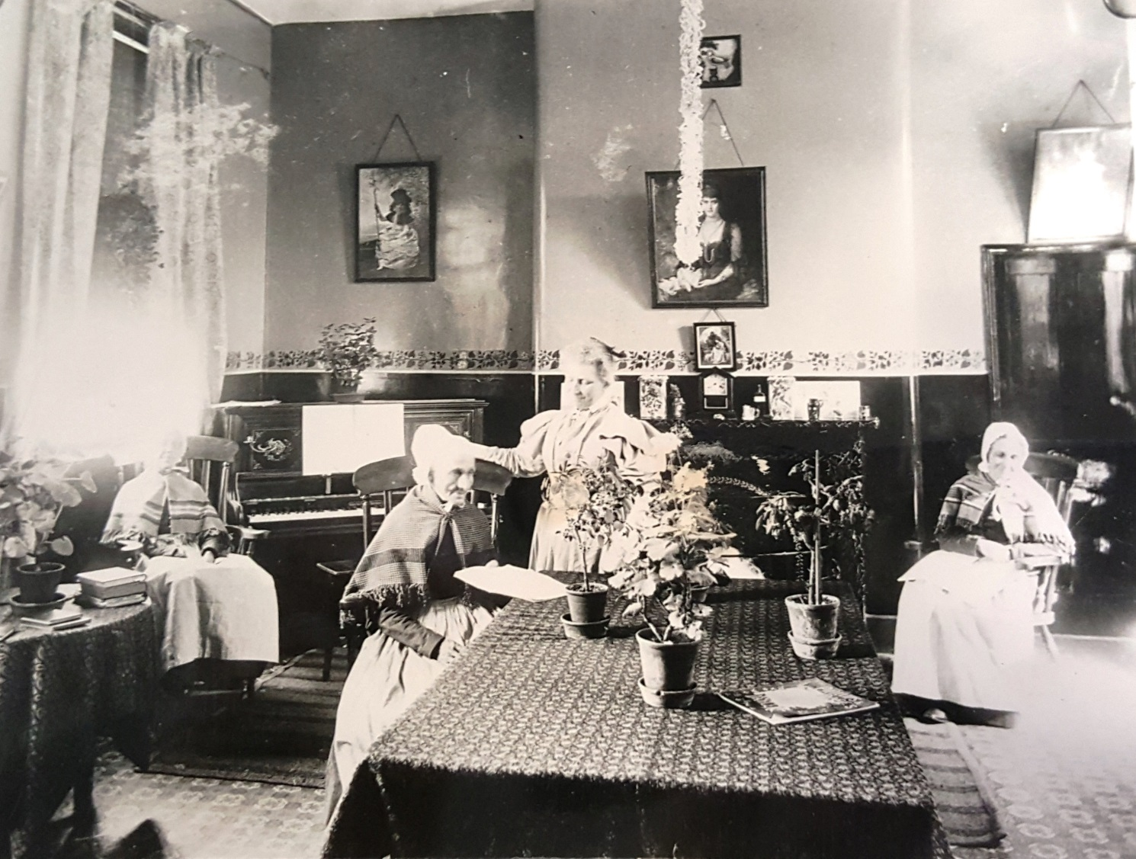
Caring for the Elderly and Ill
Nurses looked after the ill and elderly in the workhouse. This picture shows the women’s dayroom.
The woman in the middle of the picture is the matron of the workhouse.

Slide 9
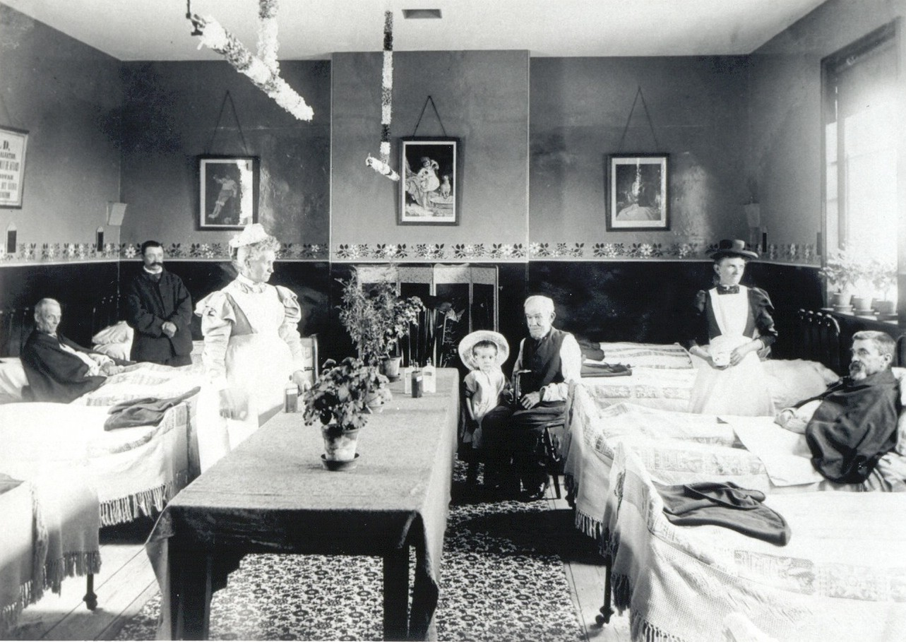
Caring for the Elderly and Ill
This picture shows the men’s infirmary.
The matron is in the centre and there is a nurse on the right helping the patients.

Slide 10
Memories of Life in the Workhouse
This is a quote from someone who lived in the workhouse as a young child and remembers being taken into town by one of the nurses:
‘The first time we went to Mill Road, I was about three. I remember sitting at a big table on a small chair with a lot of other children and I remember being put in a bath with a lot of other children. It must have been a Sunday when a nurse took a lot of the children out. There were some in a pram and I was hanging on the side of the pram. We had navy blue coats and hats. I remember walking to town. Where Marks and Spencer is now there was a shop called Coads. We walked round there and when we got back to Mill Road the Sister reprimanded the nurse for taking me out without leggings on me. I think we were there because mother was in hospital.’

Slide 11
Discover More
Online:
Information and pictures of the building are available at http://www.capturingcambridge.org/wp-content/uploads/2015/09/81a_MR-1st-edn_2015-10-10.pdf
For more information on the Poor Law Amendment Act http://www.bbc.co.uk/schools/gcsebitesize/history/shp/britishsociety/thepoorrev1.shtml
For more information on the feast on Parker’s Piece http://www.creatingmycambridge.com/history-stories/7-parkers-piece/

Slide 12
Discover More
Books:
White, G. (1978) In and out of the workhouse for a general overview of workhouses in this period
Marclay-Munro, Bridget; Cook, Helen (1991) Workhouse to Housework for more detail and accounts of the workhouse in this period
Oliver Twist, by Charles Dickens, gives a vivid account of a workhouse, from a child’s point of view

Slide 13

Web Resources available at:
http://www.creatingmycambridge.com/
history-stories

