Slide 1

EGLANTYNE JEBB

Slide 2
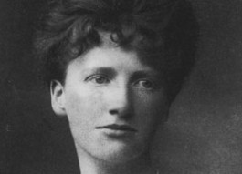
Who Was Eglantyne Jebb?
Eglantyne Jebb was born in 1876 at The Lyth, Ellesmere, Shropshire.
Eglanytne didn’t go to school and instead was educated at home. She had a happy childhood, with lots of opportunity to play outside; climbing trees, swimming and riding horses.
Her parents were well educated and had a strong social conscience, rooted in their Christian faith which had a great impact on her.
Eglantyne Jebb (1876-1928)

Slide 3
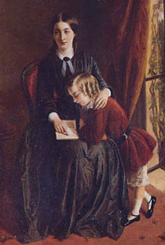
Eglantyne’s Education
Eglantyne was taught by a governess called Heddie from Alsace in France, who taught her German and French. She also shared about the cruel Prussian occupation of her country, which had happened during her lifetime, which gave Eglantyne an early lesson in understanding the suffering of people in other countries.
She was also taught by her Aunt Bun who supervised her other lessons and had a great passion in higher education for women, which was not so common back then.
Painting of a governess
and child called
The Governess (1851)

Slide 4
Studying at University
FACTOID!
Eglantyne wasn’t interested in creature comforts, so much so that whilst at University she chose to move nearly all the furniture out of her room, so she was only left with a bed, desk and washstand! Eglantyne’s action made a great impression on people and became a kind of legend.
In 1895 Eglantyne went to study at Lady Margaret Hall, Oxford, where she embraced her real love of books!
A Fresher (first year student) called Dame Kathleen Courtney, saw how different Eglantyne was compared to other people at University.
She already had a real hatred of the divide between rich and poor and rebelled again a world dominated by class, which she was born as a privileged member.

Slide 5
A Longing to do Good in the World
FACTOID!
Eglantyne became known as the ‘White Flame’ because of her dedication to help children in distress, that burnt a white heat of passion throughout her life.
Whilst at Oxford she had an impatient longing to get out into the world and do something useful.
She wondered what she would do with her life, she had always had literary ambitions, having written many stories and poems as a child.
However she also wanted to be able to do something of worth and to be of service, which stemmed from her Christian values.

Slide 6
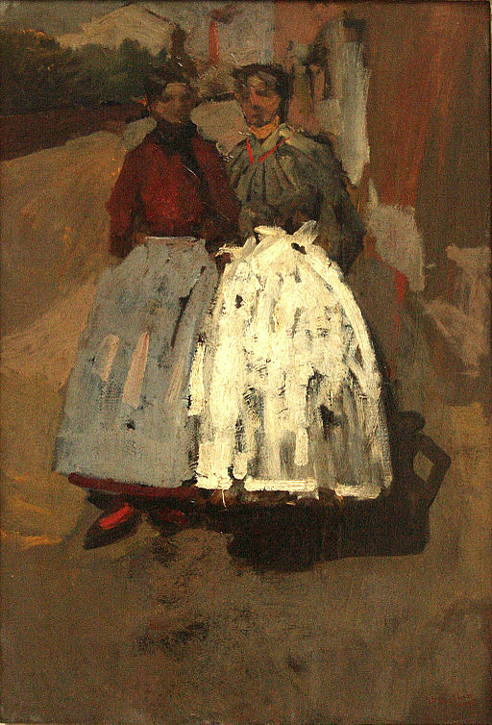
Eglantyne’s Visit to Bethnal Green in London
Eglantyne danced with factory girls in Bethnal Green and felt a real connection with them.
She was coming to resent the privileged background she came from and the class divisions there were between people and wanted to do something about it.
Factory Girls
by George Hendrik Breitner, painted circa 1898

Slide 7
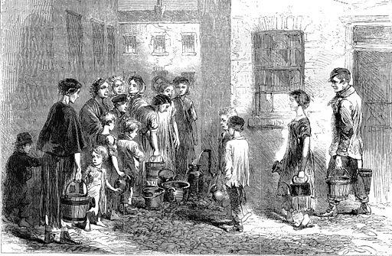
Eglantyne Trains to be a Teacher
Eglantyne then went to Stockwell Teacher Training College in 1898 to learn how to be a teacher.
It wasn’t normal for a girl who’d studied at Oxford to train to teach in a Board School, but she was encouraged to do it by a lady in Oxford called Charlotte Toynbee.
Dwellings of the poor in Bethnal Green, water supply 1863
Wellcome Images
When Eglantyne started teaching she cared a great deal about her pupils and was horrified by the poverty they lived in.

Slide 8
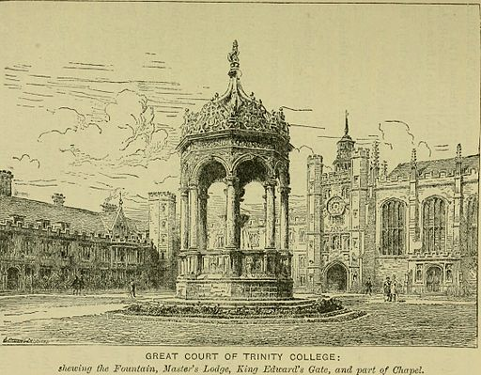
Eglantyne Moves to Cambridge
Eglantyne moved to Cambridge to live with her mother in the early 1900s.Whilst in Cambridge she met a woman called Mary Marshall who lectured in Economics. She recognised Eglantyne’s gift and didn’t want to see her at a loose end.
Mary knew that there was a part of Cambridge that had been forgotten by most people and ignored by the University: a a place of squalor, poverty and misery.
Therefore she asked Eglantyne to work for the Charity Organisation Society (COS) to get some insight into that side of Cambridge. Eglantyne jumped at the opportunity and threw herself into research and writing.
Great Court of Trinity College- 1906
From A Concise Guide to the town and university in an introduction and four walks

Slide 9
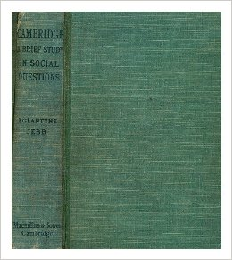
Egnatyne’s Important Book
FACTOID!
Eglantyne wrote an important book about the terrible living conditions in Cambridge, called ‘Cambridge: A Brief Study in Social Questions’ in 1906.
This book gave her a real insight into people’s suffering and mental wellbeing and the repercussions of poverty and lack of nutrition.
In her book she also suggests how people can help to make the situation better. She suggests that young people should be trained in voluntary social work, by spending a period of time with COS, to learn from more experienced people.

Slide 10
Eglantyne’s Discoveries
About Cambridge
‘Housing in Cambridge is not absolutely satisfactory, for though there are few cases of extreme density of population, the unequal distribution of the inhabitants causes some houses to be badly crowded. And over-crowding and incomplete sanitation must be regarded as serious evils.’
Eglantyne Jebb quote, from Cambridge: A Brief Study in Social Questions (1906)

Slide 11
Eglantyne’s Discoveries
About Cambridge
With regard to our fourth subject, hygiene, there is almost as much ignorance as on the one just considered. The open-air treatment of consumptive patients in the hospital, and the great benefit they experience from it, is helping to fresh air into favourable notice in all homes. But much yet remains to be done in homes where cleanliness in air and in every other way in not appreciated as it ought to be. There is something that needs saying- again on behalf of children- to remove the prejudice against fresh water as a beverage.’
Eglantyne Jebb quote, from Cambridge: A Brief Study in Social Questions (1906)

Slide 12
Eglantyne’s Words of Wisdom
‘Cultured people to do practical work
- that I think is what the world wants.’
Eglantyne saw the importance of people having rich experiences where
they learn about the world around them, about its people and its history
so they can to do practical work where they can be of real benefit to the world.
Eglantyne’s approach is something that can be an inspiration to us all.

Slide 13
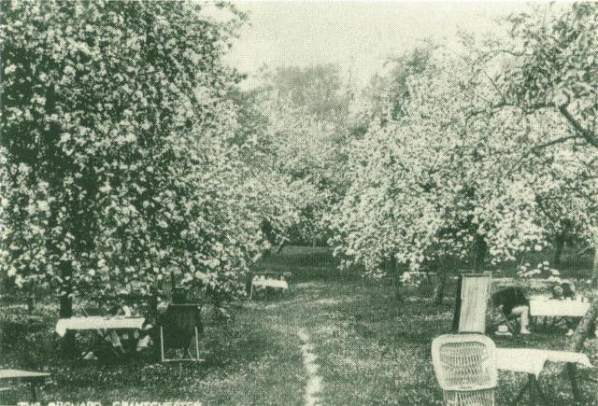
Eglantyne’s Disgust at Conditions
Eglantyne was disgusted at what she discovered and spoke passionately when describing the slums:
‘What has become of the orchards and the flowers? Here is the blackened stump of an old fruit-tree forlorn amongst the litter and the rubbish heaps, here a bit of bare ground with more paper than grass. Occasionally you find a real garden-not drying ground strewn with dented tins- but a tiny country garden, where lilacs bloom against the dingy wall and fruit trees blossom white in spring. These however…are lost amongst the dreary buildings. The names alone recall the past- Orchard Street, Flower Street, Blossom Street!’
from Rebel Daughter of a Country House, Wilson (1967)
Eglanytne longed for Cambridge
to once again be filled with
blooms like in this picture:
The Orchard in bloom c. 1910,
Granchester

Slide 14

Eglantyne’s Travels
In 1913 Eglantyne went on a great adventure to the Balkans, to be part of the Macedonian Relief Fund, as they were currently in the middle of a war over
Macadonica.
FACTOID!
When she was there she saw the
struggles of refugees, who were living in extremely
crowded conditions, where family members had to take
turns to sleep and children would shiver in the cold
waiting for portions of soup or bread to be handed out.
It is perhaps these horrific first hand experiences
that later fuelled her passion and determination to set
up Save the Children. Eglantyne returned to England
determined to raise money to help the people she met
who were in need.

Slide 15
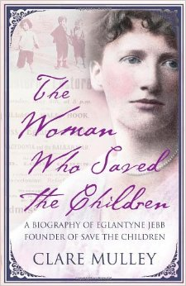
The Save the Children Fund
Eglantyne Jebb and her sister Dorothy founded the Save the Children Fund in 1919, following the atrocities of the First World War to help the starving children in Europe.
FACTOID!
Eglantyne was arrested and fined for distributing a leaflet with a
photo of a starving child which
she took on her trip to Austria!

Slide 16
Eglantyne Meets the Pope!
Eglantyne met lots of important people whilst on her mission
to help children in the world!
FACTOID!
Eglantine even went to meet the
Pope to tell him about the
Save the Child Fund!
This led to him organising two appeals a year until the famine was over, to help their cause.

Slide 17

Her Legacy Still Continues Today…
Eglantyne’s Save the Children Fund still does work all around the world to help children in need, such as helping refugee children who have had to leave their home because of war.
She also created the ‘Declaration of the Rights of the Child’ in the 1930s, which inspired the current UN (United Nations) Convention on the
Rights of the Child.
‘The SCF (Save the Children Fund) pays no regard to politics, race or religion. A child is a child whether red or white, race or black.’ Eglantyne Jebb

Slide 18
Save the Children
To find out more about Save the Children visit:
www.savethechildren.org.uk/about-us

Slide 19

Web Resources available at:
http://www.creatingmycambridge.com/
history-stories

