Slide 1

OLAUDAH EQUIANO

Slide 2
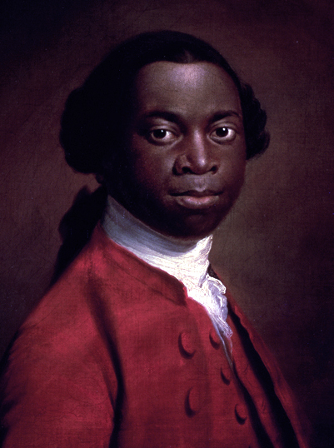
Who was Olaudah Equiano?
Olaudah Equiano was born in 1745 in Africa, in a place that’s now called Nigeria. Eqiuano played an important role in the fight for the abolition of the slave trade.
Having lived as an enslaved African himself, he had first hand experience of what the conditions of slavery were like and wanted to do something to change this.

Slide 3
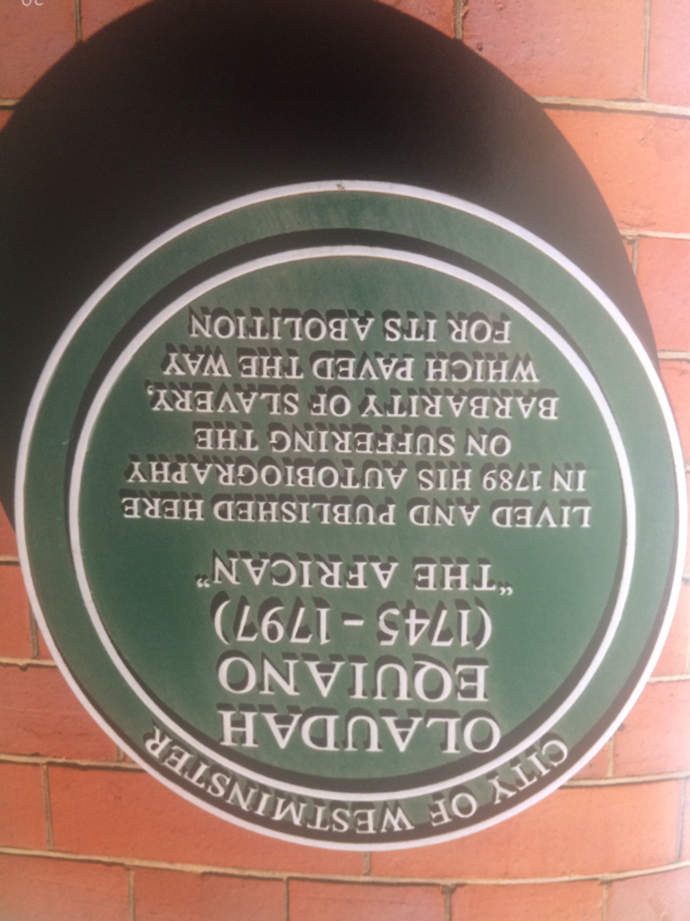
Equiano and the Fight for Freedom
This plaque was put up in Westminster in London, to commemorate Equiano’s life
and the autobiography he wrote and published about his experience as an
enslaved African, which led to slavery eventually
being abolished.

Slide 4
What’s Equiano’s Link to Cambridge?
St. Andrew’s
Church,
Chesterton
- where Equiano’s
daughter is
buried
St. John’s College- where Equiano studied
Notes:
Crop to left
Arrow to school
Arrow to chesterton church
Arror St Johns College

Slide 5
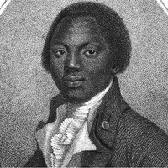
How did Equiano end up in Cambridgeshire?
Equiano came to live in Cambridgeshire much later in his life, when he married his wife Susanna Cullen in Soham in 1792. They had two children, Anna Maria and Joanna. Anna Maria’s grave is in the grounds of
St. Andrew’s Church in Chesterton, Cambridge.
This portrait of Equiano is on the
cover of his autobiography, which he
wrote to tell people about the horrors
of the reality of slavery.

Slide 6
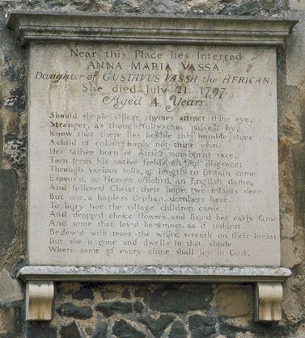
Equiano’s Daughter’s Grave at
St. Andrew’s Church, Chesterton
The plaque is engraved with the words:
Near this Place lies Interred
ANNA MARIA VASSA
Daughter of GUSTAVUS VASSA the AFRICAN
She died July 21 1797
Aged 4 Years
Should simple village rhymes attract thine eye,
Stranger, as thoughtfully thou passest by,
Know that there lies beside this humble stone
A child of colour haply not thine own.
Her father born of Africa’s sun-burnt race,
Torn from his native field, ah foul disgrace:
Through various toils, at length to Britain came,
Espoused, so Heaven ordain’d, an English dame,
And follow’d Christ; their hope two infants dear.
But one, a hapless orphan, slumbers here.
To bury her the village children came.
And dropp’d choice flowers, and lisp’d her early fame;
And some that lov’d her most, as if unblest,
Bedew’d with tears the white wreath on their breast;
But she is gone and dwells in that abode,
Where some of every clime shall joy in God.

Slide 7
What’s in a Name?...
Anna Maria Vassa, sadly died at the very young age 4 years old, from a measles epidemic. She was given the surname Vassa, after her father’s adopted name. Her father had also died that year, 4 months before her, in March 1797.
FACTOID!
Olaudah Equiano was given the name Gustavus Vassa after his owner when he became an enslaved African, as you weren’t allowed to keep your own name. This is why you can’t see the name
Equiano anywhere on the plaque.

Slide 8
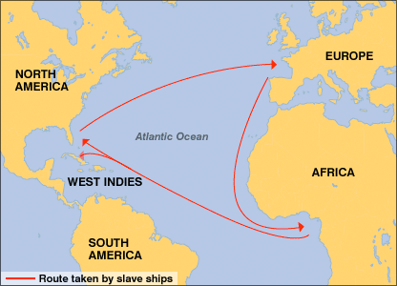
Forced to leave his country…
Olaudah Equanio was born in Nigeria, but was forced to leave his home and board a slave boat to North America when he was only 11.

Slide 9
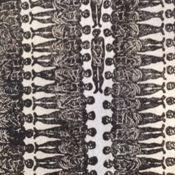
Forced to leave his country…
This picture shows a small section of a plan of the Brookes slave ship from 1788 which was used to transport enslaved Africans from Africa across the Atlantic Sea. Which shows the kind of cramped conditions Equiano would have faced on his journey across the Atlantic Ocean.

Slide 10
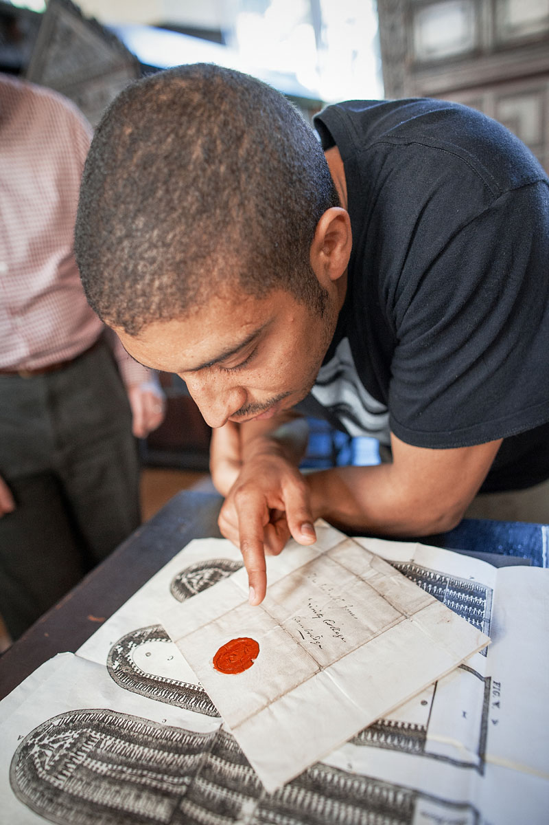
Inja Checks Out the Evidence in
St. John’s College Library
This picture shows Inja taking a close look at some of the documents about the slave trade in St. John’s College library, including the plan of the Brooks ship from 1788 (from the previous picture).
These documents were very important as they were used part of the evidence for why slavery should be abolished and helped lead to the abolition of slavery in the UK in 1807.

Slide 11
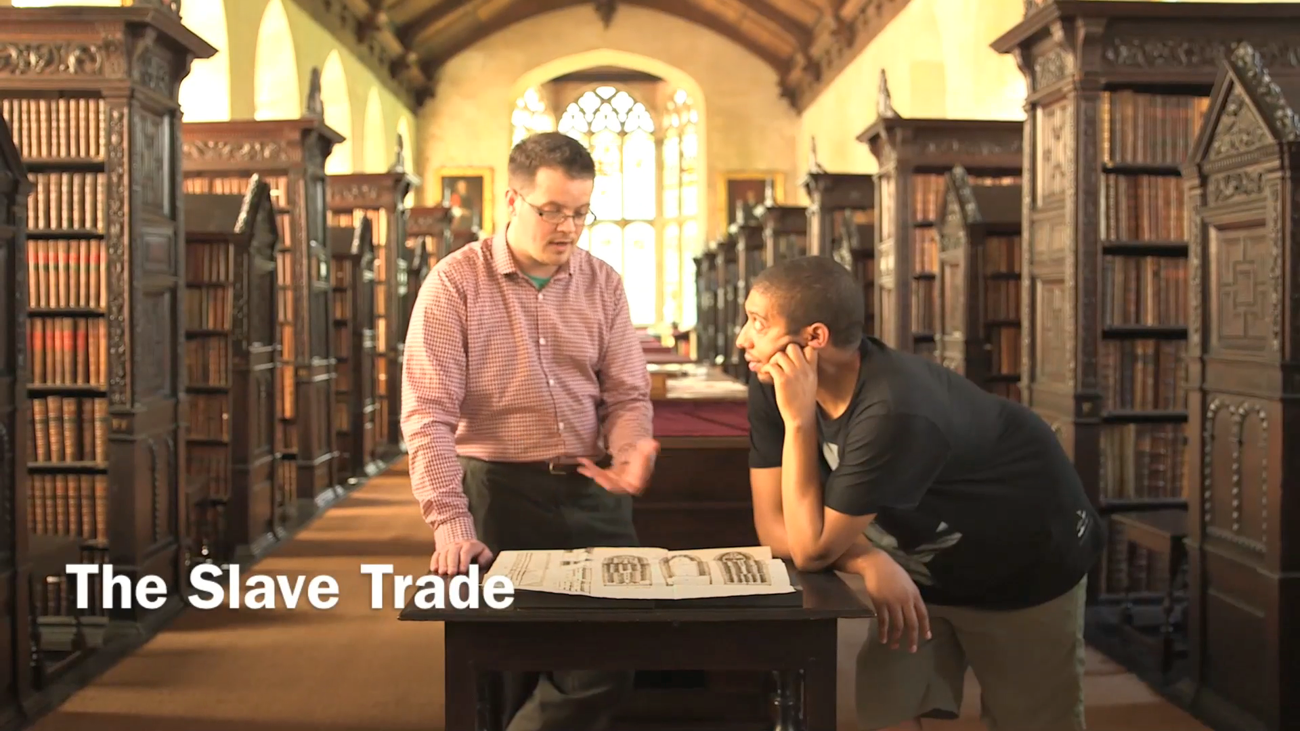
Video of Inja at St John’s College

Slide 12
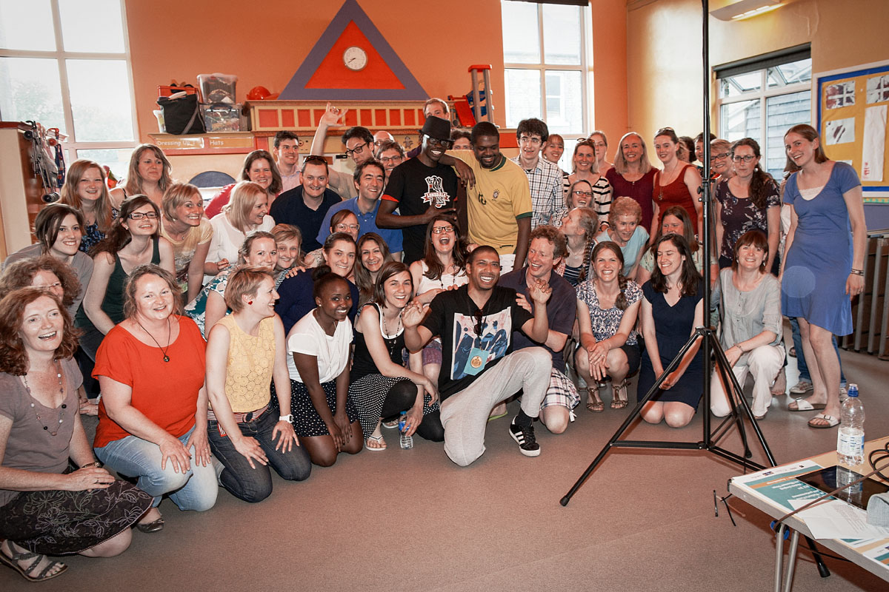

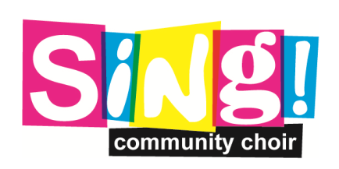
Inja with Sing! Community Choir who performed in the ‘Freedom’ recording
To listen to the
original track
click here:

Slide 13
‘Freedom’ Song Lyrics
Some live for freedom some die for freedom
Some fight for freedom some lie for freedom
Some cry for freedom some try for freedom
Some say that we ain't free till the whole worlds free
Some walk for freedom some ride for freedom
Some run for freedom some hide from freedom
Some spy for freedom some write for freedom
Some say that we ain't free till the whole worlds free

Slide 14
‘Freedom’ Song Lyrics
We all have a right to freedom

Slide 15
‘Freedom’ Song Lyrics
Just imagine being a kid
Chilling at home with your sis at your crib
Next thing kidnappers break in
Capture you both so you'll never see your kin
Separate you then ship abroad
To a place that's an unknown shore
Then you’re sold at a price
Someone owns your life
And you'll never see freedom no more

Slide 16
‘Freedom’ Song Lyricsm
Then a captain buys you and you sail with the tide
Seeing the whole world wide
Given a wage that's minimum not high
But enough to buy your freedom in time
On that day when you've got funds
Your name’s yours for the right sum
It's Equiano by the setting sun
Once papers signed your freedom comes, then

Slide 17
‘Freedom’ Song Lyrics
Go from slave to author
To protestor in one semester
Plant the seed the to get slavery ended
And go against the grain of freedoms ember
From essays to decades as activists
These grounds here produced the catalyst
To trading in slaves as an active wish
To demolishing the routes cos they had to give

Slide 18
‘Freedom’ Song Lyrics
But I can be free just like all of us
These real life stories paved the way
Enthralled in history to this day
There’s many out there that's still enslaved
Do you fight for them or just work for you
Do you care at all or just care for you
Do you use their ways to keep slavery true
Whether mind over body or in anything you do

Slide 19
‘Freedom’ Song Lyrics
I know who I am, you know bout you
No identity crisis here to view
I know my past and my parts are used
I'm part of a parcel that defends truth
And these truths are free like we all should be
Whether woman, man, child, all human beings
To the people fighting
I hope one day that
I can help you all to be free.

Slide 20
‘Freedom’ Song Lyrics
Cos they had to give
Once word spread
Of how were slaves treated the trade would end
Cos the work of men that worked to defend
Those exported, exploited, and bent
All started here in Cambridge
That's why I'm proud but still trouble breeds
One street down I was chased by three
For the colour of my skin like I can't be free

Slide 21
‘Freedom’ Song Lyrics
We all have a right to freedom

Slide 22

Web Resources available at:
www.creatingmycambridge.com/history-stories/equiano-clarkson-abolition

Slide 23
Other Resources available:
Books
Olaudah Equiano- From Slavery to Freedom,
by Paul Thomas, Collins Big Cat
Slavery to Freedom, by James Walvin, The Pitkin Guide
Equiano’s Daughter- The Life and Times of Joanna Vassa, by Angelina Osbourne, Momentum Arts

