Slide 1

Great St. Mary’s Church and the Market Square

Slide 2
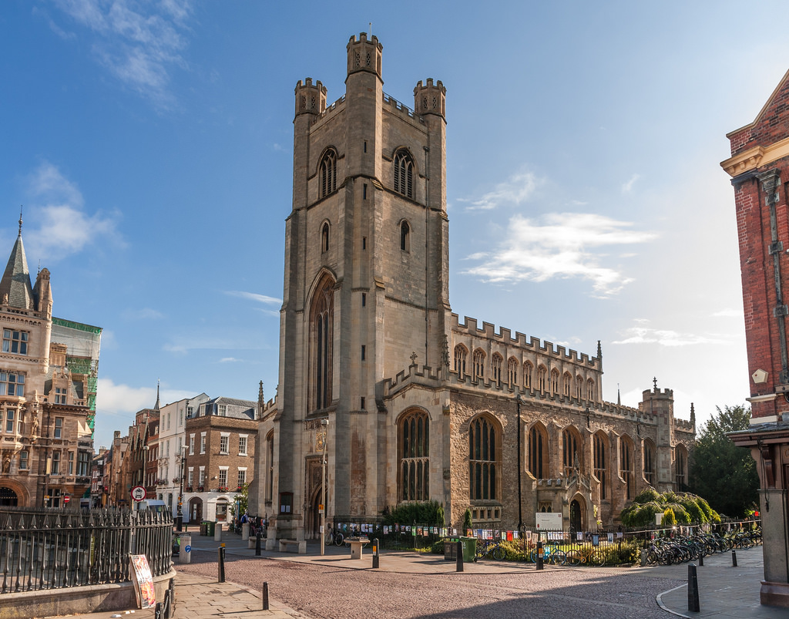
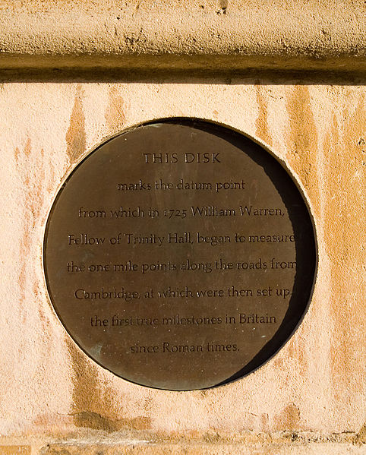
A Church at the Heart of Cambridge
Great St. Mary’s Church stands at heart of the city. It marks the central point of Cambridge, called the Datum Point where distances are measured from.
This is the datum
point milestone
on the side of
Great St. Mary’s
There has been a church on this site for over 800 years! The foundations were laid around 1010 and church records confirm there has been a church here since 1205.

Slide 3
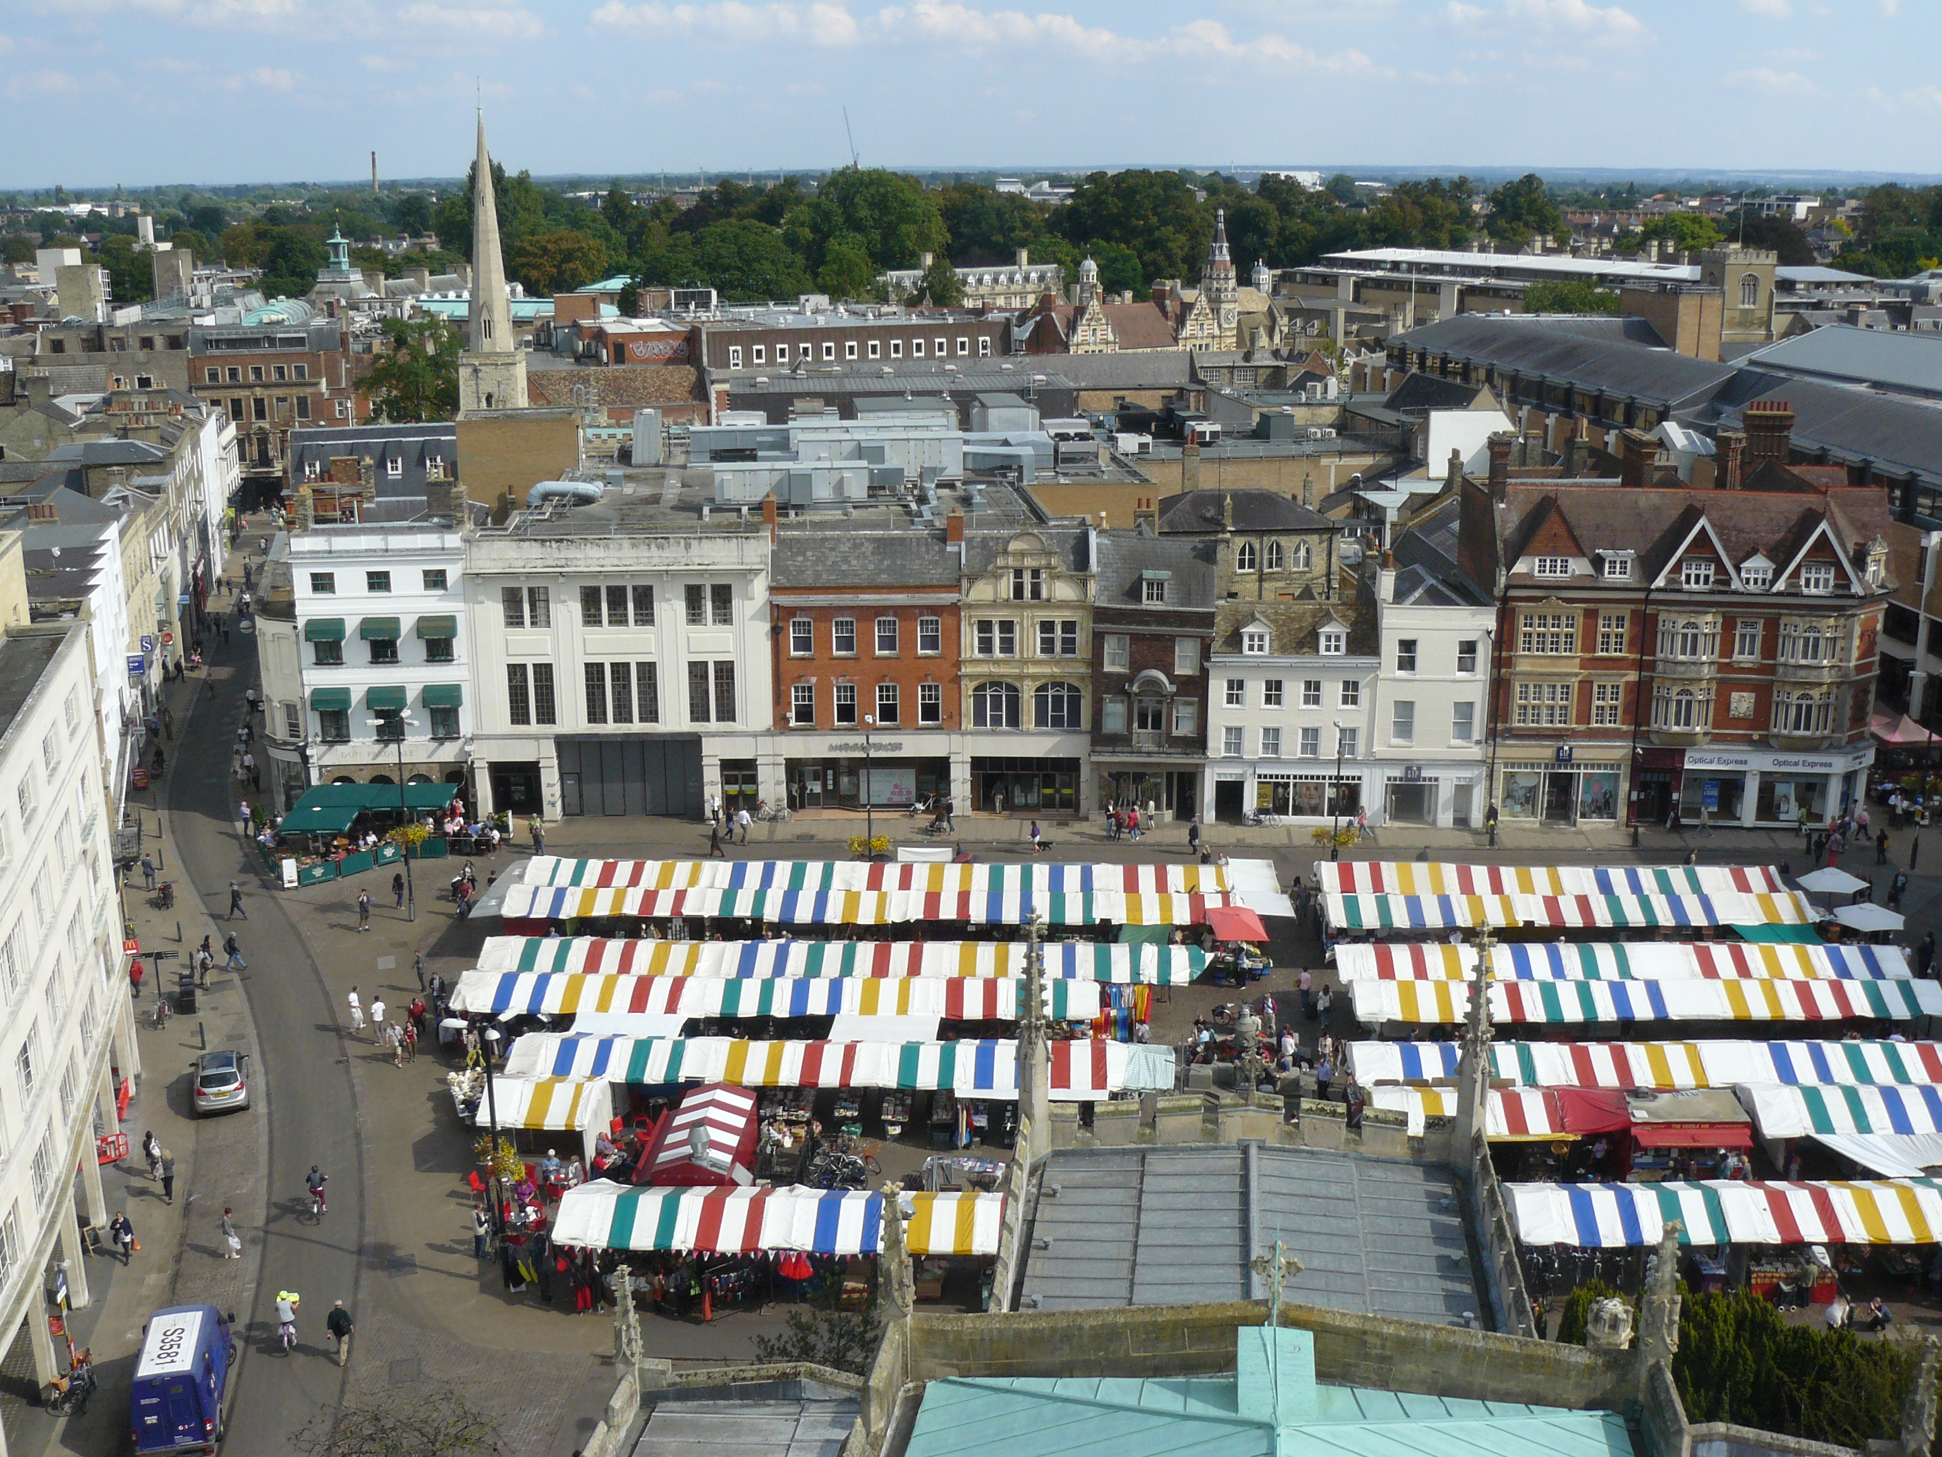
Great St. Mary’s Beginnings
Great St. Mary’s is now the University of Cambridge church
but the original church building existed even before the University was founded!
It was first mentioned in 1205, when it was called ‘St. Mary-by-the-market’. It still often gets referred to as the ‘Market Church’ today.
It serves both local Cambridge people and those from the University, being a place for both ‘town’ and ‘gown’ to enjoy.
This is the view of the market today
from the top of Great St. Mary’s Church

Slide 4
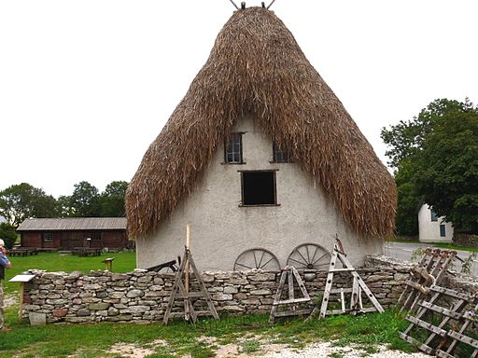
The Church is Burned To Cinders!
The church completely burnt down in 1290, which wasn’t surprising, as it was surrounded by thatched roofed buildings and wooden market stalls, which were both very flammable!
Photo by Xenophon 2007
The thatched buildings would have looked something like this!

Slide 5
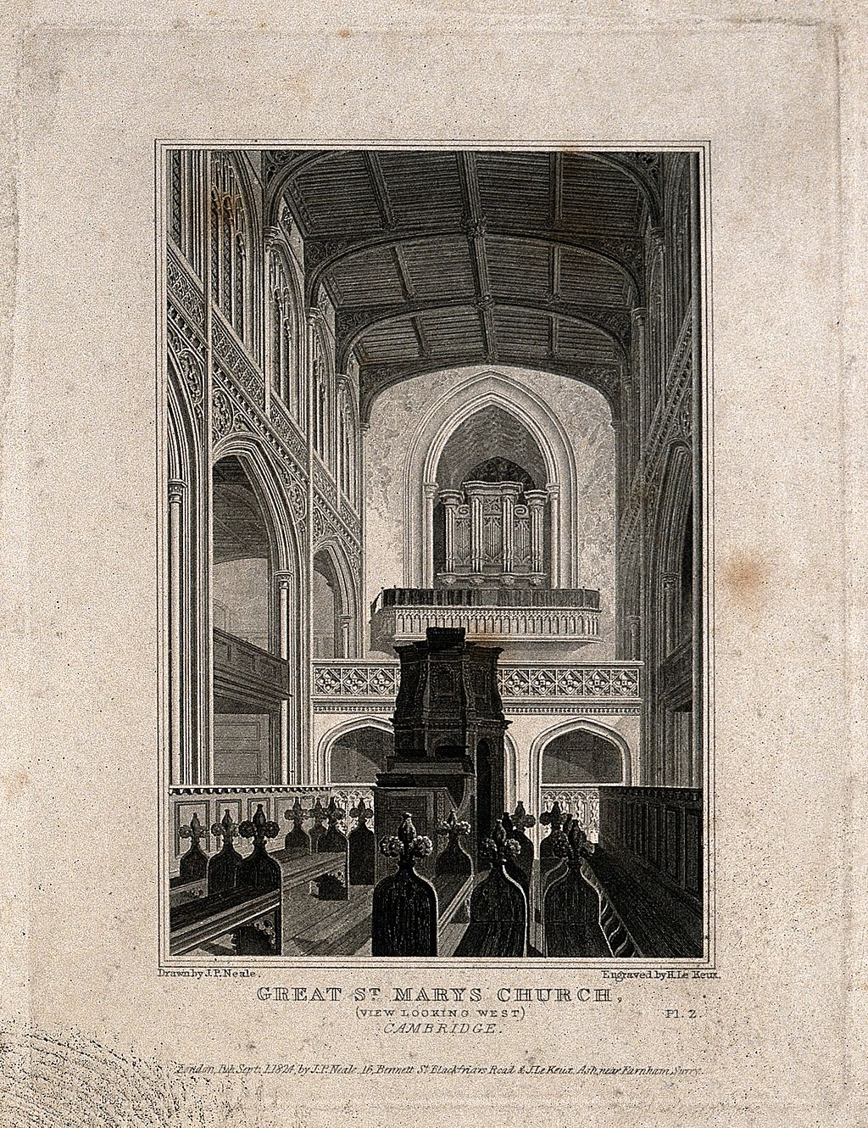
Building Today’s Great St. Mary’s Church
The church that you can see standing today started to be built in 1478, as part of a huge rebuilding programme.
The main building was completed with the addition of wooden roof beams, with carved bosses that were donated by Henry VII, in 1506.
Or did he?!...
Credit: Wellcome Library, London. Wellcome Images images@wellcome.ac.uk http://wellcomeimages.org Great St. Mary's Church, Cambridge. Line engraving by J. Le Keux, 1824, after J.P. Neale. 1824 By: John Preston Nealeafter: John Le KeuxPublished: 1 October 1824

Slide 6
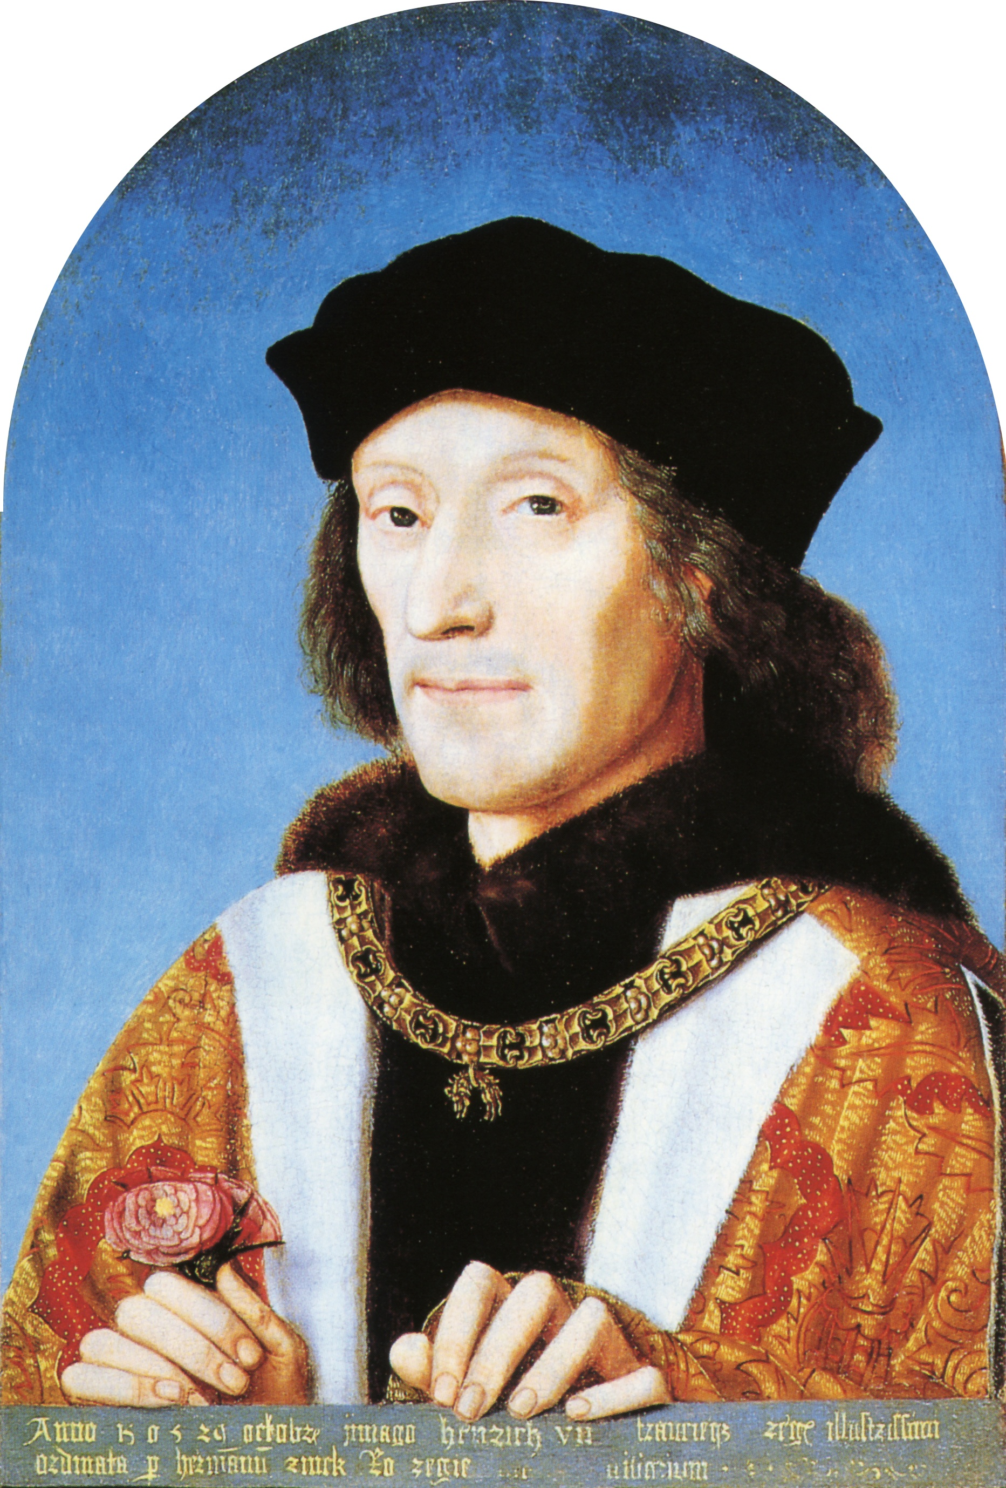
What a Naughty King!
FACTOID!
Henry VII donated 100 oak trees from Chesterford Park in Essex for the roof to be completed. However this was very naughty, as the King didn’t actually own the forest – it belonged to the Abbot of Westminster, John Islip! The Abbot wasn’t very happy about this and Henry had to write a letter to apologise for his terrible behaviour!
Portrait of Henry VII holding a Tudor Rose,1505 from the National Gallery, London

Slide 7
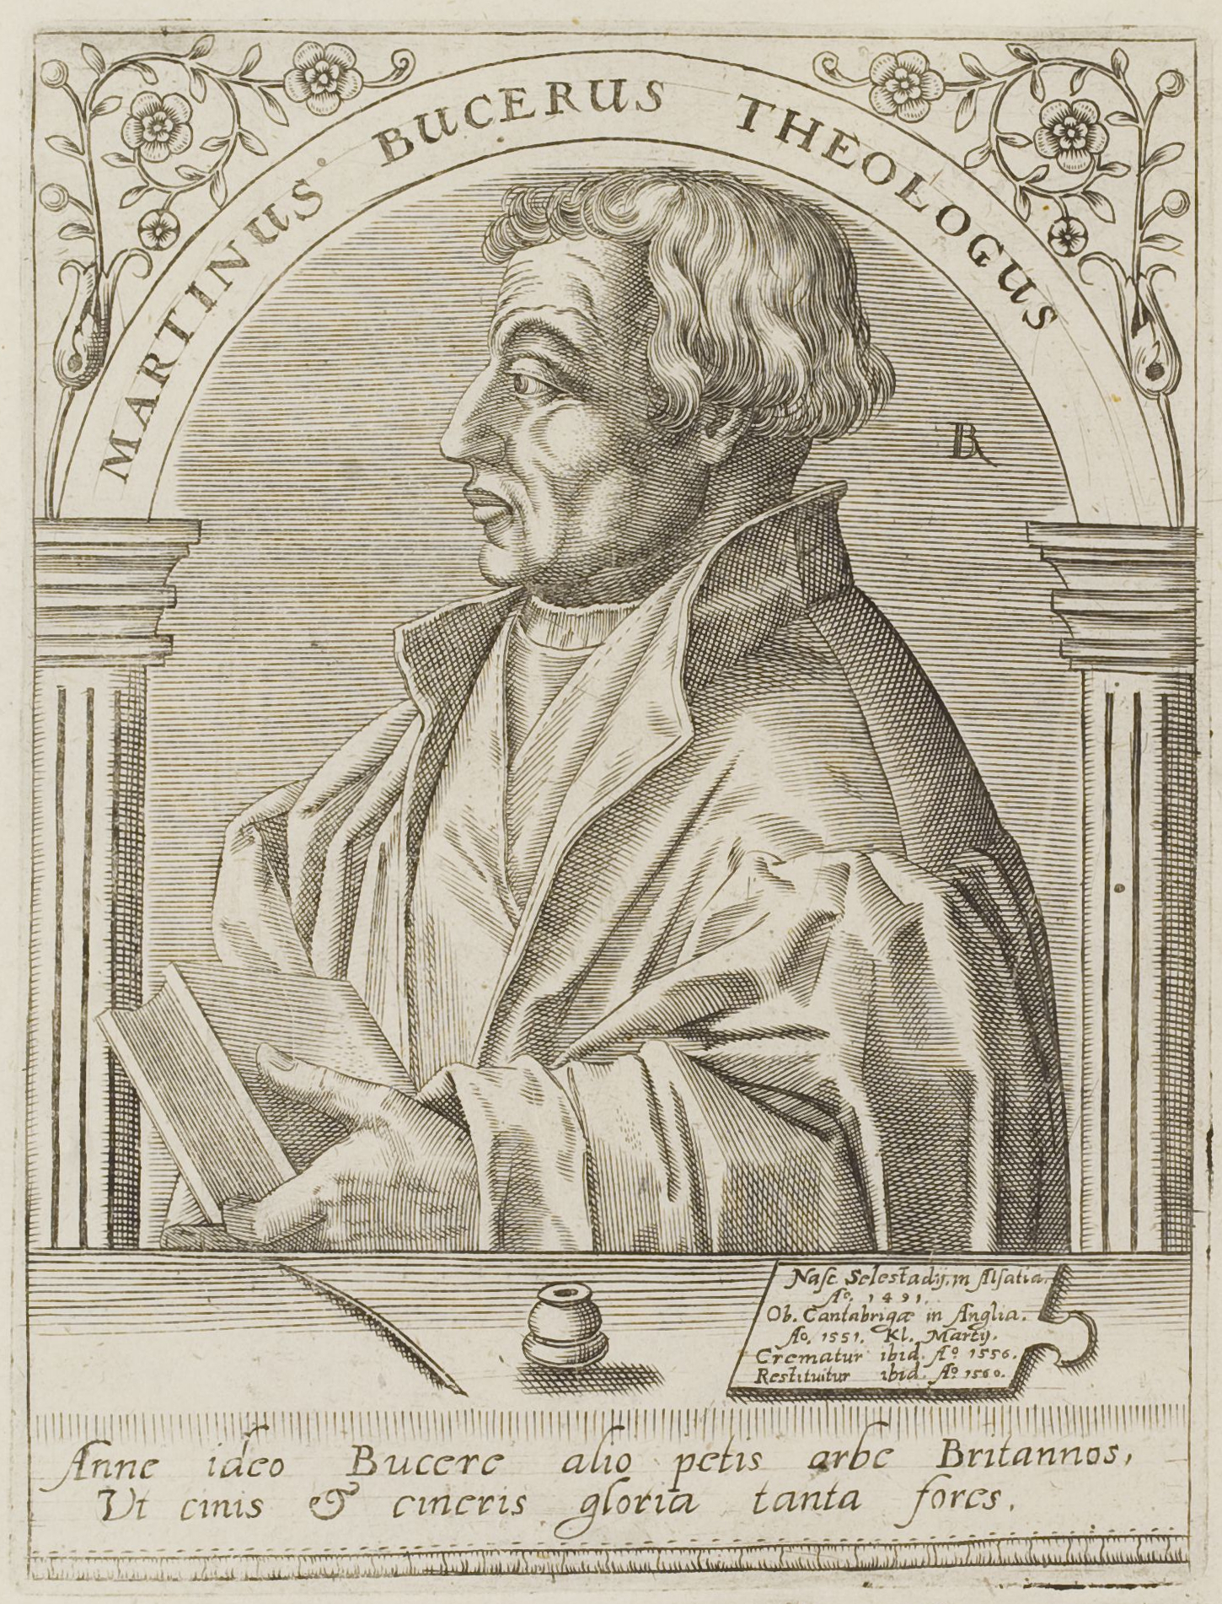
Brilliant Bucer!
During the Tudor Period, a Protestant thinker, called Martin Bucer was buried at Great St. Mary’s and had over 3000 people attend his funeral, as he was a very popular man. So many people came that lots of chairs broke, due to the church being so overcrowded! But that wasn’t the end of the tale of Martin Bucer…
Portrait of Martin Bucer,
by Jean Jacques Boissard (1528-1602)

Slide 8
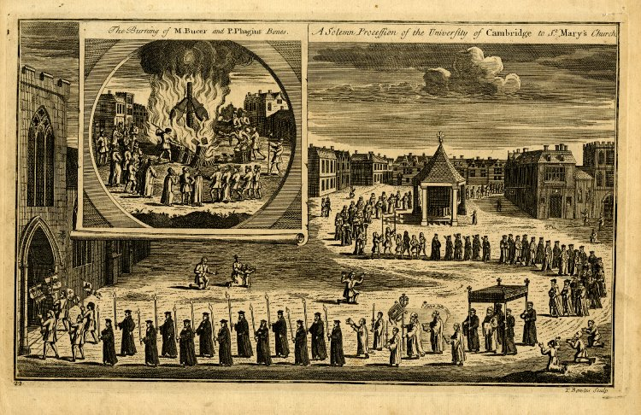
Burning Bucer!
When Mary I (otherwise known as Mary Queen of Scots) who was Catholic, came to the throne, she didn’t like Bucer’s views at all, so she ordered for his body to be dug up and then burned in public in the Market Square!
The Burning of M Bucer and P Phagius Bones / A Solemn Procession of the University of Cambridge to St Mary's Church, Thomas Bowells II, 1710-1767 (circa). The British Museum

Slide 9
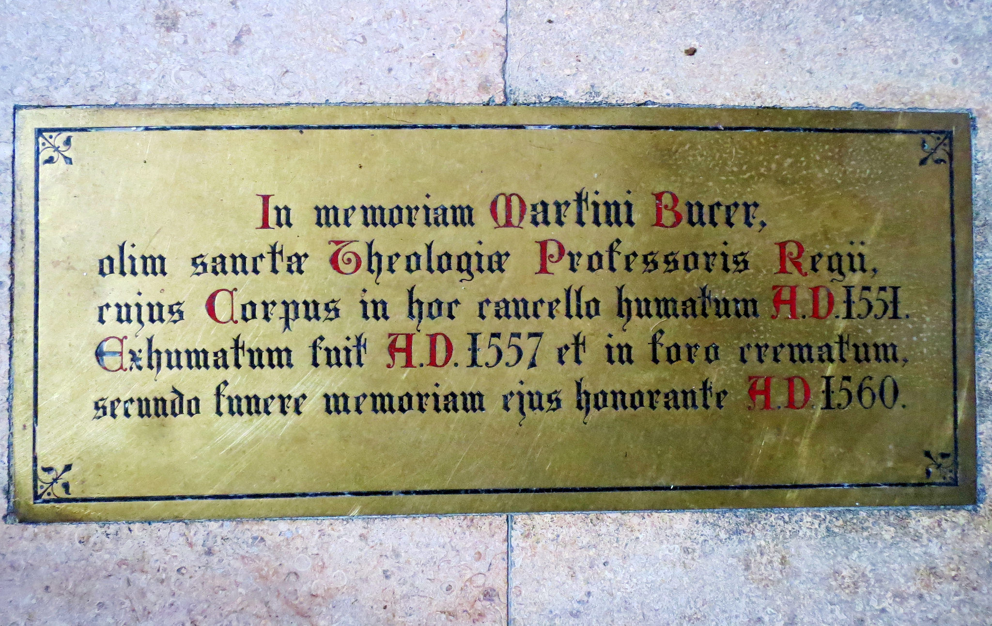
Bucer Is Remembered…
However when Elizabeth I came into power some of Bucer’s ashes were reburied in Great St. Mary’s and later a plaque was installed in his memory.

Slide 10
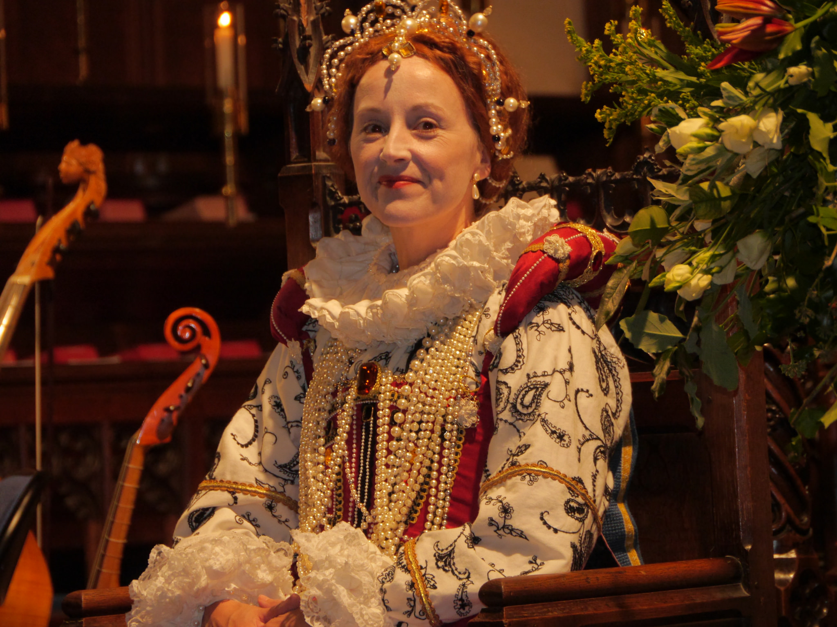
Elizabeth I Visits Cambridge!
During Elizabeth I’s reign, she visited Great St. Mary’s Church as part of a state visit to Cambridge in 1564.
The University wanted to make a good impression on the Queen however the outside of the church was covered in deep mud, so they had to disguise it with twenty loads of sand!

Slide 11
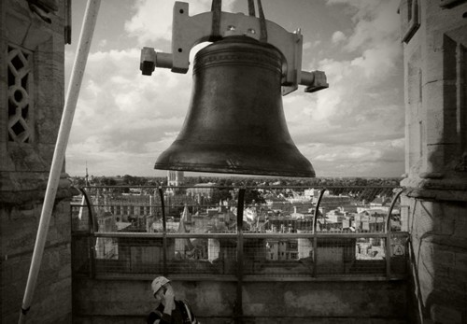
It’s a Fine if No Bells Chime!
When Elizabeth I arrived in Cambridge the tower of Great St. Mary’s still wasn’t finished, which meant that they were fined for not being able to ring the bells!
In fact, it took nearly 120 years to finish building the tower, with work starting in 1491 and ending in 1608!
This is a photo of the new bells being installed in 2009, which were made to commemorate 800 years of the University

Slide 12
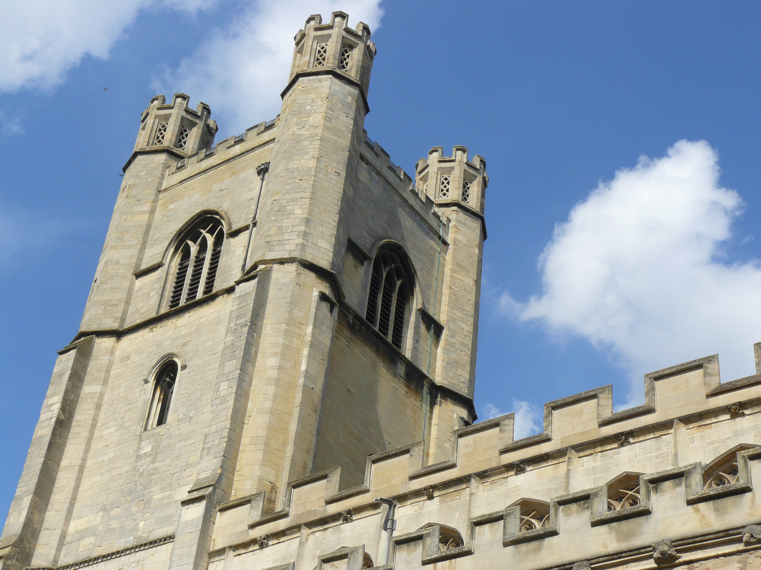
Let the Bells Ring!
Following this embarrassing event of the bells not ringing for the arrival of the Queen, the church members decided to take charge of completing the tower, due to its slow progress, and in 1593 they moved the building work forward. Finally, in 1596 the bells rung for the first time!
FACTOID!
The Westminster Chimes of Big Ben were borrowed from the Great St. Mary’s Chimes- Yes, Great St. Mary’s had them first!

Slide 13
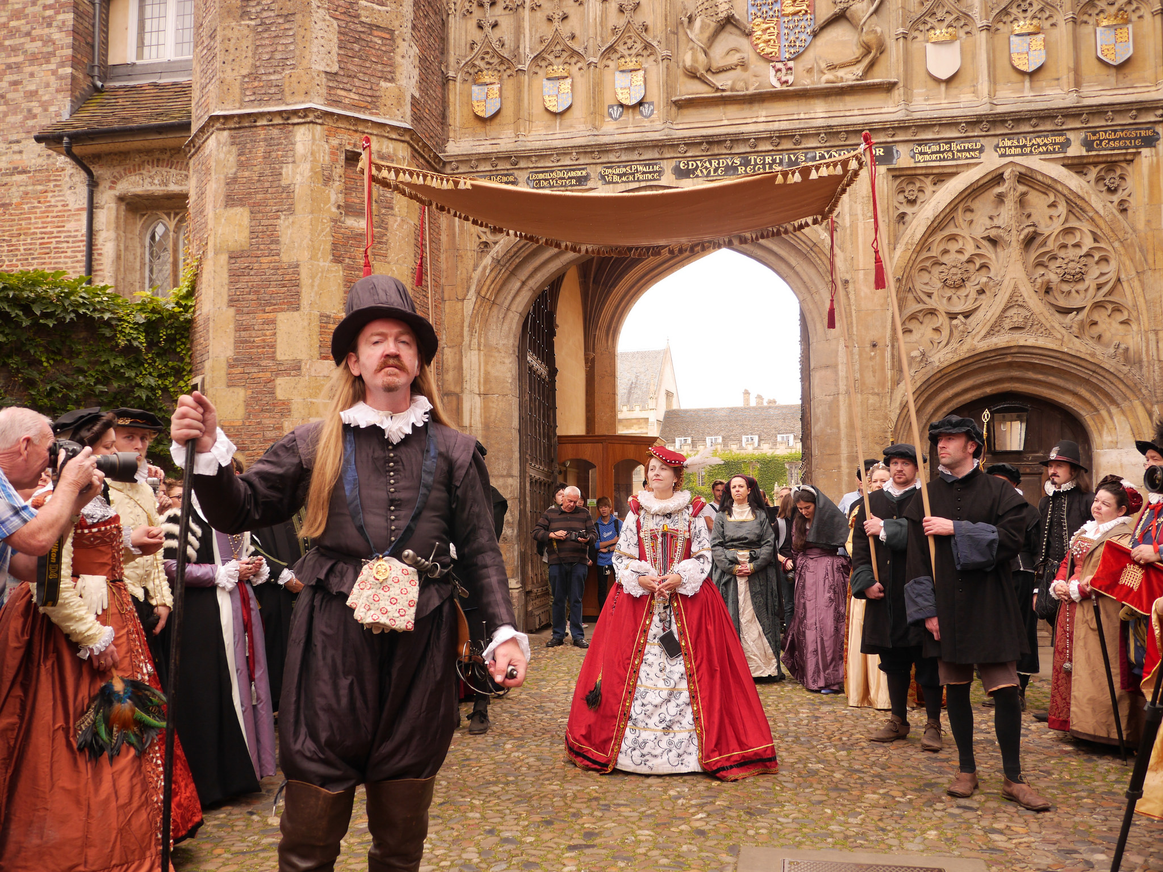
A Royal Success!
Overall Elizabeth I’s visit was seen a great success.
She attended two debates and also made a speech in Latin whilst visiting Great St. Mary’s, in which she said she would donate to the University- but she never kept her promise!

Slide 14
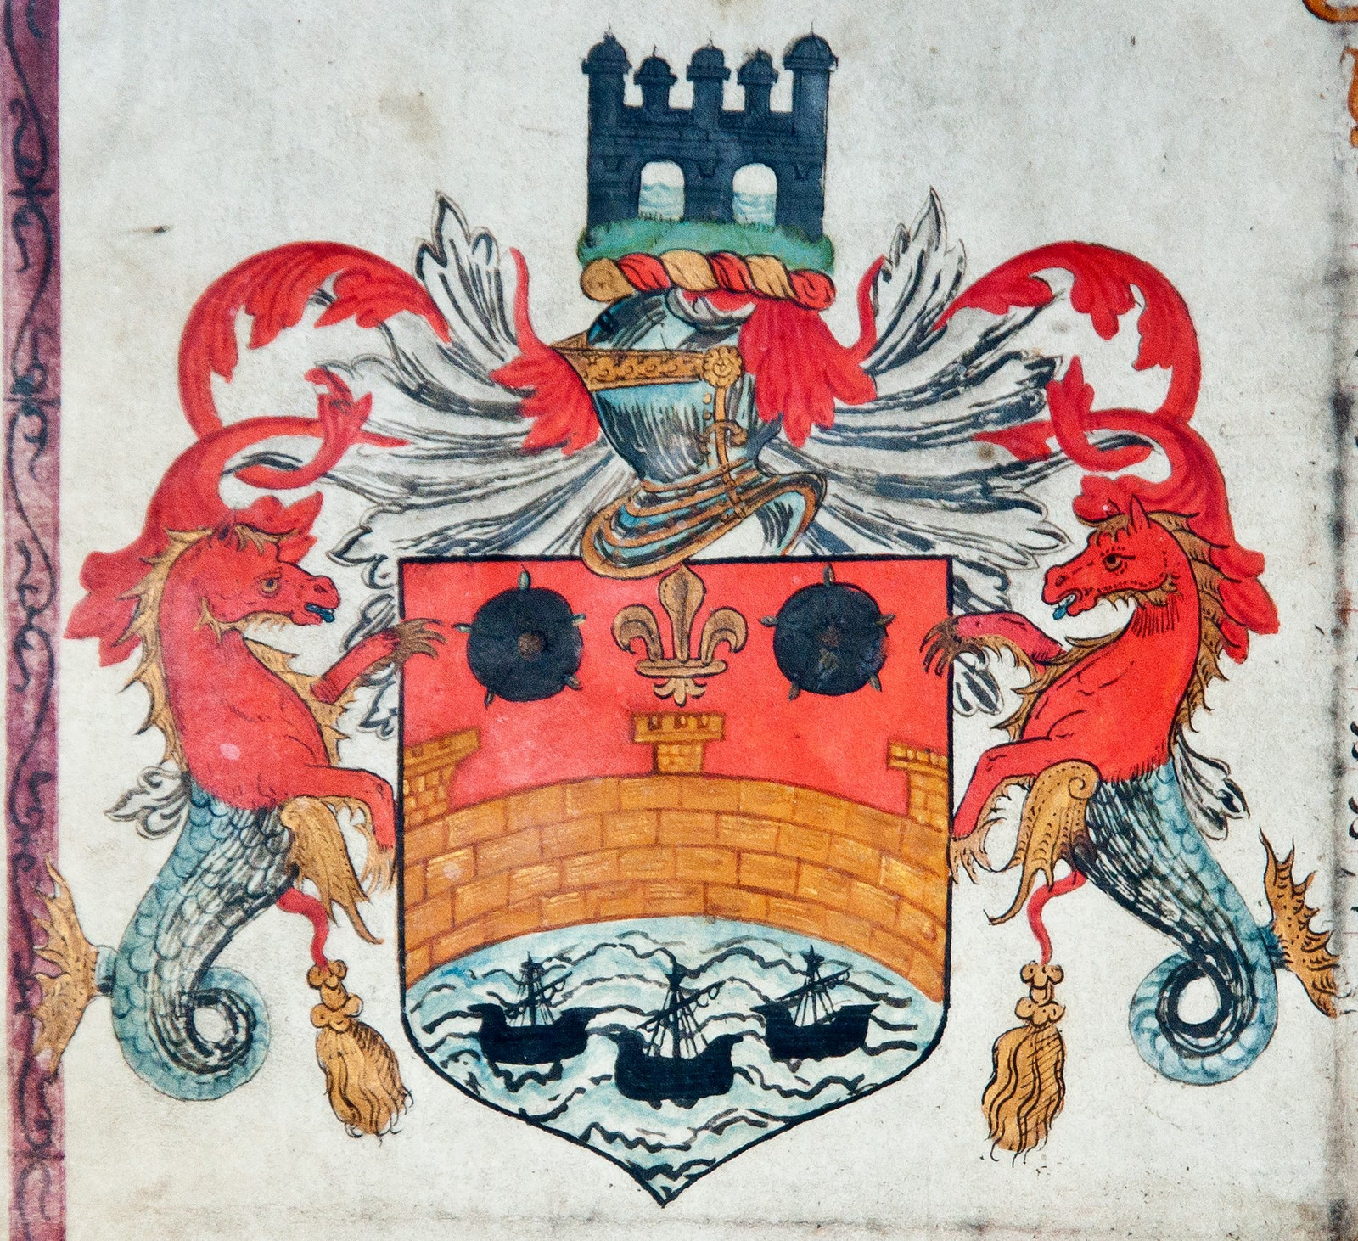
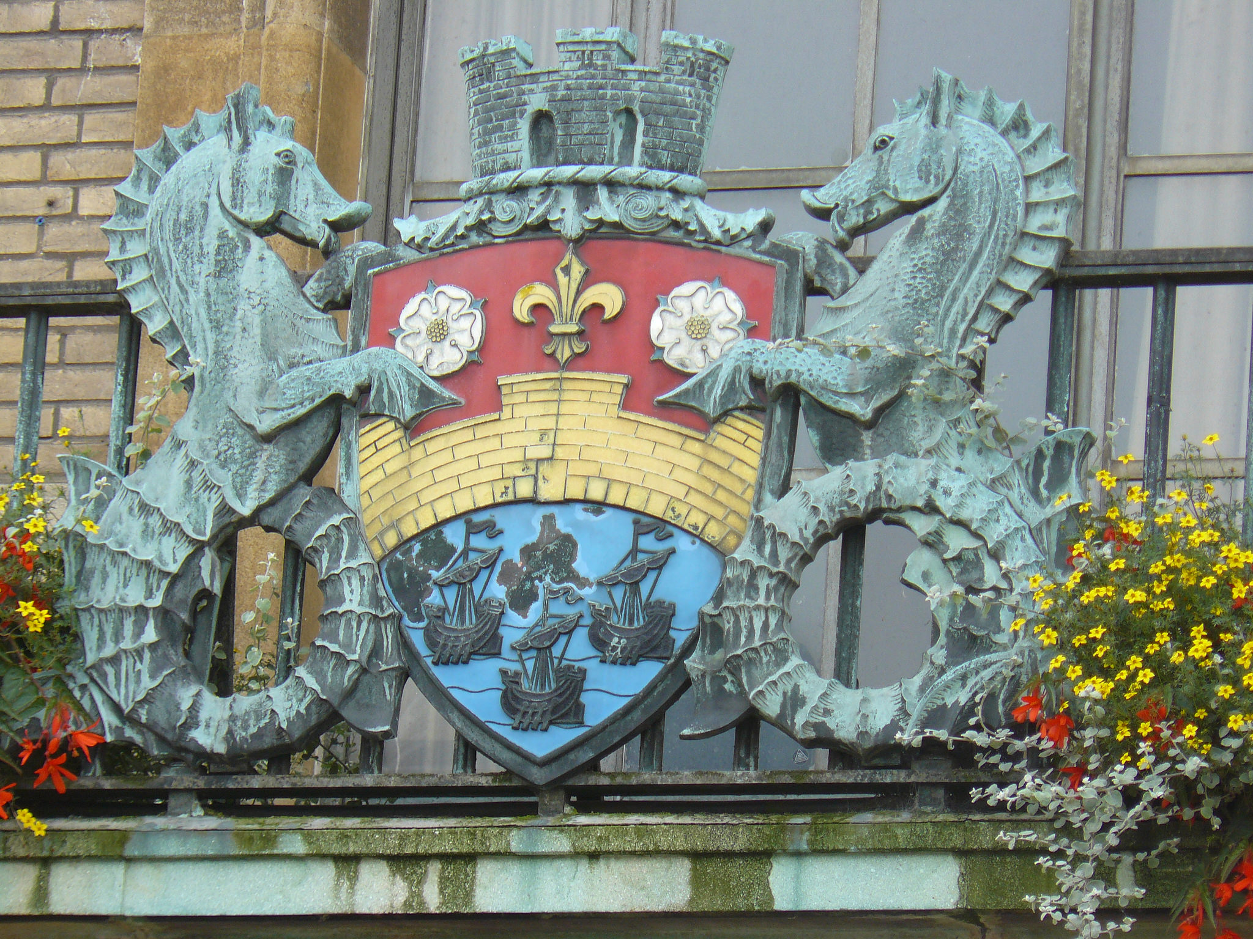
A Charter and a New Coat of Arms!
Elizabeth I’s visit not only benefited those at the University, it also helped the city’s market and traders. It led to her enacting a charter- an important legal document a few years later, in 1575, which gave permission for traders to hold the market.
The Cambridge Coat of Arms was created for the Charter and can
still be seen on the Guildhall in the Market Square.

Slide 15
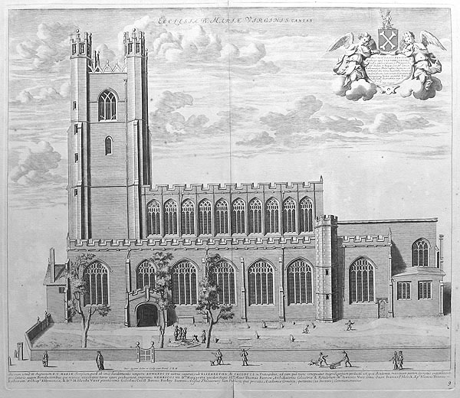
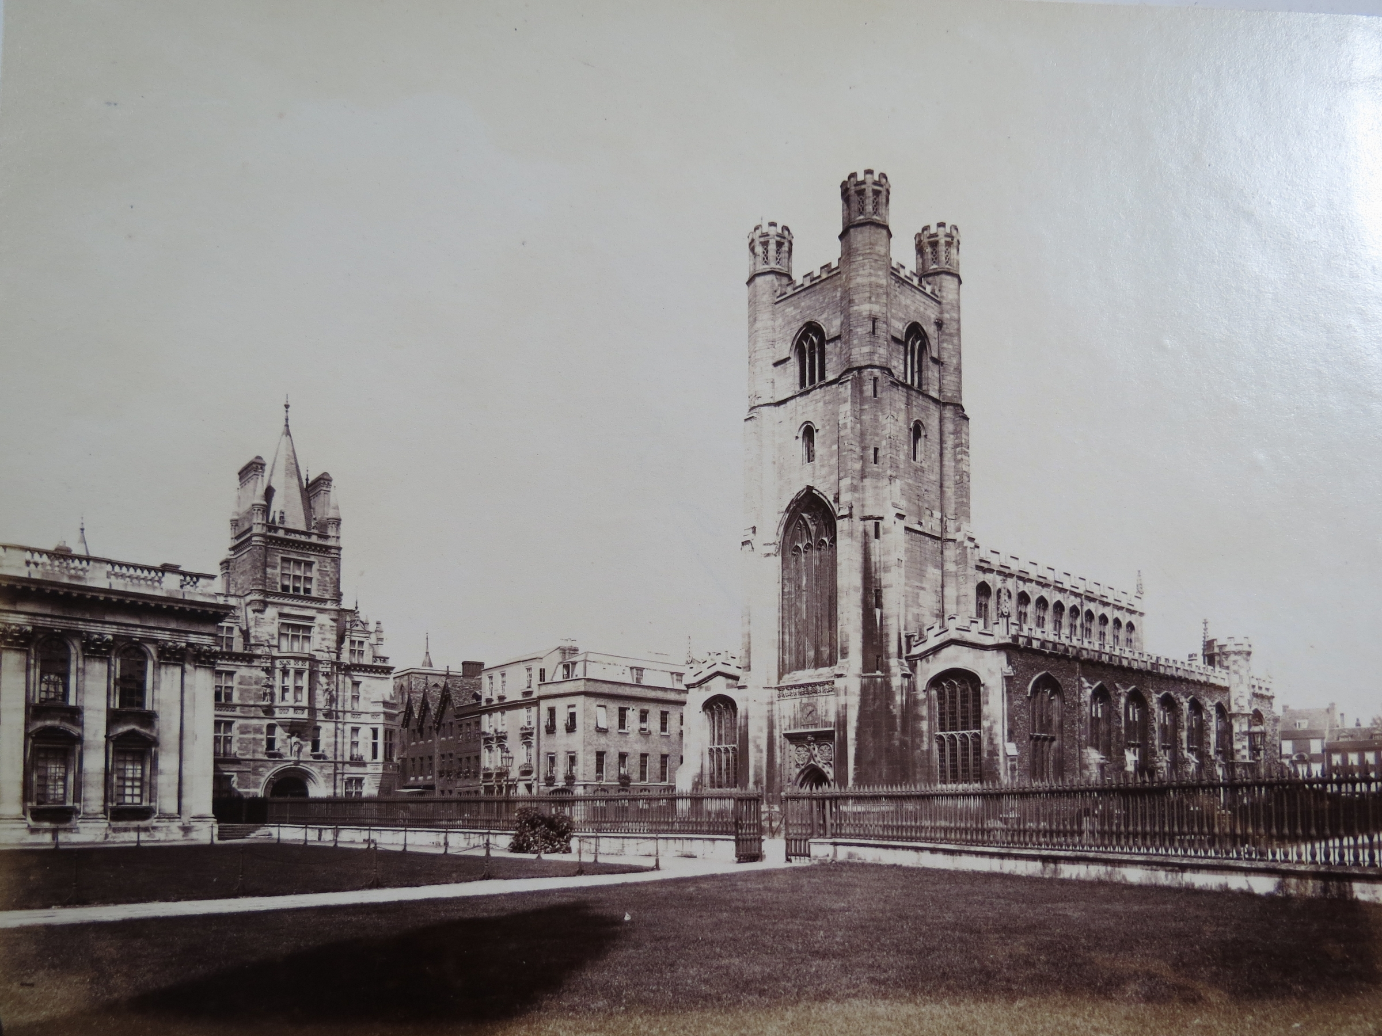
A Church That’s Survived and Grown Through History
Despite experiencing riots, unrest and even being burnt to the ground, it has managed to survive and grow to be an
extremely important part of education, culture and social reform.

Slide 16
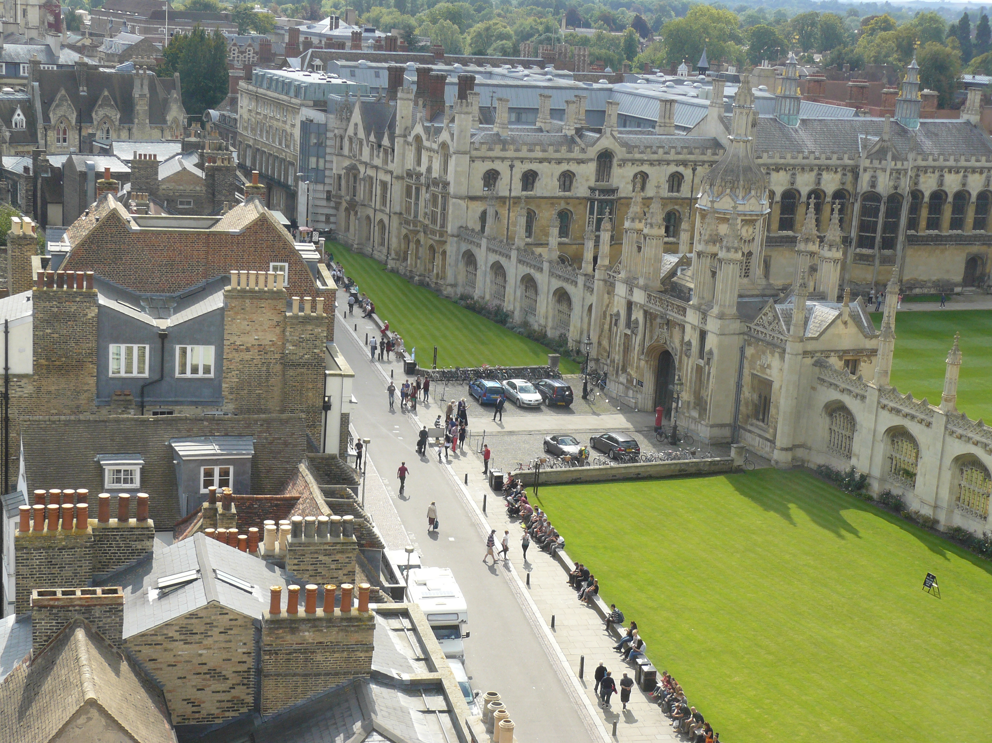
Great St. Mary’s Today
To this day, it remains an important place of worship and is an important meeting space for both the townspeople of Cambridge and the University.
It is also a very popular place for tourists to visit, especially to enjoy a trip up the tower to enjoy the views of Cambridge from the top!
This is one of the views
from the top!
Why not climb the tower next time you visit Great St. Mary’s? ☺

Slide 17
Discover More…
To arrange a visit to Great St. Mary’s as a School group get in touch with Rosie, the Heritage Education Officer at: heritage@gsm.cam.ac.uk
For more information on the amazing history of Great St. Mary’s visit:
http://www.gsm.cam.ac.uk/visitors/heritage-project/historical-notes/

Slide 18

Web Resources available at:
http://www.creatingmycambridge.com/history-stories/great-st-marys/

