Slide 1

THE GUILDHALL AND MARKET SQUARE

Slide 2
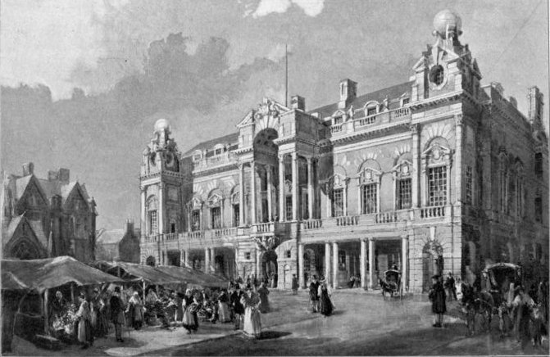
The Market Place in 12th Century
The Market was an important place for the Jewish community in the
1100s who had dwellings located where the Guildhall is now, and importantly had a Synagogue (the Jewish place of worship) on this site where they lived
and worked.
Did you know?
The Market Square had a Synagogue which stood right where the Guildhall is today!

Slide 3
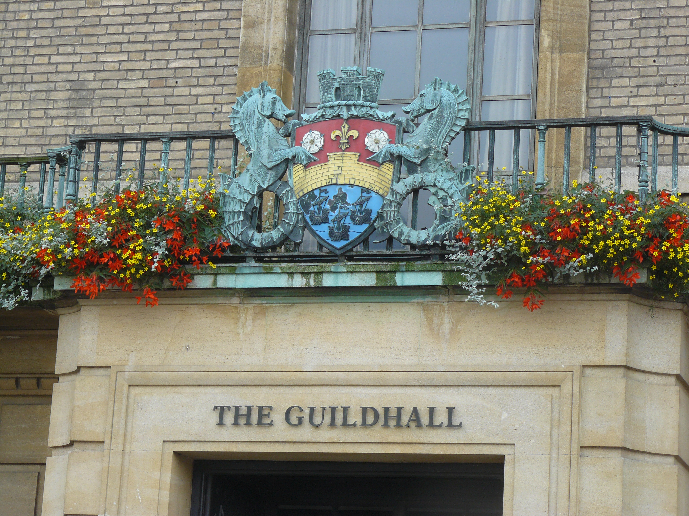
The Market Place Evolves
Once Jews were expelled from England in 1290, the site has since been used as a Tolbooth and a Gaol for the market traders, before a building was erected for the Council that is the Guildhall today.

Slide 4
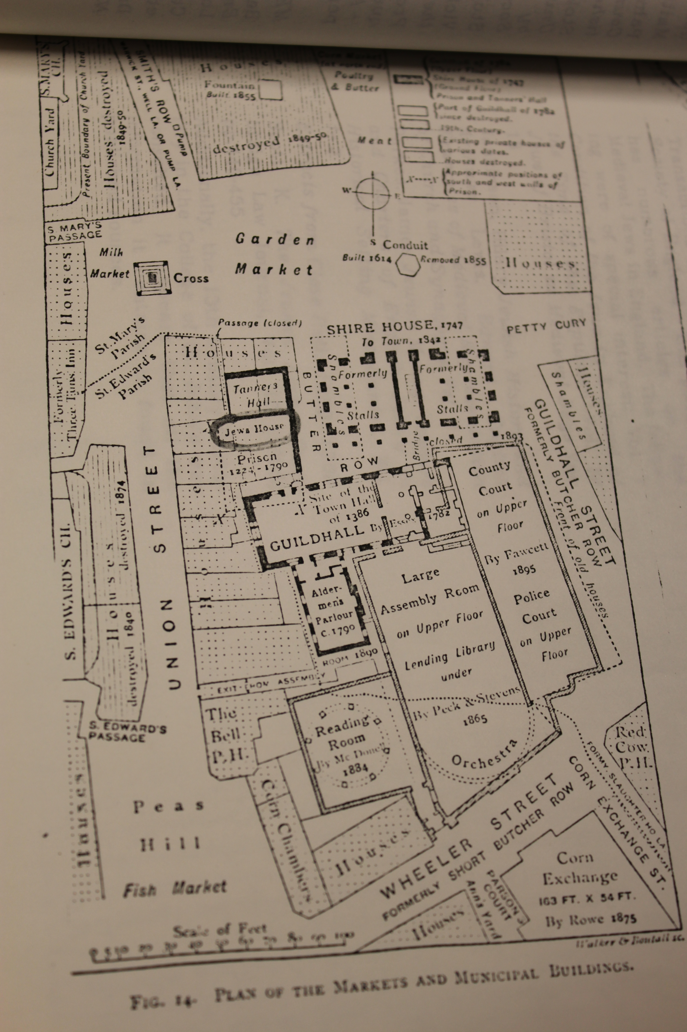
Plan of the Guildhall and Market
Can you spot any names of streets or buildings that
you recognise?
Plan of the Guildhall and Market

Slide 5
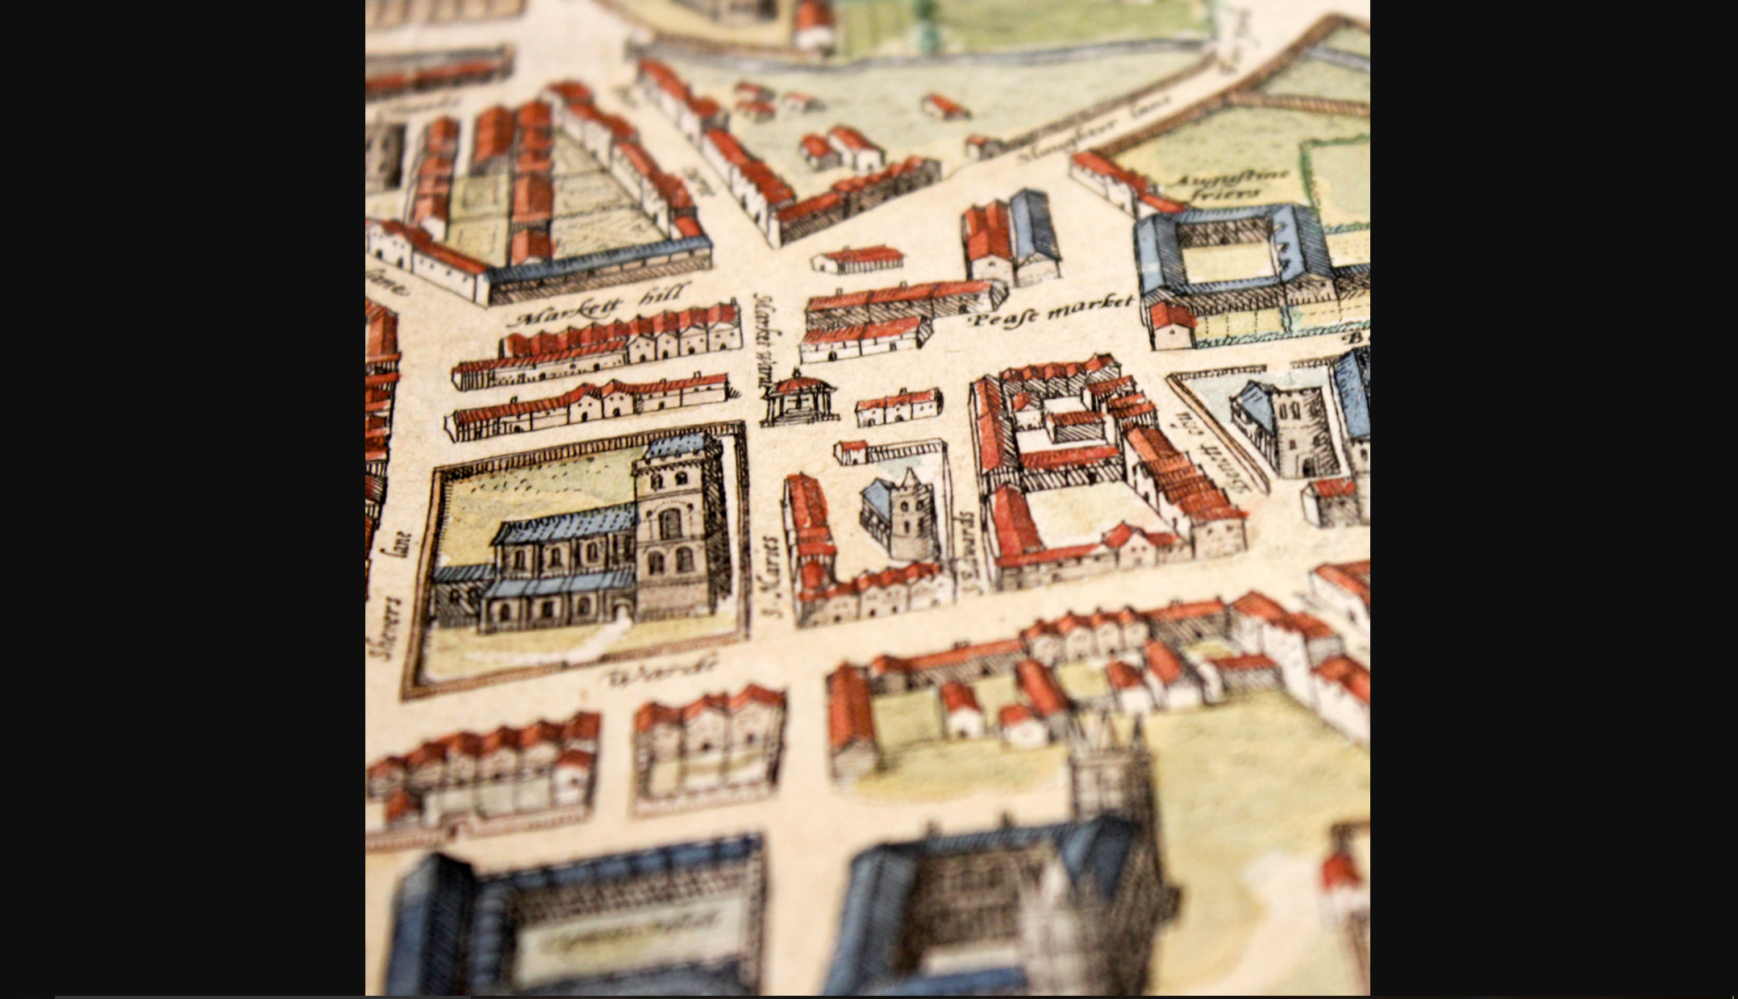
The Founding of the Market Place
The Cambridge market was founded in Saxon times and grew in size during the Middle Ages.
Cambridge was a very important trading centre in East Anglia. Stourbridge Fair was the biggest fair in England!
Braun and Hogenberg’s 1575 map shows what the market looked like in Tudor times.

Slide 6
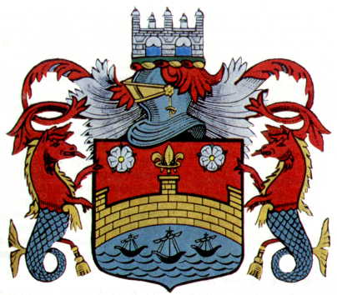
Trade in to and from Cambridge
Cambridge was in the middle of the fens so almost everything had to be brought in by boat on the Cam, which joins the Ouse and reaches the sea at King’s Lynn. Some goods came all the way from Europe!
The city’s coat of arms shows how important river trade was to Cambridge. It has three ships, two hippocampi (horses with fish tails, which belonged to the Roman sea god Neptune) and the bridge.
The Cambridge Coat of Arms

Slide 7
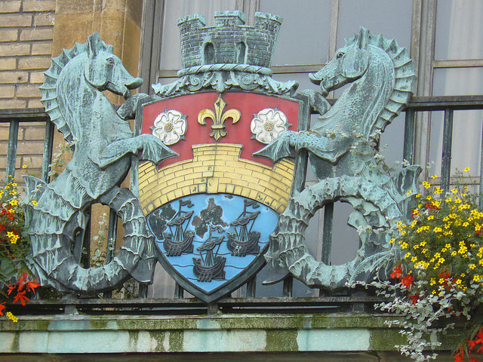
Cambridge Coat of Arms
You can still see the Cambridge Coat of Arms above the door of the Guildhall in Market Square today!
Next time you are in Cambridge city centre see if you can spot the Coat of Arms above the Guildhall or anywhere else!

Slide 8
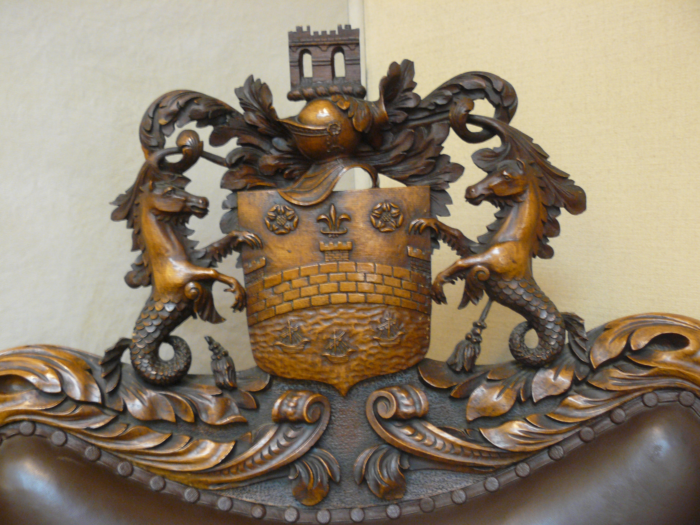
Cambridge Coat of Arms
Why do you think the Cambridge Coat of Arms has an animal that is half horse and half sea creature holding it?
What could they be a symbol of?
Here is another example of The Coat of Arms of Cambridge on the top of an important chair inside the Guildhall.

Slide 9
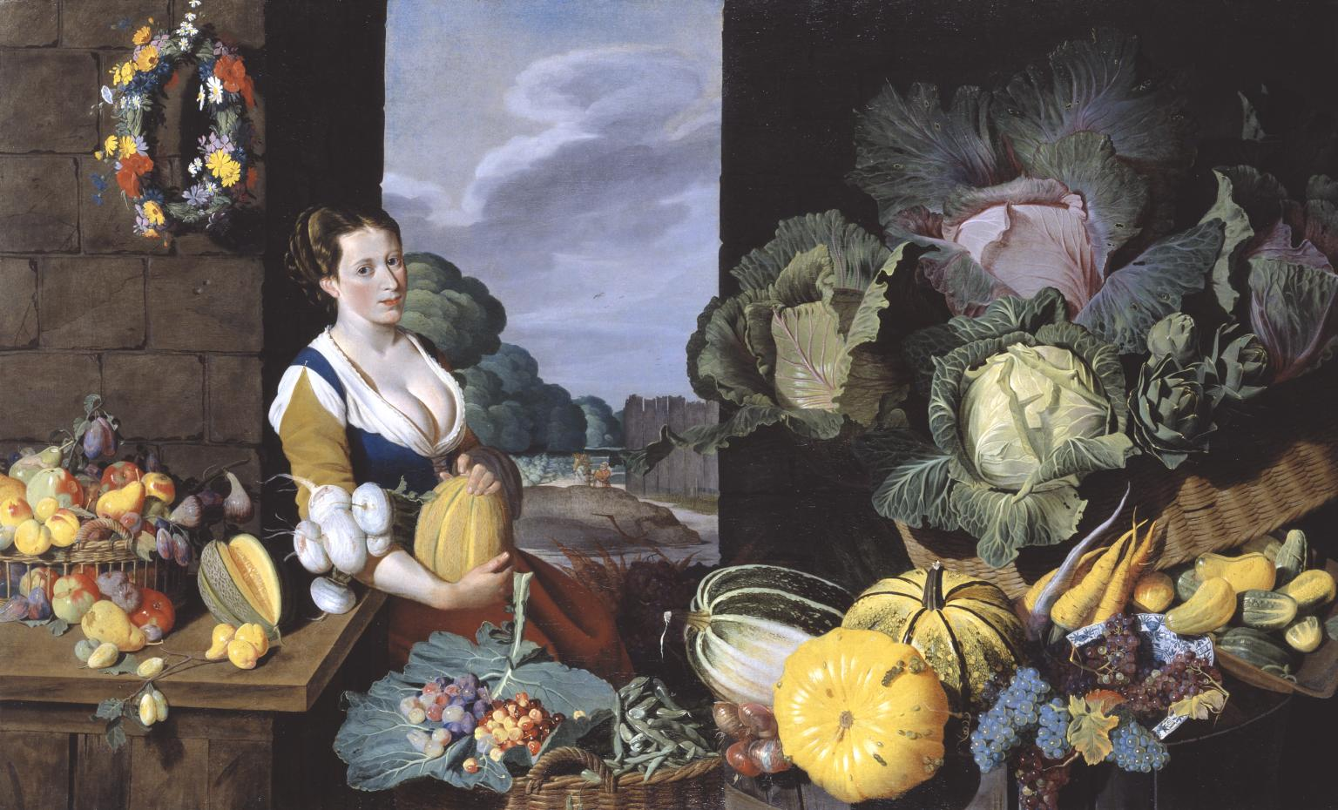
Trading at the Market
Lots of different items were sold in the market, such as fruit and vegetables, fish, fabric, and hot food, just like today. This painting shows the types of fruit and vegetables that could be bought at a market in the Stuart period.
As well as traders in stalls, pedlars wandered around with trays, calling out their wares. The market was a very noisy place!

Slide 10
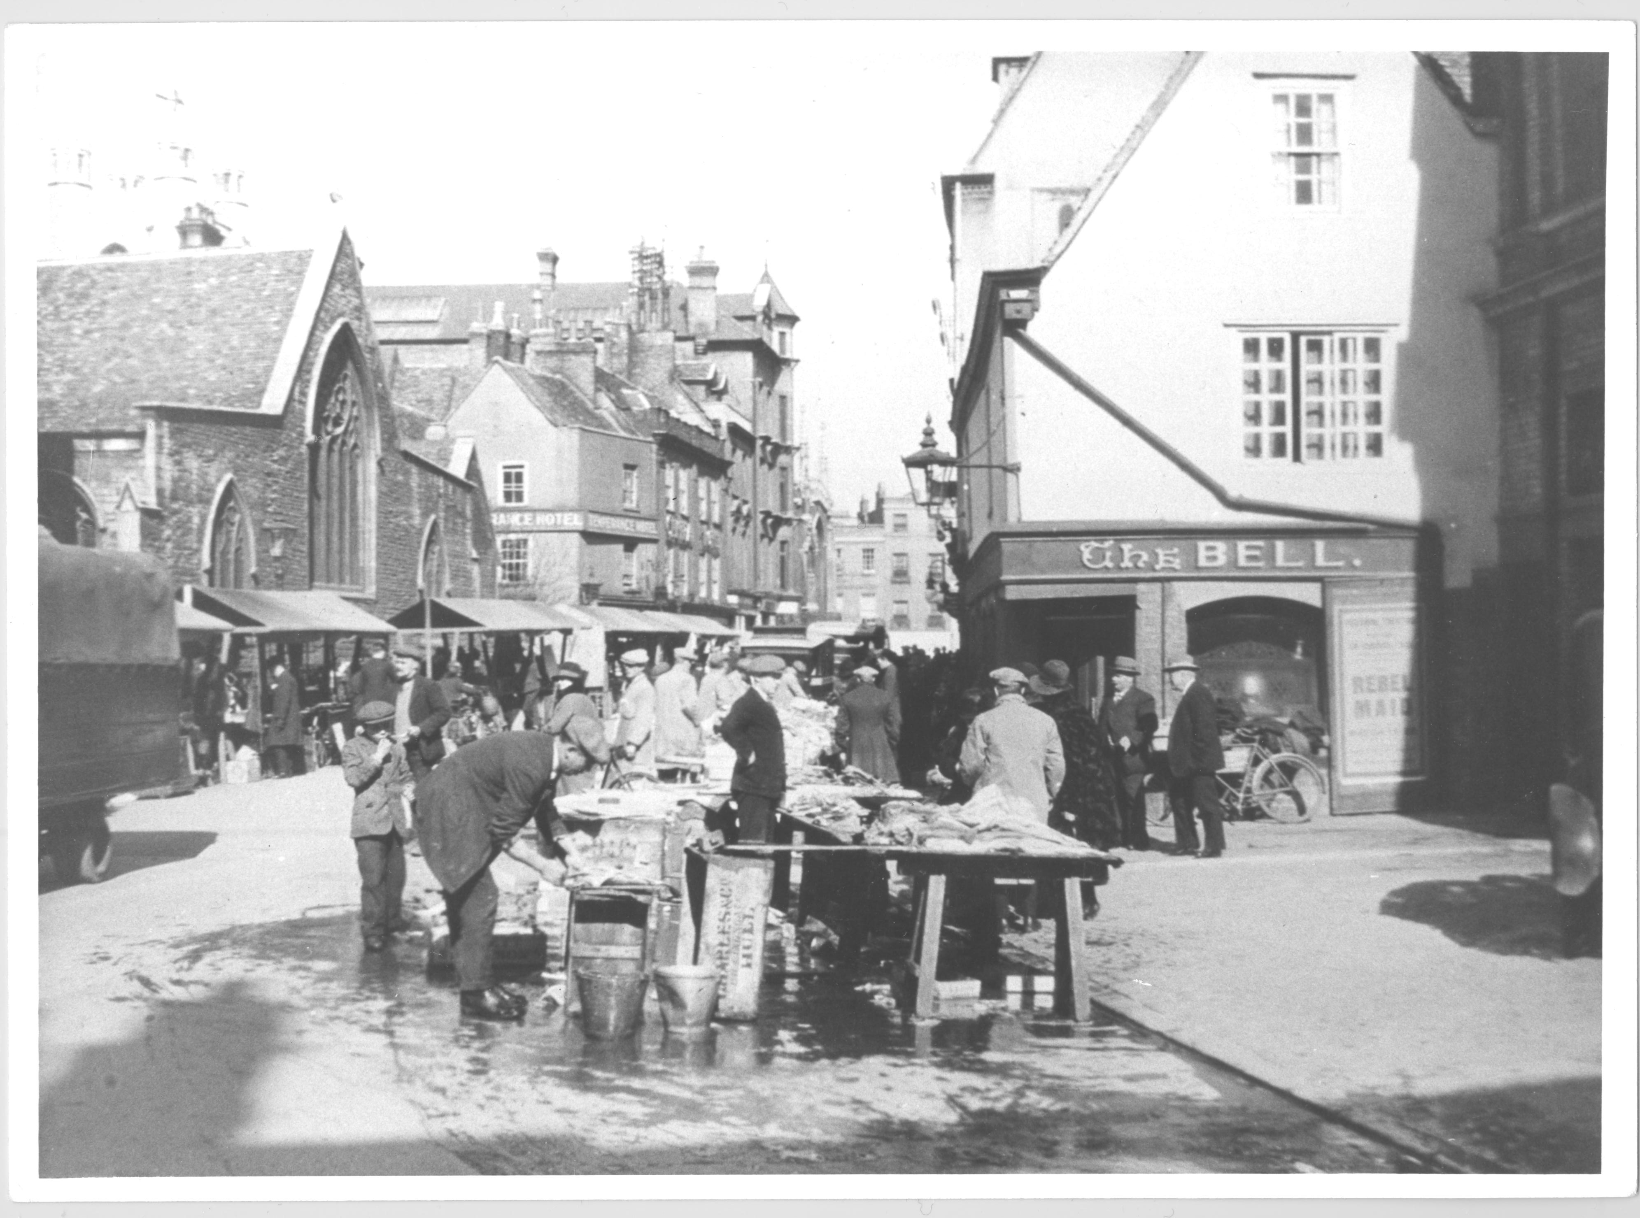
What’s in a Name?
Streets were often named after the goods that were sold there. Can you guess what was sold on Peas Hill?
It wasn’t peas!
‘Peas’ is a corruption of the Latin ‘pisces’, meaning fish.

Slide 11
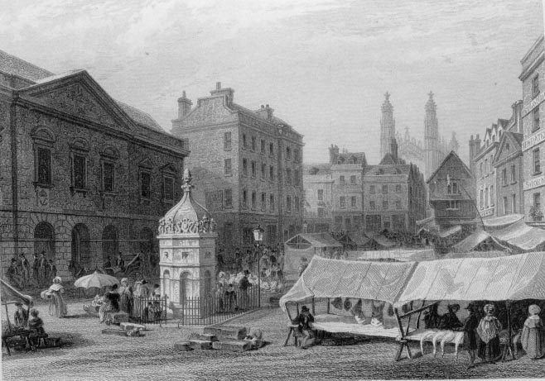
A Very Important Place
Because the market was so important, almost all of the town’s most important buildings were located around the market. These included Great St. Mary’s Church, the Guildhall; and the gaol (jail).
This picture shows the marketplace in 1897.

Slide 12
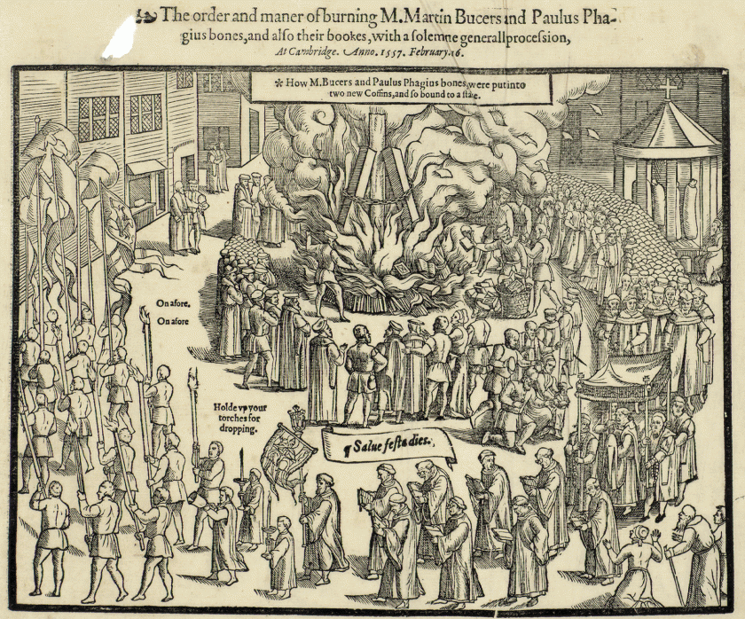
The Tudors and the Market
The market was also where justice was done. But under the Tudors, justice wasn’t very just!
Queen Mary I (also called Bloody Mary) ordered that the leading Protestants of Cambridge be burnt at the stake in the marketplace.
Two of these Protestants, Martin Bucher and Paul Fagius, were already dead! That didn’t stop Mary: she ordered their corpses dug up and burnt anyway.
Picture showing the burning
of Martin Bucer’s body

Slide 13
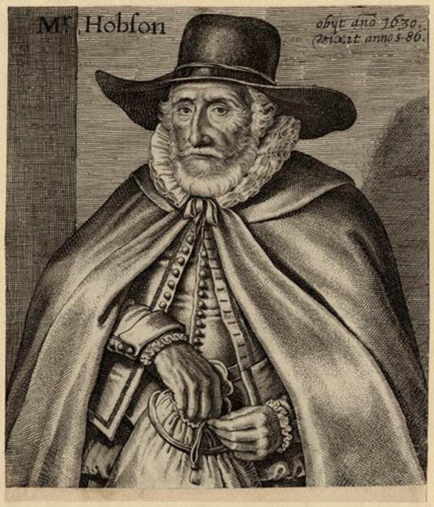
Thomas Hobson’s
Improvement of the Market
Thomas Hobson, a local Inn-keeper and horsemonger, courier for the post and news in Tudor times, made an important improvement to the market in the early 1600s.

Slide 14
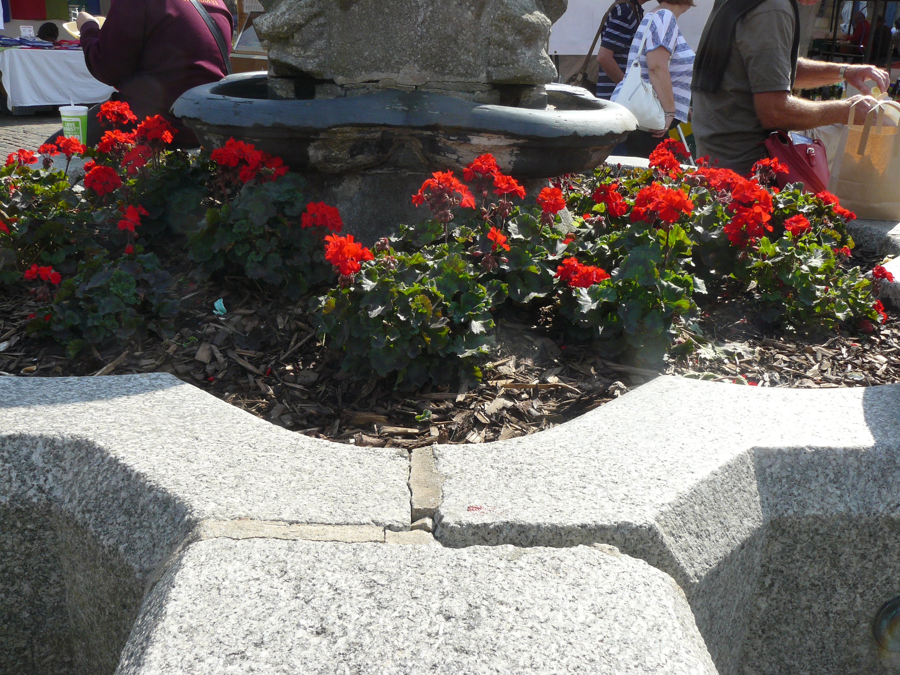
What’s That Fountain All About?
Hobson donated money for a
conduit to bring fresh water from Trumpington all the way to a fountain built to provide clean drinking water for the people of Cambridge.
The base of the remains of the fountain at the Market
See if you can spot the remains
of the fountain when you’re next
at the Market.

Slide 15
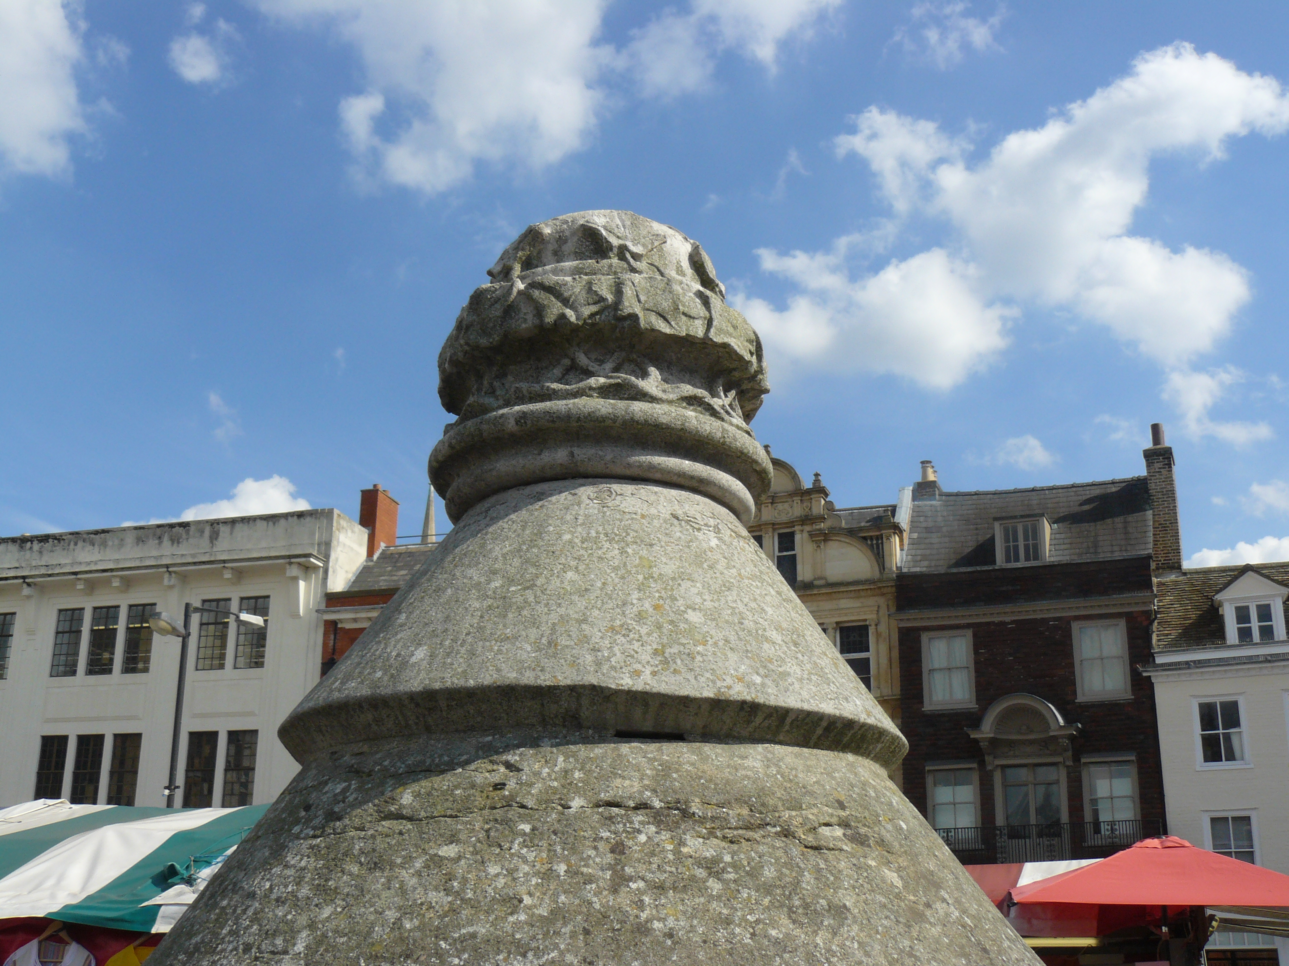
What’s That Fountain All About?
The remains of the fountain can still be seen today, looking now like a giant flower pot in the centre of the cobbled area!
The top of the remains of the fountain at the Market
See if you can spot the remains
of the fountain when you’re next
at the Market.

Slide 16
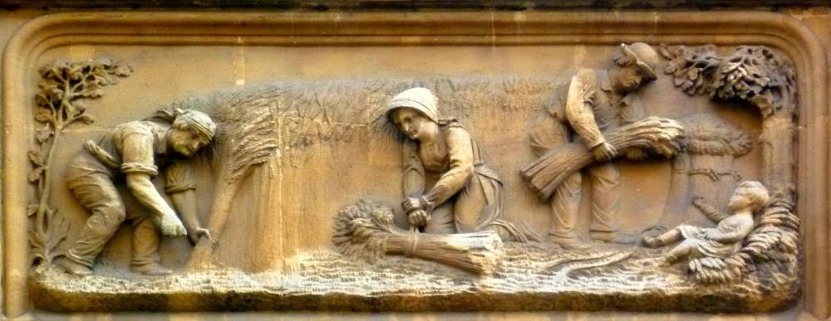
The Market in Victorian Times
The market continued to be very important for the Victorians, but the new railway meant that goods now arrived by train, not punt.
The market burnt down in 1849. Most of the buildings surrounding the marketplace were built in Victorian times.
One of the new buildings was the Corn Exchange. If you look closely, you can see carvings of people harvesting corn next to the main door.

Slide 17
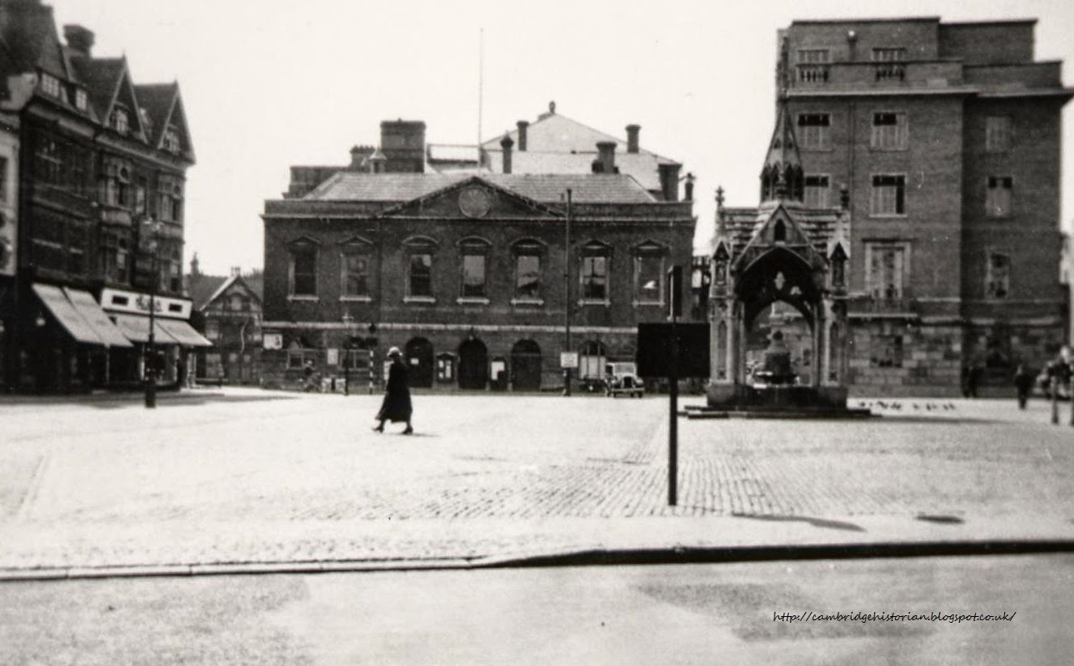
The Market Square in the 1930s
Can you spot the
Guildhall in this photo
from the 1930s?
Do you recognise any
other buildings?
What are they now?
Photo of Market Square in 1937

Slide 18
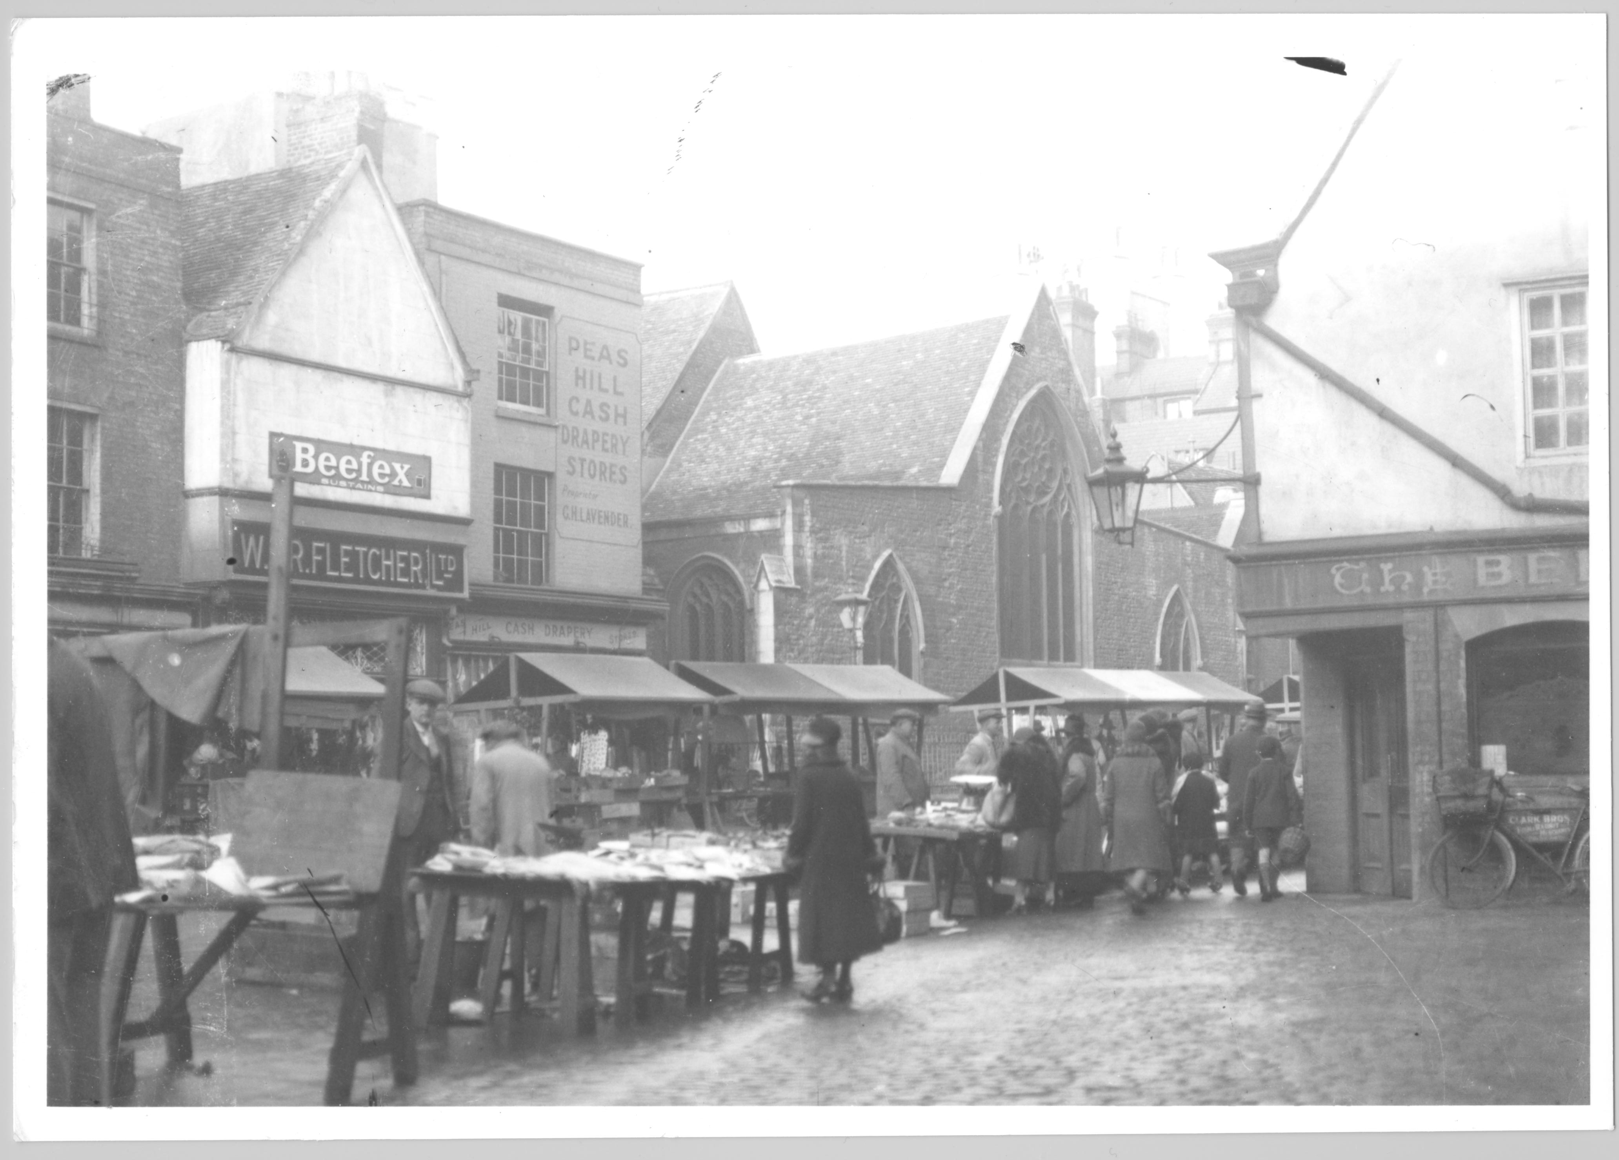
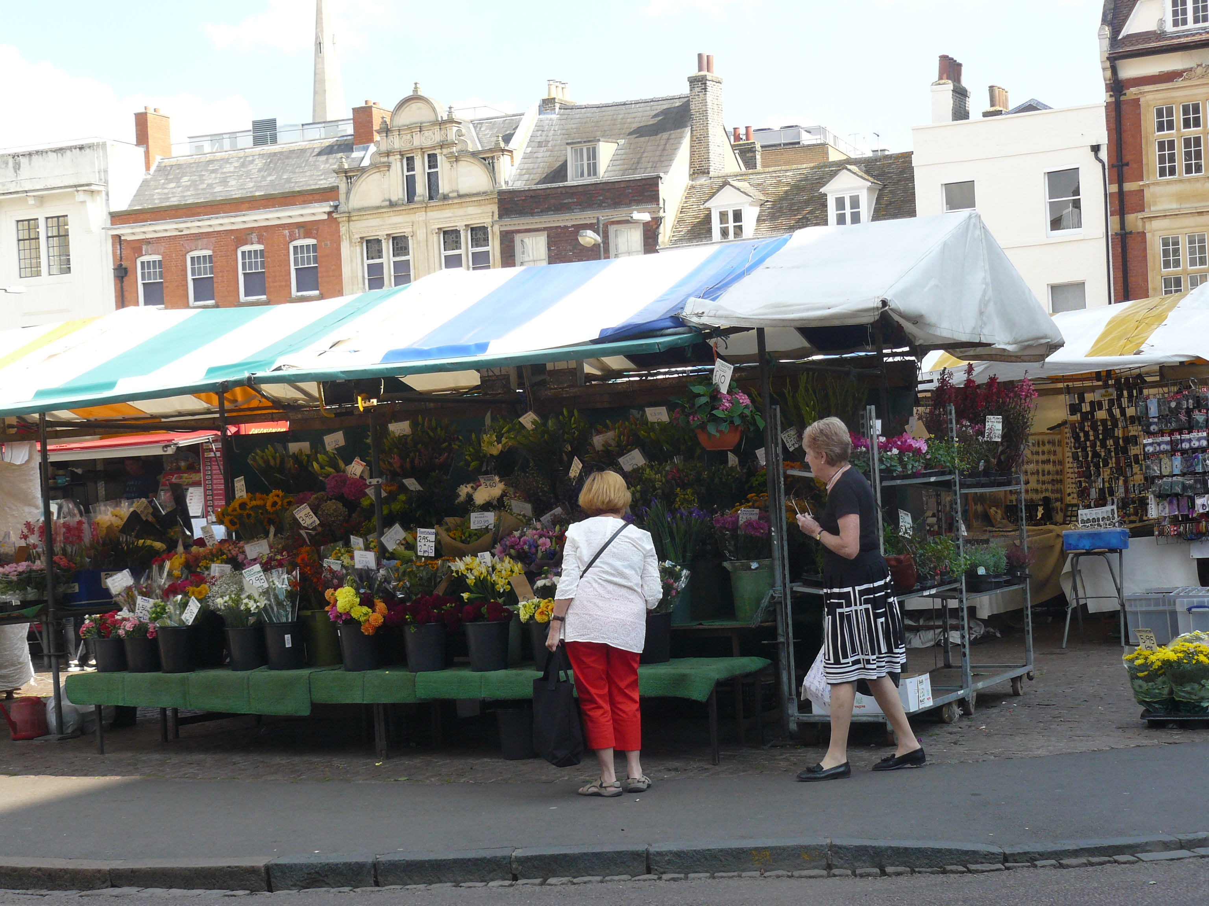
How Have Market Stalls Changed Since the 1930s?
Then
Now

Slide 19
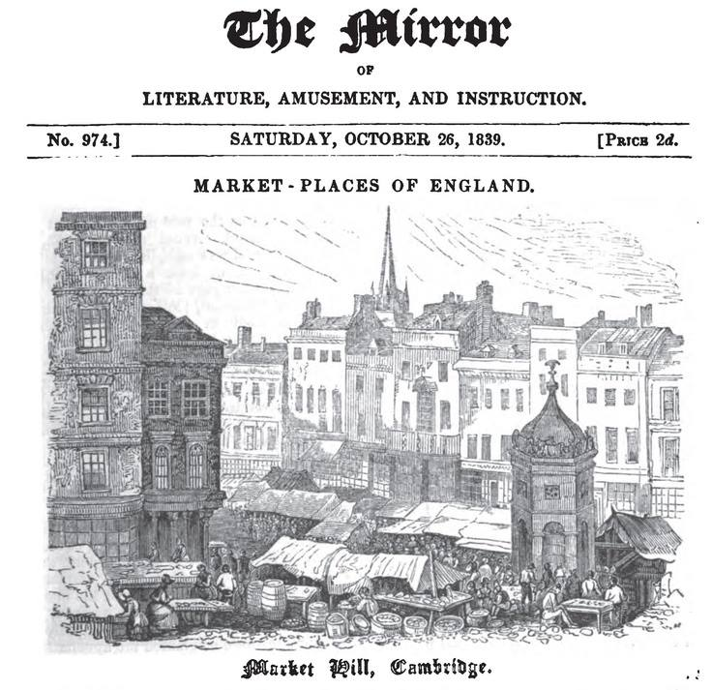
Times Change for the Market
Although the Market was originally very different in layout to now,
due to a major fire destroying the wooden booths in 1849, it is still thriving today!
Can you spot the wooden
booths in the picture?

Slide 20
Cambridge Market Today
Today the Market is known for its stripy awnings hosting numerous stalls, selling a variety of produce including locally grown fruit and vegetables, as well as produce from around the world.

Slide 21
Discover More
To find out more about the history of the Market Square and Great St. Mary’s Church visit Great St. Mary’s Heritage Centre on the Market Square to use their free interactive touch screens and climb the tower. Visit the website here for more information: http://www.gsm.cam.ac.uk/heritage/
Contact the Great St. Mary’s Heritage Education Officer to arrange a school visit at: heritage@gsm.cam.ac.uk

Slide 22

Web Resources available at:
http://www.creatingmycambridge.com/
history-stories

