Slide 1

THOMAS HOBSON

Slide 2
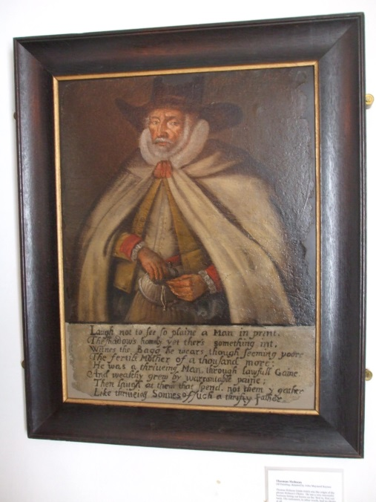
Who the Heck Was Hobson?
Hobson was a Stable Manager and Horse Monger. He delivered the post and news between Cambridge and London, on a horse!
He hired horses out to people,
a bit like we do with rental cars today!
FACTOID!
Hobson is the source of the saying – ‘Hobson's Choice’.

Slide 3
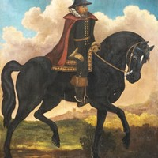
So What is ‘Hobson’s Choice’ Anyway?
The phrase ‘Hobson’s Choice’ came from the clever system that Hobson came up with.
Hobson noticed that his customers always wanted to take the fittest horses for their journeys and that they’d return exhausted.
So he devised a cunning system, that customers had to take the first horse at the entrance to the stable
(a bit like taking the first taxi at a taxi rank!) rather than choosing their own, to make sure it was fair for everyone.

Slide 4
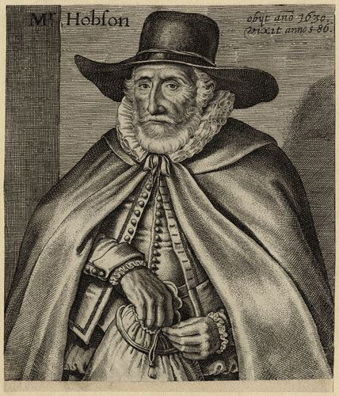
Mr. Money Bags!
Hobson became a very wealthy man due to his successful postal business and inn. He was the only business that was licensed by the University to deliver mail to and from London, which resulted in him earning a fortune during his lifetime.
Check out Hobson’s
huge money bag,
showing just how
rich he was!

Slide 5
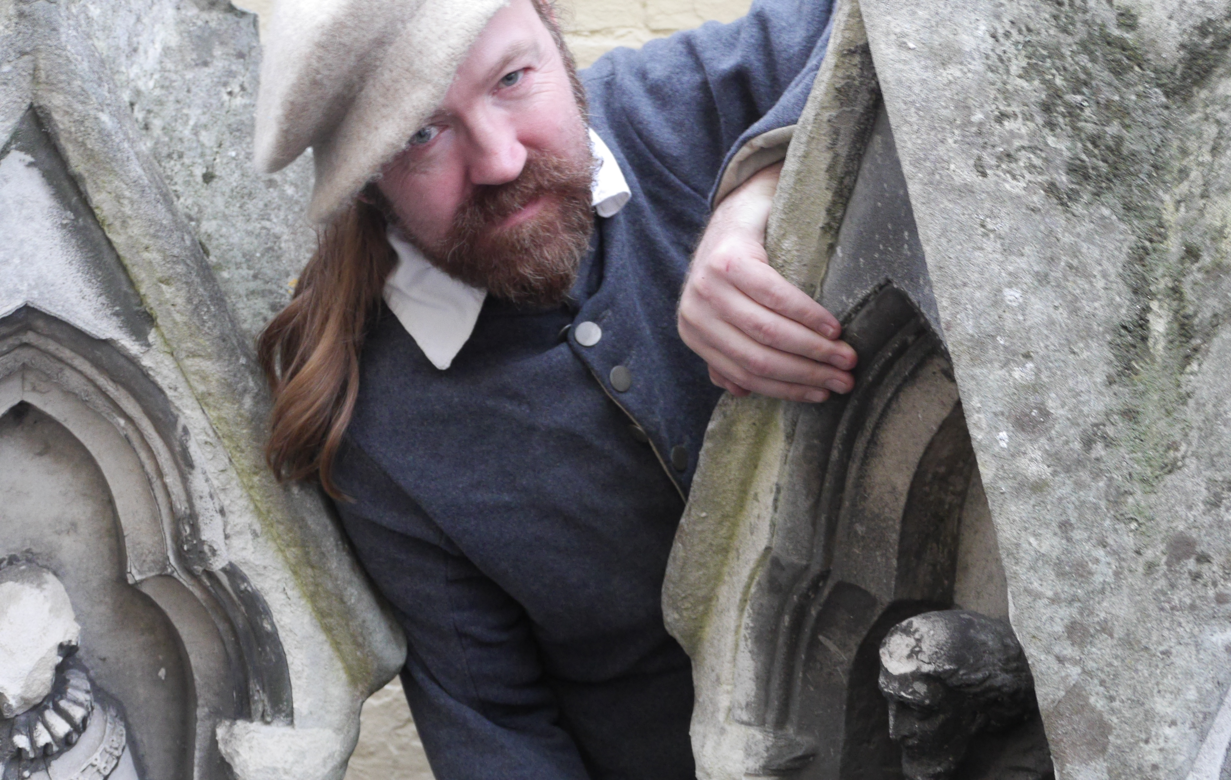
Putting His Money to Good Use
Hobson might have had a lot of money, but he didn’t just keep it to himself, he used lots of his money to fund projects to help other people, including ‘Hobson’s Conduit’.
In the 16th and 17th century people were dying of the plague due to the uncleanliness of Cambridge. A building project to build an artificial river began in 1610.

Slide 6
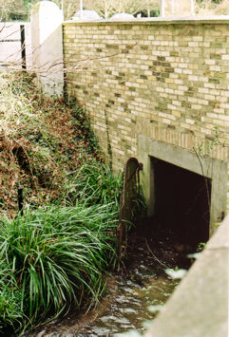
Hobson’s Conduit
Hobson gave money to pay for a waterway from Vicar’s Brook near Long Road to the top of Lensfield Road and a fountain in Market Square so people could have access to clean drinking water in the city.
They named the waterway ‘Hobson's Conduit’ in his honour and you can still see it running down Trumpington Street today!
Next time you’re in Cambridge city centre see if you can spot the fountain or conduit!

Slide 7
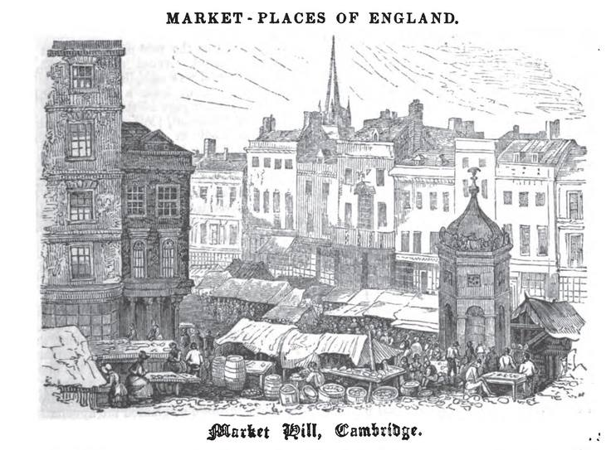
Hobson’s Fountain
Hobson’s fountain was built in Market Square in 1614 and marked the end of the conduit.
After a huge fire devastated the Square in 1849, the fountain was moved to the corner of Lensfield Road where you can see a reconstructed conduit from 1953.
You can still find pieces of the original Hobson fountain from Market Square on display in the courtyard at the Museum of
Cambridge.

Slide 8
Hobson's Horses (To tune of Frere Jacques) Words by Dave Cohen
Hobson's Horses
Hobson's Horses
Take your choice
In your voice
Ask him for another one
Ask him for the other one
He will say
'Not today!’

Slide 9
Hobson's Choice (To tune of London's Burning) Words by Dave Cohen
Hobson's Choice is
Hobson's Choice is
For a speedy horse
Very best of course
Faster faster!
Faster faster
He replied
'I decide'

Slide 10

Web Resources available at:
http://www.creatingmycambridge.com/
history-stories/hobsons-choice/

