Slide 1

The Isolation Hospital

Slide 2
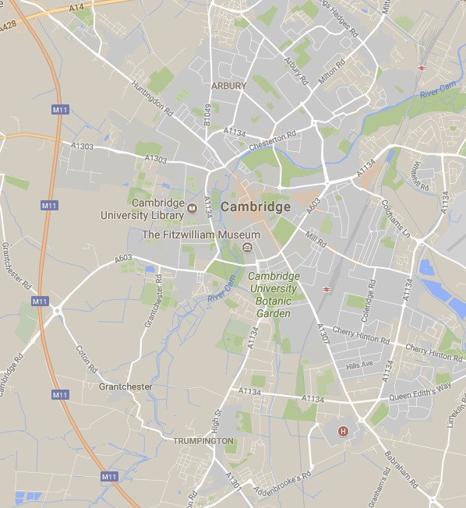
Where is the Isolation Hospital?
The Isolation Hospital is now known as Brookfields Hospital.
It is separate from the main hospital in Cambridge, called Addenbrooke’s.
Brookfields Hospital
Have you ever been to either of the hospitals?
Addenbrooke’s Hospital
Map from Google Maps

Slide 3
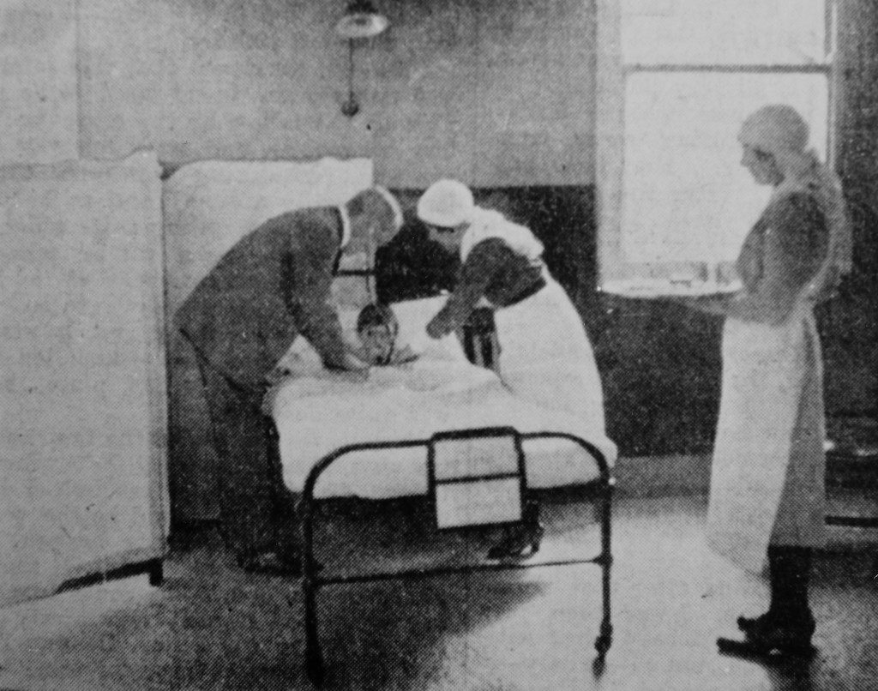
What was an Isolation Hospital?
The Isolation Hospital was founded in 1885. It was where people with infectious diseases were sent, so they didn’t pass them on to other people.
People at the time worried about children being separated from their parents. Would you like to be sent away when you were feeling really ill?
Photo of staff attending a sick boy at the Hospital, from Capturing Cambridge.

Slide 4
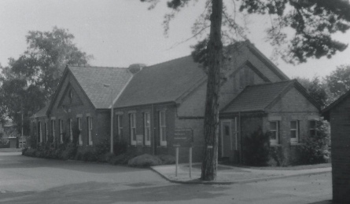
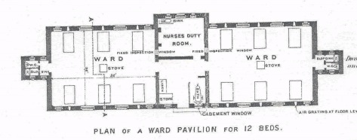
How did it work?
There were seven separate blocks. Each block treated a different disease, and had both male and female wards.
Here is a picture of the Scarlet Fever Ward, and a plan of what it would have looked like inside.
FACTOID
Scarlet Fever is called that, because one of the symptoms is a bright
red rash all over the body!
Photos from Capturing Cambridge.

Slide 5
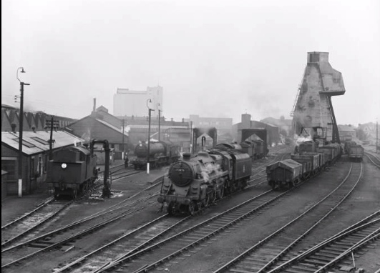
A Changing Cambridge
The Isolation Hospital was built in a time of great change in Cambridge. The Industrial Revolution had arrived!
A railway line was built to Cambridge in 1854 and new factories sprung up around town.
Photo of Cambridge Railway Shed from the National Railways Museum Collection

Slide 6
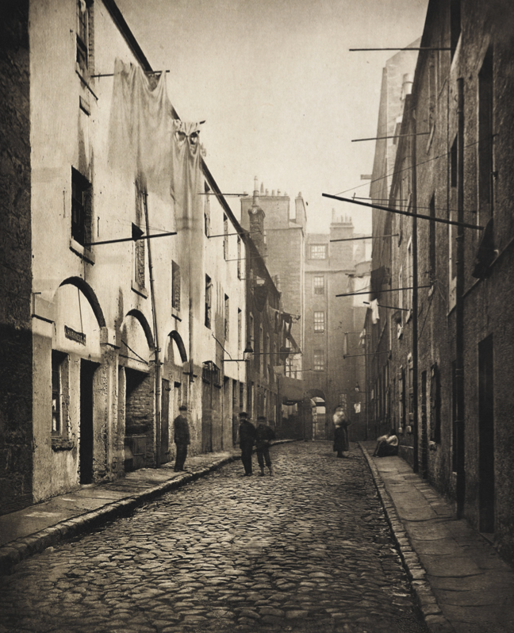
The population rises!
Because the new jobs working in the factories and on the railways paid more than farming, thousands of people moved from the countryside to the city.
To make homes for all these new people, lots of houses were built, but they were often close together, cramped and lacked toilets and running water.
Everyone threw their wee, poo and other rubbish into in the street or the river!
Can you imagine the smell?!
Here is a photo of some Victorian streets. Can you see how close together the houses are?
Photo from the British Library

Slide 7
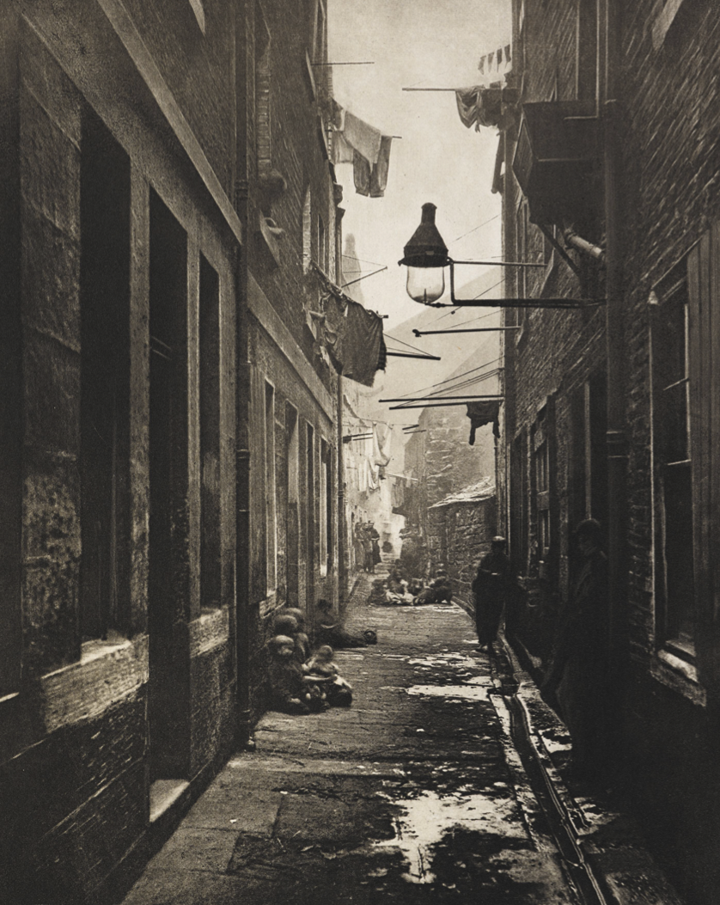
Cambridge cultivates disease!
All these people living on top of each other, surrounded by rubbish, meant that disease occurred often and spread very quickly.
The Isolation Hospital was built in response to an outbreak of Smallpox and Diarrhoea in the early 1880s.
Photo from the British Library

Slide 8
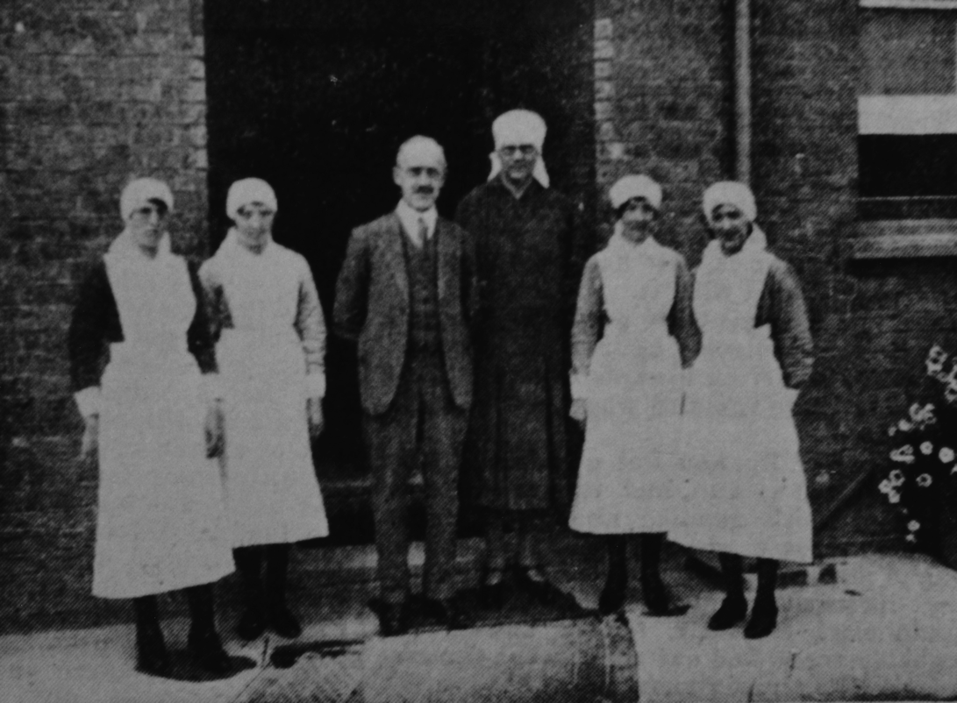
It’s in the air!
At the time, people believed sickness was carried in bad smells, or ‘miasmas’. The new Cambridge streets would have smelled awful – people thought this smell was disease!
Taking people away from their home to the Isolation Hospital was thought to help, because it
Photo of a doctor, nurses and a patient at the Hospital, from Capturing Cambridge
would take them away from the bad smell. It would also keep the bad air around them away from others.

Slide 9
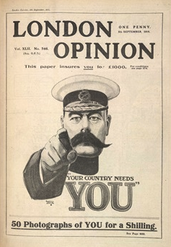
What happened to the Hospital in World War One?
In World War One the Hospital became the place where men signed up to the army.
Here is a propaganda poster, which encouraged young men to join up and fight. Would it have convinced you?
FACTOID
Although you weren’t meant to join the army until you were 18, lots of younger boys lied about their age, so they could go too! The youngest known boy who fought in the War was 12 years old!
Photo from the British Library

Slide 10
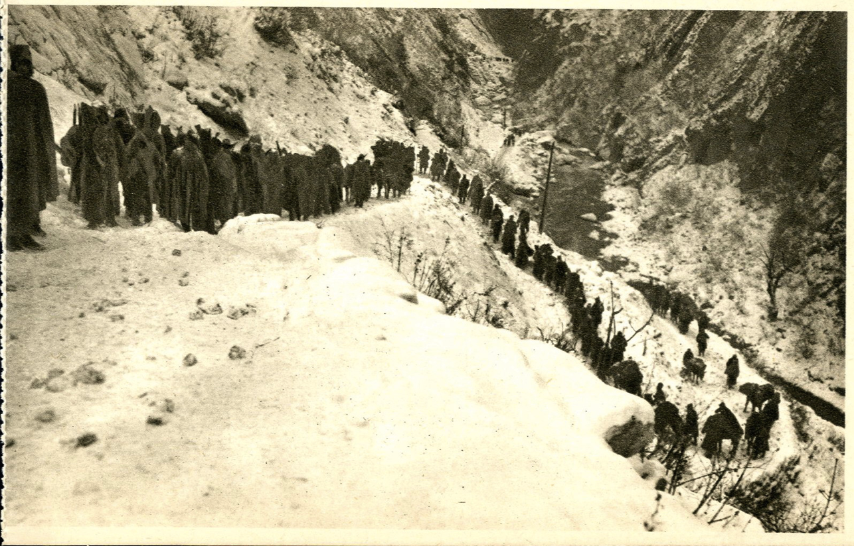
The 1,500 mile walk to Cambridge!
During World War One, the Hospital also became a home to Serbian refugees.
Fierce fighting across Europe destroyed lots of people’s homes and forced them to move. Thousands of Serbs were driven out from their country and some travelled the
1,500 miles to Cambridge.
This is a photo of people leaving Serbia. The weather and landscape are very different from Cambridge! What do you think they would have thought when they arrived?
Photo from the British Library

Slide 11
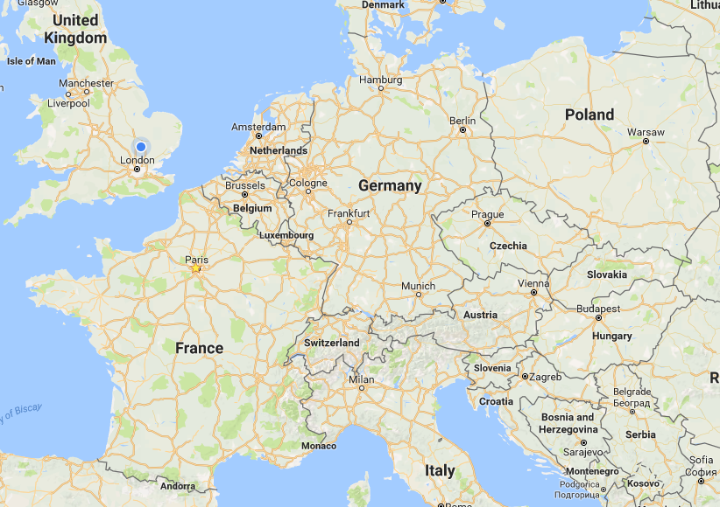
Where is Serbia?
This is Cambridge. Can you spot Serbia on the map? Can you imagine walking that far?
Map from Google Maps

Slide 12
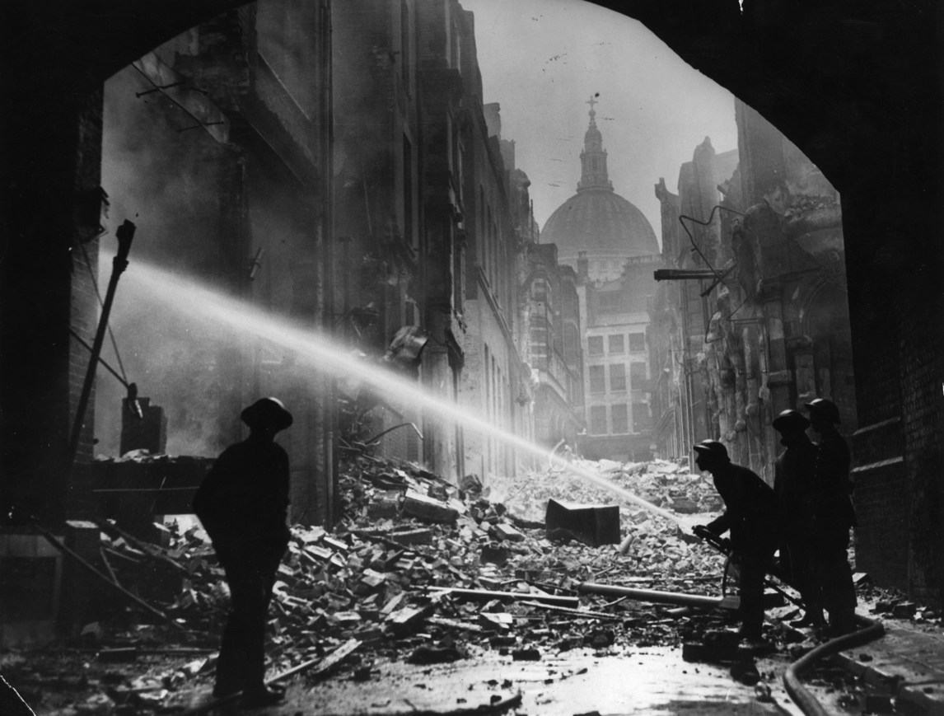
What happened there in World War Two?
During World War Two, children from big cities, such as London and Birmingham, were moved to Cambridge and other smaller towns, so that they would be safe from German bombing.
The Isolation Hospital became the place where these children went if they got sick.
FACTOID
The Germans dropped bombs on London nearly every night in 1940 and 1941! This sustained attack became known as the Blitz.
Photo of London in the aftermath of a German Bomb attack

Slide 13
Discover More
A full report on the building with more pictures, as well as a more in depth explanation of ‘miasma’ and ‘germ’ theories is available here.
http://www.capturingcambridge.org/wp-content/uploads/2015/05/InfectiousDisease.pdf
A simplified understanding of ‘miasma’ theory is available from the Science Museum
http://www.sciencemuseum.org.uk/broughttolife/techniques/miasmatheory
More details on the refugees displaced by World War One can be found at the British Library, with a specific section on Serbian refugees
https://www.bl.uk/world-war-one/articles/refugees-europe-on-the-move
More information on London evacuees, including an account of a young boy who moved from London, to Gwydir Street, cam be found on the BBC.
http://www.bbc.co.uk/history/ww2peopleswar/stories/33/a1070533.shtml

Slide 14

Web Resources available at:
http://www.creatingmycambridge.com/
history-stories

