Slide 1

King’s College Chapel

Slide 2
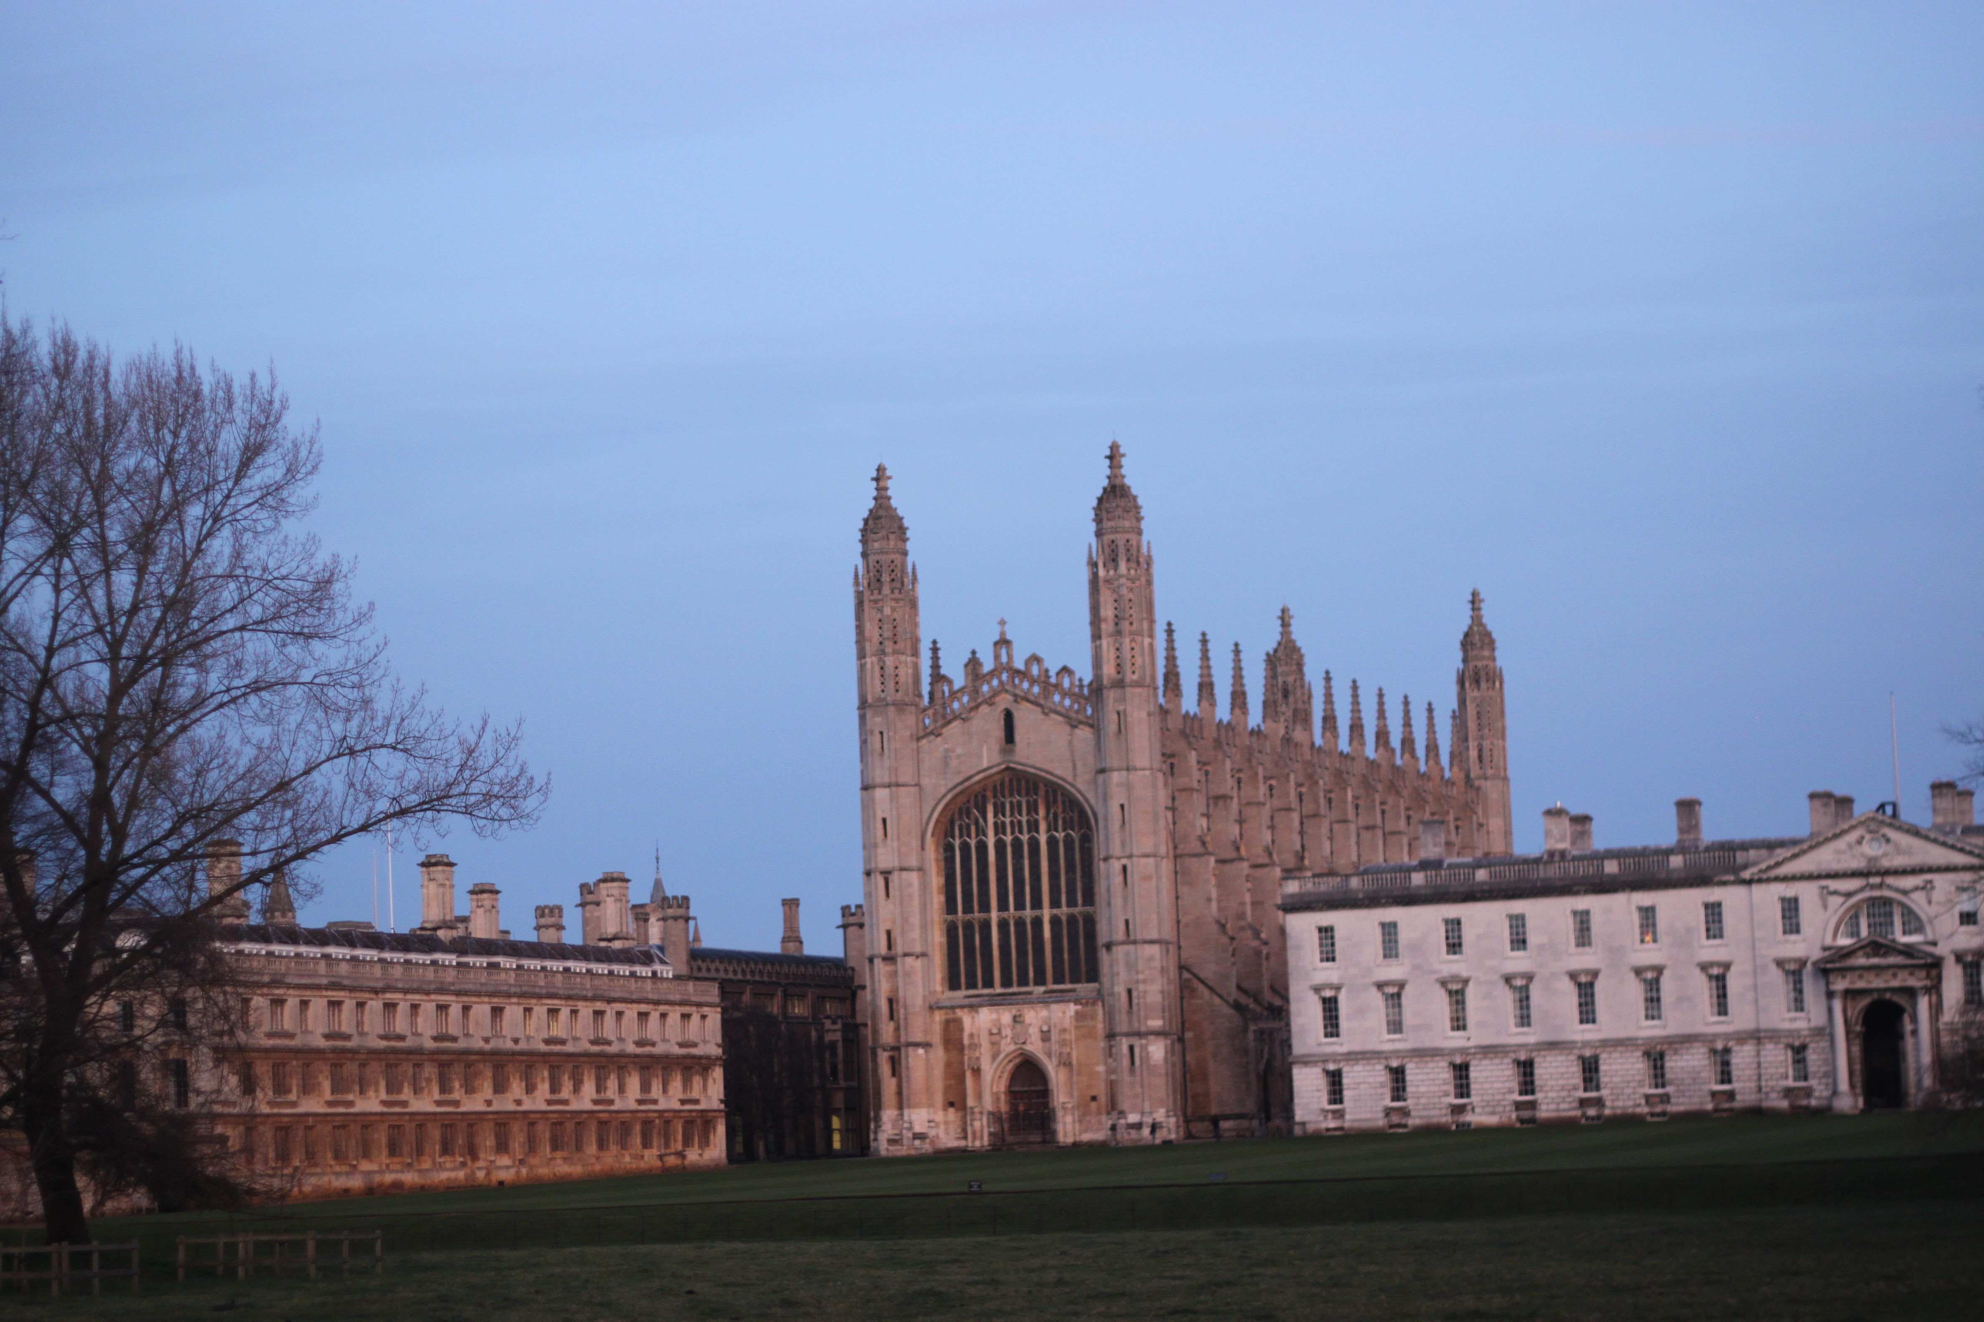
King’s College Chapel
King’s College Chapel is one of the most iconic buildings in Cambridge and took a huge amount of work to complete!.
Photo of King’s from backs
FACTOID!
It look over half a century to complete the Chapel and the reign of three different Kings!

Slide 3
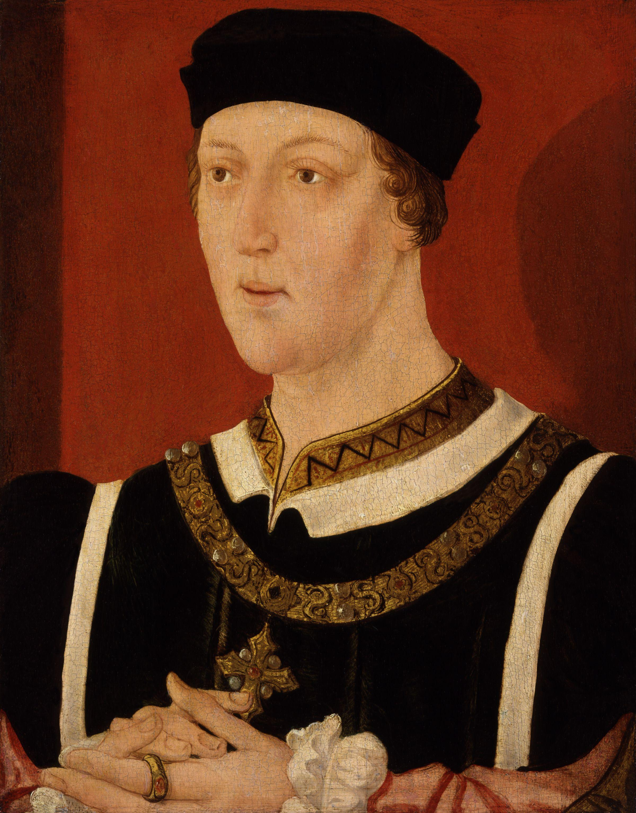
King’s College is Founded by Henry VI
King’s College and its chapel was founded by Henry VI (1421-71), however Henry did not manage to see the completed chapel, as the main structure of the building wasn’t finished until 1515, in the Tudor Period, during the reign of Henry VIII.

Slide 4
The Tudor Rose
Henry VI’s design for King’s College and it’s Chapel had many intricate Tudor Roses on it. The Tudor Rose is the symbol of the Tudor Dynasty.
Can you spot the Tudor Rose when you visit King’s College Chapel?
What other engravings can you find on the Chapel?

Slide 5
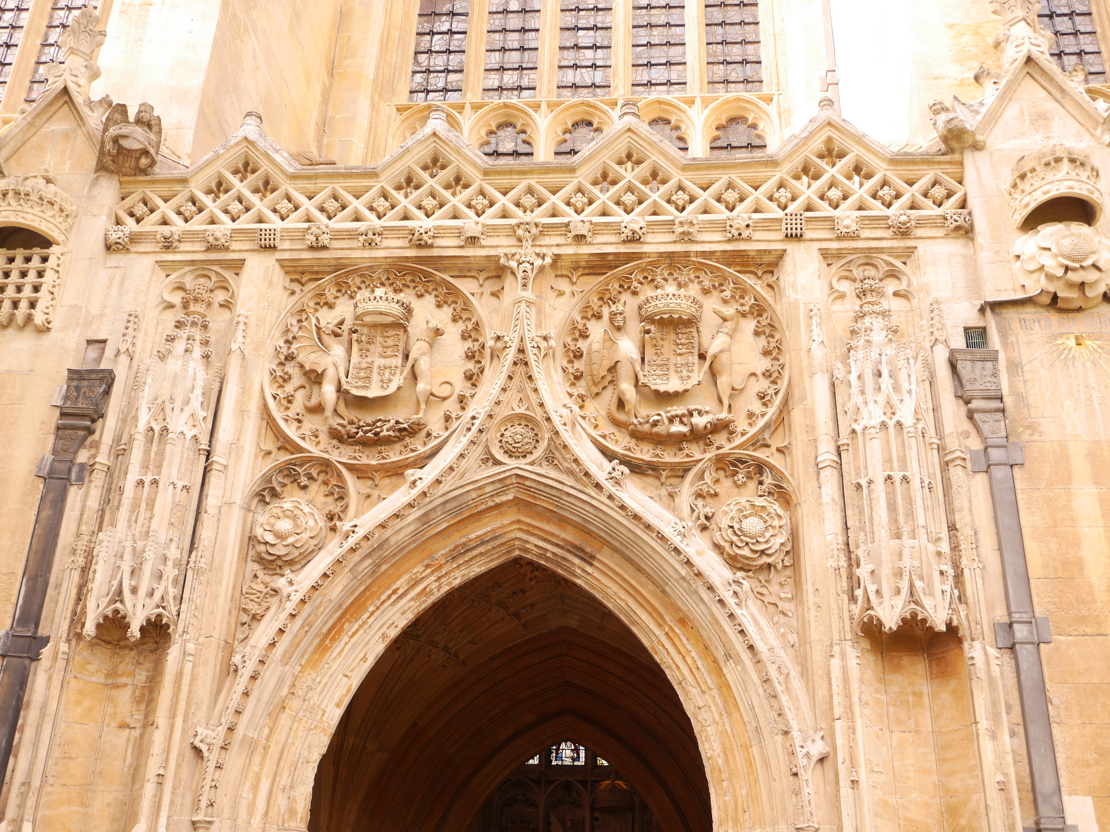
The first stone is laid!
The first stone is believed to have been laid on St. James’ Day on 25th July, 1446 by the king himself; Henry VI. However the construction of the chapel was a very slow process, largely due to funding problems, as Henry VI’s grand designs were very expensive!

Slide 6
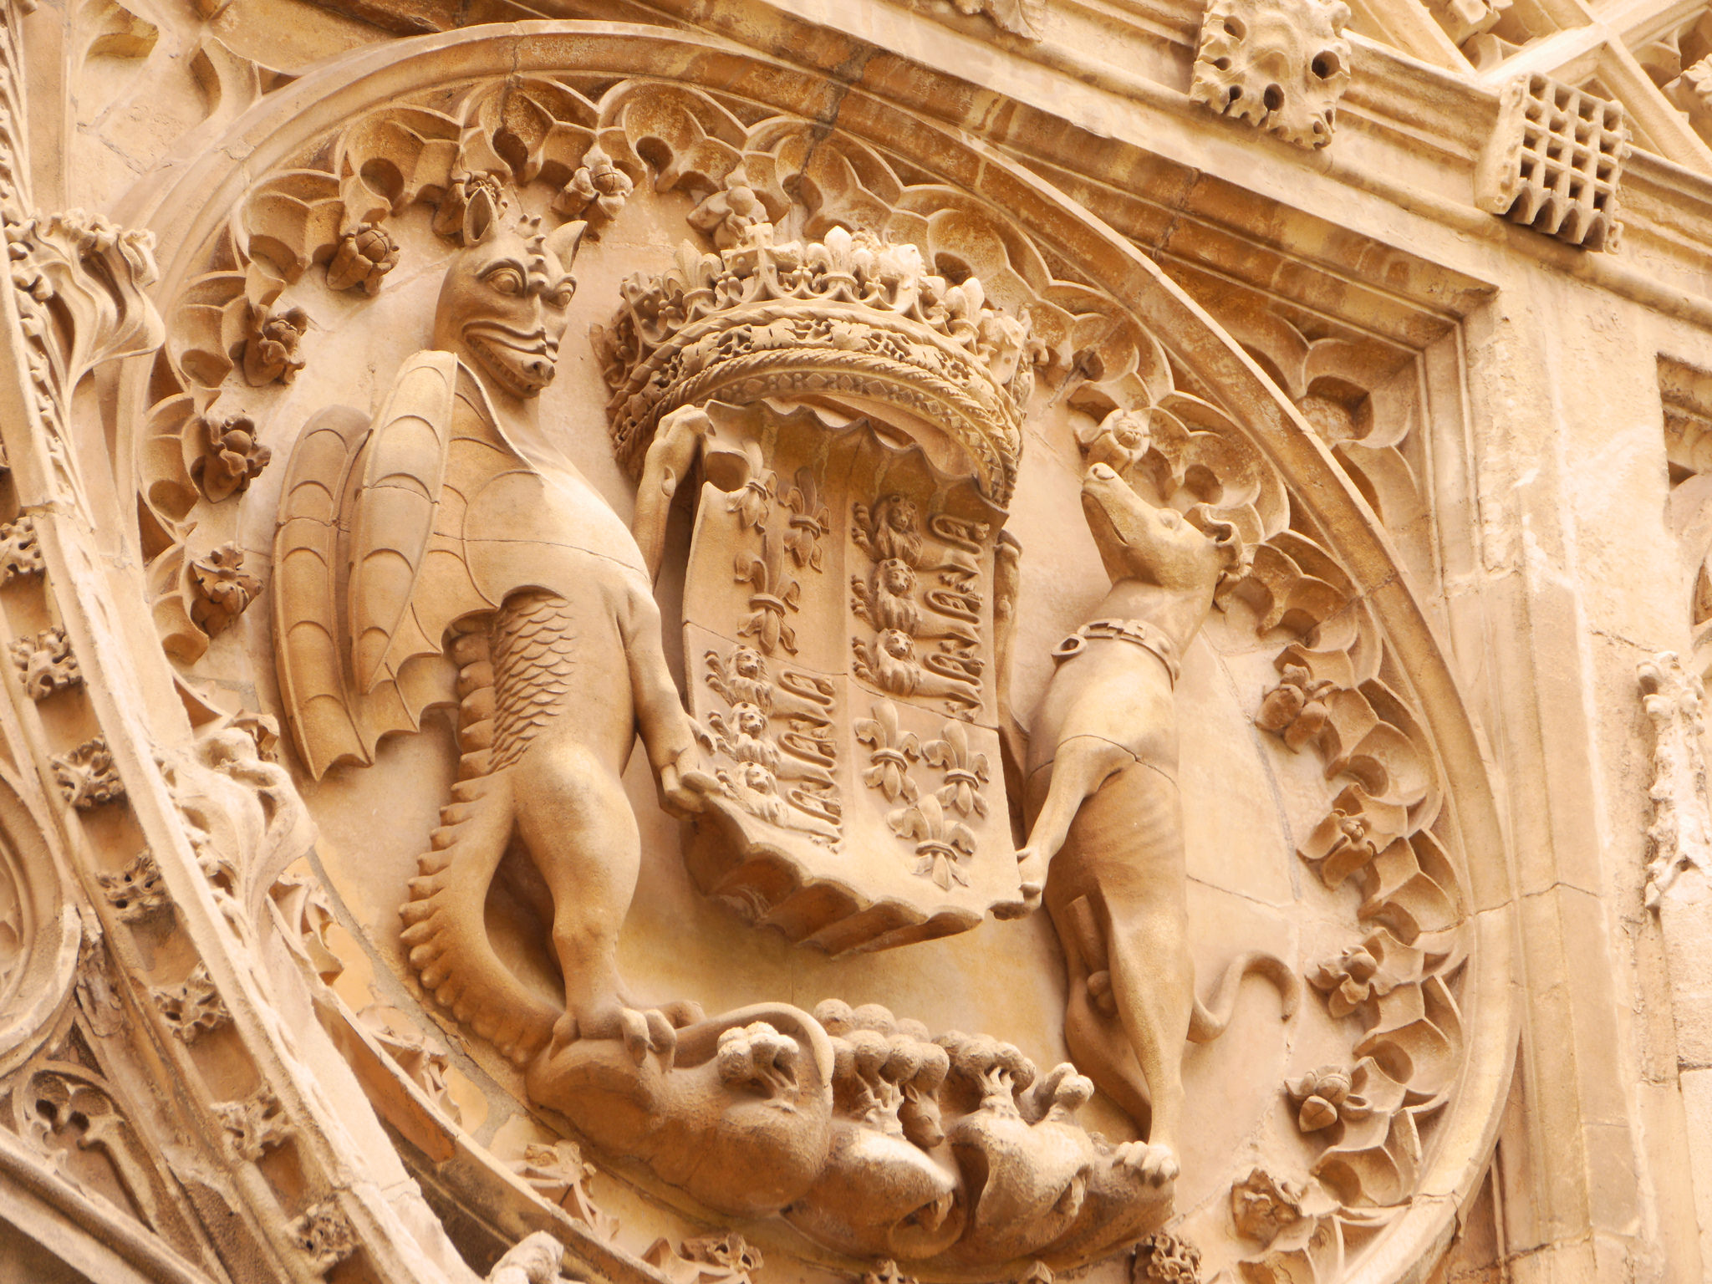
Who’s going to finish the job?!
It was the Tudor king Henry VIII that was left with the job of completing the grand structure of the chapel, that had been started decades before.
FACTOID!
Building work stopped for about 20 years due to a number of wars and funding issues, as Henry VI’s grand designs were very expensive!

Slide 7
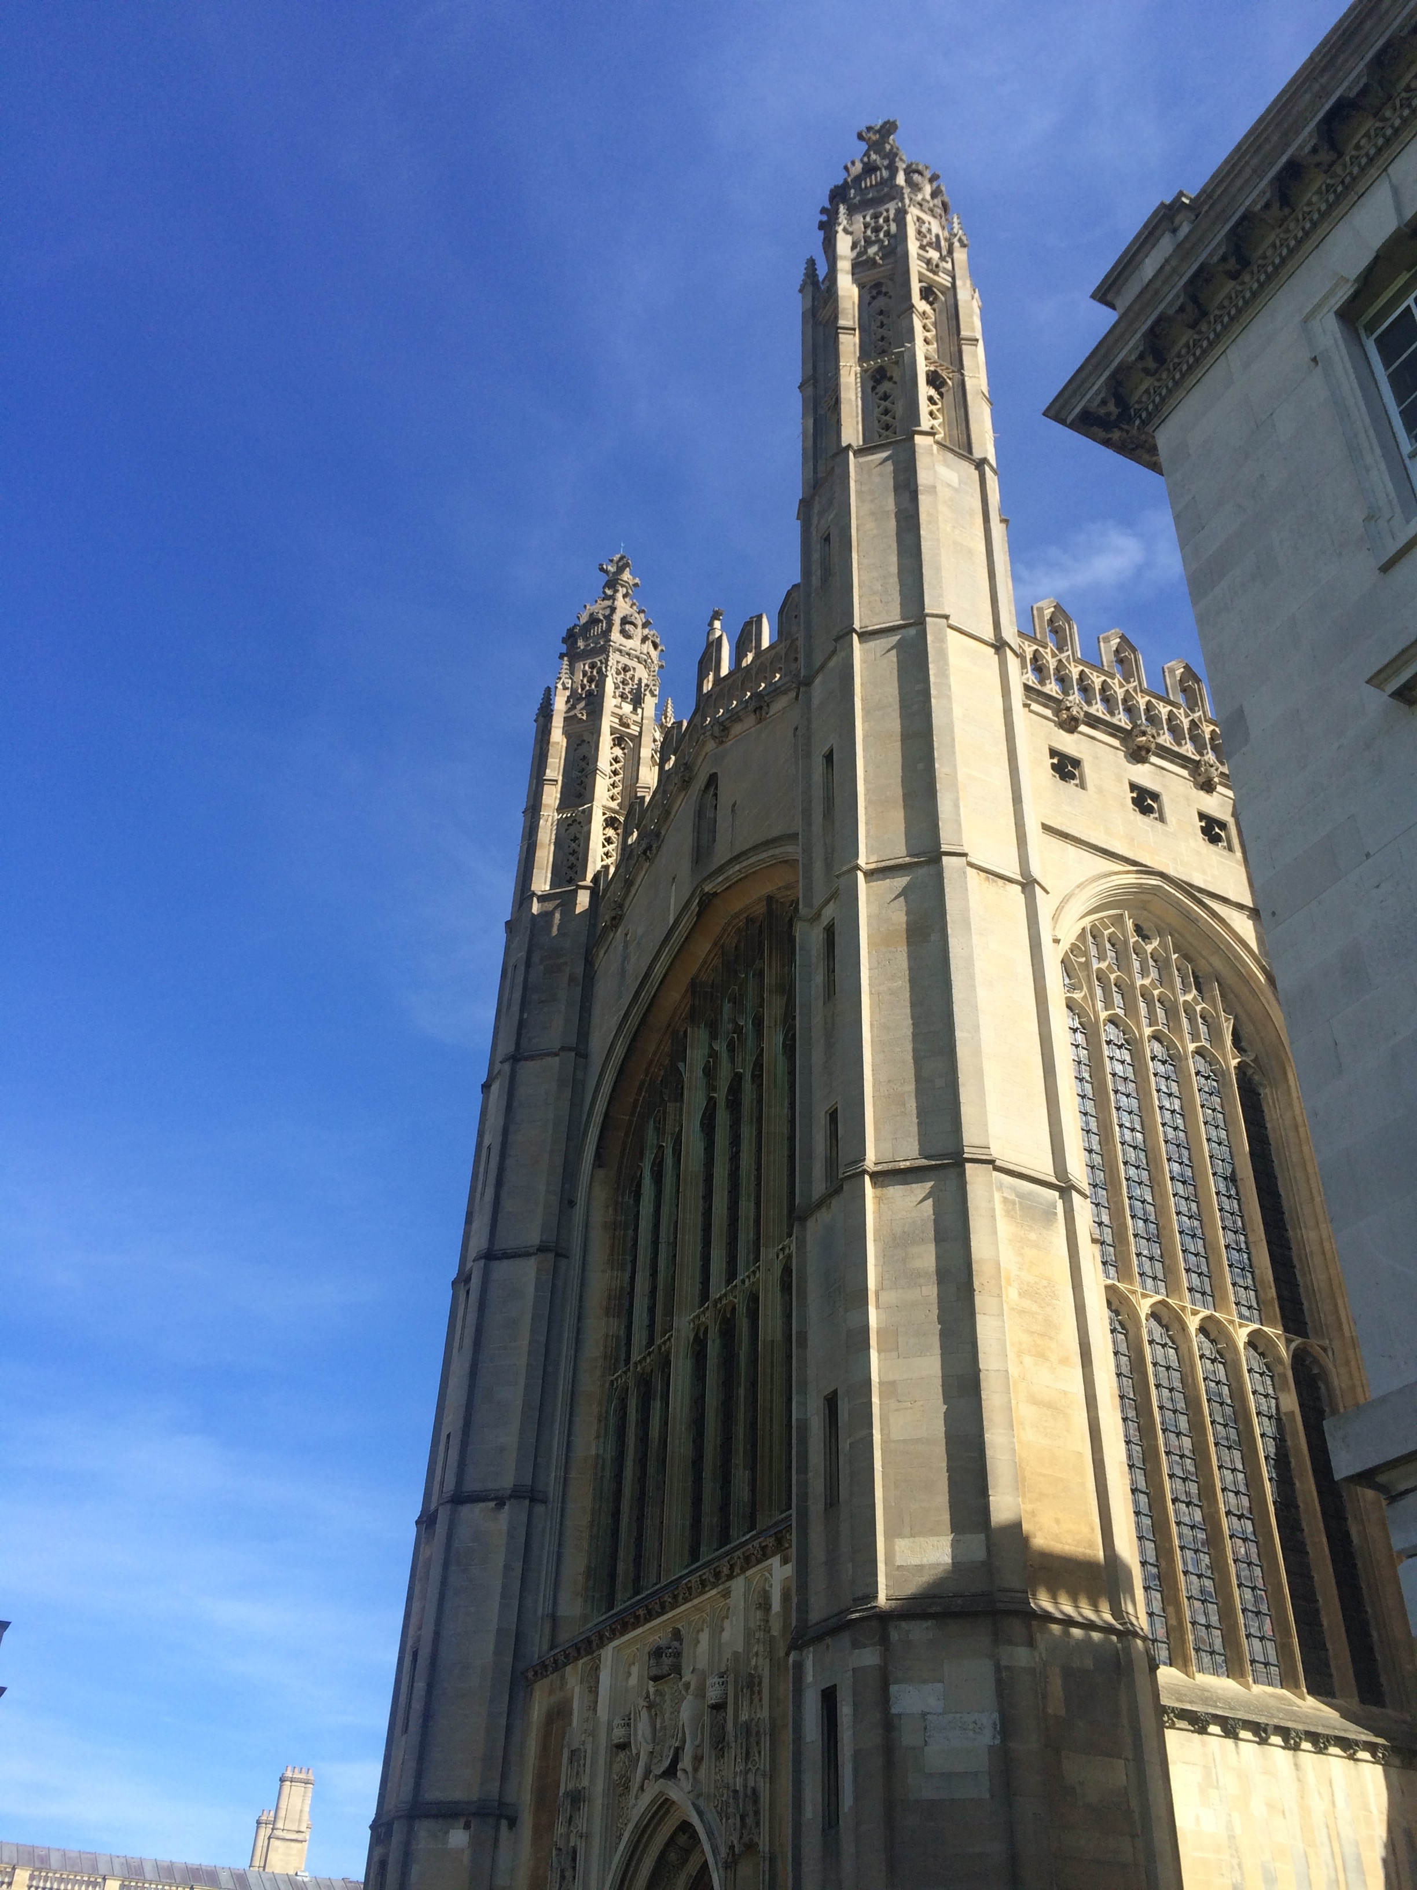
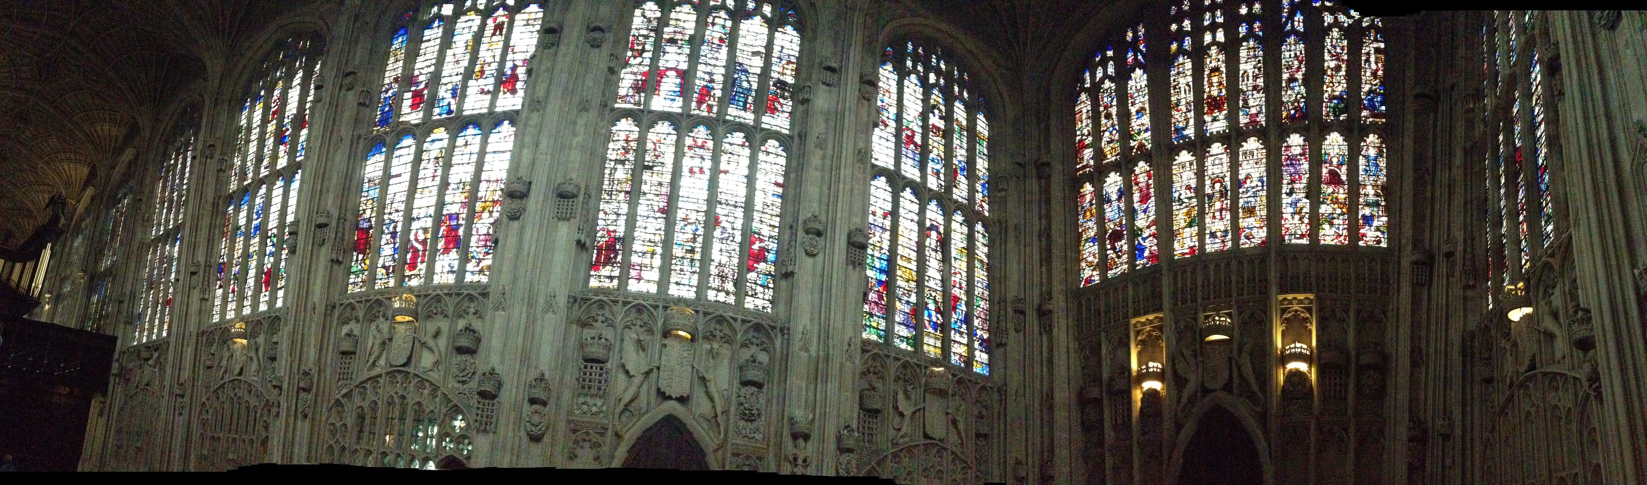
Henry VII gets the job going again!
In 1508 work restarted on a large scale and despite Henry VII death in 1509, money from his will ensured that the building work continued.

Slide 8
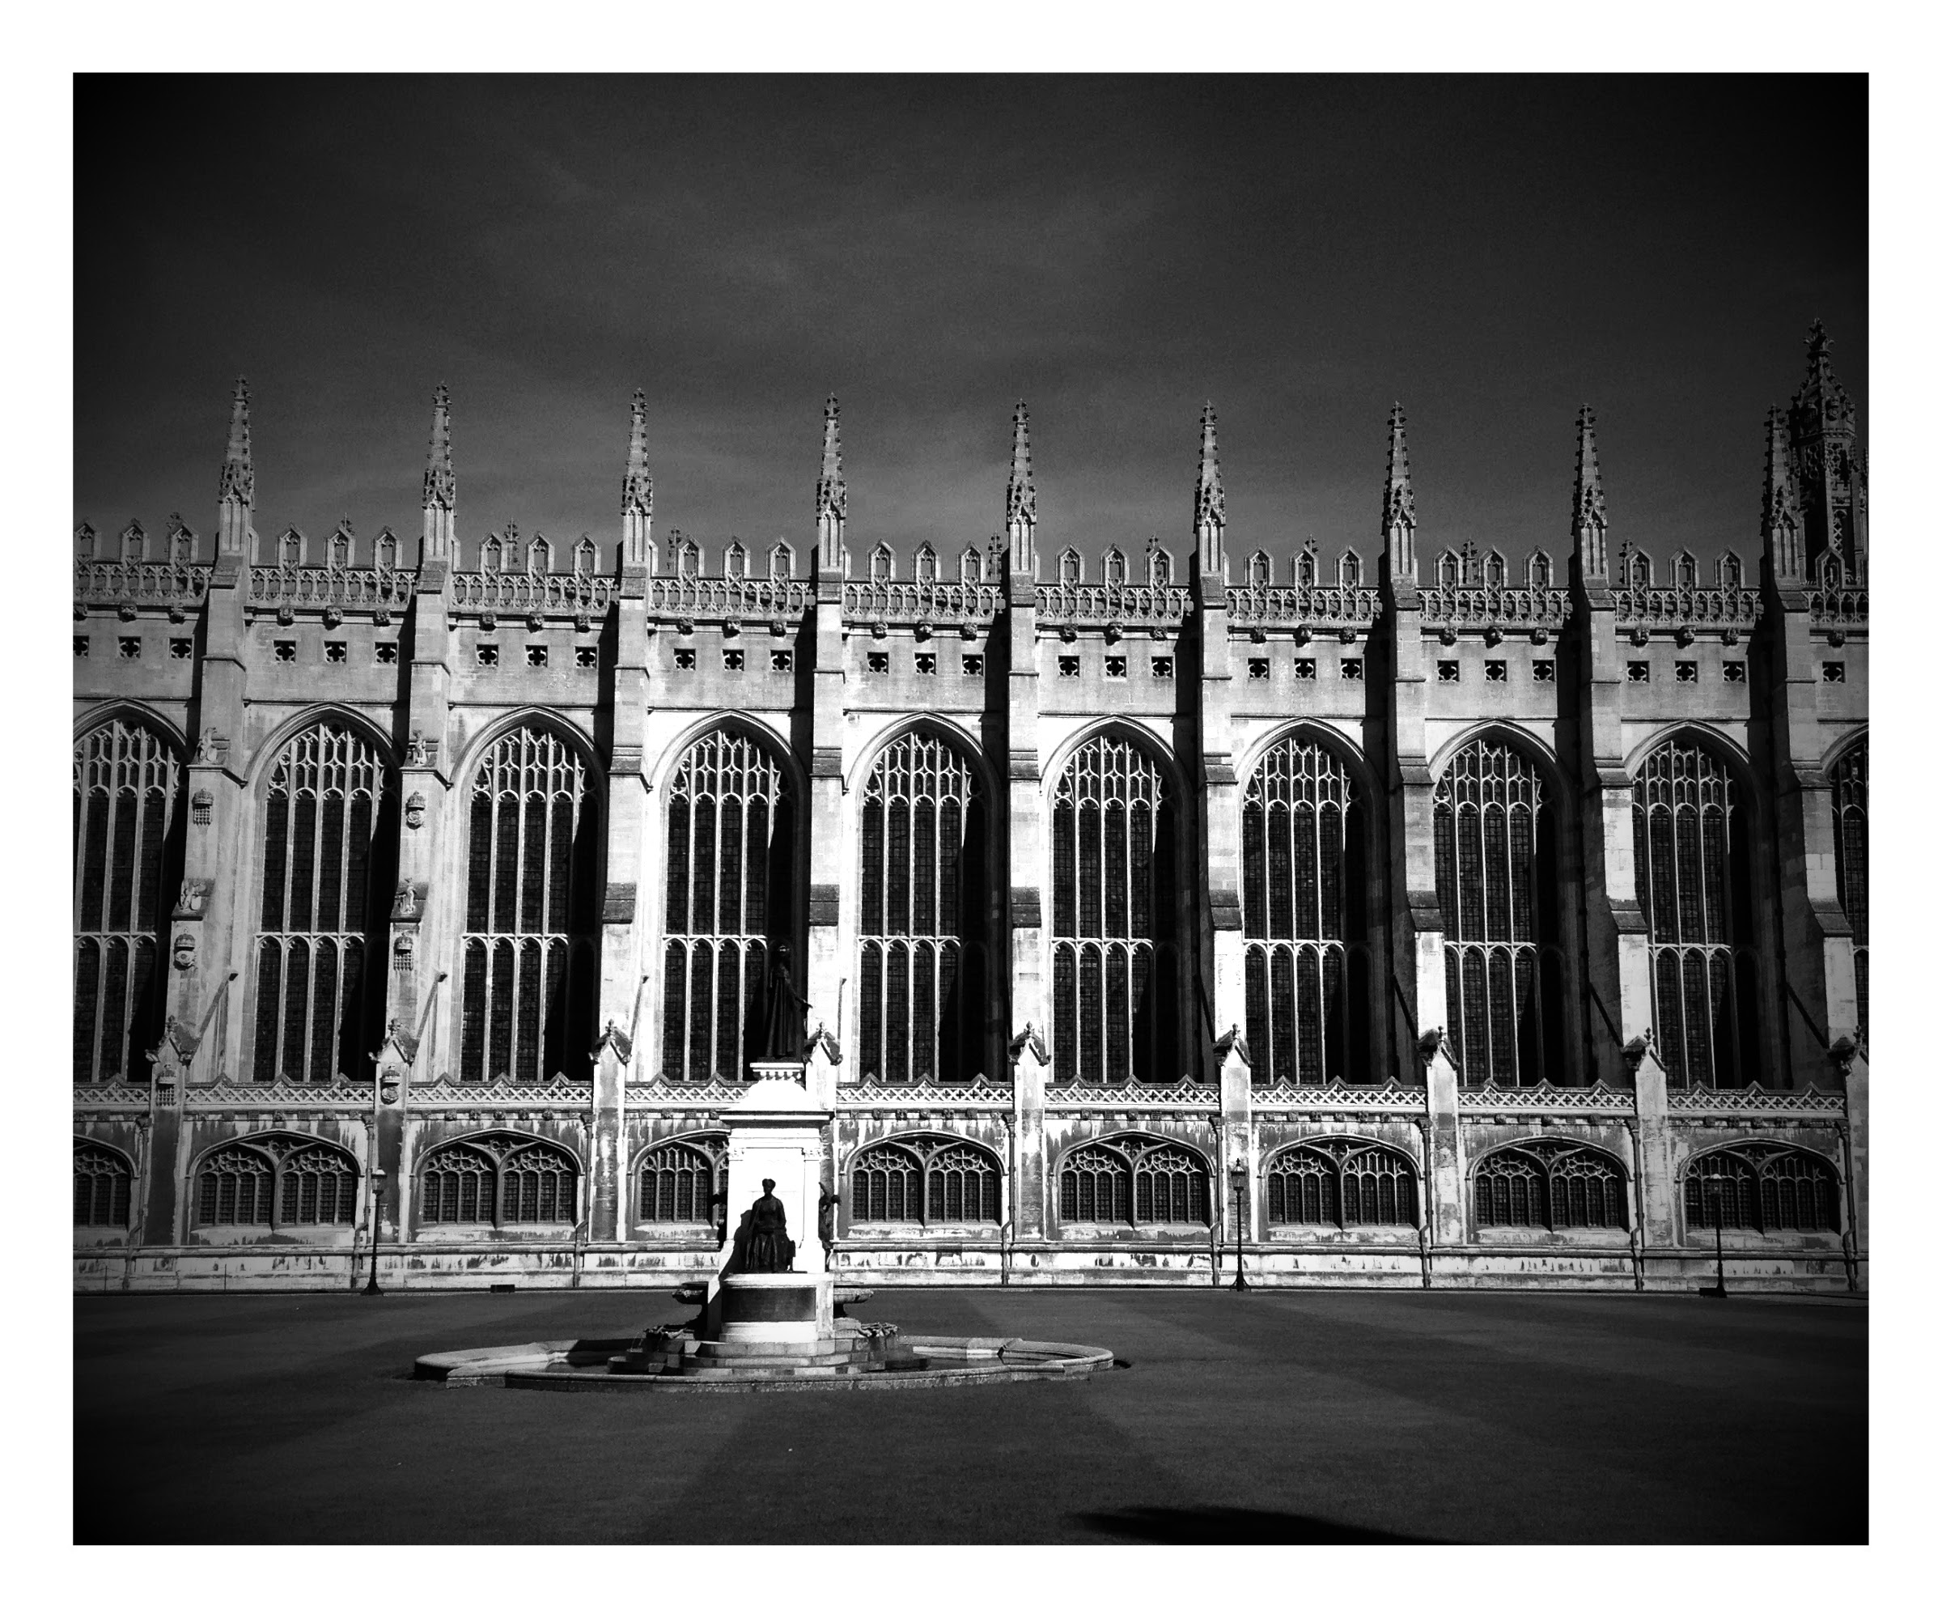
At last we have a Roof!
In 1512 the shell of the chapel was finished, including the whole roof being covered with timber and lead.

Slide 9
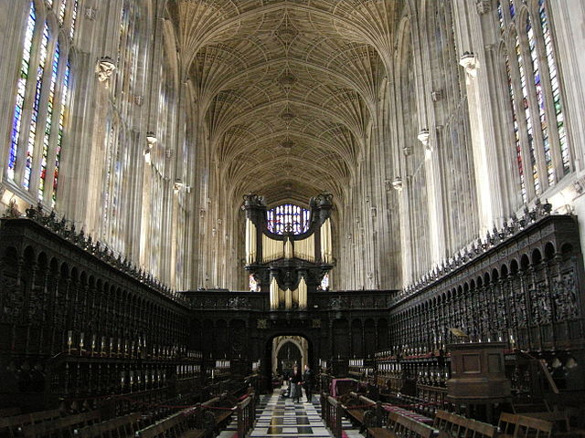
The Incredible Vaulted Ceiling!
The vaulted ceiling, screen, a large amount of the woodwork and the glazing of the windows in the Chapel, were completed during his son; Henry VIII’s reign. The architect John Wastell created the beautiful vaulted ceiling design and it took just three years to complete his impressive design and it is still the largest fan vault ceiling in the world.
Photo of inside King’s College Chapel
The executors of Henry VII also gave £5000 towards paying for the vaulting of the Chapel, which meant that by 1515 the main structure was finally complete!

Slide 10
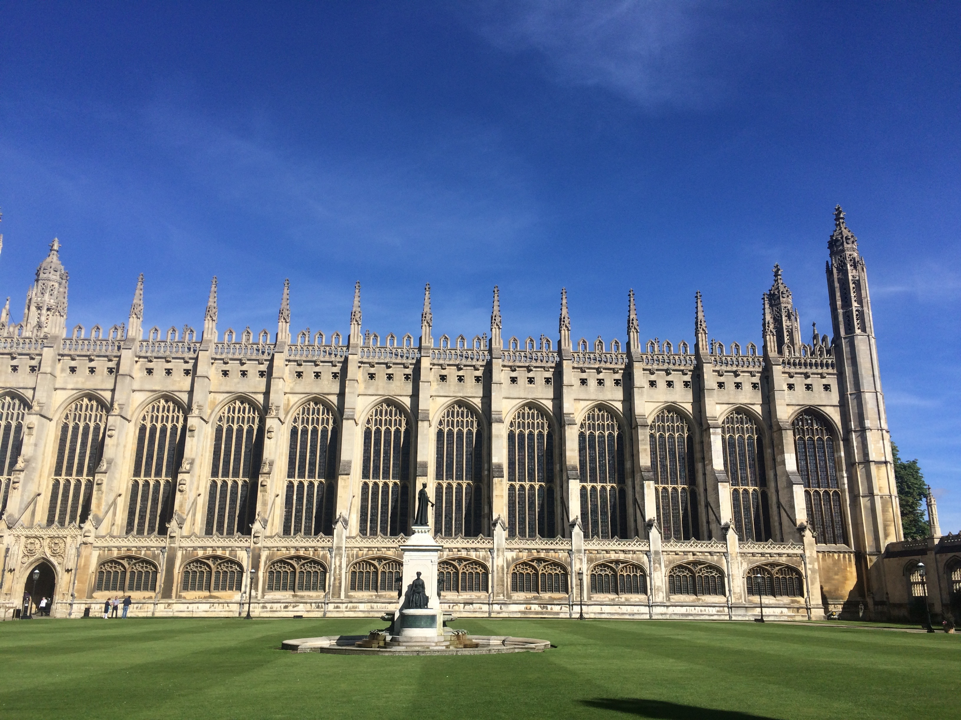
The Chapel is Finally Compete!
Just over one hundred years after the laying of the foundation stone of King’s College Chapel, at the time of Henry VIII’s death in 1547, the Chapel was considered to be one of the grandest and most exquisite buildings in Europe and is still is to this day.

Slide 11
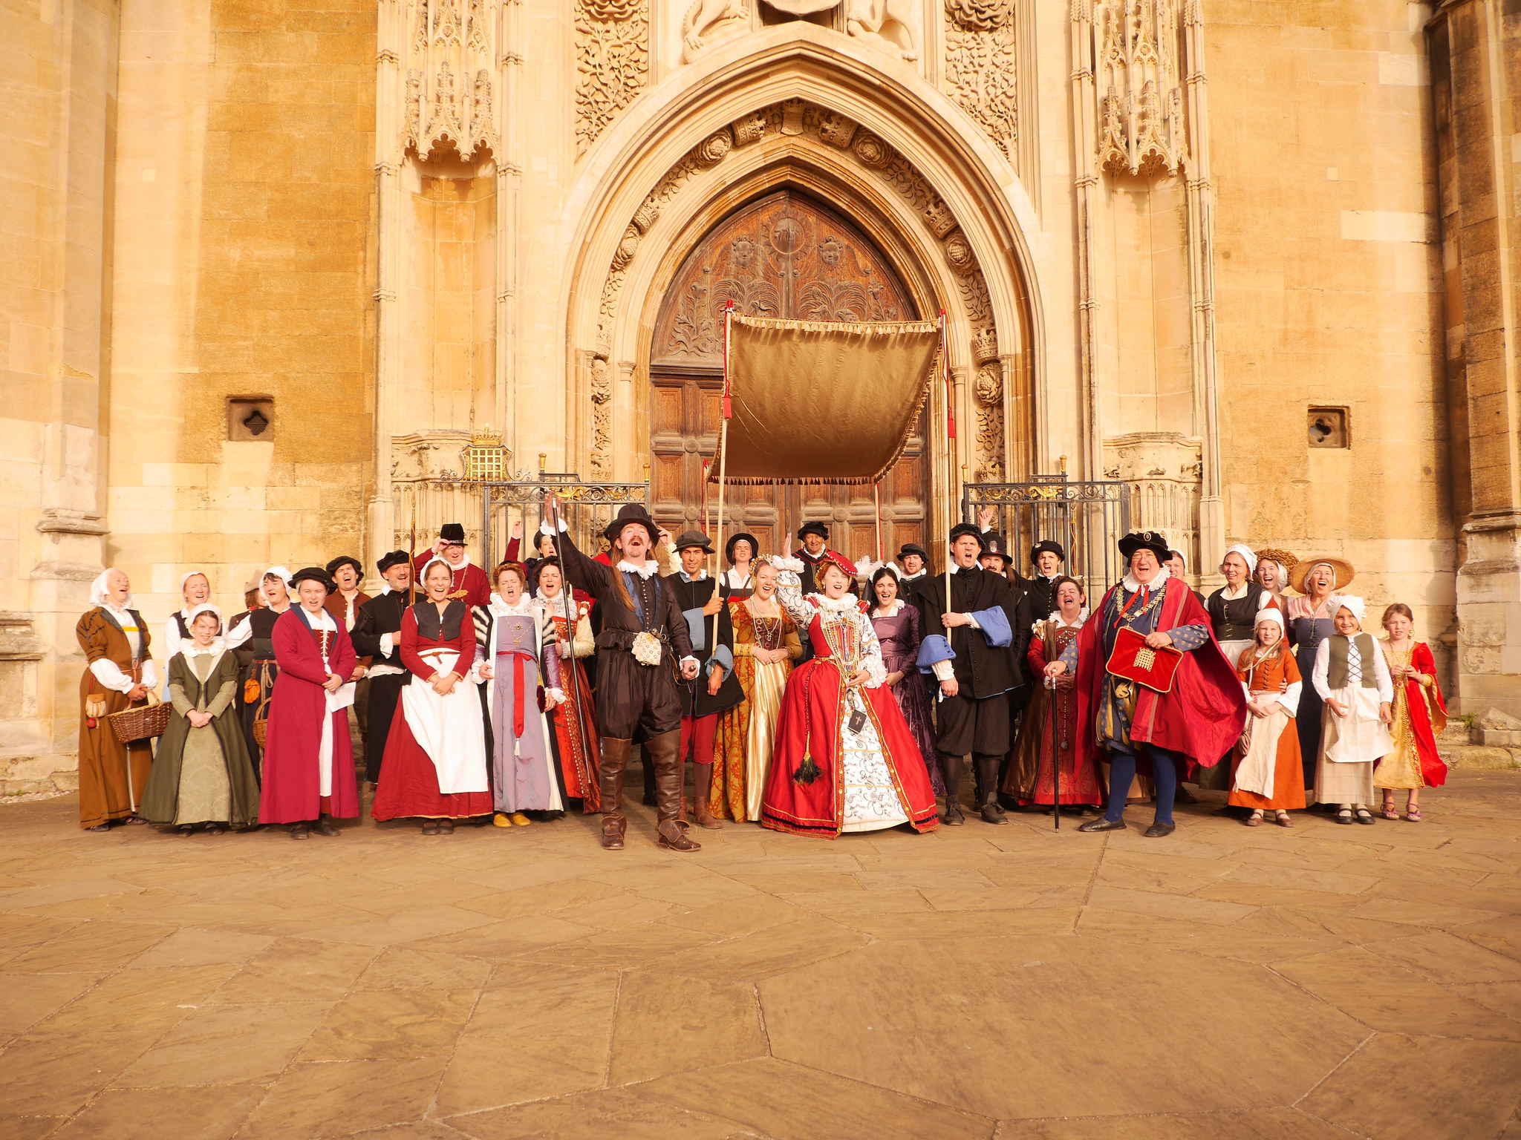
Queen Elizabeth I visits King’s College Chapel
The final Tudor monarch; Elizabeth I also visited King’s College Chapel during her reign, on her only visit to Cambridge in August 1564.
Her visit involved a hectic schedule of events including listening to speeches, sermons, debates and plays.
FACTOID!
Elizabeth cancelled attending a play which had been organised especially for her, because she was so tired from her busy day!

Slide 12
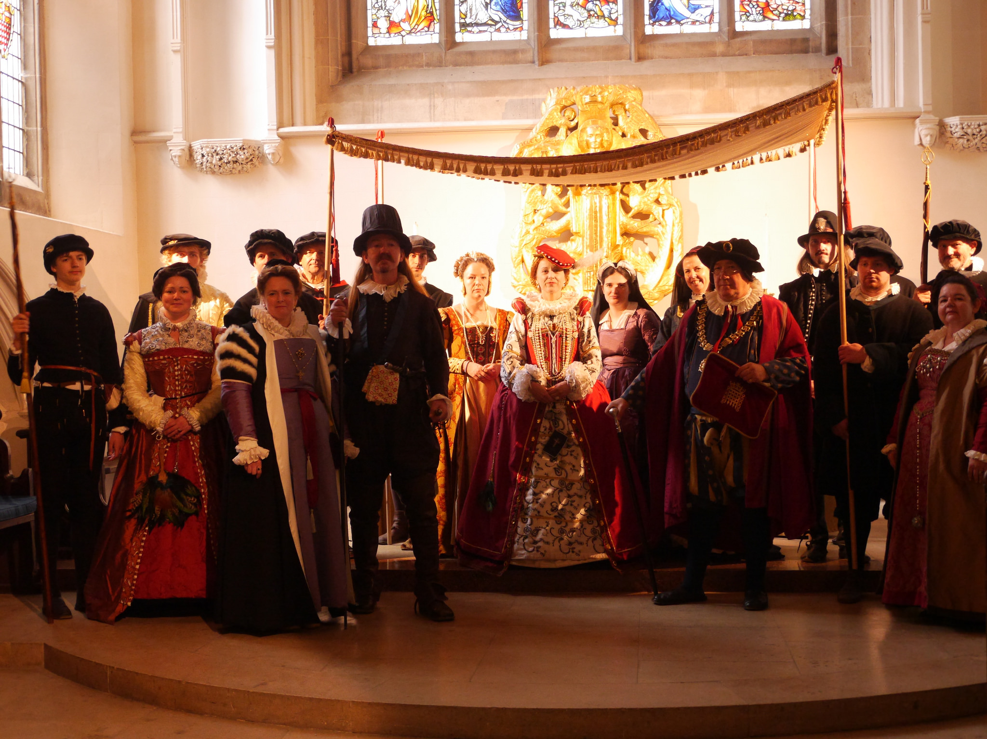
Elizabeth Tours the University
Her visit involved a tour of a number of colleges, including King’s College and St. John’s College, also a visit to Great St. Mary’s Church.
FACTOID!
You can still see one of the gold-tooled manuscripts that was presented to Elizabeth I on her visit, in the Cambridge University Library!

Slide 13
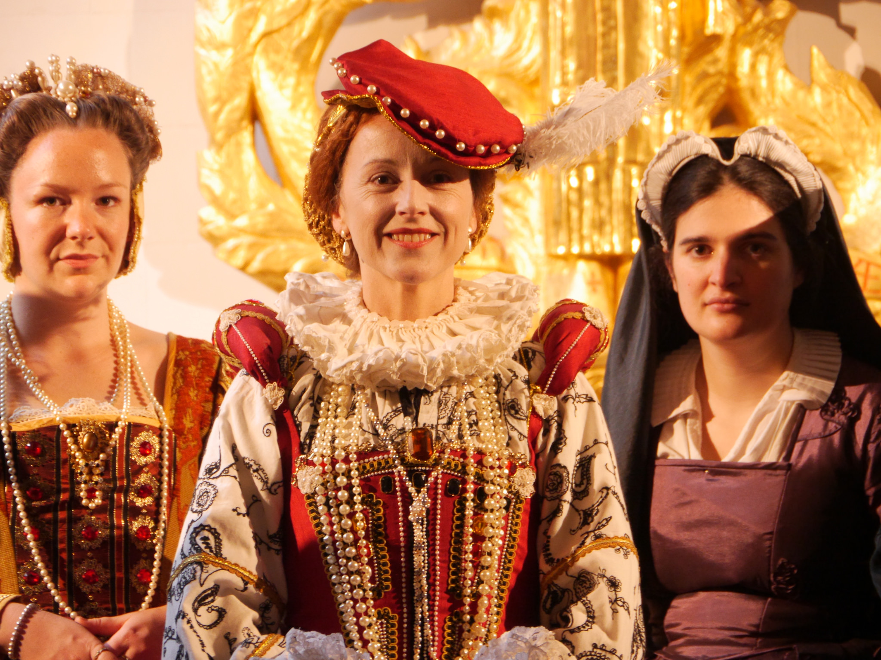
Elizabeth Wows Cambridge Scholars!
FACTOID!
She addressed everyone in Latin in her speeches, which show off how educated she was, and helped her gain respect from all the male Cambridge scholars!

Slide 14
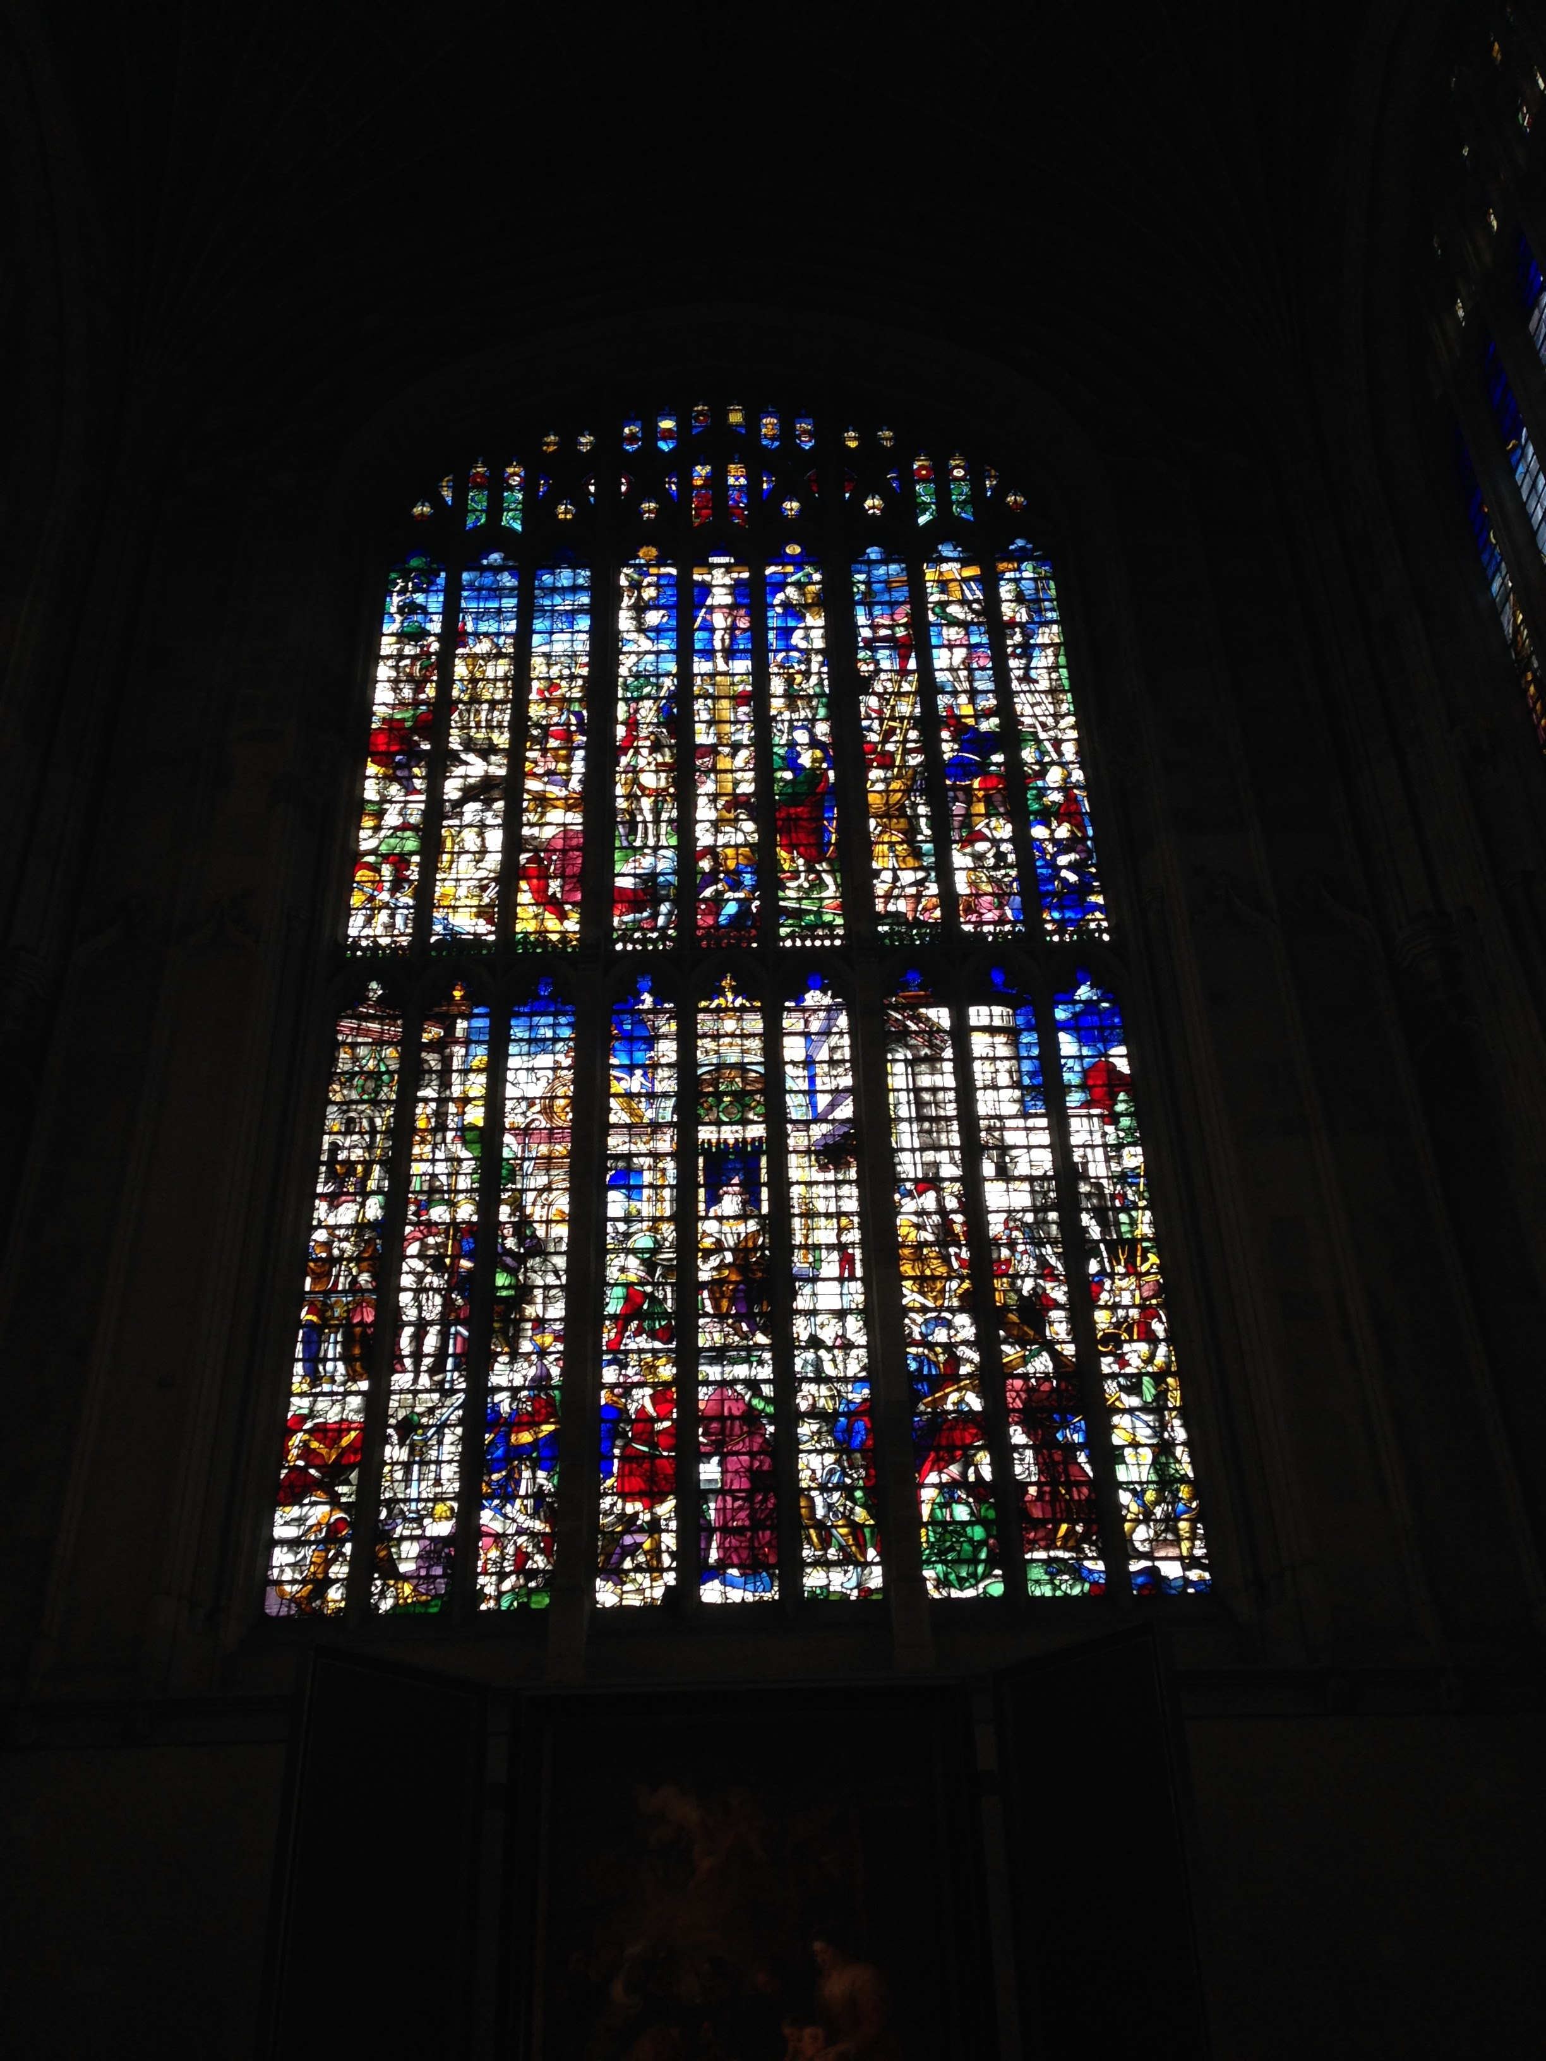
King’s College Chapel
Preserved for Generations
After all the hard work that was put into
completing King’s College Chapel by the Tudor Monarchs, King’s College takes great care in preserving the Chapel as a place of worship for future generations to enjoy.
FACTOID!
In WW2 they removed all the stained glass windows from the Chapel to ensure they didn’t get damaged! It must have been quite a job!

Slide 15
Discover More…
Admission is FREE for Cambridge children under 12 visiting with their family or school. To organise a school visit to the Chapel, contact King's College at: tourism@kings.cam.ac.uk
And for all visitors, the entrance is FREE when going to King's for sung evensong in the Chapel. This is a fantastic experience for all of the family to hear the choristers sing. To find out about concerts and chapel services, you can find the times at: www.kings.cam.ac.uk/chapel/
To find out more about the history of King’s College Chapel visit:
http://www.kings.cam.ac.uk/chapel/history.html
To find out more about Elizabeth I’s visit to King’s College visit: http://www.kings.cam.ac.uk/archive-centre/exhibitions/royal-visit-1564/index.html

Slide 16

Web Resources available at:
http://www.creatingmycambridge.com/history-stories/kings-college/

