Slide 1

THE LEPER CHAPEL

Slide 2
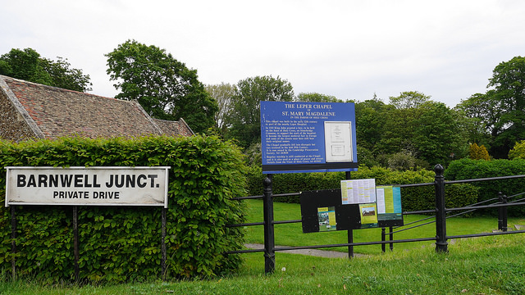
The Leper Chapel
Do you recognise
this sign on
Newmarket Road?
The Leper Chapel of St. Mary Magdalene was built in the
mid 12th Century. It was named after Mary Magdalene, the Patron Saint of Lepers and Leprosy.

Slide 3
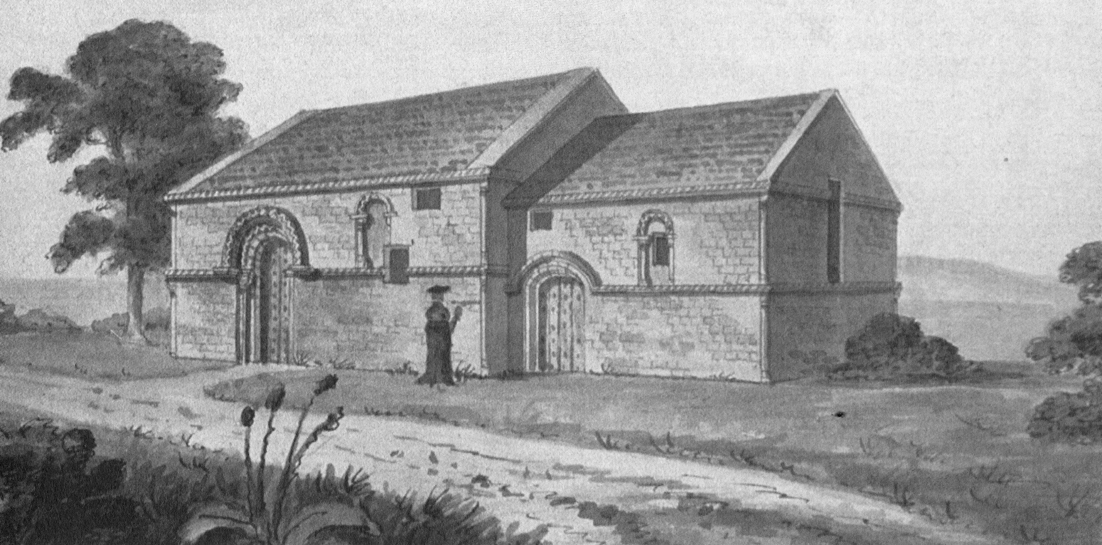
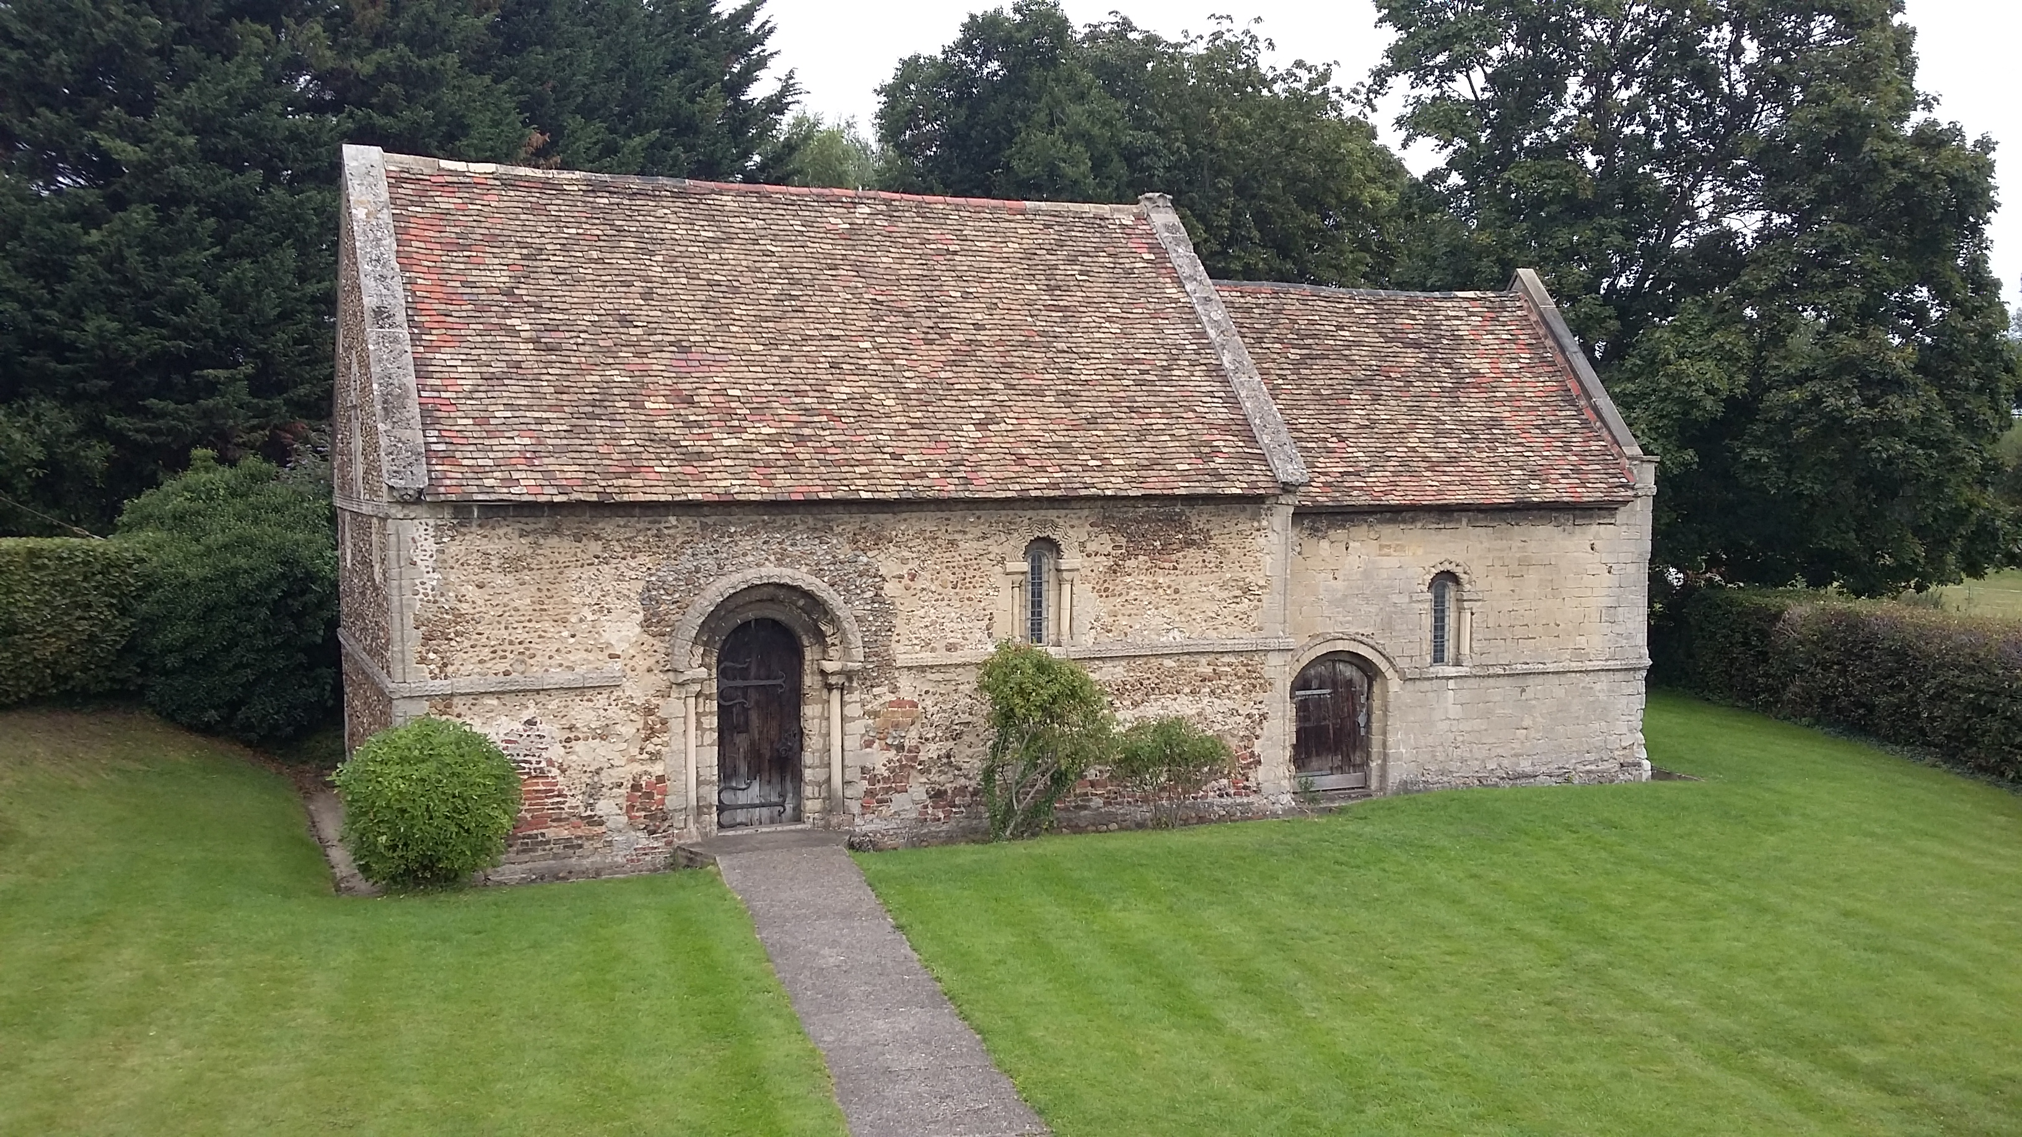
The Leper Chapel
Then
Now
FACTOID!
The leper chapel is the oldest surviving building in the whole of Cambridge and is over 800 years old!
Can you see how
little it’s changed
on the outside since
the 12th Century?

Slide 4
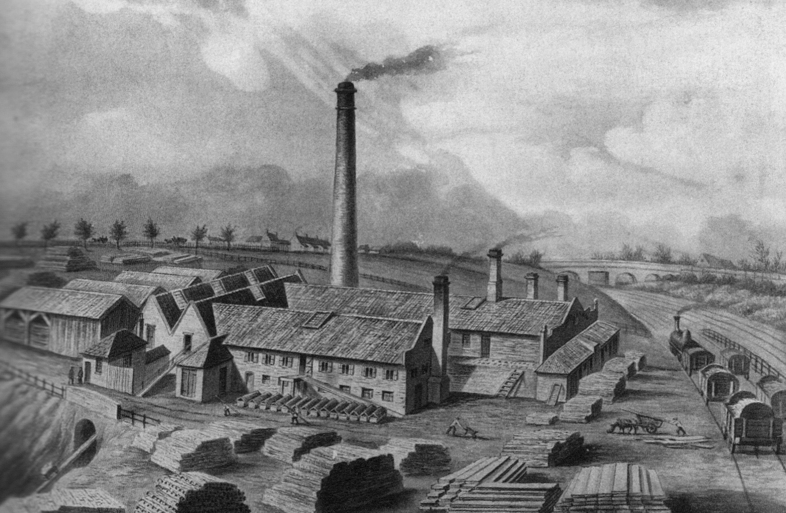
Where Was The Leper Chapel?
Can you see the
Leper Chapel in
the distance?
The Leper Hospital was built on the road linking Newmarket to Cambridge away from the centre of the city of Cambridge.
What else can you
spot in the picture?
Picture of Watts Brick and Timber Yard
on Newmarket Road, seen from
Coldhams Lane from around 1875

Slide 5
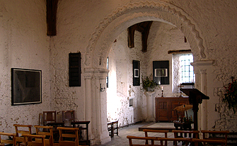
The Leper Hospital
The Leper Chapel is the only remaining building left from the site’s time as a leper hospital.
People were afraid of catching leprosy from other people,
so medieval lepers were kept away from others in their own designated areas. Therefore the leper hospital was built as a place where lepers could pray, farm and live in isolation.
This is a photo of inside the Leper Chapel
which was part of the Leper Hospital

Slide 6
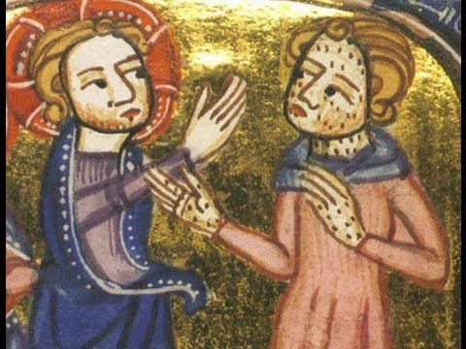
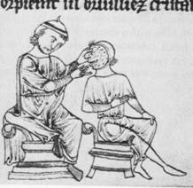
Life Was Hard as a Leper
Can you see the
a leper being treated
for their condition in
and the marks they
had on their bodies
and faces?
Life was difficult as a leper, they were usually very poor people, who had to survive by making a small income from farming which they had to supplement by begging.
When they went out they had to wear clothes that marked them out and had to shout ‘unclean!’ or ring a bell to tell people they were approaching.

Slide 7
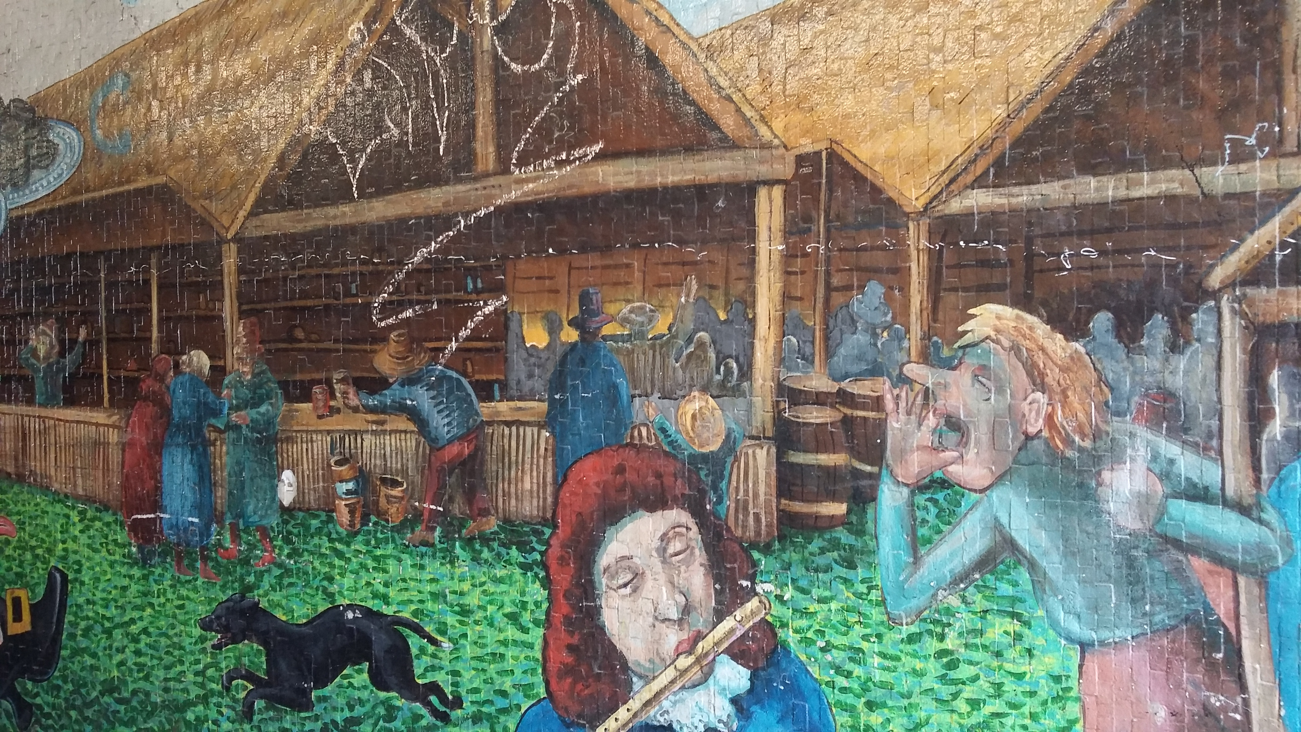
Stourbridge Fair to the Rescue!
In 1211 King John decided that the lepers could use the hospital grounds to hold a fair and keep the profits for themselves. So Stourbridge Fair was born!
Once a year, at the beginning of September the hospital land became the meeting place for local traders to sell their wares.

Slide 8
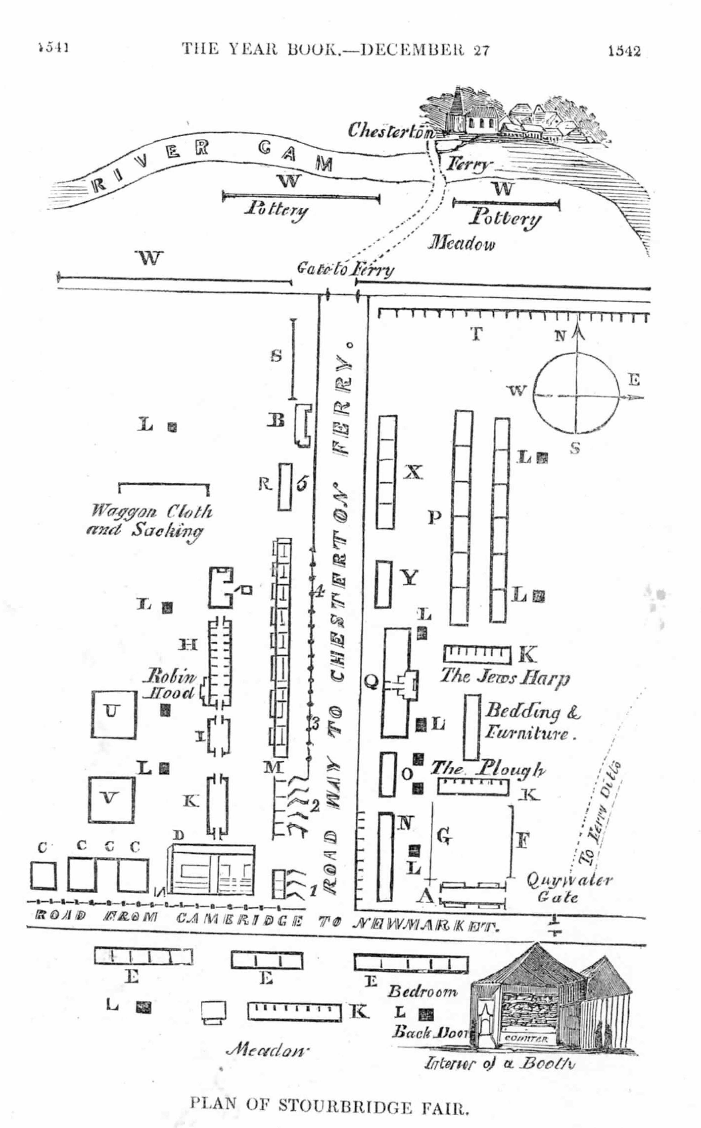
Stourbridge Fair to the Rescue!
The lepers wouldn’t go to the fair, but could charge an entry fee and make money by selling goods and renting out spaces for stalls.
People sold all sorts of things, from pungent cheese and oysters to silks and spices from exotic lands.
Can you spot that street names such as Oyster Row, Garlic Row and Mercer’s Row still exist in the area today?

Slide 9

Web Resources available at www.creatingmycambridge.com

