Slide 1

THE FITZWILLIAM LIONS

Slide 2
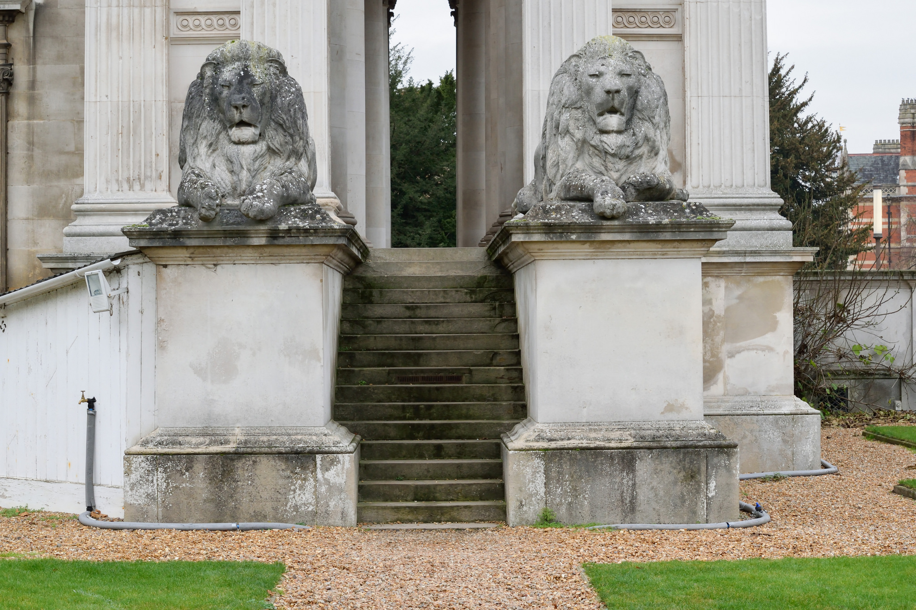
THE FITZWILLIAM LIONS
In 1816, Richard, VII Viscount Fitzwilliam of Merrion donated his library and art collection to the University of Cambridge, as well as £100,000 to construct a building to house them all in. This building is what we now know as the Fitzwilliam Museum in Cambridge.

Slide 3
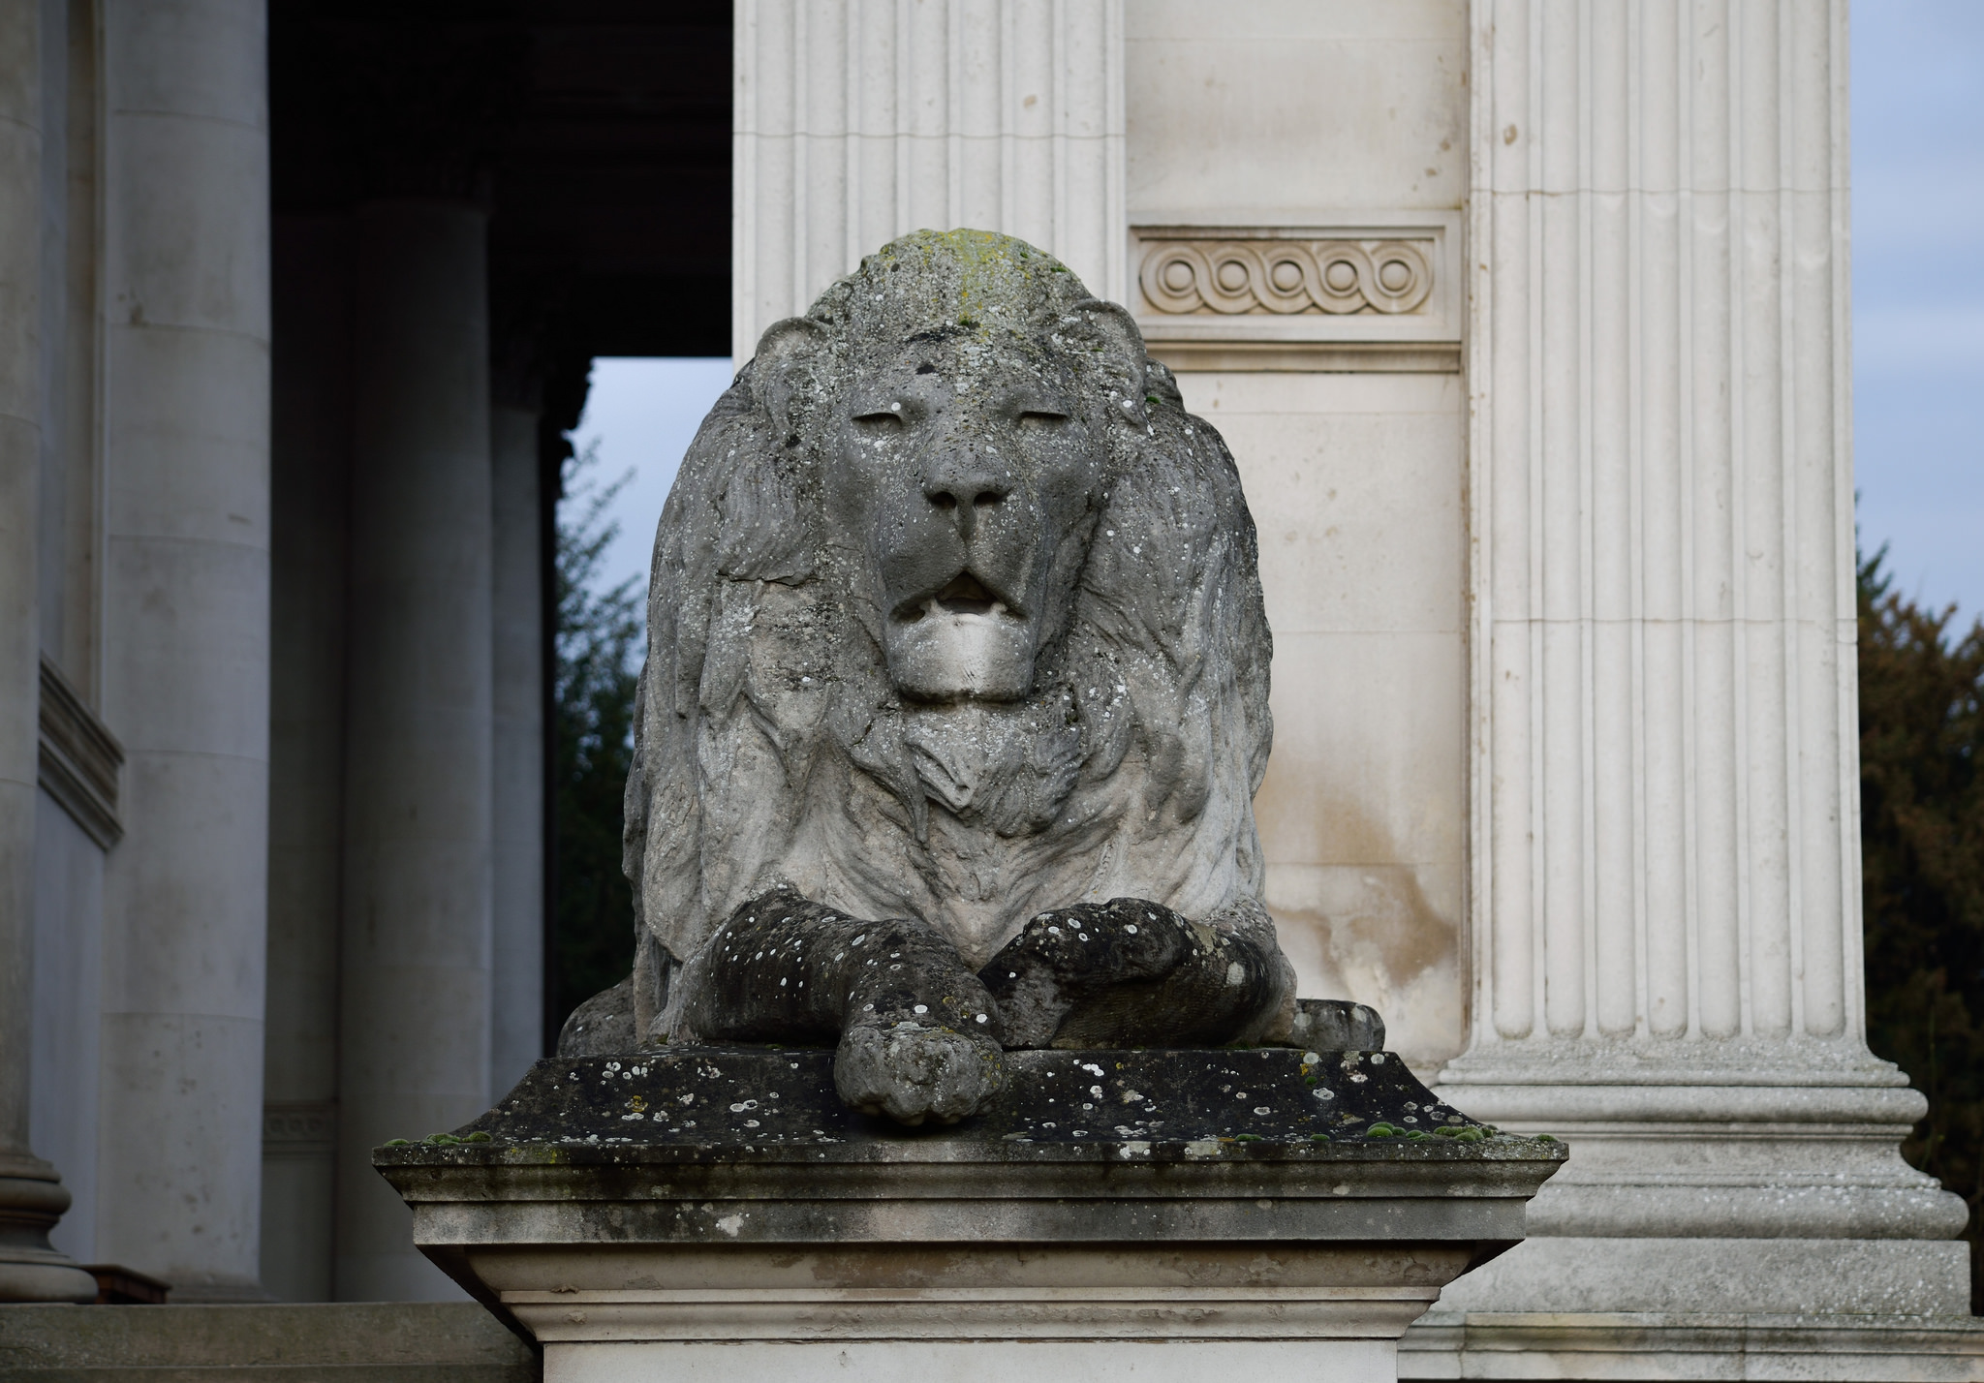
THE FITZWILLIAM LIONS
In 1937 the first stone of the Fitzwilliam Museum was laid.
Two years later, in 1939, William Grinsell Nicholl was commissioned to create the lions that still decorate the outside of the Fitzwilliam Museum today!

Slide 4
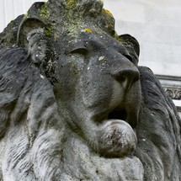
The Fitzwilliam Lions
Come Alive!
The Fitzwilliam Lions have their very own story in folklore. The story goes that when the clock on the church of Our Lady’s and the English Martyr’s Church strikes midnight the lions rise from their plinths and make their way to drink from the gutters in front of the museum on Trumpington Street and sometimes even make it all the way to Hobson’s Conduit.

Slide 5
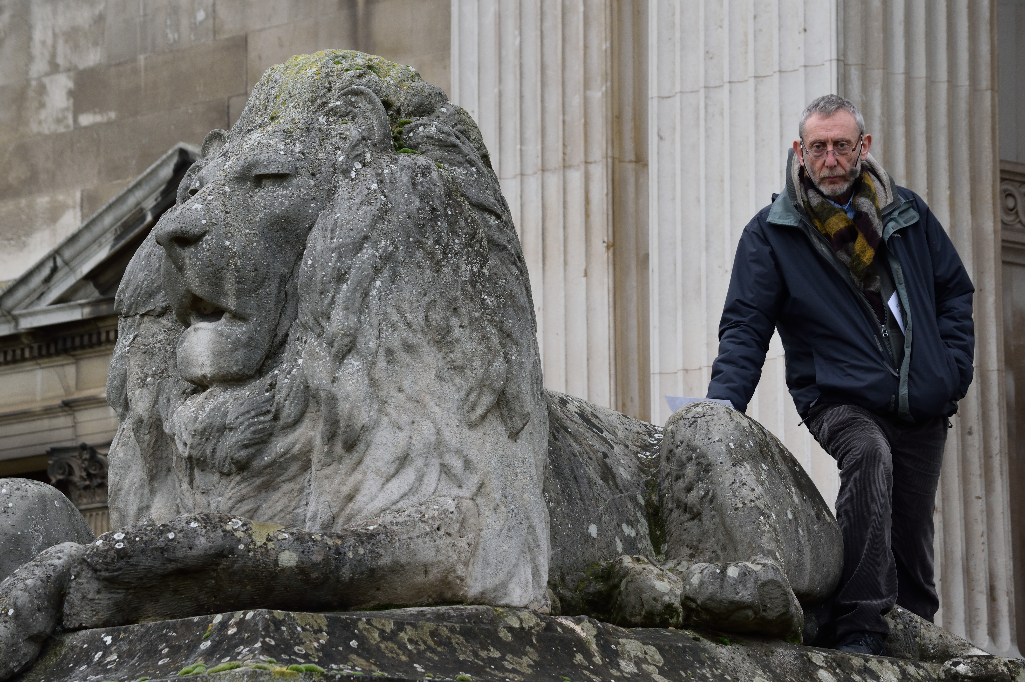
THE FITZWILLIAM LIONS
Michael Rosen wrote a poem inspired by this story about what the lions might see and hear outside the museum, which was then arranged into a song by Kirsty Martin.

Slide 6
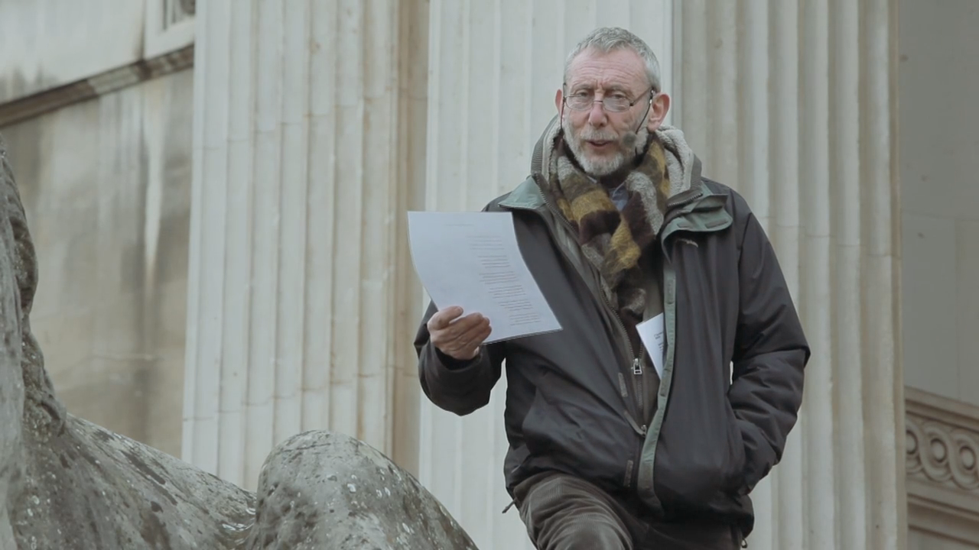
Michael Rosen Talking About his Inspiration for the Listening Lions Poem

Slide 7
LISTENING LIONS SONG
CHORUS
We are the Listening Lions
We hear you walking the steps of the Fitz
Your voices come and go
What you say is what we know

Slide 8
LISTENING LIONS SONG
REFRAIN
Trip-trap, amble, clamber or run
We are the Listening Lions - ROAR!

Slide 9
LISTENING LIONS SONG
VERSE 1
We hear your feet on the steps
We hear you moan about the weather
We hear you laugh when you see the sun - ROAR!

Slide 10
LISTENING LIONS SONG
VERSE 2
We hear you talk of war and peace
We hear you pockets full or empty
what you say is what we know - ROAR!

Slide 11
LISTENING LIONS SONG
VERSE 3
We hear you whisper, We hear you sigh
We hear the hug of hope and the smile of pride
We hear the hug of hope and the smile of pride

Slide 12
LISTENING LIONS SONG
VERSE 4
We hear you studying our faces
We hear you wonder if we slumber
Like lions hunting in far-off places - ROAR!

Slide 13
LISTENING LIONS SONG
VERSE 5
And we are dreaming of other times
We hear a dream of how we rise
and breathe in the living air - ROAR!

Slide 14
LISTENING LIONS SONG
VERSE 6
And we all four together
walk the street, none last or first
to find the water
to help us quench this terrible thirst - ROAR!

Slide 15
The Fitz Trip Trap Round
Trip-trap, Amble, Clamber or Run
We are the Listening Lions! ROAR!

Slide 16

Web Resources available at:
www.creatingmycambridge.com/history-stories/
lions-fitzwilliam-museum

