Slide 1

MAGDALENE BRIDGE

Slide 2
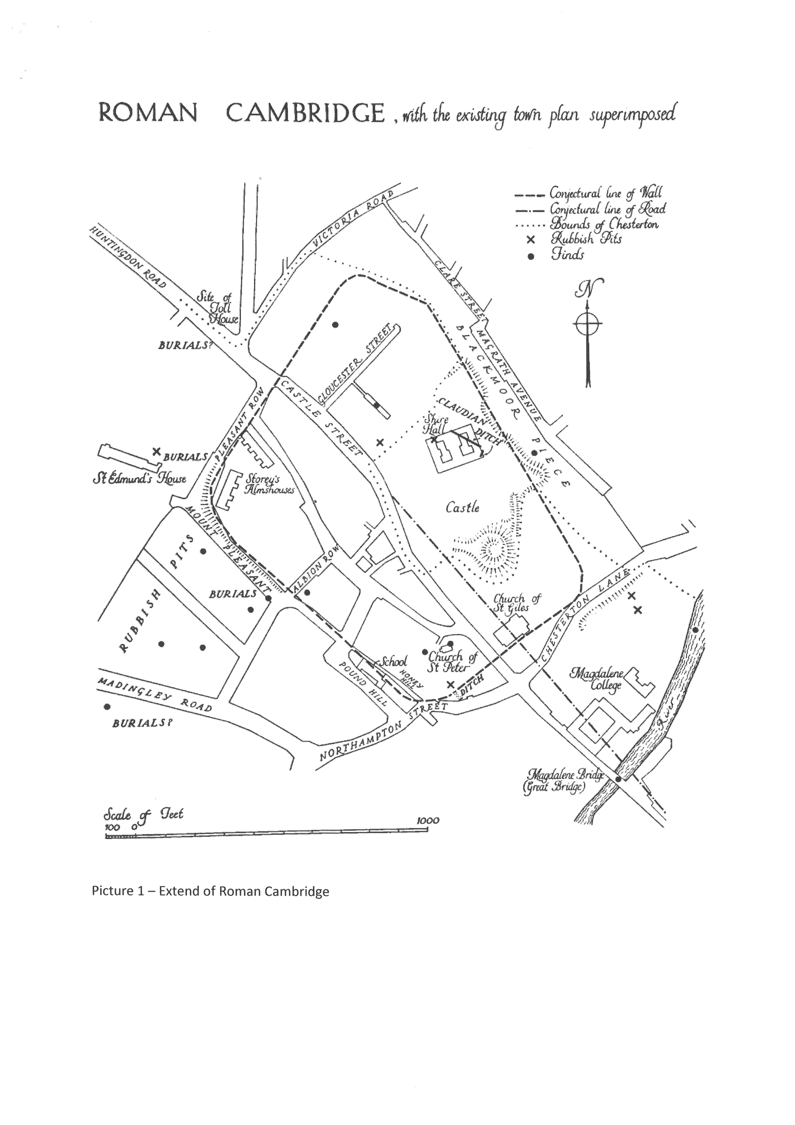
Cambridge’s Important Position on the River Cam
Can you spot the
River Cam and
Magdalene Bridge
on the map of
Roman Cambridge?
During Roman times, the River
Cam was fully navigable from the
Wash as far as Cambridge and was the northernmost point where transport from
East Anglia to the Midlands was
practicable.

Slide 3
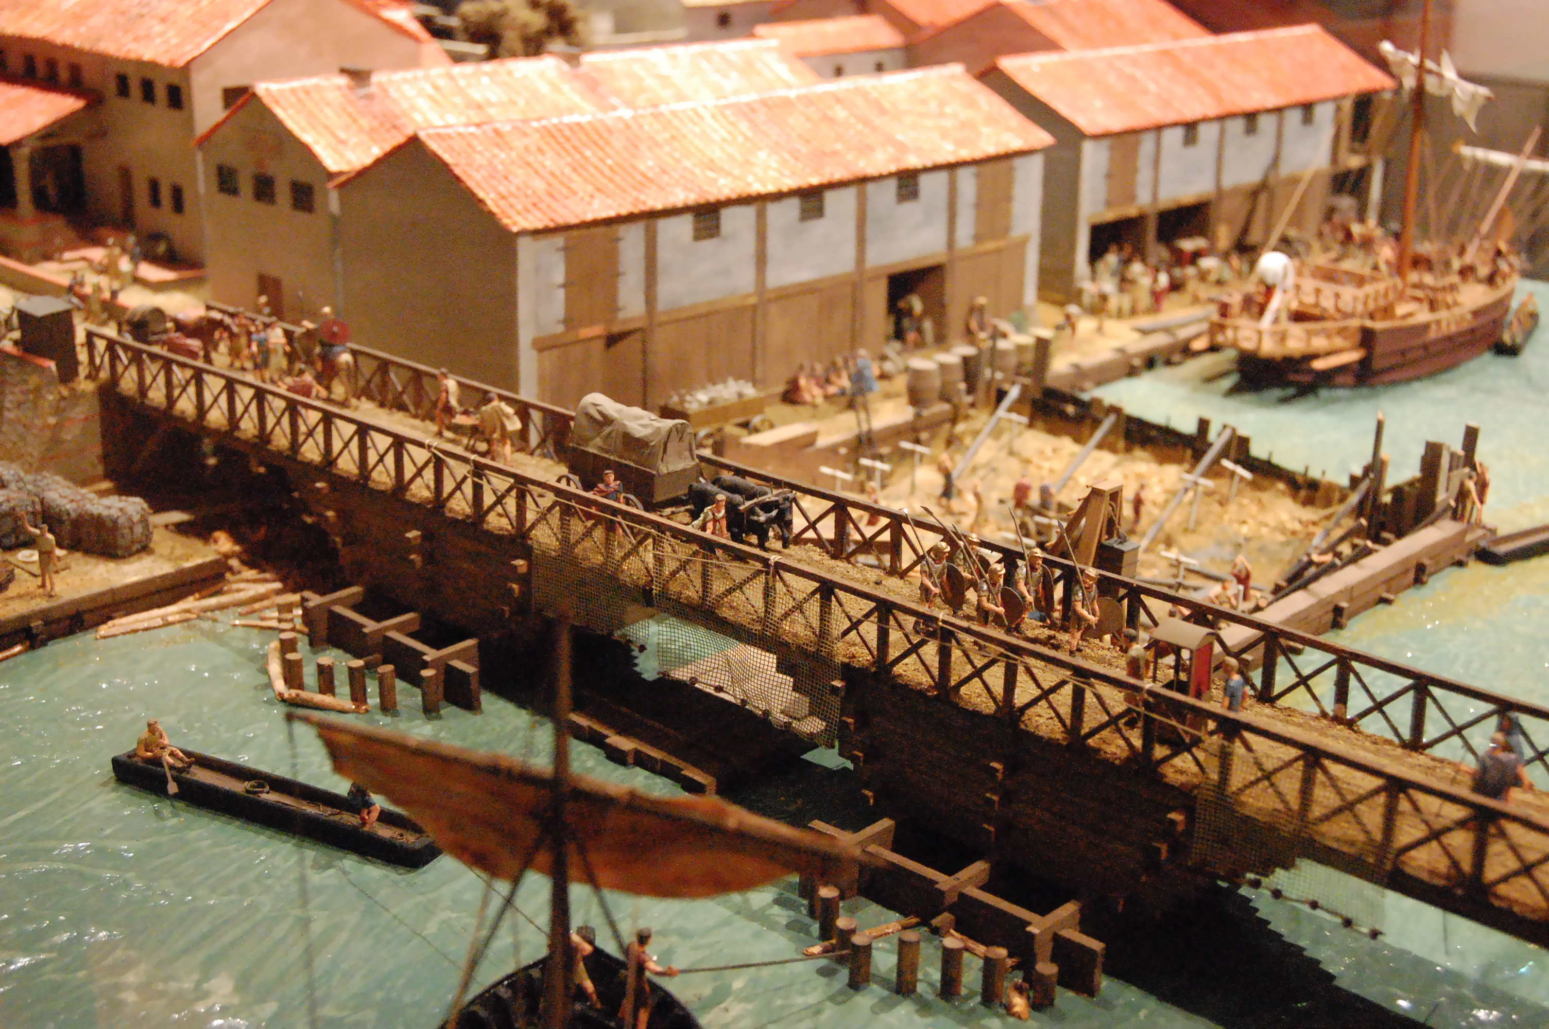
What did the Roman bridge look like?
Unfortunately, we don’t have any traces left of the original Roman bridge. However, we are certain that it was made of wood; this model of London under Roman rule in AD 85-90, (on display at the Museum of London) which displays the first bridge over the Thames (close to the current location of the London Bridge), river boats in the foreground, and a sea-going boat at upper-right, can give us a very good idea of how the area around Magdalene Bridge might have looked like.
Notes:
Image free for non-commercial use (CC BY-SA 3.0), taken from Wikipedia

Slide 4
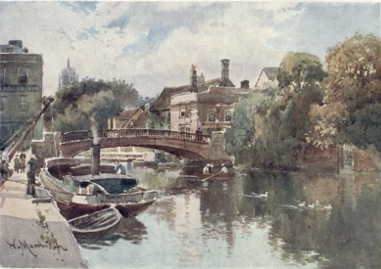
The Great Bridge!
Therefore, Magdalene Bridge
marks the site of an important Roman era river crossing.
It used to be known as
“Great Bridge”. All routes, both local and long- distance, had to through this crossing point, giving it strategic importance.

Slide 5
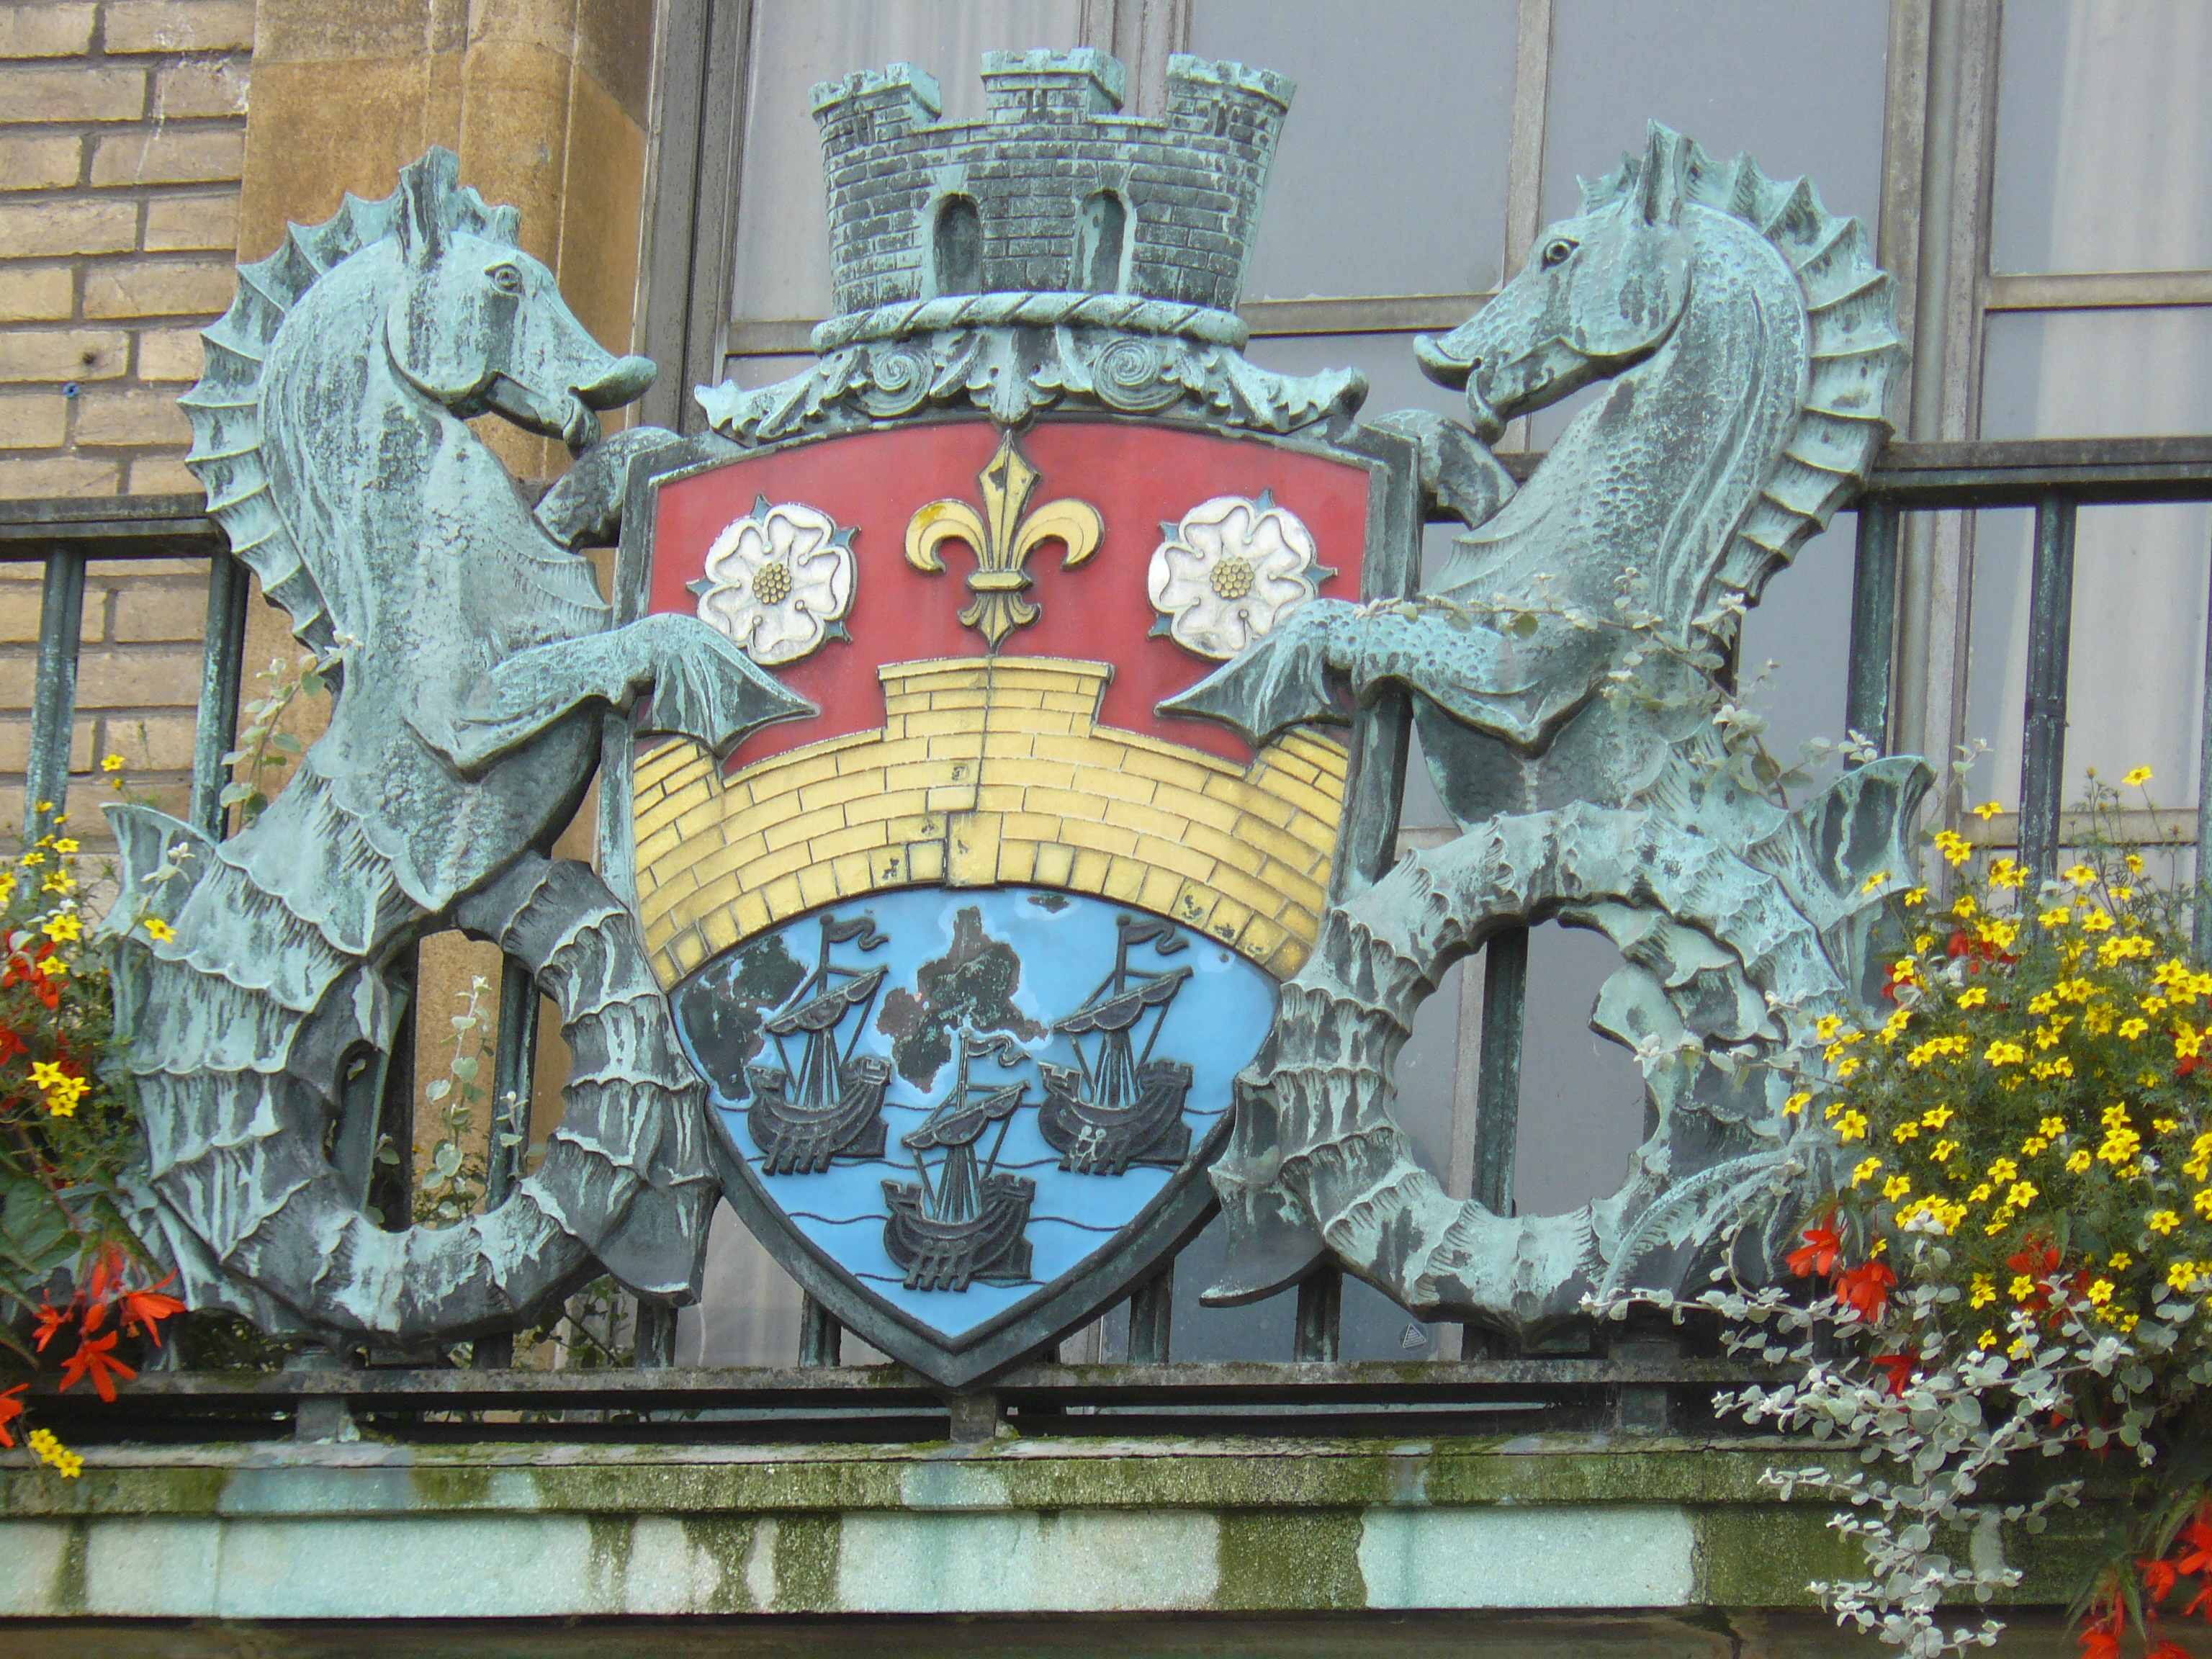
Important Trading Route
Via Boats
From 1118 to 1845, when
the opening of the railway to London dealt the river trade its death-blow, the River Cam was the essential travel and trading route by which Cambridge was fed and built with boats bringing fish and grain, meat and salt, coal and reeds, timber and stone.
This is why there is a bridge and boats on the Cambridge Coat of Arms that appears above the Guildhall!

Slide 6
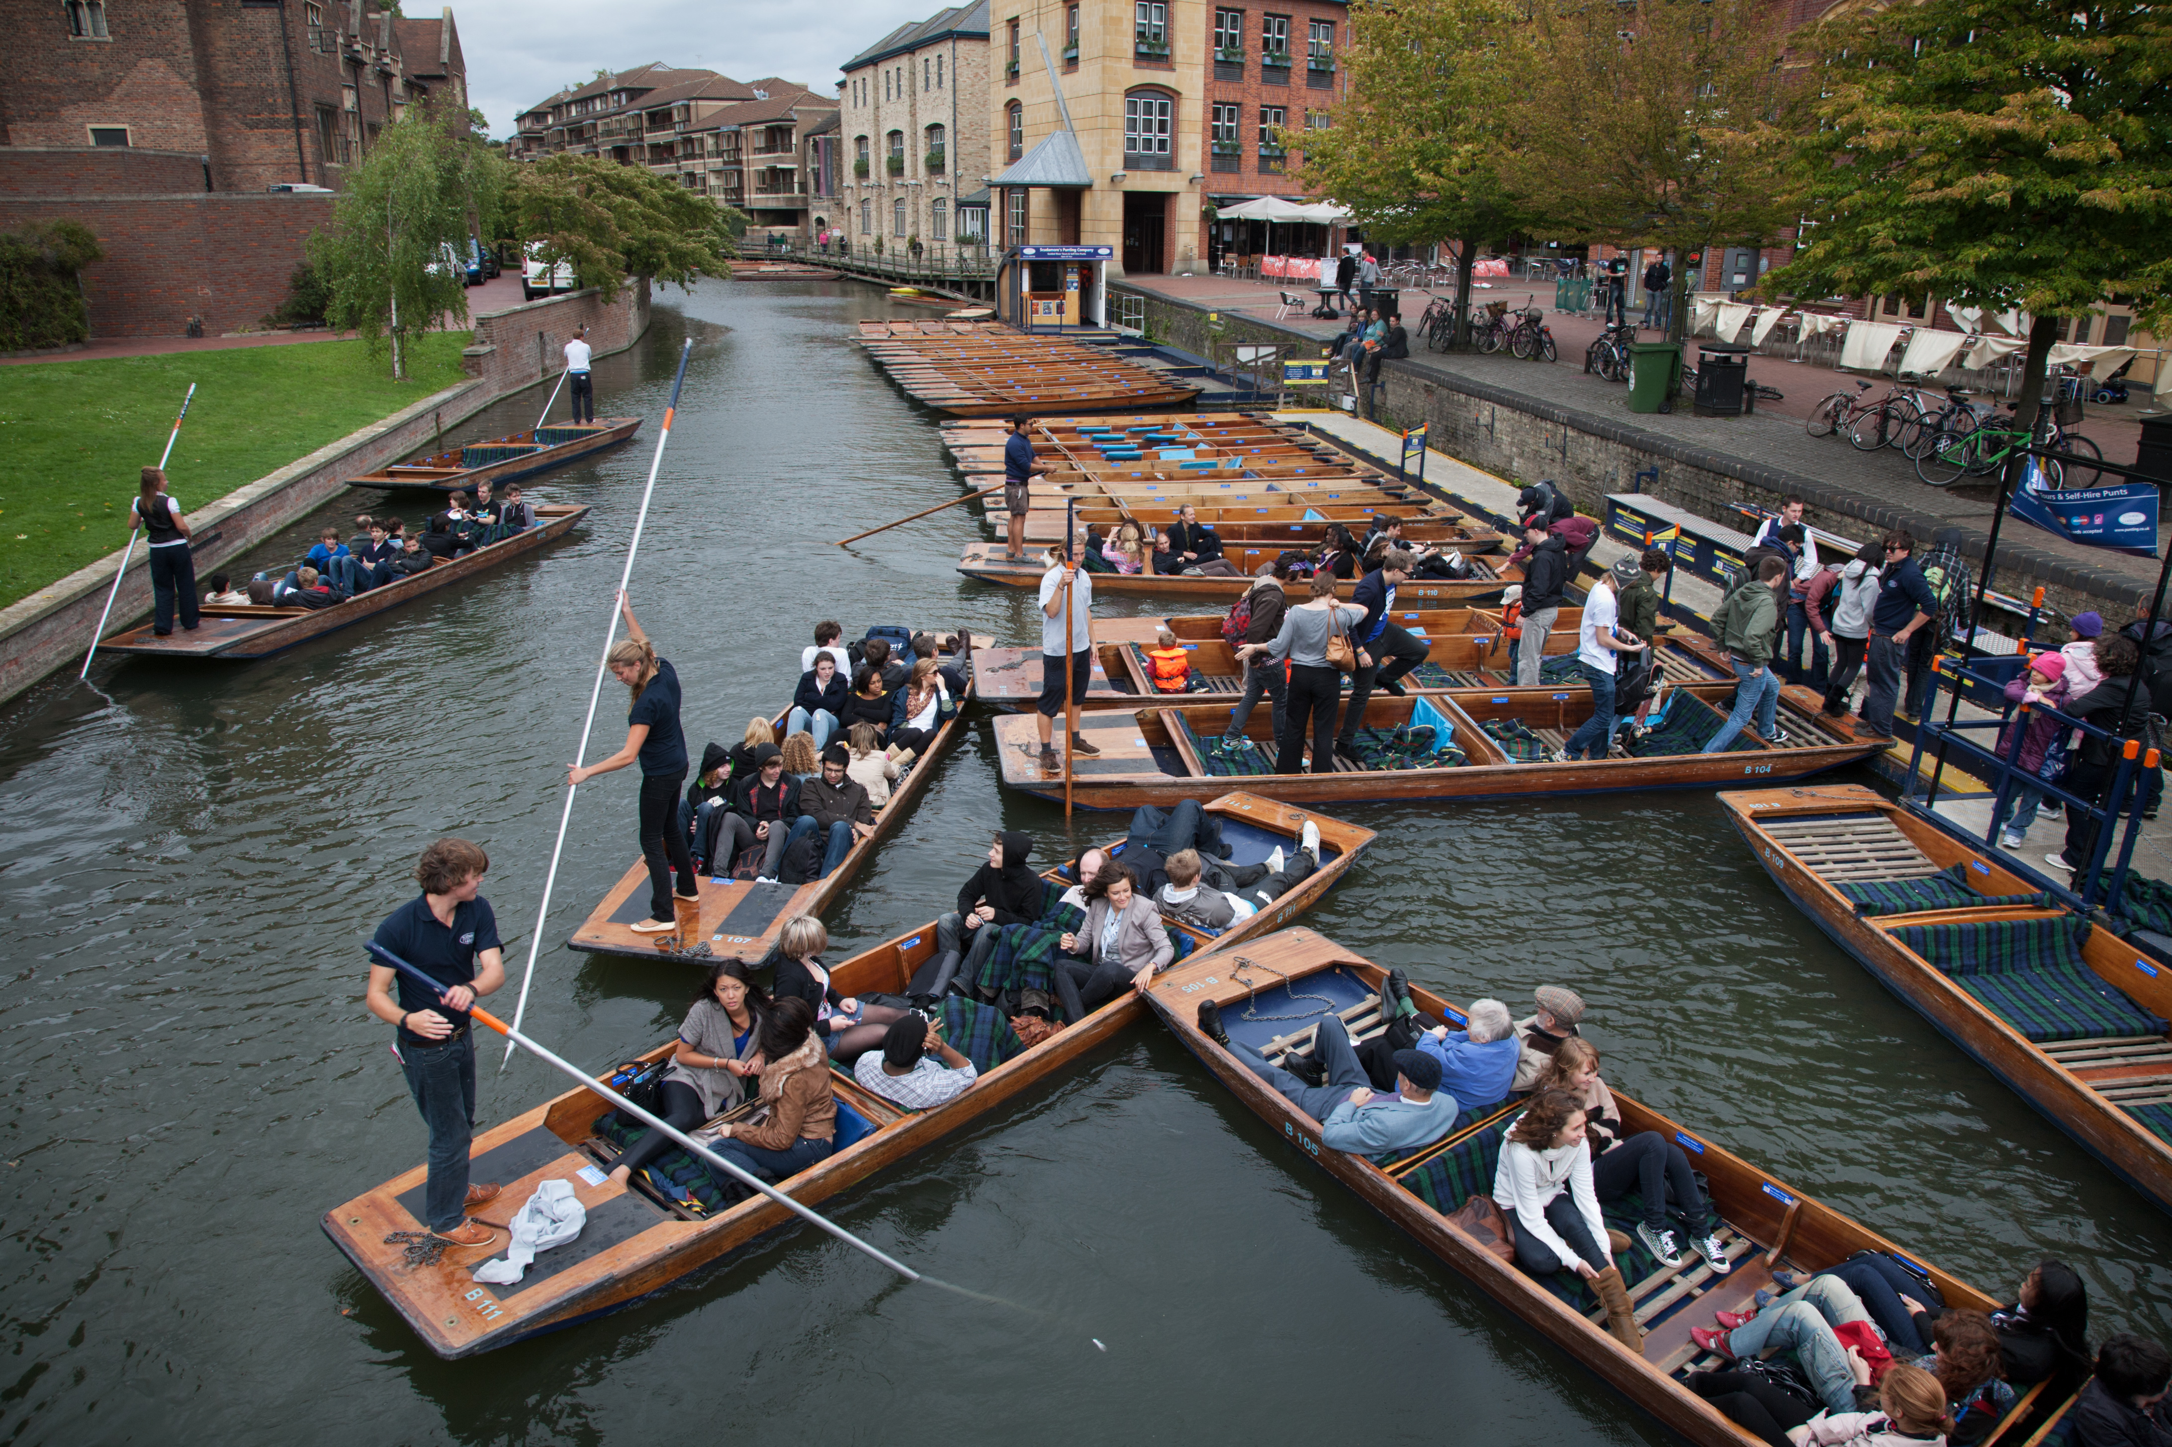
Quayside
But you don’t have to go far away from Magdalene Bridge to discover the trade tradition of the River Cam! Just visit the nearby Quayside: a place with a name true to its origins!
Bustling with punts, instead of fully loaded merchant ships, Quayside still retains something of its ancient glory as a busy wharf!
Notes:
Image free for non-commercial use (CC BY-SA 3.0), taken from Wikipedia

Slide 7
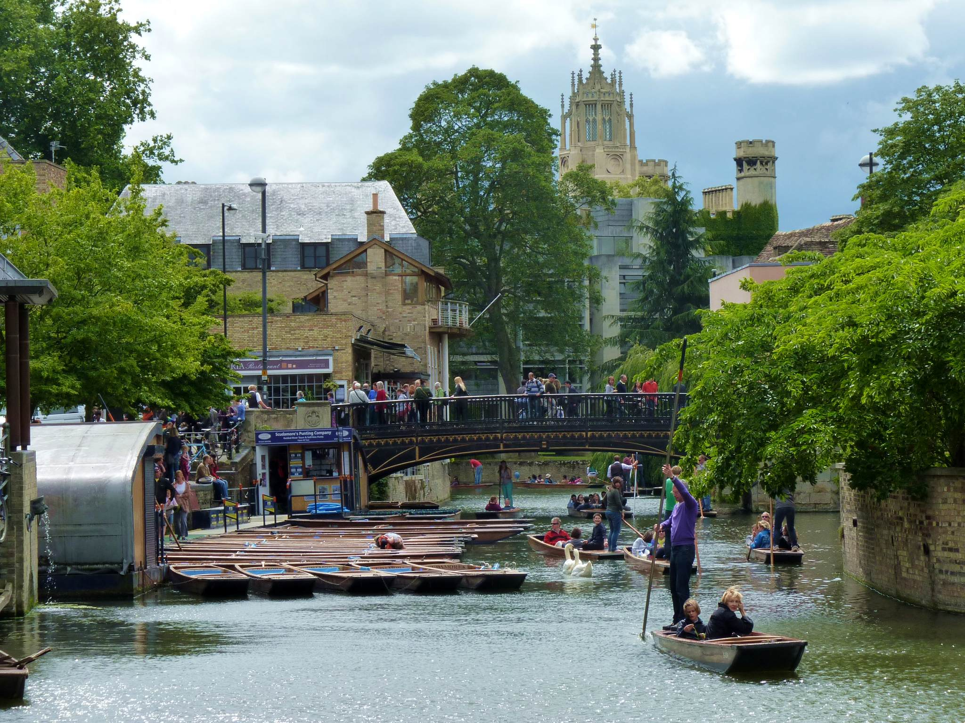
The Modern Bridge
Named after the Magdalene College, which stands nearby,
the latest bridge was designed by Arthur Browne in Gothic revival style and was rebuilt in the same style in 1982.
Notes:
Image free for non-commercial use (CC BY-SA 3.0) , taken from Wikipedia

Slide 8
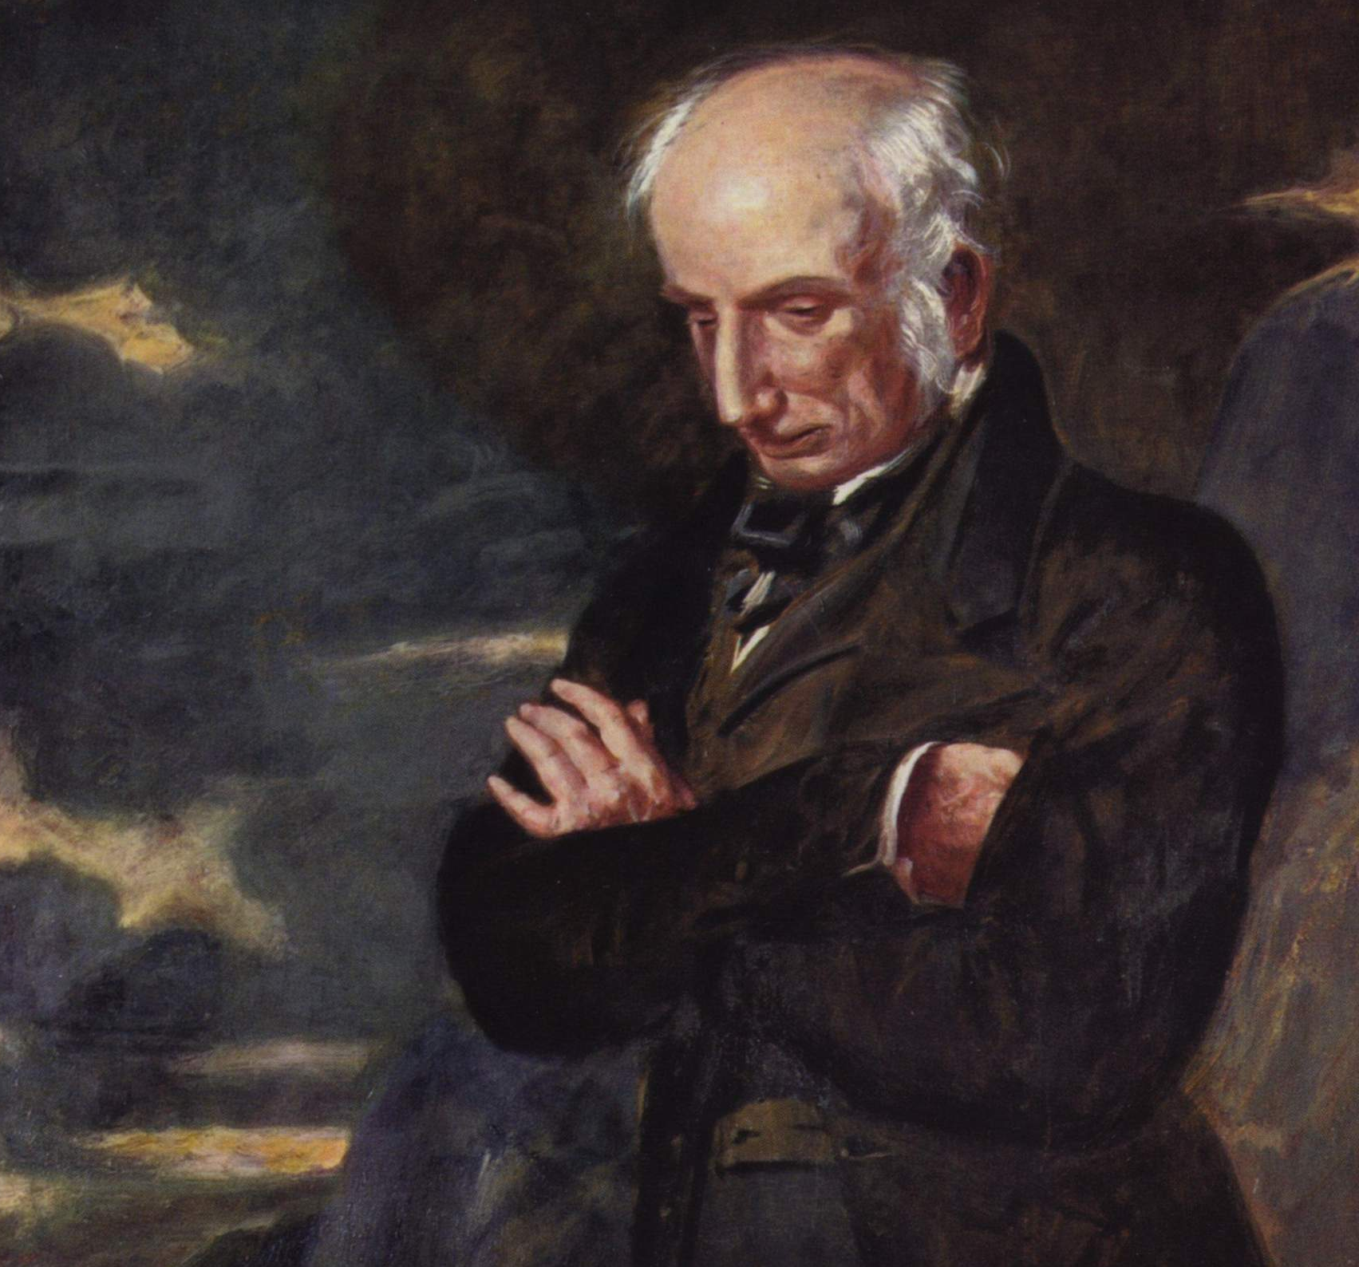
A poem for the Bridge
“…Onward we drove beneath the castle; caught,
While crossing Magdalene Bridge, a glimpse of Cam;
And at the Hoop alighted, famous inn. My spirit was up, my thoughts were full of hope!…”
William Wordsworth
William Wordsworth went up to Cambridge in 1787. He was an undergraduate at St John's College. He graduated in 1791.
Notes:
Public domain image, taken from Wikipedia

Slide 9

Web Resources available at:
http://www.creatingmycambridge.com/history-stories/magdalene-bridge/

