Slide 1

ISAAC NEWTON

Slide 2
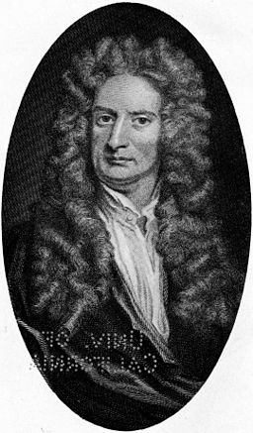
Newton’s Theory of Gravity
Sir Isaac Newton, famous for his work on the theory of gravity, never kept a record of what happened that day, back in 1666 or where in fact it happened!
A number of different stories still survive as to how and where Newton first thought about his theory of gravity, told by a variety of people.
Keith Moore from the Royal Society explained:
“The story was certainly true, but let’s say it got better with the telling.”

Slide 3
William’s Stukely’s Story
William Stukely, who was a good friend of Newton’s wrote about Newton’s
Discovery in his ‘Memoirs of Issac Newton’ in 1752.
He wrote:
‘After dinner, the weather being warm, we went into the garden, and drank tea
under the shade of some apple trees…he told me, he was just in the same
situation as when formally, the notation of gravitation came to his mind.
“Why should that apple always descend perpendicularly to the ground,”
thought he to himself.’

Slide 4
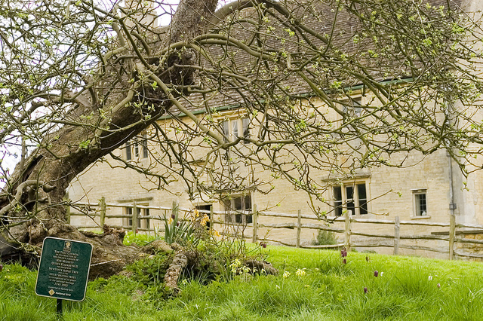
The Site of Newton’s Discovery
The tree mentioned in
Stukely’s story is still there
today!
This picture shows the place
where Newton is meant to
have witnessed a green
apple falling from the tree
Outside his family home
and first thought of his
system of gravity.
Woolsthorpe Manor - Isaac Newton's home
Newton's Apple Tree © Nick Harrison, 2006
You can still visit this place today, as the house and grounds are now looked after by the National Trust.

Slide 5
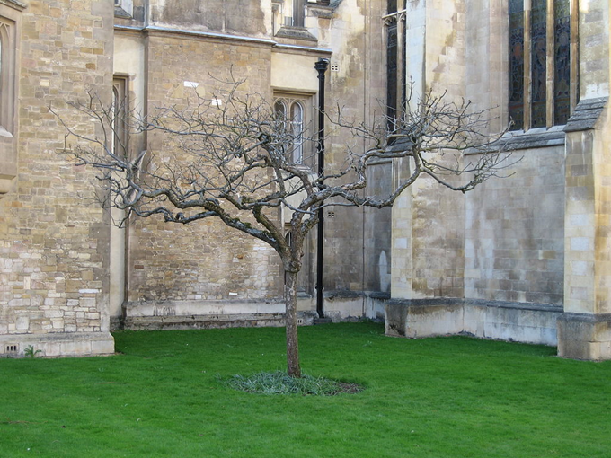
Cambridge’s Very Own Newton’s Apple Tree!
As a young man, Newton went to Trinity College in Cambridge to study.
Despite it being very unlikely that
Newton actually made his discovery of gravity in the grounds of Trinity College, his college has now placed a special tree to remember him.
FACTOID!
The tree is of the Flower of Kent variety which produces green cooking apples. It was grafted from the original
tree at Newton’s home and was planted in 1954.
The Newton Apple Tree in Trinity College

Slide 6
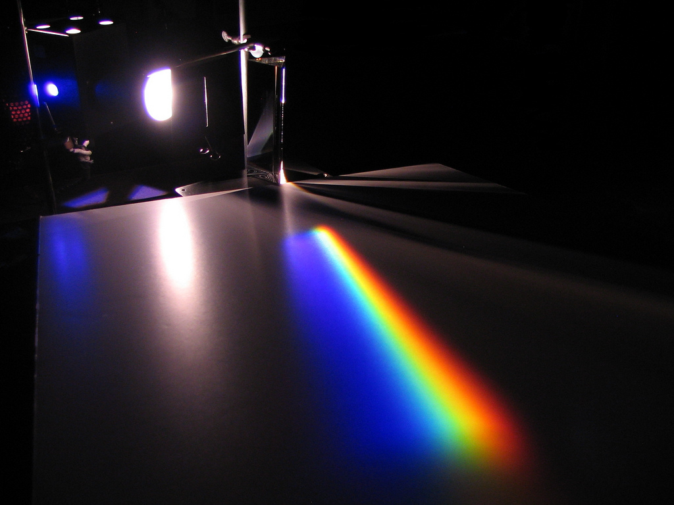
Newton’s Theory of Light
FACTOID!
It is thought that Newton bought a prism at Stourbridge Fair which he used to discover how white light disperses into many colours!
From this discovery using a prism he made a ‘Theory of Light’ which states that when light refracts that the colours that are visible are made from the white light itself rather than the object they are visible on.
Dispersion by a prism
Alfredo Louro © 2008

Slide 7
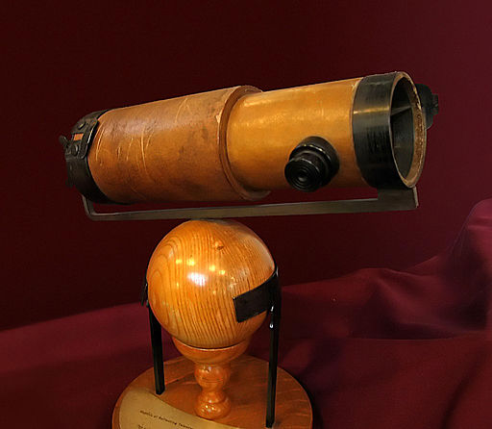
Newton’s Telescope
FACTOID!
Newton telescope was 10 times smaller than the telescopes of the time and was much more accurate.
This picture shows a replica of it and can be found in the Whipple Museum in Cambridge.
Photograph © Andrew Dunn,
5 November 2004

Slide 8

Web Resources available at:
http://www.creatingmycambridge.com/
history-stories/newtons-apple-tree/

Slide 9
For further information visit:
Information and Videos
BBC iWonder- Isaac Newton: The Man Who Discovered Gravity http://www.bbc.co.uk/timelines/zwwgcdm
Isaac Newton Institute: http://www.newton.ac.uk/about/isaac-newton

