Slide 1

PARKER’S PIECE

Slide 2
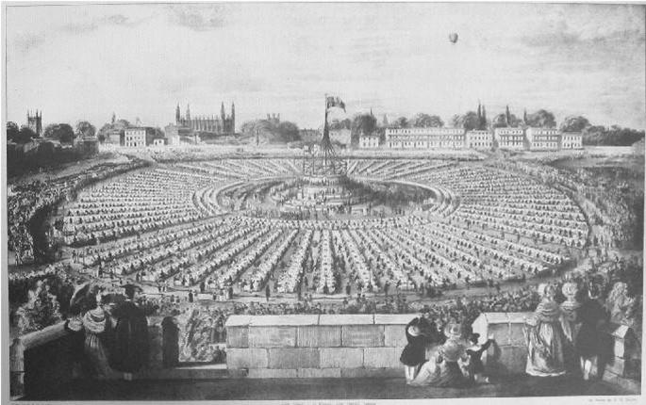
What Was Parker’s Piece in the Past?
Parker’s Piece used to be part of Trinity College until 1613, when Cambridge town acquired it as pasture land to graze animals on.
It has since been used for
a wide variety of events including Royal celebrations and
sporting events.

Slide 3
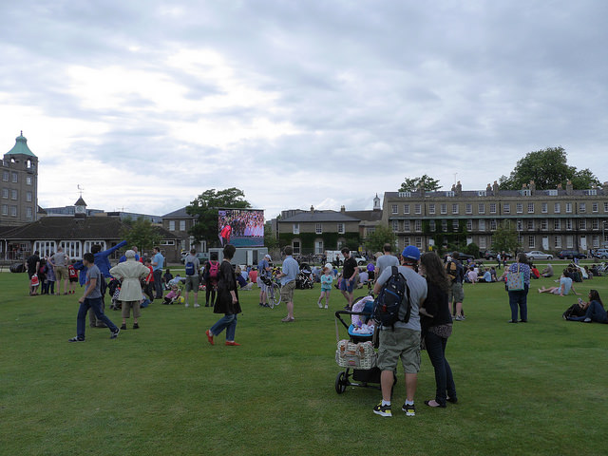
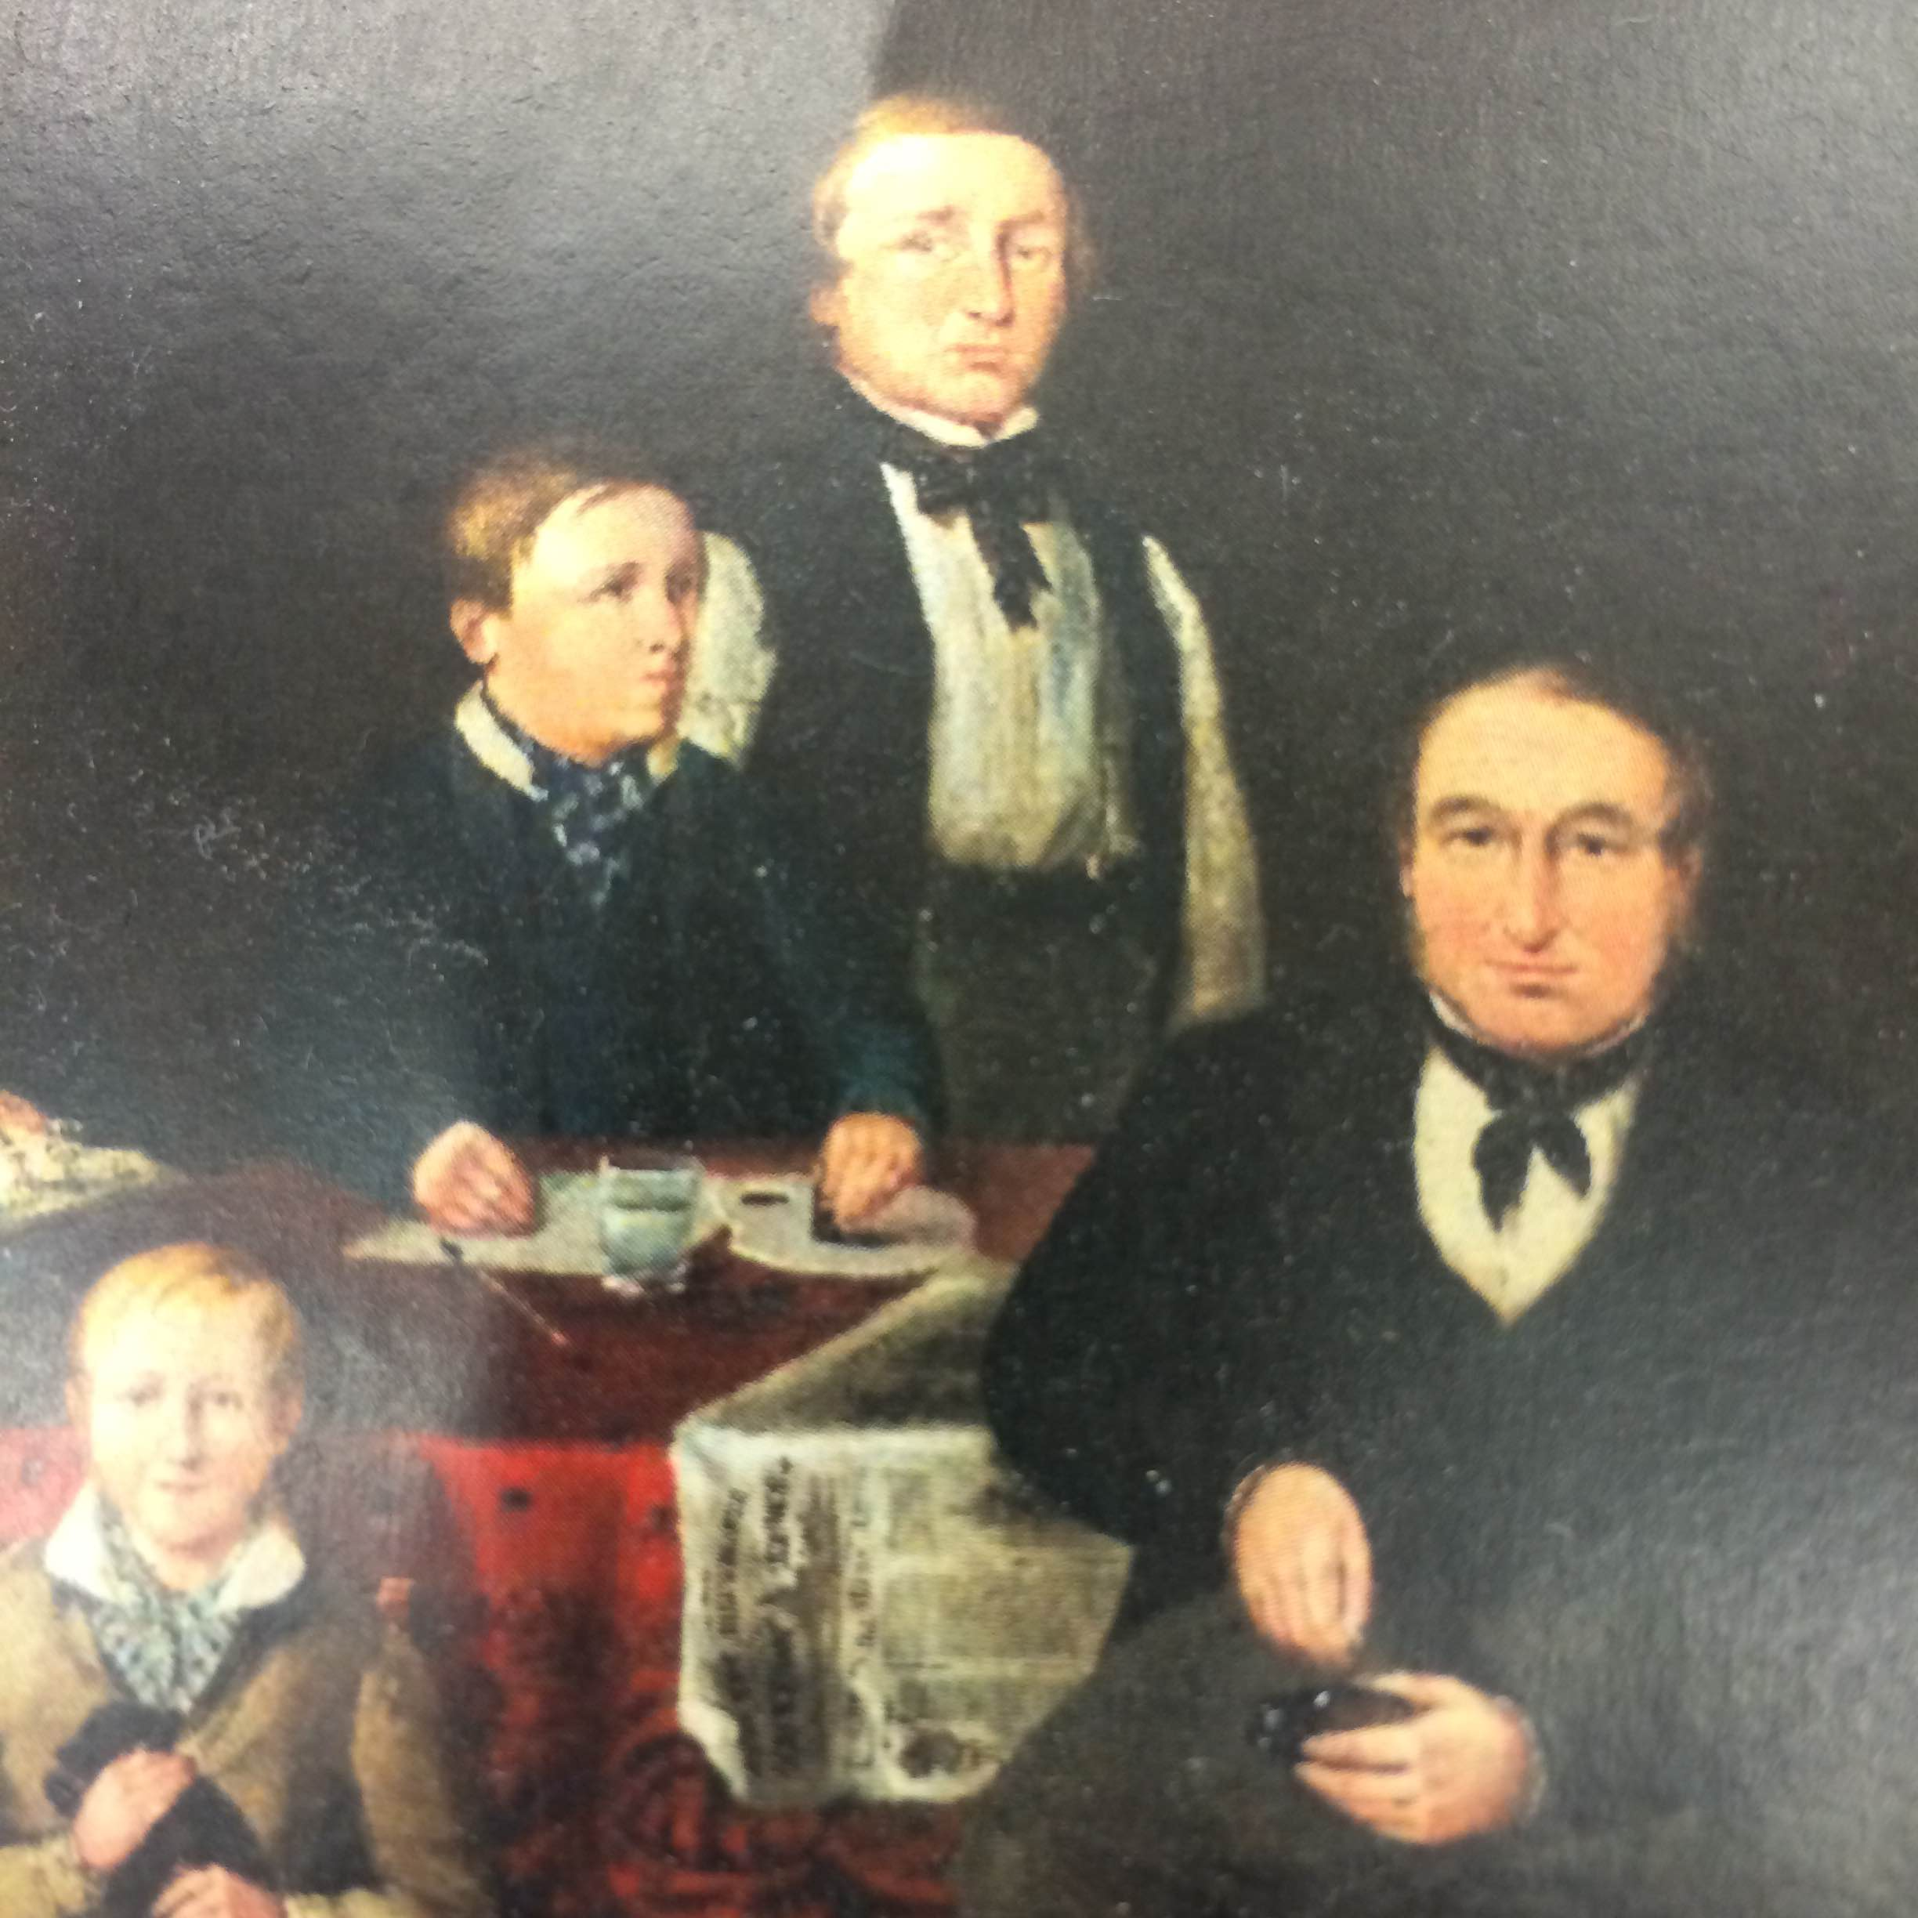
So who was Mr. Parker?
Mr. Edward Parker was a college cook and Parker’s Piece is named after him!
He leased the land south of Trinity College- a whole 25 acres (much larger than Parker’s Piece is today).
We don’t have any pictures of Mr. Parker,
but this is a picture of another college cook,
So we imagine he might have looked
something like this.

Slide 4
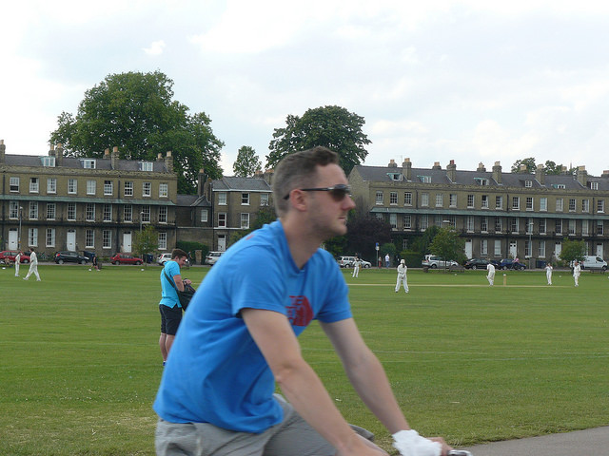
Anyone for Cricket?!
In 1831 members of the University requested the city council’s permission to level 60 square yards to make a cricket pitch.
The request was granted on the condition that the cricket pitch had to be for public use as well as the university.

Slide 5
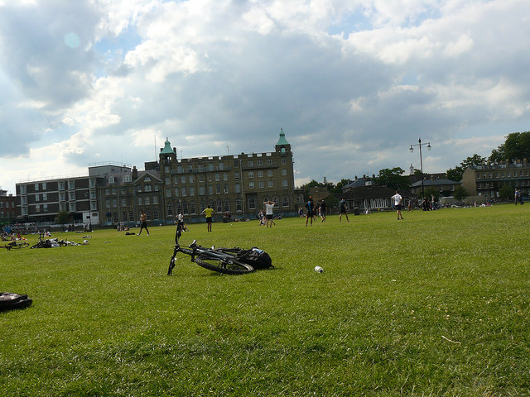
The Pavilion is Built
In 1930 a pavilion was built on Parker’s Piece, named after the famous cricketer, Jack Hobbs.
It was used by people who played sports, including the footballers.
The pavilion being built meant that they didn’t have to get changed in tents anymore- which I’m sure they were very pleased about!
The cricket pavilion behind footballers on
Parker’s Piece today

Slide 6
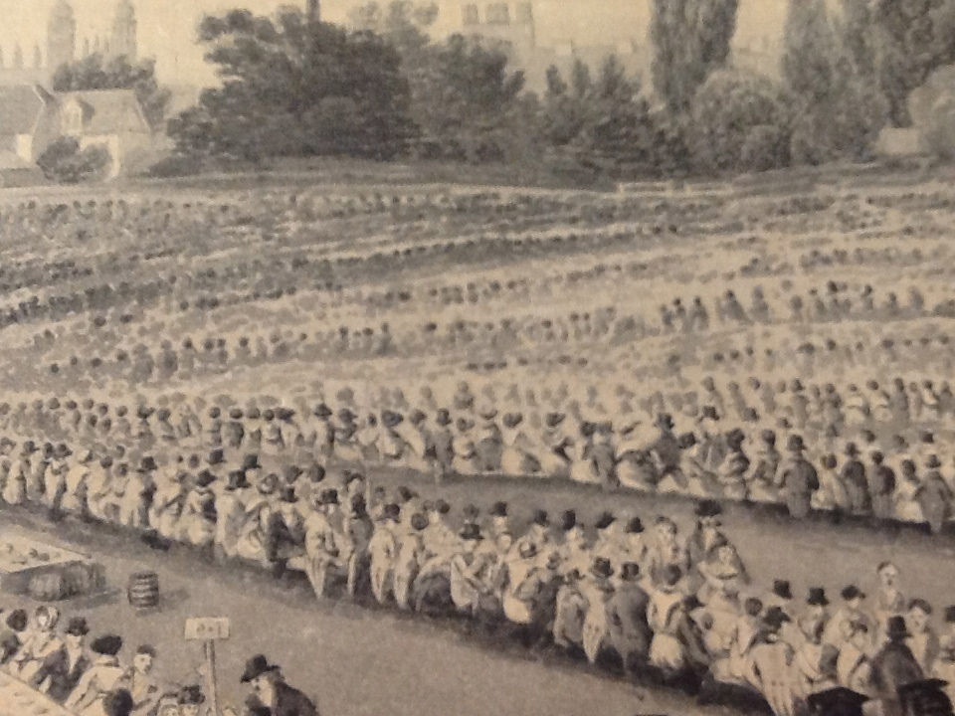
A Place of Celebration!
Parker’s Piece has been used as a place for all sorts of celebrations and
exciting events over the last few hundred years and is still used for events today.
FACTOID!
In 1838 a feast for over 15,000 diners and 17000 spectators was held to celebrate
Queen Victoria’s Coronation
- that’s a lot of guests at a party!

Slide 7
How Much Food was Consumed at the party?
FACTOID!
In total, the diners consumed
1,015 stones of meat,
72lbt of mustard,
140 lbs salt,
125 gallons of pickles,
4,500 loaves of bread,
1,608 plum puddings of 6.5lbs
each
and 99 barrels of ale.

Slide 8
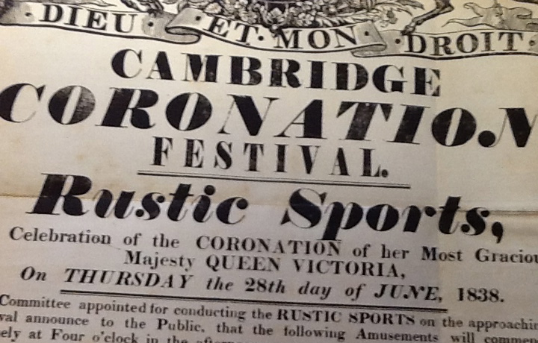
What happened after Dinner
After dinner the ‘Rustic Sports’ began. These included

Slide 9
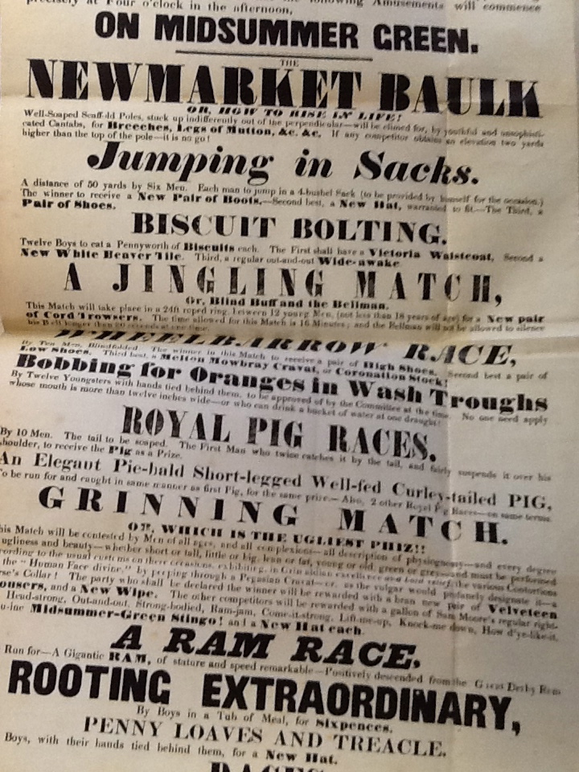
What happened after Dinner
After dinner the ‘Rustic Sports’ began. These included

Slide 10
What happened after Dinner
After dinner the ‘Rustic Sports’ began. These included

Slide 11
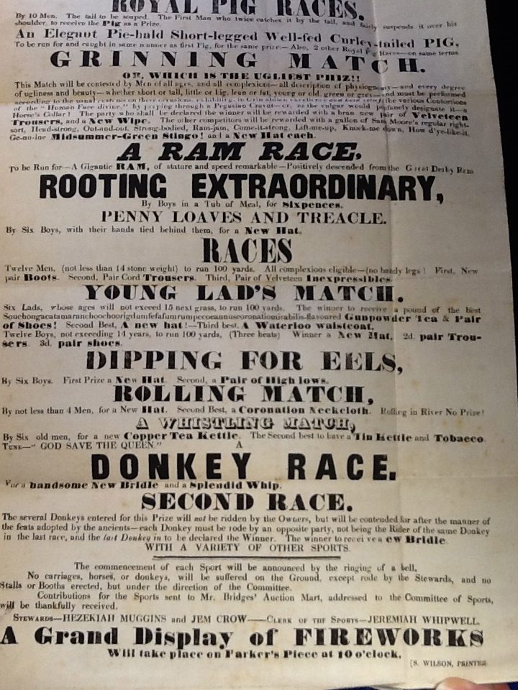
What happened after Dinner
After dinner the ‘Rustic Sports’ began. These included

Slide 12
What happened after Dinner
After dinner the ‘Rustic Sports’ began. These included

Slide 13

A Place of Celebration!
Back in July 1893, as part of the festivities to celebrate the wedding of
Prince George and Princess Mary, a thousand “aged poor” were entertained
with tea on the park.
The event also included the flight of a hot air balloon which people found
extremely fascinating, as most would never have seen one before, as it had only recently been invented.

Slide 14

Football History Made Here!
FACTOID!
Did you know that the Football Association’s rules of football are based on rules drawn up in 1848 by players who played on Parker’s Piece?
Before the rules were set the teams
would play on the Piece and each
game would be played with a different
set of rules.
In 1948 players met to decide on one
set of rules and fixed it to the trees
on Parker’s Piece.
When the Football Association was
founded in 1863 they used these
rules as their basis.

Slide 15
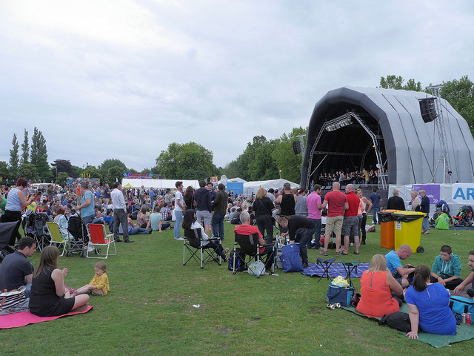
Parker’s Piece Celebrations Today!
More recently Parker’s Piece has been used for celebrations such as the arrival of the Olympic Torch in 2012 and the start of the Cambridge leg of the Tour de France in 2014.

Slide 16

Web Resources available at:
http://www.creatingmycambridge.com/
history-stories

