Slide 1

Prison on Castle Hill

Slide 2
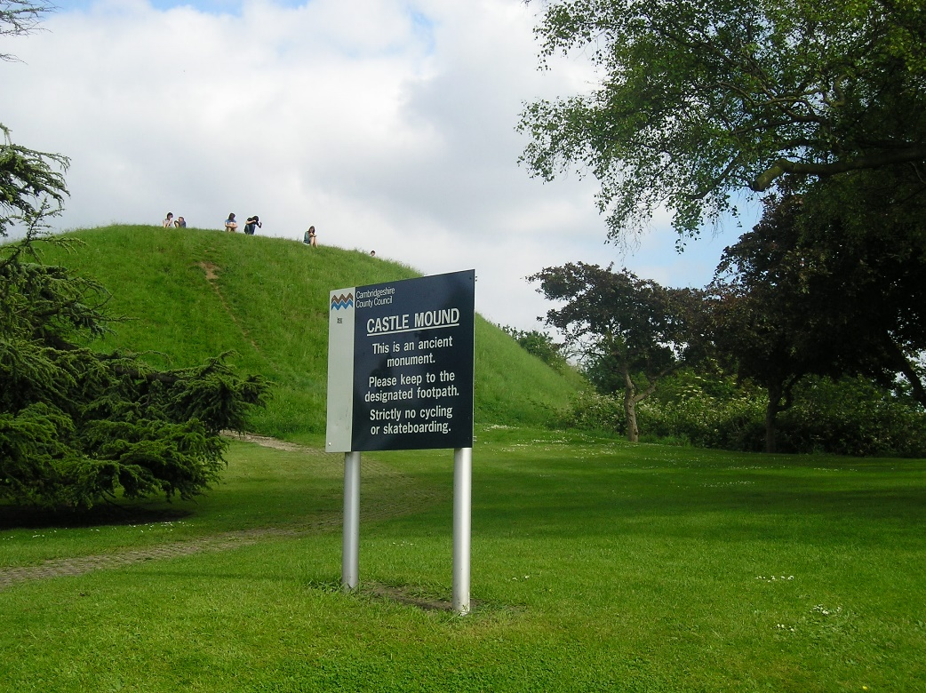
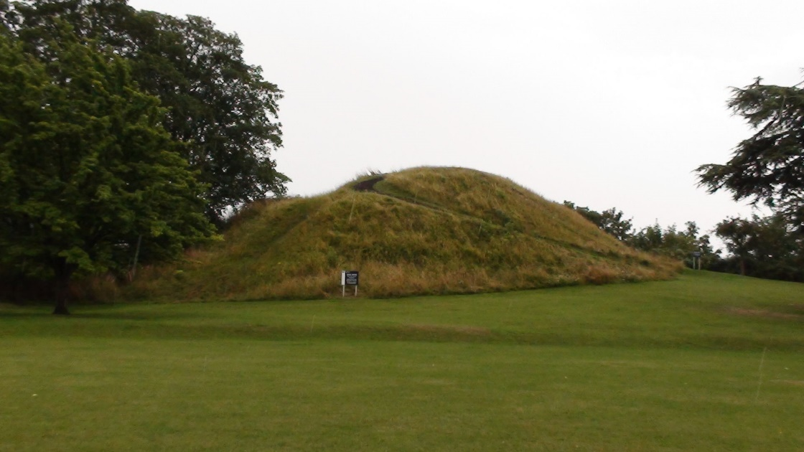
The Norman Castle
Do you recognise this sign on Castle Hill?
This is the motte which survives from Cambridge Castle, which was built in 1068

Slide 3
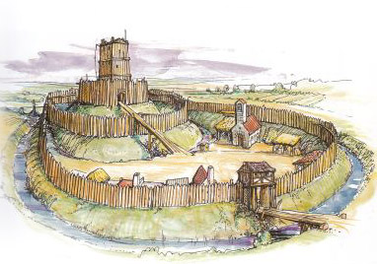
Motte and Bailey Castle
Motte
This is what we think a Norman ‘motte and bailey’ castle would have looked like.
The castle sat on the steep mound called a motte. The enclosure on the ground, directly below the motte was called the bailey. The bailey had lots of different buildings in it, such as kitchens, stables, workshops and a chapel.
Bailey

Slide 4
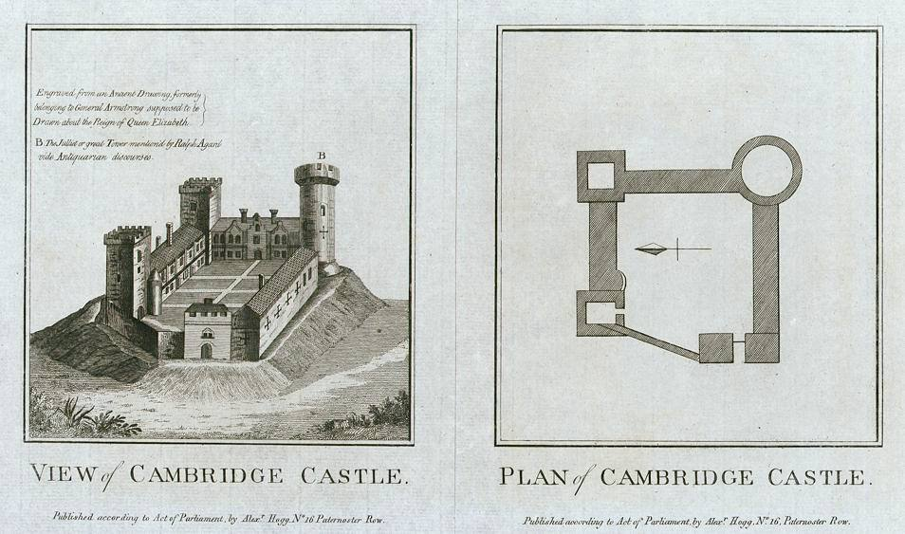
William the Conqueror’s Castle
In 1068 William the Conqueror ordered that a new castle was to be built from wood
on the same site of the previous Roman fort.
This was later rebuilt and made out of stone in the 12th Century, following the
Cambridge fire of 1174, as stone was a much more durable material.
View of Cambridge Castle and Plan of Cambridge Castle engraved by Warren and published in Picturesque Views of the Antiquities of England & Wales, 1786

Slide 5
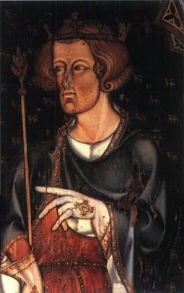
The King Visits the Castle!
Edward I was the only king ever to stay at the Castle in Cambridge.
He ordered for the Castle to be rebuilt between 1286-9 before he actually visited. However we have very little idea of what the castle actually looked like back then as we have no pictures of it from back then!
Edward eventually visited and stayed at the Castle from 23rd-24th March 1293 once the castle building work was
completed.

Slide 6
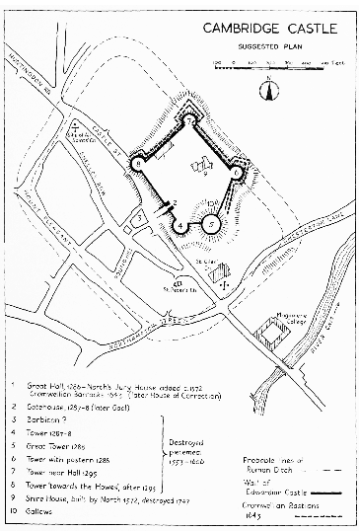
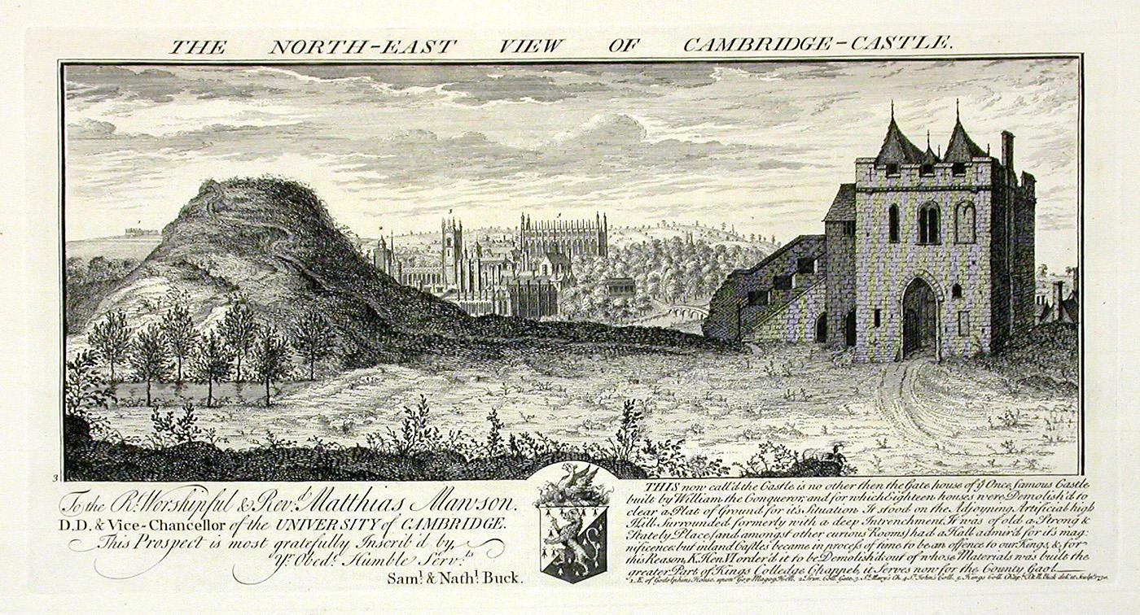
The Gatehouse of the Castle Becomes a Prison
But the Castle in Cambridge didn’t just stay as a Castle. In the 14th Century the Gatehouse of the Castle was used as a prison!
It stayed as a prison until the end of the 18th Century when it closed and all local prisoners were taken to
Huntingdon Prison
instead.

Slide 7
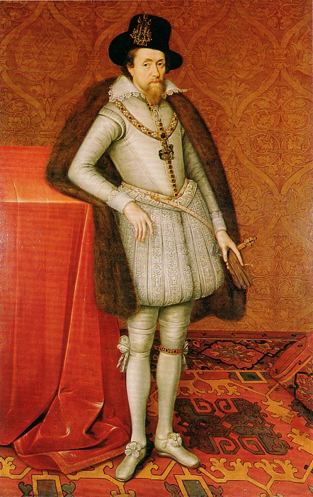
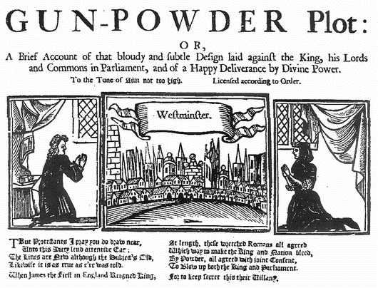
Gunpowder Plot Prisoners in the Castle Prison
There were a lot of thieves and people who couldn’t pay off their debts in the Castle Prison, but there were also people who had committed more unusual crimes.
In 1605 Guy Fawkes tried to blow up the House of Lords, to kill everyone in the building, including the king, James I.
In the 17th century Roman Catholics who were associated with the Gunpowder Plot were imprisoned there.
Guy Fawkes

Slide 8
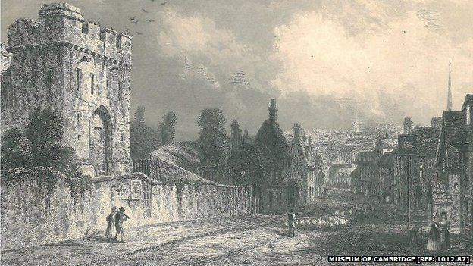
An unusual agreement…
Francis Holcroft, a non-conformist preacher who was a prisoner from 1663 to 1672 made a ‘gentleman’s agreement’ with the gaoler (or jailer- the person in charge of the prison), who was let out after dark on a Saturday night, as long as he got back to prison before daylight on Monday. Which meant that he still could carry out his duties as pastor of his church in the countyside!
Picture of the Gatehouse of the
Castle from the Museum of Cambridge

Slide 9
A New Prison on the Hill
The new County Gaol and House of Correction (prison) was built on the site of what previously was the Norman castle and was built between 1802 and 1807.
It was designed by G. Byfield on 'Benthamite' principles, which came from the ideas of Jeremiah Bentham.
DID YOU KNOW?
Lots of the stone from the old castle was re-used to build King’s College and other university college buildings!

Slide 10
Prison Bricks Used to Make
Shire Hall!
It was used until 1915, but was eventually demolished was demolished in 1928 – 9. It was subsequently replaced with a new Shire Hall for the county council. Bricks from the prison were re-used to build the walls of the new building.
Now only the castle motte and minimal earthworks remain.
Pic of Shire Hall today

Slide 11
Discover More
For more information about the Prison on Castle Hill visit the Museum of Cambridge, visit their website or contact their Education Officer here:
http://www.museumofcambridge.org.uk/

Slide 12

Web Resources available at:
http://www.creatingmycambridge.com/
history-stories

