Slide 1

DISCOVERY OF DNA: ROSALIND FRANKLIN

Slide 2
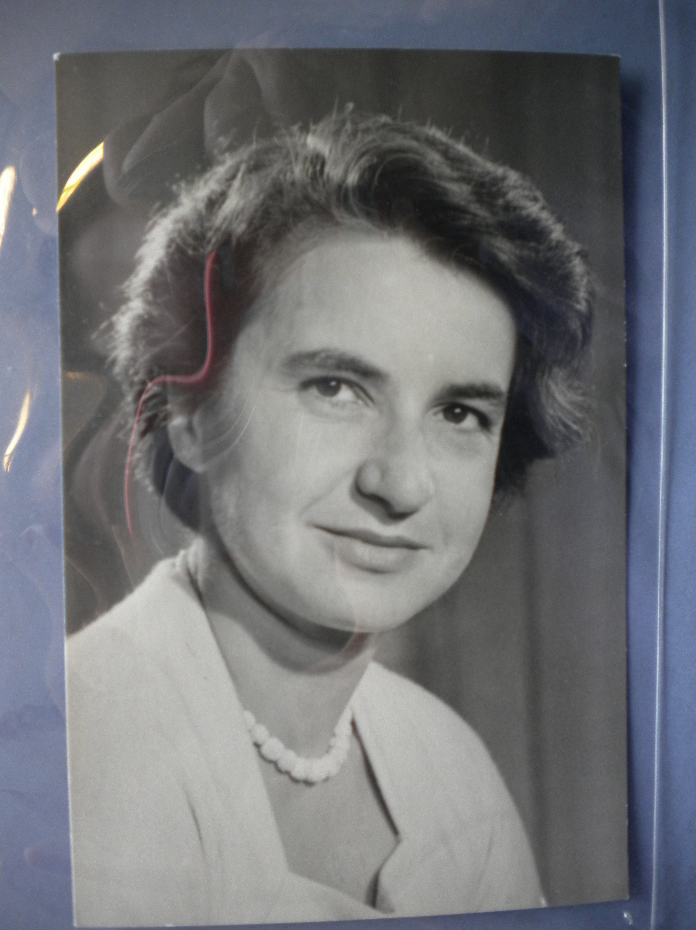
So Who Was Rosalind Franklin?
Rosalind Franklin was a scientist and had a very important role in
The discovery of DNA- the building blocks of all living things!
Rosalind used sophisticated
x-ray techniques to make a number
of important scientific discoveries.

Slide 3
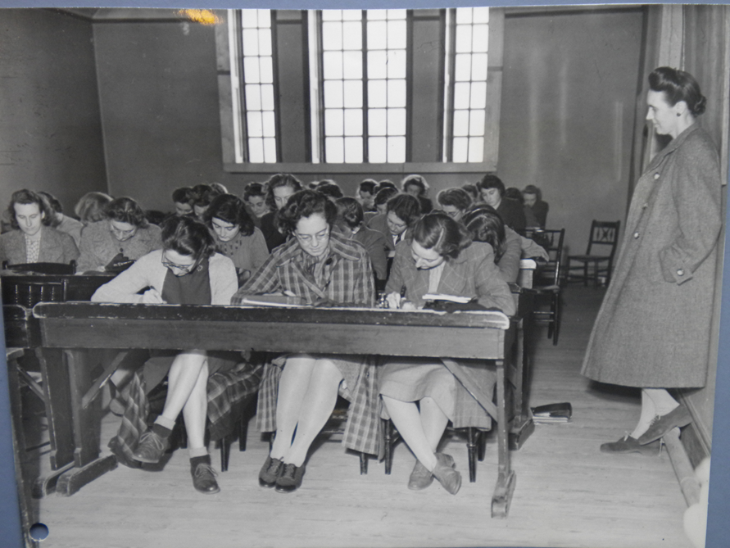
What Was Rosalind like as a Child?
Rosalind was a very logical and determined child. She hated playing with dolls
and playing make belief games. Instead she much preferred playing with Meccano
and doing carpentry, which she learnt from her brothers.
When she was in Primary School she already knew she wanted to be a scientist!
She grew up in Notting Hill in London and went to St. Paul’s Girls’ School.
She then studied at Newnham College at the University of Cambridge in 1938.

Slide 4
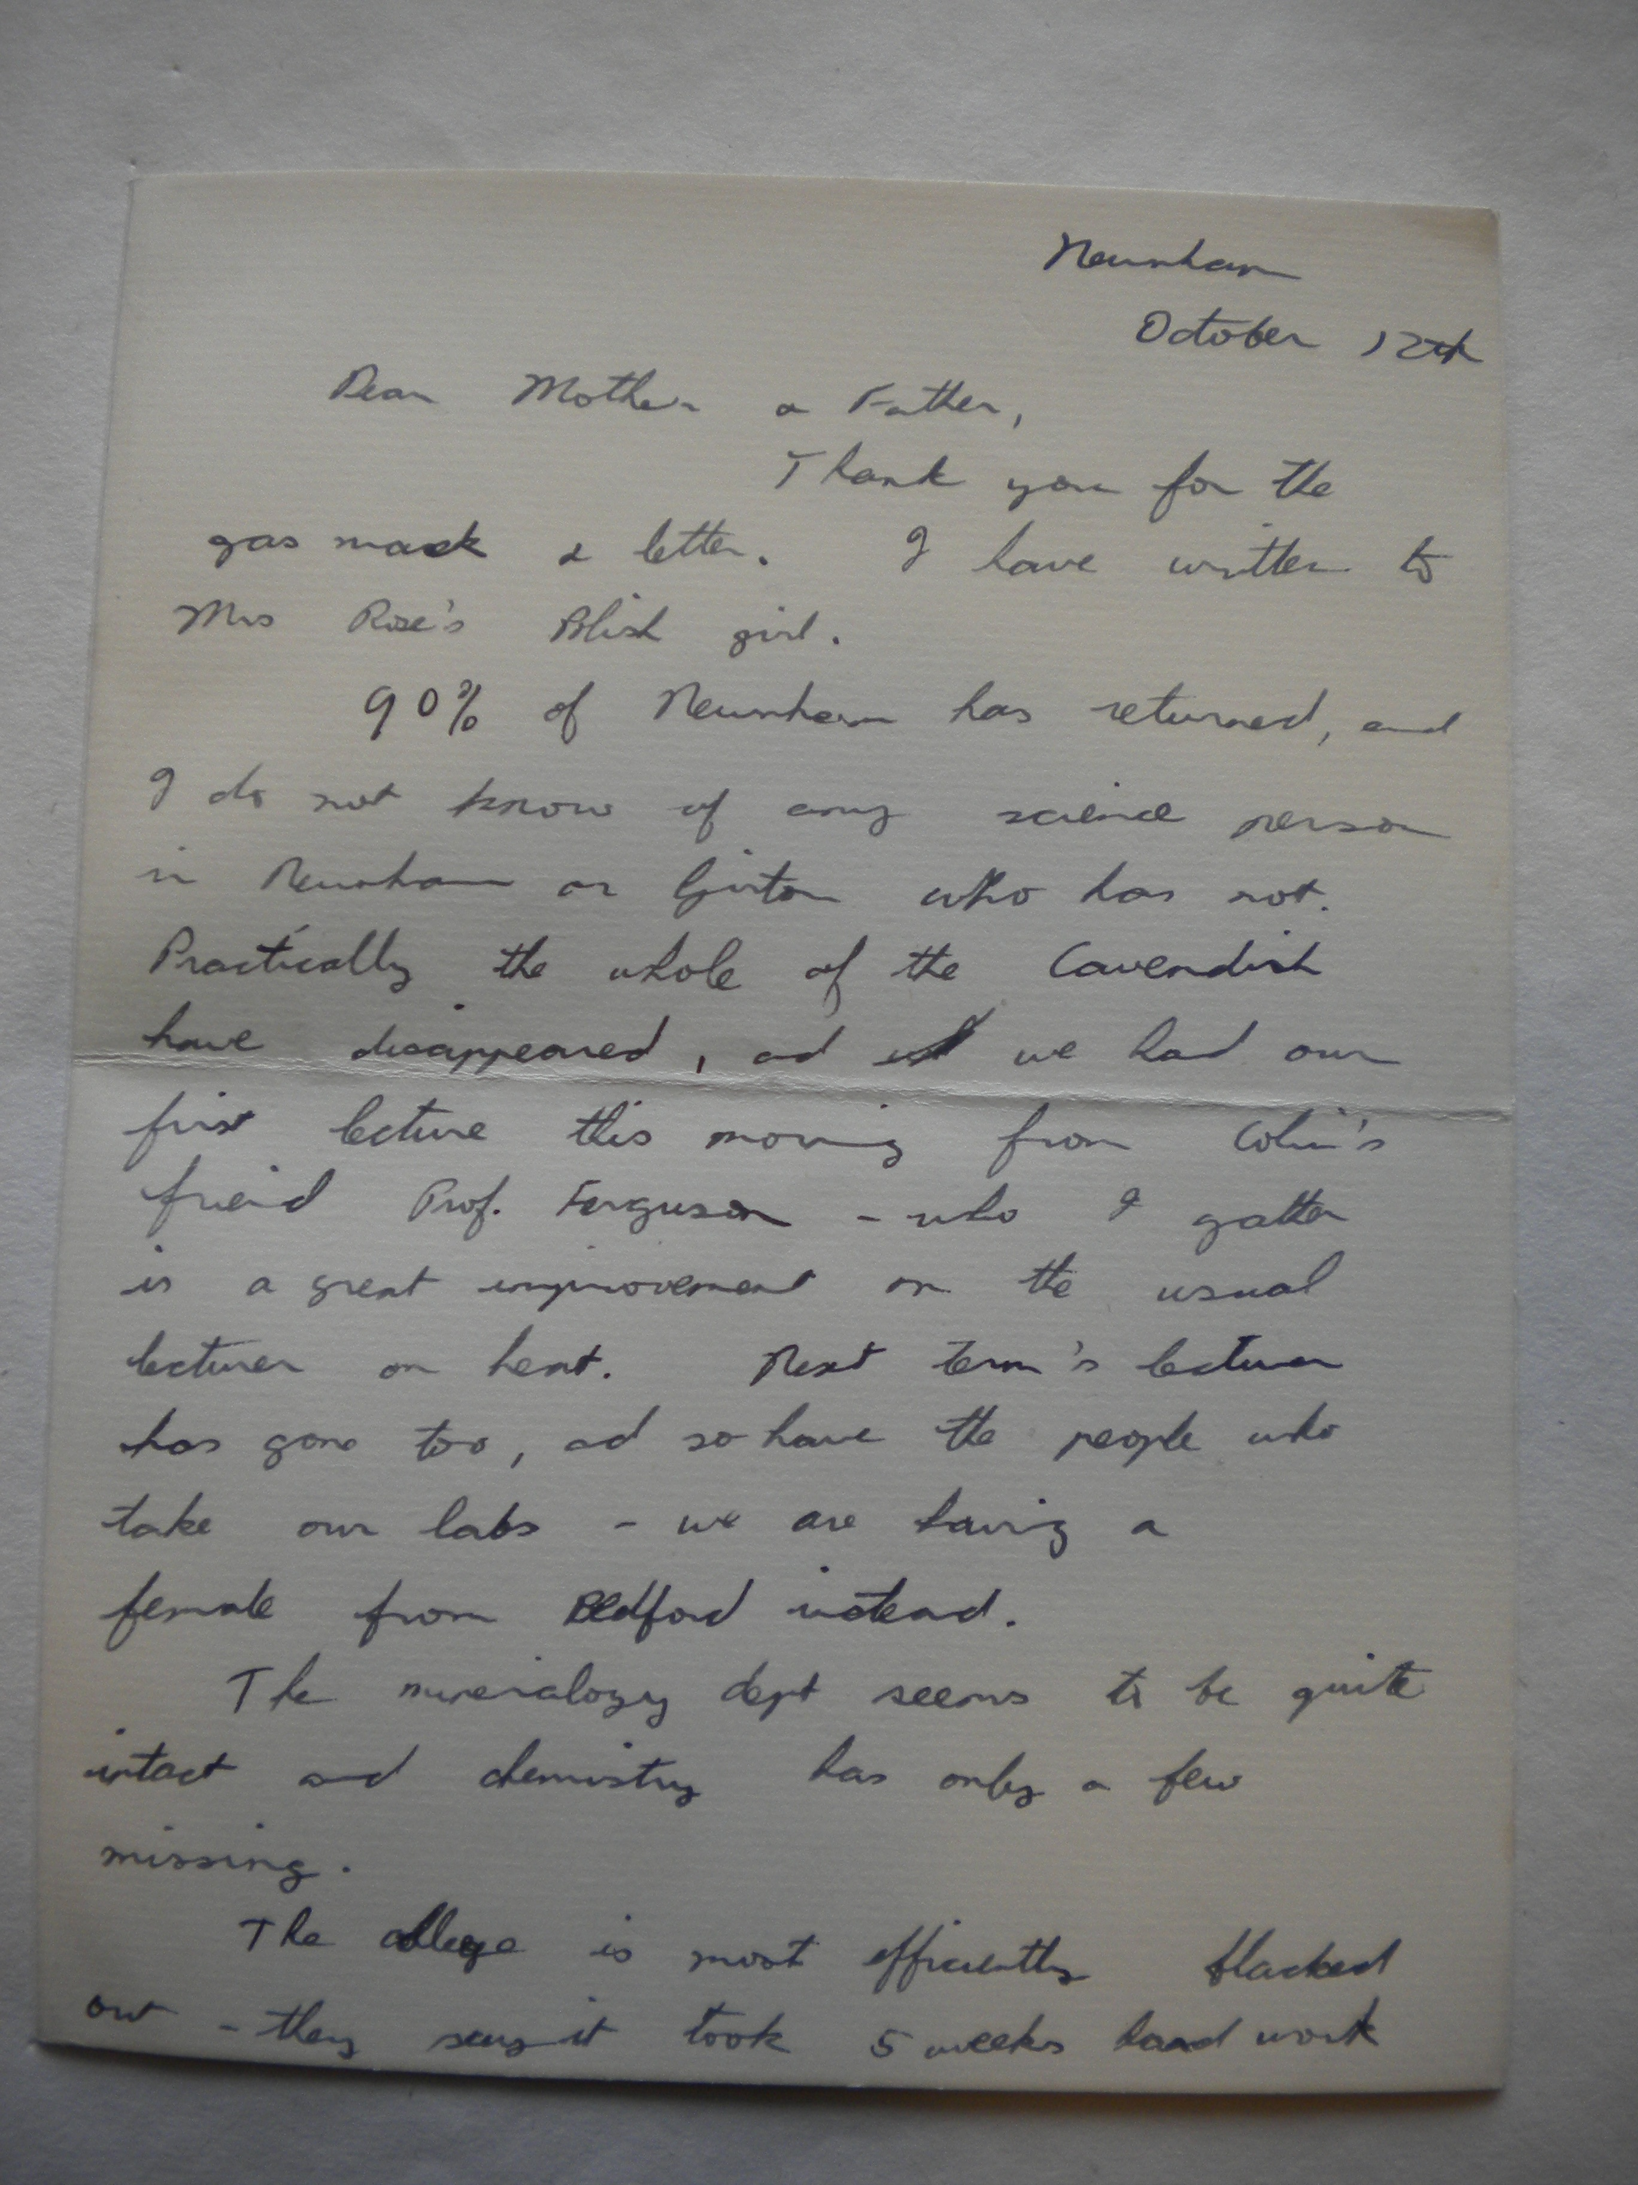
Life at Uni in Cambridge
Only a year after Rosalind arrived in Cambridge the Second World War
began. Although Cambridge was a relatively safe city at the time, it was
still quite frightening.
Rosalind wrote to her family in 1939 saying:
“Thank you for the gas mask- we still don’t have to wear them, but we
spend hours in the trenches every time there is a warning.”

Slide 5
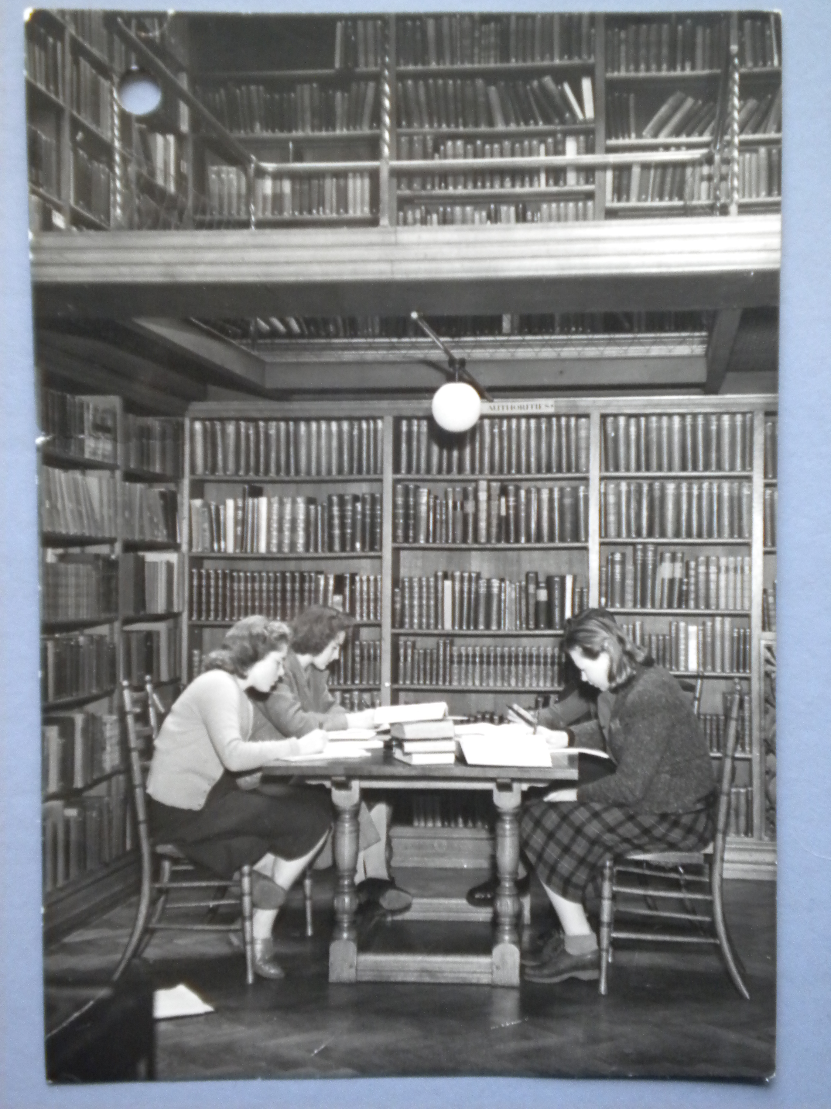
Life at Uni in Cambridge
Rosalind made friends with Adrienne Weil, who was a student of the scientist Marie Curie, who did some key research on radioactivity at the time.
This friendship led her to continue doing her research in Paris and helped her improve her skills as a crystallographer- someone who studies the structure of molecules and atoms, the smallest things in the Universe!

Slide 6
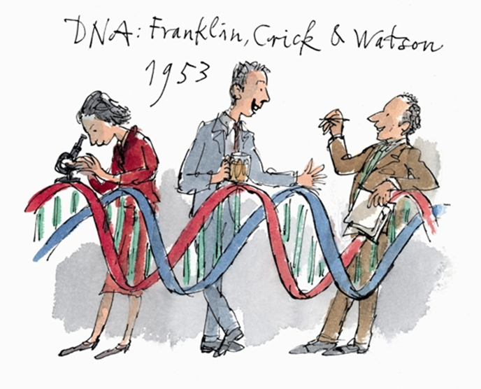
What did Franklin Discover?
Rosalind made some amazing scientific discoveries about
DNA (Deoxyribonucleic acid).
These included proving that phosphates (the ‘backbone’ of DNA) were
on the outside of the DNA structure, rather than on the inside like other
scientists thought at the time.
Quentin Blake Illustration © University of Cambridge

Slide 7
Life Back in London
Rosalind decided to move back to London in 1951 to work in a laboratory at King’s College.
However she had a very difficult time when she was there as women didn’t have the same rights as men, such as not being allowed in certain parts of the university.
Her research partner, Maurice Wilkins, treated her like an assistant, rather than being head of her own project.

Slide 8
Naughty Wilkins!
But then Wilkins (her research partner) showed Rosalind’s picture of DNA (which is known as Photo 51) to their colleagues Watson and Crick, in
secret, without Rosalind knowing!
Watson and Crick then published their findings as the main article in an important journal called ‘Nature’, with Rosalind’s work just as an
accompaniment before Rosalind had published her own work.
Quentin Blake Illustration © University of Cambridge

Slide 9
Who Gets the Prize?
Watson, Crick and Wilkins all received the prestigious Nobel Prize for
Medicine in 1962, for their work.
However Rosalind Franklin never received an award, she sadly died of cancer four years before the award was handed out at only
37 years old, possibly from exposure to the
x-rays during her work.
And Rosalind didn’t even get a degree from her time at Cambridge, as at that time women weren’t accepted as full members of the University until 1948 (when she’d already left).
FACTOID!
Watson, Crick and Wilkins all received the Nobel Prize, but Rosalind Franklin sadly never did.

Slide 10
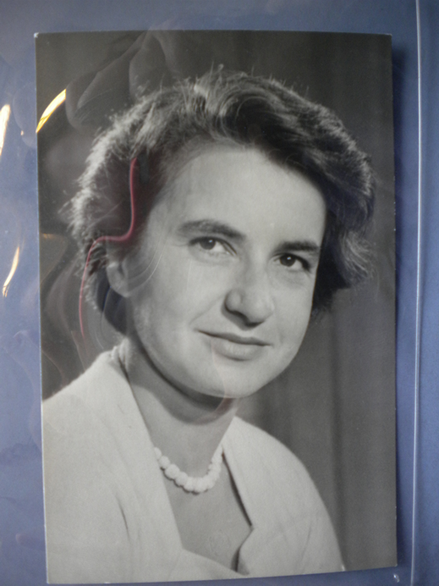
Rosalind’s Aspirations
Rosalind Franklin once wrote in a letter whilst at University:
“My main aim is to do my best to improve the lot of mankind, present and future.”
Although Rosalind didn’t receive a degree or Nobel Prize for her achievement, but the part she played in helping us understand the puzzle of the origins of life are surely proof that she managed to achieve her goal.

Slide 11

Web Resources available at:
http://www.creatingmycambridge.com/
history-stories

