Slide 1

COSTUMES FOR VICTORIANS IN CAMBRIDGE 1845

Slide 2
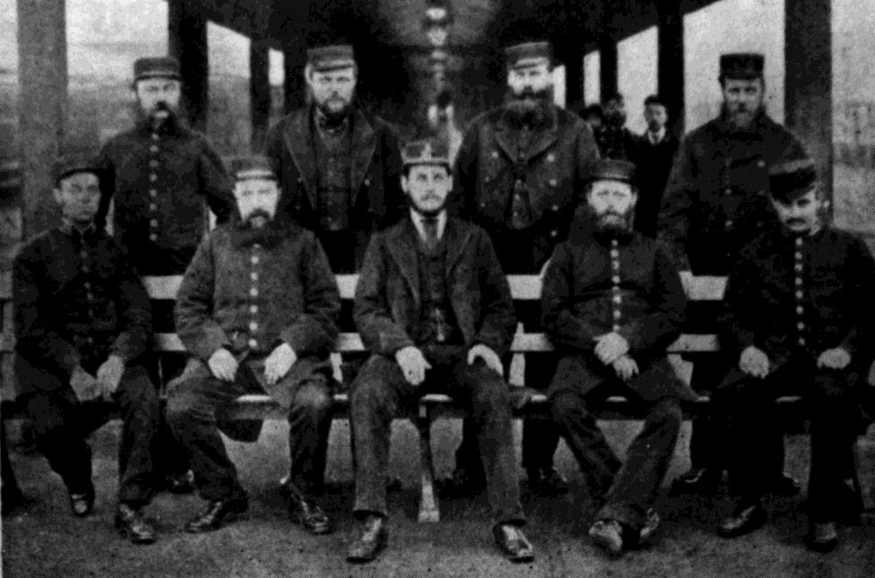
The Station Master and Workers of Cambridge Costumes ideas
A costumes that can be easily copied by wearing black trousers and Jacket. A manager would have worn a waistcoat and tie as you can see from the picture.
Photo of Station Master and workers, from Capturing Cambridge

Slide 3
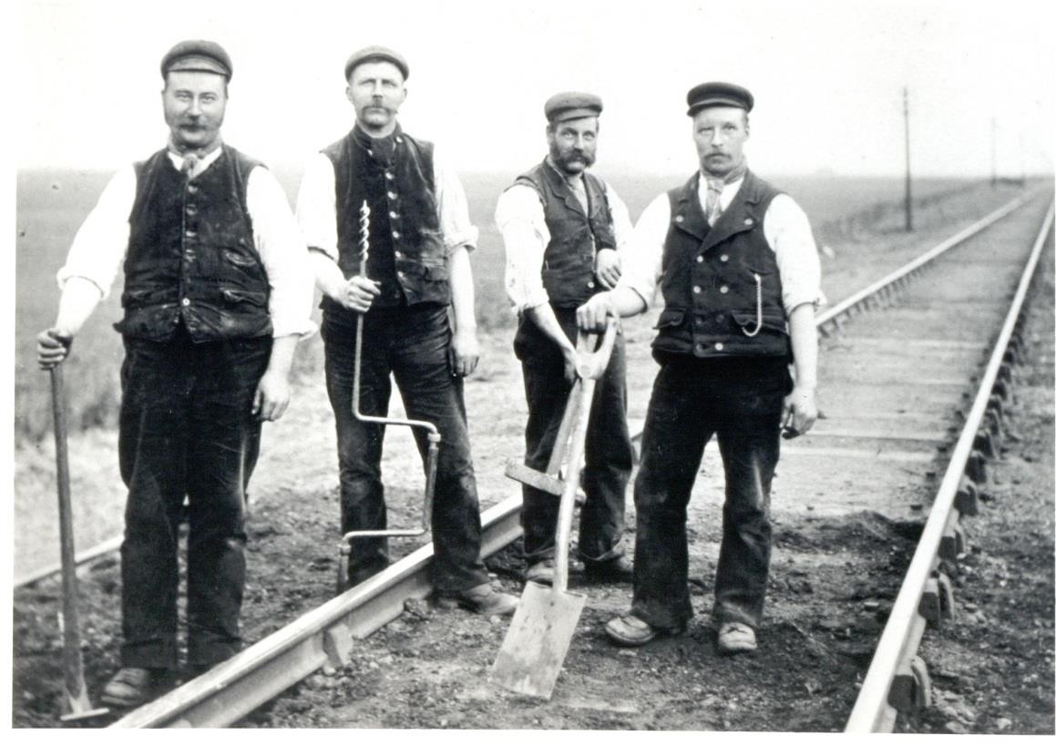
The Railway Workers of Cambridge Costume ideas
A costumes that can be easily copied by wearing black trousers and vest top or waistcoat as you can see from the picture.
Photo of Station Master and workers, from Capturing Cambridge

Slide 4
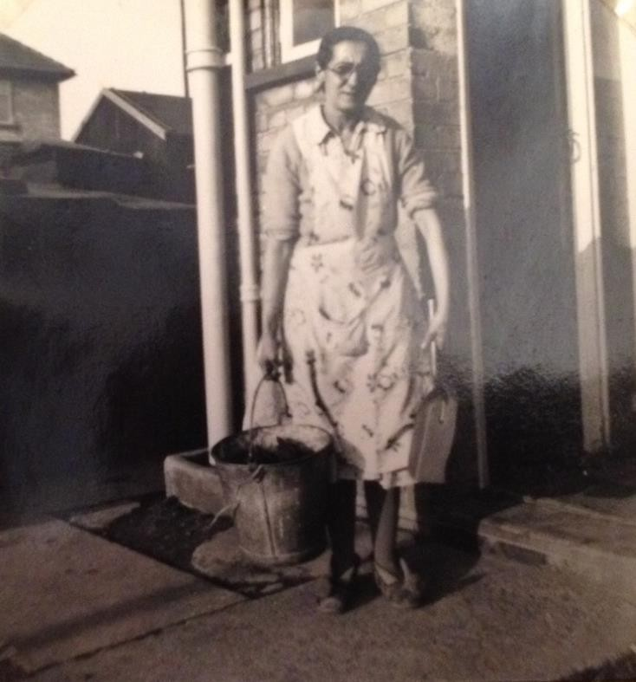
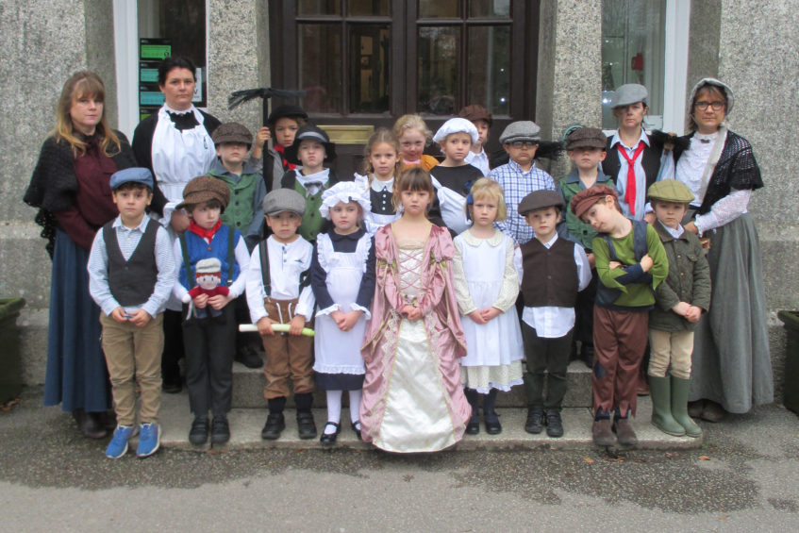
Clothes the Herbert Family would have worn and costume ideas
The Herbert family lived in the Railway Cottages.
Photo of Mrs. Simpkins, in later life,
From Capturing Cambridge

Slide 5
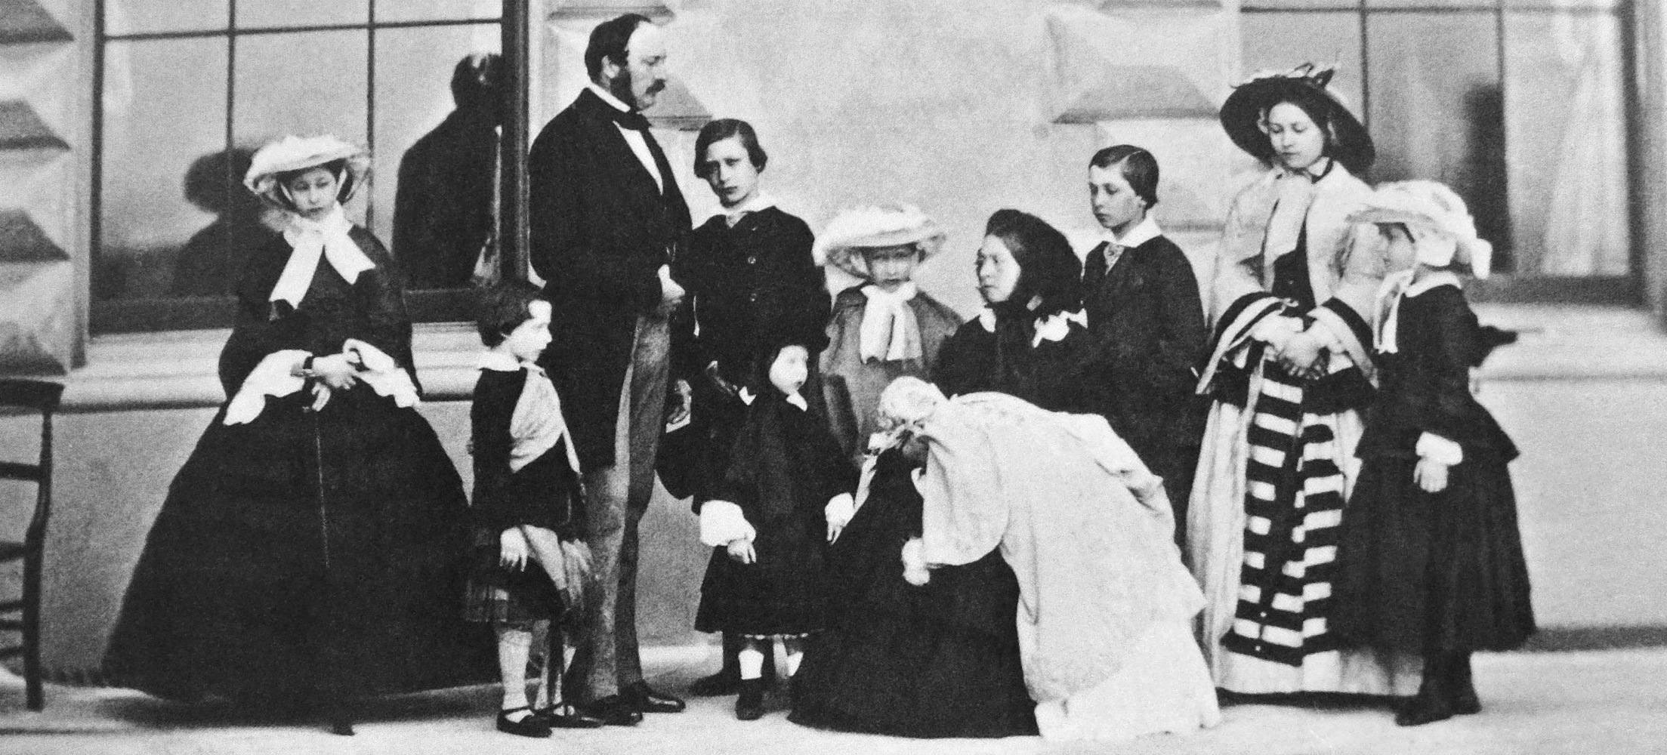
Clothes the Royal family would have worn and costume ideas

Slide 6
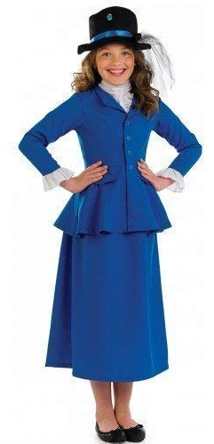
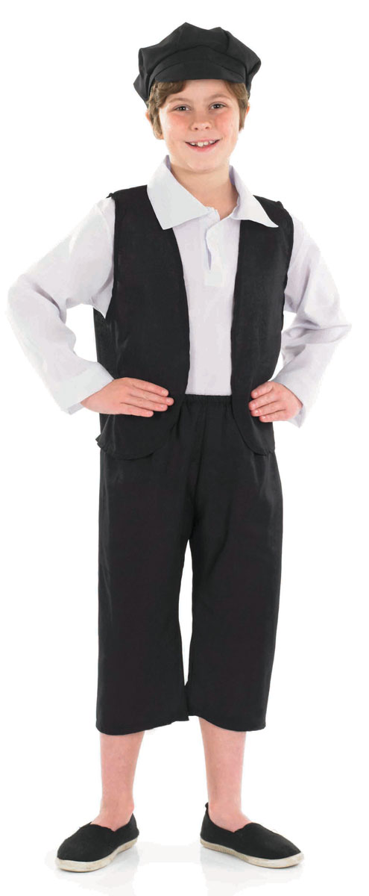
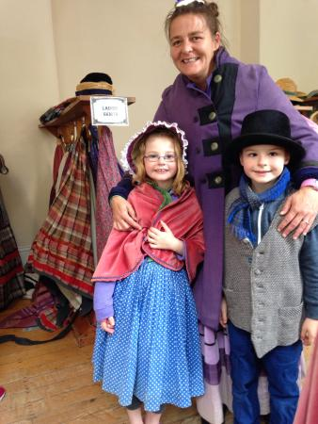
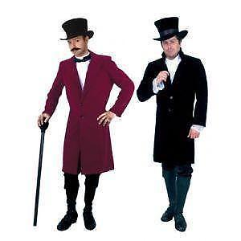
Clothes the Royal family would have worn and costume ideas

Slide 7
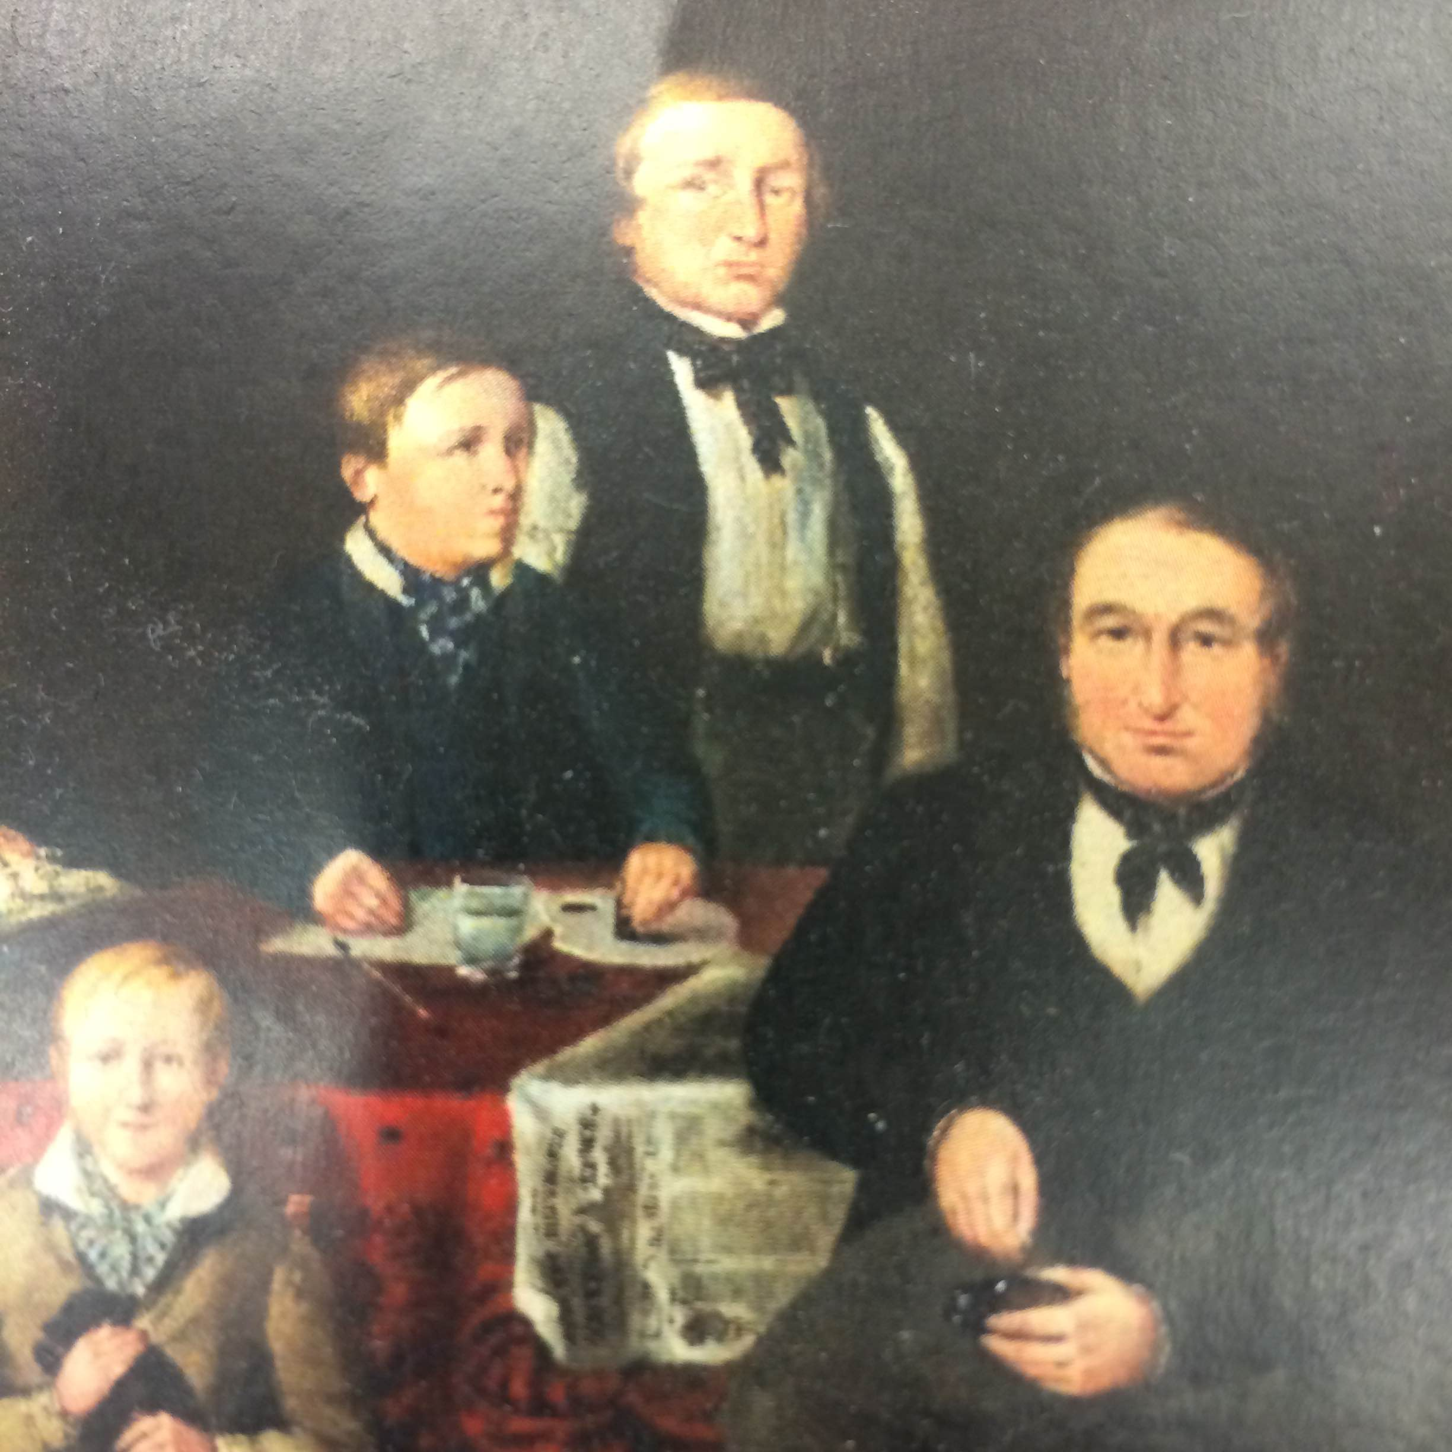
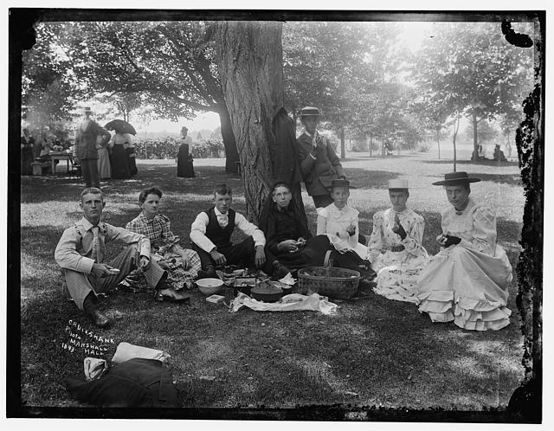
Families at the Victorian feast on Parker's Piece and costume ideas

Slide 8

Web Resources available at:
http://www.creatingmycambridge.com/
history-stories

