Slide 1

The Coming of the Railway to Cambridge

Slide 2
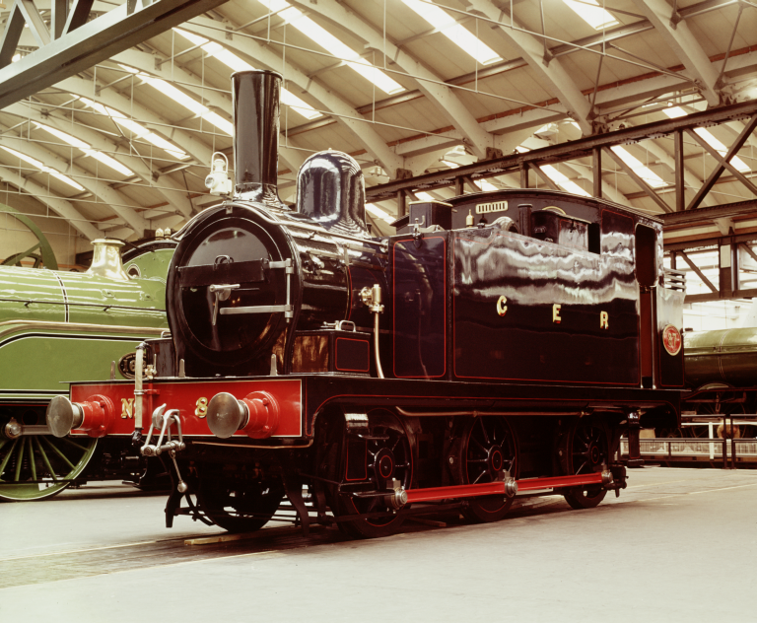
The Railway Comes to Cambridge!
The first successful railway locomotive train ran in 1804 and Stephenson’s Rocket was designed in 1829. Railways then started to expand across the UK.
Eventually the railway reached Cambridge in July 1845, when the first trains made their way there from both London and Norwich.
A Great Eastern Railway Train on display at the National Railway Museum © National Railway Museum and SSPL

Slide 3
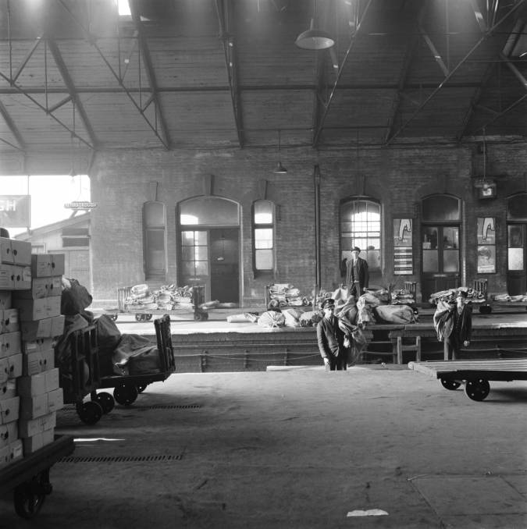
The Train Routes Keep Expanding !
Two years later, in 1847, the line from Peterborough to Cambridge was built, with stops at both March and Ely on the route.
Parcel Delivery Sorting at Peterborough Station- 1970
© National Railway Museum and SSPL

Slide 4
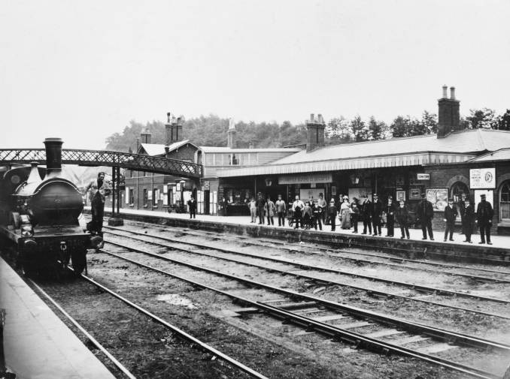
From Train Line to Bus Route…
There was also another line, going west towards St. Ives and Huntington.
FACTOID!
The route of the old railway tracks is now the route that the guided bus uses to get to Cambridge.
Station in Great Eastern Railway Line from
National Railway Museum Collection ©

Slide 5
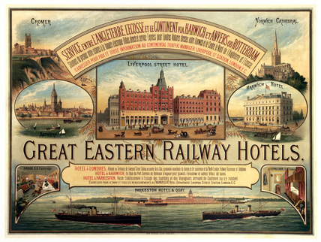
Great Eastern Speed!
FACTOID!
The old Great Eastern route to Cambridge had some of the fastest trains on it- with a train recorded at going at 70mph! The trains had a non-stop time of 72 minutes from Liverpool Street to Cambridge, covering 55.75 miles on
its journey.
Great Eastern Railway Hotels poster © National Railway
Museum, York/ Science & Society Picture Library

Slide 6

Time for a Change!
FACTOID!
British time was standardised across the whole country for the very first time in 1880,
as trains needed to be able to run to a set timetable.

Slide 7
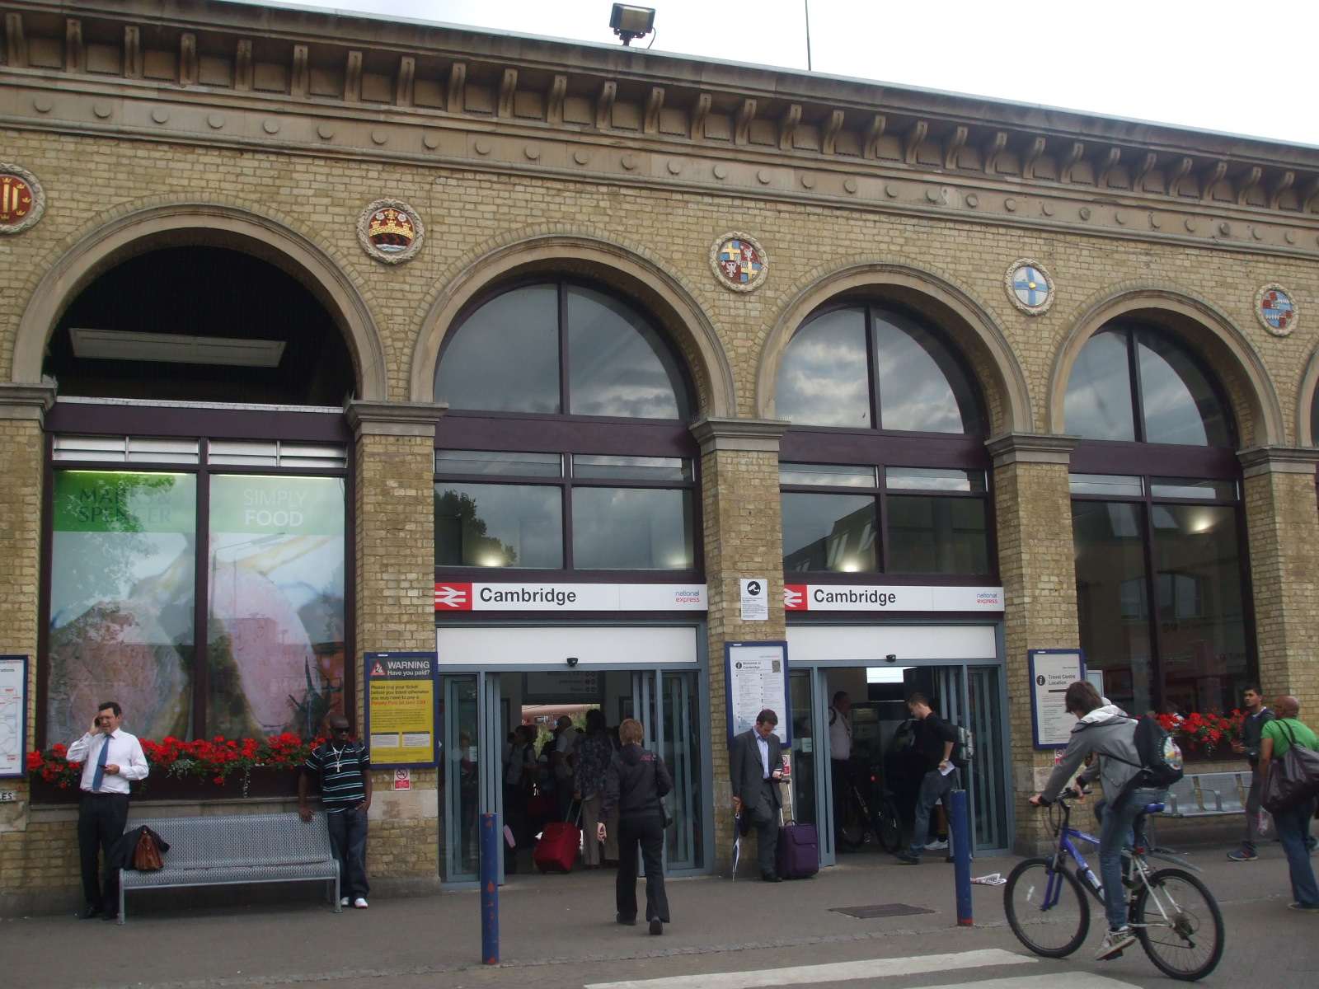
The Grand Design of the Railway Station
The Victorian design of the station was mainly the inspiration of architect Francis Thompson. The very first station opened in 1845 and had just one platform for trains to go both up and down on.
However, the design of station was seen to be more impressive than the other stations along the line, with its grand columns and arches. It also had decorative cornices and friezes- some of which you can still see in the station today!
FACTOID!
The original part of the station is now a Grade II listed building and has been since 1962.
Photo of Cambridge station building close-up, showing the entrance, Sunil Prasannan, 2009

Slide 8
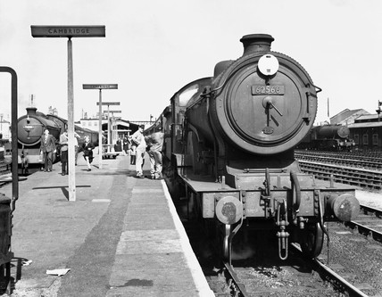
All Aboard the Train!
When the Victorians first built the station there was just a wooden platform for passengers to stand on while they waited for their train.
There was no tunnel or footbridge for people to safely access the train, so people just climbed down onto the line and walked across the tracks to get there- which was incredibly dangerous!
This was later replaced with a larger ‘island platform’ with a tunnel and footbridge, which was much safer.
Picture of old locomotive at Cambridge Station in 1958 © National Railway Museum and SSPL

Slide 9
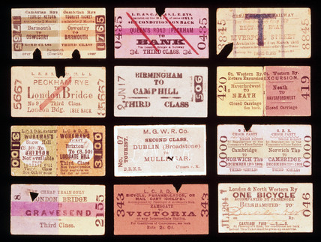
A New Found Freedom to Travel
However it was not all bad news, one of the great positives of the coming of the railway was that it provided the opportunity for people of all walks of life and class to travel.
The train was much quicker, cheaper and more reliable than travelling by horse drawn coach, which was the main way that Victorians travelled long distance.
A selection of early railway tickets-1870-1920
© National Railway Museum / Science & Society Picture Library

Slide 10
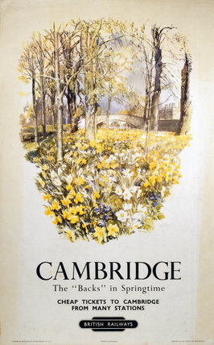
Fancy a Day Trip?
The railway provided the opportunity for working class people to travel.
They were encouraged to use the
excursion trains to go on day trips on a Sunday for a cheap fair, such as visiting Cambridge for 5 shillings, or visiting the seaside.
Cambridge- The Backs at Springtime Poster, 1950
© NRM / Pictorial Collection / Science & Society Picture Library

Slide 11
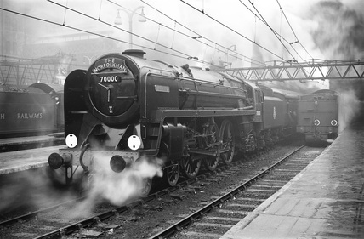
Oh I Do Like to Be Beside the Seaside
The Directors of the Eastern Counties Railway decided to allow their staff to go on daytrips to the seaside in East Anglia, such as Walton-on-the-Naze and Cromer.
The 'Norfolkman’ locomotive
2 February 1951
© National Railway Museum / Science & Society Picture Library
'Come to Cromer, Where the Poppies Grow', LMS/LNER poster, 1923-1947.""Angrave, Bruce"© National Railway Museum / Science & Society Picture Library

Slide 12
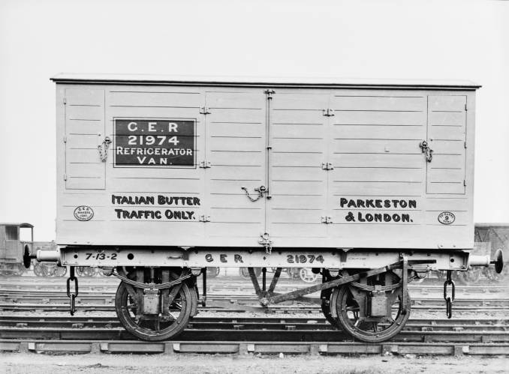
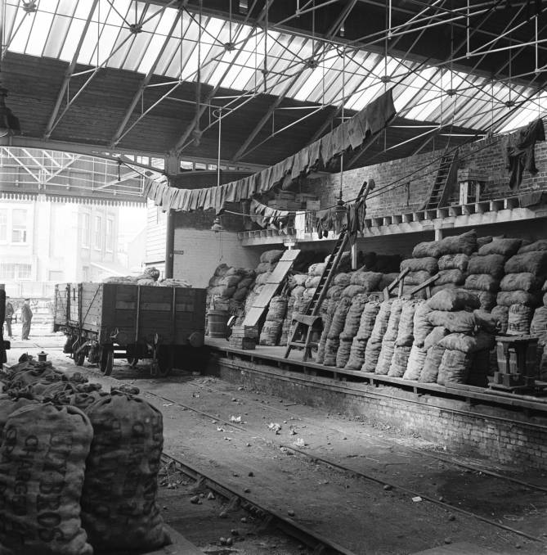
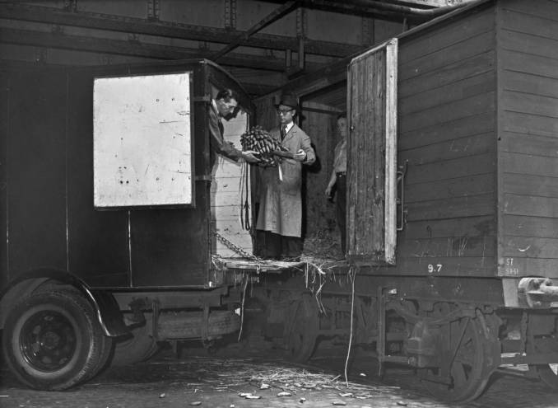
A New Way to Deliver!
The coming of the railway also meant that fresh fruit, vegetables, dairy and fish could all be transported much quicker than by horse or boat. This meant that fresh produce could be delivered from different areas of the country and from ports, to be sold at market much more easily. National newspapers could also be delivered via train, so more people could read newspapers than had done before.
Great Eastern Railway Refrigerator Van, 1898
© National Railway Museum and SSPL
Transporting potatoes by rail ©
National Railway Museum and SSPL
Transporting bananas by rail © National Railway Museum and SSPL

Slide 13
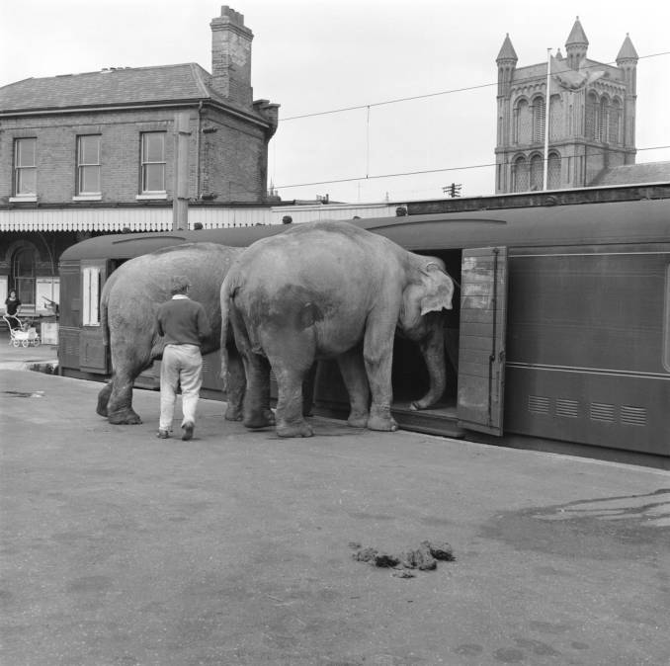
Delivering All Sorts!
Businesses usually used the railway to deliver coal, post or food, but they even used the railway to transport elephants!
Transporting Elephants
© National Railway Museum and SSPL

Slide 14
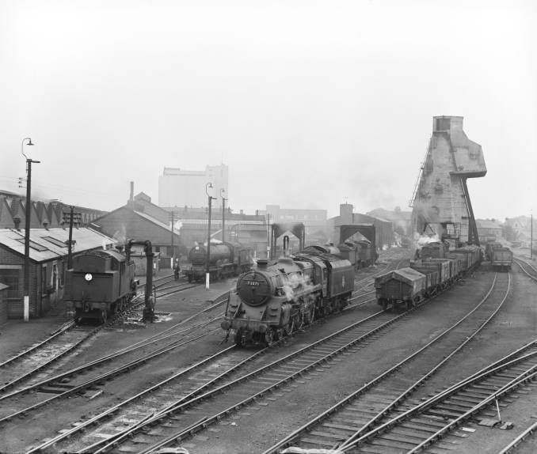
Beware- Danger at Work!
But it was dangerous working on the Victorian railway and many railway workers were seriously injured or killed whilst at work.
The Eastern Counties Railways did however offer a subscription to a kind of hospital healthcare from Addenbrooke’s, which cost employees 10 guineas a year.
As there was no free healthcare from the NHS back in the Victorian Era!
Photo of Cambridge Railway Shed
from National Railways Museum
Collection ©

Slide 15
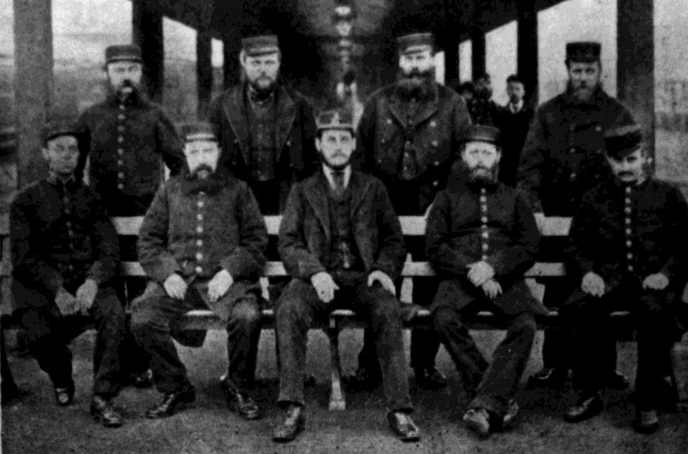
The Railway Workers of Cambridge
One of the Victorian workers on the railway was William Bright, who was described as a ‘good staff man’ and was the station master from 1884 to 1894.
Photo of Station Master and workers, from Capturing Cambridge

Slide 16
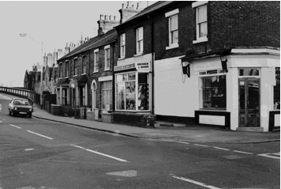
The Station Master’s House
William Bright was the first person to live in Morcombe House, which was the Station Master’s House for many years. It was quite a spacious house compared to the houses of other railway workers.
It stood where the Mill Road Butchers Shop now stands at number 128 Mill Road, on the corner of Devonshire Road, which you can see in the photo.
Photo of the corner by the Butchers shop (where Morcombe House was), from Capturing Cambridge

Slide 17
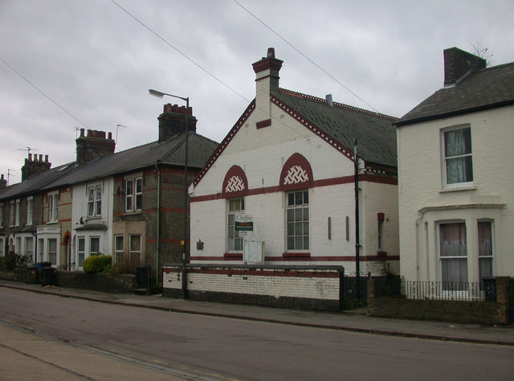
William Promotes
St. John Ambulance
William helped to promote St. John Ambulance Brigade in Cambridge, which trained people to provide free ambulance services to railway workers and other local people (as there was no NHS then).
Records show that in 1893 he oversaw a demonstration of the St. John ambulance work and 59 people were presented with badges and certificates in the Railway Mission Hall for their achievements. The Hall was just round the corner from William Bright’s house, so very convenient for him to get to meetings.
Photo of the Railway Mission Hall, Devonshire Road, 1889, where St. John Ambulance meetings took place
Keith Edkins 2008, geography.org.uk

Slide 18
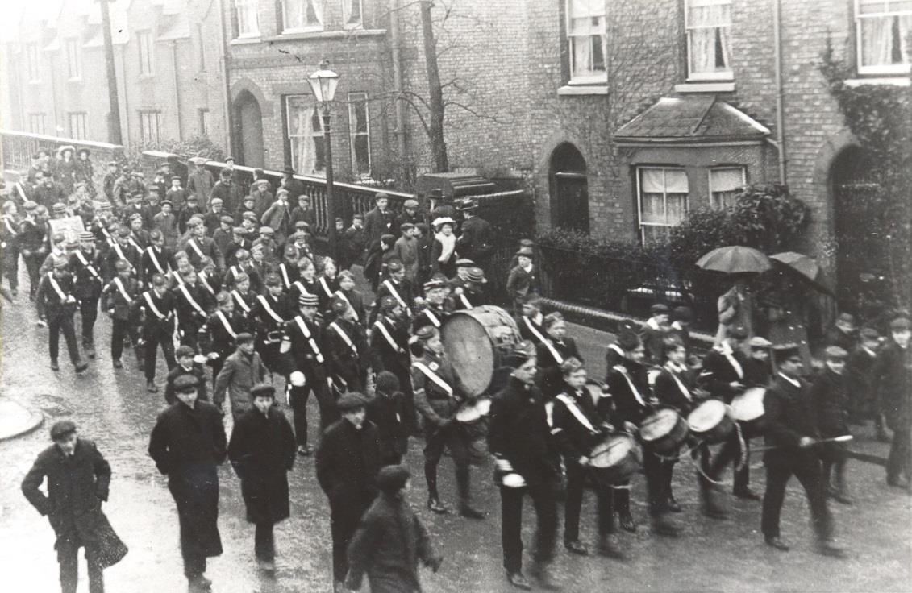
The Cambridge Railway Band
During William Bright’s time, around 1892/3 the Cambridge Railway Band was formed. It was a brass band for local people to join, which was very popular, with about 30 members.
They played in a number of local venues, such as the Railway Mission Hall on Devonshire Road.
Photo of Boys Brigade band, from Capturing Cambridge

Slide 19
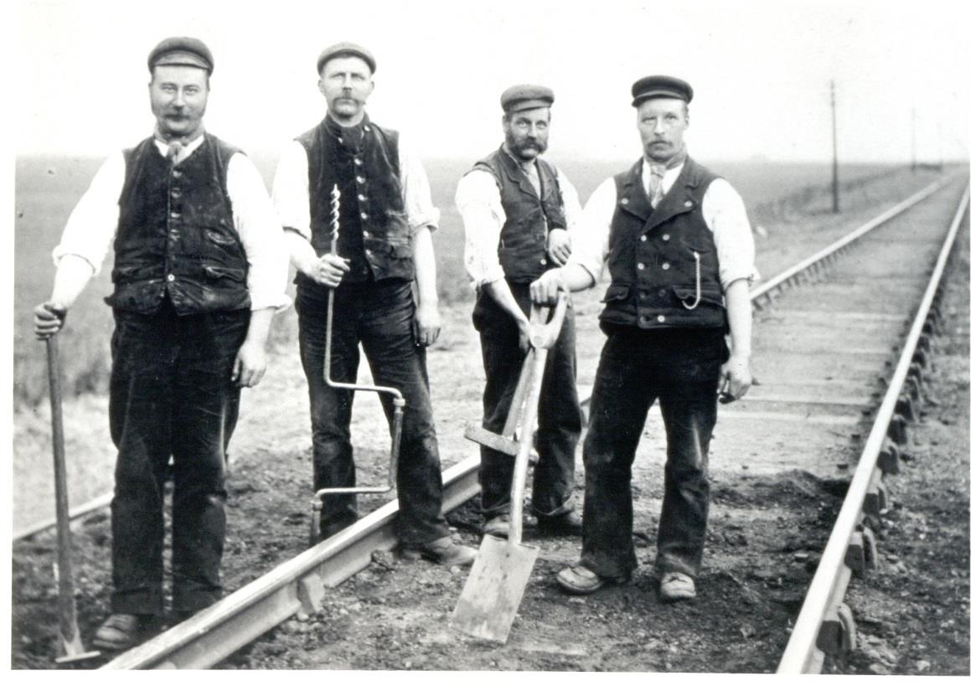
The Railway Men
The railway workers dominated the area- for example in one street in 1900 there were:
4 porters
1 railway labourer
2 fitters
5 drivers
1 coal porter
2 stone breakers
1 boilermaker
1 signalman
3 railway clerks
2 guards
1 foreman
1 shunter
1 goods inspector
1 carriage inspector
1 railway examiner
So there were a huge number of
railway workers, all doing different jobs,
but living on one street with their families!
Photo of Cambridge Railway Track Layers,
from Capturing Cambridge

Slide 20
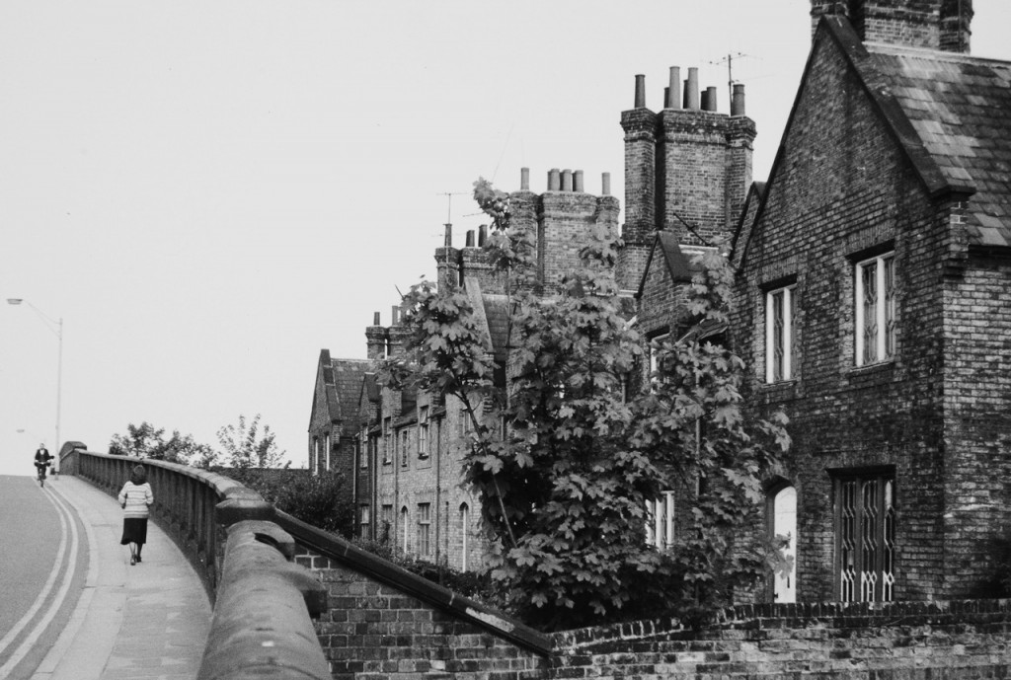
The Railway Men of Cambridge
The Railway Men (Workers on the Railway) usually lived in walking distance of the station.
The Victorian Railway Cottages where workers lived can still be seen on Mill Road today.
Once the railway grew workers then moved over the bridge into other areas close to the station such as Romsey Town.
Photo of The Railway Cottages on Mill Road- where some of the railway workers lived, From Capturing Cambridge
The census of 1851 shows that 29% of people who lived on Mill Road were in some way employed by the railway, a big change from the previous decade, before the coming of the railway.

Slide 21
Cramped Living Conditions in the Railway Cottages
So not everyone lived in such spacious houses like the Station Master. Most railway workers would have
lived in cramp conditions.
For example in the No. 28, one of railway cottages on Mill Road, there were 5 members of the Butler family and 9 members of the Linsey family all living in the same house, so 8 people earning a wage and 6 children under 15 years old.
Photo of Railway Cottages from Capturing Cambridge

Slide 22

Bombing of the Railway Cottages in World War II
Eric Lee was 7 years old when the planes bombed the Railway Cottages during World War II.
He lived just round the corner on Great Eastern Street and remembers the bombing happening.
The Dornier aircraft that bombed the Railway Cottages,
From Capturing Cambridge

Slide 23
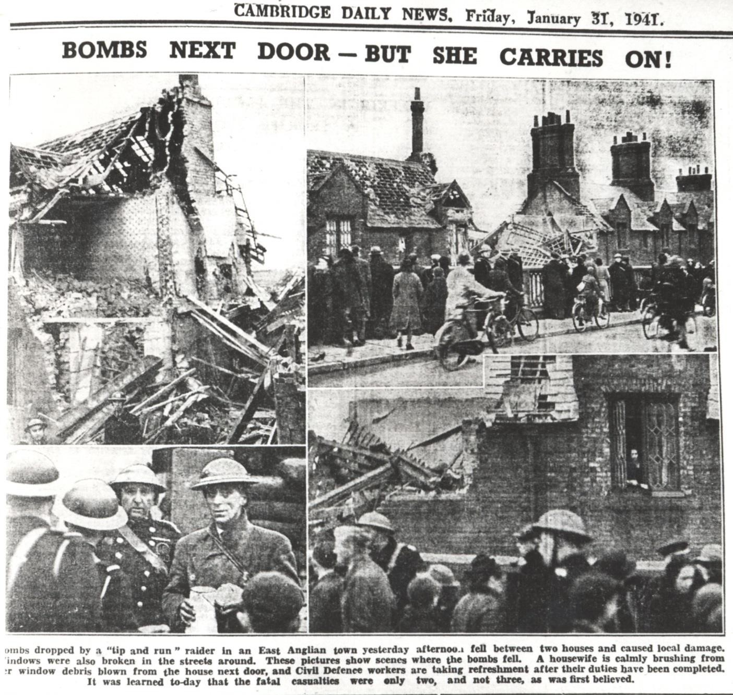
Eric’s Memories of the Bombing on Mill Road in WWII
“On the day of the Mill Road bombing we came out of school in Ross Street ‒ my brother Tony and I. We ran all the way home and on the way the air raid siren went. We looked down the railway track and there was a German plane, and he came up the line dropping bombs. We ran in the house and hid under the stairs with our Mum as you did in those days. The Cambridge Daily News must have sent a photographer early the following morning (a January afternoon would have been dark by 4 p.m.) as the following remarkable photographs and commentary appeared in the newspaper of 31 January”
Cambridge Daily News,
31st January 1941-
Mill Road Bridge Bombing

Slide 24
Cambridge Daily News
31st January, 1941
The Newspaper Article read:
“BOMBS NEXT DOOR — BUT SHE CARRIES ON!
Bombs dropped by a “tip and run” raider in an East Anglian town yesterday afternoon fell between two houses and caused local damage. Windows were also broken in the streets around. These pictures show scenes where the bombs fell. A housewife is calmly brushing from her window debris blown from the house next door, and Civil Defence workers are taking refreshment after their duties have been completed. It was learned to-day that the fatal casualties were only two, and not three, as was first believed.”
The writers of the newspaper were careful not to give the Germans any clues about the bombing, for example not stating the name of the town or mentioning how close it was to the railway line or station.

Slide 25
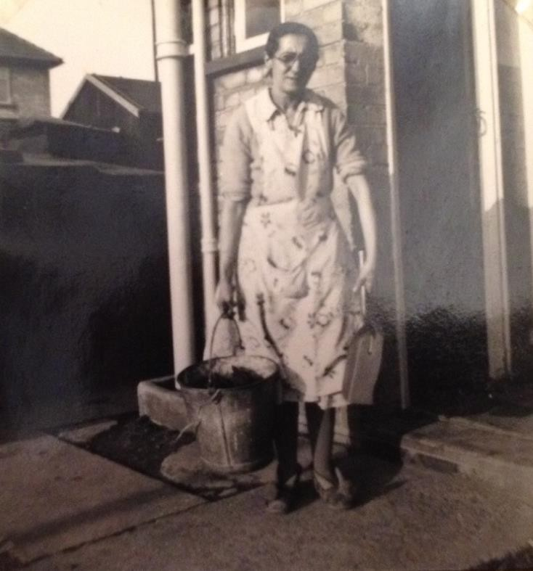
The Herbert Family’s Memory of the Bombing
The Herbert family also lived in the Railway Cottages. On 6th May, 1938 Roger Simpkins was born in the Railway Cottages. He was 3 years old when the bombing happened. He shared this memory with the Mill Road History Project:
“Dad was a messenger boy when he first started with the railway, but when they were bombed out he was a guard, a goods guard during the war. Ours was actually knocked down because me and mum were in it. I can’t remember it because I was too young but mum went under the stairs, we got under the stairs and I suppose it all come down on us. They must have dug us out. I know she got a cut, I didn’t get nothing, me, but Mum had a cut on her head. I suppose that was quite serious. I never heard anyone else was injured.”
Photo of Mrs. Simpkins, in later life,
From Capturing Cambridge

Slide 26
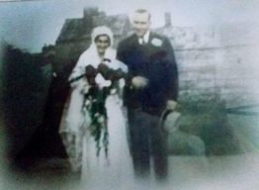
The story continues…
Roger’s brother Robin (who was born a year after the bombing) continued
the story:
“The old chap, my dad, used to say he came back from a work shift early in the
morning about 3 or 4am and walked over the bridge from the Argyle Street side.
He met a policeman who said ‛So where are you going?’ and he said ‛I’m just going
home; I live just over the other side of the bridge’. The policeman said ‛I’m afraid your
home isn’t there any more.’ Apparently he always used to say to Mum ‛If anything
drops out of the sky get under that staircase’.”
Photo of Herbert and Edith Simpkins
on their wedding day
From Capturing
Cambridge

Slide 27
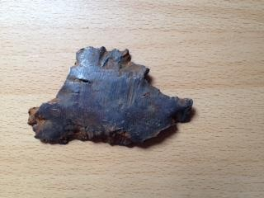
Fragments of the Bomb
Still Survive
“I was 13 in 1941 and went to Central school. January 30th was the day of my grandmother’s funeral. She lived in Mawson Road so after the funeral the family apparently collected back at Mawson Road. And as I was thought to be young to attend the funeral I was staying with a neighbour at 37 Ross Street.
And of course the bomb fell. As far as I can remember I was expected back at the house about four o’clock or half past three, but I thought they said leave at four o’clock and of course my parents panicked because when the bomb dropped I could possibly have been on the bridge. My father walked as far as the bridge and he had quite a job getting over because they were stopping people coming over at the time, but when he explained that his daughter could have been on the bridge they let him through to check I was still at Ross Street.
I remember him arriving at Ross Street , great great relief. And of course then we had to go back and they let us back over the bridge. I can’t remember what it looked like at all. They must have been holding people back; there was very little traffic in those days; it was mainly pedestrians. I’ve no idea when he picked up the bit of bomb…. this is completely guess work.. I would have said when he was asking permission to go over the bridge, when he was standing there. I don’t recall him stopping when we were together but I really don’t remember. I remember the gap in the bridge, about half way up where the bomb caught the railing. They didn’t start mending that for a long long time, till after the war I think. Somehow we’ve kept that bit of the bomb all the time, through all the house moves.”
Photo of fragment of bomb picked up by Charles Langley on 30 January 1941 From Capturing Cambridge (Reproduced by kind permission of Pam Seaber. Photograph Caro Wilson)

Slide 28

Inspiration for Your Own
Poetry About the Railways
Michael Rosen has lots of great ideas to help you get started with your own poetry writing inspired by the railways.
Watch Michael Rosen performing his poem ‘Hand on the Bridge’ here which is inspired by the rhythm of the train going down the track.
In his book ‘What Is Poetry?’ (pages 16-20) Michael also talks about Robert Louis Stephenson’s poem ‘From a Railway Carriage’ which is a great example of a poem that gives an impression of something – in this example it’s going on a train. Listen to children from Ridgefield performing Robert Louis Stephenson’s poem ‘From a Railway Carriage’ and their own poems inspired by his poem here.

Slide 29
More Inspiration for Your Own Poetry About the Railways
Another poem to help inspire your poetry writing is called ‘This is the Night Mail’ by W. H. Auden, which also has a great sense of rhythm and pace, to mimic the trains. The poem was written especially for a documentary about the trains that delivered mail called ‘The Night Mail’.
Watch a video of the poem being performed here.
You can use these these poems as inspiration for writing your own poetry about the railways, travelling by train and working on the railways!

Slide 30
Discover More…
The Railway Cottages Report- from Capturing Cambridge
Capturing Cambridge- Mill Road Area- further information
The National Railway Museum - http://www.nrm.org.uk/
The National Railway Museum Collection- with hundreds of railway images, posters etc.

Slide 31

Web Resources available at:
http://www.creatingmycambridge.com/
history-stories

