Slide 1
River Cam

Slide 2
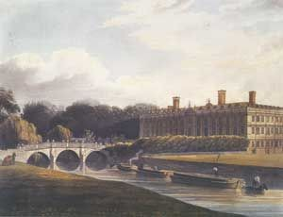
The River Cam
The River Cam has been
navigable at least since
Roman times, and from the Middle Ages onwards, barges were used to bring heavy
goods to Cambridge. The people working on the boats lived on them.

Slide 3
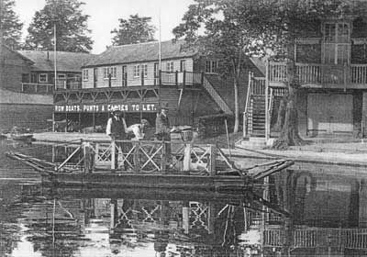
The River Cam
Barges brought stone for the
College and University
buildings (including King’s College Chapel). They also carried the goods for trading at

Slide 4
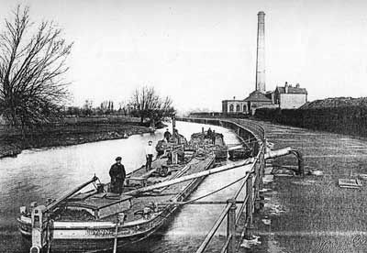
The River Cam
In addition, a variety of boathouses, ferries for
crossings and industrial boats going to and from the gasworks on Riverside plied

Slide 5
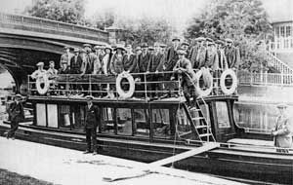
The River Cam
With the coming of the railway in 1845, the industrial traffic on the river waned, leaving the river purely for recreational
and residential use

Slide 6
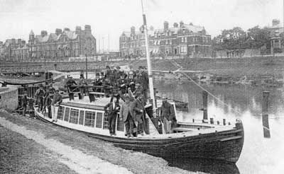
The River Cam
The last thirty years have seen a renaissance in the use of the
river. There are now more than
2,000 rowers registered at over 30 boathouses in Cambridge. There are also a large number or liveaboard boats

Slide 7
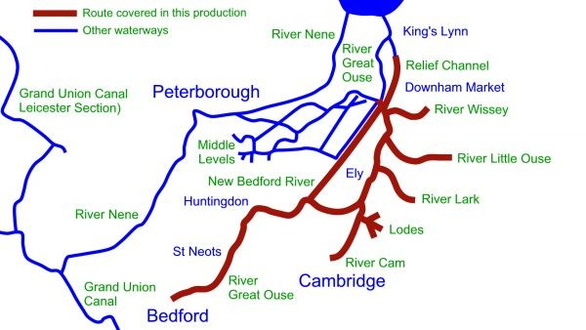
The River Cam
In 1699, the Corporation of Cambridge sought to obtain an Act of Parliament which would allow them to improve the river from Clayhithe to Queens Mill at
Cambridge.

Slide 8
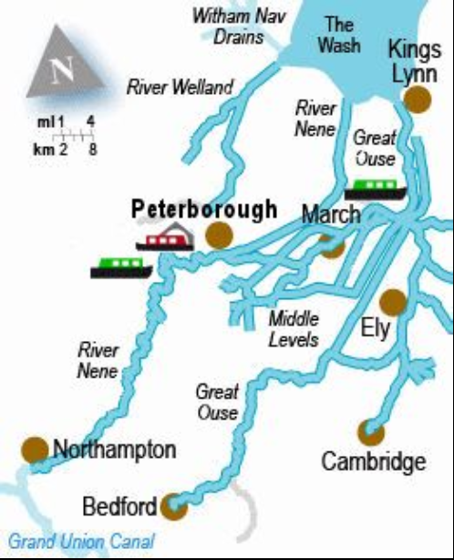
The River Cam
This was obtained on 27
February 1702 and created the Conservators of the River Cam, a legal body with authority to charge tolls for use of the river, which ranged from four shillings (20p) a ton for wine to one penny (0.4p) per person for passengers.

Slide 9
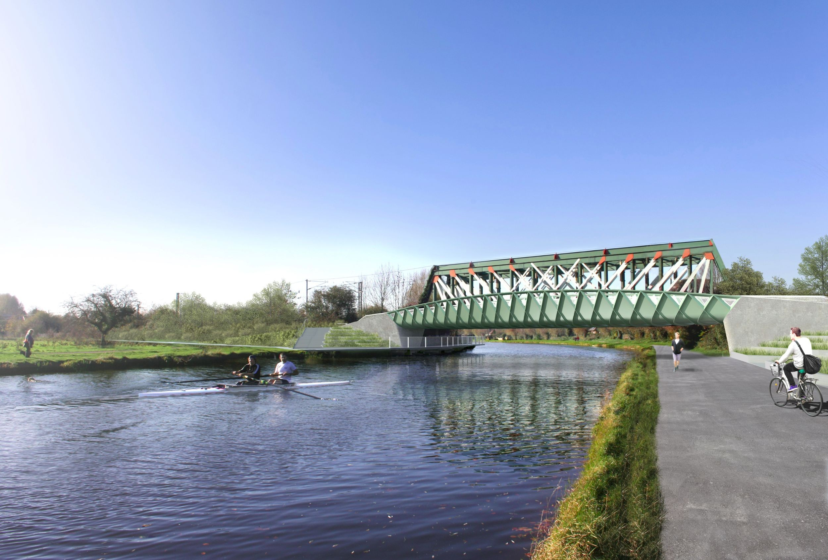
The River Cam
The Conservators raised
capital for improvements to the river immediately. They built sluices at Jesus Green, Chesterton and Baits Bite.

Slide 10
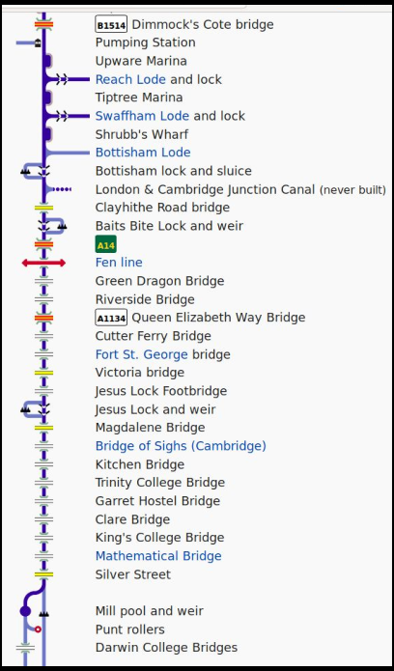
The River Cam
The river entered a period of steady
profitability, with toll receipts rising from £432 in 1752 to over £1,000 by 1803. In 1835 they peaked at £1,995, and then declined slightly until 1846.
The Convervators also raised some
revenue from rents on the public houses which they owned adjacent to each of the sluices.

Slide 11
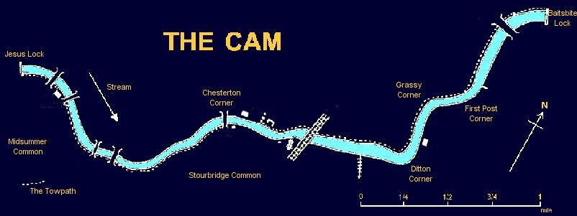
The River Cam
In 1699, the Corporation of Cambridge sought to obtain an Act of Parliament which would allow them to improve the river from Clayhithe to Queens Mill at Cambridge.

Slide 12
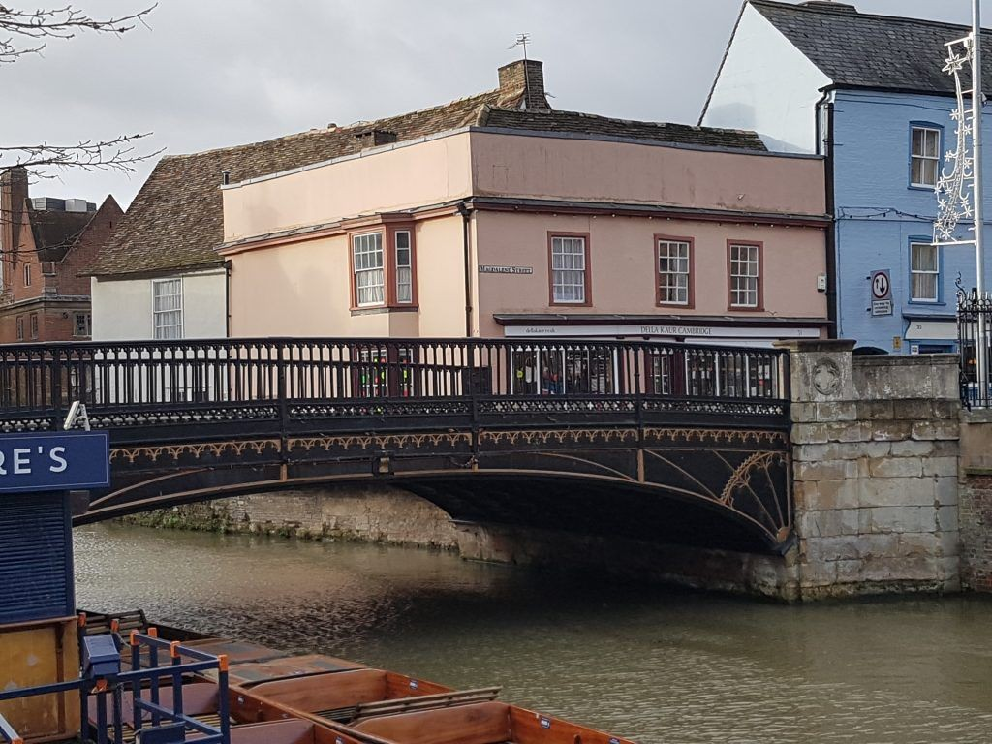
The River Cam
The river was sufficiently profitable that the Conservators were able to
contribute £400 towards the cost of rebuilding the Great Bridge, now called Magdalene Bridge

Slide 13
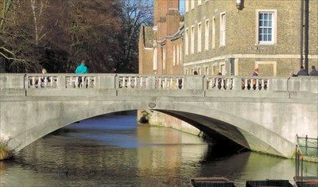
The River Cam
In 1823, and a further £300
for the rebuilding of the Small Bridge, now Silver Street Bridge, in 1841.

Slide 14
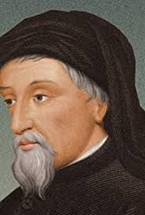
The Reeve’s tale by Chaucer (1476)
At Trumpyngtoun, nat fer fro Cantebrigge,
Ther gooth a brook, and over that a brigge, Upon the whiche brook ther stant a melle; And this is verray sooth that I yow telle:
A millere was ther dwellynge many a day.
The mill pond is extant and the foundations of the mill can be seen when the water is low

Slide 15
www.cambridgeriver.info
http://www.creatingmycambridge.com/songs-creative/magdalene-bridge/
https://www.waterways.org.uk/waterways/canals_rivers/river_cam/river_cam
https://www.camconservancy.org/

Slide 16

Web Resources available at:
http://www.creatingmycambridge.com/
history-stories

