Slide 1

The Cambridge Suffragettes

Slide 2
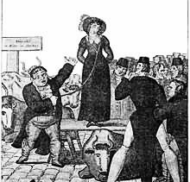
It’s Not Your Right!
Until recently, women were not thought to be equal to men. Women were thought of as weak and stupid.
FACTOID
Some women were even sold at a market, alongside cows and sheep. As late as 1928 a woman was sold for only £1!
Women were denied rights that now we take for granted. They were not allowed to get a degree, to vote in general elections or to do lots of jobs, like being a doctor.
Indeed, women were regarded as the property of their father or husband. This meant women couldn’t own anything themselves and that these men could do what they wanted to them. Hitting your wife was not against the law!
Here is a drawing of a wife sale. Can you imagine how this woman would have felt?

Slide 3
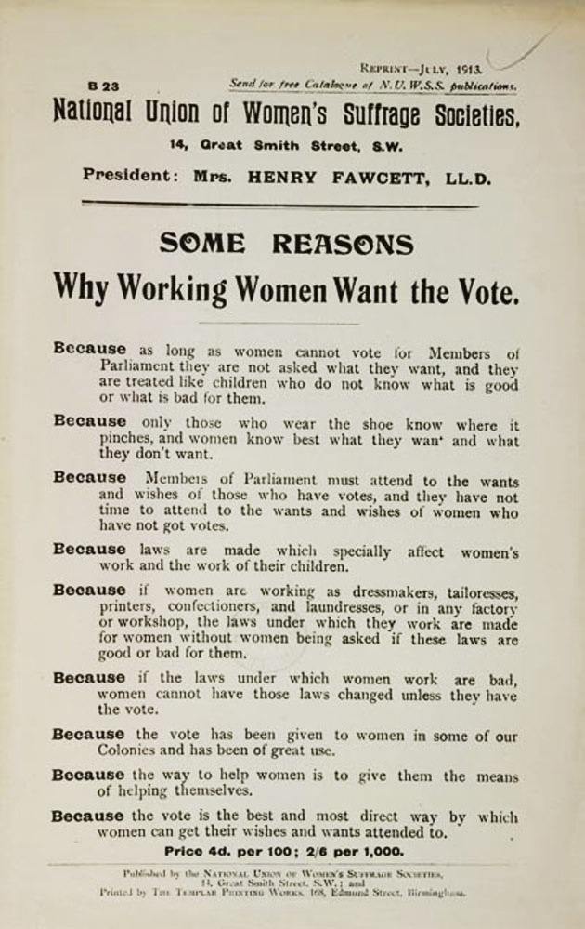
Women Fight Back!
In the mid 1800s, women grew frustrated with the inequality. They began to unite, and to campaign for women’s rights.
The first group to do so, called themselves the Suffragists. They campaigned using peaceful means, for lots of different rights. They focused, however, on getting women the vote!
This is a pamphlet from 1913, listing the reasons why women thought they should have the vote. Which one do you think is the most convincing?
Photo from the British Library

Slide 4
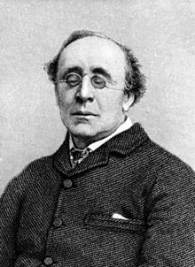
The Suffragists in Cambridge – “No vote, No Census!”
The Suffragists were very active in Cambridge! They held SIX meetings in the area in 1907.
At one meeting, the Suffragists were encouraged to bring their husbands! Do you think the men would have wanted to go?
Here is a picture of Henry Fawcett, husband to Milicent who led the Suffragist movement. What do you think he thought of the campaign?
FACTOID
A Census is when the government records who everyone is and where
they live
In 1911, the Cambridge Suffragists gathered together and refused to fill in the Census. If the government wouldn’t treat them as citizens, they would not comply with it’s regulations.

Slide 5
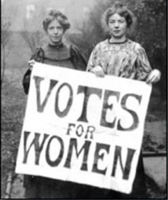
Women Fight Back, Harder!
FACTOID
‘Suffrage’ means the right to vote. This is why they called themselves Suffragettes!
In the early 1900s, some women got tired
of the lack of progress the Suffragists had made using peaceful means. They broke
away into a new group called the
Suffragettes.
The Suffragettes used much more violent means to pressure the government into giving them the vote. They planted bombs at train stations, churches and even at the houses of politicians! They smashed all the shop windows in Oxford Street and even slashed up paintings in the National Portrait Gallery!
Photo from HerStoria

Slide 6
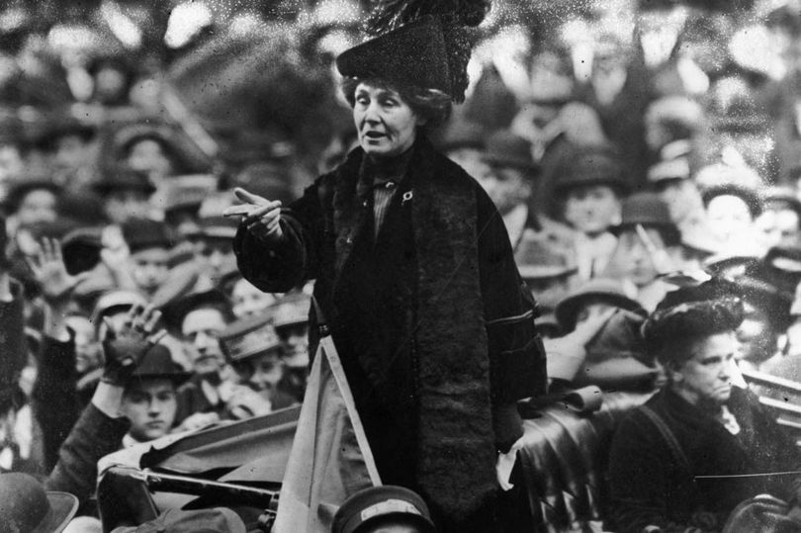
The Suffragettes in Cambridge
Like the Suffragists, the suffragettes were also very active in Cambridge. Their leader, Emmeline Pankhurst came to speak three times!
Their speeches often became loud or violent events, as men tried to prevent the Suffragettes from getting across their message. Opponents would sing, blow whistles, or even ring the bells of Great St Mary’s for hours, so no one could hear the speakers.
Once, a suffragette, Mrs Brailsford was speaking to a crowd from a lorry on Parker’s Piece. Children and teenagers, trying to silence Mrs Brailsford, started moving the van from side to side, then pushed it into the middle of a cricket match!
Photo of Suffragette leader Emmeline Pankhurst talking from a car to a large audience

Slide 7
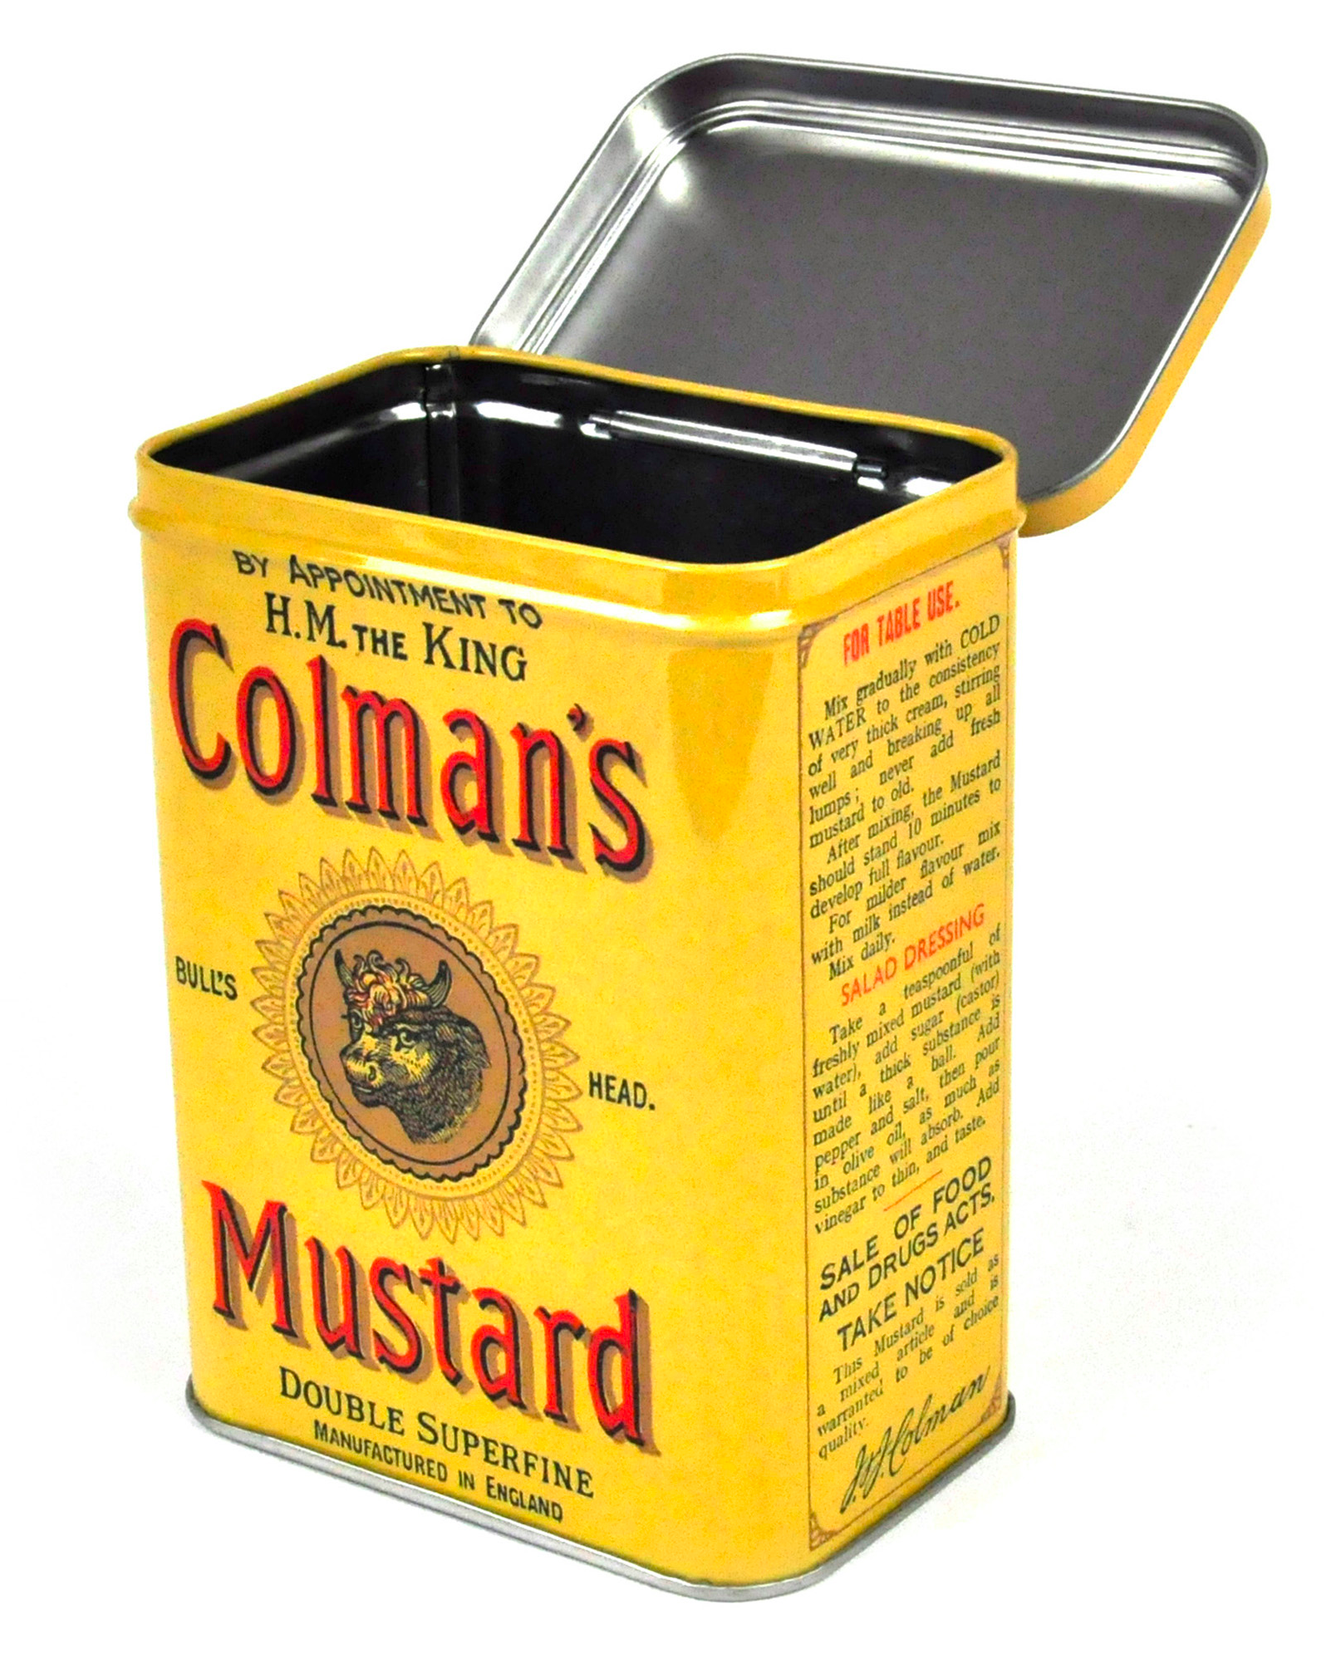
“Deeds Not Words”
The Suffragettes did more than just talk – their motto was “Deeds not words”. They proved this in Cambridge!
In 1913, the Suffragettes tried to set fire to the Varsity Rugby Pavilion using a bomb they had made at home in a mustard tin! A woman’s shoe and a card reading ‘Votes for women” was found near the scene of the crime!
At almost the same time, a square parcel, labelled ‘Votes for Women”, was discovered in the lounge of a hotel in Cambridge! Everyone was terrified because they thought it was another bomb, about to explode, but it turned to be only a block of wood!

Slide 8

That Wasn’t All..!!
In the same year, 1913, a suffragette was also convicted of setting fire to a house in Storey’s Way, just a few minutes from the town centre!
And as if that weren’t enough, the Suffragettes also planted a bomb at a railway crossing! It was made from a bootlace, leading into a tin filled with flammable materials, like cotton-wool soaked in oil and charcoal. It didn’t go off, but it was a close call!

Slide 9
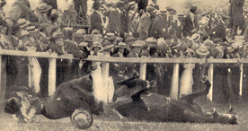
A Sacrifice for the Cause
In June 1913, Emily Davidson, a suffragette, died after she tried to pin a suffragette scarf to the King’s Horse as it raced in the Epsom Derby.
People are unsure whether she intended to die, but regardless, she became a martyr for the Suffragette cause.
Emily
The King’s Horse
Photo from the British Library

Slide 10
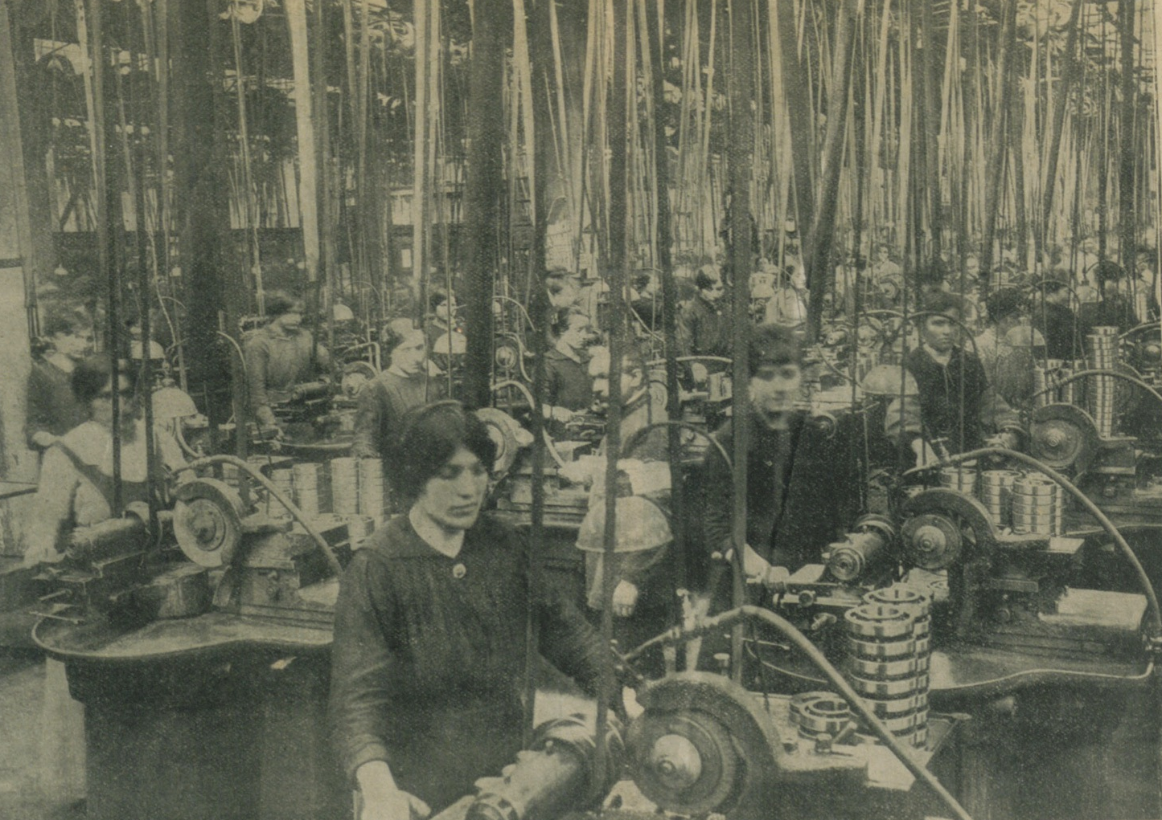
Success!
Emily Davidson’s death, along with the horrible force-feeding of Suffragettes, who went on hunger strike when arrested, meant that gradually the public began to sympathise with these women.
After women helped out a lot at home during the First World War, working in factories and as nurses, some women were given the vote in 1918.
Photo of women working in a factory in World War One from the British Library

Slide 11
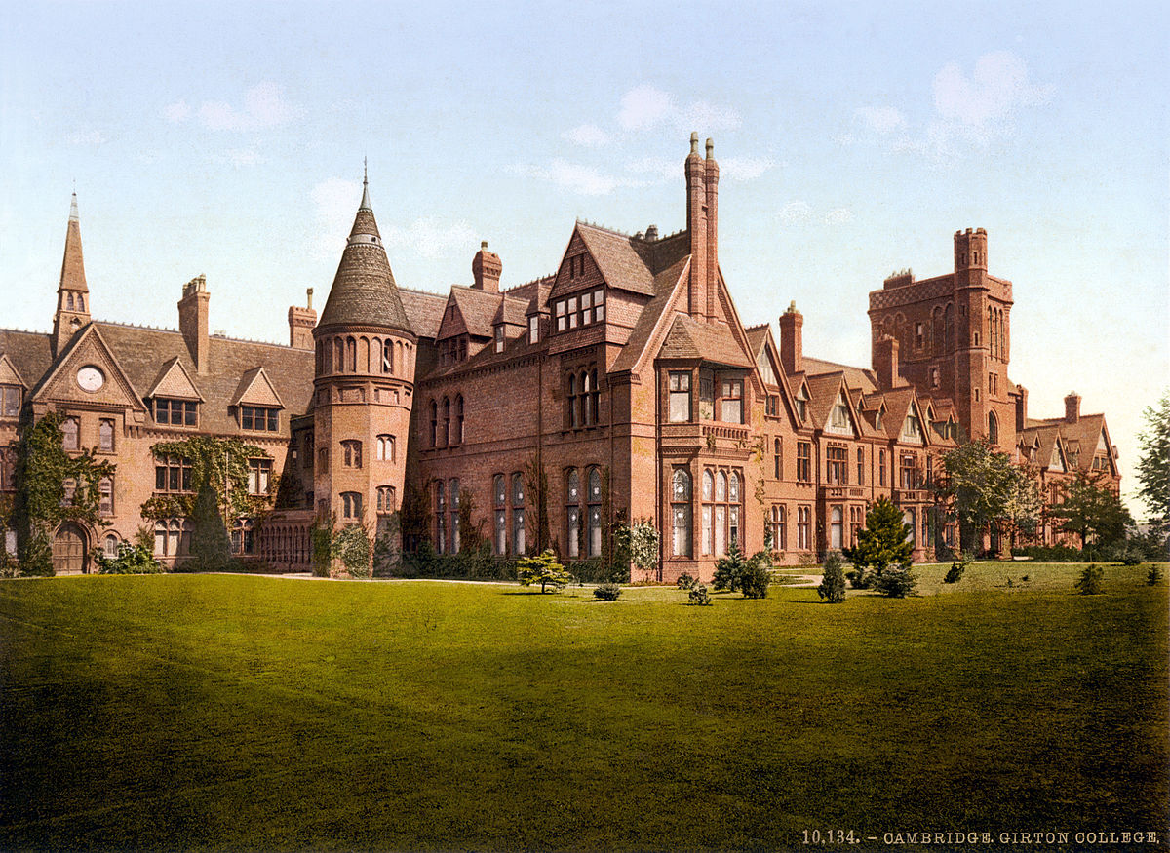
But the Fight Isn’t Over!
FACTOID
There were only 5 girls at Girton College in 1869, but hundreds of men in the University! Can you imagine being one of those five? Would you feel special? Intimidated?
It wasn’t just the ability to vote that women wanted. The suffrage movement wanted other rights and they had to fight for these too!
Women also wanted to be educated alongside men. This would allow them to qualify for jobs, such as a doctor, or lawyer. In the 19th century, women couldn’t do these jobs!
In 1869, Emily Davies set up Girton
College, the first College at Cambridge
for women. It was set up 30 miles from
Cambridge, so they did not to offend
the male students!
Photo of Girton College

Slide 12
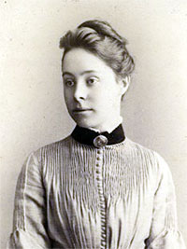
Women Still Faced Problems!
Lots of people thought girls were incapable of doing hard, logical, subjects like Maths.
In 1890 Philippa Fawcett proved them wrong! In the University’s maths exams she stunned all the boys by getting the highest mark by far!
But, women also were not actually awarded degrees, even if they studied hard and passed their exams!
This meant a woman couldn’t be a doctor, even if
she had all the training, because the job required a degree!
This is a photo of Philippa. Can you image how she would have felt when the results were announced? Remember, she still didn’t actually get a degree!
Photo from the University of Cambridge

Slide 13
The Push for Change
In 1897, the two female colleges, Girton and Newnham, proposed to the University that female graduates be given a degree. The University held a vote on the matter.
At the time, there was a great surge of anti-women feeling among the male students, who were threatened by women’s rise to equality.
Mr J. P. Thompson said: “If I gave a beggar my coat, he had no right to demand my trousers too.”
Mr. Thompson was using a metaphor! Can you think what he was trying to say?
Hint: women are the beggars in his scenario!

Slide 14
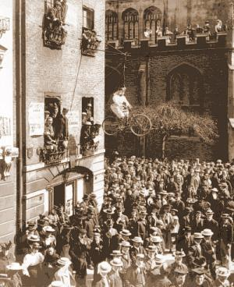
“Frustrate the Feminine Fanatics!”
On the day of the vote, a crowd gathered outside the Senate House. The men put out lots of posters against the female students.
One read “Frustrate the feminine fanatics!” and another “No gowns for Girtonites!”
Above what is now the University Press Bookshop, male students hung a mocking effigy of a female student riding a bicycle, wearing bloomers and coloured stockings.
Here is a picture of the scene! Can you see the effigy? Which building is St Mary’s Church? Can you imagine the tense atmosphere, as people waited for the result?

Slide 15
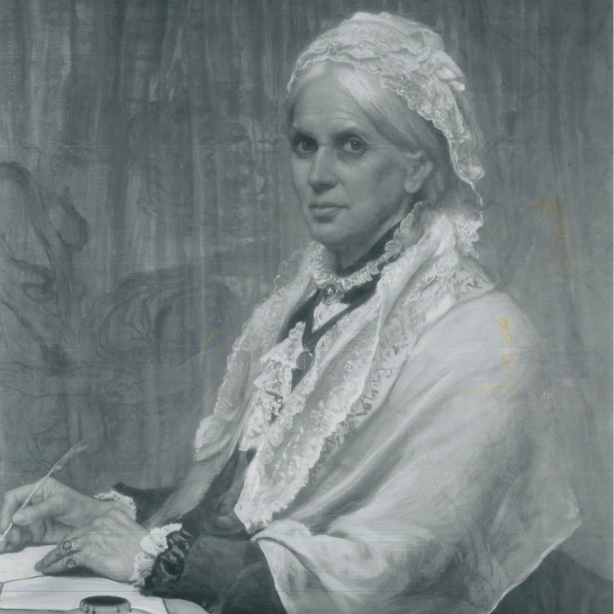
The Riot!
FACTOID
Riding a bike, was seen as something only men did. A woman on a bike was a symbol of the new woman, claiming equality.
The result came in… Women were
NOT allowed degrees!
Suddenly, the thrilled male students
started throwing eggs, flour, confetti and even fireworks! They tore down the effigy of the woman on the bike and shredded it to pieces, then stuffed it through the gates of Newnham College
They lit a bonfire outside of the college and burnt effigies of the colleges’ principles, Miss Clough and Miss Jex-Blake.
Here is a picture of Anne Clough! How do you think she and her students felt on that day?
Photo from Newnham College

Slide 16
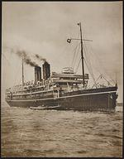
The Steamboat Ladies
After all that fuss, women still were not allowed degrees!
Between 1904 and 1907, Trinity College in Dublin allowed women who had studied at Oxford or Cambridge, to get there degree from there! 700 women took up their offer and got the steamboat across to Ireland to receive their degree. They were known as the Steamboat Ladies because of the transport they took!
Photo of a steamboat from the British Library

Slide 17
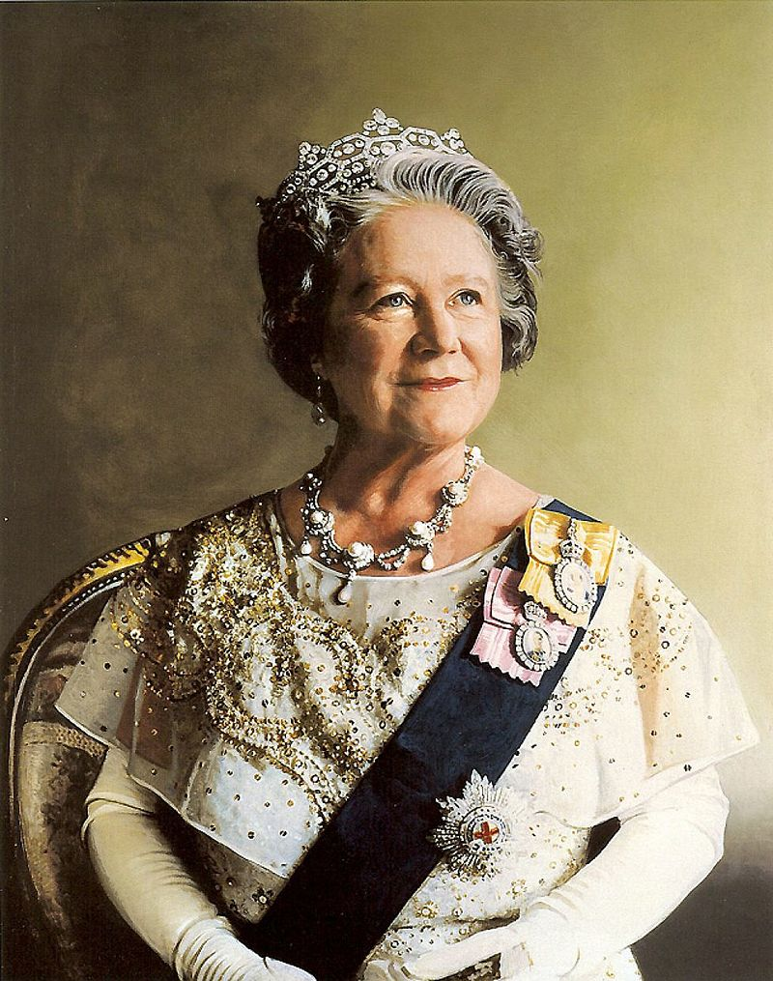
A Degree, at Last!
After the failure of 1897, women tried again in 1921 to get a degree. They failed, again!
In 1947, the women tried once more and, third time lucky, they were given the right to receive a degree!
The first degree was given out in 1948.
FACTOID
The first ever degree from Cambridge went to Queen Elizabeth II’s mum!
Painting of the Queen Mother by Richard Stone

Slide 18
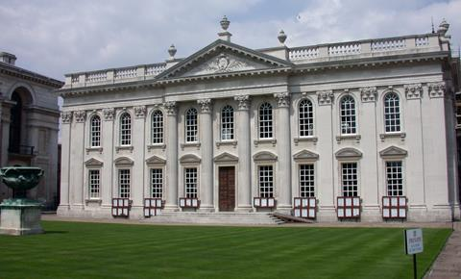
All That Hard Work Pays Off, Eventually!
In 1998, Cambridge University held a ceremony to honour all the women who had passed it’s exams, but who had not received a degree.
More than 900 women attended the event at the Senate House!
This is a picture of the Senate House, where Cambridge Students graduate from. How do you think the women felt, as they finally stepped into such a grand building?

Slide 19
Discover More
Lots of information on the protest at the senate can be found here: http://historyworks.tv/projects/2014/03/13/cycle-of-songs/#8-on-her-bike-womens-fight-for-degrees
Information on the key players of the early suffragette movement can be found here: http://herstoria.com/womens-access-to-higher-education-an-overview-1860-1948/
A simple summary of the wider Suffragette movement can be found on BBC Bitesize: http://www.bbc.co.uk/bitesize/higher/history/britsuff/suffrage/revision/1/
For more information about the Cambridge Suffragettes and Suffragists, there is a online ‘scrapbook’ of every mention of women from 1897 to 1990. It can be found here: https://archive.org/details/CambridgeshireWomenScrapbook1897To1990
By searching “Suffragette” or other key words, such as “Suffrage”, the relevant articles can quickly be found.

Slide 20

Web Resources available at:
http://www.creatingmycambridge.com/
history-stories

