Slide 1

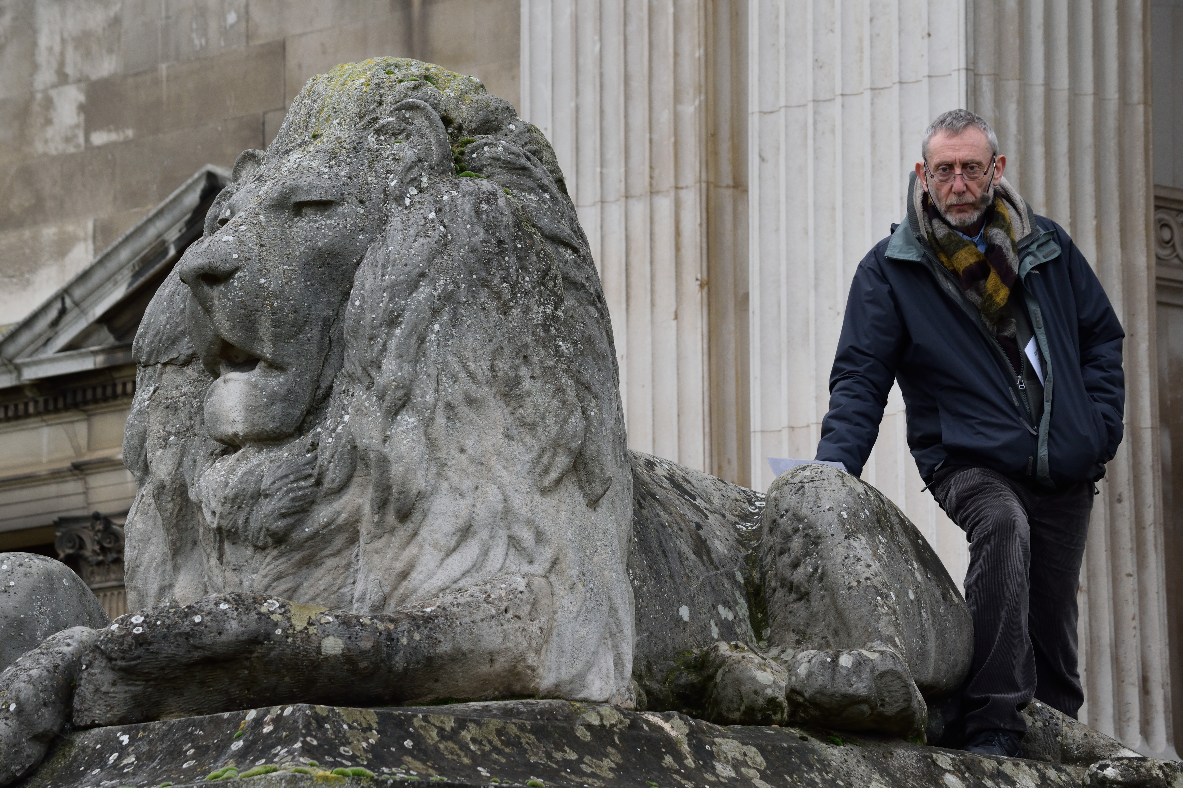
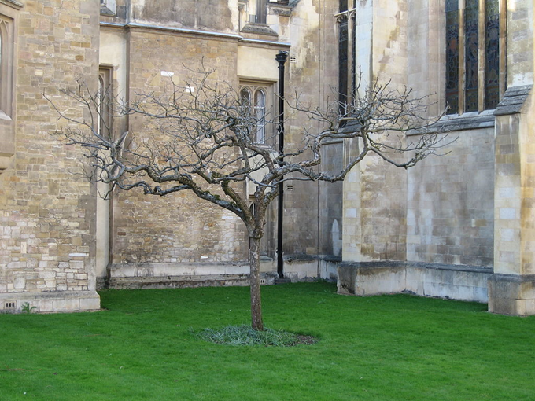
CREATING MY CAMBRIDGE WORKSHOP WITH MICHAEL ROSEN

Slide 2
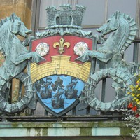
SEA HORSES (to the tune of Three Blind Mice)
Sea hors-es, See them on,
Cambridge Coat of Arms,
Why? What are their charms?
It dates from hund-reds of years ago
When so many diff-er-ent riv-ers flow
Around the town, so now you know
Why sea hors-es

Slide 3
Hobson's Choice (To tune of London's Burning) Words by Dave Cohen
Hobson's Choice is
Hobson's Choice is
For a speedy horse
Very best of course
Faster faster!
Faster faster
He replied
'I decide'

Slide 4
Tudor Song Subjects
Creating My Cambridge has songs inspired by Cambridge Tudor & Stuart histories:
Seahorses:
Hobson’s Horses:
Cromwell’s Head:
Burning Bucer:
We look forward to hearing your poems & songs!

Slide 5
Milton Road School History Trail
MICHAEL ROSEN WILL BE THE VOICE-OVER FOR YOUR HISTORY TRAIL
YOUR PICTURES AND POEMS WILL ALSO BE ADDED ONLINE TO ILLUSTRATE THE TRAIL!

Slide 6
Milton Road School History Trail
MICHAEL ROSEN WILL BE THE VOICE-OVER FOR YOUR HISTORY TRAIL
YOUR PICTURES AND POEMS WILL ALSO BE ADDED ONLINE TO ILLUSTRATE THE TRAIL!

Slide 7
History Walking Trail – Draft of Route & Subjects
MICHAEL ROSEN WILL BE THE VOICE-OVER FOR YOUR HISTORY TRAIL
YOUR PICTURES AND POEMS WILL ALSO BE ADDED ONLINE TO ILLUSTRATE THE TRAIL!

Slide 8
A Day in the Life of a Tudor School Child

Slide 9
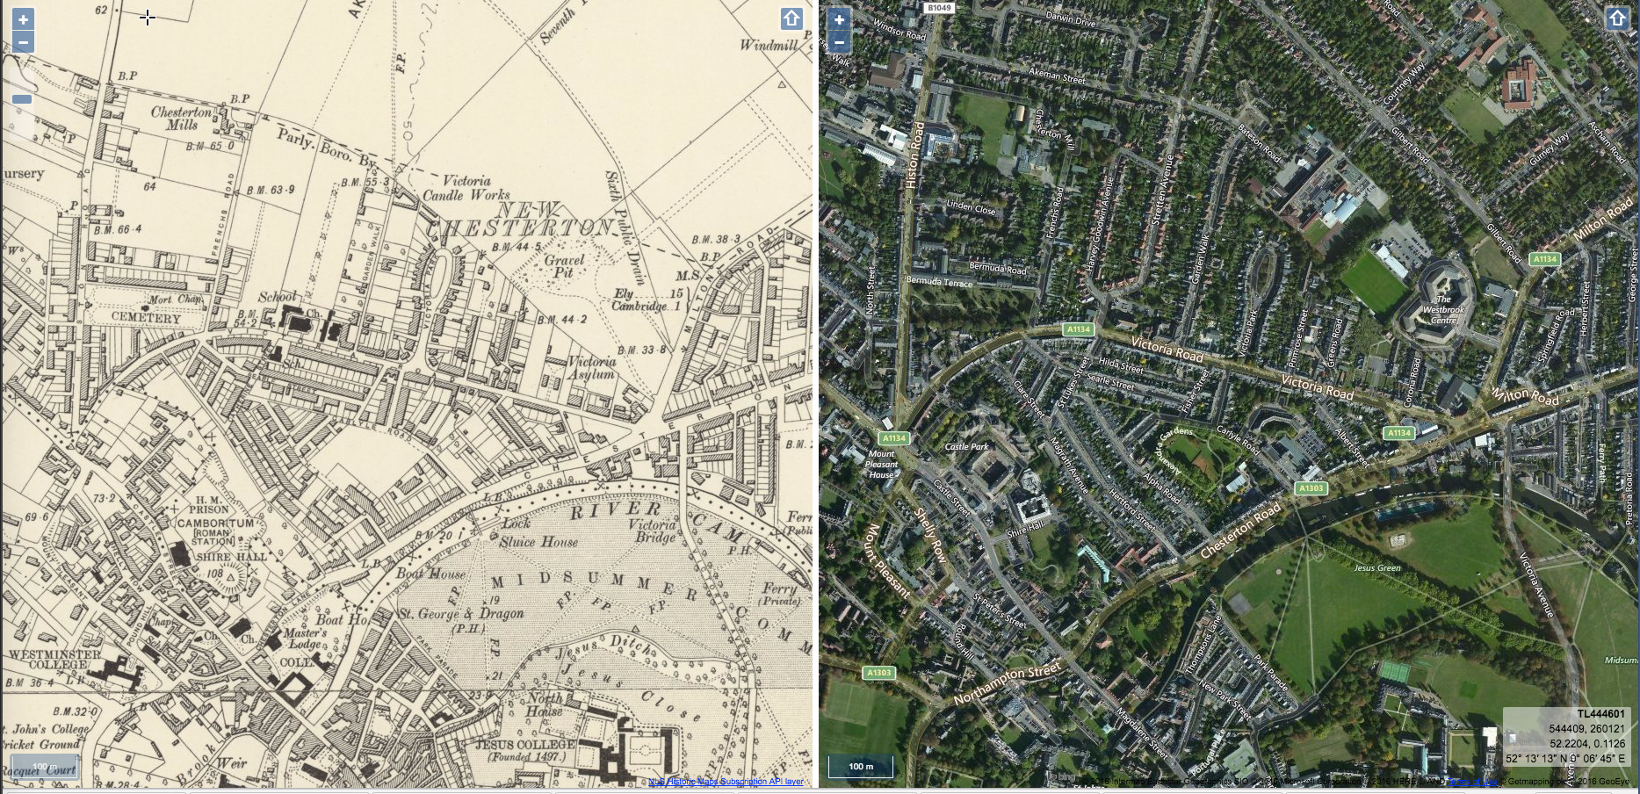
School in Tudor and
Stuart Times
THEN
NOW
This old map shows the area around Milton Road School in Victorian Times
before Roger Ascham Road was built. Today Milton Road School is on this very road!

Slide 10
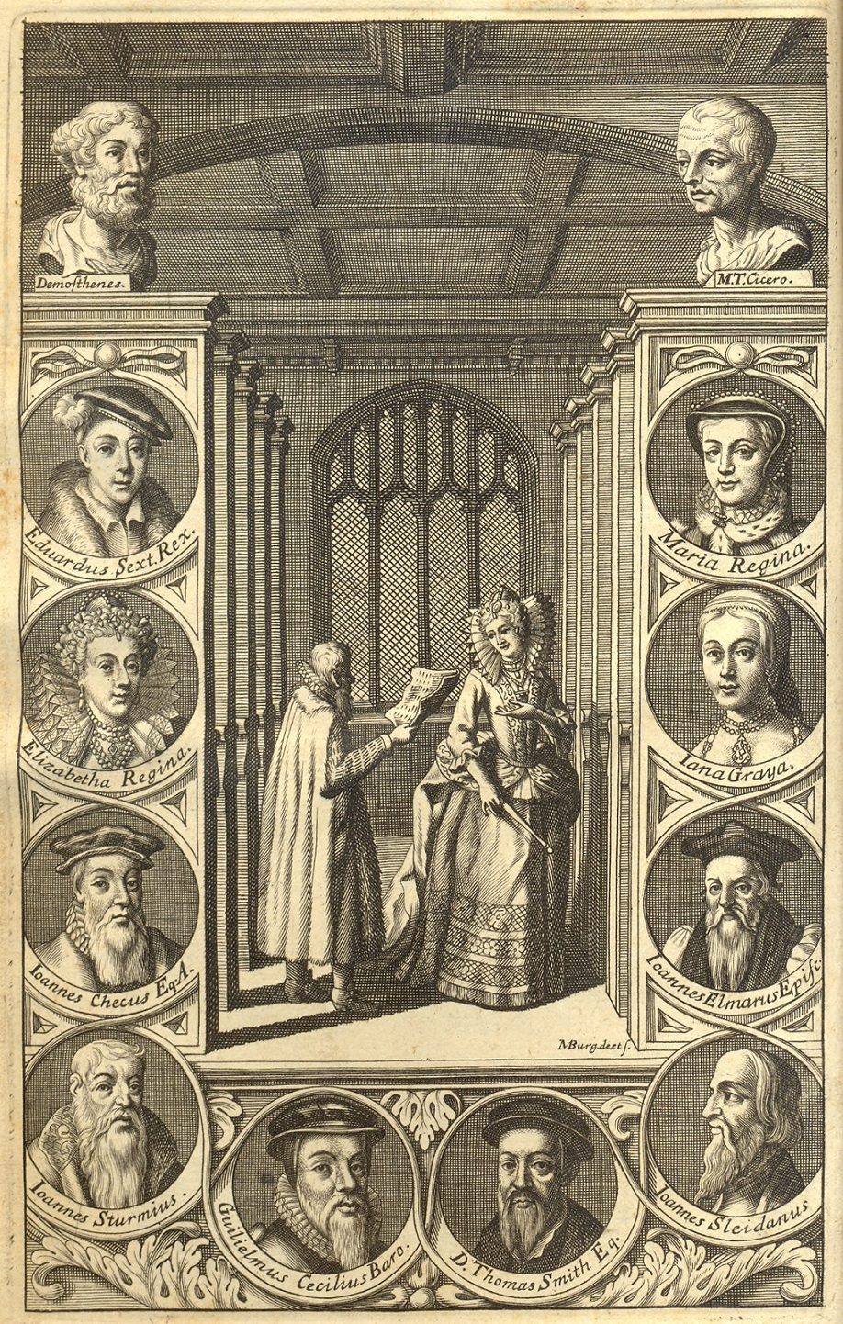
Who Was Roger Ascham?
Roger Ascham was originally from Askam in Yorkshire. He came to Cambridge as a student aged about 15 in 1530 and then became a teacher of Greek aswell as Latin at St. John’s College at the University of Cambridge.
Ascham is important because he worked for the Tudor monarchs and was Princess Elizabeth’s private tutor from 1558-1560 when she was 15-17 years old, before she became Queen.
FACTOID!
Roger Ascham also worked as a kind of diplomat, as a Latin Secretary to her sister, Queen Mary I and her brother Edward VI.

Slide 11
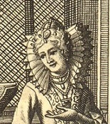
Who Was Queen Elizabeth I?
Queen Elizabeth I was daughter of Henry VIII and Anne Boleyn.
She was born in 1533 and reigned as Queen for 45 years, from 1558 - 1603.
She was brought up to read and write, not just in English, but also in International languages, Italian French and Spanish. Elizabeth was best at the Classical languages, Latin and Greek.

Slide 12
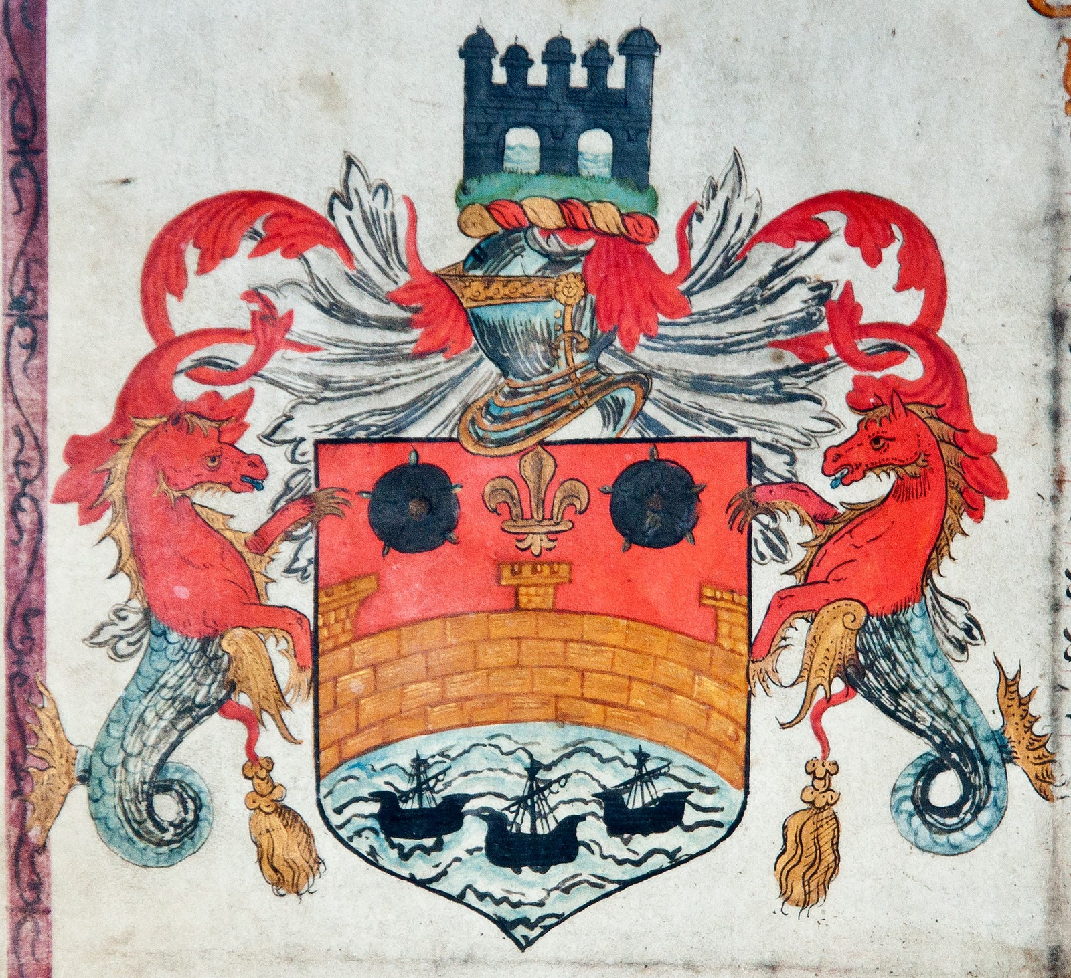
Queen Elizabeth I’s
Connection to Cambridge
Queen Elizabeth I stayed in Cambridge only once for a royal visit to the University on a tour of the area in 1564.
She is important to Cambridge as she granted a Royal Charter in 1575 with the Cambridge Coat of Arms, showing the River Cam, Great Bridge and Seahorses on it, which can still be seen on buildings around Cambridge today such as The Guildhall in Market Square.

Slide 13
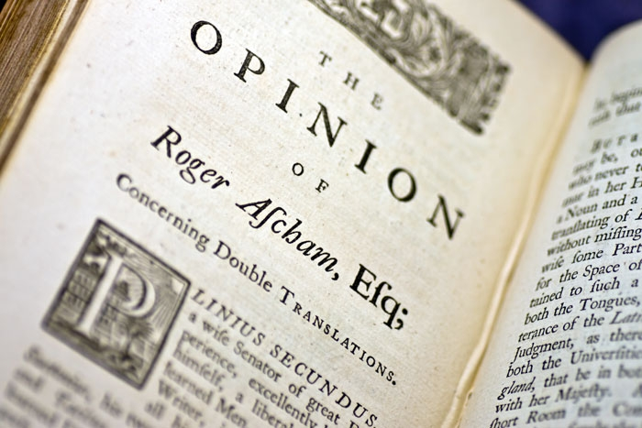
Roger Ascham Famous for his book called ‘The School Master’
Roger Ascham was not only famous because he worked for the Tudors, but also for publishing a book about his Theories of Education.
At the time of Henry VIII children in England were taught to read using Latin or Greek, and not in English, their everyday language!
Ascham believed it was important for all children to learn to read using English and not start learning to read in another language.
FACTOID!
Ascham was a Humanist, so he believed that everyone should be educated, girls as well as boys!

Slide 14
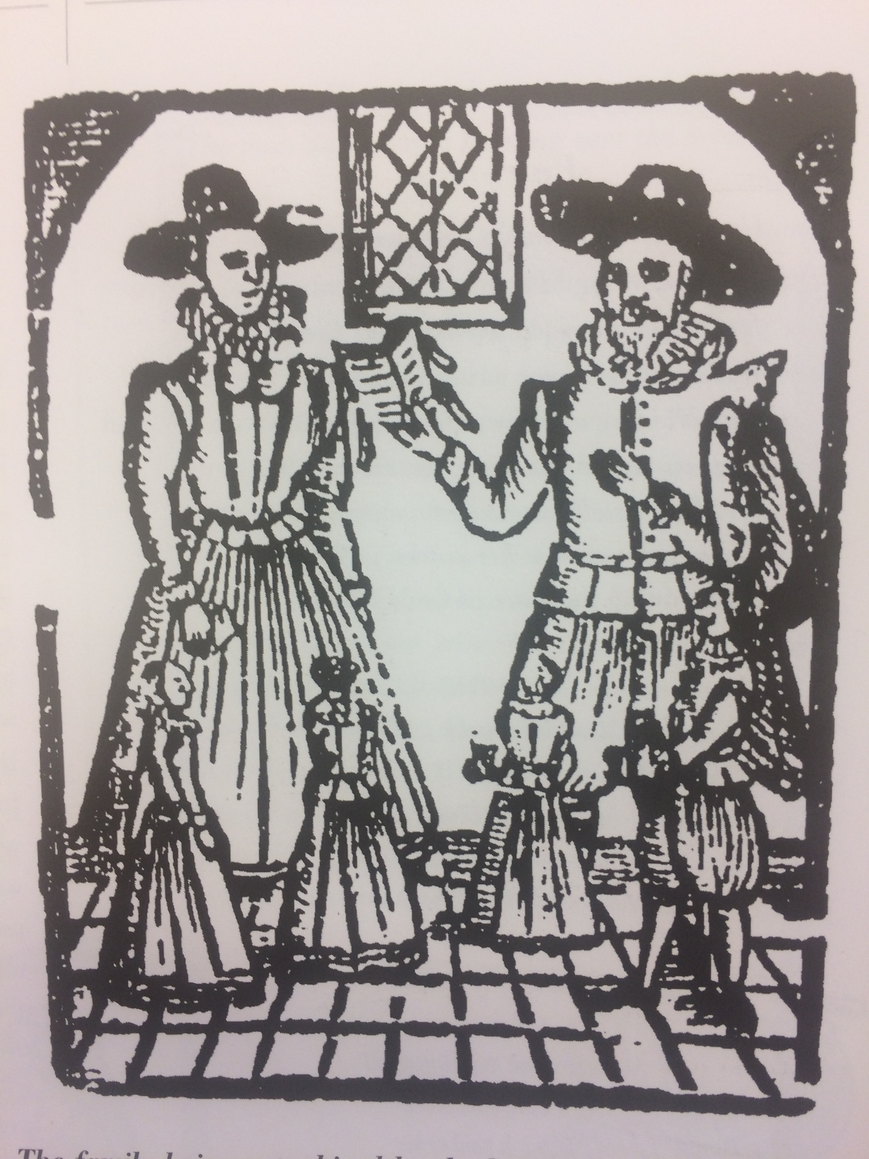
Change in National Religion: Catholic to Protestant
Henry VIII’s divorce caused the Reformation and this act
broke the relationship of England with Rome, which was
where the Pope lived, the Head of the Catholic Church.
Henry VIII became the leader of the Church instead of the Pope. When England was ruled by his children, Edward VI
& then Queen Elizabeth I, it became a Protestant.
FACTOID: The Bible was printed in English for the first time
instead of Latin, as it had always been done previously.
There was a rule that all children were to learn the ABC with prayers in English and be tested at church. It was the law that everyone must go to their church service every Sunday.
Picture of a family saying their prayers together

Slide 15
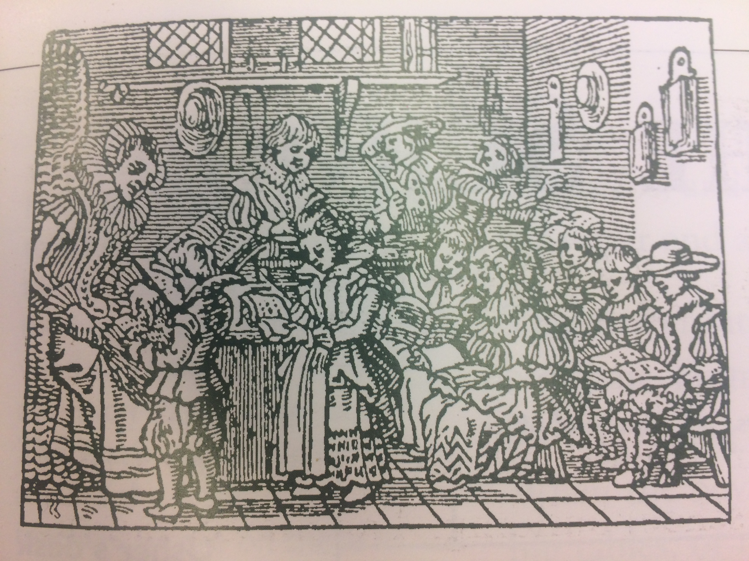
The First Steps in Learning-
Where Did Children Go to School?
Before the Reformation you could learn to read at a Monastery or a Convent if you were the poorer sort, and if you were the richer sort from a private tutor at home.
After the Reformation many children from ordinary families were sent to school to learn their ABC and have Christian teaching in new schools. These schools were often called a ‘dame school’ if the teacher was a woman and a ‘petty school’ if the teacher was a man.
Boys and girls went to these schools which were often held in the church porch or the teacher’s front room rather than a specially designed classroom like we have today.

Slide 16
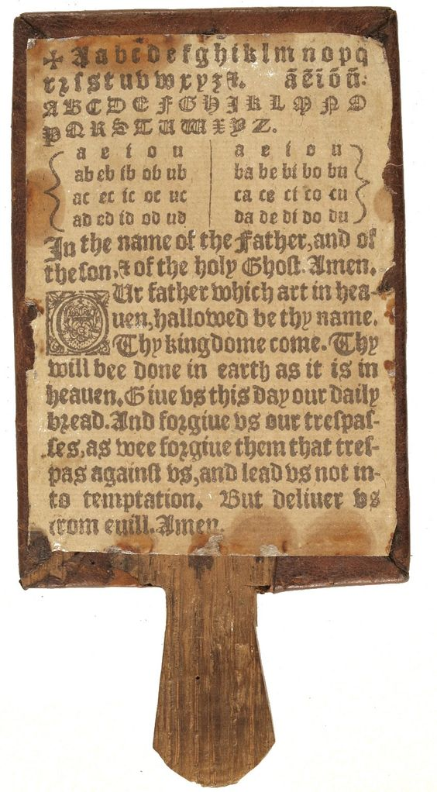
The Hornbook
The Hornbook was made of wood and the words were printed on paper, pinned under the animal horn.
FACTOID: The alphabet was often called ‘the Criss Cross Row.’ Can you spot the cross at the top before the start of the alphabet?
The long piece of text is called ‘The Lord’s Prayer’ . It is from the Bible. Christians believe it is the special prayer that Jesus taught his disciples.

Slide 17
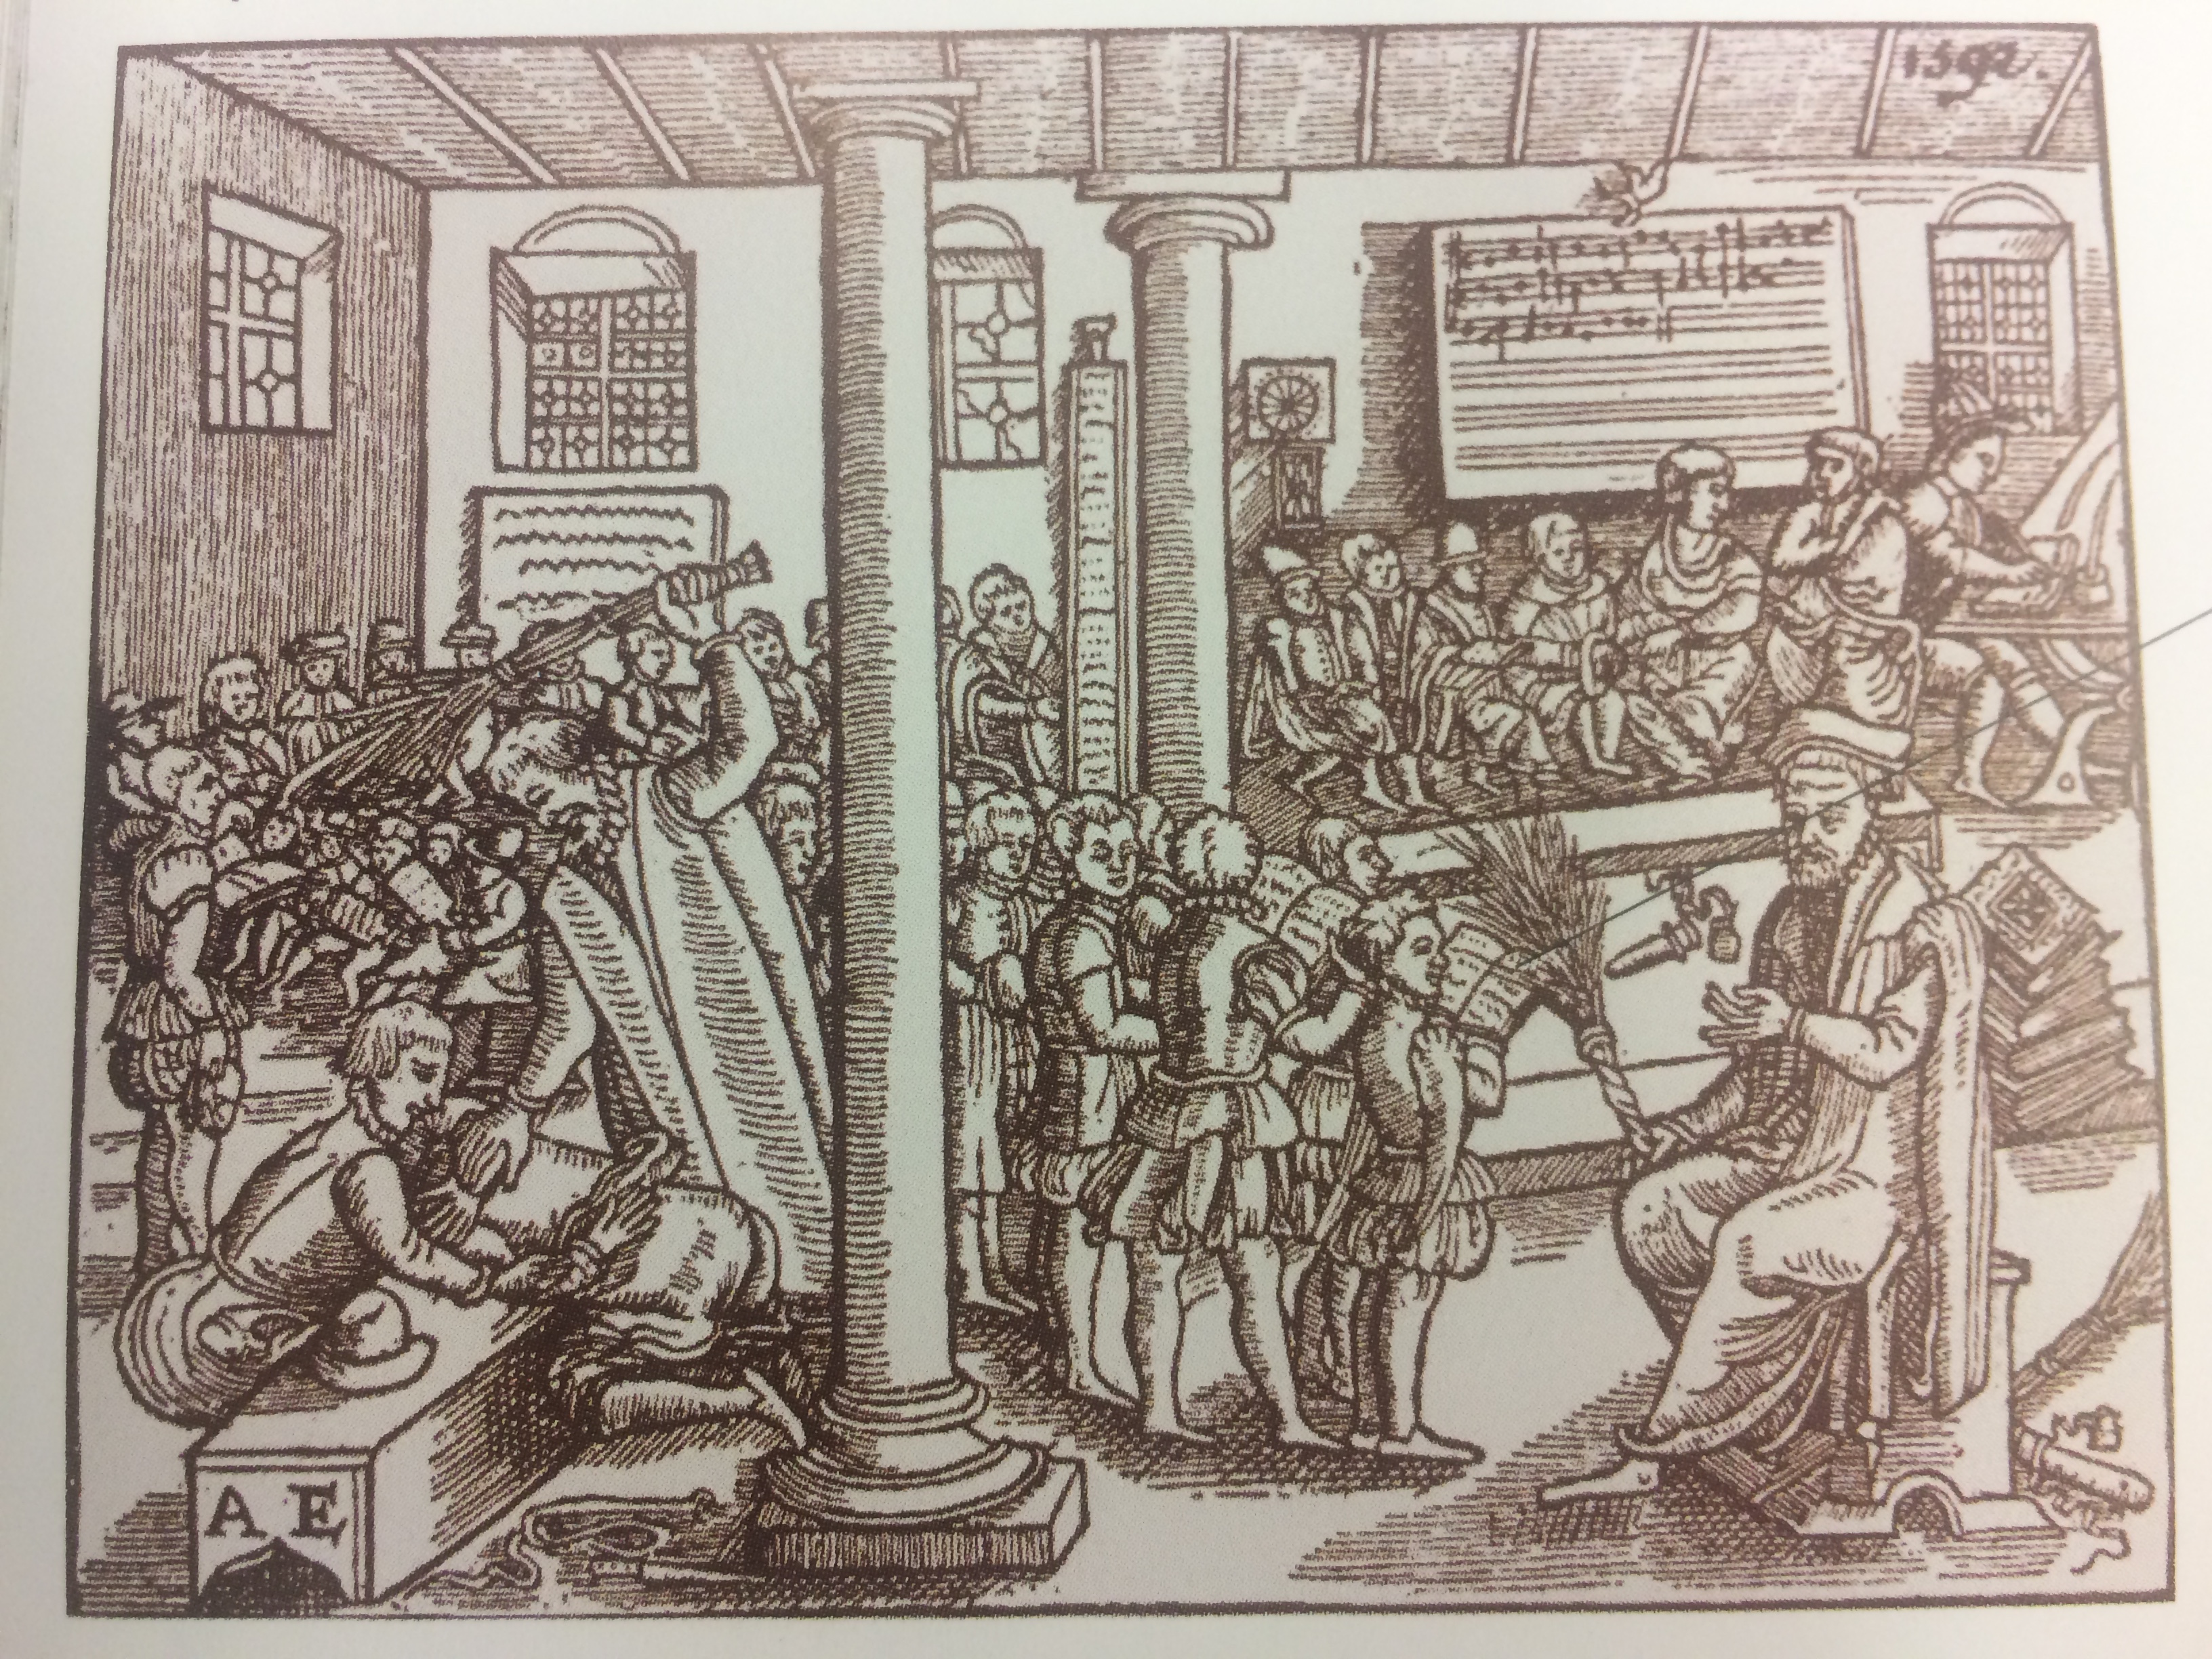
Where Did Children
Learn to Read?
How many teachers and different class groups can you see in this picture of a Tudor Schoolroom?
What activities do you notice the different classes are doing in the schoolroom?

Slide 18
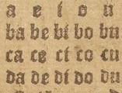
Learning to Read from the Hornbook was noisy!
Children learnt their spellings by rote - which means learning them by heart and saying them out aloud lots of times!
Now have a go seeing if you can read the lines from the syllable table on the Hornbook like children would have learnt from in the Tudor times!
a e i o u
ba be bi bo bu
ca ce ci co cu
da de di do du
fa fe fi fo fu

Slide 19
Children Learnt their Numbers by Rote and by Song too!
I & II One and one is two
II & III One and two is three
III & IV One and three is four
IV & V One and four is five
V &VI One and five is six
VI & VII One and six is seven
VII & VIII One and seven is eight
VIII & IX One and eight is nine
IX & X One and nine is ten

Slide 20
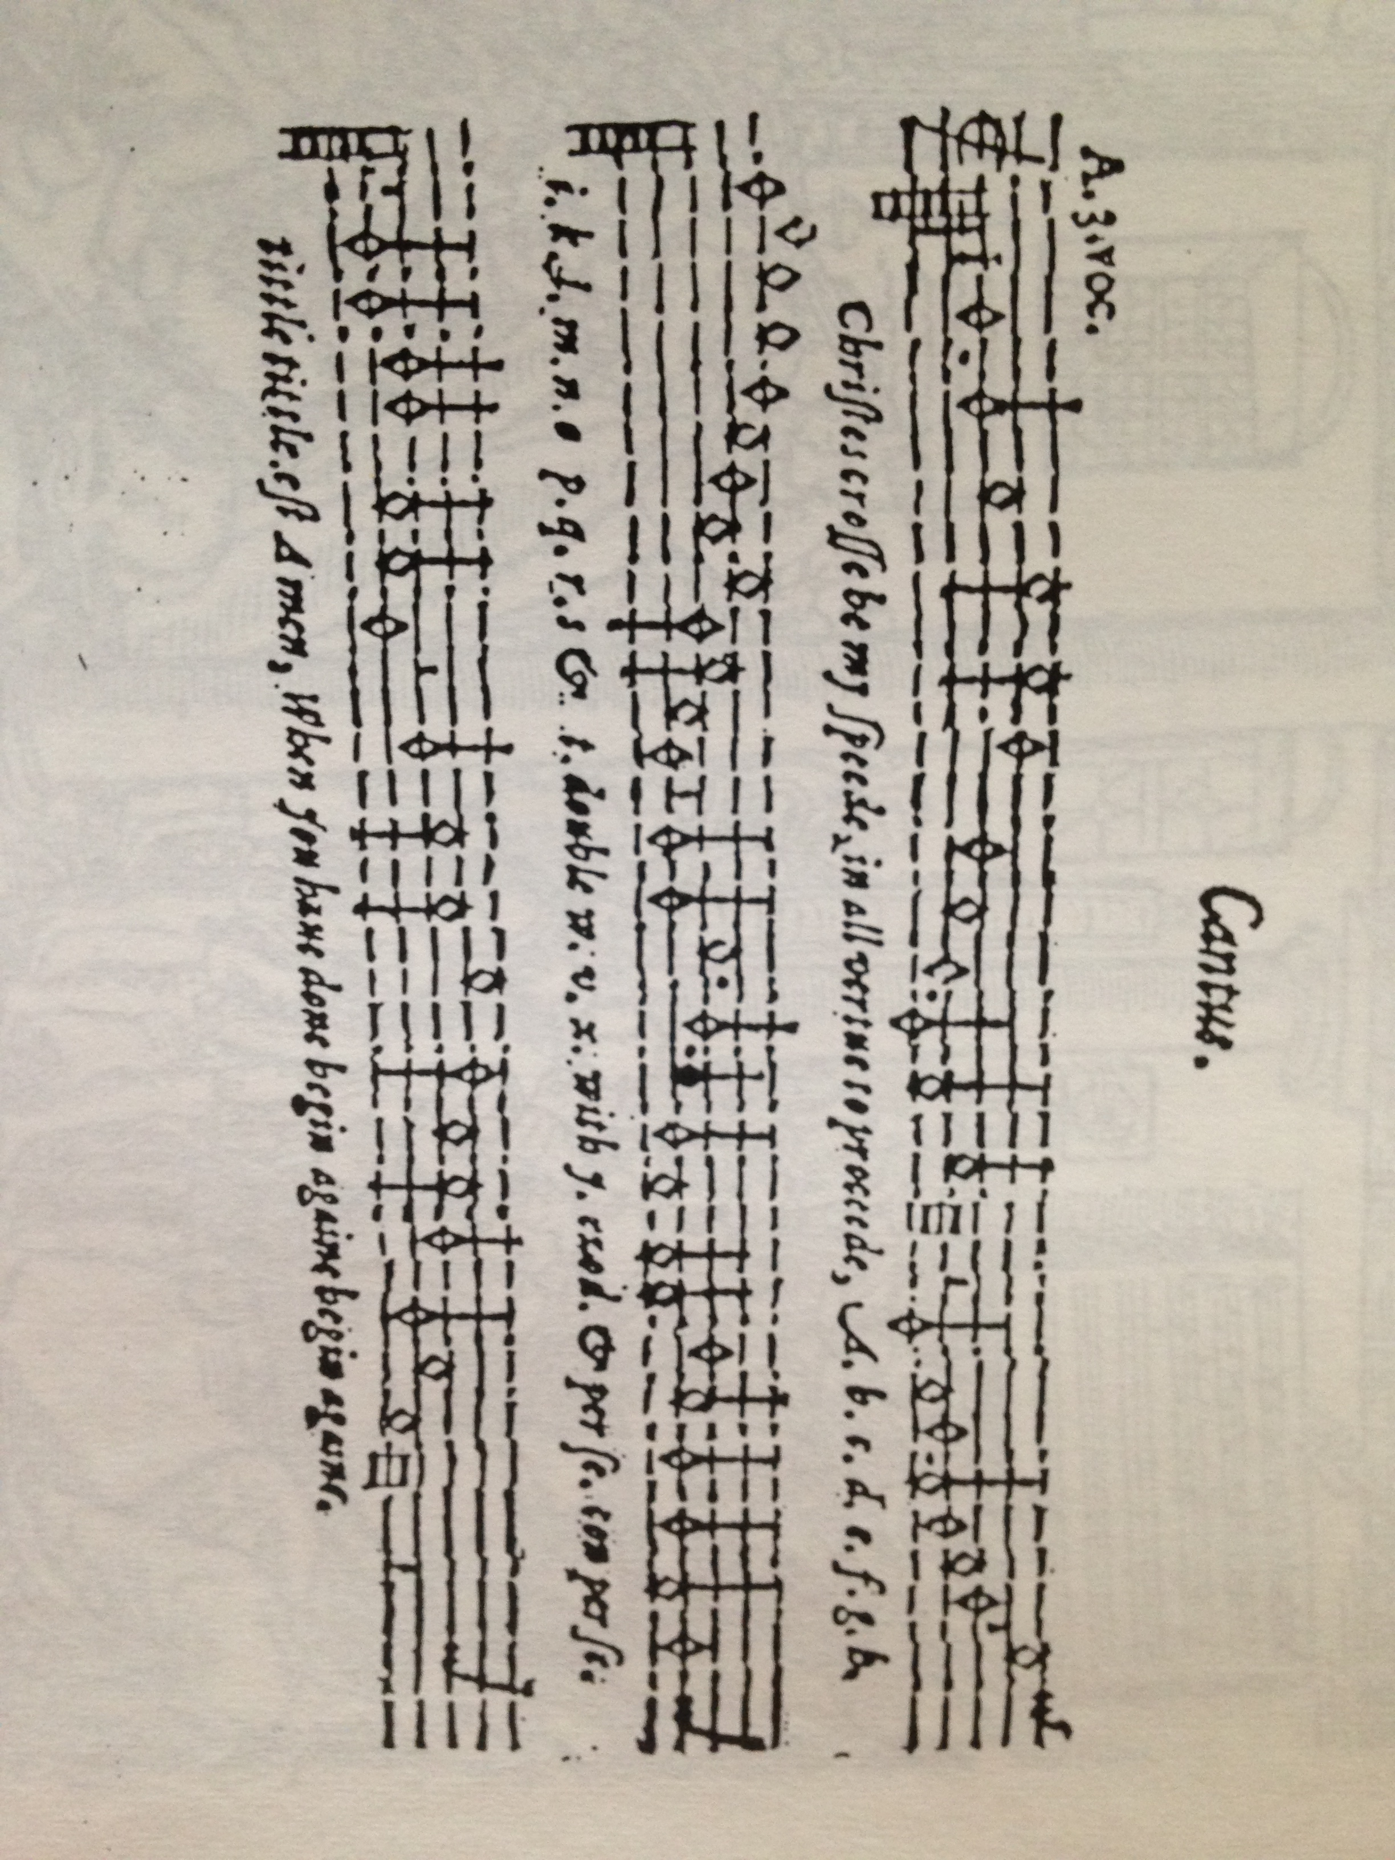
Learning the ABC Song!
More adventurous teachers started teaching the alphabet using sheet music,
a bit like how we learn the alphabet with the ABC song in school today!

Slide 21
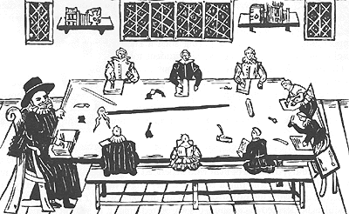
Learning to Write after Learning to Read at About Age 7
Children usually learnt to read from the age of 4 to 7 years old.
Children only learnt to write from 7 years old. Notice in the picture there are ink pots & quills so it was messy and more expensive to pay a writing teacher than a reading teacher!
FACTOID
Many children left school at 7 because they needed to help their families by working for a a wage, so they only learnt to read their ABC not to write it !

Slide 22
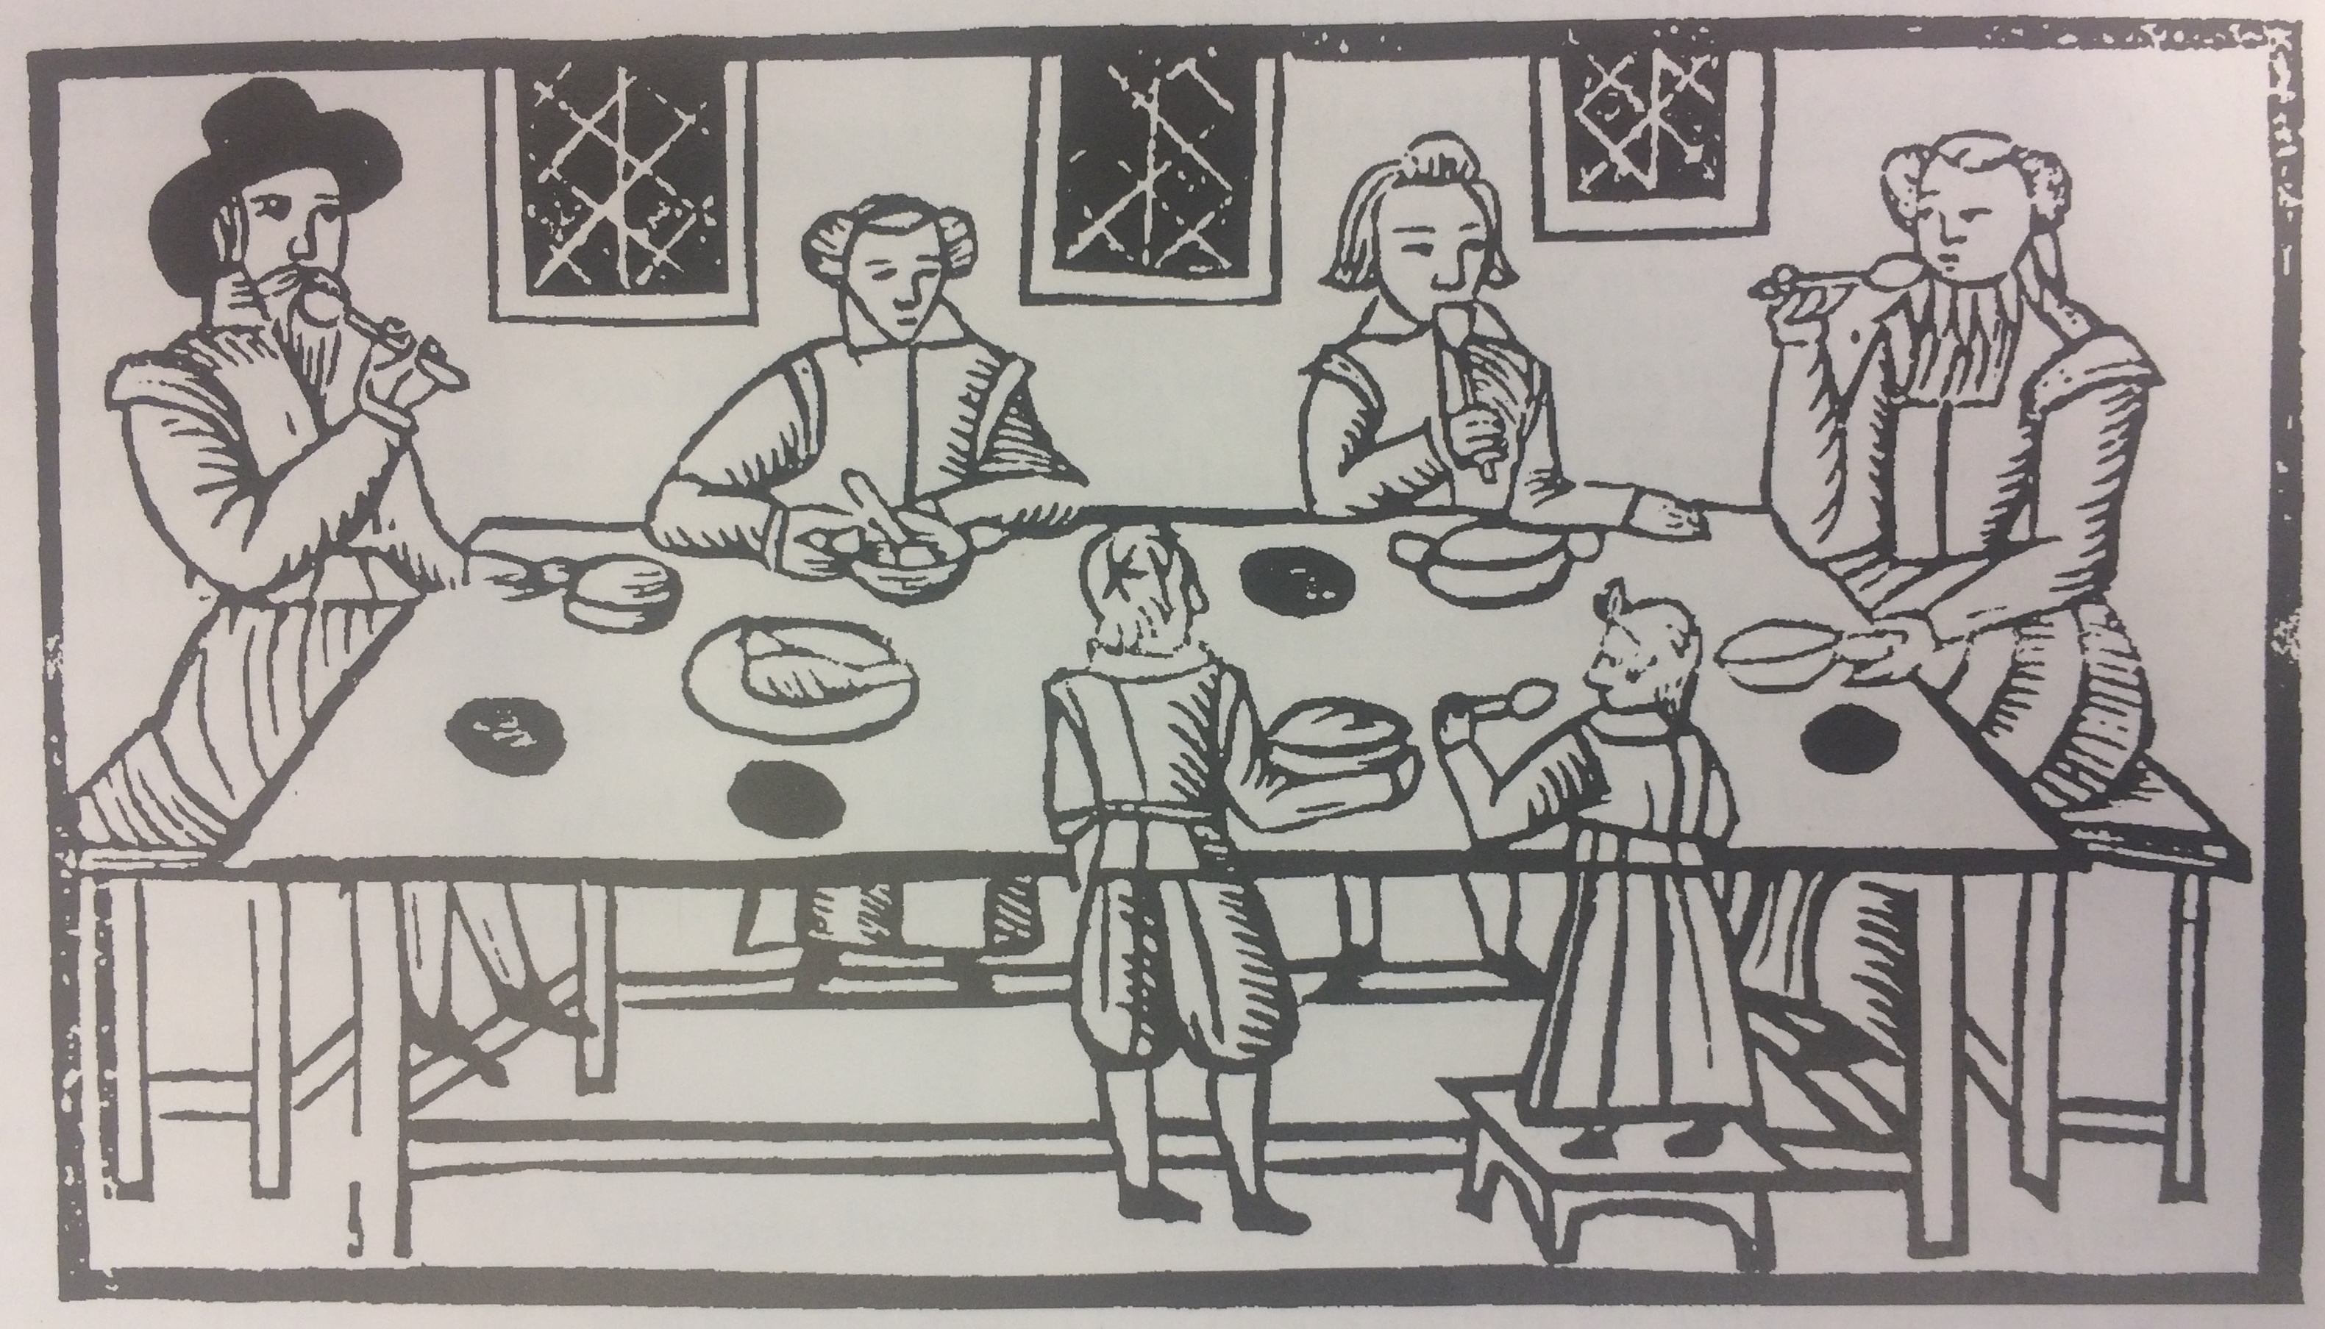
School Timetable and Meals
Children had a long school day ending at 5pm. School started early at 7am in Winter and 6am in Summer.
Pupils were given pottage before they started school, at lunchtime as their main meal and after school about 6pm.
FACTOID!
Pottage is a thick soup, like a stew made of barley or oats, and in our area it often had peas in as an extra ingredient. If children were lucky then there was a bit of protein added such as dried fish or some bacon!

Slide 23
Manners for Children
Printed Rules- ‘At Table’
Lean not they Elbow on the Table, or on the back of thy Chair
Throw not any thing under the Table
Spit not, Cough not, nor blow they nose at Table if it may be avoided; but if there is necessity, do it aside, and without much noise

Slide 24
Rules for Children-
Behaviour in School
Bow at Coming in, Putting off thine hat
Loiter not, but immediately take thine own seat; and move not from one place to another; til School time be over.
If thy Teacher speaker to thee, rise up and bow, making thine answer standing.
Bawl not aloud in making Complaints
At no time talk or quarrel in the School; but be quiet, peaceable, and silent

Slide 25
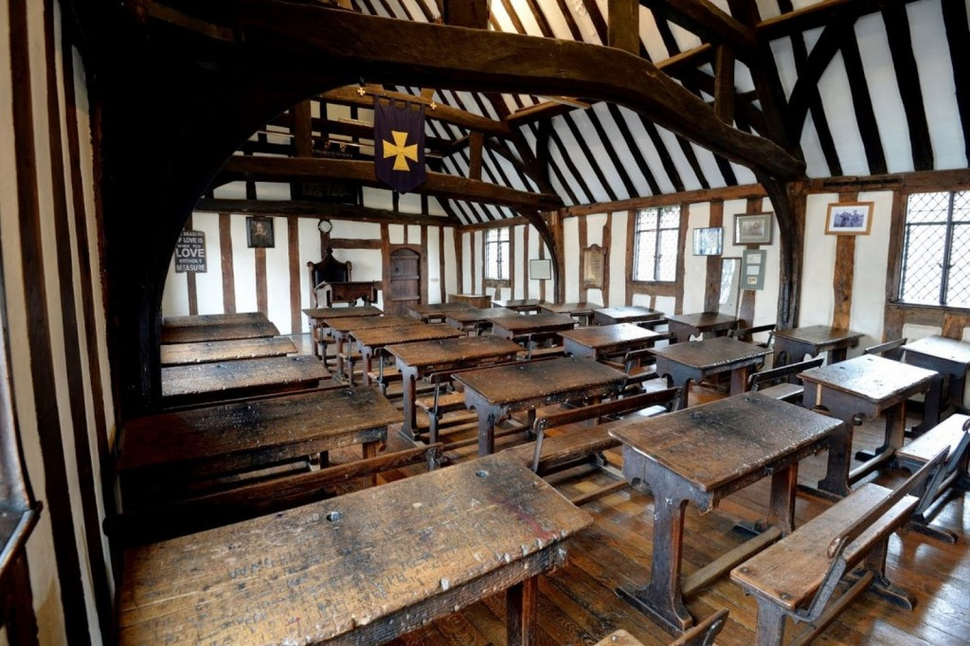
From ABC School to
Grammar School to Uni
When children left their ABC School at 7 years old their next school was called a Grammar School. Most of the pupils were boys but there were exceptions, such as one Alice Show who went to Rivington Grammar School in 1615.
Shakespeare went to Grammar School and his schoolroom survives with all the wooden desks in his home town of Stratford.
The rich boys went on to University at aged 14 or 15, as did Roger Ascham, when he came to Cambridge to study Theology in 1530.
Photo of King Edward VI School where
they believe Shakespeare went to school

Slide 26
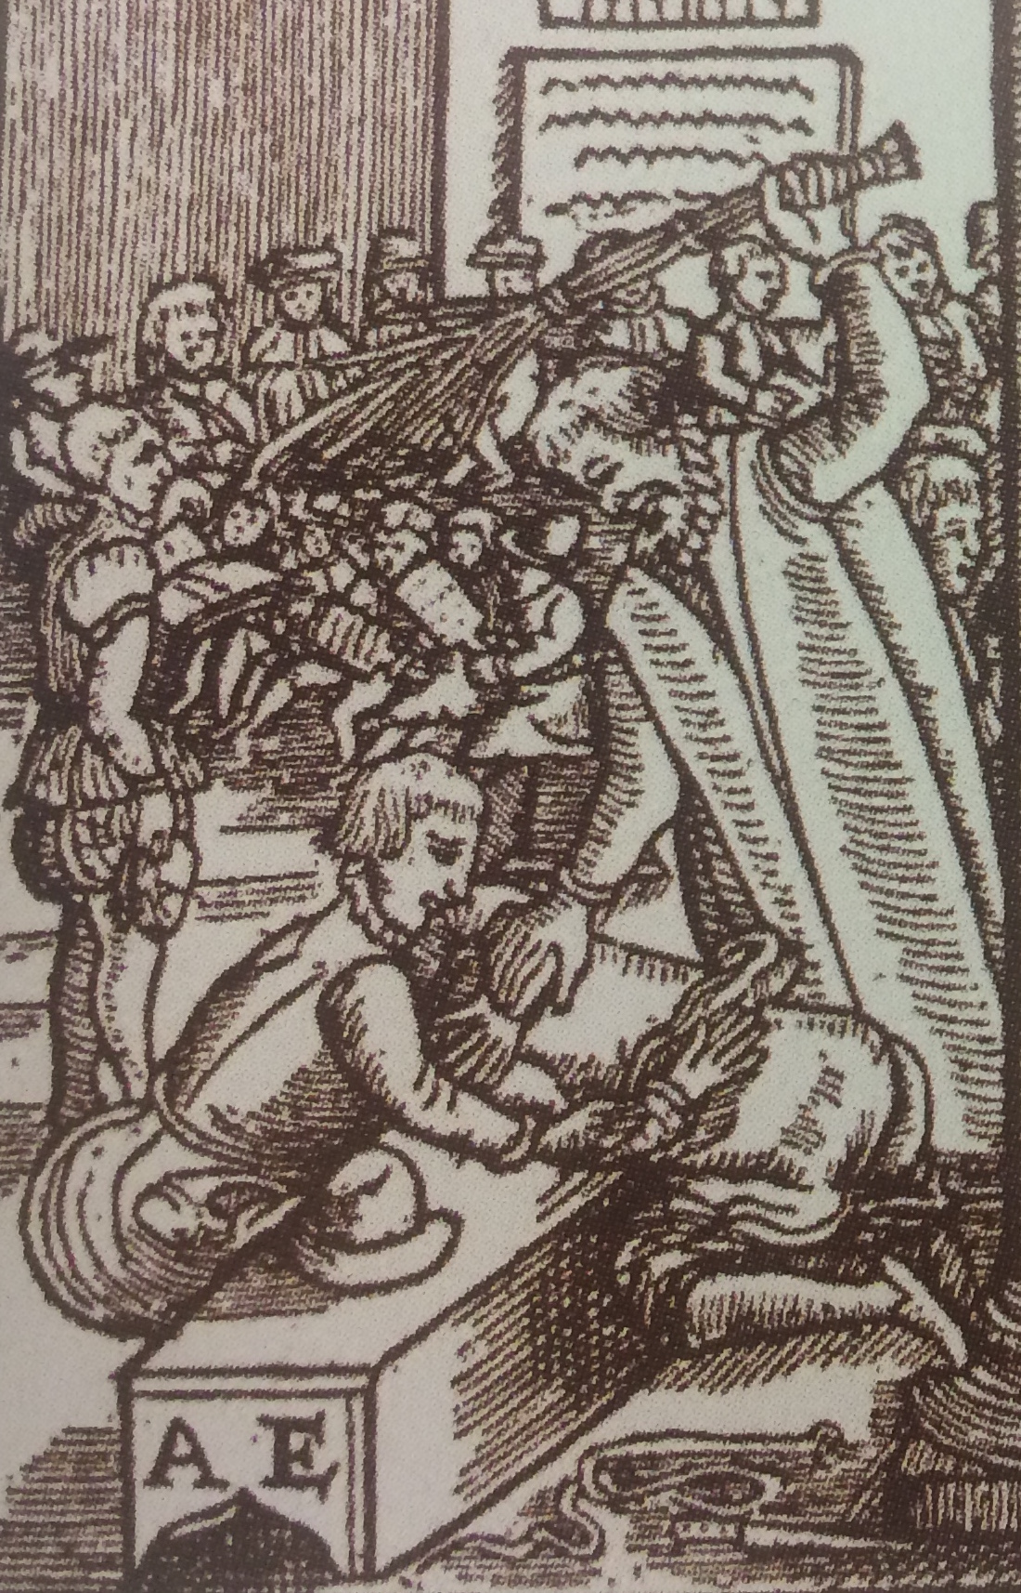
School Punishments
Children were hit by teachers if they did not behave or if they did not understand their lessons.
Sometimes children were hit with a shoe or with the bat side of a Hornbook when learning to read.
Once they were over 7 years old and at Grammar School, they were most likely hit with a birch twig.
At Shakespeare’s School the boys were tested every Friday and were given their punishments on Friday too- a dreaded day!

Slide 27
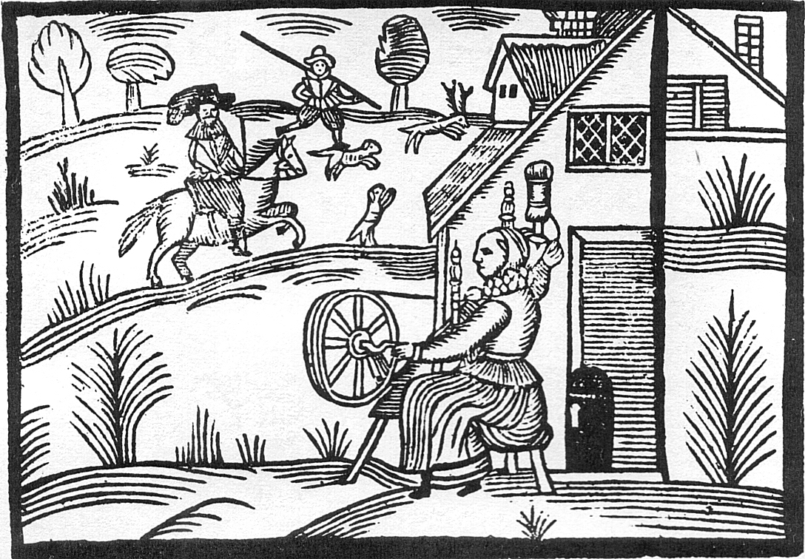
What Happened to Children
When They Left School at 7?
Most girls went to work at 7 years old to learn how to do domestic work and run a home. Girls could earn a good daily wage spinning or knitting. Many girls became servants in households, starting off with jobs such as washing up the kitchen pots, making the beds, helping with the laundry, cleaning the fire places and the floors.
Boys in both the countryside and town also worked in spinning as household servants,
and in agriculture, with 7 year olds often put to work as scarecrows in the fields, or as shepherds. Many children were also apprenticed to trades for 7 years, when they were
a bit older, where they had to work for no pay expect their clothes and food from about aged 12 to 19. So they could become a blacksmith, a butcher or baker if they were a boy or a lace maker or seamstress if they were a girl.

Slide 28
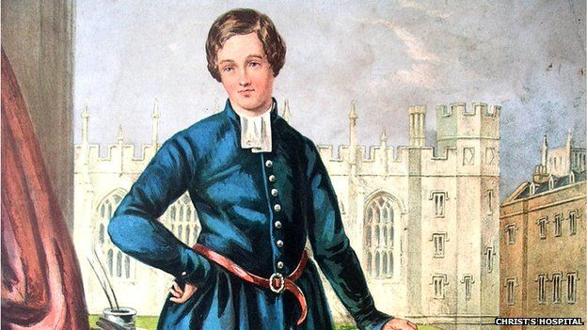
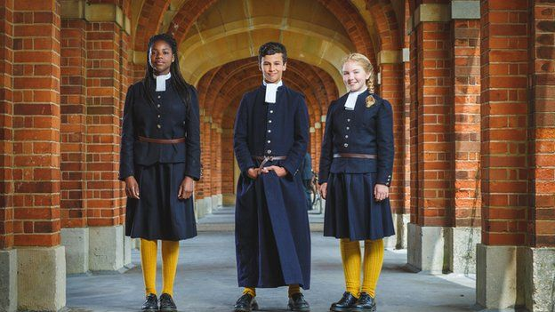
Growth in Charity Schools Such As Christ’s Hospital, Hertfordshire
Christ’s Hospital was founded in 1552 by the Tudor, King Edward VI, a keen Protestant who wanted the poor and orphans to have a good education to read the Prayer Book and the Bible. It was one of several famous charity schools with donations from the Royal Family and wealthy families across England, which is still open as schools for girls and boys today!
FACTOID!
It was called a Bluecoat School because of the unique blue and yellow uniform with buttons showing the head of Edward VI on it.

Slide 29
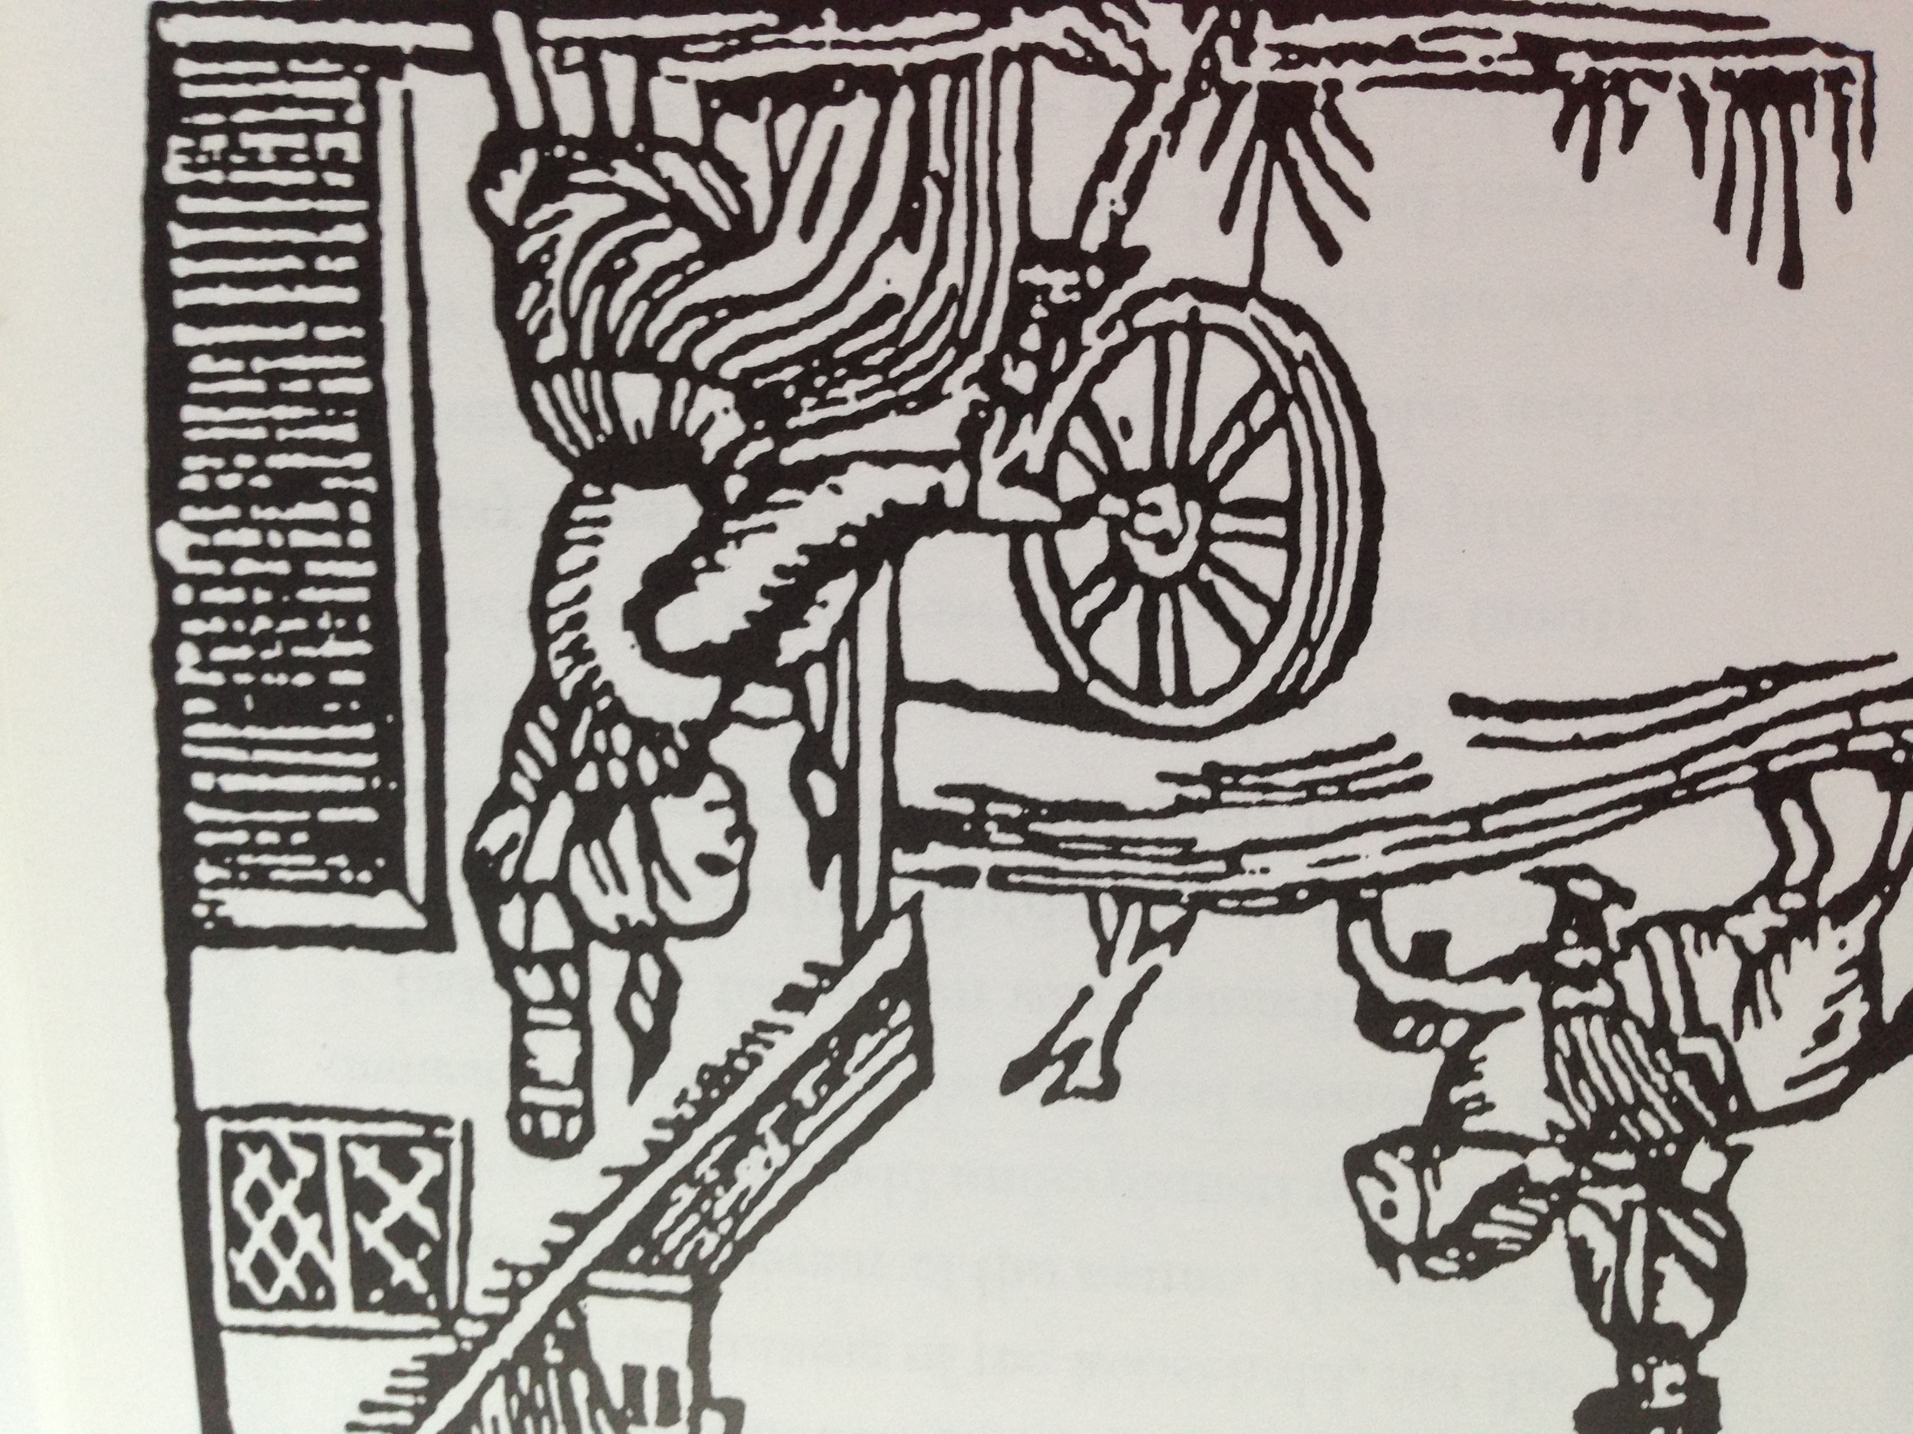
Learning Life Skills
Children who were poor and with no father were taught to read and write, and also skills for earning a living at these Blue Coat Schools.
Boys learnt specific skills such as mathematics to be navigators for Navy and girls learnt other specific skills such as sewing to be servants, seamstresses and milliners.

Slide 30
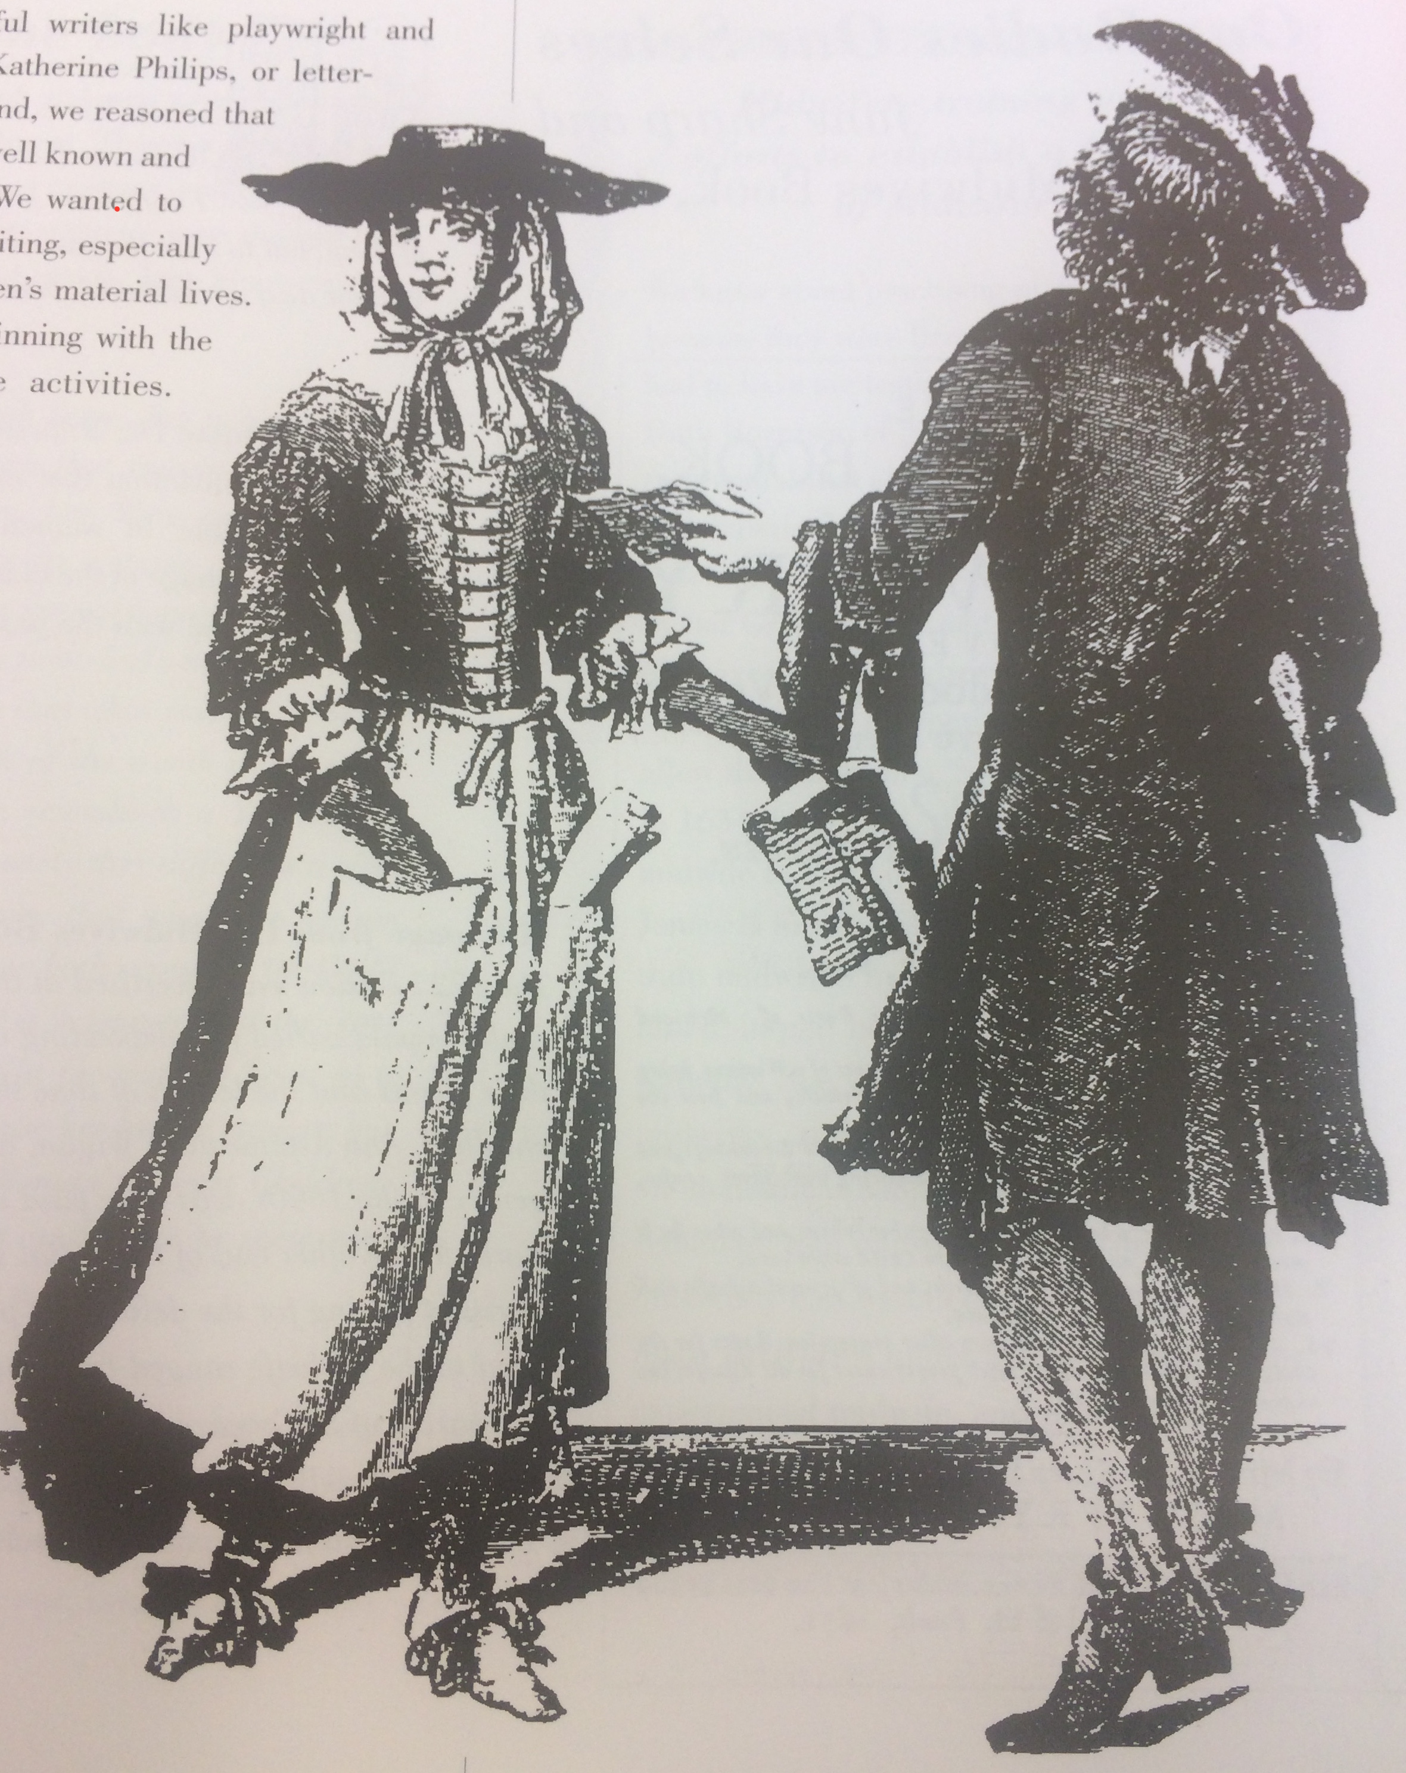
Change Over Time: Tudors to Stuarts- Progression in Education and Printed Publications
With the Reformation, England had changed to a country where many people could read instead of only a few rich people. In the Tudor Era many families wanted to read for the first time so that they could read the Bible in English for themselves.
In the Stuart Era everyone was discussing Politics and there was a huge growth in penny news sheets, which was a bit like an early type of newspaper!
There were also lots of women writers a century after the Tudors, writing and selling printed song sheets, cookbooks, religious texts, medicine and midwifery books, as well as books to teach people how to run a successful business!

Slide 31

Web Resources available at:
http://www.creatingmycambridge.com/
history-stories

