Slide 1

The Bombing of Vicarage Terrace in WW2

Slide 2
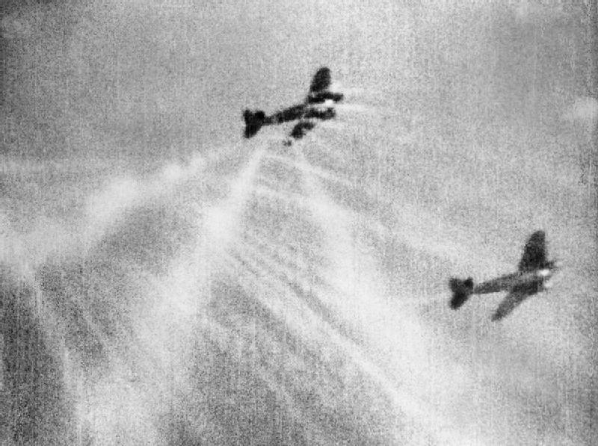
The Second World War
The Second World War started on the 1st of September 1939, when Britain declared war on Germany. Soon, the Germans had invaded France and had started to attack England from the air.
By No. 609 Squadron RAF [Public domain], via Wikimedia Commons
Notes:
Hi

Slide 3
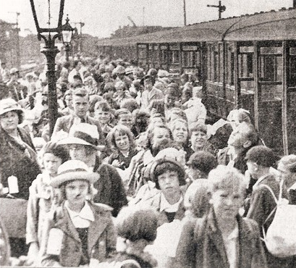
The War comes to Cambridge
At the start of the war, the Government decided that all the children should be evacuated from the bigger cities, so they wouldn’t be bombed. A lot of evacuees from London came to Cambridge.
Evacuees arrive at Barnwell Junction Station, 1939

Slide 4
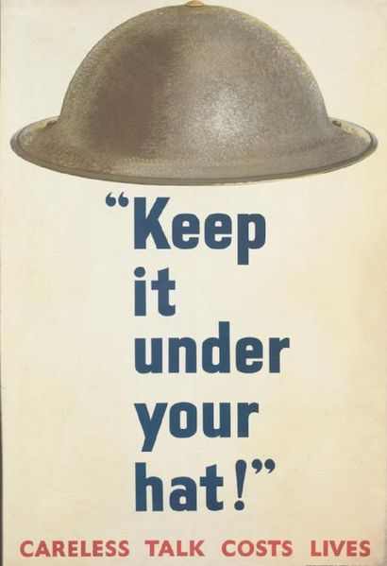
Fear of Invasion
Lots of people were scared that England would be invaded by Germany. The police even thought the newspaper reporter was a German soldier because he was wearing red and grey pyjamas.
By Unknown (artist), J Weiner Ltd, 71/5 New Oxford Street, London WC1 (printer), Her Majesty's Stationery Office (publisher/sponsor) [Public domain], via Wikimedia Commons

Slide 5
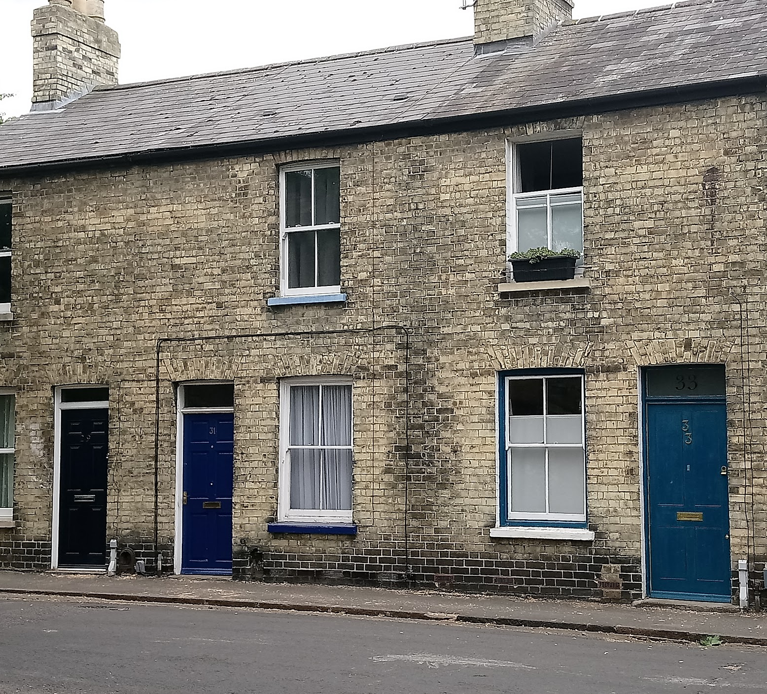
Cambridge in 1940
In the 1930s and 1940s Cambridge was a very mixed town, with a lot of rich people at the University and a lot of poorer working families, often living in terraced houses like the ones that were on Vicarage terrace.
Typical Cambridge Victorian Terrace

Slide 6
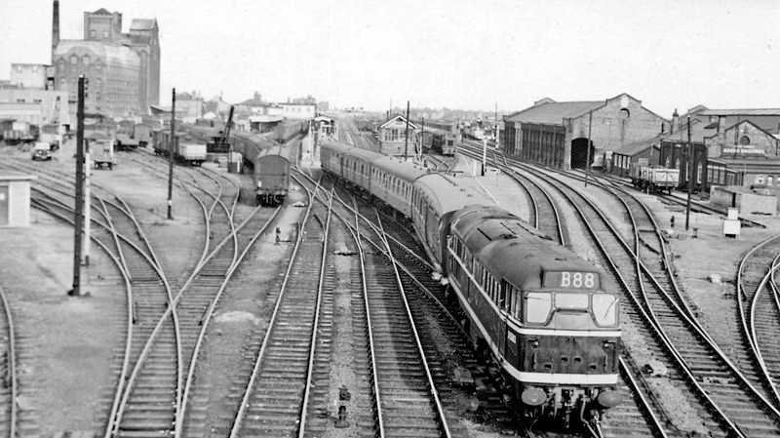
First Bombs in Cambridge
A few weeks before Vicarage Terrace was bombed, a Nazi plane dropped 11 bombs on Cambridge, aimed at the train station. All of them missed, and landed in fields, only causing harm to the sugar beet crops.
Cambridge Railway Station
Ben Brooksbank [CC BY-SA 2.0 (https://creativecommons.org/licenses/by-sa/2.0)], via Wikimedia Commons

Slide 7
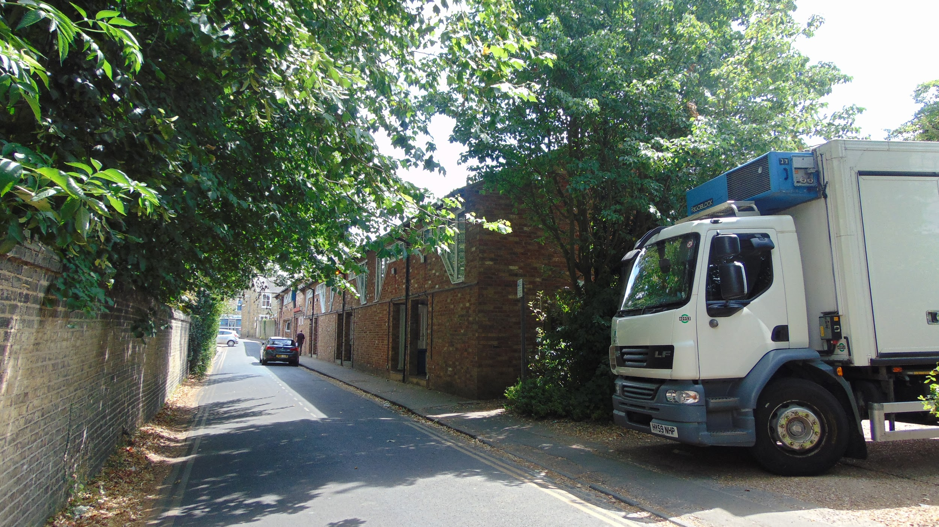
Then and Now
Vicarage Terrace was a typical victorian working class street. This is a picture of Vicarage Terrace now.
Modern Houses on Vicarage Terrace

Slide 8
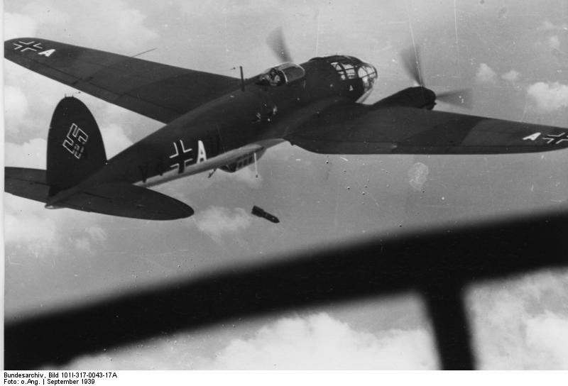
But why was it rebuilt?
On the night of the 18th of June, a German bomber plane mistook the nearby Church for a control tower, and dropped bombs on what they thought was Marshalls airport.
Bundesarchiv, Bild 101I-317-0043-17A / CC-BY-SA 3.0 [CC BY-SA 3.0 de (https://creativecommons.org/licenses/by-sa/3.0/de/deed.en)], via Wikimedia Commons

Slide 9
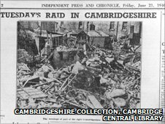
The Bombing
The Bombs fell on numbers 6 and 7 of Vicarage Terrace, destroying most of the houses on the street.
FACT!
St. Matthews Church was only 18 meters from the bombs, but was undamaged

Slide 10
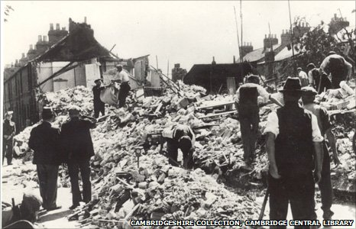
The Toll
FACT!
A rabbit whose hutch was hit by the rubble survived none the worse
Sadly, 9 people died, including 4 children. Lots more people were hurt, including Lily Itzcovitch, an evacuee

Slide 11
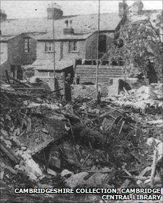
Eyewitness
Barbara Wright, who was six at the time, recalls it vividly: "We were grabbed and my father said 'Quick - to the stairs'. It was an old two-up and the stairs were in a cupboard off the kitchen. We huddled there, my father in front with my brother Stuart and sister Anne, then mother with the baby and me behind them and it went quiet. Suddenly there was a huge noise, the actual walls on either side came in and practically touched us."

Slide 12
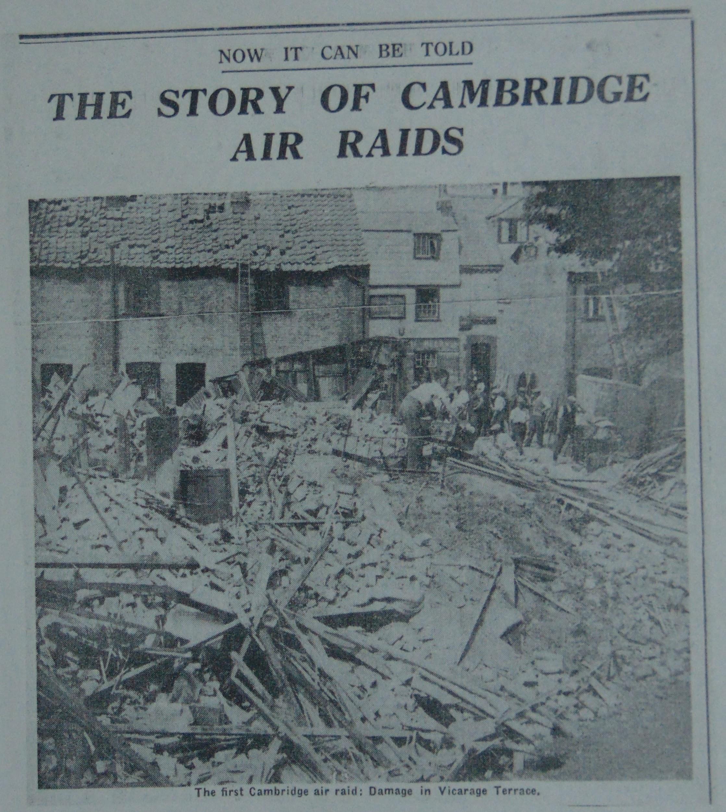
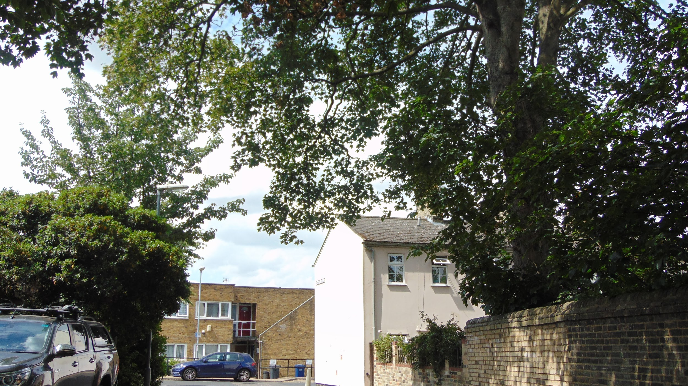
Then and Now
After the bombing, the rubble was cleared up and all remains of the houses destroyed. The street remained empty until the 1970s when new homes were built
The scene of the bombing. Cambridge Chronicle 14/8/1945
The same place now. The houses in the distance of the first picture were rebuilt down in the 1960s

Slide 13
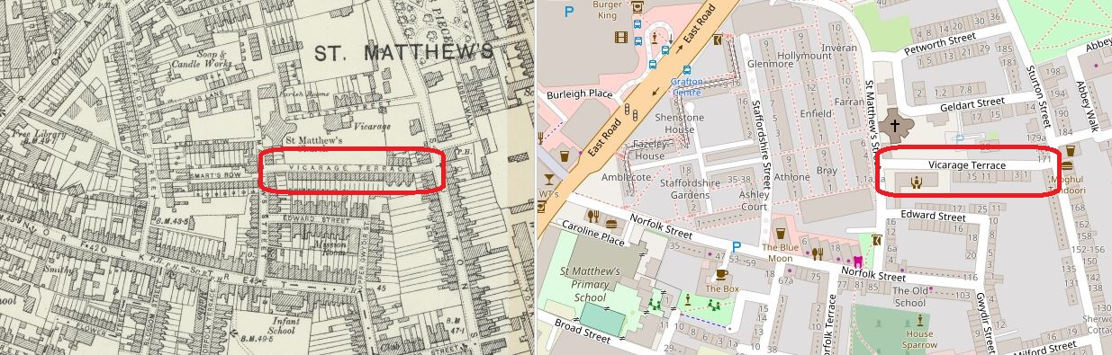
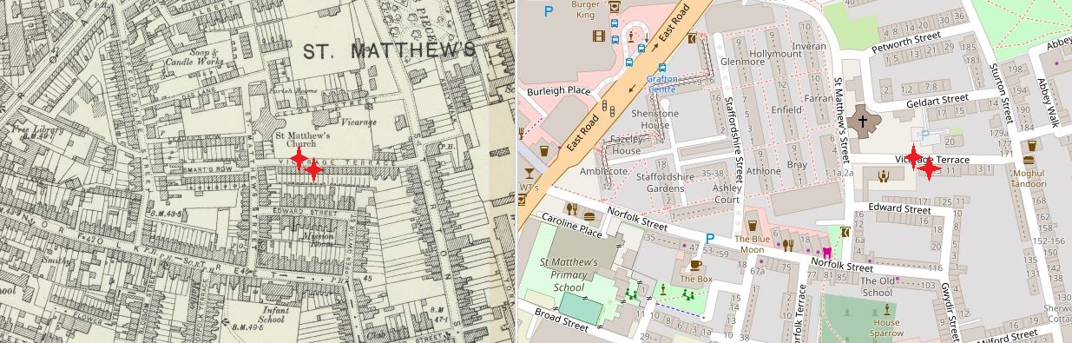
Then and Now
Vicarage Terrace then and now
Where we think the bombs hit
Reproduced with the permission of the National Library of Scotland
CC BY-NC-SA 4.0

Slide 14
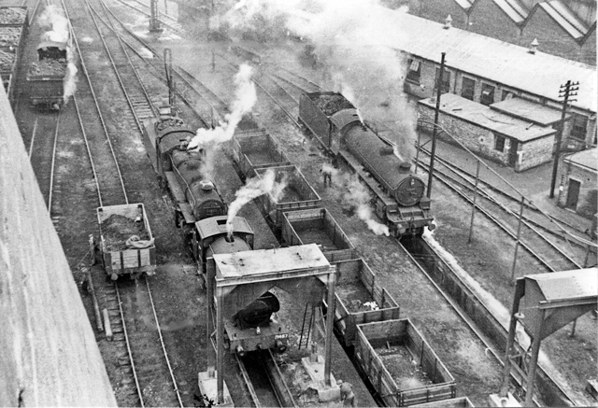
More Bombs on Cambridge
Cambridge was bombed again several times in WW2, often near to the railway.
The railway cottages, off Mill Road, were also hit.
Cambridge Station Rail Yard
Ben Brooksbank [CC BY-SA 2.0 (https://creativecommons.org/licenses/by-sa/2.0)], via Wikimedia Commons

Slide 15
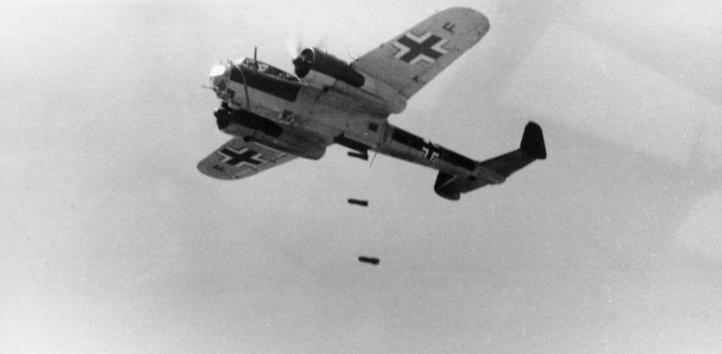
Bombing of the Railway Cottages in World War II
Eric Lee was 7 years old when the planes bombed the Railway Cottages during World War II.
He lived just round the corner on Great Eastern Street and remembers the bombing happening.
The Dornier aircraft that bombed the Railway Cottages
Bundesarchiv, Bild 101I-341-0489-13 / Spieth / CC-BY-SA 3.0 [CC BY-SA 3.0 de (https://creativecommons.org/licenses/by-sa/3.0/de/deed.en)], via Wikimedia Commons

Slide 16
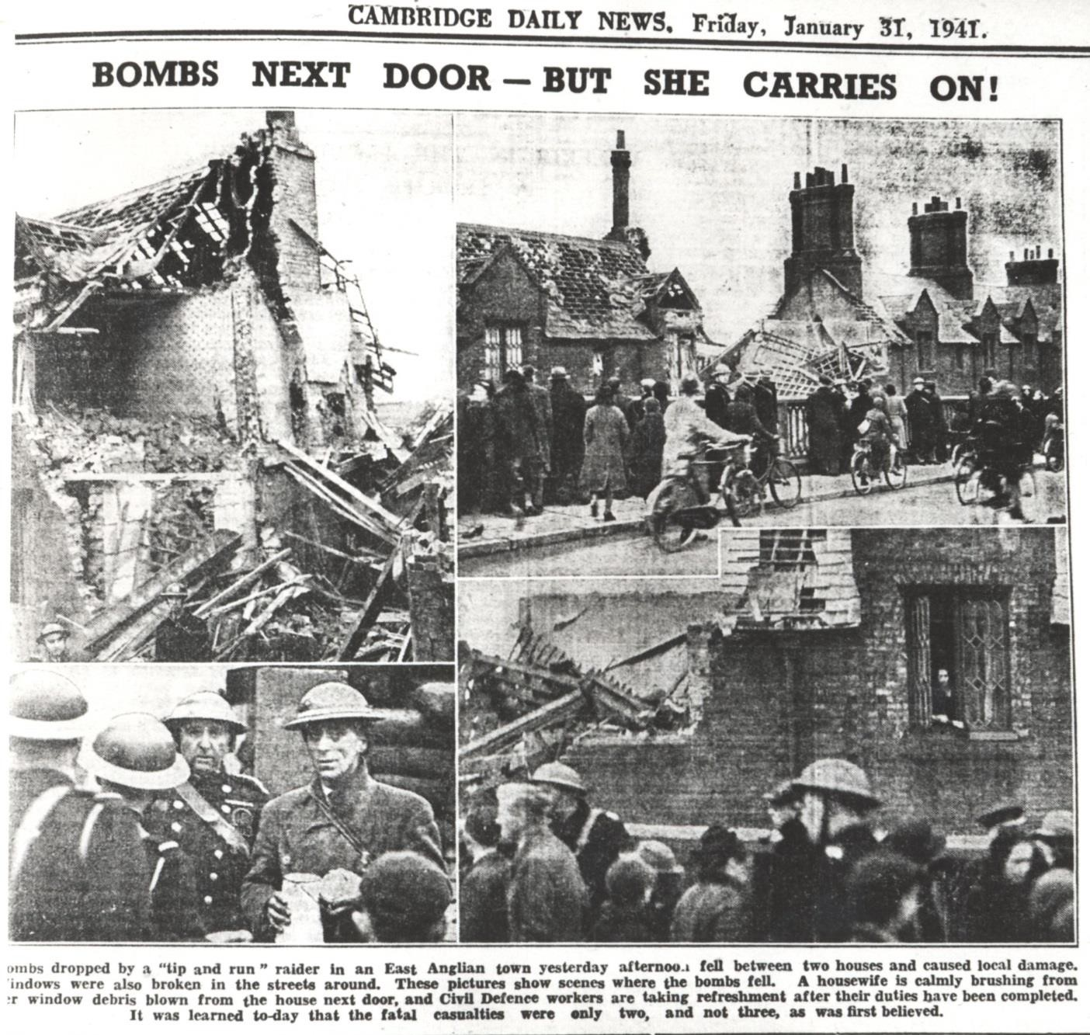
Eric’s Memories of the Bombing on Mill Road in WWII
“On the day of the Mill Road bombing we came out of school in Ross Street ‒ my brother Tony and I. We ran all the way home and on the way the air raid siren went. We looked down the railway track and there was a German plane, and he came up the line dropping bombs. We ran in the house and hid under the stairs with our Mum as you did in those days. The Cambridge Daily News must have sent a photographer early the following morning (a January afternoon would have been dark by 4 p.m.) as the following remarkable photographs and commentary appeared in the newspaper of 31 January”
Cambridge Daily News,
31st January 1941-
Mill Road Bridge Bombing

Slide 17
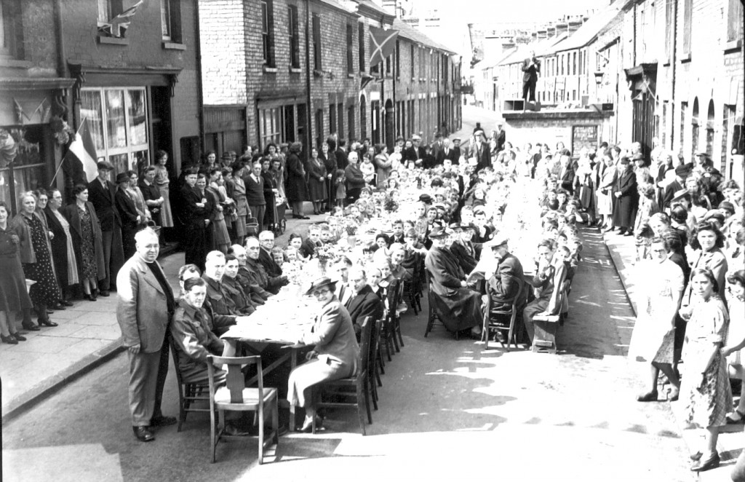
The End of the War
Lots of people celebrated the end of the war on VE Day (8th of May). Many people held street parties.
Gwydir Street VE Day Party, from Capturing Cambridge. Gwydir St. is very close to Vicarage Terrace.

Slide 18
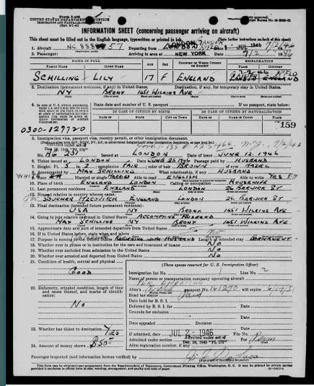
After the War
People were badly affected by the war. It changed people’s lives. After the war many families left Cambridge, and some went to America, including Lily Itzcovitch, the 11 year old evacuee who was injured in the bombing of Vicarage Terrace
Lily Itzcovitch’s landing card
www.libertyellisfoundation.org

Slide 19
Further Links
http://cambridgehistorian.blogspot.com/2012/06/bombing-of-vicarage-terrace_7702.html
http://news.bbc.co.uk/local/cambridgeshire/low/people_and_places/history/newsid_8754000/8754009.stm
Letters from local residents
Survivors Accounts
Map of Bombs in Cambridge
Map of Bombs in Cambridge (2)
Cambridge WW2 Statistics
Cambridge Evacuation Survey

