Slide 1

Life in a Victorian School

Slide 2
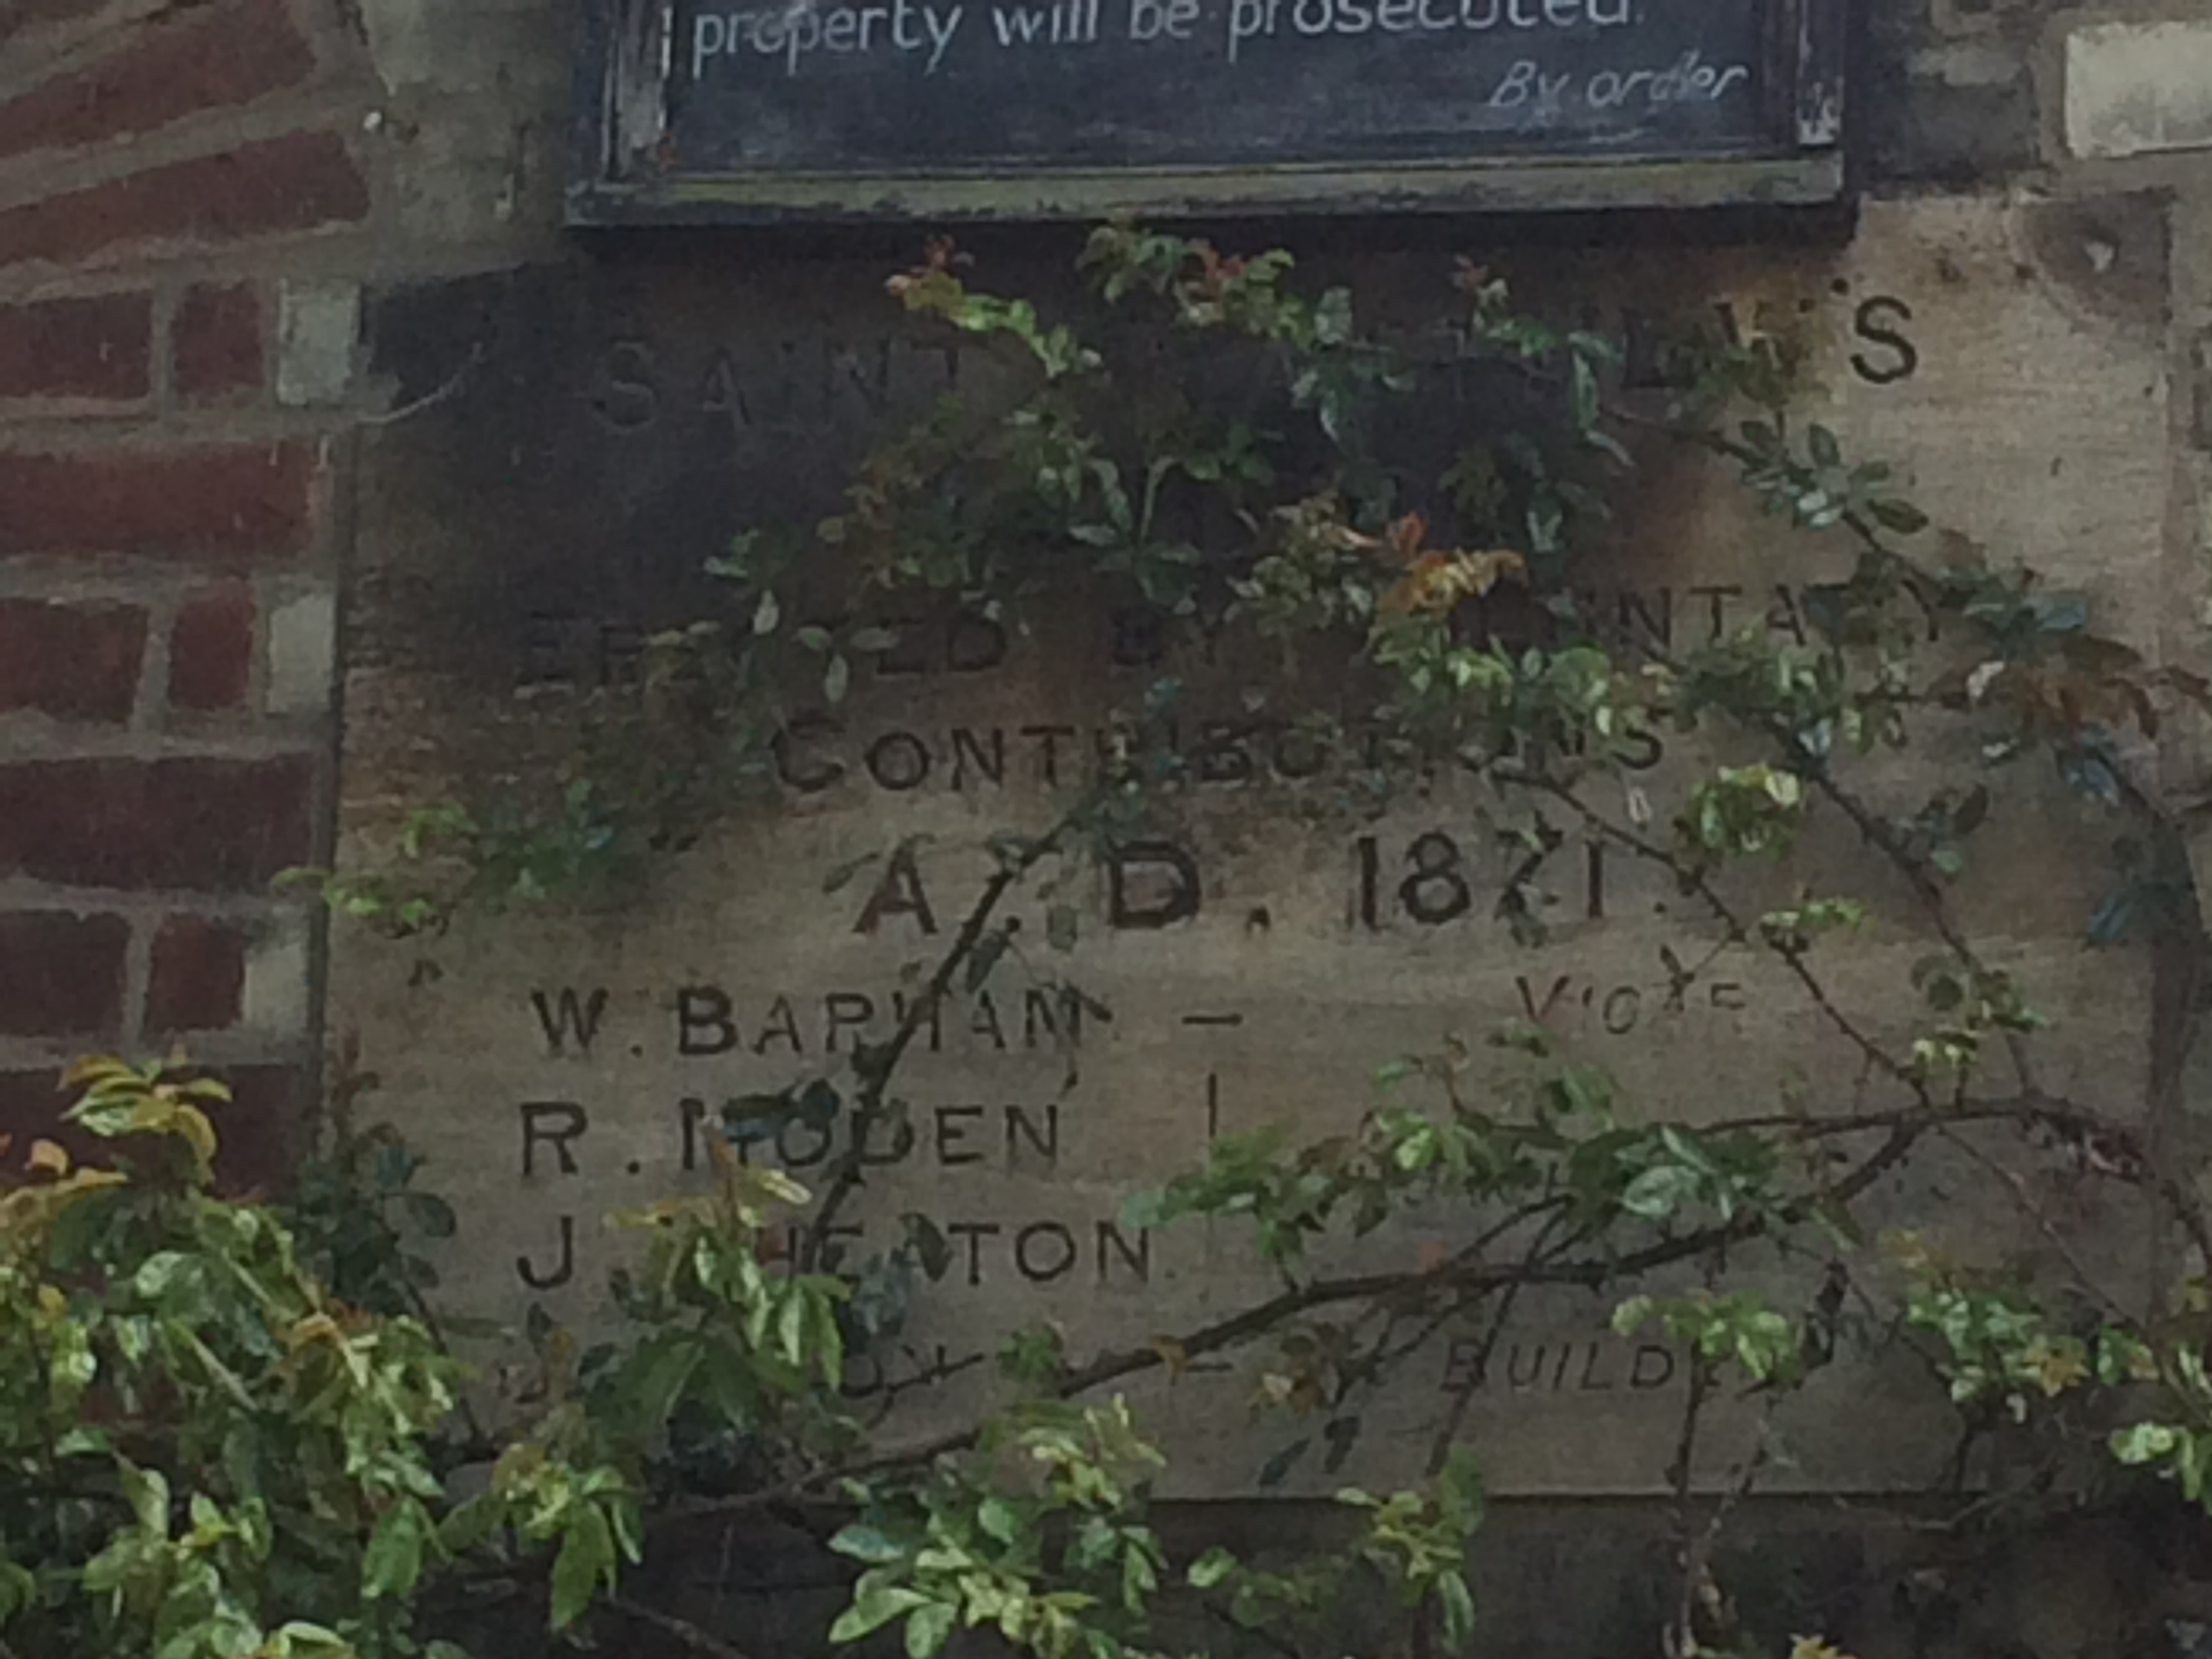
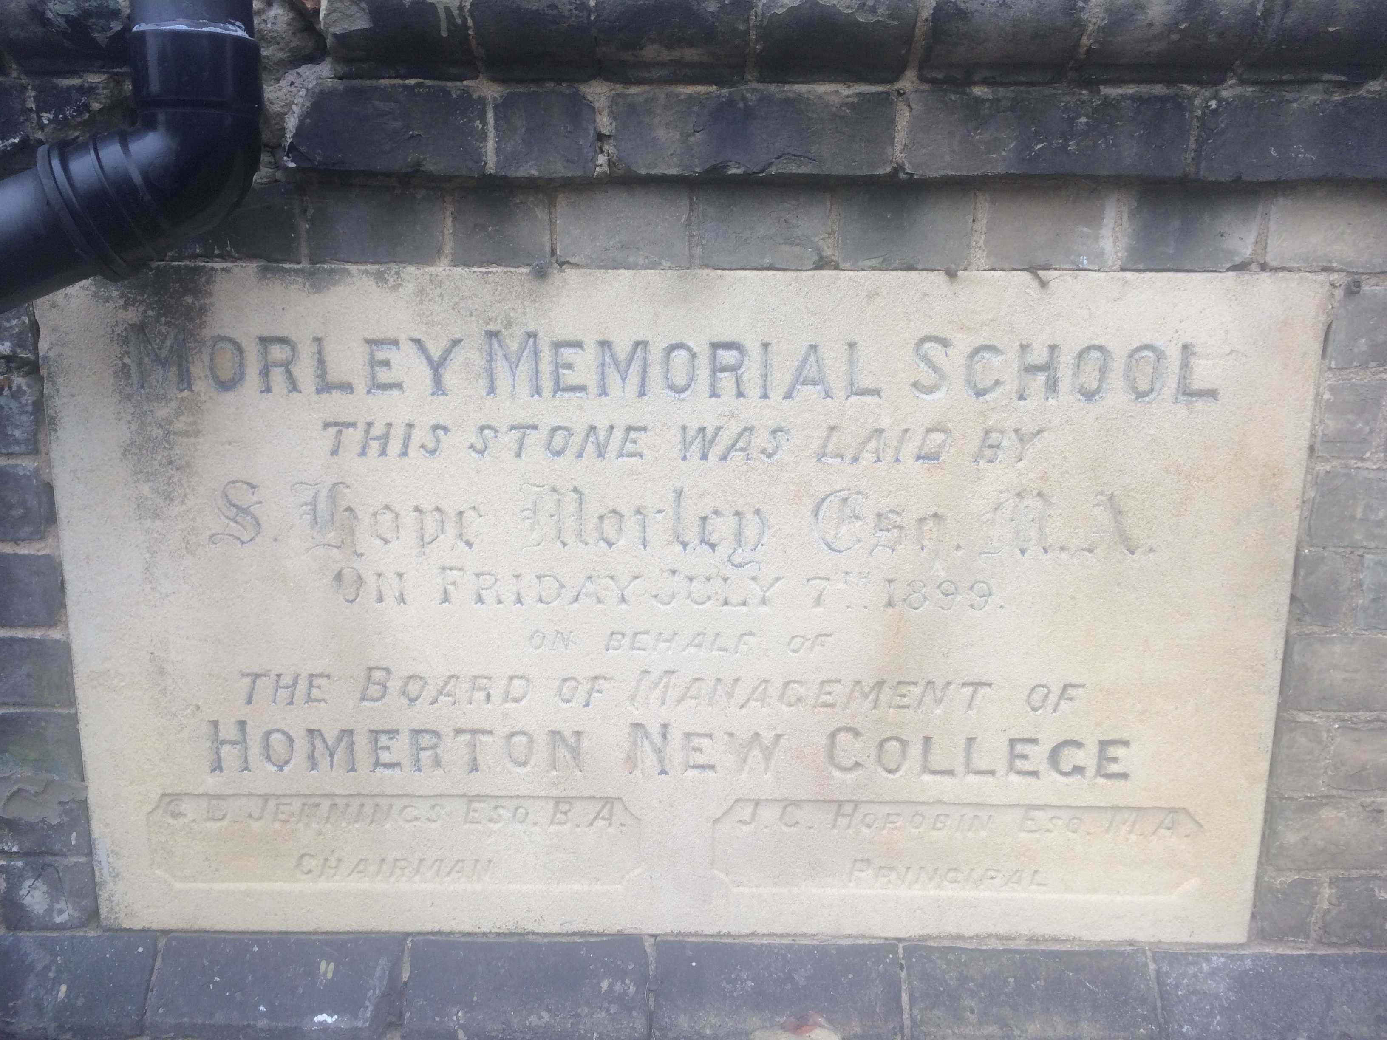
Cambridge’s School Numbers Continue to Grow!
In the Victorian Era the number of Cambridge Schools grew massively for a number of reasons.
The population was growing because of industrialisation and the coming of the Railway in 1845 which brought more trade and families to live and work in Cambridge. A number of charities opening schools to help educate poor children, new education acts being passed in 1870 and 1880 and school becoming free for all in 1891, were amongst the reasons for the large number of schools being built in the Victorian Era.
Can you
spot the
dates
on the
signs?
Plaques showing the dates of opening
from outside St. Matthew’s School and
Morley Memorial School Victorian buildings

Slide 3
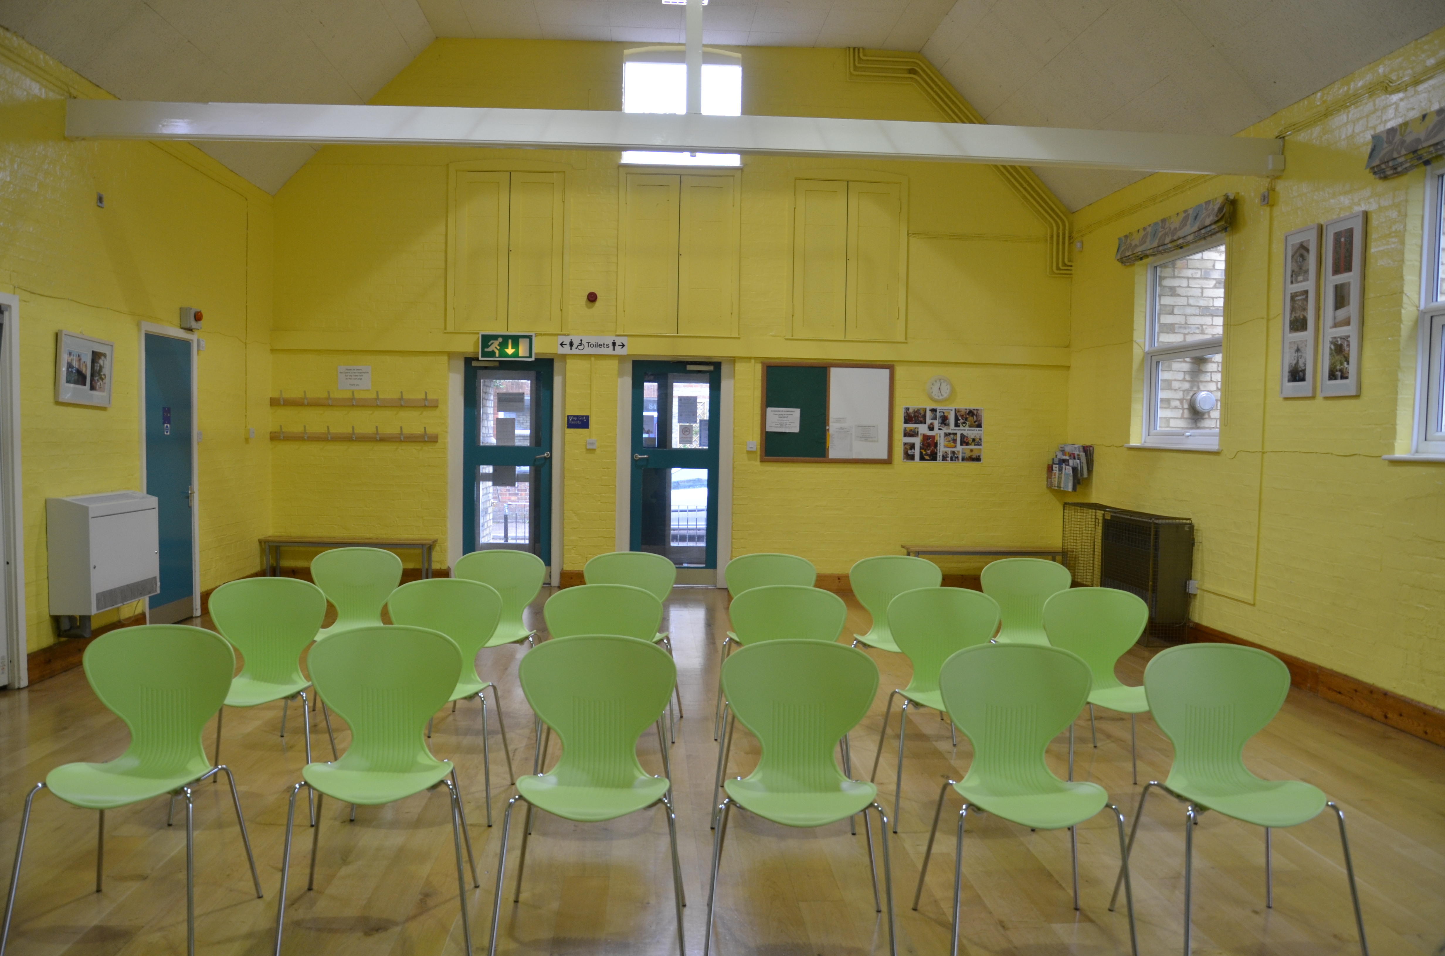
Cambridge builds new Schools in the Victorian Era
So many families settled in Cambridge for work that the newly founded schools became full, especially those close to the Railway Station where the railway workers families lived. For example, St Philip's School became too crowded with hundreds of children trying to squeeze into the classrooms. This led to the school splitting into parts and girls and boys were separated in different schools.
The boys were in Ross Street which although it was enlarged in 1898, it soon filled up with schoolboys, so that the Romsey Council School had to be built in 1904.
The girls were next to the infant school for St Philip's on Catherine Street. This also filled up with over 870 children in two rooms by 1911 so they had to build a larger school!
This is a picture of inside Ross Street Community Centre today, which used to be St. Philip’s boys school. You can still see the wooden beams and original walls and roof which were built in the Victorian Era.

Slide 4
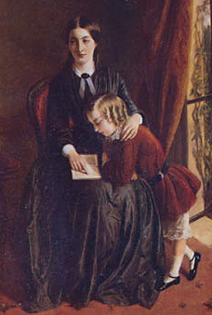
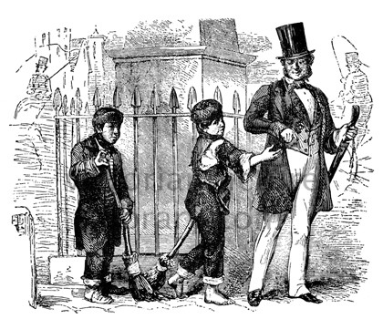
Life in a Victorian School
It’s difficult to imagine, but in in 1837, at the beginning of the Victorian Era, there was no law saying that children had to go to school!
Children from richer families paid to send their boys to school and the girls and younger boys would be taught at home by a Governess.
But many poor children did not have the opportunity to go to school at all and worked from a early age.
Like the children in this picture.
Painting of a Governess, by Rebecca Solomon, painted c. 1851, exhibited at the Royal Academy 1854

Slide 5
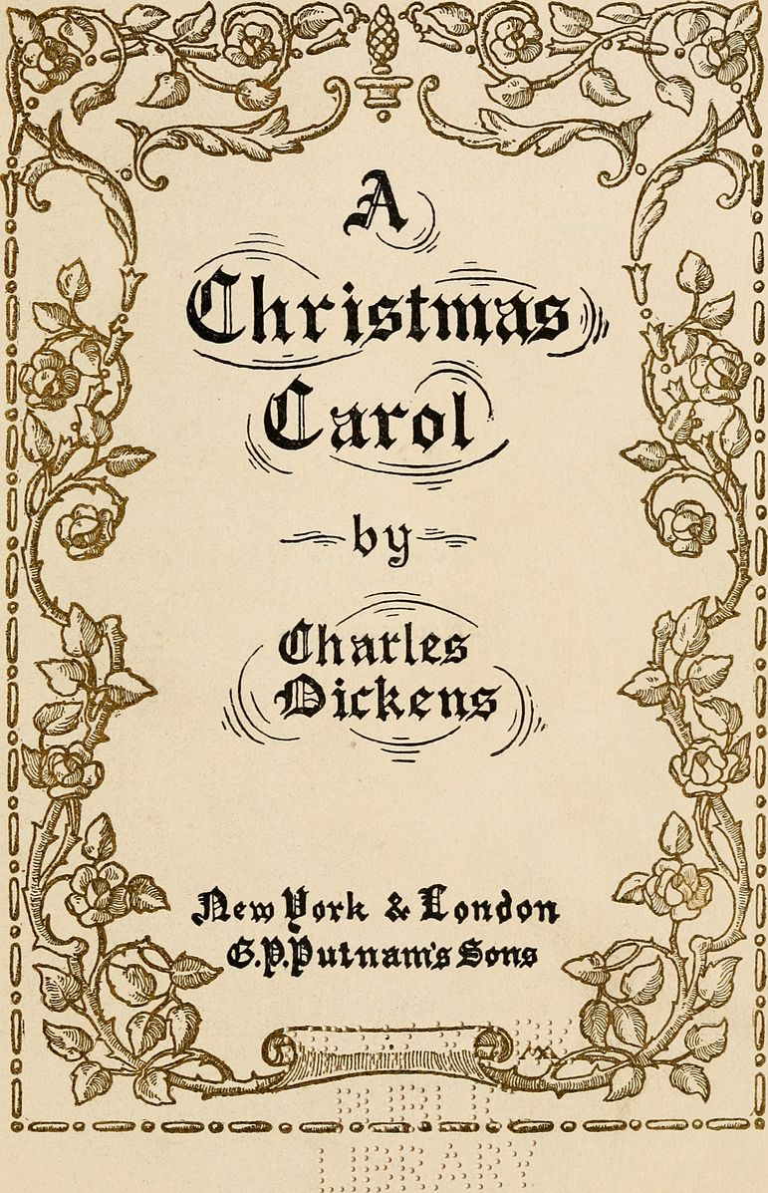
Ragged Schools
Some poor children went to ragged schools, which were schools that were set up in big cities, offering poor and homeless children free school teaching.
Charles Darwin wrote about children going to the ragged schools in his book ‘A Christmas Carol’ which he wrote in the Victorian Era.

Slide 6
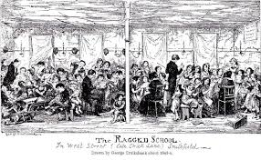
Brunswick Infant School
(feeder for St Matthew’s School)
There was a Ragged School in Cambridge which was founded by a charity.
It was located near St Matthew's School and the building is still there today!
We have descriptions from Victorian diarists of fundraising for shoes and clothes and books to help the Ragged School.

Slide 7
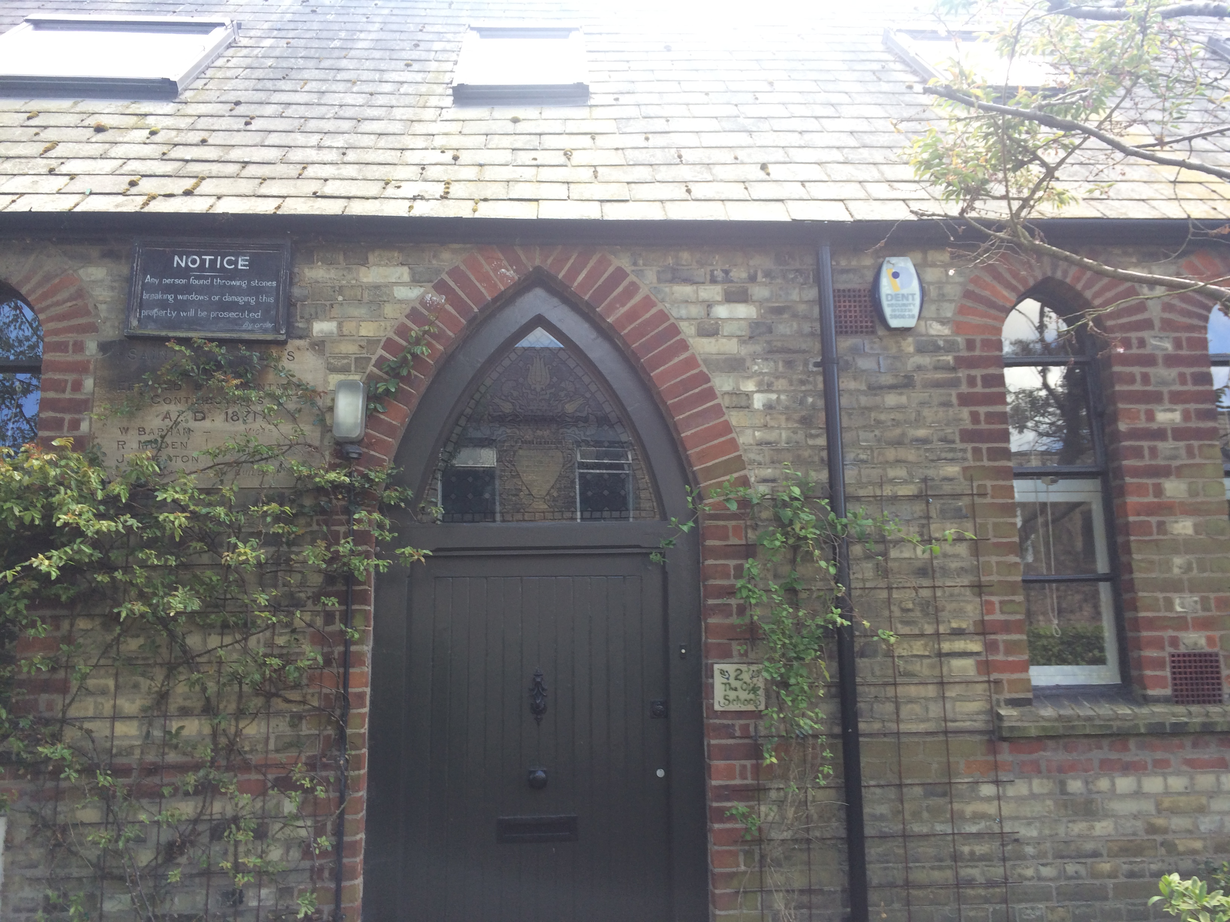
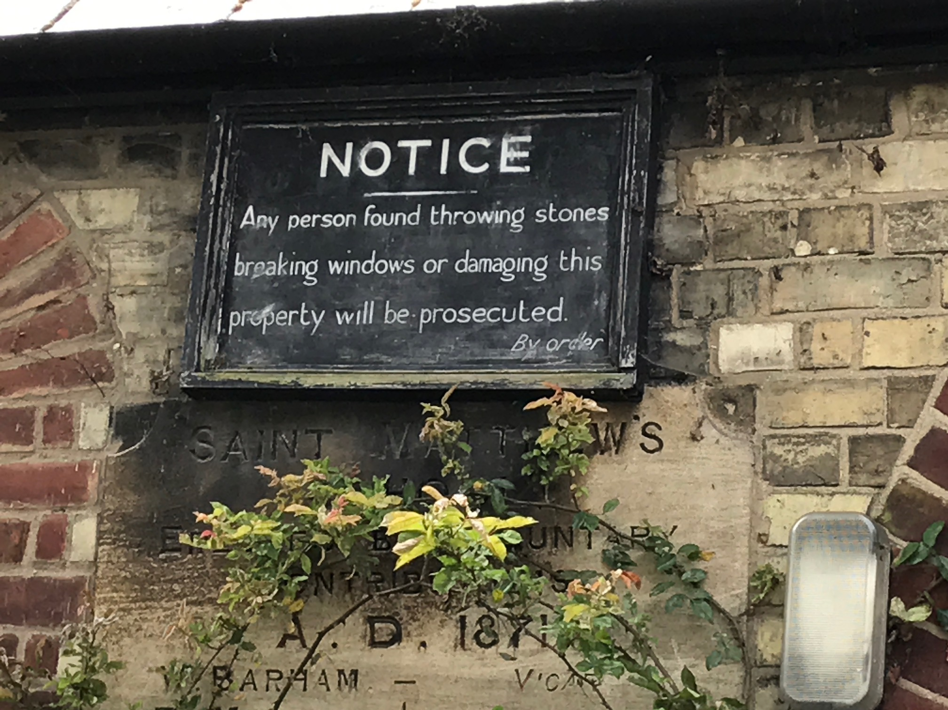
Elementary Education Acts: 1870 & 1880
In 1870 a new law was passed to ensure all children could go to school, meaning new schools were built all over the country.
St. Matthew’s School on Norfolk
Street was opened in 1871 shortly after
the first Education Act was past in 1870.
Can you spot the date on the plaque outside the school?
A new Elementary Education Act was past in 1880
which mean children had to attend school
between the age of 5 and 10.
Parents paid about 2p (2d) each
week for them to attend.

Slide 8
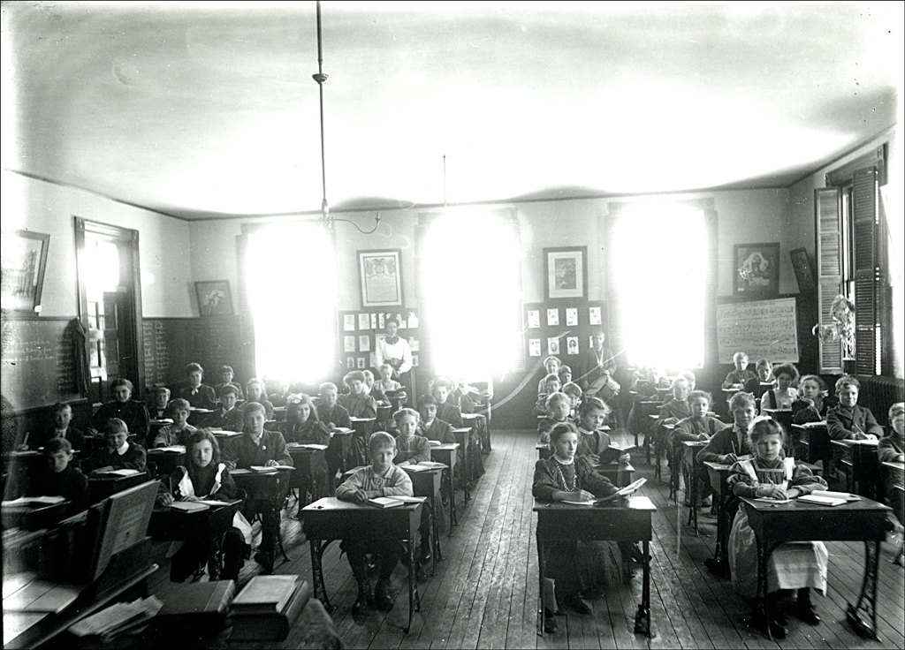
School Free for All!
In 1891 the law changed so that parents no longer had to pay for their
children’s education from the age of 5-10. So it was now free for children
to go to school.
FREE EDUCATION FOR ALL!

Slide 9
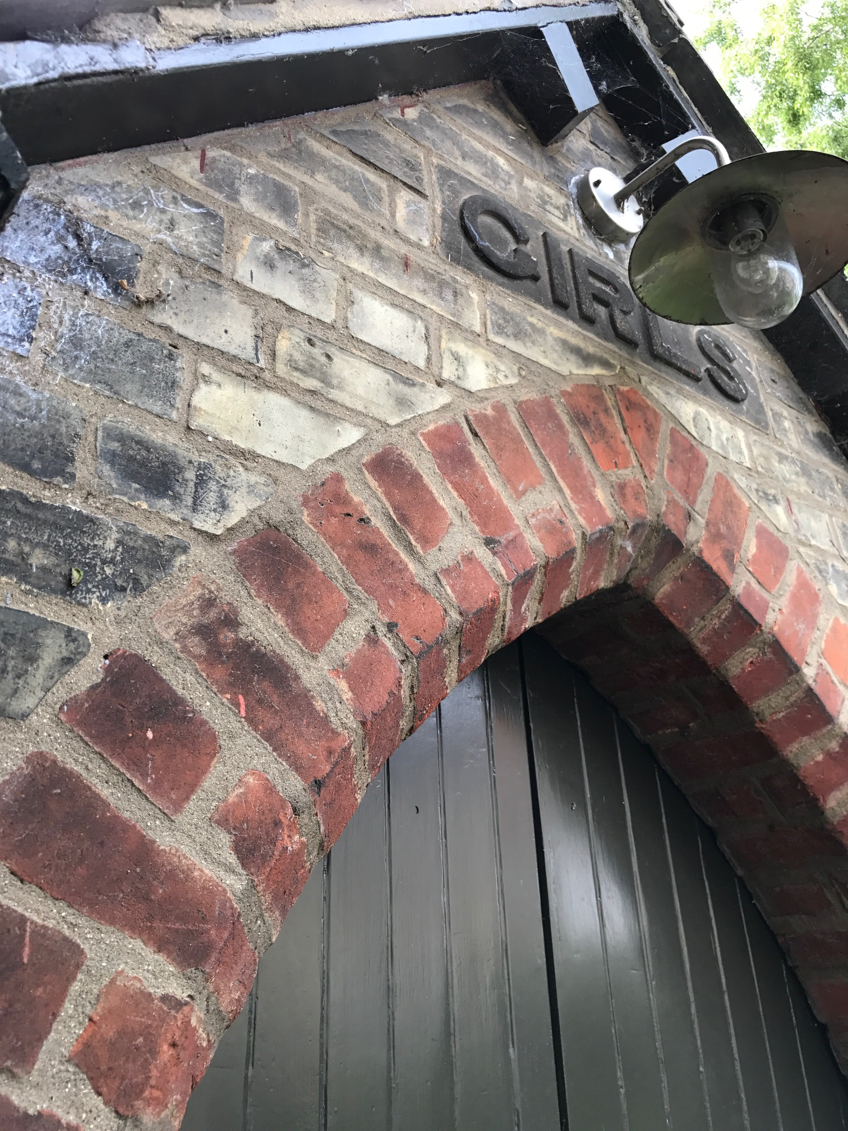
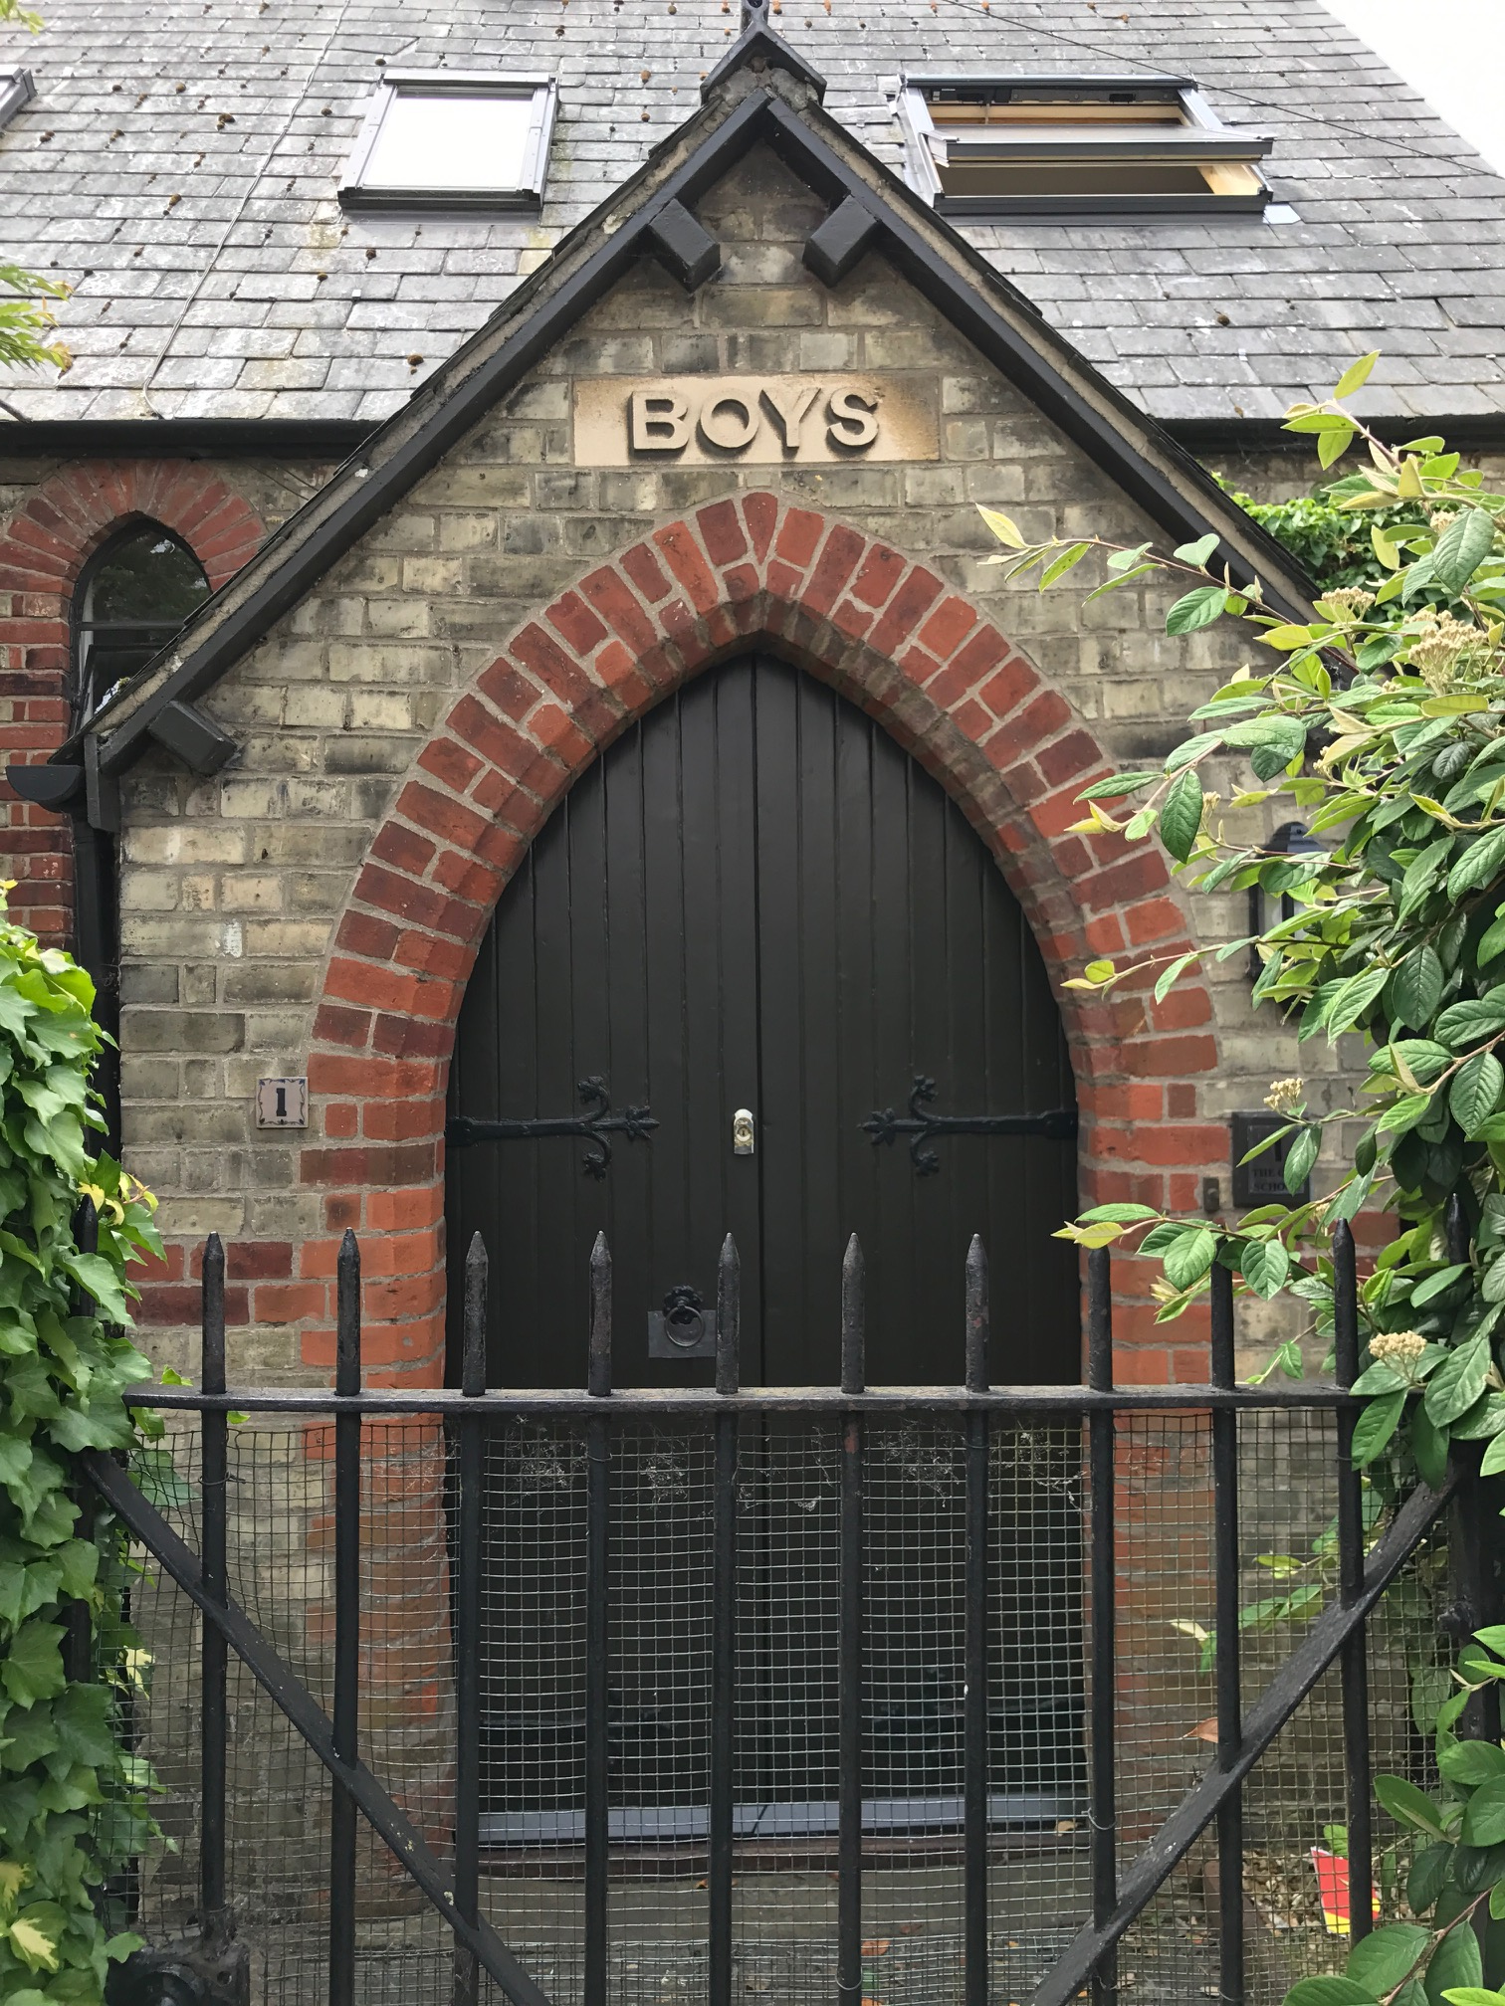
Separating Girls and Boys
All children aged 5-7 were taught in the Infant School, but from the age of 7 girls and boys were taught separately.
Girls and boys had to use different
entrances and had separate classrooms.
Photos of St. Matthew’s School Girls
And Boys Entrances at the Victorian
School House

Slide 10
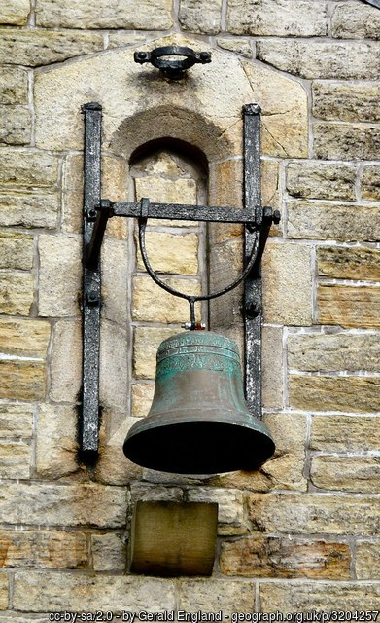
The Victorian School Day
The Victorian School day started at 9 o’clock sharp. You needed to make sure you were on time, or you would be sent to the Headteacher’s Office for a telling off and some Headteachers hit pupils with a cane!
The day always started with Assembly, which went on until 9.30am. At Assembly the Headteacher would lead all children in saying ‘The Lord’s Prayer’, singing a hymn and listening to a story from the Bible.
FACTOID!
The bell would ring to tell children it
was time for school as not many people
had clocks or watches at home.

Slide 11
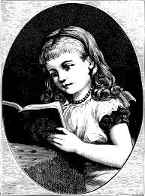
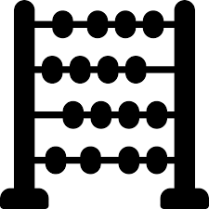
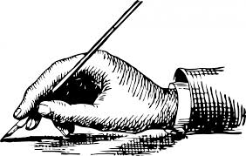
School Lessons- The ‘3 Rs’
After Assembly it would be time to get on with your lessons.
Each day lessons were based around the ‘3 Rs’:
Reading
wRiting
aRithmetic
Reading
Arithmetic
FACTOID!
If you didn’t sit up straight in your lessons you could be forced to sit with a back straightener pressed into your back to make you sit up straight and concentrate!
Click here to see a picture of a back straightener.
Writing

Slide 12
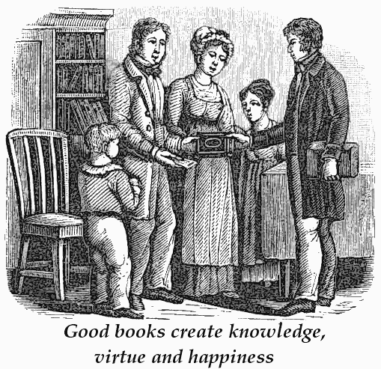
Learning to Read
The first lesson of the day was reading, which started straight after the register had been taken. At the start of the lesson everyone would be given a ‘reader’ by a monitor. A ’reader’ was a special book that had simple sentences for children to learn to read from. Children took it in turns to read out loud to the rest of the class, stood at the front of the classroom while the other children would follow along in their own ‘reader’.
If you made a mistake then the teacher would tell you to try again until you got it right!
The picture shows a Victorian
family buying an educational
book from a book seller

Slide 13

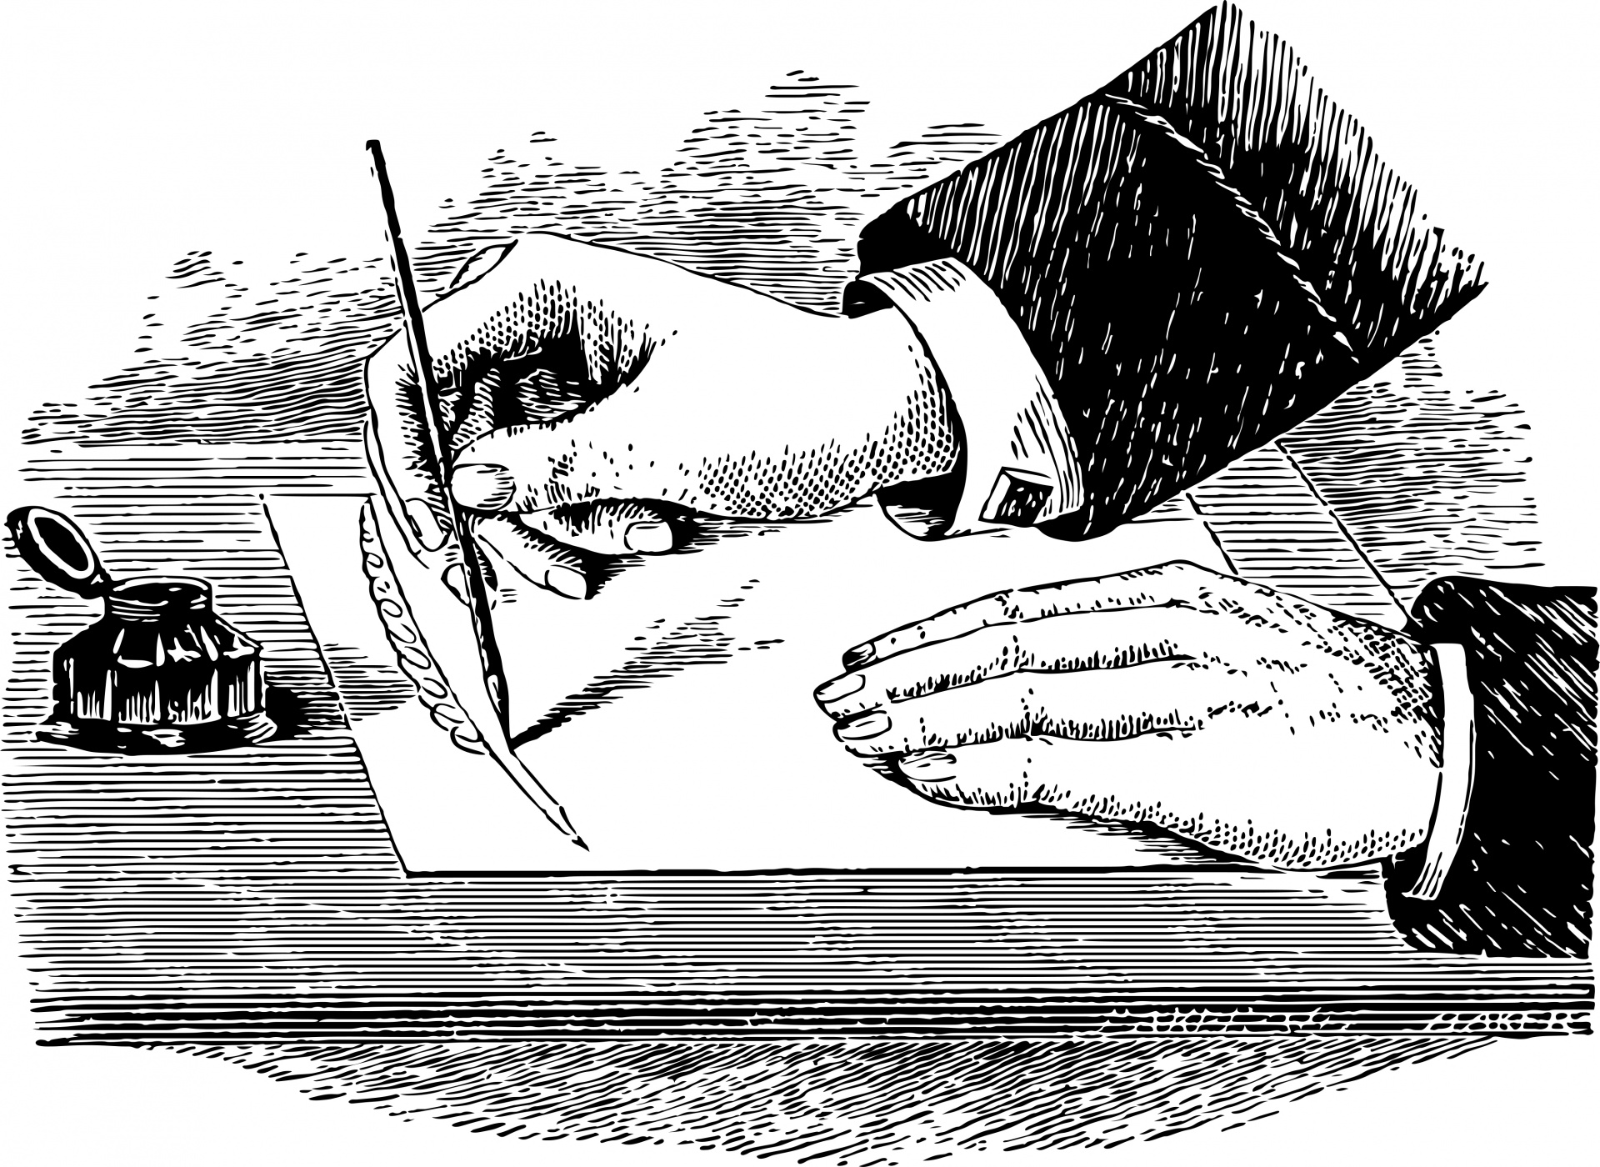
Learning to Write
Children learnt to write on slates using thin slate pencils, as it was much cheaper than paper.
Writing slate, purchased in 2011 in the Portuguese city Oporto.By Petr Adam Dohnálek
Once they were older they used copybooks, made of paper, which they wrote in with pen and ink, stored in inkwells on their desks, which often dripped in and could get very messy!
But beware, if you made ink blots in your copybook then you would be punished!

Slide 14
Learning Arithmetic
Children learnt to count using an abacus but were also expected to do a lot of mental arithmetic, so doing lots of sums in your head.
They learnt to add, subtract, multiply and divide using this method of the abacus and practicing doing sums in your head.

Slide 15
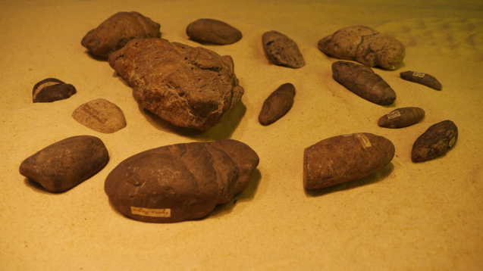

Object Lessons
As school lessons developed other more interesting lessons were also introduced.
In Infant Schools children had object lessons, where the teacher would hold up an object or picture for the class to look at, such as a rock, mineral, dead insect or dried plant to help them learn about the world around them. Then they would ask children questions about it. It was in a way an early kind of Science lesson.

Slide 16
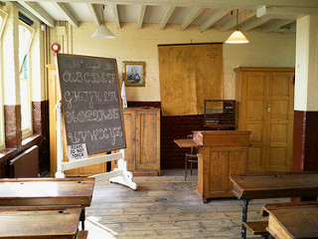
The Victorian Classroom
What can you spot in this photo that would be used for the different Victorian lessons?
Photo of a Replica Victorian School Room at the Ragged School Museum London | by Karen V Bryan

Slide 17
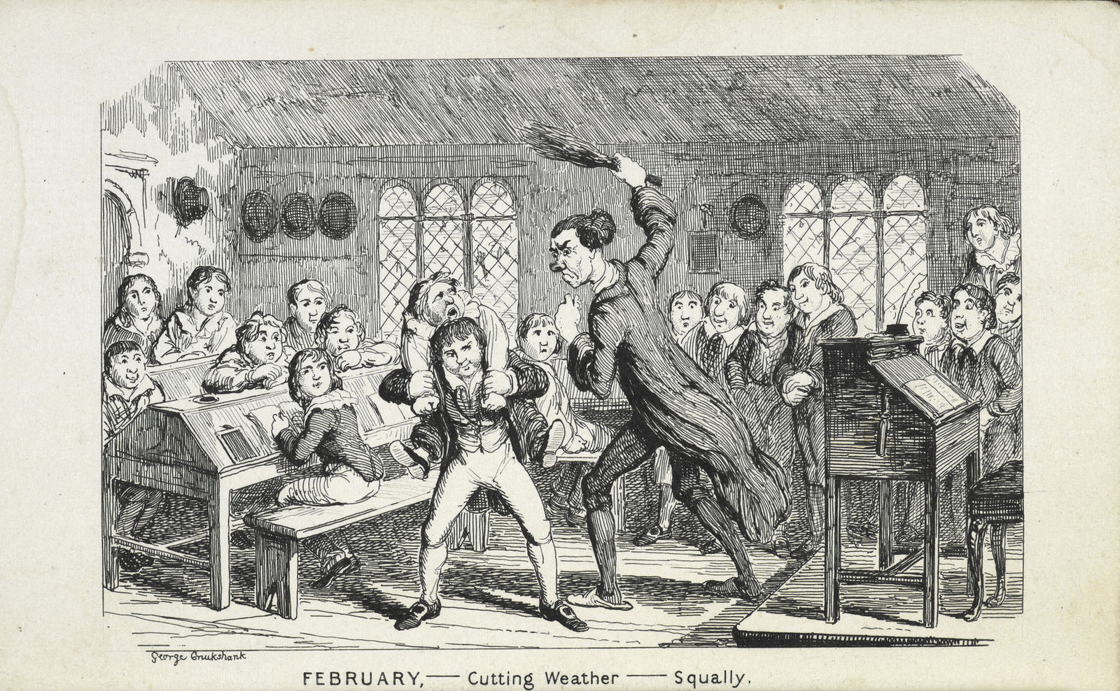
School Punishment
Victorian Schools were very strict places and if you did not obey the teacher, concentrate hard or give the correct answer you would be severely punished.
Children were often given the cane, which meant they were whacked on the bottom or hands with a special stick called a cane.

Slide 18

The Dunce Cap Punishment
Like using 'the naughty step' for infants who are playing up today, in the Victorian era, children who were not paying attention or didn't know the answer to a question, would often be given a dunce cap to wear until the end of the lesson, or the end of the school day, as humiliation.
FACTOID!
The hat was always pointy and had a big letter D on it short for 'Dunce Cap’.

Slide 19
Schools Built in the Victorian Era (1837-1901)
Here is a list of some Cambridge schools founded during the reign of Queen Victoria. Was yours one of them?
St. Philip’s
Abbey Meadows
St. Paul’s
St. Matthew’s
Morley
Ragged School

Slide 20

Web Resources available at:
http://www.creatingmycambridge.com/
history-stories

