Slide 1

Chesterton Mills in the Victorian Era

Slide 2
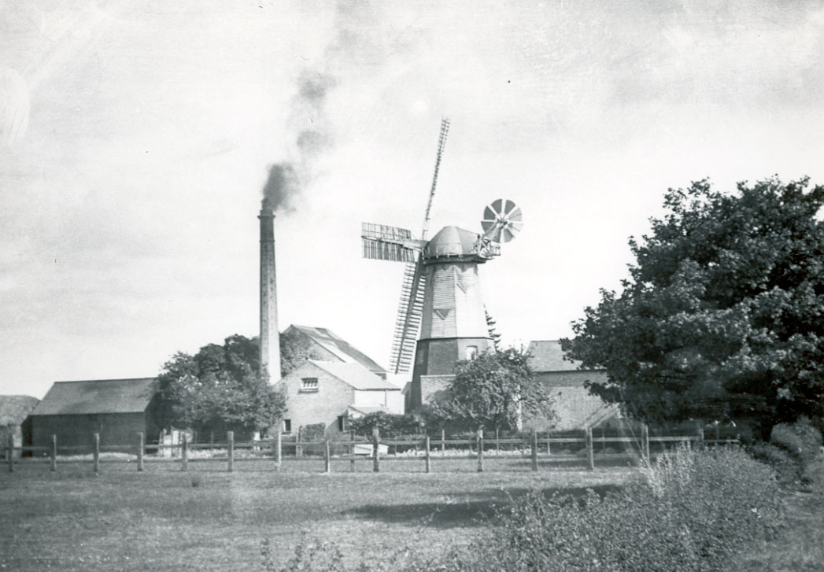
Chesterton Mills
In 1847 William French, a local miller moved to Cambridge and began to rent Chesterton Mills.
Then in 1853 he bought the ½ acre plot of land, which included the Mill for £440 at a public auction and the Mill was run by many generations of the French family for over 100 years. Most people now know it by the name French’s Mill.
FACTOID!
The original windmill at Chesterton Mills is called
a Smock Mill which means it is half brick, half wood and looks like a workman’s smock.
Chesterton Mill Photo,
Published with permission of owner of
photograph Michael French.
Also avaliable at National Mill Archive

Slide 3
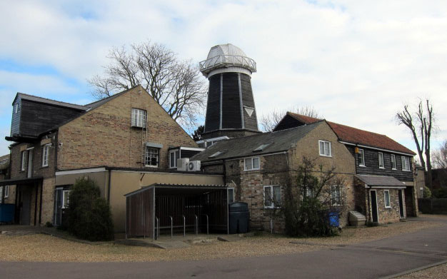
Then and Now – Chesterton Mill
Chesterton Mill Photos,
Published with permission of owner of
photograph Michael French.
Also avaliable at National Mill Archive

Slide 4
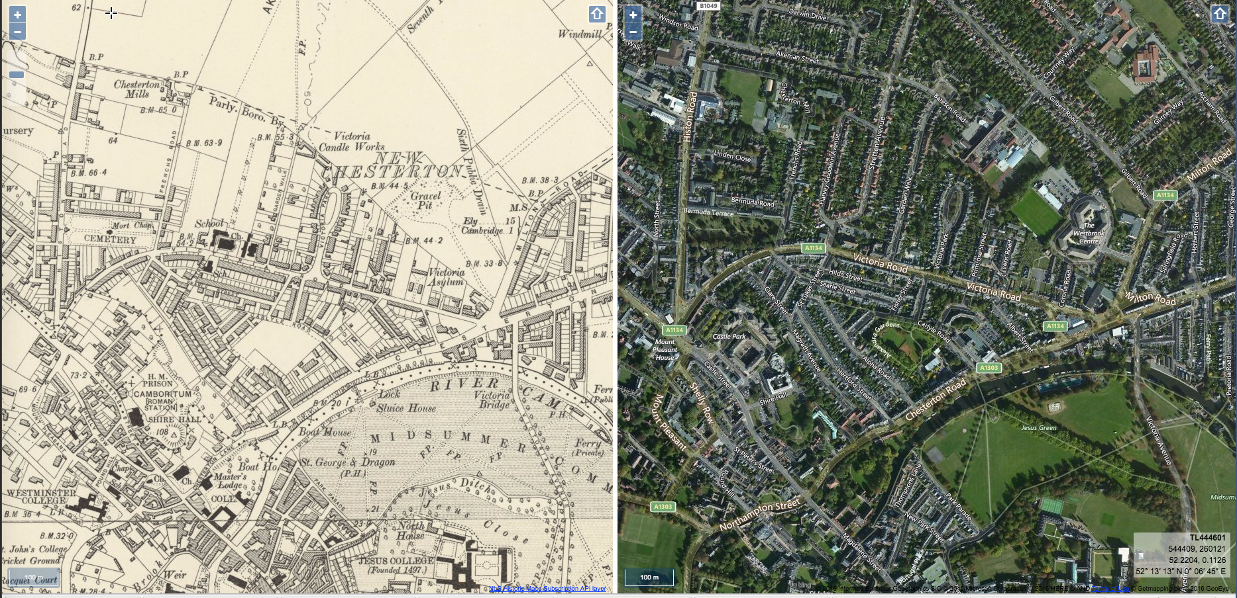
Then and Now- Map
Can you spot Chesterton Mills?

Slide 5
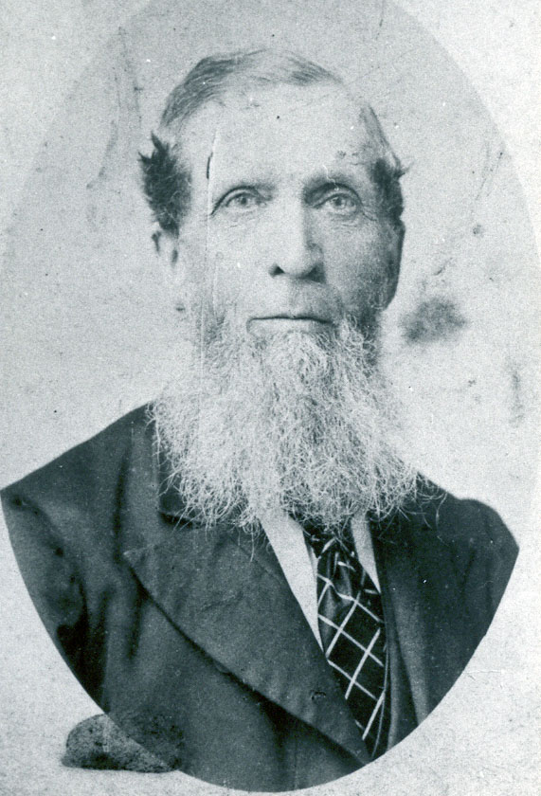
William French
William French was born in 1820 and was son of the miller, Thomas French.
He followed in his father’s footsteps in becoming a miller himself and worked at the family’s mill in Harston, nearby Cambridge.
William died in 1901, the same year as Queen Victoria. He is buried in Histon Road Cemetery at the bottom of French’s Road and you can still see his grave there today.
Photo of William French
Published with permission of owner of
photograph Michael French. Also avaliable at National Mill Archive

Slide 6
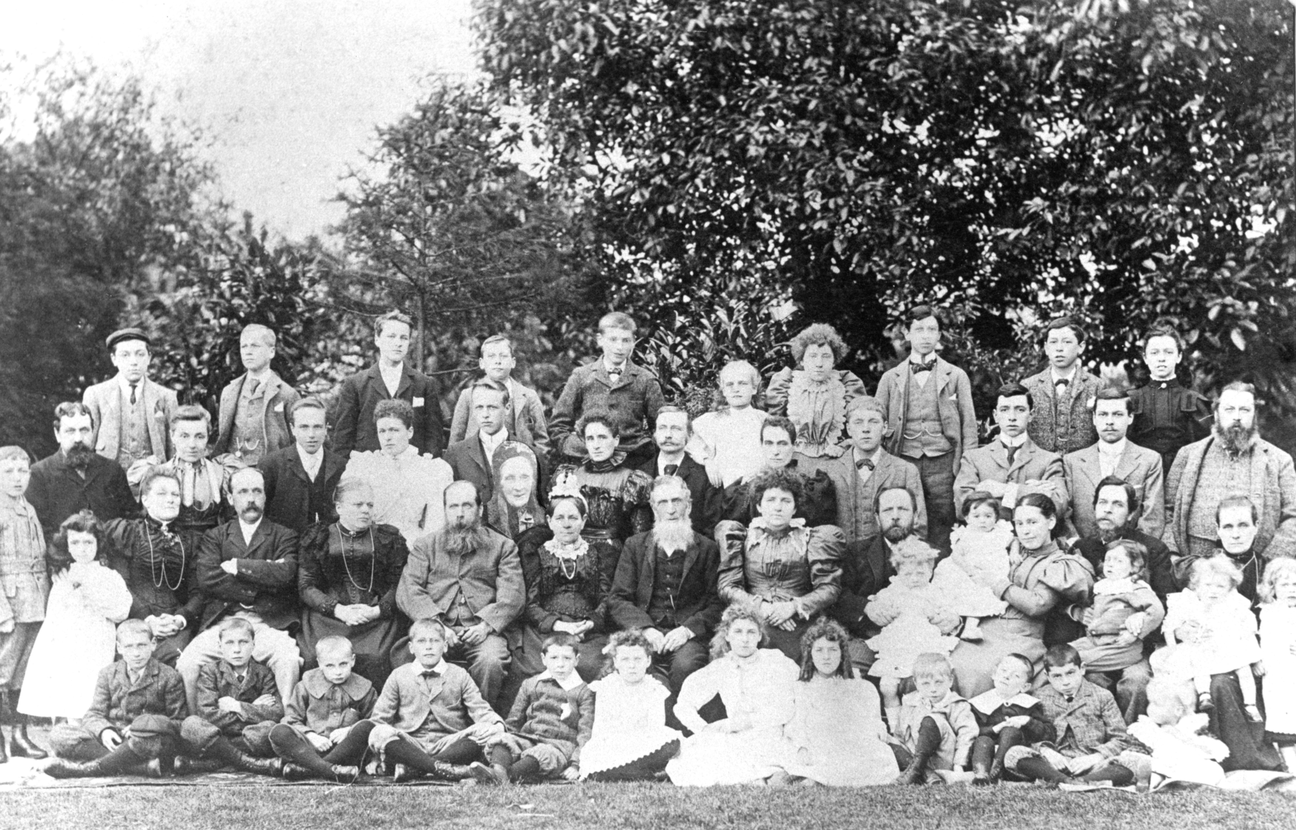
A Victorian French Family Photo!
This family photo is from 1890 and shows all the French Family.
Notice how many people there are in the family and the Victorian outfits they are wearing.
Photo reproduced with permission
of Michael French
Can you spot William French in middle of the photo?

Slide 7
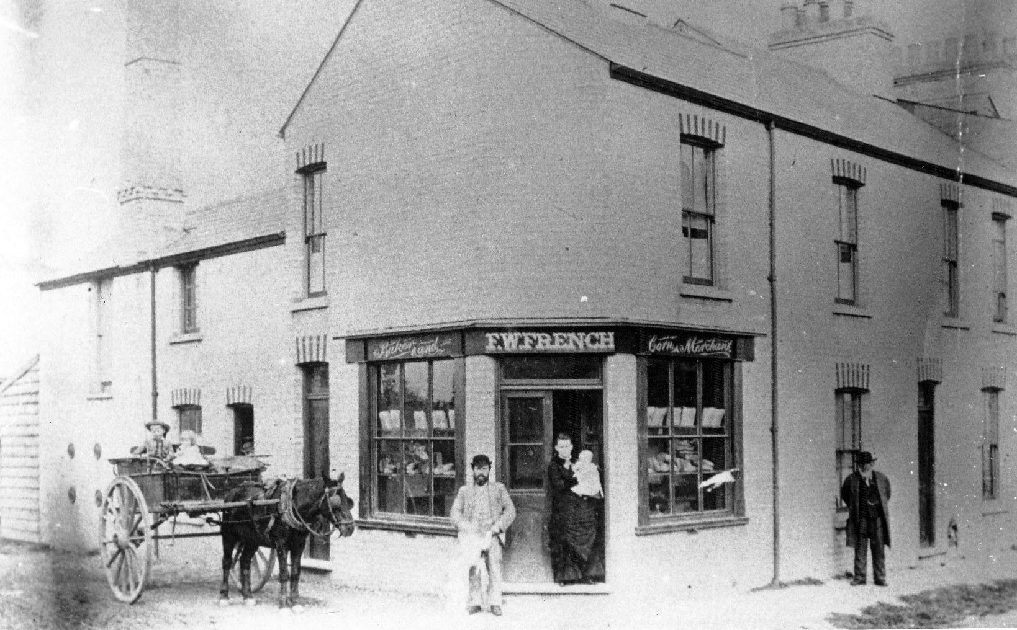
Frederick the Baker
Frederick William was born in 1851 the second son of William French. He married Abigail Hicks in America but they soon decided to return to England and Cambridge. By 1885 they were in business as ‘Baker and Corn Merchant’ at 74 Searle Street where they lived with their 9 children. After Frederick’s death in 1903 Abigail continued to run the shop until her death in 1921.
Like several of his brothers and cousins Frederick took advantage of his connection of being in a street close to the Mill and worked in a related trade using the flour from the family mill to make bread. He hoped to to buy flour and grain at discounted prices.
Photo published with permission of Cambridge Collection
Notes:
Frederick William was born in 1851 the second son of William French. Around 1870 he went to America to seek opportunities and work. Whilst there he met and married Abigail Hicks.
The newly married couple decided to return to England and Cambridge. By 1881 they were living in Old Chesterton and running a Bakery on the High Street. By 1885 they were in business as ‘Baker and Corn Merchant’ at 74 Searle Street where they lived with their 9 children. After Frederick’s death in 1903 Abigail continued to run the shop until her death in 1921.
Like several of his brothers and cousins Frederick took advantage of his connection to the Mill by working in a related trade. He was not doubt able to buy flour and grain at favourable prices.
It would have been very common at this time for people to keep a few chickens in their back yards or gardens. They would buy the small amounts of grain to feed them from their nearest corn merchant.
His shop was one of many serving this small neighbourhood. Few remain but if you look carefully you may still be able to make out the large windows of house that were once shops.
If you look closely at the photo you can see the large chimney above the bake house at the back of the shop. Frederick with a child and Abigail with a baby stand in the doorway with two older children in the horse and carriage.

Slide 8
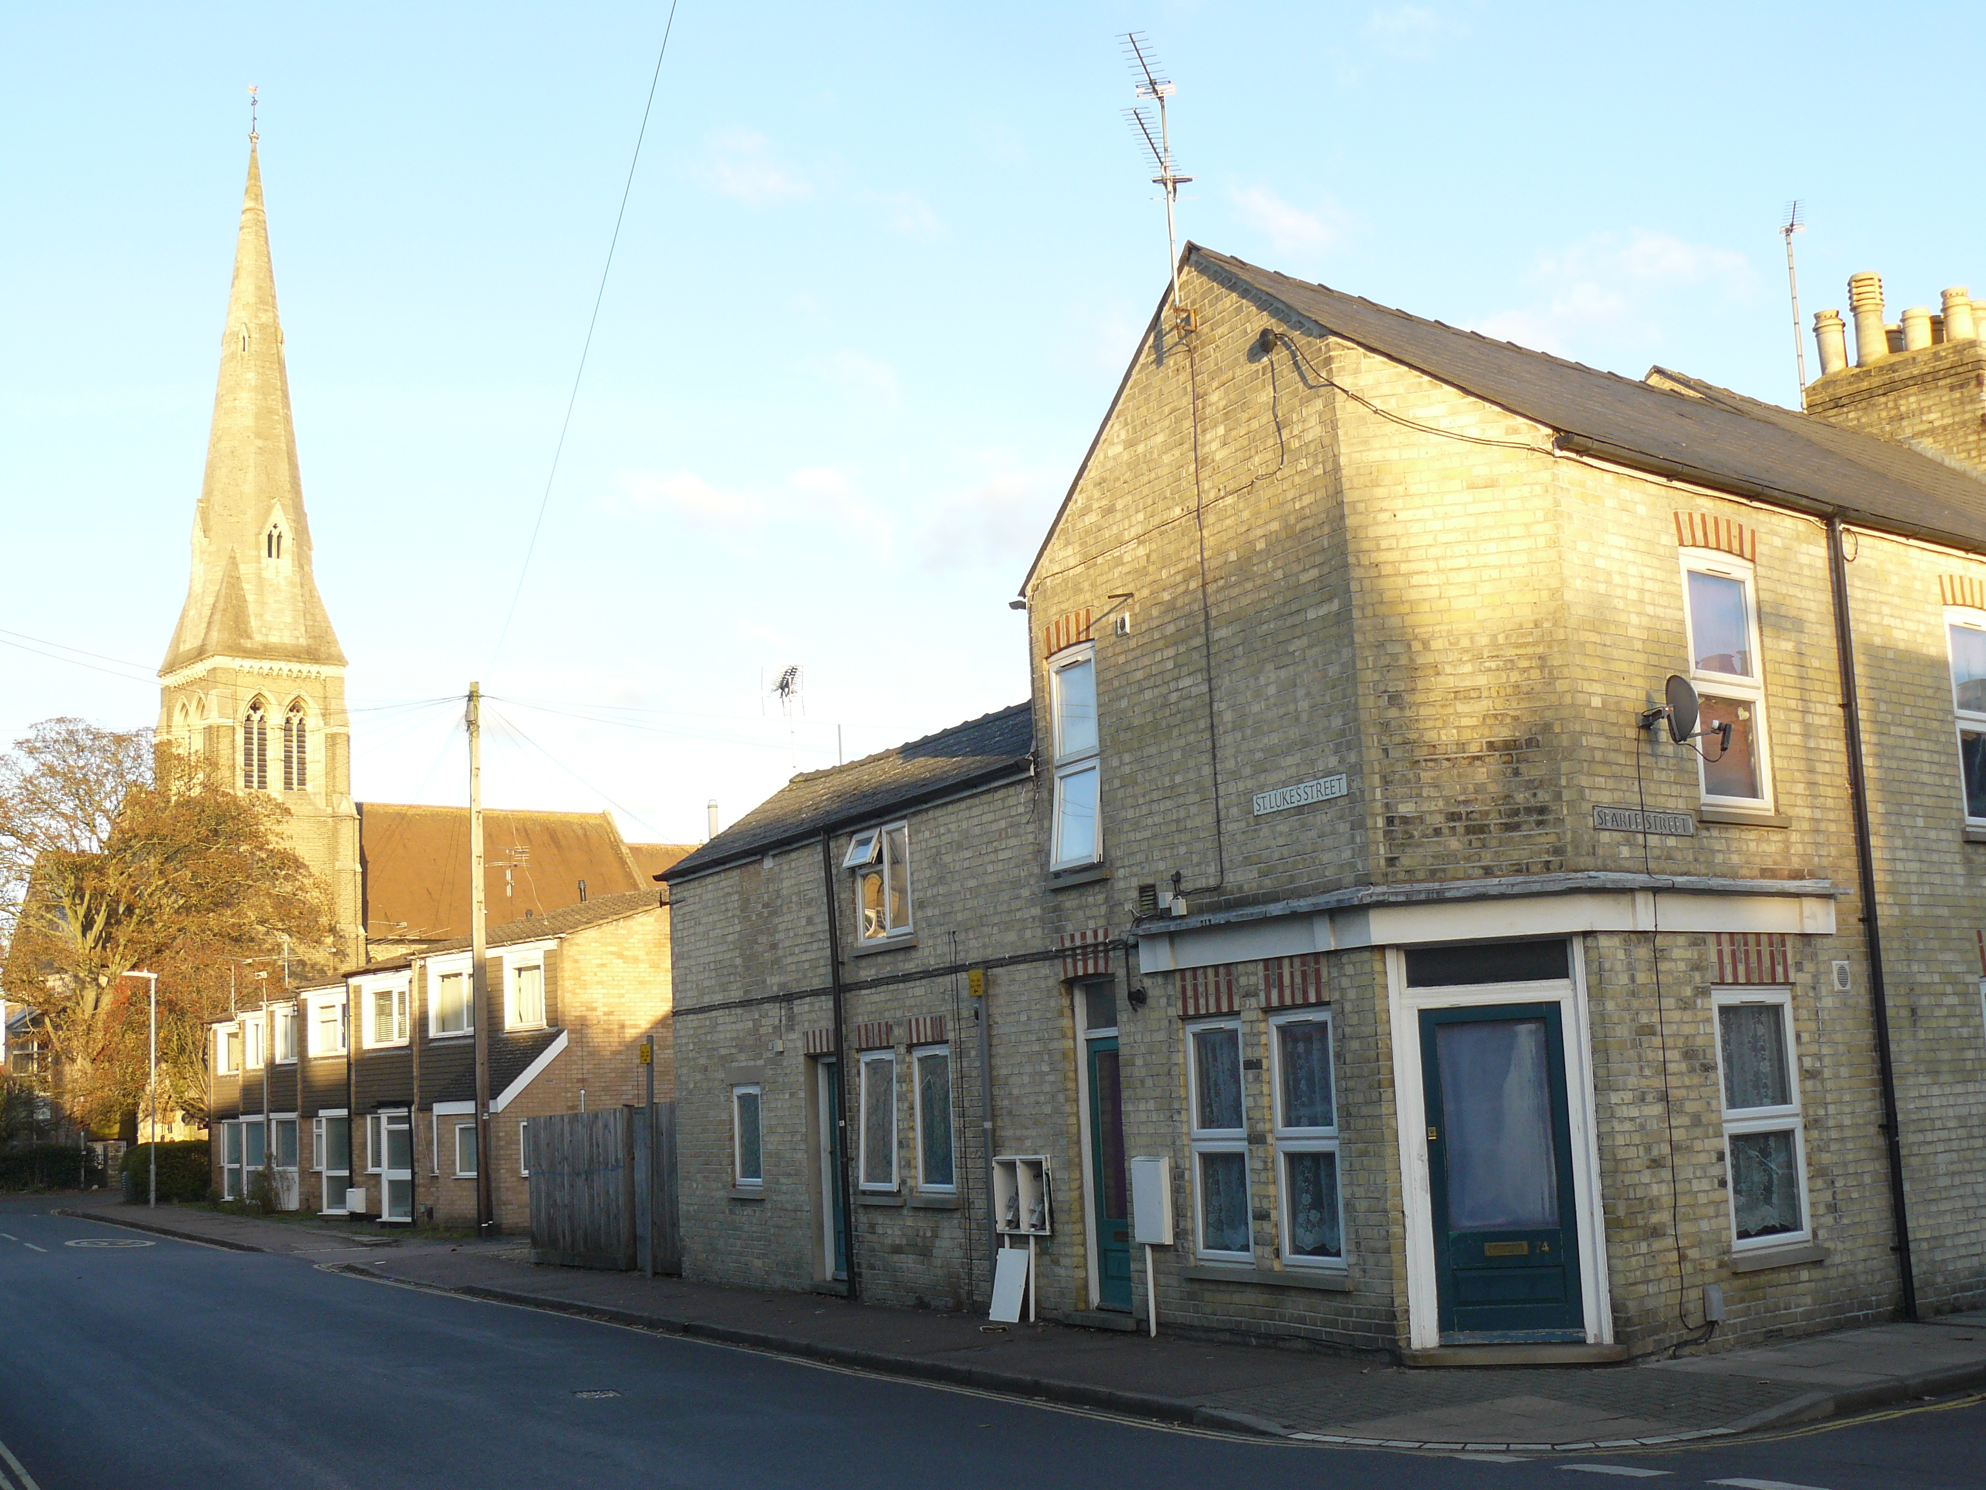
74 Searle Street- Bakers and Corn Merchants- Then and Now
It would have been very common at this time for people to keep a few chickens in their yard or garden. They would buy the small amounts of grain to feed them from their nearest corn merchant such as this one, as well as their fresh bread. Now there aren’t many shops in the area, but if you look carefully at the modern day picture you can see where the shop front once was.

Slide 9
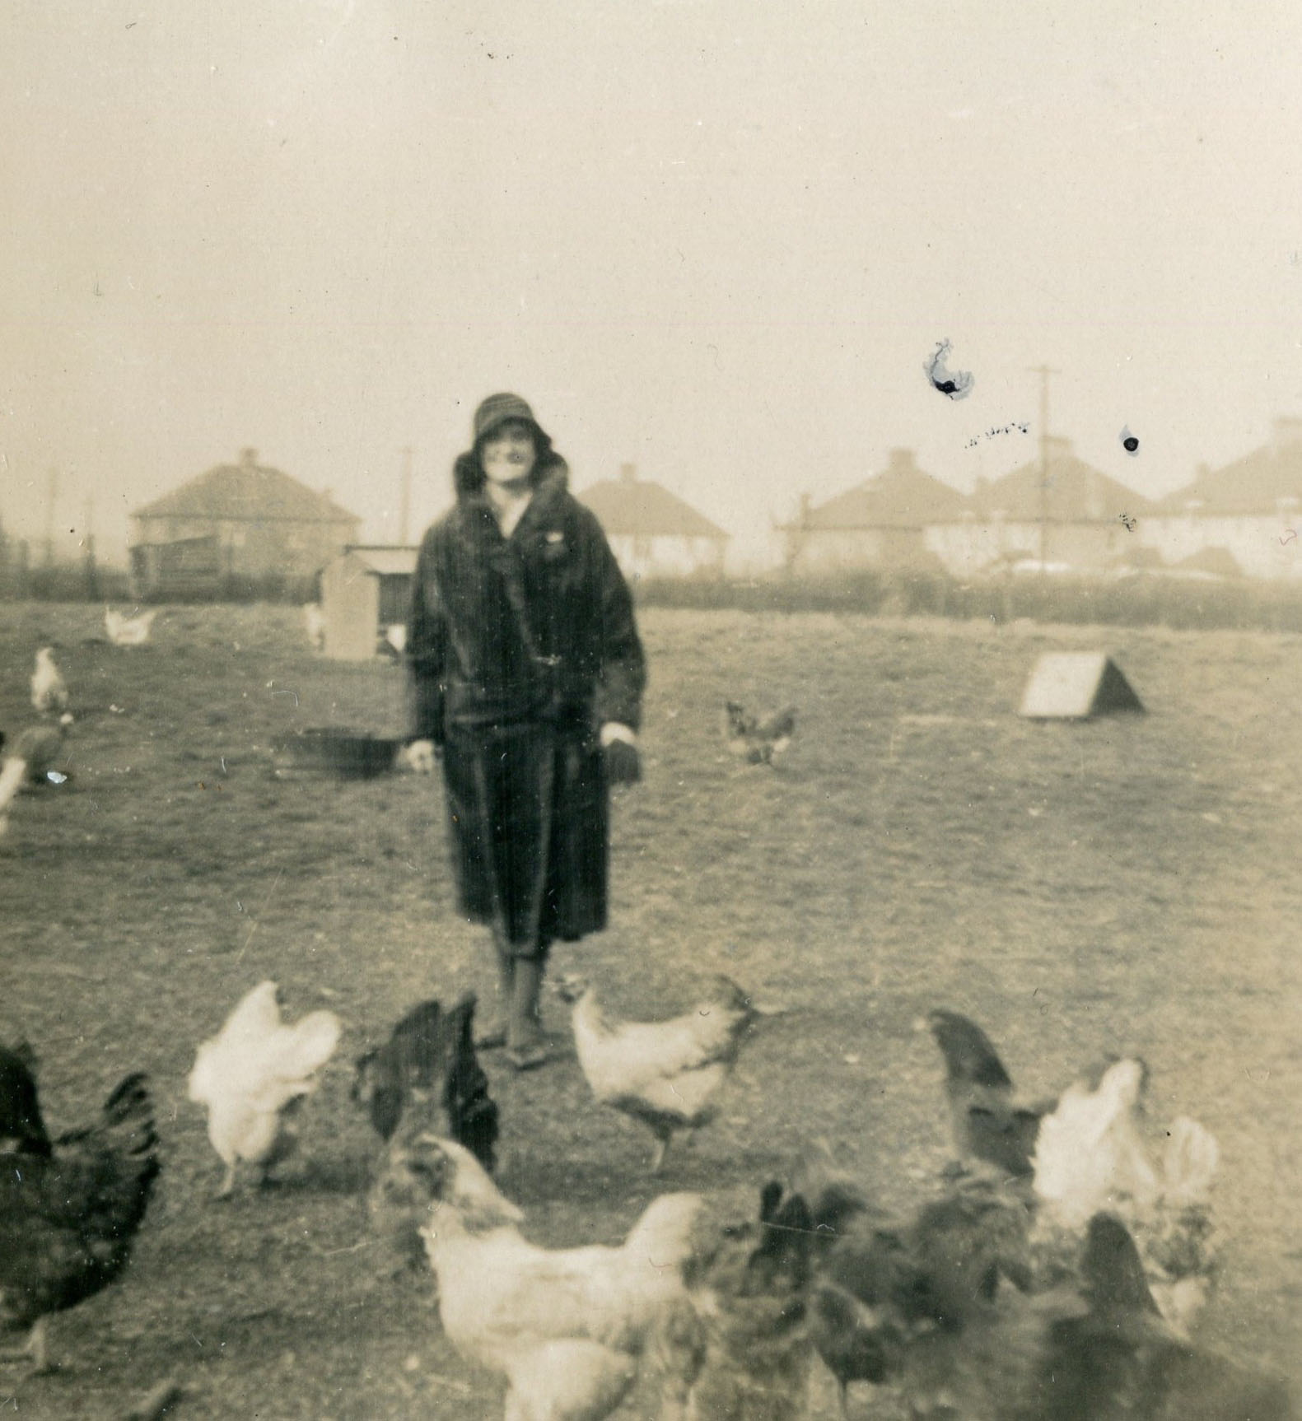
Maude’s Move from the
Country to the Town
This photo show’s Maude French with the chickens in the field next to the Mill, which is where St. Luke’s School now stands today!
The field would have looked similar to this in the Victorian Era too.
She moved from the country, in Castle Camps to Cambridge town with her cousin Elsie, both to find work and to meet new people. It was in Cambridge that she met her future husband Edwin French, who continued to live a house next to the Mill and run the Mill after his father Arthur, and grandfather William before him.
Maude with chickens on the field by the Mill
Published with permission of owner of
photograph Michael French.
Also avaliable at National Mill Archive
Living in a house next to the Mill felt very much like living on a farm, with animals such as chickens, turkeys and pigs living outside and an orchard and garden with fruit trees and vegetables

Slide 10
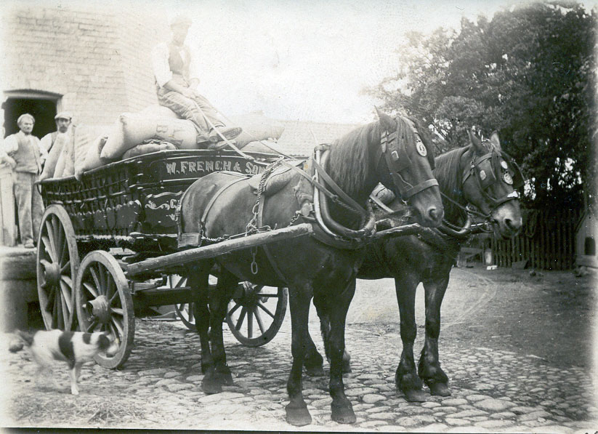
Delivering Flour and Grain by Horse and Cart
Grain and flour from the Mill would be delivered by horse and cart from the mill to local bakeries in and around Cambridge.
Michael French, a member of the family shared a memory from his childhood of the smell of delicious baked goods, especially the doughnuts on display at the Oakington bakery. He would be allowed to have a doughnut as a treat for coming to help his father on the delivery round, which he very much enjoyed!
Photo of French’s Horse and Cart outside Mill
Published with permission of owner of
photograph Michael French.
Also avaliable at National Mill Archive

Slide 11
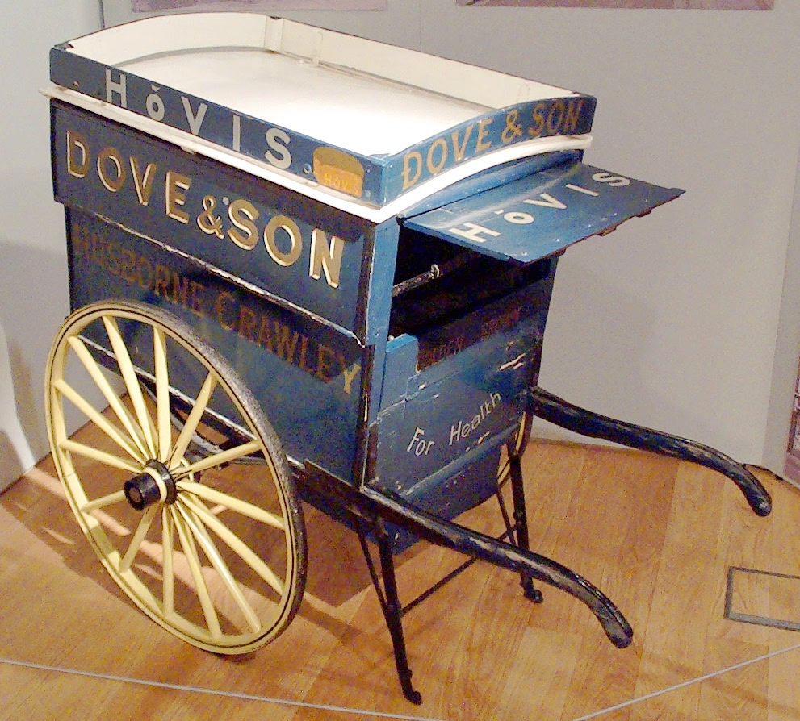
Delivering Baked Goods by Handcart
The French family used to deliver
flour to Maskell’s Bakery on
Victoria Road, near St. Luke’s School. Maskell’s would
deliver the bread and other baked
goods they made using a handcart like this one.
To see a Maskell’s handcart from the local Maskell’s Bakery in Cambridge visit: http://www.bbc.co.uk/ahistoryoftheworld/objects/Q9wMpXihT_2FCQMdSG0Tpw

Slide 12
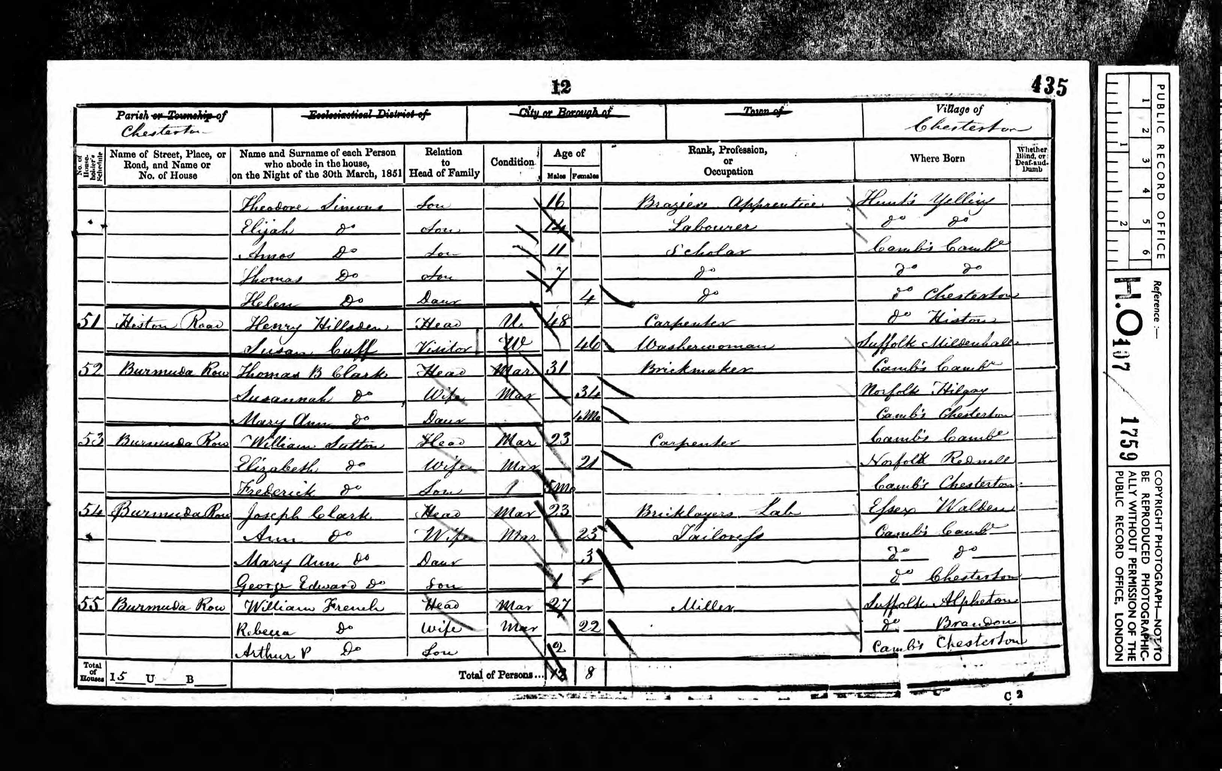
French Family Census
This census from 1851 shows William French and his family living in Bermuda Row, near
to the windmill, after they’d moved into Cambridge from Harston.

Slide 13
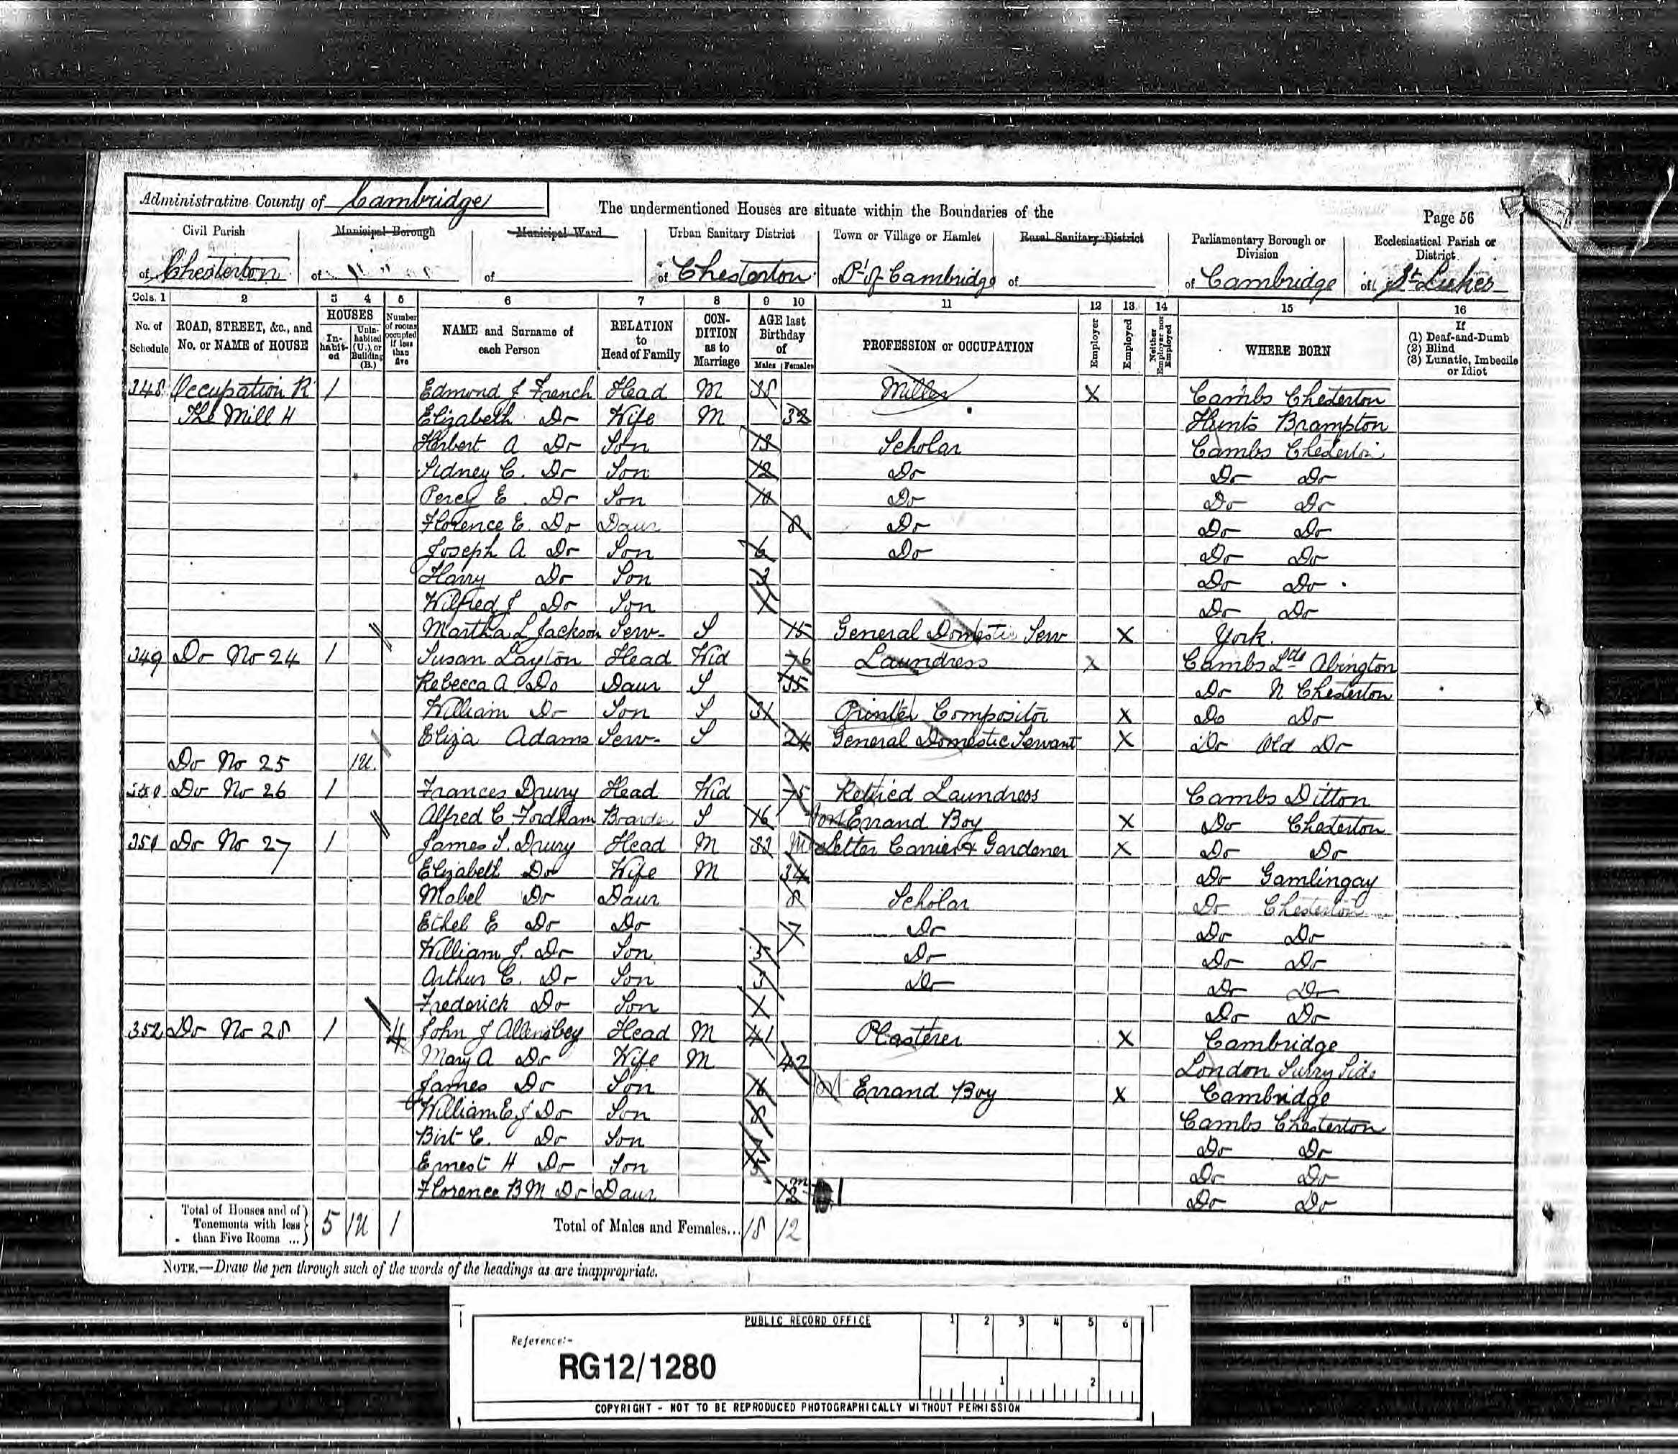
French Family Census
This census is from 1891
and shows William’s son,
Edmund, his wife Elizabeth
and their children all living at
their house next to Chesterton
Mills in the Victorian Era.
Can you spot the names of all the children who lived in the French’s house and how old they were? Who else also lived with the family?

Slide 14
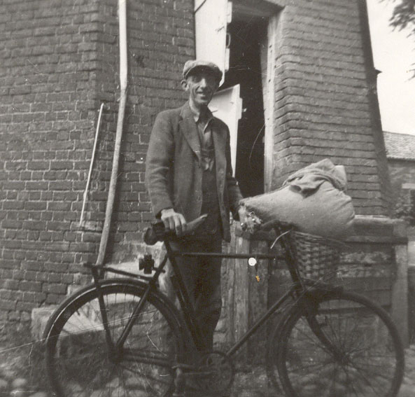
Bill Mead- Worker at the Mill
Bill Mead worked at the Mill in the 1930s until it closed in the 1950s. It was extremely hard work working at the Mill as it was difficult manual work, with lots of lifting of heavy things such as the bags of grain and flour.
It would have been very similar for workers at the Mill in the Victorian Era, with workers being expected to do lots of manual work for long hours, which must have been exhausting!
Published with permission of owner of
Photograph, Michael French.
Also avaliable at National Mill Archive
When Bill Mead died he was remembered in an article in Cambridge Evening News, in 1976.

Slide 15
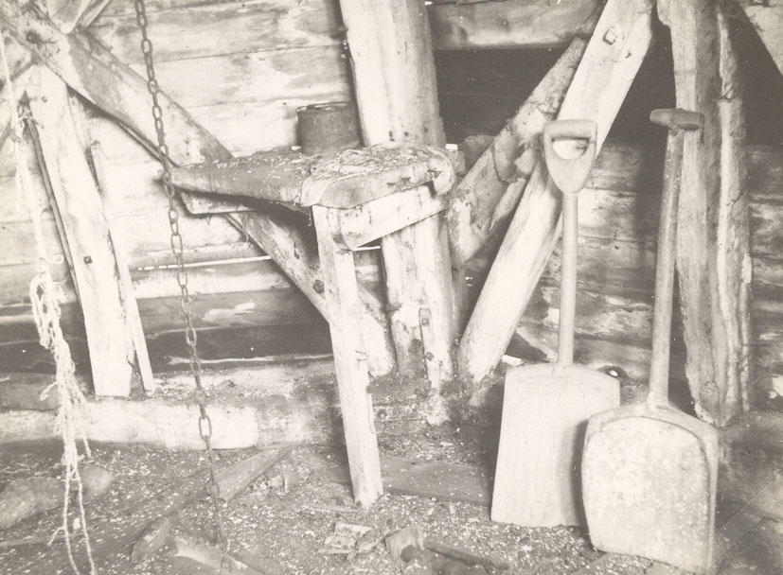
Life Working at Mill
Here is a picture of inside
the windmill where grain was brought from the fields.
These wooden shovels were used to move the grain so it could then be milled into flour, which would then be baked into bread and pies by local bakers and colleges.
Published with permission of owner of
Photograph, Michael French. Also avaliable at National Mill Archive

Slide 16
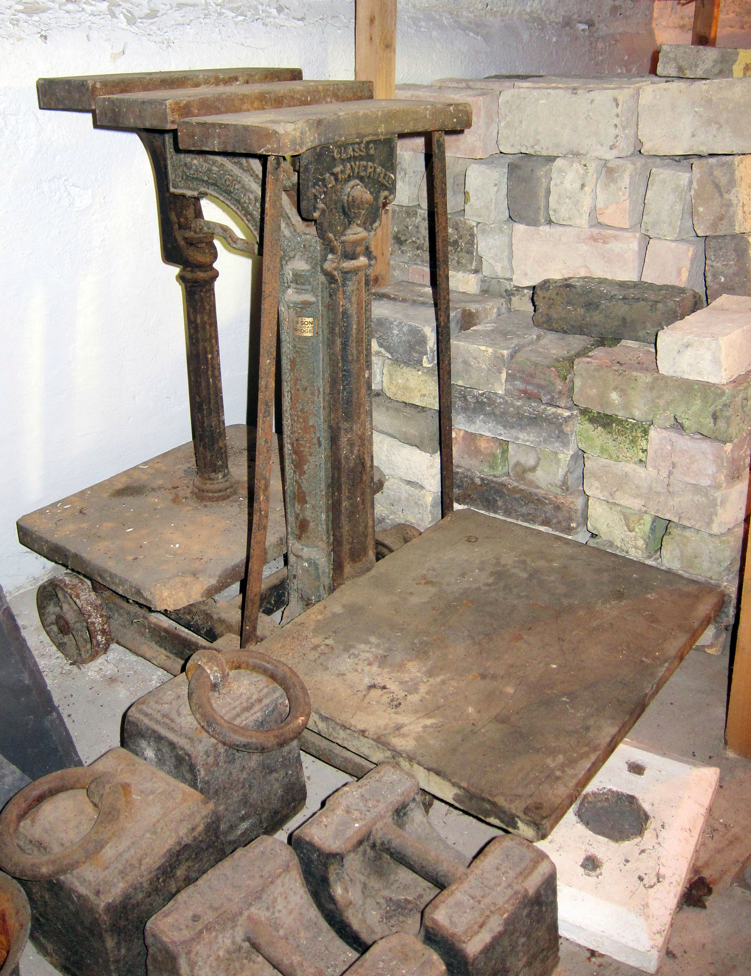
From Wheat to Flour
Millstones were made of a special hard stone so they didn’t wear away in the grinding process and mix stone dust with the flour !
A pattern of grooves was carved into the surface of the stones so the grain and flour moved from the centre to the edges as it was ground. It collected in a large bin (a hopper) before sieving to separate flour, bran and chaff. The flour would then be put into hessian sacks and weighed on the mill scales before being sold.
This photo shows the scales and weights that were used in the mill to weigh bags of flour, grain etc.
Published with permission of owner of
photographer Michael French. Also avaliable
at National Mill Archive

Slide 17
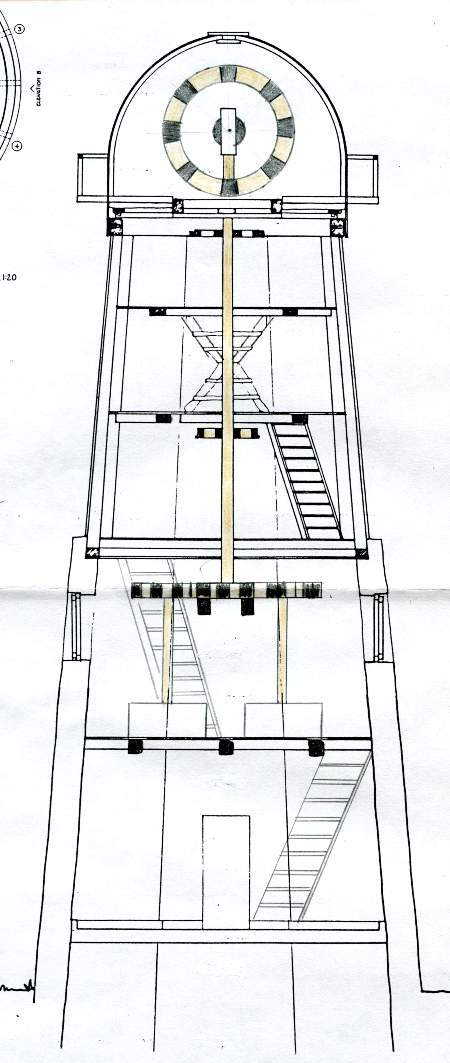
Wind Power at the Mill
The first 20 years the windmill relied solely on its sails to drive the millstones which ground the wheat.
However they discovered that wind power did not create sufficient energy to keep the millstones grinding the grain for as long as power was needed.
The gears
The millstones
This diagram shows the mechanism of the windmill,
including the gears that turned the mill stones.

Slide 18
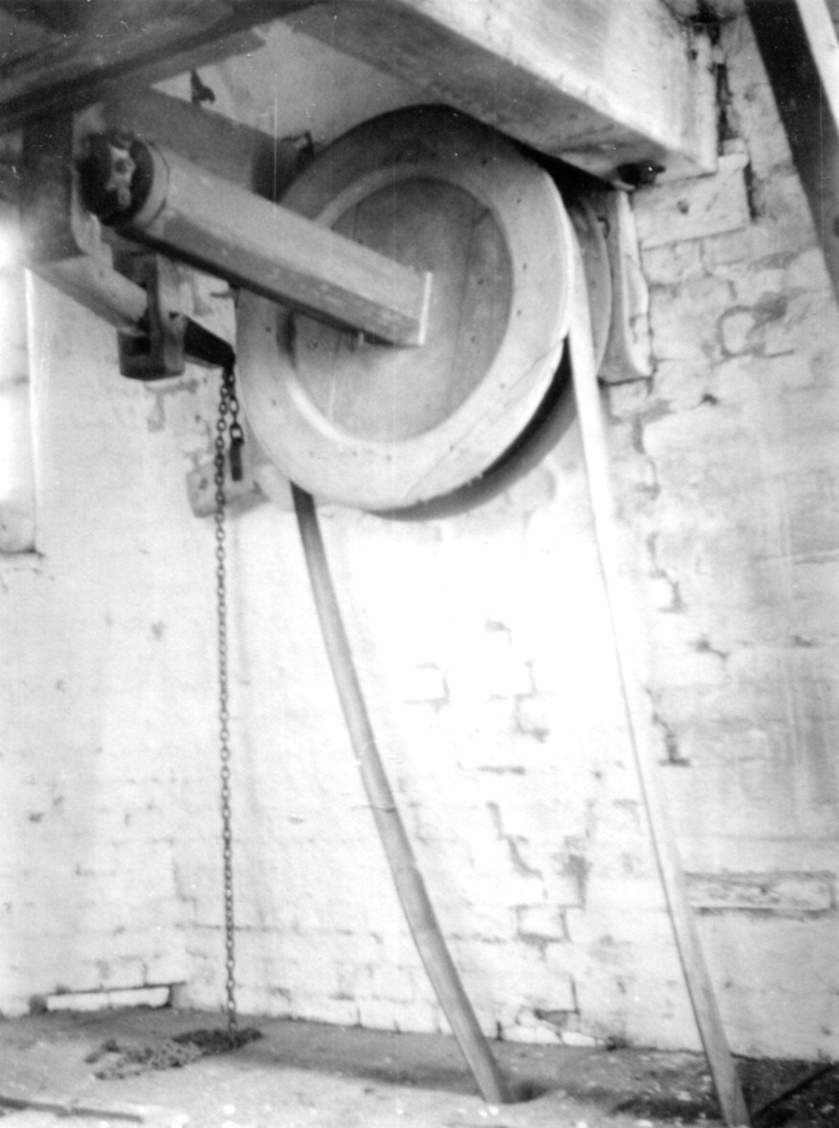
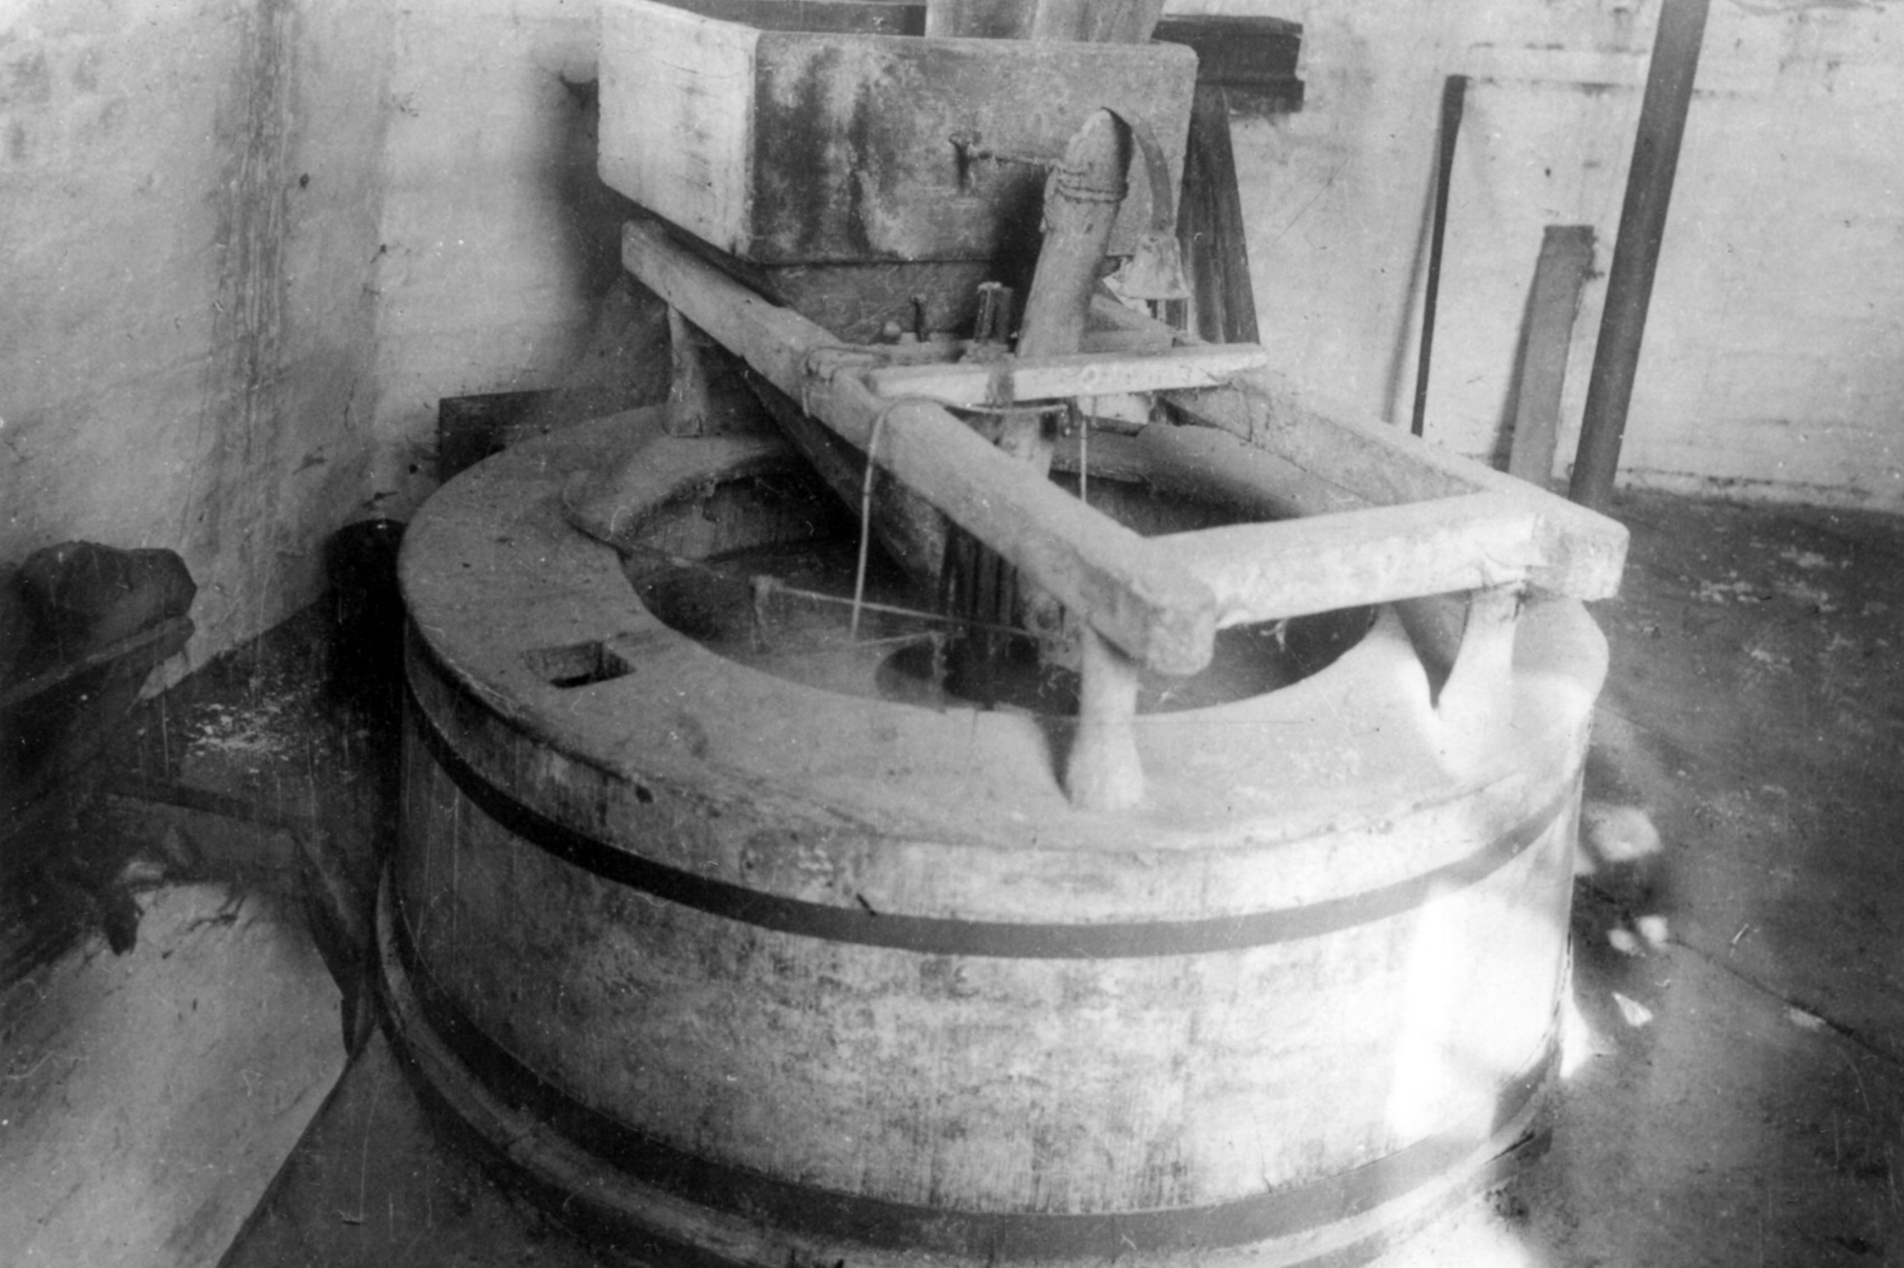
Inside the Mill
-the Workings of the Mill
Photos of the pulley and grindstone in the Mill
Published with permission of owner of photographs, Michael French.
Also avaliable at National Mill Archive

Slide 19
The Need for Steam!
The Industrial Revolution
Wind was not a reliable source of energy for the Mill. So in 1868 William French installed a steam engine. This had its own Engine House with a very tall chimney. Coal was used to heat water making steam under pressure. The steam drove the pistons of the engine which turned the drive wheel. A belt connected the drive wheel to the machinery in the windmill. When there was too little wind the new engine would be used.
Can you spot the chimney in the background of the photo which shows that this picture was taken after the installation of the steam engine?
Published with permission of owner of
photograph Michael French. Also avaliable at National Mill Archive

Slide 20
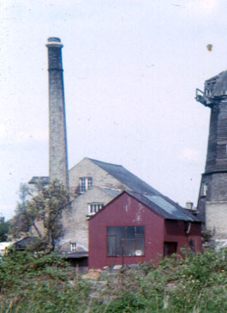
The Evolution of Technology
steam- back
building and
chimney
With the dawn of the Industrial Revolution, the Chesterton Mills started to embrace new technologies as they emerged.
Firstly with steam power, then gas, and finally diesel in the 20th Century.
gas- middle
bulding
This photo shows these three different technologies that were located in different buildings on site; steam in the big building at the back with the chimney, gas in the middle building, and diesel in the red building in the foreground.
diesel-
red building
Published with permission of owner of photograph Michael French. Also avaliable at National Mill Archive

Slide 21
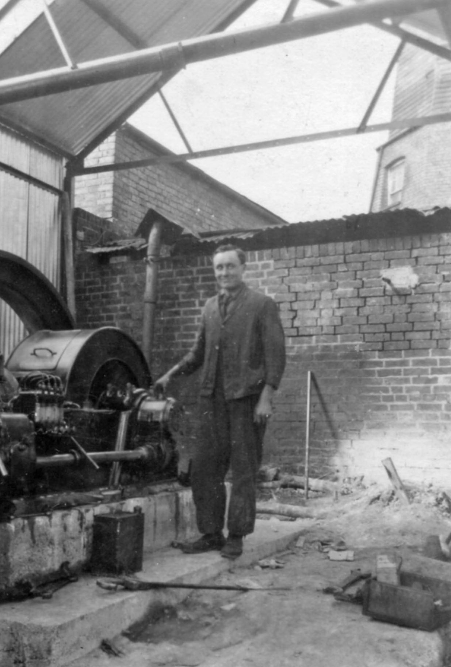
The New Diesel Engine
This photo shows Eddie French, another family member who worked at the local engineering firm and installed the working on the Diesel Engine in the new engine house in 1937.
Can you spot part of the windmill in
the back of the photo?
Published with permission of owner of
photograph Michael French. Also avaliable at National Mill Archive

Slide 22
Discover More…
All photos from Michael French’s Collection also available along with other resources at: National Mill Archive
From Quern to Computer- a new book from the National Mill Archive
Cambridgeshire Collection at Cambridge Central library
Victorian Bakers- BBC programme clips

Slide 23

Web Resources available at:
http://www.creatingmycambridge.com/
history-stories

