Slide 1

World War I- Histon Road Cemetery and St. Luke’s Church

Slide 2
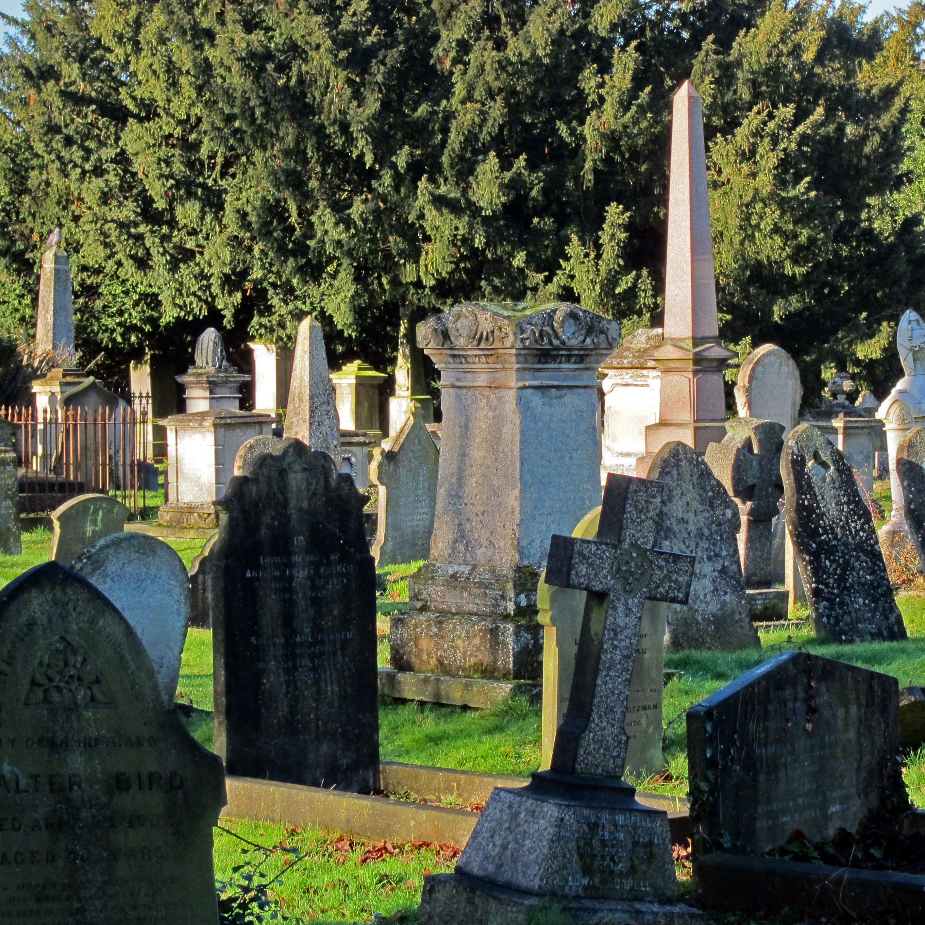
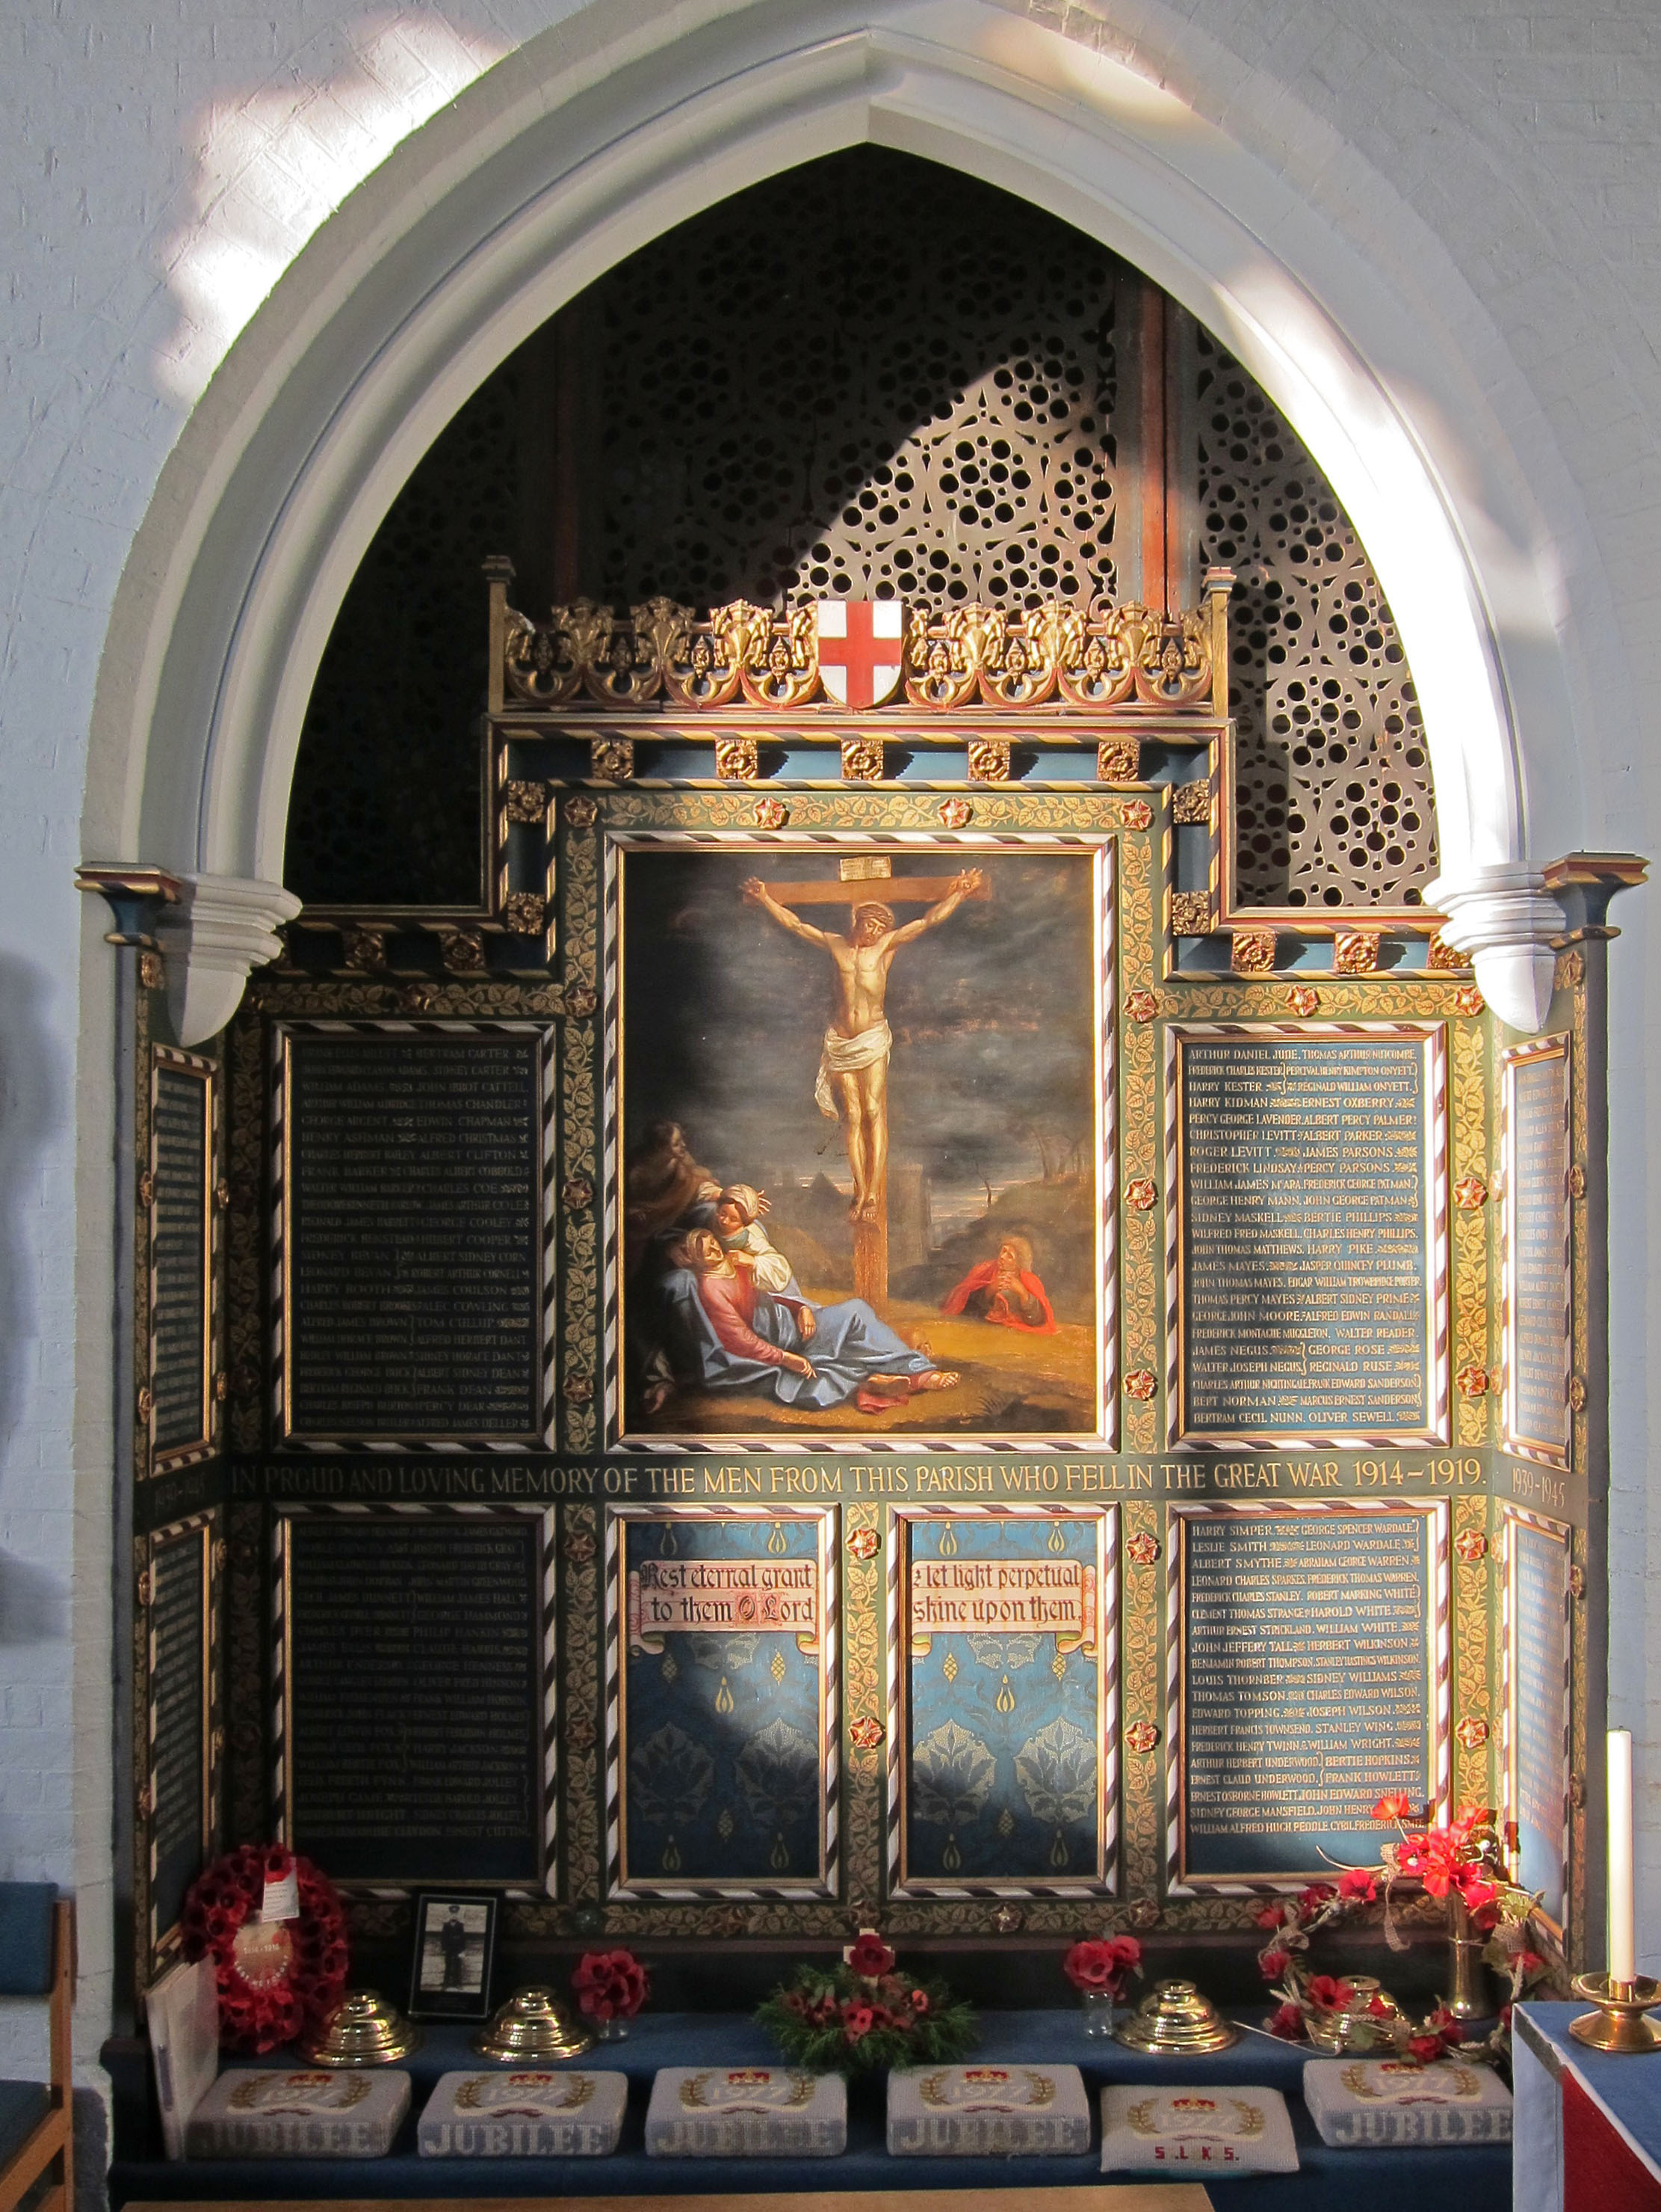
Memories of World War I
There are many places commemorating World War I in the local area surrounding
St. Luke’s Primary School, including at Histon Road Cemetery and St. Luke’s Church.
Photos by Michael French

Slide 3
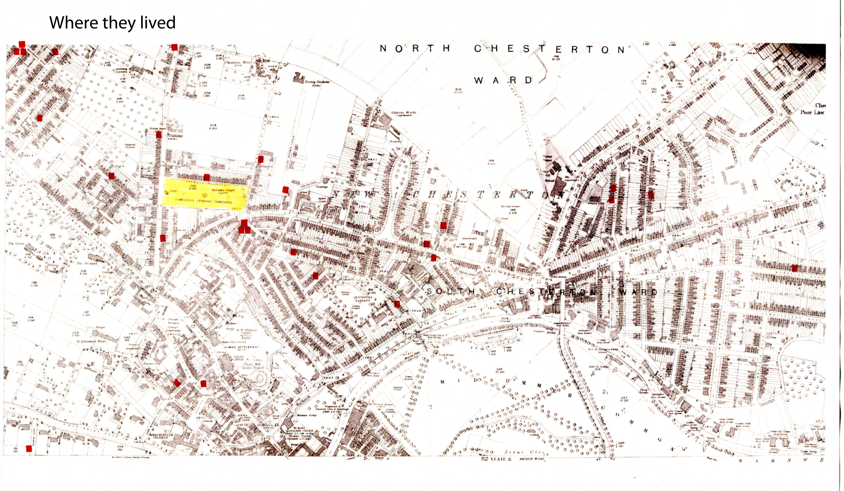
Map Showing The Homes of the Men Who Were Lost in WWI
Hundreds of thousands of men died in WWI, including many men from this area.
This map shows where all the men lived before they went to fight in the war.

Slide 4
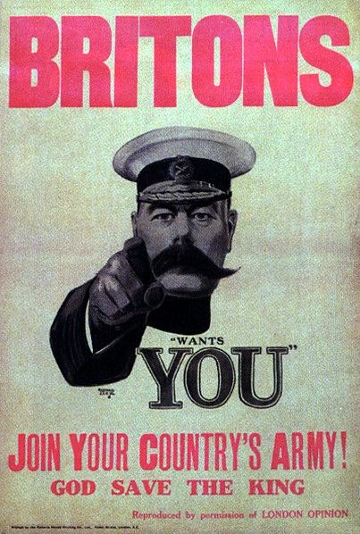
Britons Wants You!- Recruiting for the Army in WWI
In early 1914 the Army was a ‘professional’ force as it still is today. When vacancies came up, men applied for the positions and if they were selected they would serve for an agreed number of years. After this they could stay on and make their career as soldiers.
In August 1914 when the War began Lord Kitchener was appointed as the Secretary of State for War. He was the politician in charge of organising troops. He realised far more soldiers were needed, so many that he had to set up several complete new armies. He asked for volunteers. 2.5 million young men came forward.
The "Britons (Lord Kitchener) Wants YOU" poster dating from September 1914

Slide 5
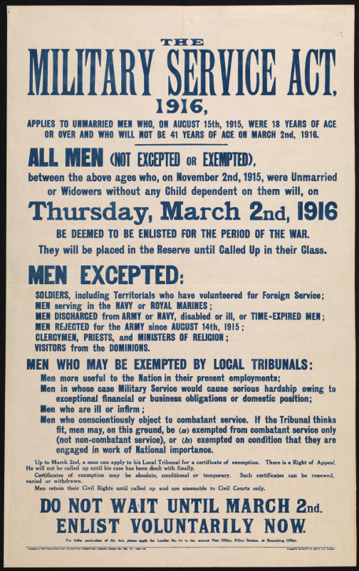
Everyone Must Join-
Conscription in 1916
By 1916 there were no longer enough volunteers and conscription was introduced. All men between the ages of 18 and 40 had to join the army when ordered to.

Slide 6
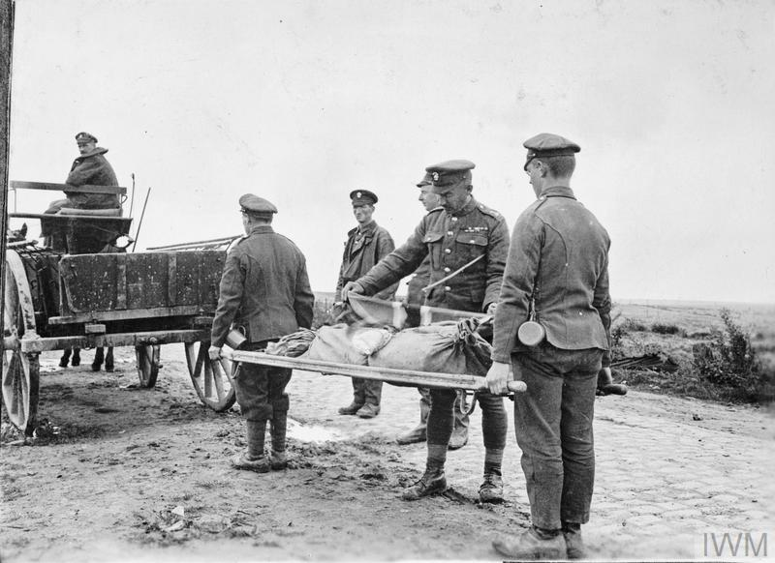
The Royal Army Medical Corps- Caring for the Wounded
The role of the RAMC (Royal Army Medical Corps) was to care for the injured soldiers. Stretcher bearers would move them to field stations for initial treatment and then they would be moved to one of the many base hospitals set up in France. Once well enough to be moved again, they would be evacuated to Military Hospitals back in Britain. Members of the RAMC working near the front line were often in as much danger as the fighting troops.
Photo of unknown soldier being
Taken from battlefield on a stretcher
From Imperial War Museum Collection

Slide 7
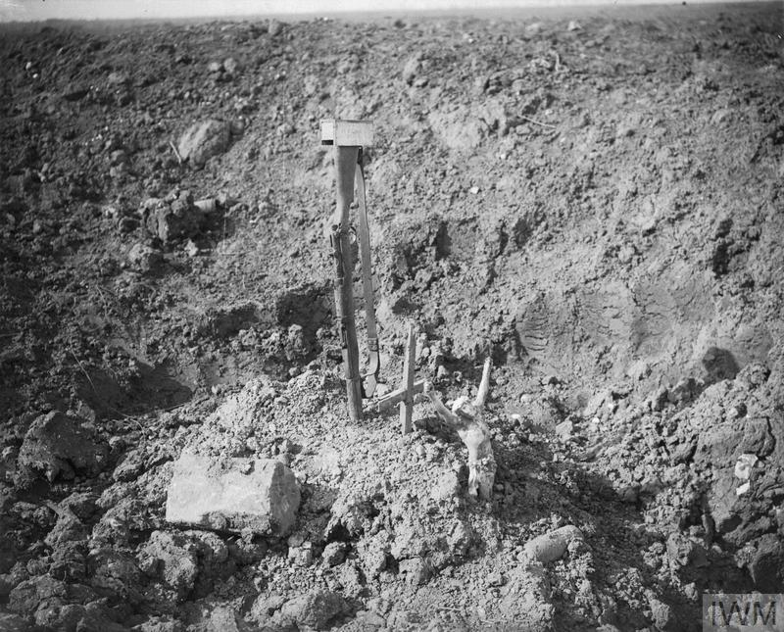
No Graves for the Lost…
Soldiers who died on the battlefields were always buried in the area where they fell.
They were not returned to their home countries. Many have no known graves as their bodies, buried in the chaos of battle, could not be identified or even found.
Picture of makeshift grave on the
Battlefield near Combes

Slide 8
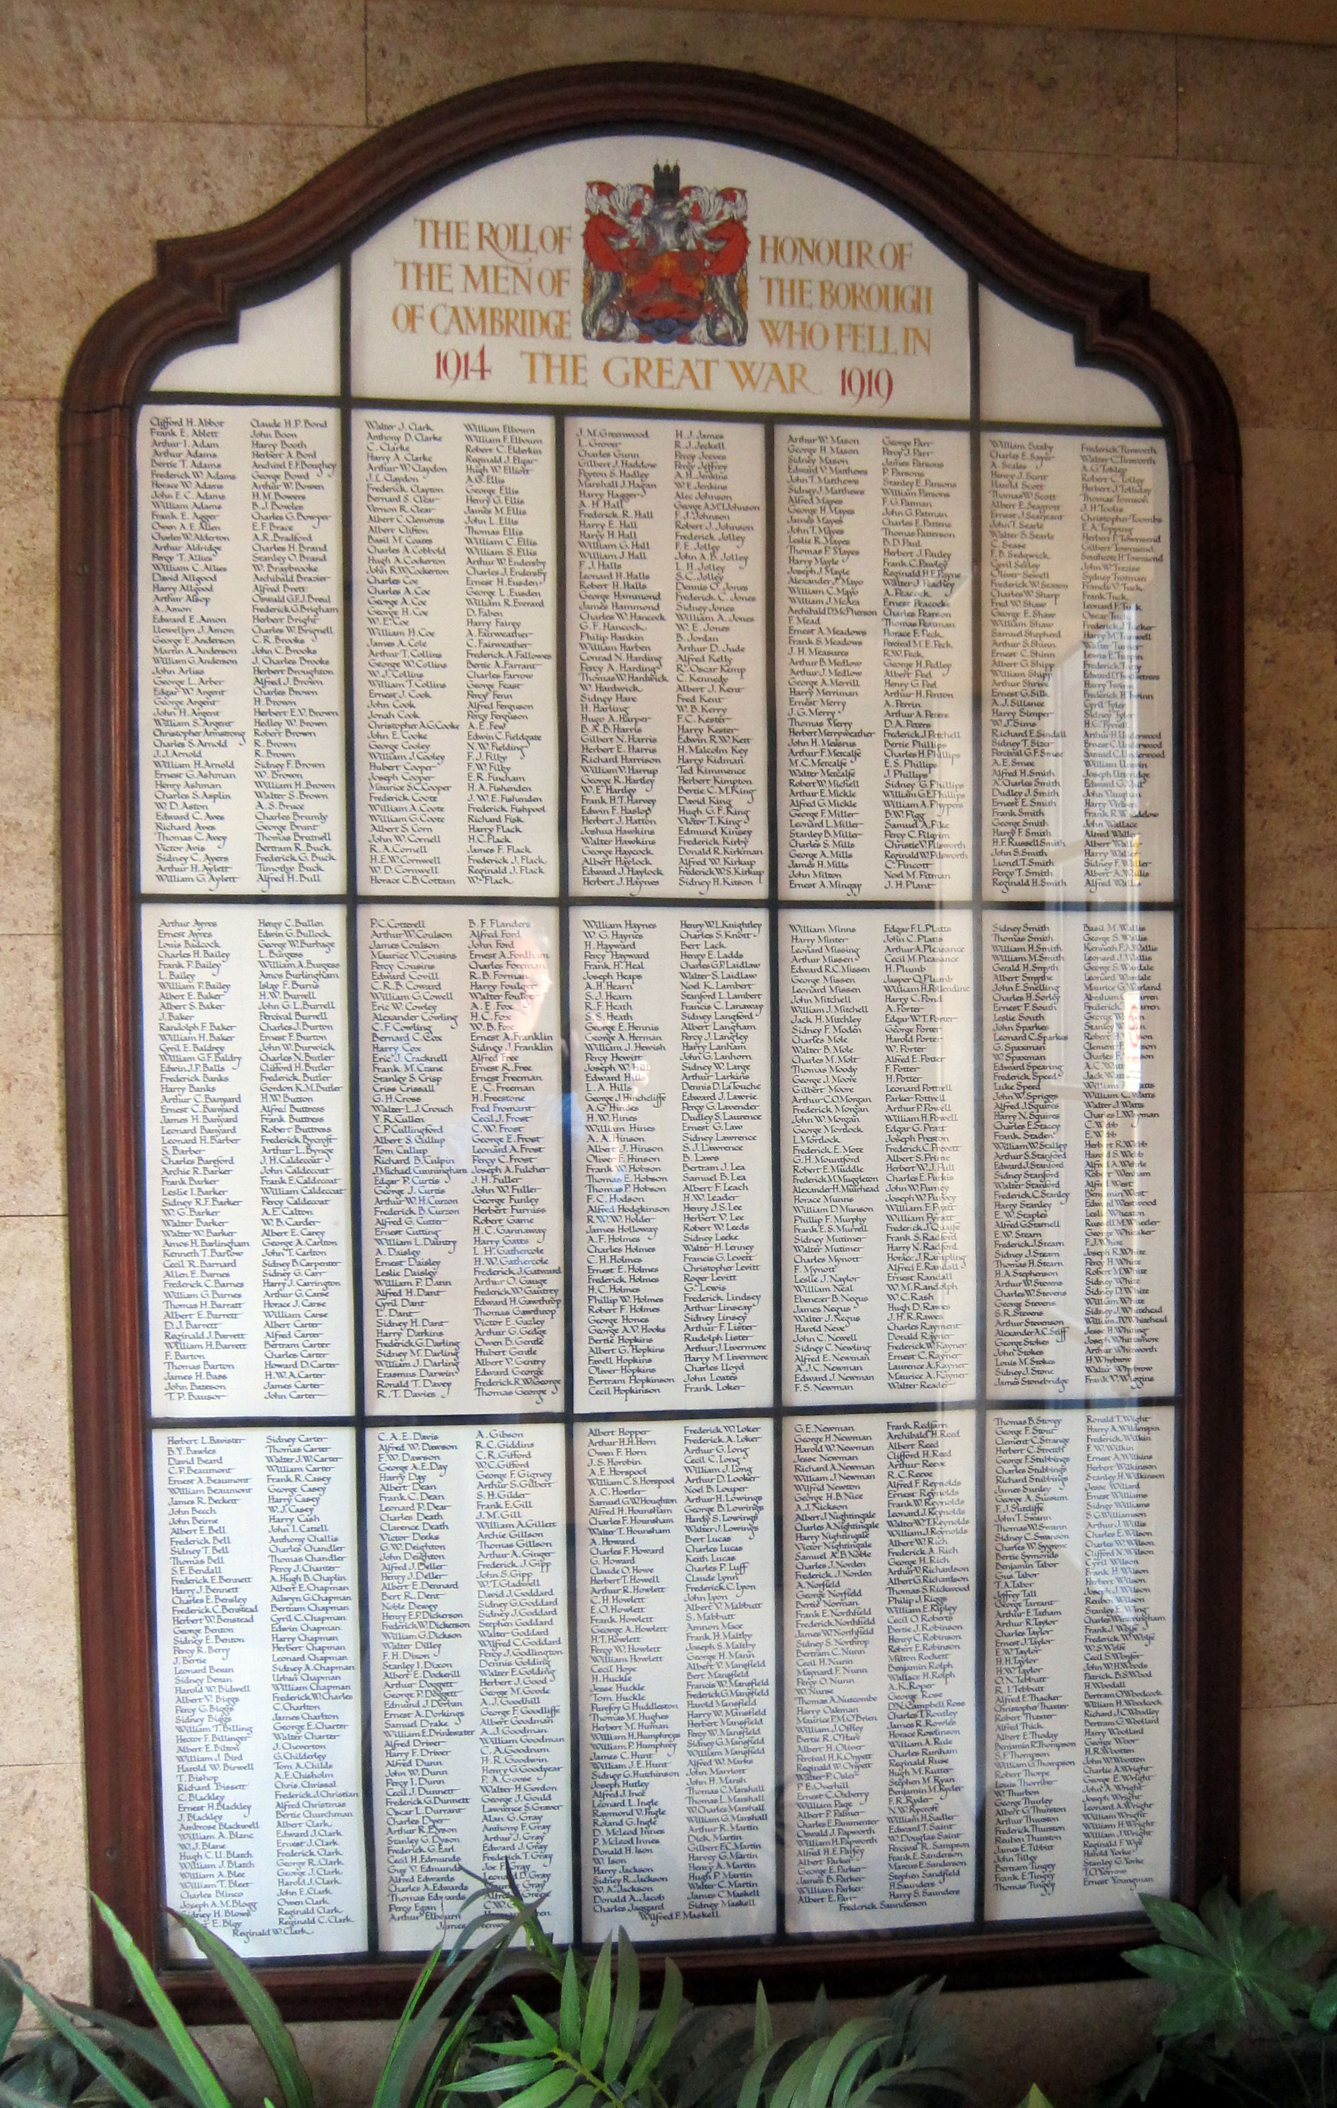
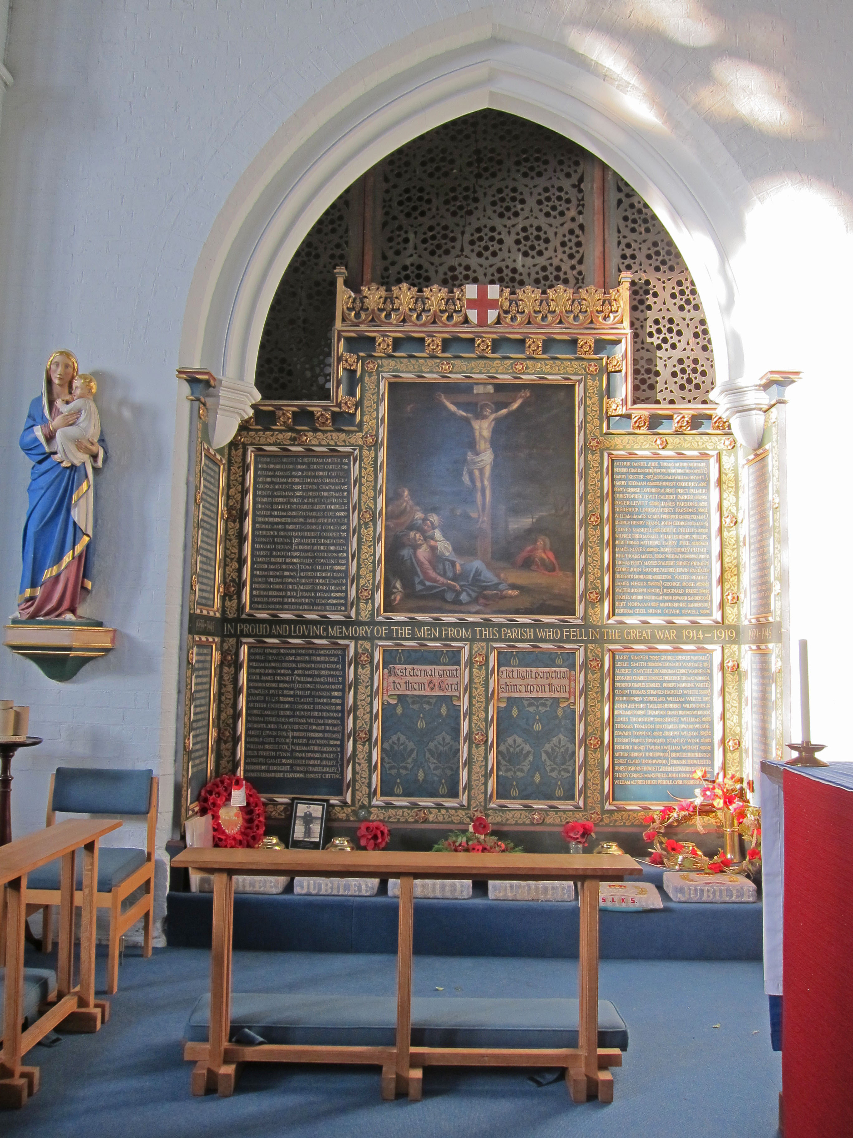
Memorials Made Back Home to
Remember Those Who Died
As the soldiers bodies never returned back to the UK memorials were created to remember those who had died in WWI.
This memorial is in St. Luke’s Church and lists all those who died who lived in the Parish of St. Luke’s
This memorial is inside the
front entrance of The Guildhall on Market Square, and is called a roll of honour, as it names all those who died in WWI from the Cambridge area.

Slide 9
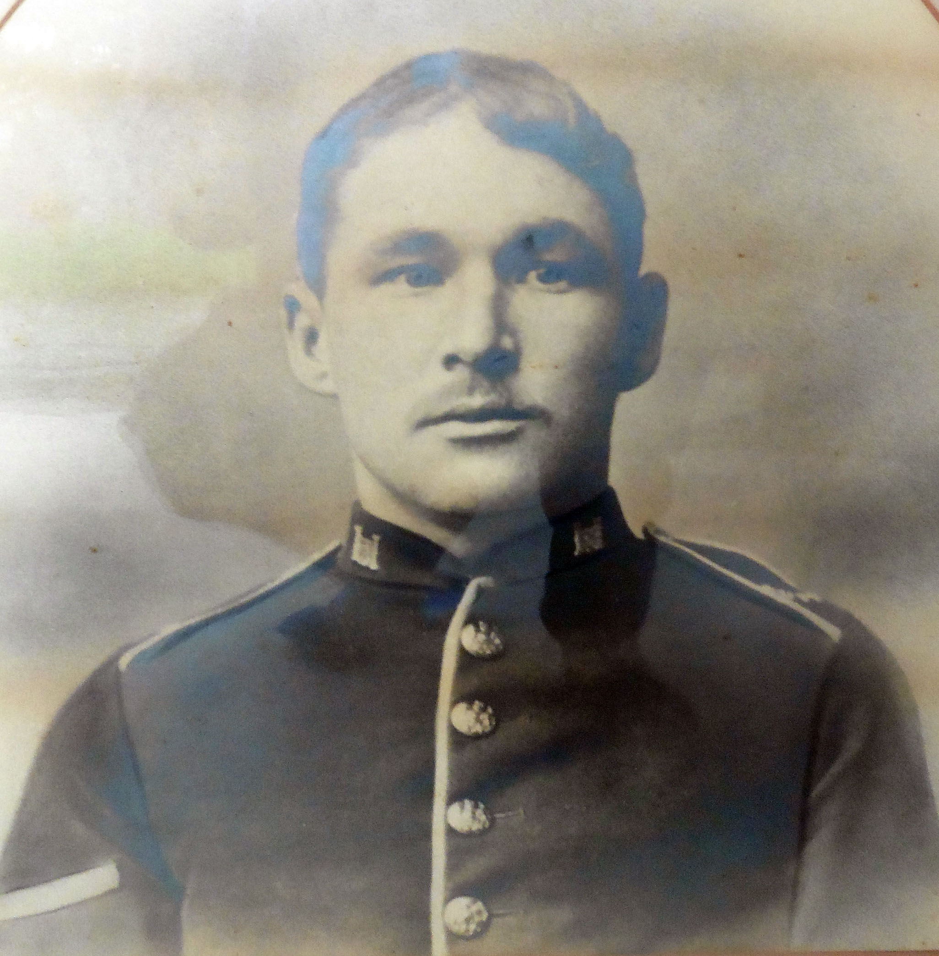
Sergeant Arthur Henry Aylett 2nd Battalion Suffolk Regiment
Sergeant Arthur Henry died from his wounds on 10th June, 1916, aged 32.
He was born in the Autumn of 1884 in Cambridge.
His parents were called John & Lydia Aylett and lived on 12 Albert Street.
He married his wife Maud in April/June 1909, in Cambridge.

Slide 10
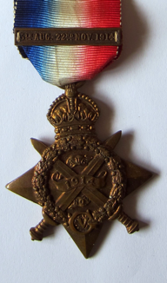
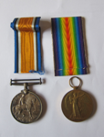
Arthur’s War Medals
Arthur was awarded a number
of medals during his time on
the battlefields.
The 1914 Star was awarded to those who served in France and Flanders between 5th August and 22nd November 1914. The clasp was given to those actually under fire between these dates.
Sergeant Aylett’s medals. The British War Medal, the Victory Medal and the 1914 Star.

Slide 11
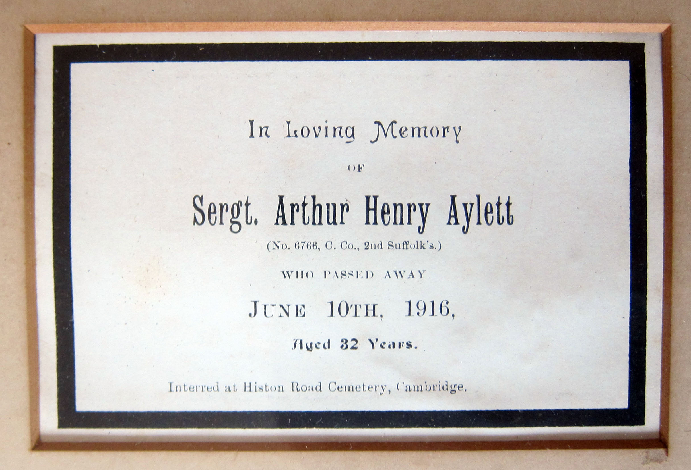
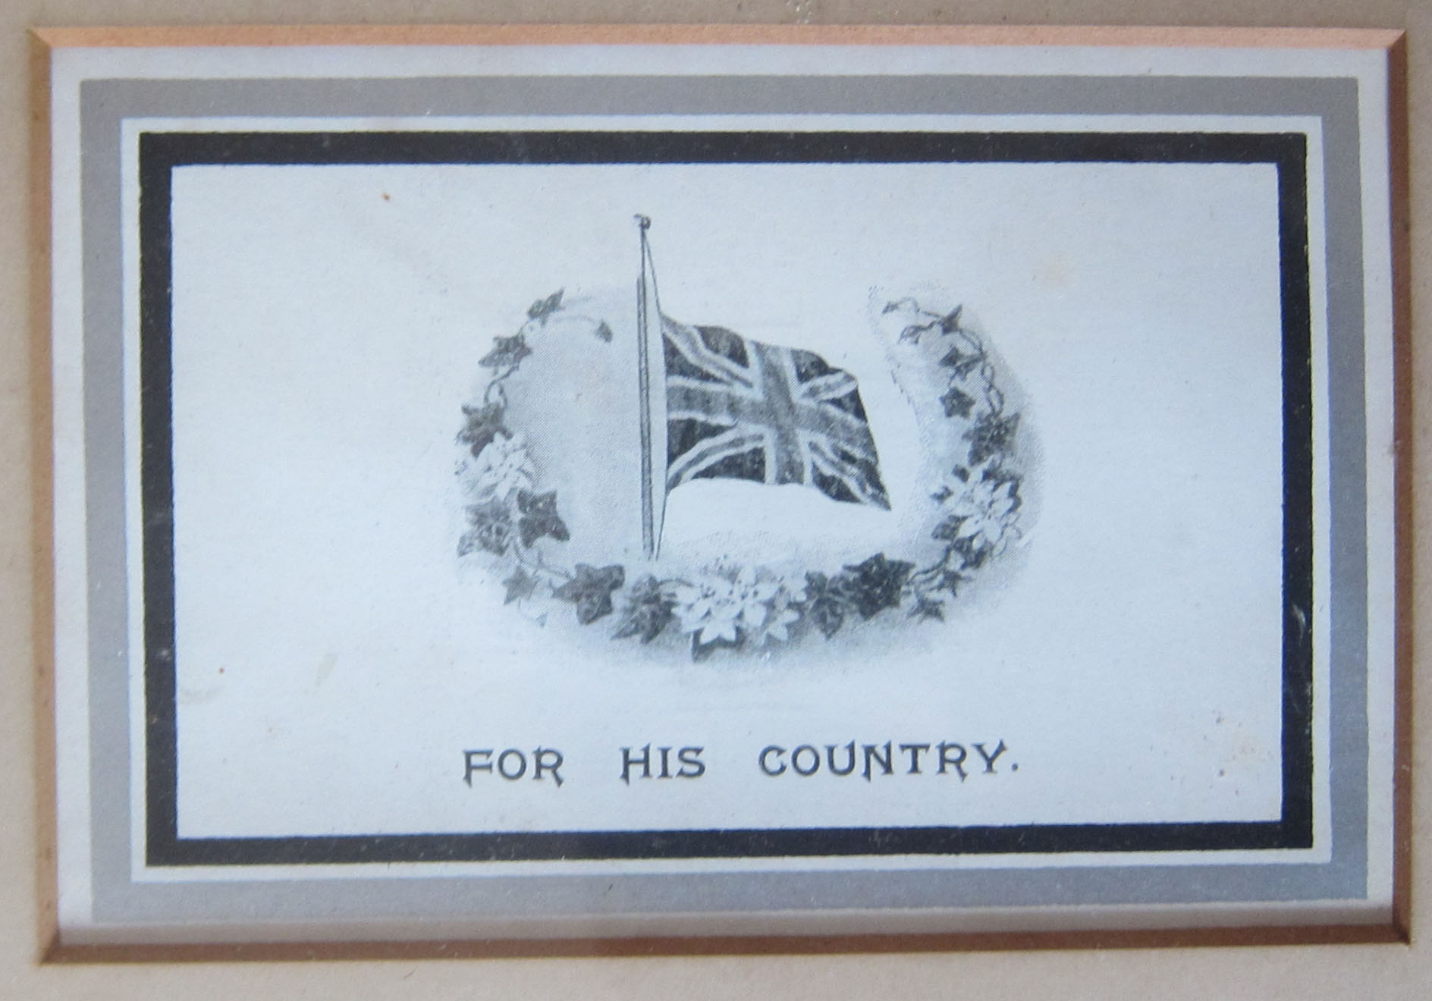
Arthur Returns to Hospital in Cambridge
Arthur was shot in the neck by a German sniper when, on returning from patrol he found one of his men missing and then went back out to find him. He was returned to England possibly first to Royal Victoria Military Hospital, Netley, Southampton and then the 1st Eastern General Hospital in Cambridge (where the Cambridge University Library now stands) where he died from septicaemia of his wound on 10th June 1916.

Slide 12
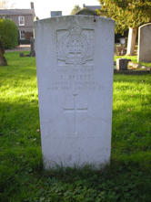
Arthur is Remembered
Arthur’s grave can be found in Histon Road Cemetry, as he returned to the UK as a wounded soldier before later passing away in Cambridge at the 1st Eastern Hospital.
Therefore his body could be buried in the graveyard at Histon Road Cemetery. But many other soldiers were not so fortunate, as their bodies were never found or returned to this country.
Arthur is buried in Histon Road Cemetery and is remembered on the Rolls of Honour at St Paul’s Church, Hills Road and the Guildhall, Cambridge.
Arthur Aylett’s gravestone in Histon Road Cemetery

Slide 13
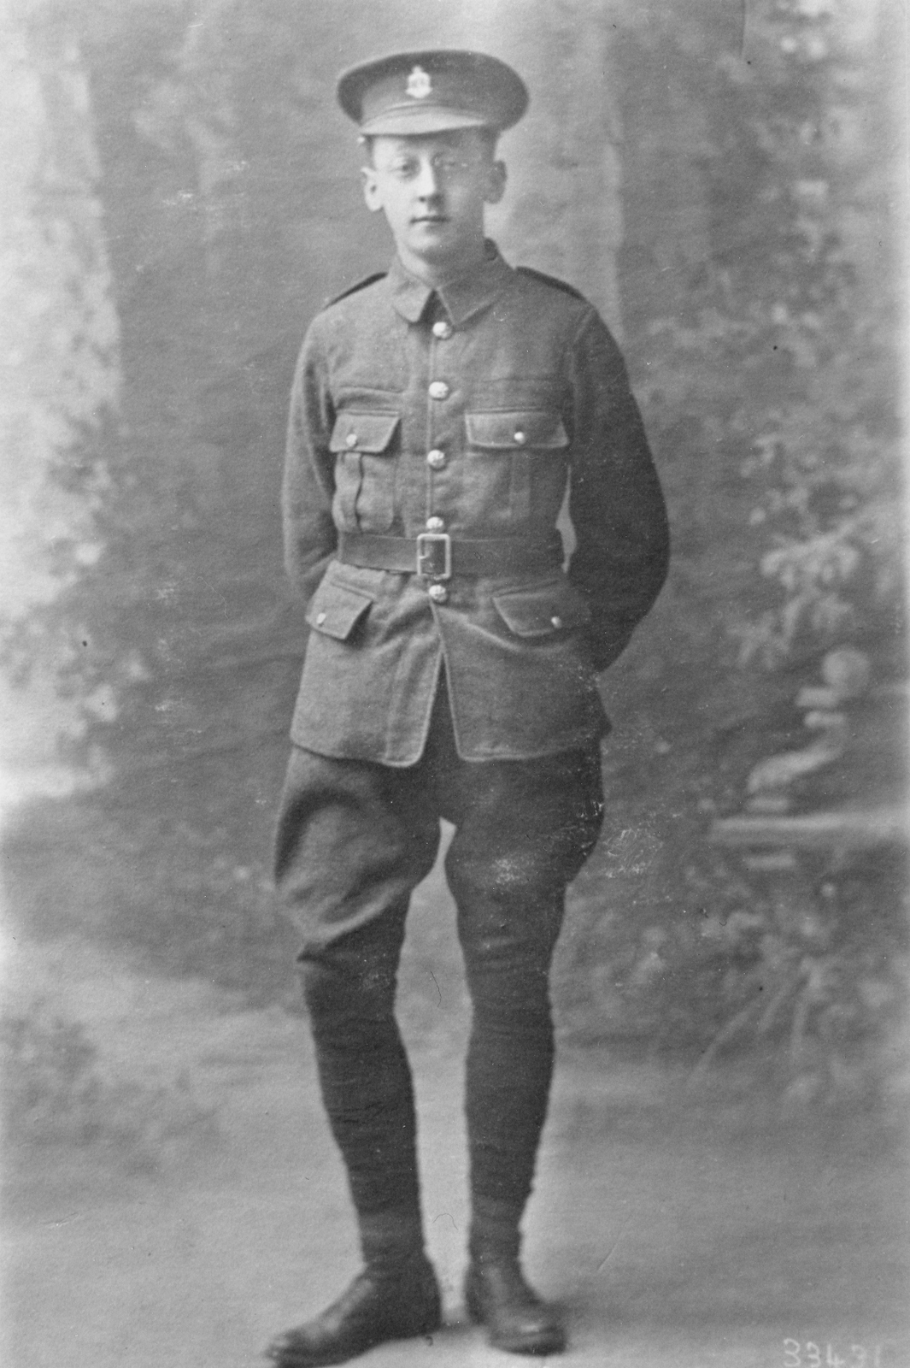
Private Edmund John DORBAN 88th Field Ambulance RAMC.
One of those people who’s body was never found was Edmund John Dorban who was killed in action on 09.10.1917, age 23.
Edmund was born in Cambridge in 1894, son of John Charles and Annie Elizabeth Dorban of 57 Searle Street, Cambridge. Edmund had three sisters and one brother.
A family photo of Edmund, from the Dorban family
photo collection, from Michael French’s research

Slide 14
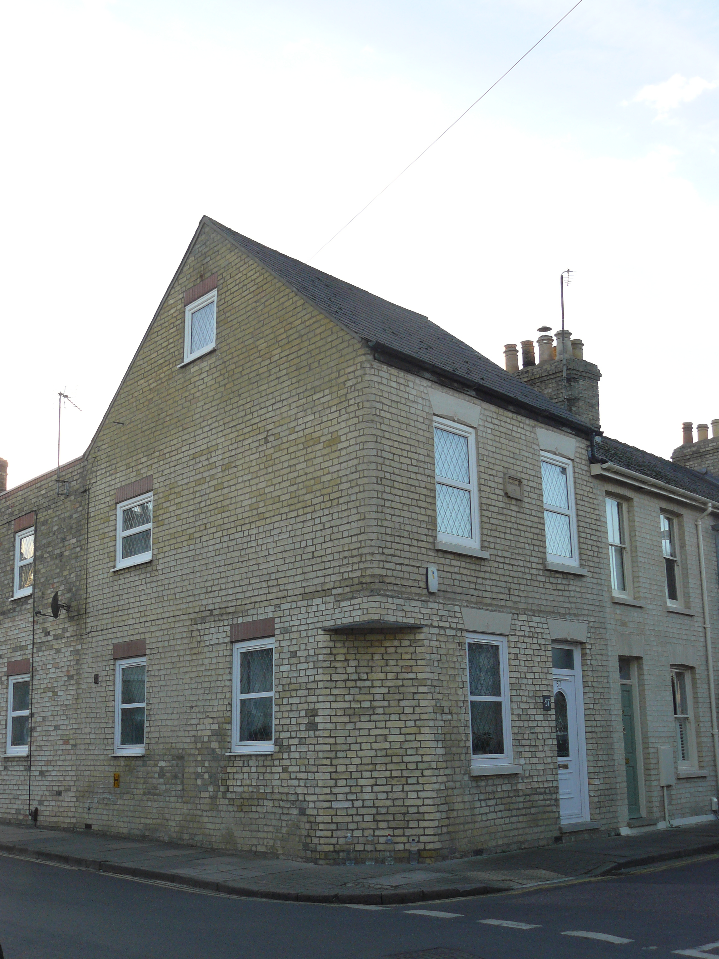
Edmund’s Family Home on Searle Street
The family lived above the small grocery store that was run by John Dorban. This was on the corner of Searle Street and St. Luke’s Street and just across from the French Family bakery.
In the 1911 census Edmund is shown as a Grocer’s Apprentice working at Lipton’s Grocery store in the town, his brother Reginald was also a Grocer’s Apprentice.
Photo of 57 Searle Street, where the
Grocer’s shop was and the family lived.

Slide 15
Edmund’s Role as a Stretcher Bearer
Edmund became a stretcher bearer when he joined the army, meaning that he wasn’t fighting, but instead was helping get the wounded soldiers off the battlefield.
However this was also a dangerous job as he sadly died whilst serving as part of the 88th (1st East Anglian) Field Ambulance served with the 29th Division.
On 9th October 1917 they were supporting the fighting in the Battle of Poelcapelle, part of the 3rd Battle of Ypres, in France where Edmund was killed. In a letter to his parents Edmund’s Commanding Officer praised his ‘gallant performance as a stretcher bearer.’
Photo of a stretcher bearers carrying a
soilder from battlefield
From Imperial War Museum Collection

Slide 16
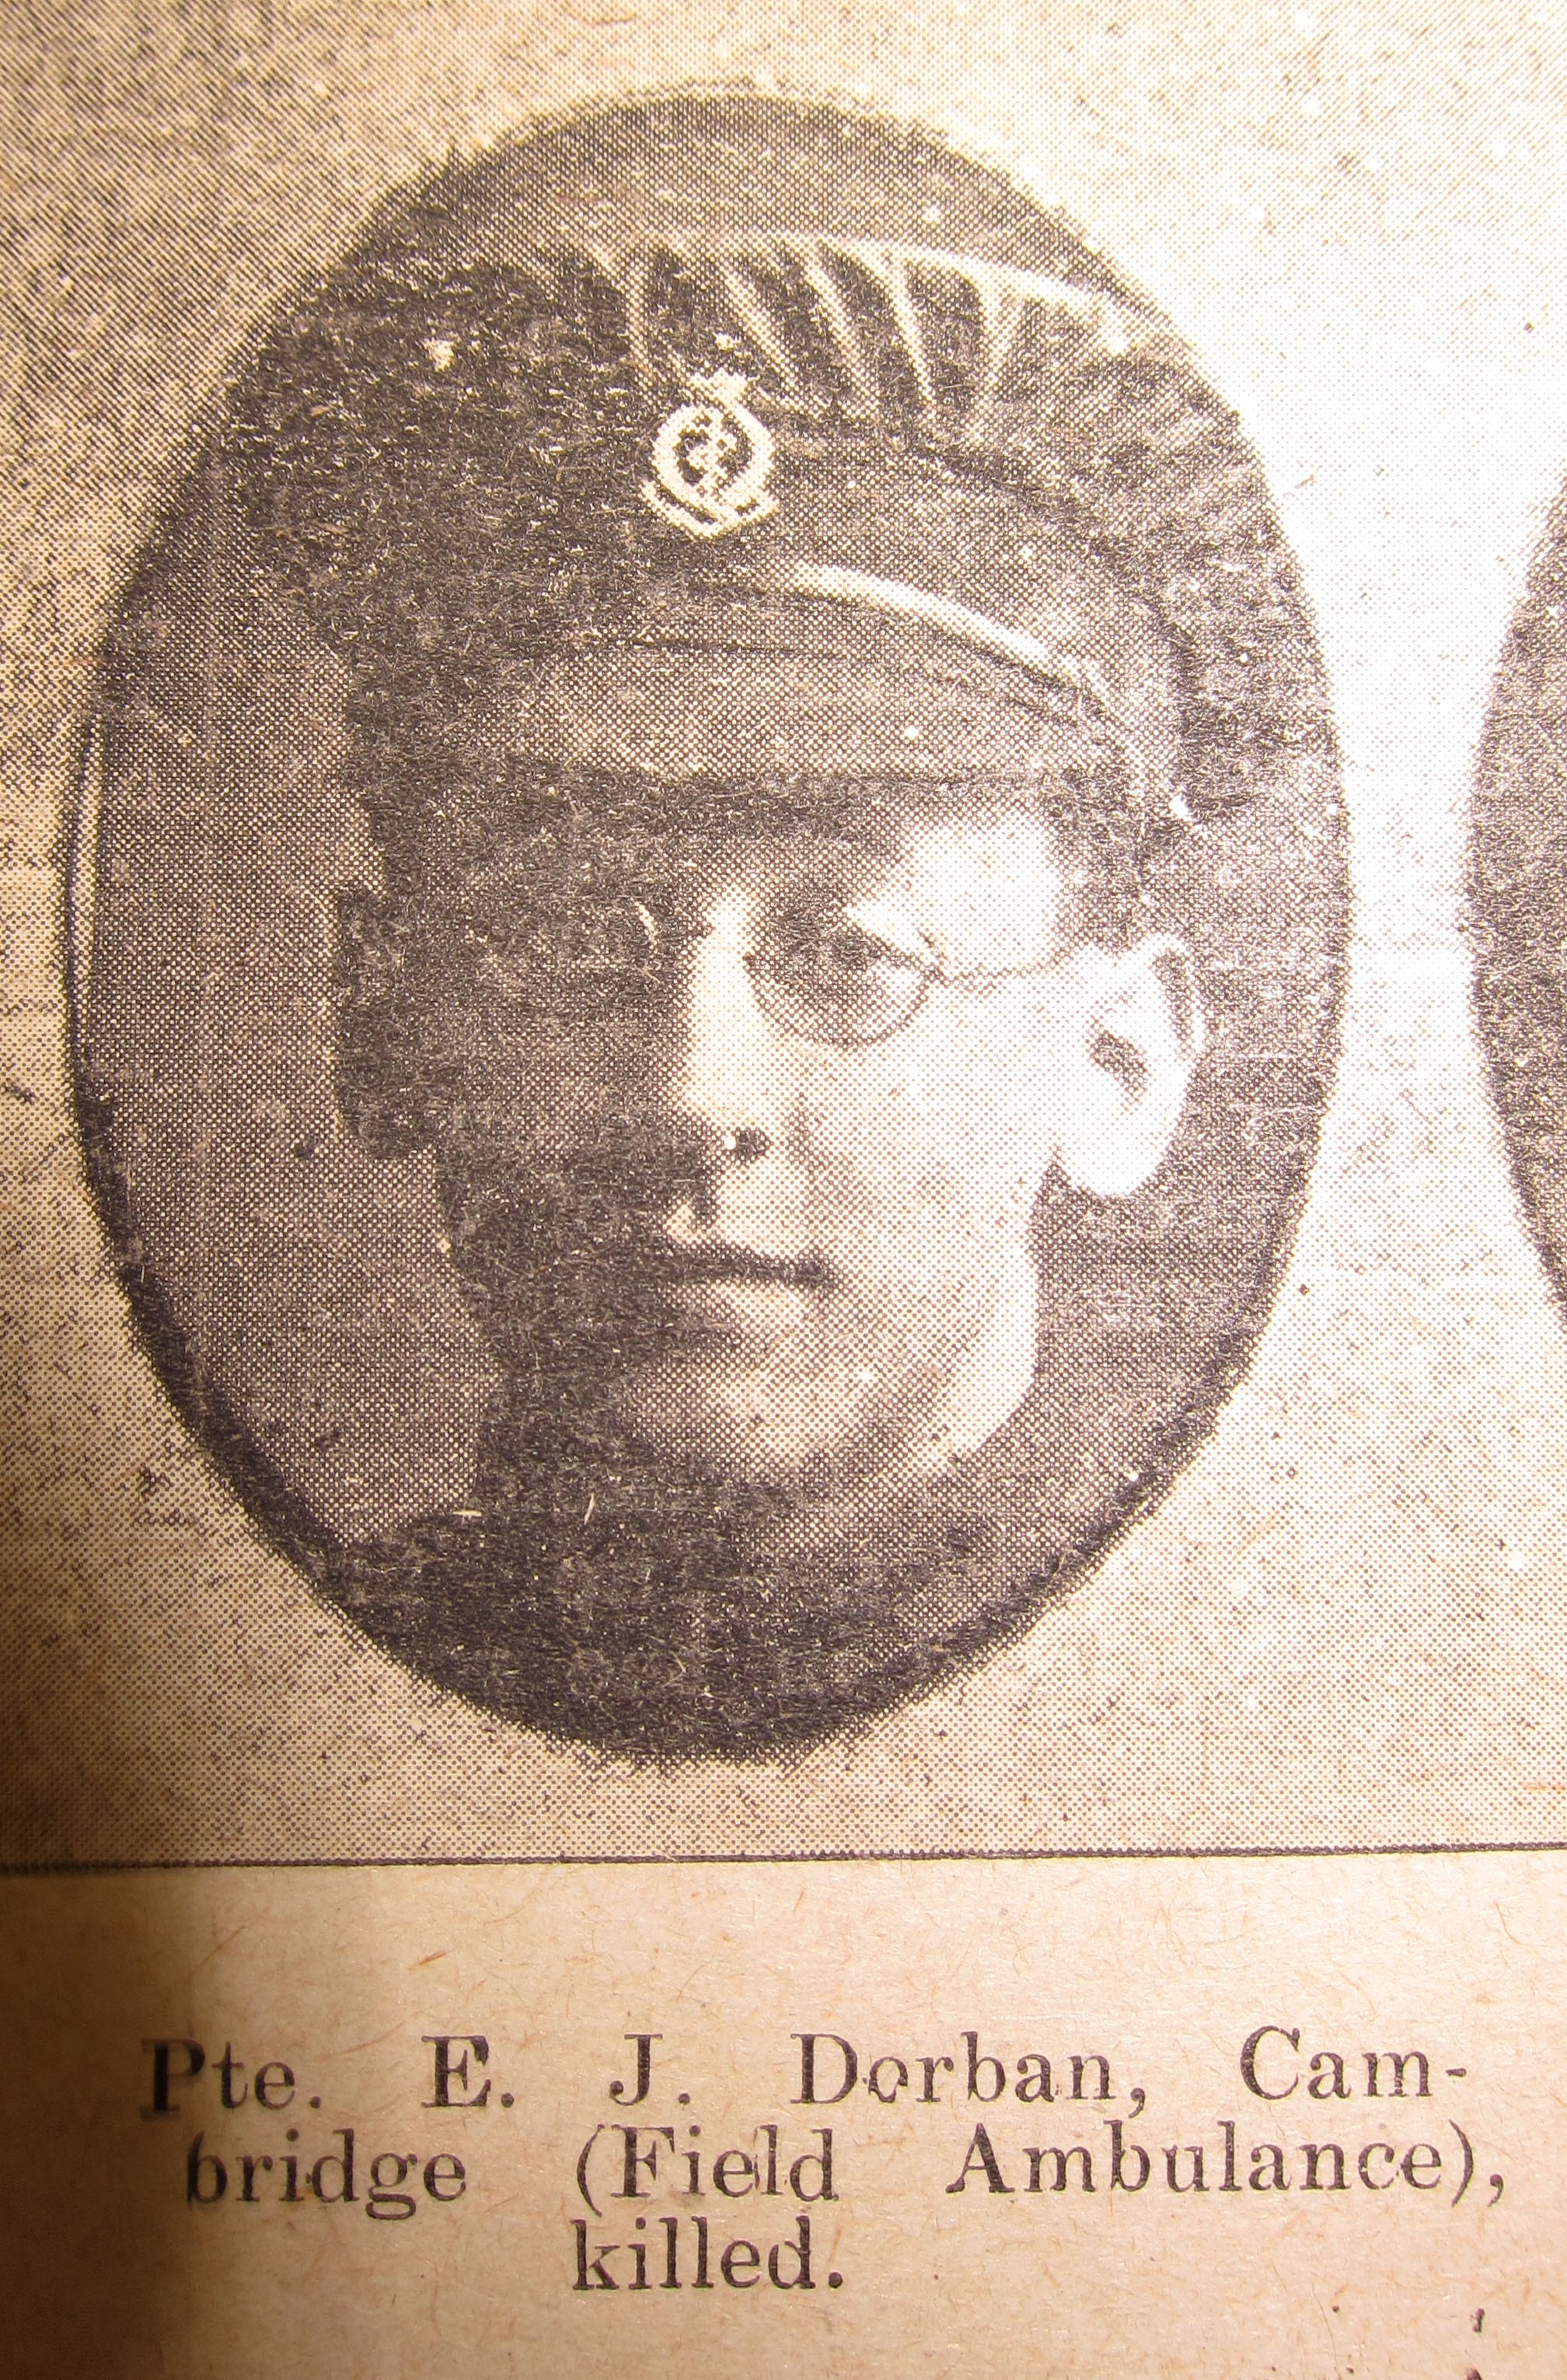
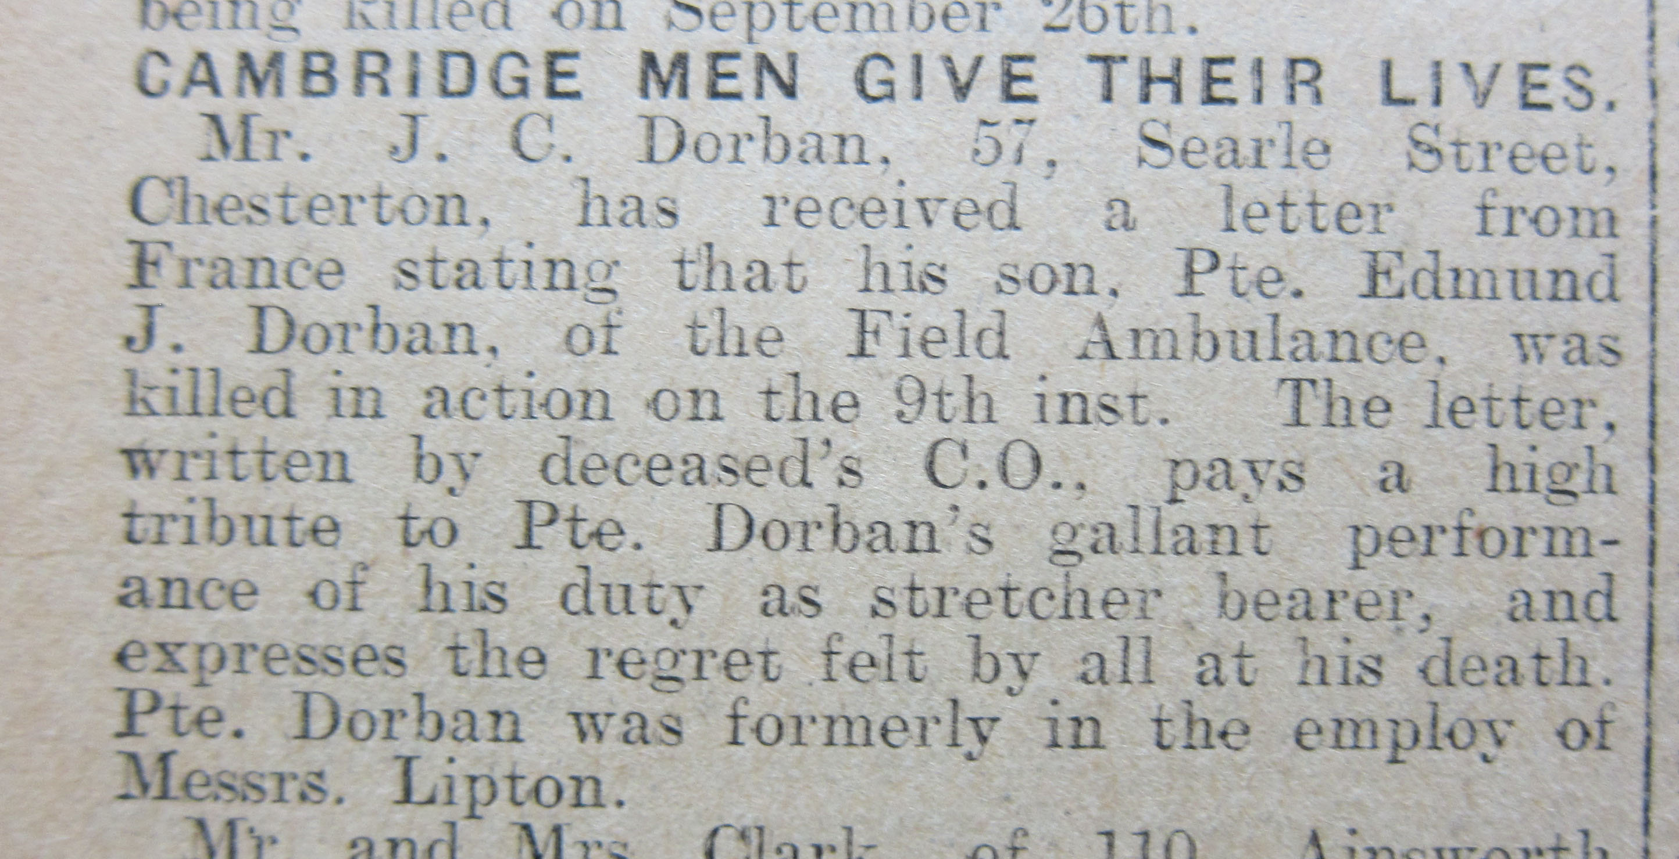
Edmund is Remembered in the Local Newspaper
These cuttings from the local Cambridge newspaper
show how the men such as Edmund who gave their lives
were remembered.
Paper cuttings from Cambridge
Collection

Slide 17
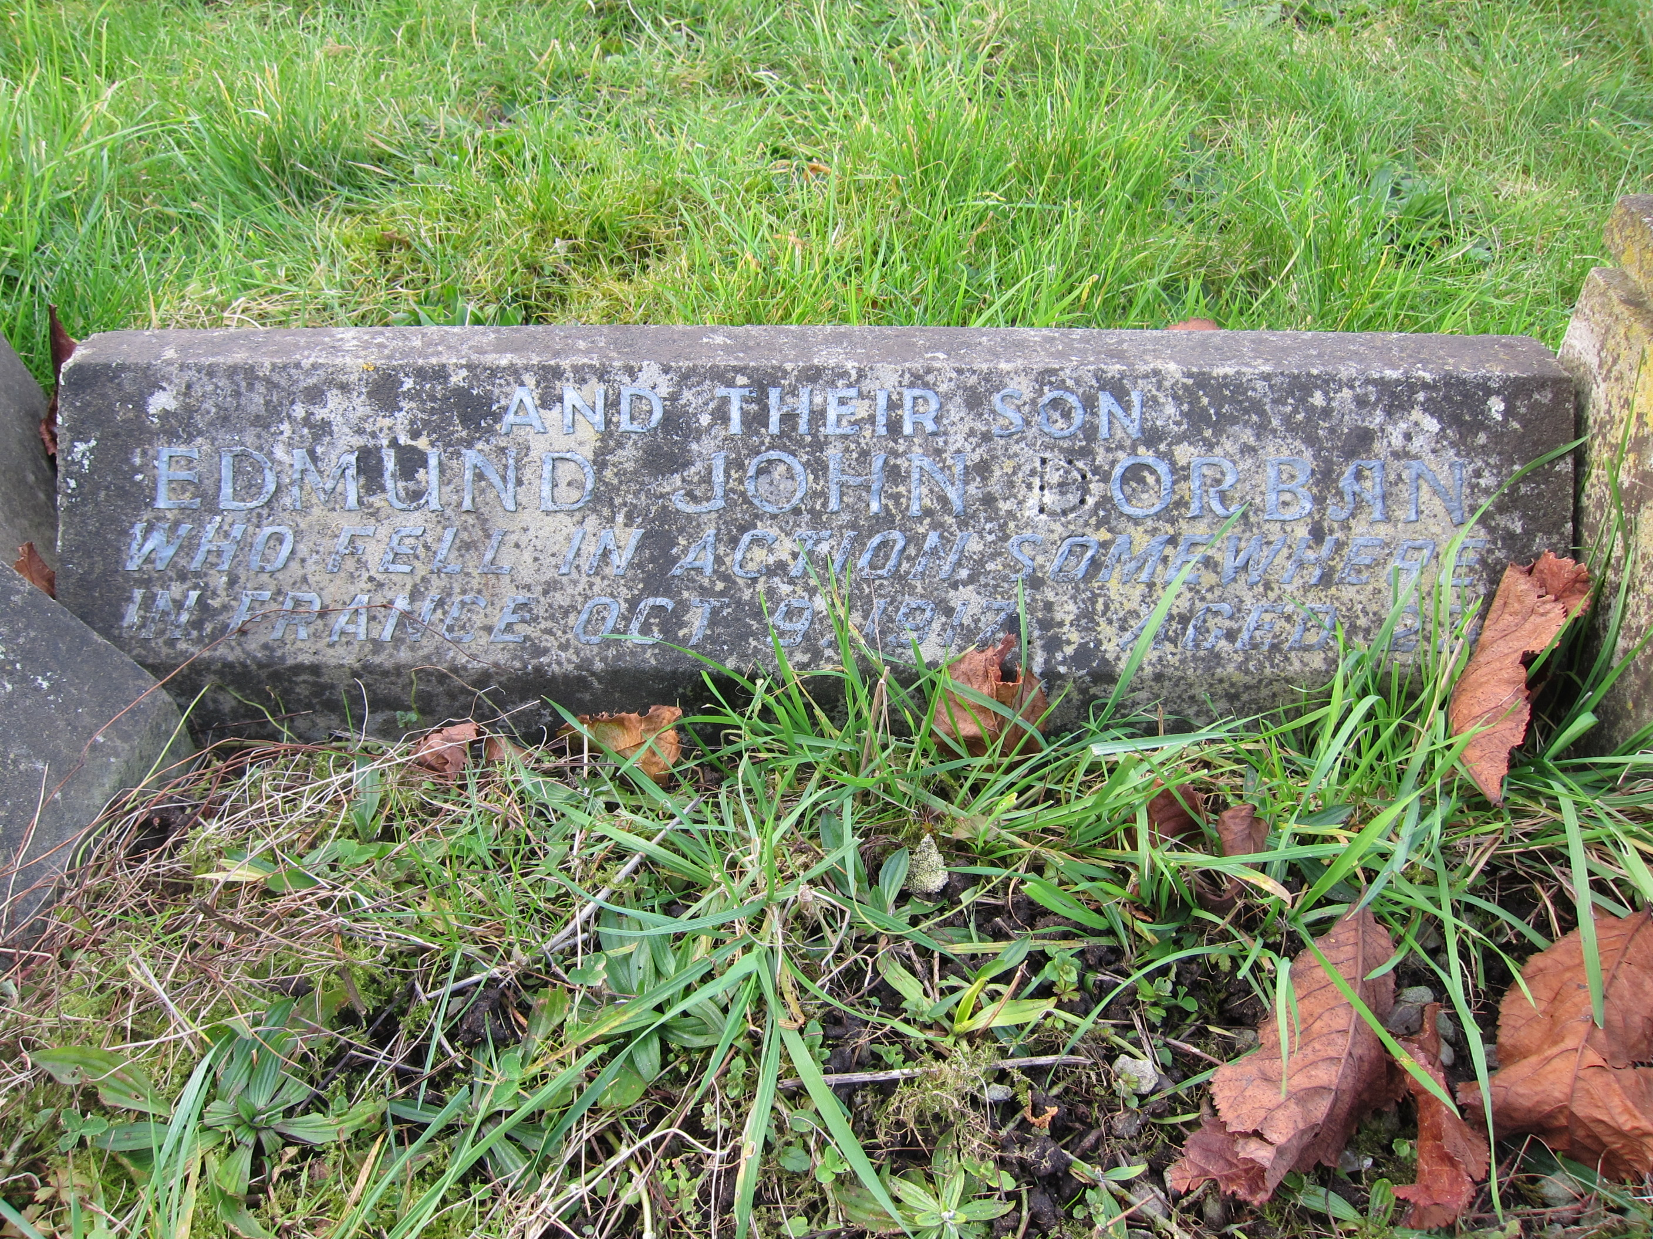
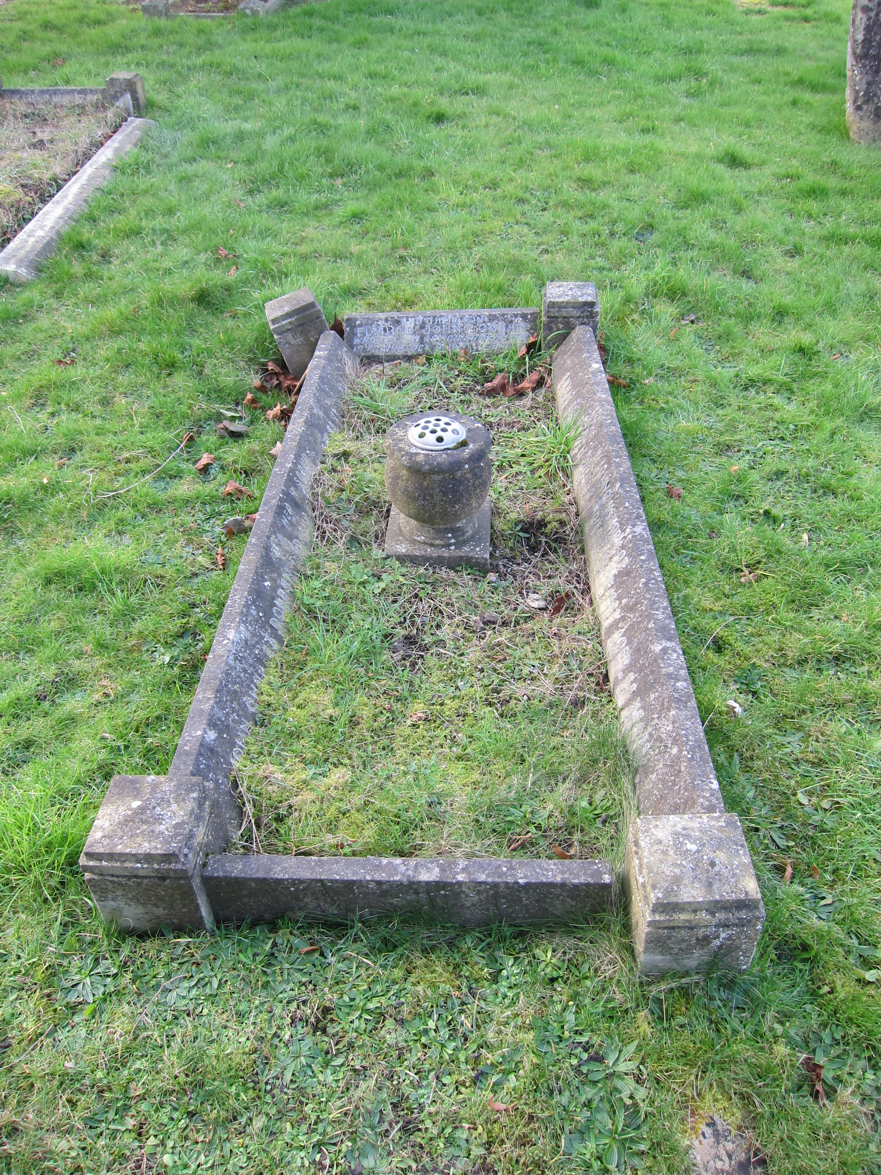
Edmund is Remembered by his Family
Edmund has no known grave, but is remembered on his parents’ grave in Histon Road Cemetery.
Photos of Dorban family grave in
Histon Road Cemetery

Slide 18
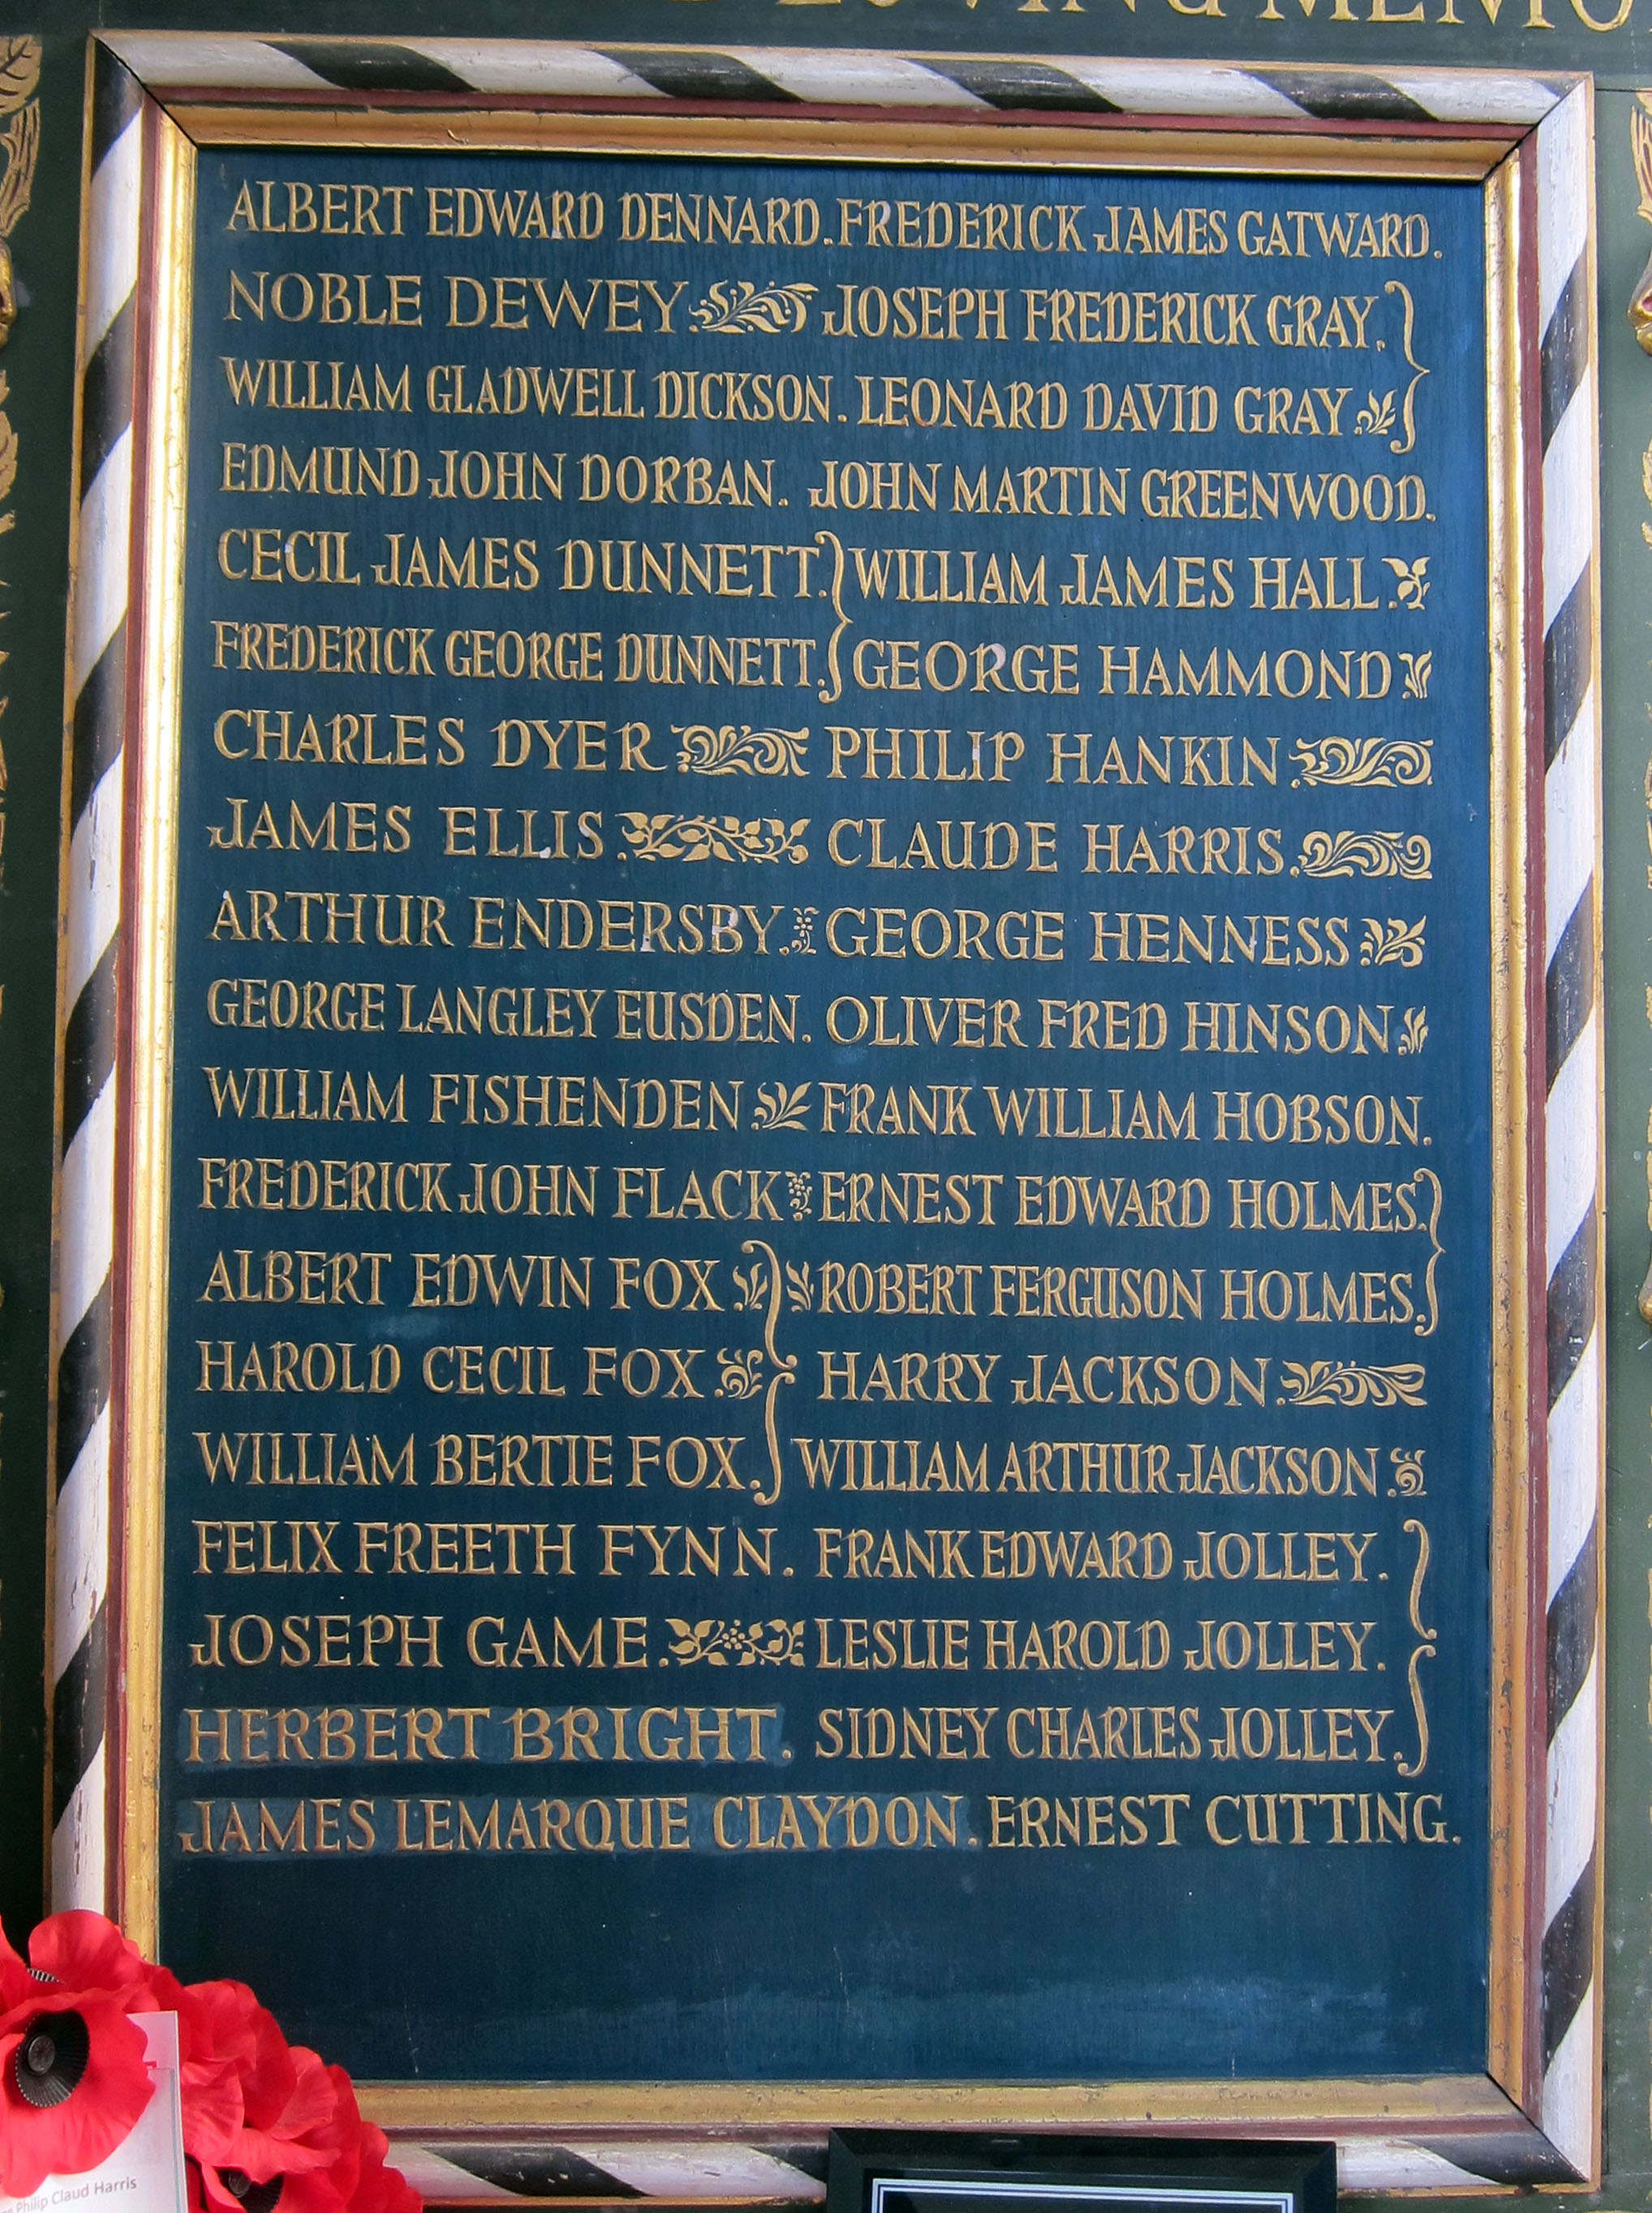
Edmund is Remembered in Cambridge
He is remembered on St Luke’s War Memorial and on the Roll of Honour, Guildhall, Cambridge.

Slide 19
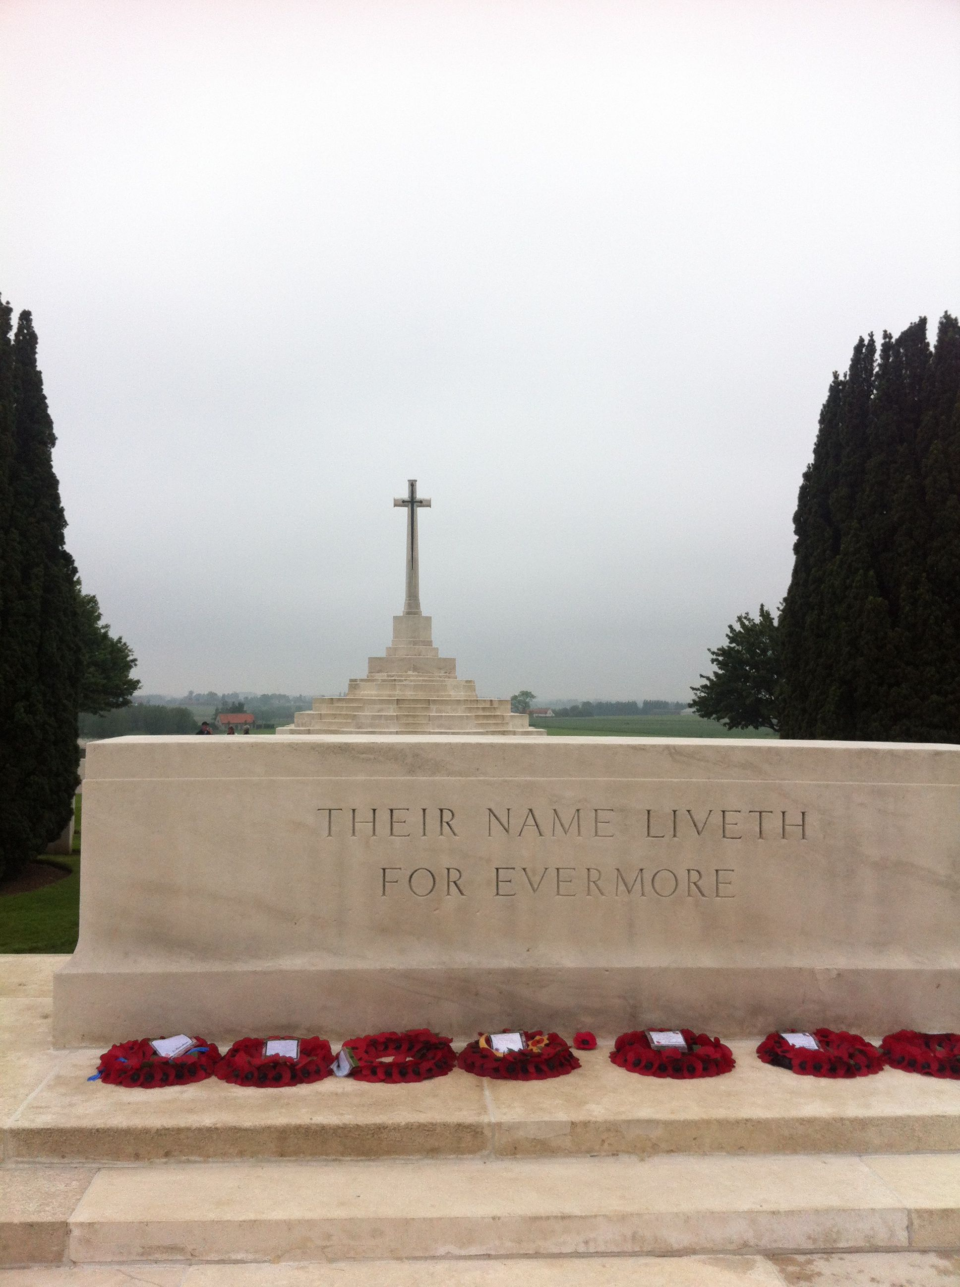
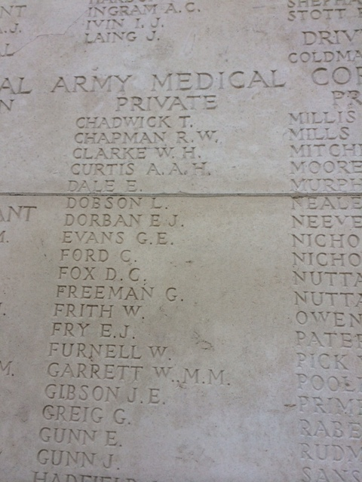
Edmund is Remembered in Belgium
Edmund is also remembered on the Tyne Cot Memorial, Belgium [Panel 160] in the country where he died.

Slide 20
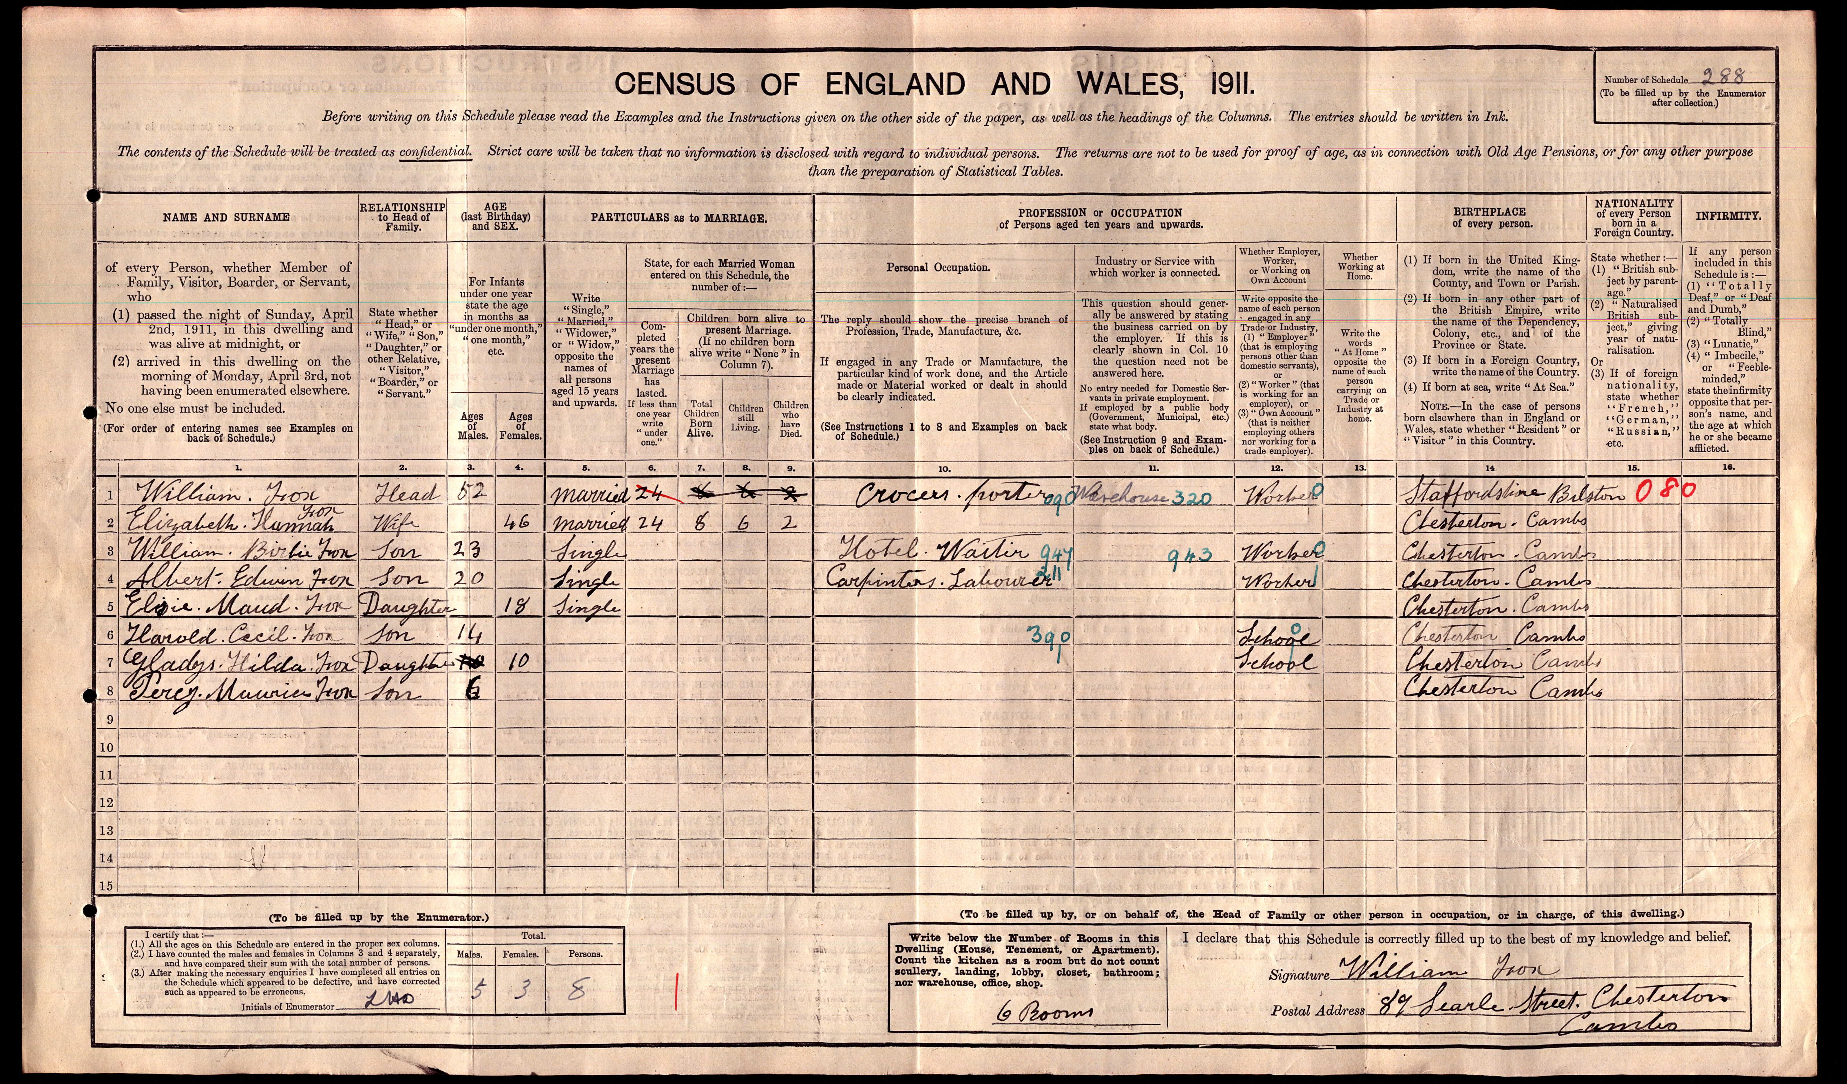
The Fox Family
This census document from 1911 shows the names of all the Fox Family who lived at 89 Searle Street before the start of World War I. Three of the sons from this family sadly died in World War I.
What information can you spot on this census record?
Can you imagine what it must have been like to loose 3 of your sons in the war?

Slide 21
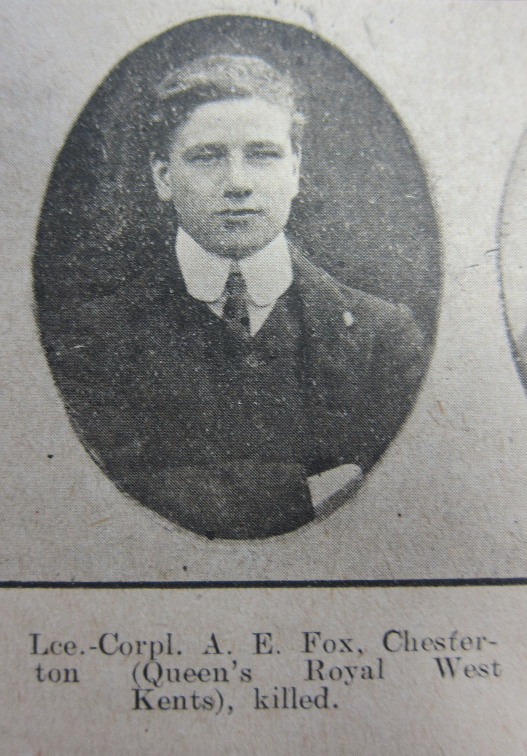
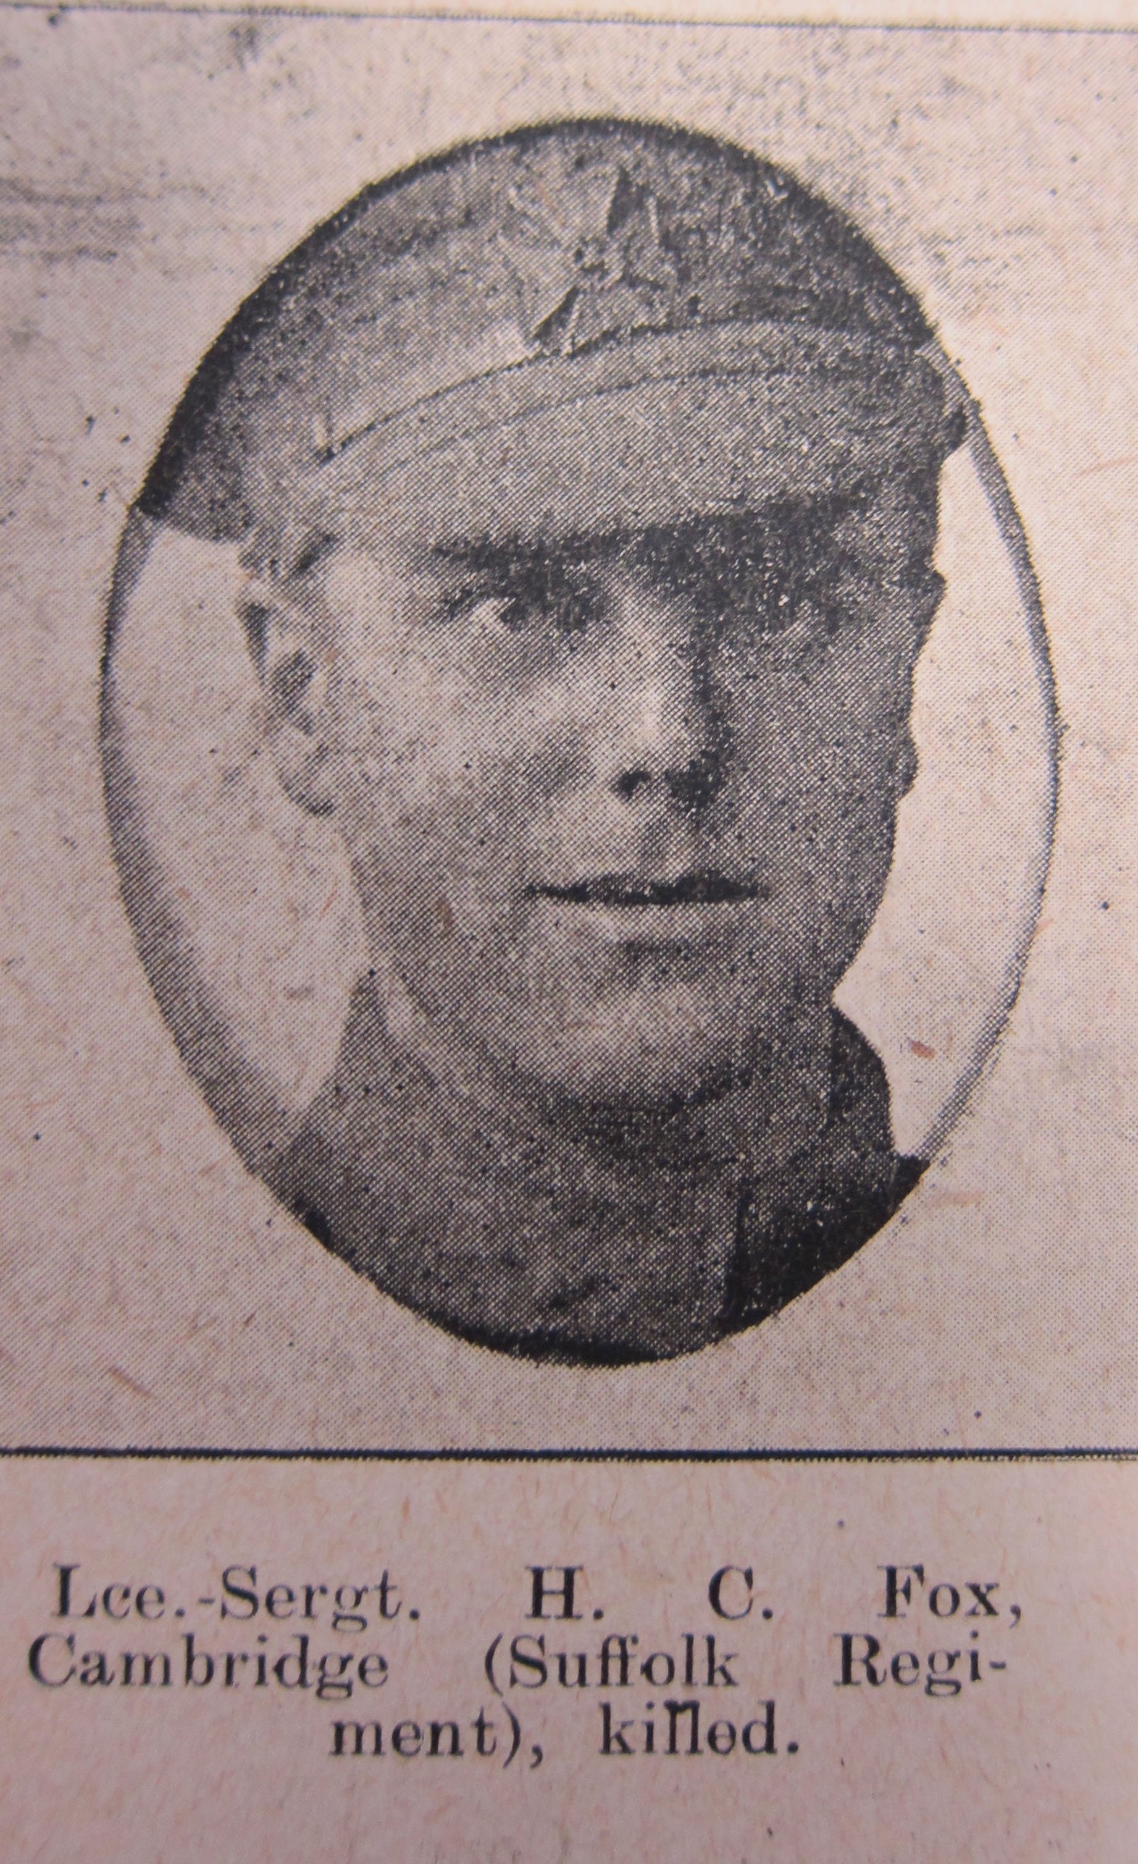
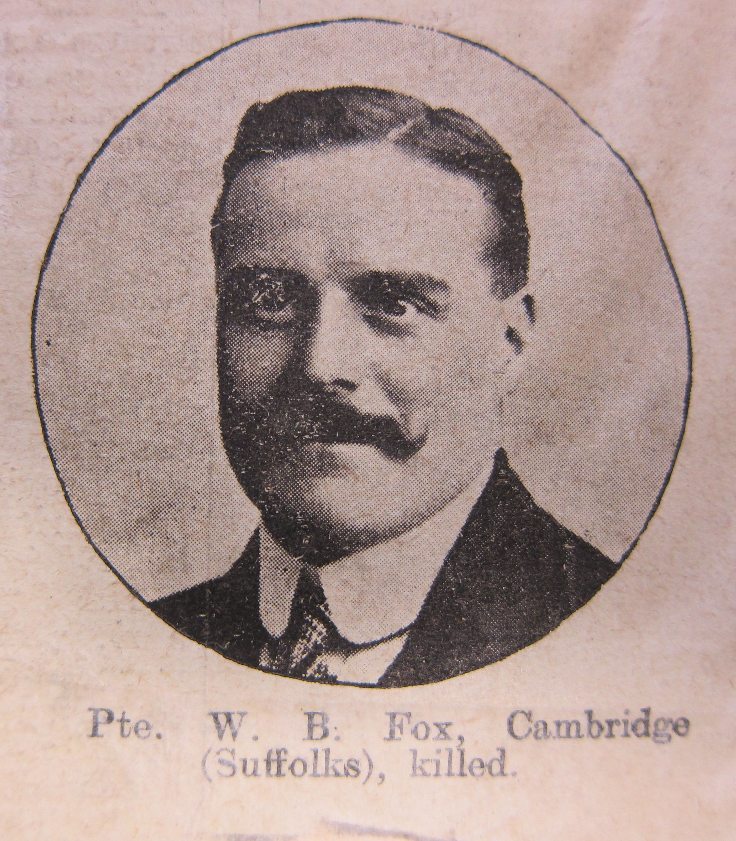
The Fox Family of 89 Searle Street
William and Elizabeth Fox of 89 Searle Street, Cambridge had three out of their six of children die in World War I. William, Albert and Harold, were all in their 20s when they were killed in action during the War.
All these men went to St. Luke’s Primary School. How would you feel to loose 3 of your friends from school?

Slide 22
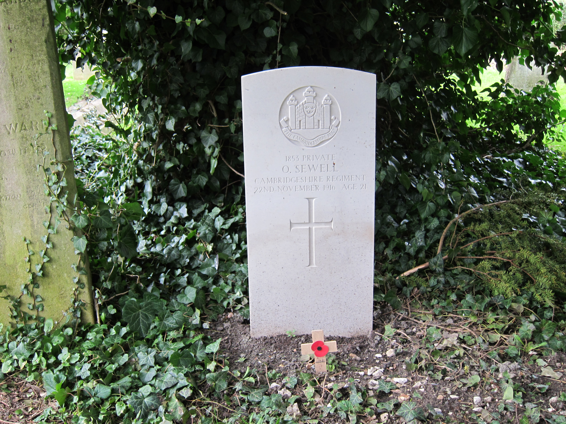
Commonwealth War Graves Commission
The Commonwealth War Graves Commission (CWGC) was set up during the First World War. It now cares for the graves and memorials of Commonwealth War dead from both World Wars.
All the dead are remembered uniformly and equally by the CGWC headstones or for those with no known grave by the lists of names on memorials.
Every year memorial services are held on Remembrance Day to remember those who fell.

Slide 23
Discover More…
Imperial War Museum website- WWI resources:
http://www.iwm.org.uk/learning/resources/first-world-war
Imperial War Museum website- WWI War Posters
http://www.iwm.org.uk/learning/resources/first-world-war-recruitment-posters
The First Eastern General Hospital Cambridge and Memorial:
http://www.firsteasterngeneralhospital.co.uk/index.html

Slide 24

Web Resources available at:
http://www.creatingmycambridge.com/
history-stories

