Slide 1
Xu Zhi Mo Poem
"On Leaving Cambridge"

Slide 2
China

Slide 3
Things you may recognize

Slide 4
Xu Zhi Mo –
On Leaving Cambridge

Slide 6
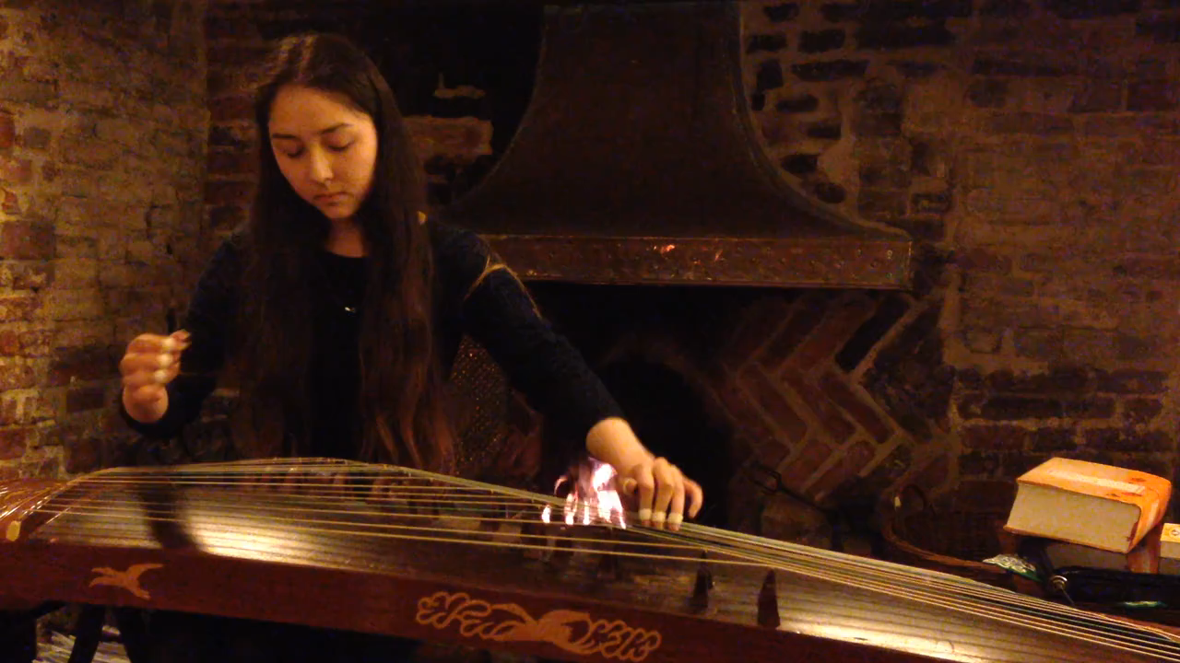
Hannah Brock
“Soft Rain on a Midnight Lake”

Slide 7
Chinese Characters

Slide 10

Web Resources available at:
http://www.creatingmycambridge.com/
history-stories

